Slide 1
KAGGLE • SPRING 2026
Linear Regression Challenge
Recovering a clean signal from a deliberately noisy, outlier-dominated target
Beat the baseline | Public R² 0.0544 · Private R² 0.0463
Shuonan Chen

Slide 2
1
TL;DR — one idea, carefully executed
The target is a monotone non-linear transform of a linear combination of features
— so the structure is simple, but the transform's explosive tails make raw R² an outlier-dominated, high-variance metric. The winning move is not a fancier model; it is predicting the conditional mean and shrinking it to avoid catastrophic tail overshoot.
0.67
49.6%
α = 0.40
x4 rank-corr vs 0.04 linear
of total SST in ONE point
shrinkage toward the mean
signal is monotone, not linear
metric ruled by a few outliers
turns R² from −0.45 to positive
RESULT A seed-averaged, regularized gradient-boosted tree on the raw target, shrunk toward the train mean. Cleared the Baseline (200 pts) with Public 0.0544 / Private 0.0463 — both above the cross-validated estimate.

Slide 3
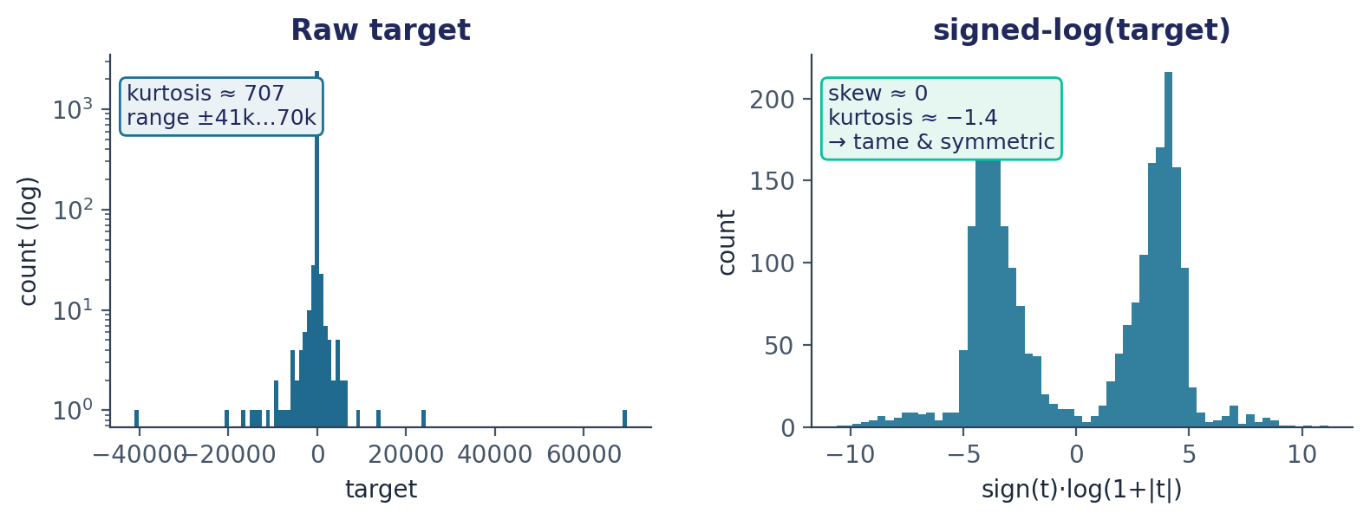
2
EDA — what the data looks like
2,500 train / 2,500 test · 15 anonymous numeric features (x0–x14) · ~1.2% values missing per column
First read
Median ≈ 0, IQR ≈ ±43, but min/max reach −41k / +70k.
Raw target is wildly heavy-tailed (kurtosis ≈ 707).
A signed-log transform makes it tame and symmetric.
Missingness ~equal in train & test, non-informative.
Why the raw distribution matters
R² is a sum-of-squares metric. A target whose values span four orders of magnitude means a few extreme rows dominate the error — so the way the target is shaped, not just the features, dictates the entire modeling strategy. The signed-log view tells us a clean linear story is hiding underneath.

Slide 4
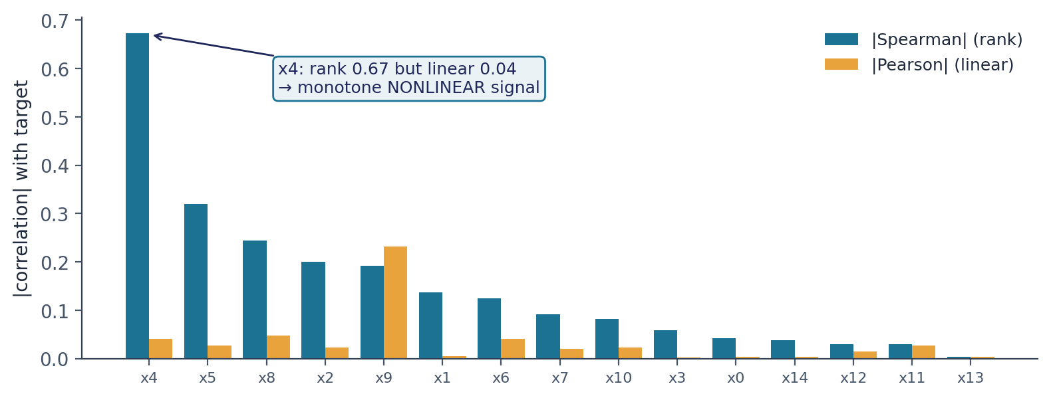
3
EDA — the key discovery
Rank correlation reveals a strong signal that linear correlation completely hides
Pearson lied; Spearman told the truth
x4 has rank-corr +0.67 but linear-corr only +0.04.
x5, x8, x2, x9 follow the same pattern.
A monotone transform preserves rank, destroys linearity.
Products & ratios show nothing (<0.08) → no interactions.
The structural hypothesis
target = g( β·x + noise ) with g a steep, sign-preserving, tail-exploding monotone map.
Confirmed: a linear fit in signed-log space reaches Pearson 0.80 / Spearman 0.88 with the target. The deliberate noise lives inside g, where it is amplified into the extreme tails.

Slide 5
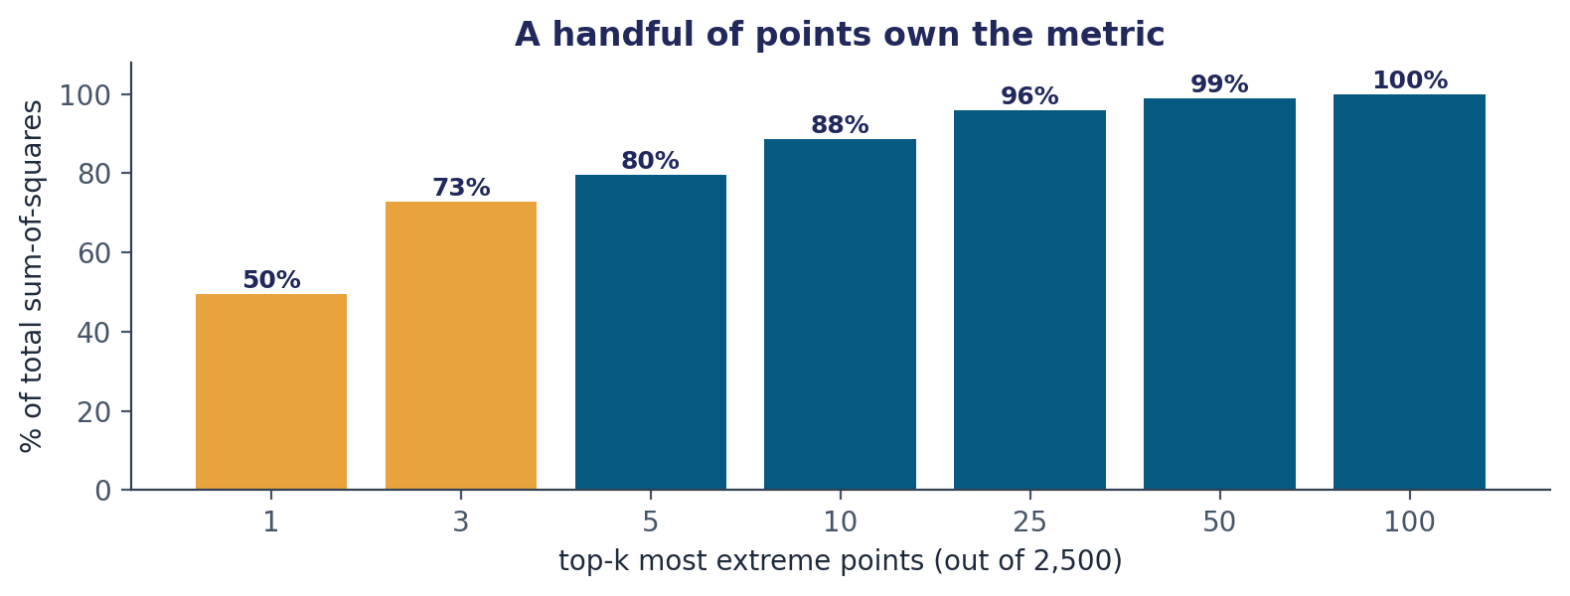
4
EDA — why this metric is a trap
The score is decided by a handful of unpredictable points
Consequences
1 point = 50% of SST; top 10 = 88%.
Those extremes are noise-driven → unpredictable.
Linear-signal raw-R² ceiling is only ≈ 0.012.
Public & private hold DIFFERENT outliers → public LB is near-luck (exactly as organizers warned).
Strategic takeaway
Don't chase the public leaderboard, and don't overshoot. Predictions max out near ±1,000 while true extremes are ±40,000, so we massively undershoot every big point — meaning getting the sign right and the scale modest is what reduces error. Optimize expected R² with a robust, fixed shrinkage rather than a data-fit scale that overfits training outliers.

Slide 6
5
Experiments — what we tried and why
Every approach validated on the raw-R² metric with repeated 5-fold CV
Approach | Motivation | CV raw R² | Verdict
Ridge on raw target | name says 'linear' | −0.45 | tails wreck least-squares
Ridge on signed-log → invert | clean linear fit there | −72 | exp inversion explodes tail error
GBM on signed-log → invert / isotonic | capture the monotone map | −1.7 … −0.03 | calibration fixes sign, not variance
GBM on raw target (no shrink) | predict conditional mean | −1.2 (high var) | overfits & overshoots outliers
GBM on raw + shrinkage α ≈ 0.4 | tame overshoot, keep signal | +0.03 | CHOSEN — best expected R²
+ seed-averaging ×8, mild clip | cut prediction variance | +0.03 (stabler) | final submission
R² values are 6×5-fold CV means; the chosen shrinkage row also raises the typical (median) fold to ≈ 0.035.

Slide 7
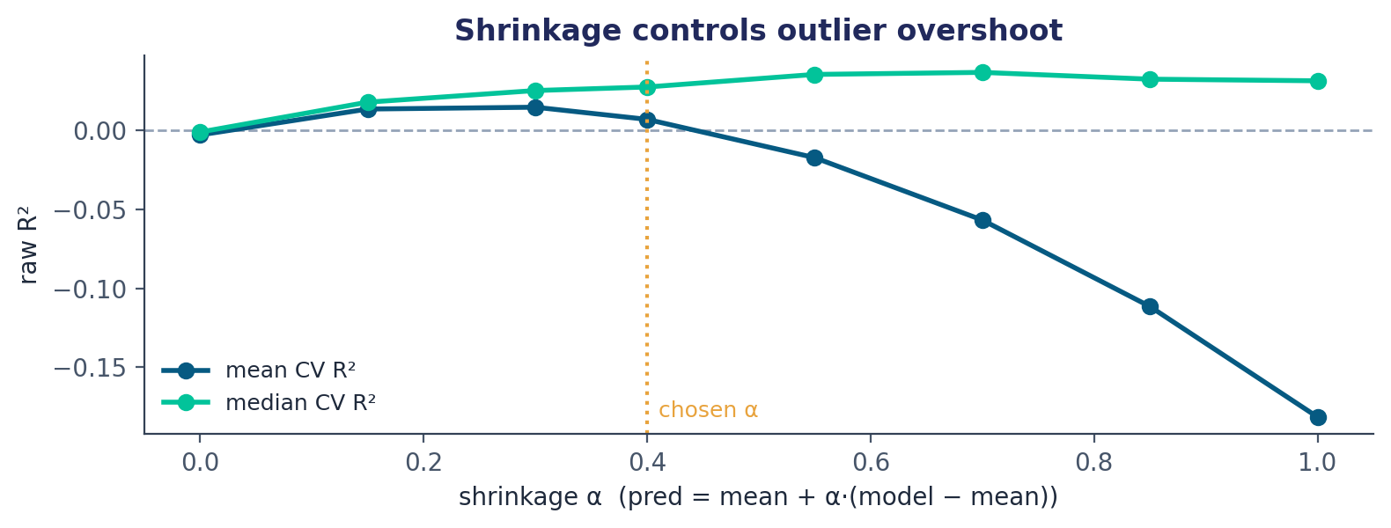
6
The final model & the shrinkage insight
Pipeline
HistGradientBoosting on raw target (native NaN handling)
depth 3, leaf 80, lr 0.03, L2 5 — deliberately shallow
averaged over 8 seeds to cut prediction variance
shrink: pred = mean + 0.40·(model − mean)
clip to observed train range as a safety net
Why shrinkage is the whole game
Fitting the scale by least-squares overfits to training outliers (nested-CV R² collapses to 0.005). A fixed, modest shrinkage instead maximizes expected R²: it keeps the genuine signal, gives big-z points the correct sign and a sensible magnitude, and refuses the wild predictions that turn one unlucky outlier into a −1 score. The CV mean peaks near α 0.4–0.55; the typical fold keeps improving to ~0.7, so 0.40 is the robust, low-variance choice for a single private draw.

Slide 8
Results & reproducibility
0.0544
0.0463
✓
Public score
Private score
Baseline cleared (200 pts)
Reproducibility
solution.py — self-contained, deterministic, regenerates submission.csv exactly
scikit-learn HistGradientBoostingRegressor only — no external data, no leakage
Run: python solution.py → submission.csv (Id, target)
Code & PDF: github.com/ARevX/ml-hw-spring-2026-python

