Slide 1
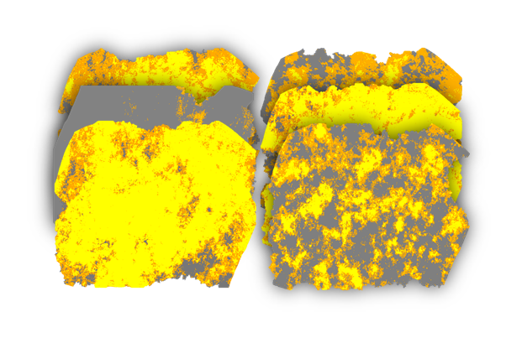
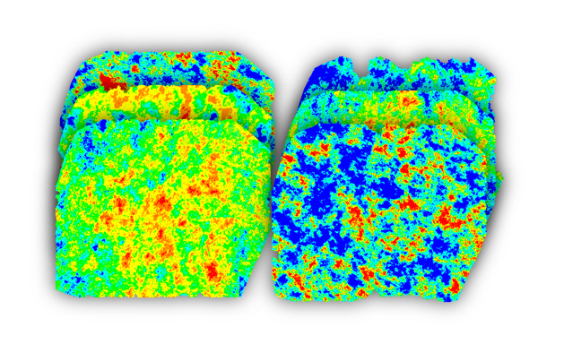
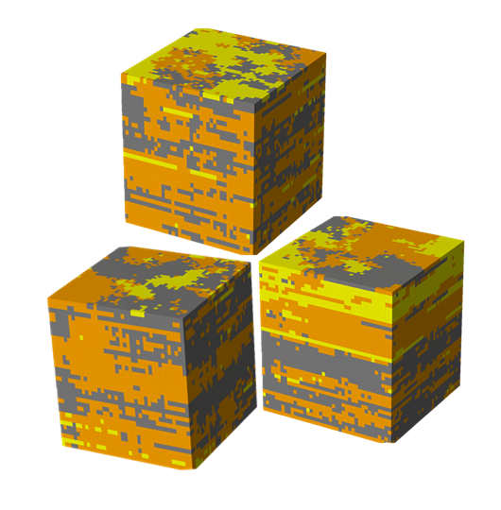
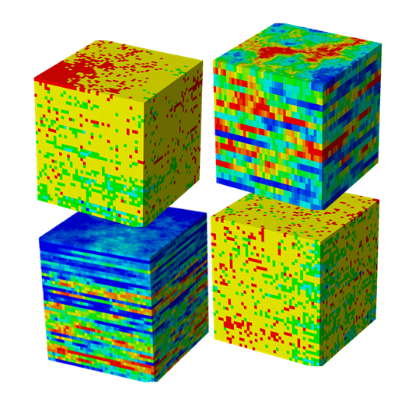
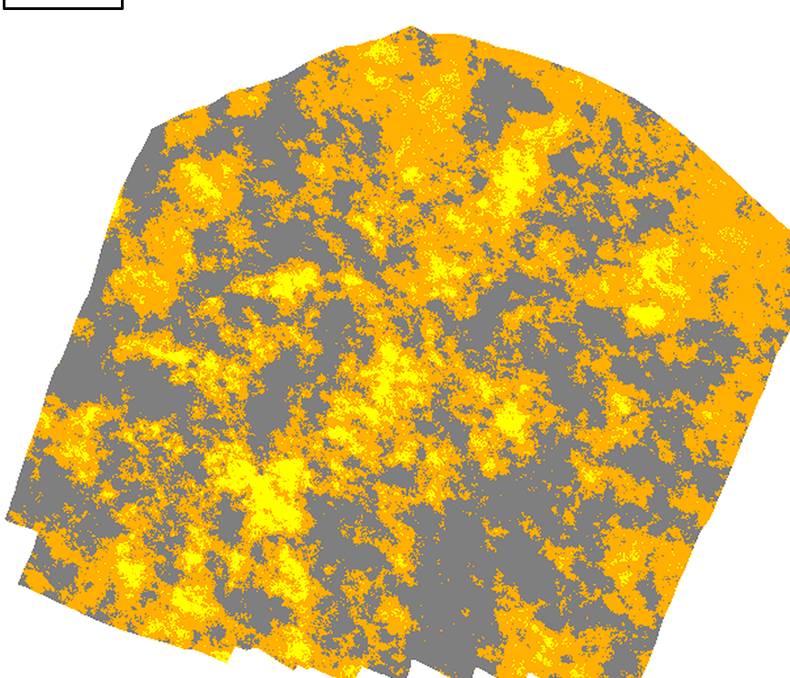
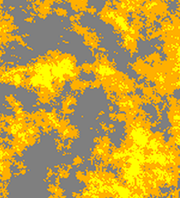
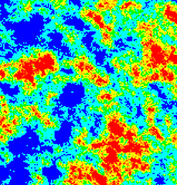
Property maps
Unseen test maps
paired patches 256²
2D facies
2D porosity
3D facies
3D (Por/Perm)
facies (test)
Traditional: single pass
training phase
inference — reliability
PERCEIVE · TTA×8
RELIABILITY
Pix2Pix G
trained G
gated LEARN
DECIDE · τ (val.)
A: facies
B: porosity
input
UNet Generator
score
≥ τ ?
GAN + λ·L1
deliver
PatchGAN D
optimize
abstain
one-shot output
no reliability estimate
no abstention
4 models, one per direction
LLM: orchestrate + audit
27 135 patches · 100 epochs
delivered output
reliable property predictions
volumetrics
history matching
well placement

