Slide 1
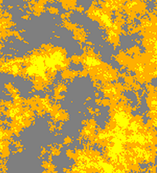
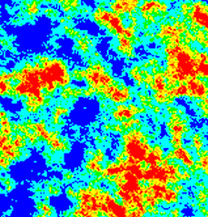
GeoAgent — reliability loop with LLM orchestration
1 PERCEIVE · TTA×8
2 DECIDE
LLM orchestrator
claude-sonnet-5 · Anthropic
written policy, tool calls
tool calls
and audit
get_reliability
decide
batch audit note
input patch
rule-based policy;
LLM applies + audits
4 LEARN (gated)
3 DELIVER
tools
used in PERCEIVE
2D generator
3-ch slice
adjacent-slice (2.5D)
9-ch triplet i−1·i·i+1
TTA ×8
reliability
estimator
percentile ≥ 25
accept
delivered prediction

