Slide 1
BuildMaster
Find your perfect PC

Slide 2
Introduction:
The "PC Build Website" aims to streamline the process of customizing and assembling personal computers. This online platform addresses the challenges of manual PC building by providing a user-friendly interface and educational resources. It is designed to meet the specific needs of users, fostering a smooth and effective PC building experience. The surge in custom PC building's popularity highlights a growing demand for a user-friendly platform to cater to this trend.
Intro

Slide 3
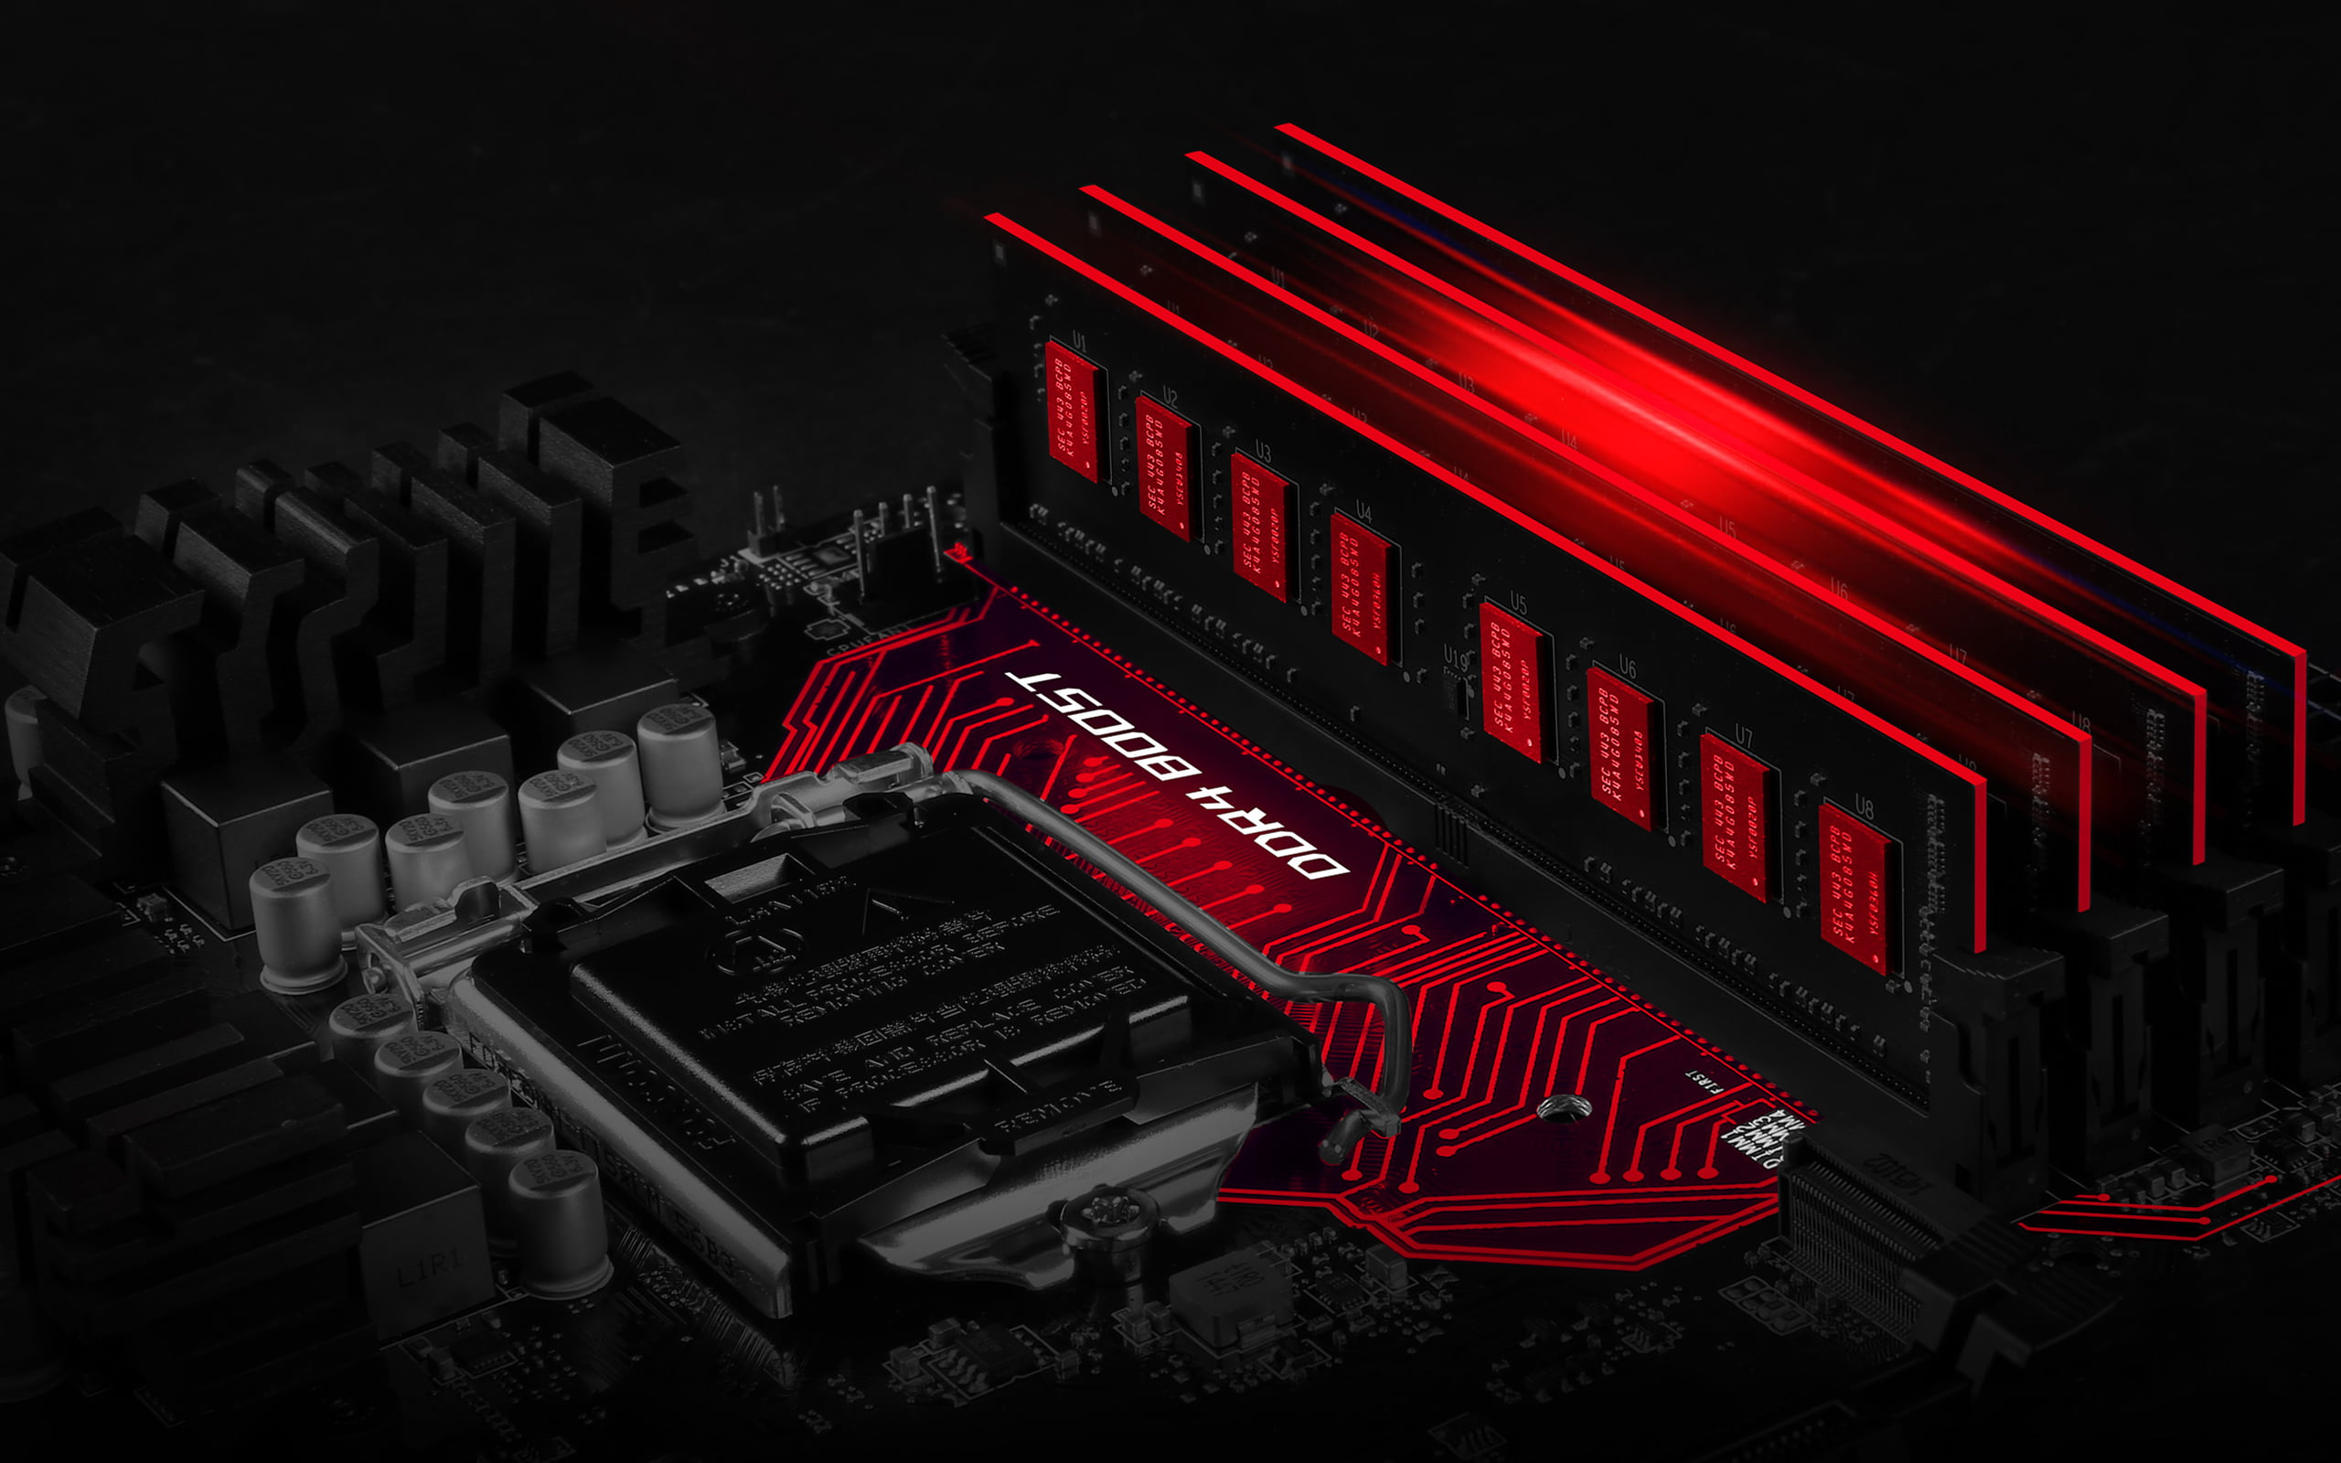
Objectives
Simplify PC Building
Educate Users
Ensure Compatibility
Provide an intuitive platform to guide users through the process of selecting and assembling PC components.
Offer comprehensive information, guides, and tutorials to empower users with the knowledge needed for informed decisions.
Implement a robust PC builder tool to prevent component incompatibility issues during the assembly process.
Community building
Usability
Cultivate a sense of community through user reviews for users to share experiences and advice
People want something that’s easy to adopt and simple to use for their daily use

Slide 4
M
1
Components
1
Maintains
ADMIN
Manages
adminUsername
sno
adminPass
M
M
username
buys
Product
1
User
password
photo
id
email
IS A
Custom PC
item_id
description
prdid
price
prdprice
category
item_name
photo
prddesc
prdname
prddesc
prdname
Prebuilt

Slide 5
ram
cpu_full_name
cpu_id
ram_id
ram_full_name
price
full_name
price
cabinet
psu_id
price
ISA
psu
cabinet_id
price
psu_full_name
cooler_id
mb_id
gpu
motherboard
cpu_cooler
gpu_id
price
price
cooler_full_name
mb_full_name
hdd
price
processor
price
gpu_full_name
hdd_id
hdd_full_name

Slide 6
users
payment
pay_id | Int(11)🔑
pay_amt | int(11)
pay_date | datetime
trsc_id | int(11)
prod_id | int(11)
user_id | int(11)
id | Int(11)🔑
username | Varchar(50)
email | Varchar(100)
password | Varchar(255)
prod
prod_id | Int(11)🔑
prod_name | Varchar(255)
prod_price | Int(10)
prod_desc | Varchar(255)
prod_type | Varchar(255)

Slide 7
DFD
Build master
0.0
USER
ADMIN

Slide 8
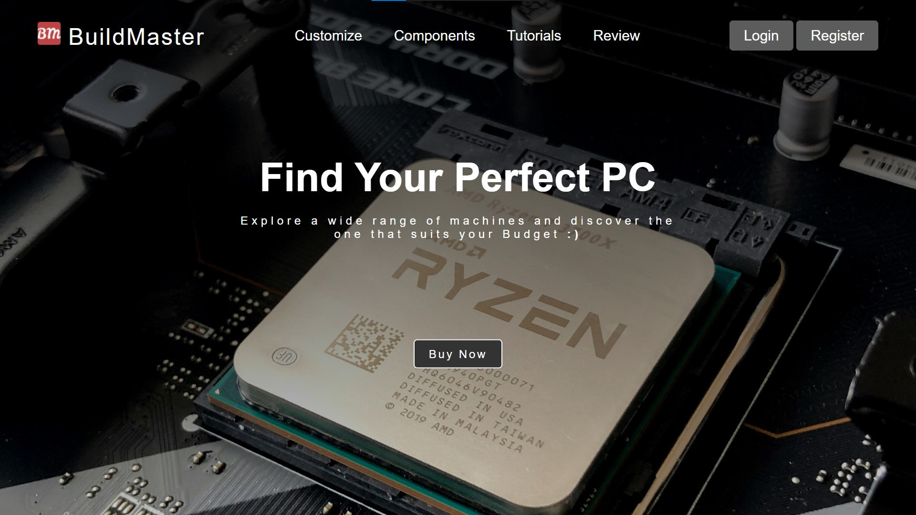

Slide 9
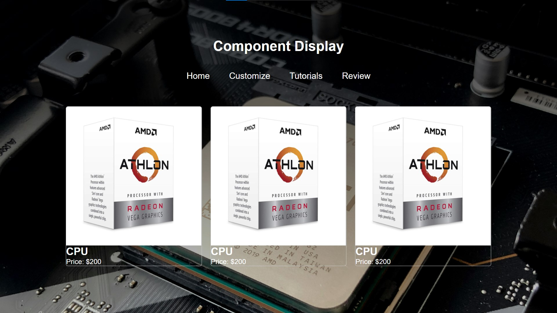

Slide 10
