Slide 1
Big Data & Food Waste
Data 603
Technical Research Paper Assignment
Alejandro Robalino

Slide 2
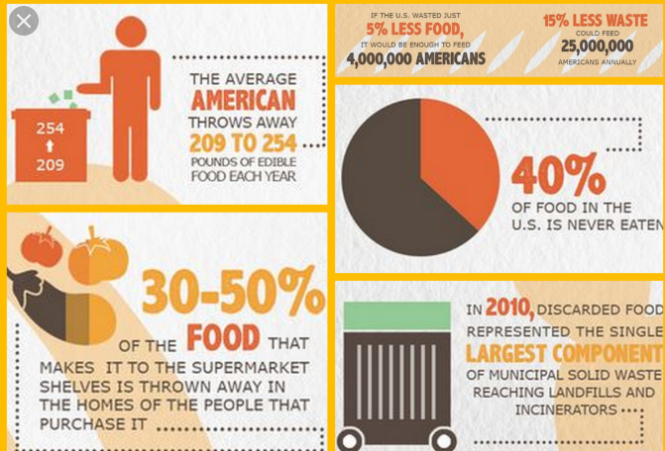
Problem: Food waste Today
According to the USDA, the Unites States is wasting between 30-40% of its food supply annually. This translates to roughly 133 billion pounds of nourishment that goes unused annually.
The US government has identified as an issue and is working to reduce the amount by 50% by 2030

Slide 3
Questions I want to answer
My research will review the existing implementations of Big Data in the US at the three tiers of the supply chain. I will be reviewing the advancements by supply planning companies and their use of big data. Lastly, I want to analyze the possible implementation issues of this solution.
What areas of the United State’s food supply chain can Big Data help with ?
What are the data & implementation issues are retailers or vendors facing ?
What are some examples of efficiencies that Big Data has found so far ?
How can consumers better manage their food supply ?

Slide 4
Deviations from the original Paper
Removed “How can consumers better manage their food supply ?”
Did not research on Big Data and asset protection issues
Adjusted focus to Food Waste based on loss of quality

Slide 5
What areas of the United State’s food supply chain can Big Data help with ?
Supplier
Retailers
Consumers
Not in their current state
Large concerns in data privacy
No standardization
Yes, companies currently implementing solutions
Only to those who are actively engaged in their eating habits

Slide 6
What are the data & implementation issues are retailers or vendors facing ?
Suppliers |  | Retail |  | Consumer
Available | Issues | Available | Issues | Available | Issues
POS Sales Data | Data Integration | POS Sales Data | Data Integration | Health App data | Limited Records of Waste Management
Planning Data | Data Quality | Planning Data | Data Quality |  | Data Quality
Vendor Sales history | Data Ownership | Waste Management

Slide 7
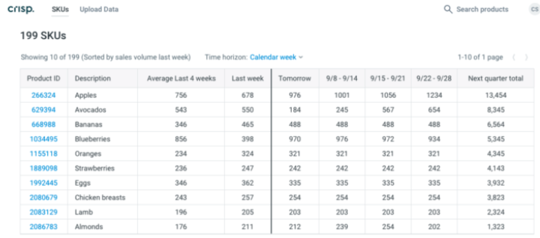

What are some examples of efficiencies that Big Data has found so far ?
CRISP – A.I for planning and waste management
Grocery Chain – AI and machine learning
Smart Appliances – In home tech with lifecycle management capabilities
Education – Personal planning

Slide 8
Conclusion
Suppliers are in need of data ownership before they can implement big data solutions
Retailers are executing big data solutions, however its limited to those who can afford it
Consumers will continue to drive a data gap until the technology is available to simplify the logging process

