Slide 1
Gravitational Ray Marching using CUDA
Atom Roese

Slide 2
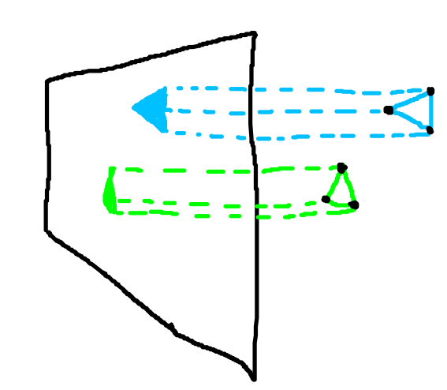
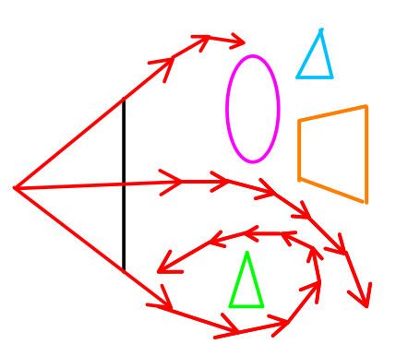
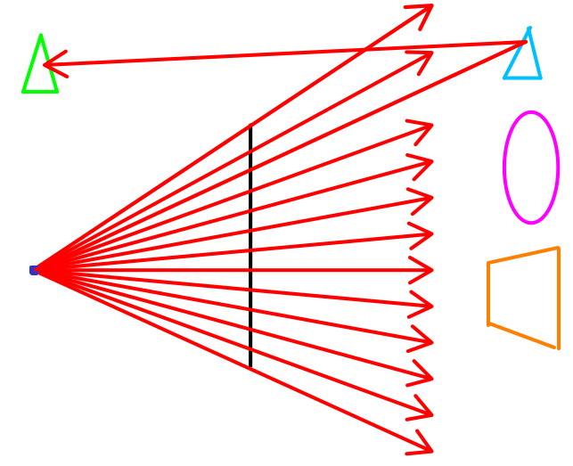
Rasterization vs Ray tracing vs Ray Marching
As slow as you want
Fast
Slow
Shoots a ray out of every pixel and sees what it hits. Optionally shoot another ray from the impact. Don’t necessarily need vertexes anymore, just intersection.
Transforms vertices directly onto the screen using scary linear algebra
Paths no longer have to be straight, and you don’t even need to be able to calculate an intersection point—only a distance from the surface

Slide 3
Why?
More immediately intuitive
Closer to real life, so many difficult-to-model phenomena come as side effects (free!)
  Reflections
  Shadows
  Fog/Scattering
Ok, but that applies to ray-tracing too… Why do ray-marching?

Slide 4
Why??
Approximates reality even closer
  To render something, you only need to be able to approximate the distance to its surface from any point.
    https://youtu.be/9U0XVdvQwAI?feature=shared&t=218
    ^ Infinitely complex object, not a vertex in sight
  Light paths can curve
    You’ll see an example soon

Slide 5
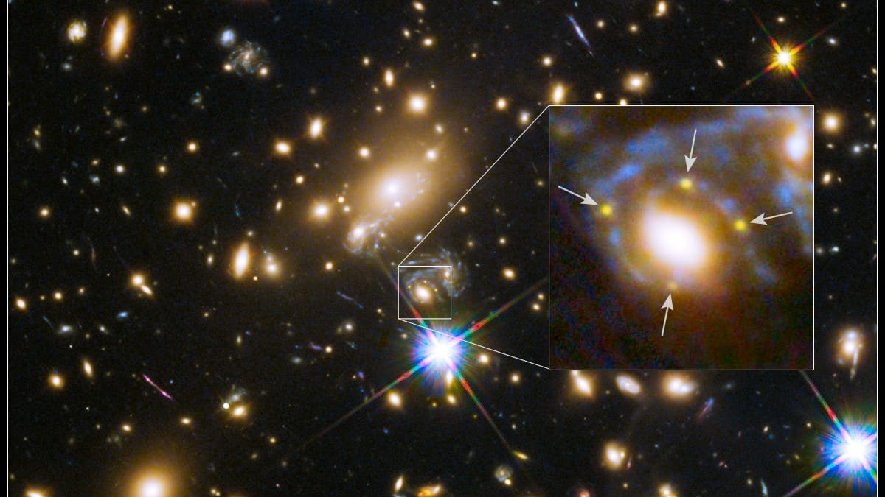

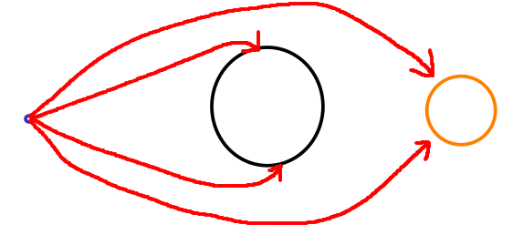
Gravitational Ray Marching
Ray marching, but light paths are influenced by gravity
Gravity curves the path of light and it looks cool
Hubble telescope
Same star visible in 4 different locations

Slide 6
Gravitational Ray Marching (continued)
What color is a pixel?
  Shoot a ray out of it
  Step that ray forward in a timestep based on it’s velocity
  Use to calculate how much it was pulled towards objects by their gravity (changes the ray velocity and “bends” its path over time)
  If it hit something, (negative distance to surface) decide its color based on the color of that object (among other options)
  If it hit nothing after so many timesteps, assume it never will and give it a background color

Slide 7
Easy enough… --NOT!
A 1024x1024 image is 1,048,576 pixels!!!
Each pixel gets its own ray that moves for 10,000 timesteps (if you want accurate results)
=14,400,000,000 steps, with however many cycles each!
A single pixel might only take a couple milliseconds to render, (optimistic) but you need to do it millions of times!
Even with all CPU cores churning away, it will take forever! (trust me, I tried.)
If only we had several thousand cores...

Slide 8
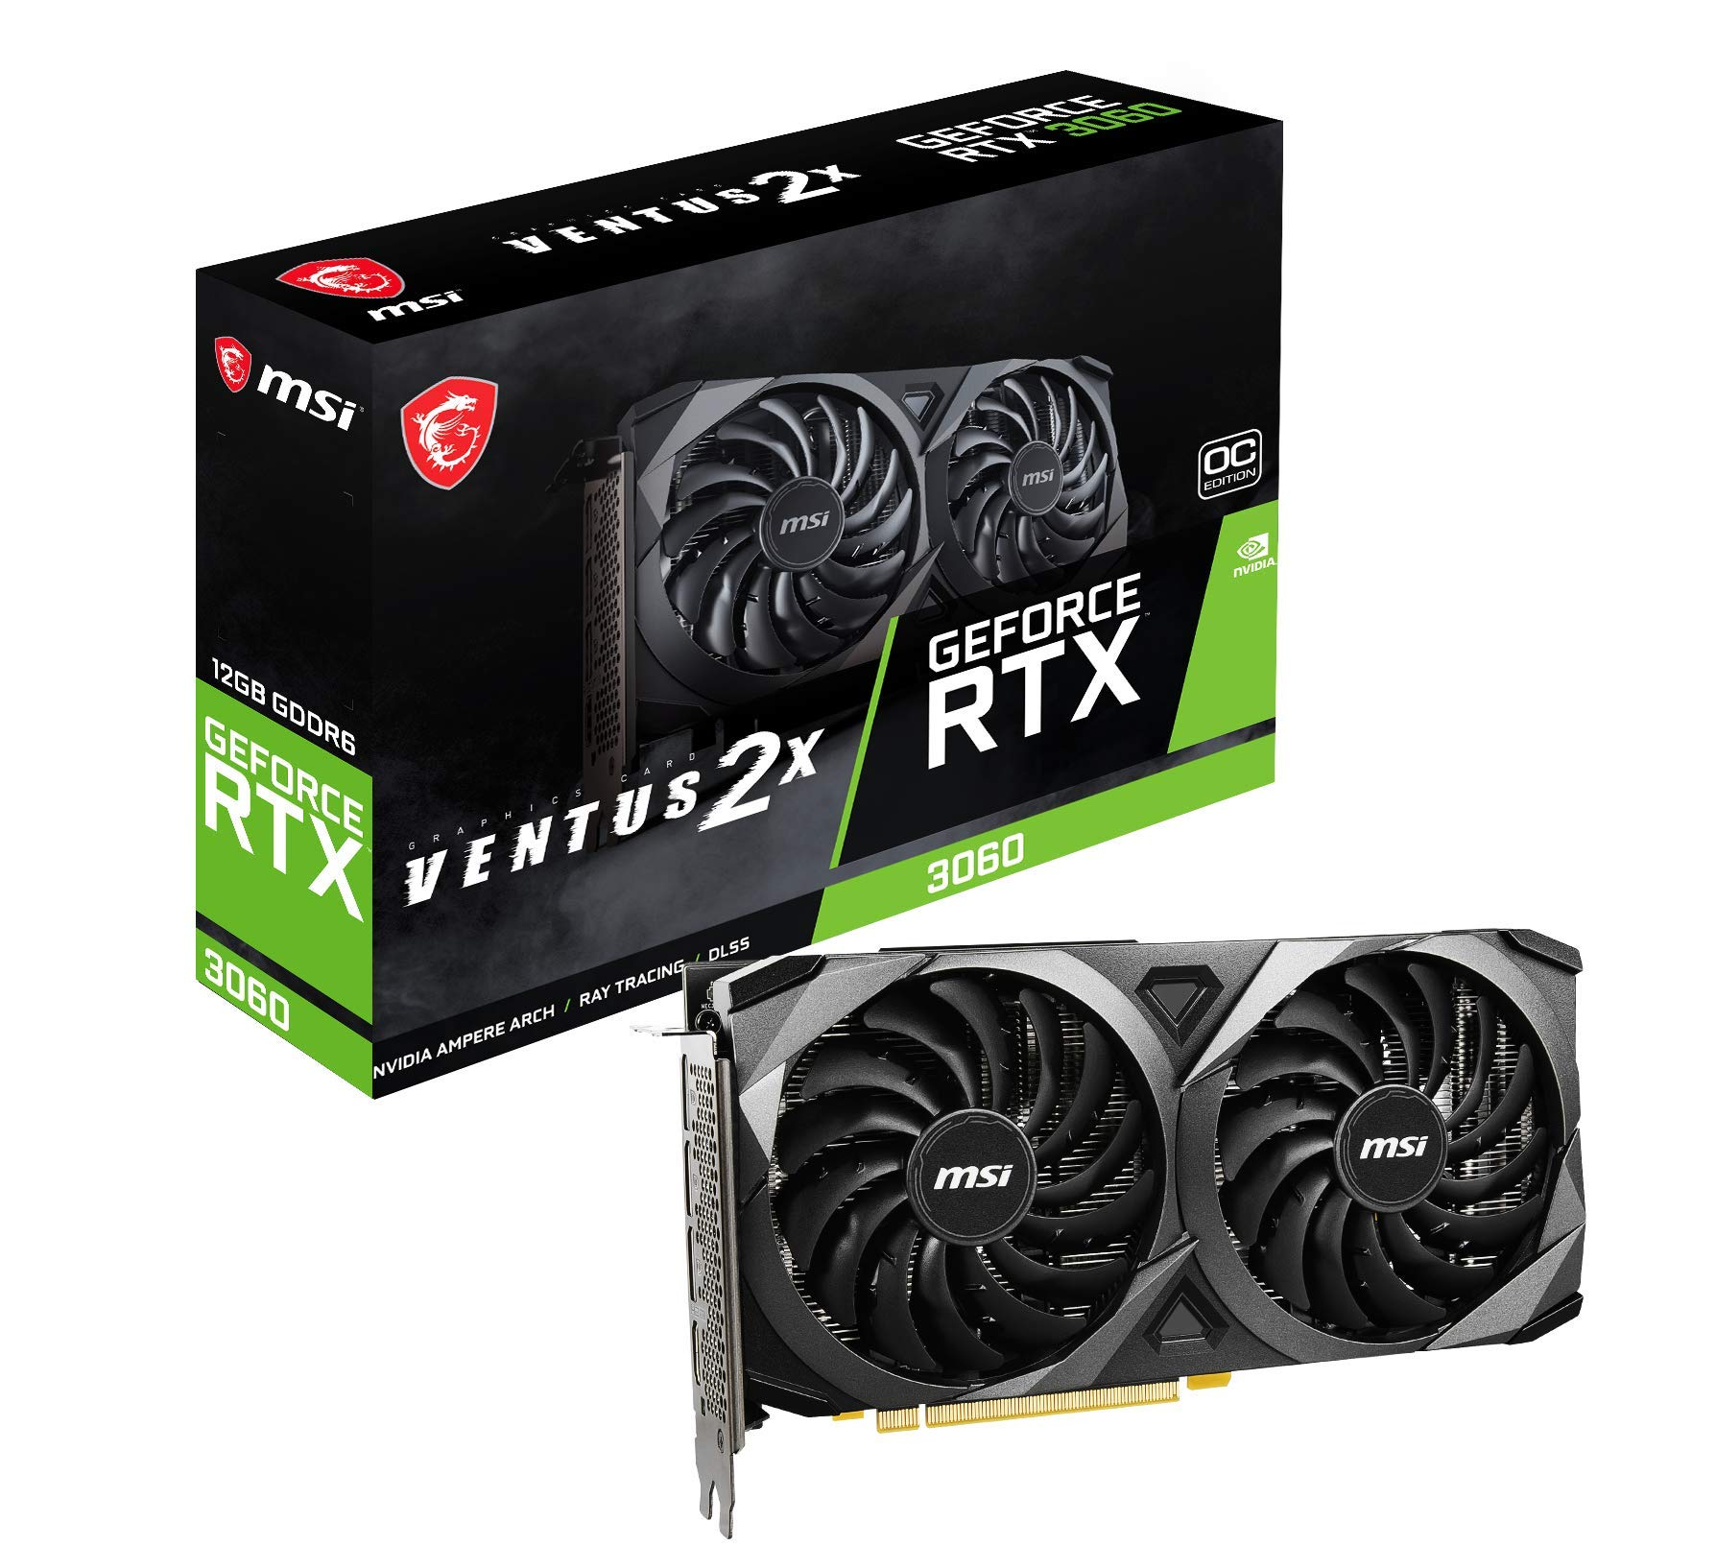
GPU to the rescue: Massively parallel computing
Pixels can be rendered simultaneously
Capable of general-purpose computing/custom algorithms
  Supports subroutines, any math operations, if statements/branching, classes/polymorphism, memory allocation/access
  Has its own memory with paging and caching
  Can be debugged live with some effort. Breakpoints, memory inspection, stepping, and everything
  Basically more computer per computer
    Amazing at doing thousands of the same thing at once.
    Horrible at doing different things at once
I have 3,584 cores*
NVIDIA + Mythbusters
https://www.youtube.com/watch?v=-P28LKWTzrI
* The concept of a “core” on GPUs is fuzzy at best. Not the same thing as on the CPU

Slide 9
CUDA: Nvidia’s API for GPU programming
GPU has x Streaming Multiprocessors (3060 has 28)
One SM can run y blocks (16 on 3060)
Each block can have up to z threads (1024 on 3060)
Theoretically, x*y*z threads can run simultaneously
  This simultaneous execution happens using SIMD instructions on groups of 32 threads called “warps”
    Thanks to pipelining, multiple instructions from different (or even the same) warps can happen simultaneously on the same hardware so long as the subunits aren’t in contention.
    This is not context switching. This is more akin to hyperthreading where each physical core splits into even more than 2.
  That’s a big “theoretically”. Unlike on the CPU, code complexity influences how many things can happen concurrently

Slide 10
CUDA Programming
Mostly C++ with some tags and funny syntax
  Functions can be compiled for the CPU, GPU, or both
  CPU is called the “host”
  GPU is called the “device”
  GPU code entry point is “Kernels” which are launched by the CPU via a special function call (funny syntax)
CPU and GPU code can run simultaneously
  GPU can be processing an image while the CPU reads files or does physics calculations. They are different devices, after all

Slide 11
CUDA Dogma
Write a function that handles a single element of your problem set.
  It uses special global variables threadIdx and blockIdx to figure out which element that actually is. There will be a unique threadIdx and blockIdx combo for each of your elements
CUDA runs that function on the GPU once for every element
  Each launch sees a different threadIdx and blockIdx
  This is how each one works on different elements.
Try to maximize threads per block
  More threads in a block = more warps in that block
  More warps = more hardware utilization and opportunities to hide latency from memory accesses and other stalls
    Waiting on something? Just run one of the other warps in the meantime!
    Scheduling happens in hardware. A context switch here takes 0 (yes, 0!) clock cycles.

Slide 12
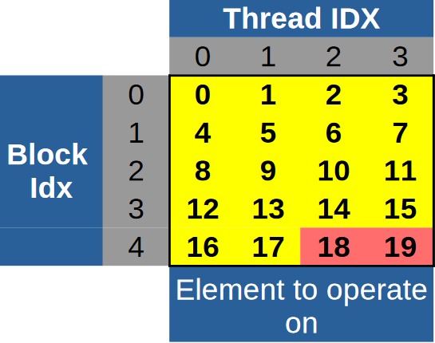
Broad Example
Have an array with 18 elements
Launch a kernel in 5 blocks with 4 threads each
  blockIdx and threadIdx is different
  for each thread.
  blockIdx is 0,1,2,3,4
  (up to number of blocks)
  threadIdx is 0,1,2,3
  (up to number of threads in a block)
Out-of-bounds threads
  Elements 18 and 19 don’t exist, but threads are still launched to “handle” them.
  Each thread should first check if its element is valid. If not, it returns immediately.
  Some level of wastefulness is not only acceptable, but normal.
  Thread launches are proportionally free.

Slide 13
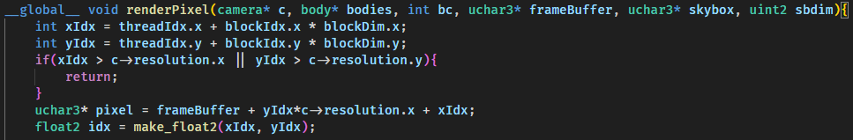
Specific Example
Figure out x and y coords of the pixel we’re rendering
do bounds check
Pointer arithmetic based on underlying image representation. Point is, this is where we put our color when done
CUDA allows you to launch kernels with 1D, 2D, or 3D indexes so it’s easier for kernels to figure out which element they’re working on. That’s what I’m using here.
This is a 2D launch—that way, the thread/block indexes map more cleanly to (x,y) pixel coordinates

Slide 14
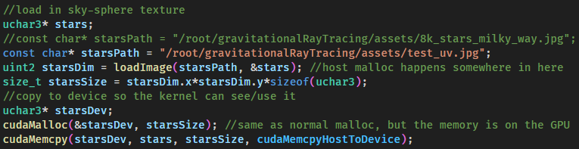
Host vs Device Memory
The GPU has its own memory
  Anything that runs on the GPU is using device memory, NOT the host memory. They CANNOT share pointers without some legwork and severe performance hits.
  Anything you want kernels to use needs to be copied to the device
  Classes initialized on the host can be safely copied to device iff they are plain-old-data
  Basically all kernels return via output parameters, cudaMemcpy’d back from the device when done.

Slide 15
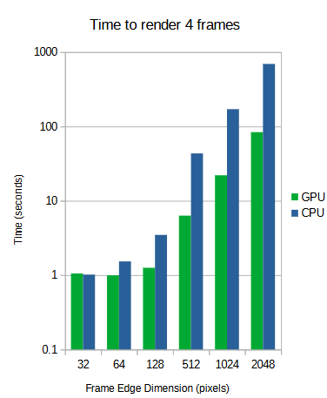
Rendering times (benchmarking)
GPU vs CPU using 12 cores
  GPU: RTX 3060 (x² threads, 1.8 GHz)
  CPU: Ryzen 7 3700X (12 threads, 4 GHz)
  Both running the exact same C++ code
Workload-dependent benefit
  Approx. equivalent < 128px
  Note the log scale
    At 2048px, the GPU is running circles around the CPU at 10x throughput

