Slide 1
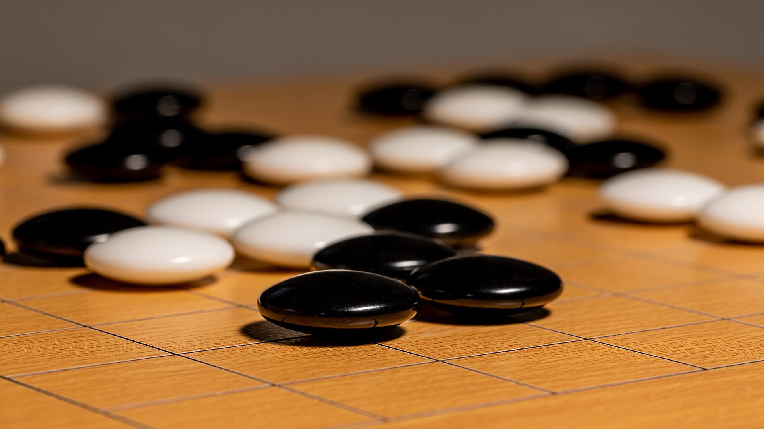
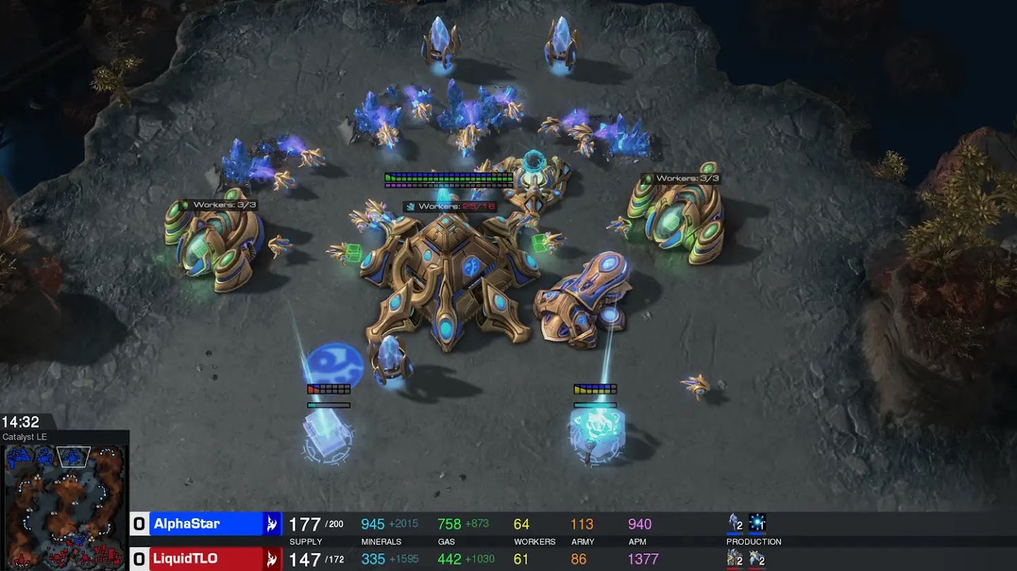
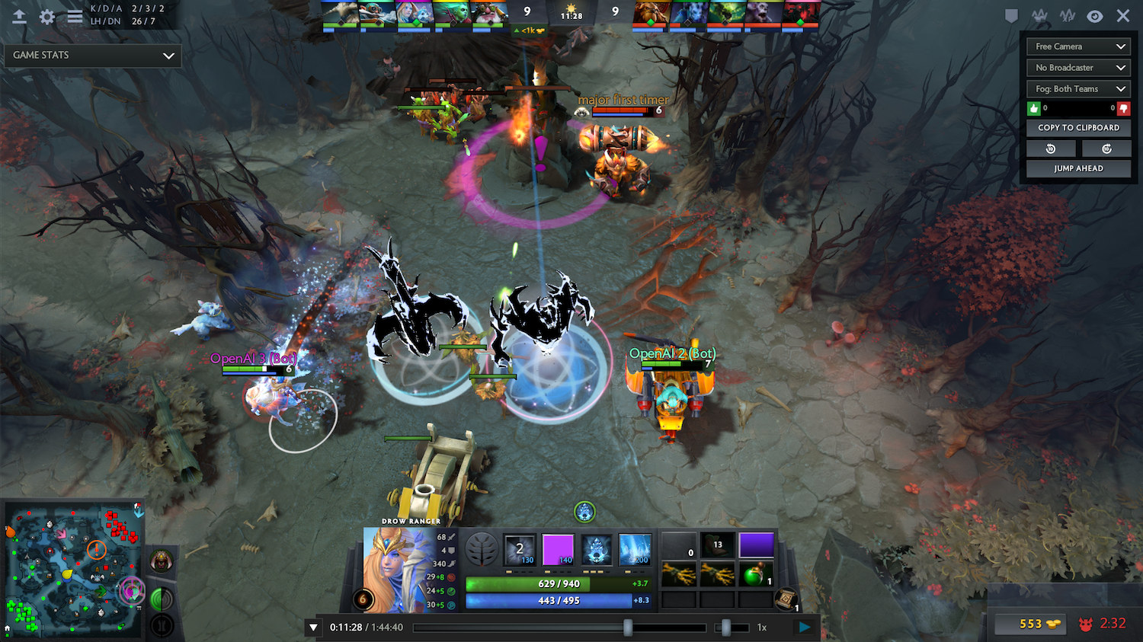
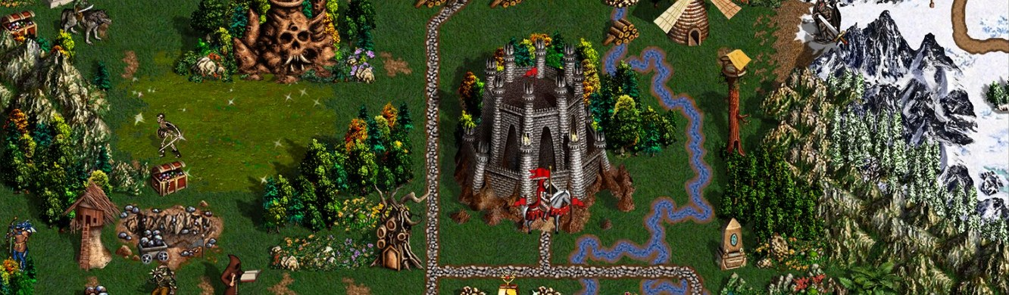
From AlphaGo
to Heroes III
DEEP REINFORCEMENT LEARNING IN GAMES
Go
StarCraft II
How deep RL mastered Go, StarCraft II and Dota 2, one trick at a time, and why Heroes III is harder still
Dota 2
Heroes III
AlphaGo
·
AlphaGo Zero
·
AlphaStar
·
OpenAI Five
·
Heroes III
Notes:
The same history as before, plus a fourth game. Parts I–III cover how Go, StarCraft II and Dota 2 were mastered, one trick at a time. Part IV is our own project: what makes Heroes of Might and Magic III harder than all three, and which tricks we borrowed, invented or still plan to try.

Slide 2
Four years, three games
ROAD MAP
Six milestones, from the Go board to real-time strategy.
Oct 2015
Mar 2016
Oct 2017
Dec 2018
Apr 2019
Oct 2019
AlphaGo Fan
AlphaGo Lee
AlphaGo Zero
AlphaStar
OpenAI Five
AlphaStar Final
Beats European champion Fan Hui 5–0
Beats Lee Sedol 4–1 in Seoul
No human games; beats AlphaGo Lee 100–0
Beats pros TLO and MaNa 5–0 each
Beats world champions OG 2–0
Grandmaster with all three races
Silver et al. 2016, 2017 · DeepMind blog, Jan 2019 · Vinyals et al. 2019 · OpenAI et al. 2019

Slide 3
Go
PART I
Perfect information on a 19×19 board, about 250 legal moves per turn
AlphaGo (2016) · AlphaGo Zero (2017)
Photo: Dietmar Rabich, Wikimedia Commons, CC BY-SA 4.0

Slide 4

Search the whole game tree
GO · STEP 0
Brute force
P(win)
Policy
Search
Self-play
Exhaustive minimax visits every line of play: roughly b^d positions for breadth b and depth d.
CHESS GAME TREE
GO GAME TREE
LEGAL GO POSITIONS
10¹²³
10³⁶⁰
10¹⁷⁰
≈ 35⁸⁰: 35 legal moves, 80 moves deep
≈ 250¹⁵⁰: 250 legal moves, 150 moves deep
2.08 × 10¹⁷⁰, counted exactly by Tromp in 2016
Chess engines prune this tree with alpha-beta search and a hand-written evaluation. Go programs before AlphaGo used Monte Carlo tree search and topped out at strong amateur level (KGS 6 dan).
Silver et al., Nature 2016 (b, d; prior programs in Extended Data Table 6) · Tromp, “Number of legal Go positions” (2016)

Slide 5
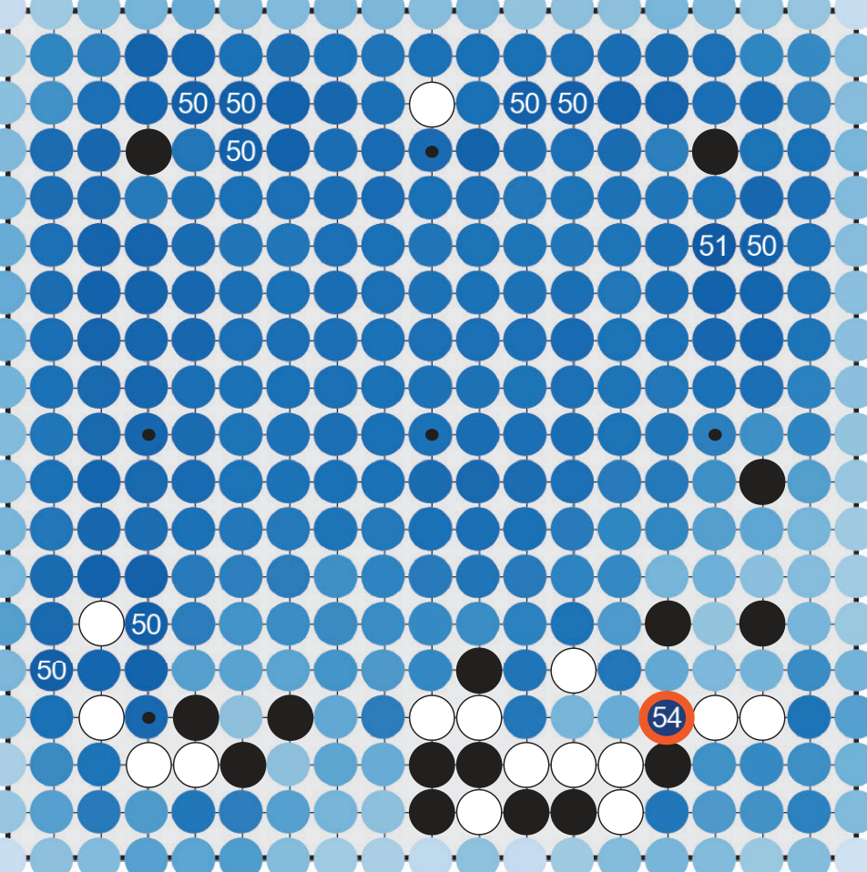
Predict P(win), play the best next position
GO · STEP 1
Brute force
P(win)
Policy
Search
Self-play
Train a value net v(s) ≈ P(win | s). Each turn, score every legal successor and play the argmax.
Why one step is not enough
250
net calls per move to score every legal reply
62,500
to look two moves ahead (250²)
≈10²⁴
to look ten moves ahead (250¹⁰)
Millions
of (position, winner) pairs to train v(s) without overfitting
AlphaGo’s value net scoring every legal reply, game vs Fan Hui. Best: 54%
Board: Silver et al., Nature 2016, Fig. 5a (AlphaGo plays black in an informal game vs Fan Hui)

Slide 6

One network, two heads
GO · STEP 2
Brute force
P(win)
Policy
Search
Self-play
Scoring every reply costs ≈250 network calls a move. Add a policy head: the pass that scores the position also ranks all 362 moves.
WHAT EACH HEAD LEARNS FROM
Policy head p
362 move probabilities (19×19 + pass)
1 per move
Policy: the move that was played, from human games first and from search later
Residual tower
Input
19 × 19 × 17 planes: 8 past positions per colour, plus side to move
20 or 40 blocks, shared by both heads
1 per game
Value: who won, shared by every position of that game
Value head v
one number in [−1, 1]: who will win
loss = (z − v)² − π·log p + c‖θ‖²
One shared tower and one loss train both heads together.
Architecture from AlphaGo Zero: Silver et al., Nature 2017 · Methods (neural network architecture, loss)

Slide 7
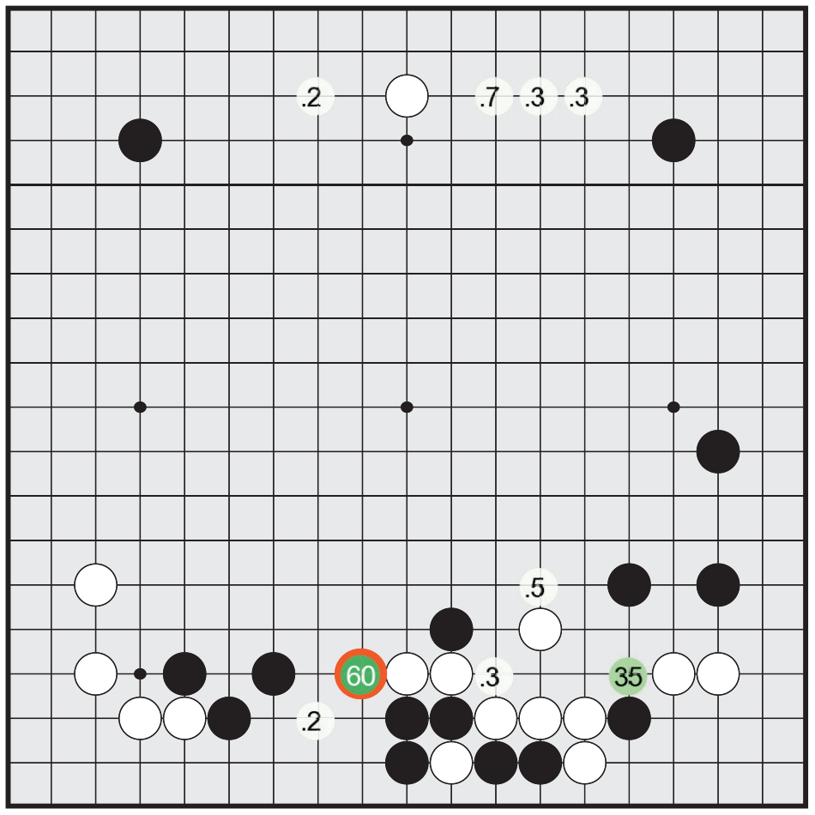
Learn the policy from human moves
GO · STEP 2 · TRAINING THE POLICY
Brute force
P(win)
Policy
Search
Self-play
The policy head imitates strong players: every human move is one training label.
57.0%
29.4M
accuracy predicting expert moves (previous best 44.4%)
move labels from 160,000 KGS games by 6–9 dan players, ≈184 per game
3 weeks
1,517 Elo
on 50 GPUs to train it
playing its top move, no search (best earlier program: 1,929)
Policy head, same position: 60% on one move, 35% on another
Silver et al., Nature 2016 · Methods (supervised learning of policy networks), Fig. 5d, Extended Data Tables 6–7
Notes:
Why human moves are a good training signal: - One label per move, not one per game. A game result gives a single win/loss label shared by all ~184 moves; imitation gives every move its own target (29.4M labels from 160K games). - Much less noisy. A win/loss is a weak signal for any single move, while the move a strong player actually chose is a direct, clean target. The catch: - People make mistakes, even 6 to 9 dan players. The policy learns "what would a strong human play here", not "which move wins". - The label is the move a human picked, not a human judge's P(win) for each candidate move. That would be a much better label, but nobody can produce it at scale.

Slide 8
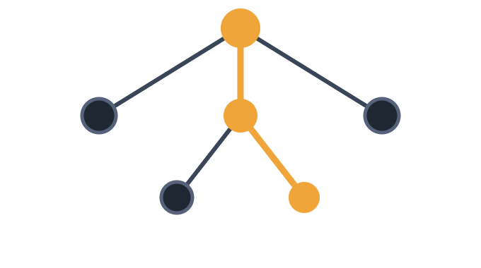
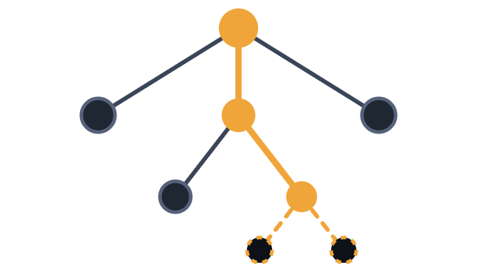
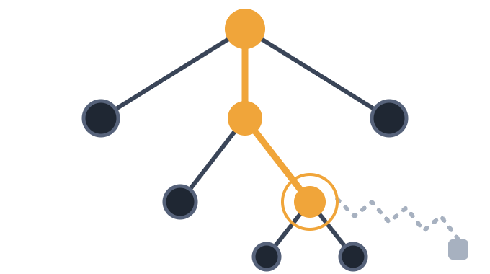
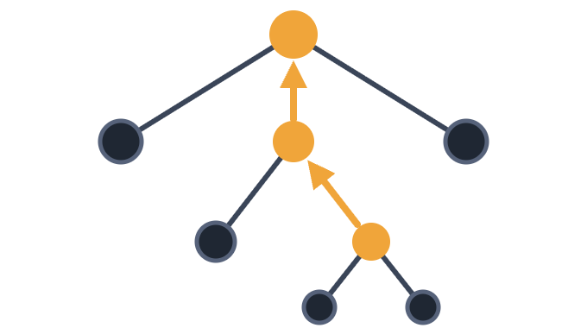
Search with both: Monte Carlo tree search
GO · STEP 3
Brute force
P(win)
Policy
Search
Self-play
Thousands of simulations per move: walk down the tree, grow a leaf, score it, back the score up.
1 · Select
2 · Expand
3 · Evaluate
4 · Backup
a = argmax Q + u
P(s, ·) = p(· | s)
V = (1 − λ)·v + λ·z
N ← N + 1
u ∝ P / (1 + N)
The policy head puts priors on the leaf’s legal moves
v from the value head, z from a rollout: a quick game played to the end
Q ← mean of V
The prior P steers early visits; the measured value Q takes over as N grows
Every edge on the path updates its visit count and mean value
After the last simulation, AlphaGo plays the most visited move at the root.
Silver et al., Nature 2016 · “Searching with policy and value networks”, Fig. 3, Methods

Slide 9
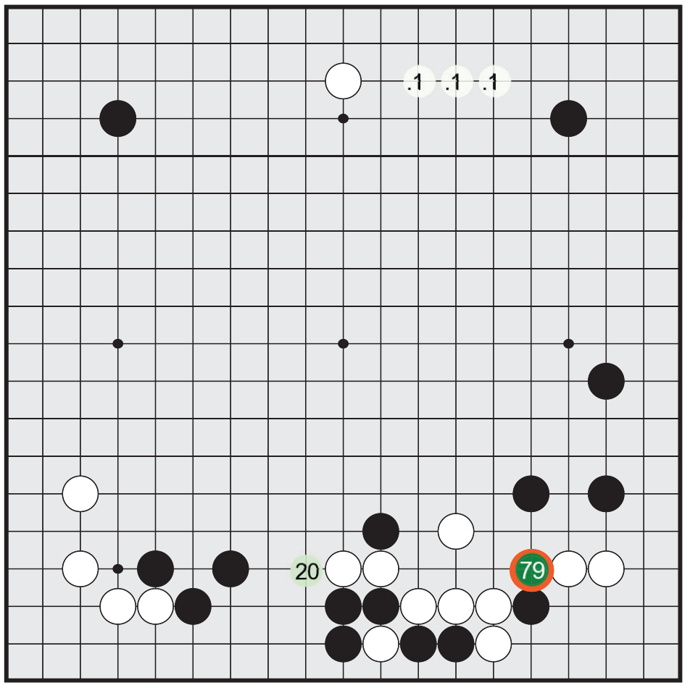
One real move: search overrules the policy
GO · STEP 3 · IN A REAL GAME
Brute force
P(win)
Policy
Search
Self-play
AlphaGo (black) vs Fan Hui. The policy’s favourite got only 20% of the simulations; AlphaGo played the policy’s 35% move, the reply the value head rated highest.
Value head: best reply 54% win probability
Policy head: 60% on its favourite, 35% on the move played
Search: 79% of simulations on the move played, 20% on the favourite
Silver et al., Nature 2016, Fig. 5 a, d, e (informal game, AlphaGo black to play)

Slide 10
Every component adds Elo
GO · ABLATION
Brute force
P(win)
Policy
Search
Self-play
A rollout finishes the game from the leaf with a fast pattern policy and scores who won.
SEARCH
MOVE PRIORS
LEAF SCORE
ELO · 230 ≈ 79% WINS
MCTS
pattern model
rollout
1,457
No search: play the policy head’s top move
1,517
MCTS
pattern model
value head
1,655
MCTS
pattern model
½ value + ½ rollout
2,077
MCTS
policy head
value head
2,177
MCTS
policy head
rollout
2,416
MCTS
policy head
½ value + ½ rollout
2,890
Crazy Stone, the best program before AlphaGo
1,929
Fan Hui, professional 2 dan
2,908
Pattern models: linear softmax over local stone patterns, one for rollouts (2 μs a move), a larger one for priors.
Silver et al., Nature 2016 · Extended Data Tables 4, 6, 7 · one machine (48 CPUs, 8 GPUs), 5 s per move

Slide 11
One game, one label
GO · STEP 4 · SELF-PLAY
Brute force
P(win)
Policy
Search
Self-play
AlphaGo Zero’s only ground truth is who won. Search makes a policy target at every move, and each one costs 1,600 simulations.
LABELS PER GAME
WHAT ALPHAGO ZERO PAID
1
The result
4.9M games
over 3 days, to beat AlphaGo Lee 100–0
Who won: one value label, shared by every position in the game. Self-play has no other ground truth.
29M games
over 40 days, to beat AlphaGo Master 89–11
≈184
Human moves
Each move is a policy label: 29.4M from 160,000 KGS games.
1,600
simulations to choose each move, ≈0.4 s
P(win)
Live odds
AlphaGo 2016: value training on whole KGS games memorised the results (MSE 0.19 train, 0.37 test). The fix was 30M self-play games, one position each.
A betting or prediction market would price the position after every move: value labels as dense as moves. None of these systems had one.
Silver et al., Nature 2017 (empirical analysis, self-play) · Silver et al., Nature 2016 (KGS data, value network)

Slide 12
Search adds 2,130 Elo
GO · ABLATION · THE NUMBER TO REMEMBER
AlphaGo Zero’s raw network, playing its top policy move, rates 3,055. The same network inside MCTS rates 5,185.
Raw network
AlphaGo Fan
AlphaGo Lee
AlphaGo Master
AlphaGo Zero
3,055
3,144
3,739
4,858
5,185
Silver et al., Nature 2017, Fig. 6b · 5 s per move · Zero and Master on 4 TPUs, Fan on 176 GPUs, Lee on 48 TPUs

Slide 13
StarCraft II
PART II
Real time, imperfect information, about 10²⁶ possible actions per step
AlphaStar (2019)
Image: DeepMind, AlphaStar vs TLO (2019)

Slide 14
Why StarCraft II is harder than Go
STARCRAFT II · THE PROBLEM
Seven properties that break the AlphaGo recipe.
PROPERTY
GO
STARCRAFT II
Information
Perfect: the whole board is visible
Imperfect: fog of war hides the opponent, so you must scout
State
19×19 points, 3 values each
Up to 512 units × 14 attribute groups, plus 128×128 map layers
Actions per step
≈250 legal moves
≈10²⁶: action type × unit subset × target × timing
Decisions per game
≈150 moves
Thousands of actions over tens of thousands of 45 ms steps (≈10 min)
Thinking time
Turn-based: seconds of search per move
Real time with ≈110 ms latency; AlphaStar runs no search
Strategy space
Plain self-play works (AlphaGo Zero)
Non-transitive: A beats B, B beats C, C beats A
Value-net data
30M self-play games, one position each
One sample per ≈10-minute game is unaffordable: learn from every step
Vinyals et al., Nature 2019 · main text, Methods, Extended Data Tables 1–2 · Silver et al. 2016, 2017

Slide 15



What is easier, and the data available
STARCRAFT II · WHAT HELPS
Machines have mechanical advantages, and there is a large public replay set.
Mechanics
HUMAN DATA
Perfect precision, no fatigue, units selected anywhere on the map. AlphaStar had to be throttled (Trick 8).
971,000
Raw interface
replays from players above 3,500 MMR (top 22%), game versions 4.8.2–4.8.6
An exact list of units and their attributes, so there are no pixels to parse.
16,000 winning replays above 6,200 MMR for fine-tuning
Simulation at scale
For comparison, AlphaGo learned from 160,000 KGS games (29.4M positions).
16,000 concurrent games for every learning agent.
Vinyals et al., Nature 2019 · Methods (supervised learning, infrastructure) · Silver et al., Nature 2016

Slide 16

Encode units, decode structured actions
ALPHASTAR · TRICK 1
A transformer reads the unit list, a deep LSTM keeps memory through the fog of war, and an autoregressive head picks each action argument in turn.
Units → Transformer
SUPERVISED WIN RATE VS ELITE BOT
up to 512 entities
ACTION HEAD
Baseline
1 · Action type
0%
Minimap → ResNet
Deep LSTM
+ action delays
128×128 map layers
2 · Delay to next look
7%
memory through the fog of war
3 · Queue it?
+ pointer network
Scalars → MLP
36%
race, resources, z
4 · Which units (pointer)
+ transformer
Scatter connections place unit embeddings onto the map grid
5 · Target: unit or point
71%
+ scatter connections
No joint softmax over type × units × target
Each head samples, and its pick feeds the next
Units: a pointer picks one at a time, up to 64
87%
139M weights, 55M needed at inference
Vinyals et al., Nature 2019 · Fig. 3F (Protoss vs all), Extended Data Fig. 3, Extended Data Table 2
Notes:
How the action head works: - The encoders and the LSTM run once per step. Then the argument heads run one after another, because each needs what the earlier heads picked. - 1. Action type: a softmax over all action types, from the LSTM output, gated by context that includes which actions are available now and the strategy statistic z. - 2. Delay: how many game steps until the agent looks again. 3. Queued: do it now, or after the current orders. - 4. Which units: a pointer network over the transformer's unit embeddings. It picks one unit at a time, up to 64, until it picks a special end-of-selection token. Each pick is fed back, so the next pick knows what is already selected. - 5. Target: a pointer to one unit, or a point on the map from a 2D spatial head, depending on the action type. - Every pick is embedded and added to an autoregressive embedding that the next head reads. So it is never one softmax over every type × units × target combination (about 10^26 per step). The action's probability is the product of the heads' conditional probabilities, and heads the type does not use are skipped. - To score a human action in supervised training, the heads are fed its real arguments, so the whole chain trains in one pass. Same as Heroes III? Yes in spirit: type first, then each argument in turn, each conditioned on the earlier picks. Differences: our argument chain depends on the type (ARMY has five steps, BUILD two), where AlphaStar has fixed slots a type uses or skips. We pick one hero, town or army, not a set of up to 64 units. And there is no delay head, since the game is turn-based.

Slide 17
Imitate 971,000 human games first
ALPHASTAR · TRICK 2
Predict every human action from the observations, conditioned on a strategy statistic z taken from the same replay.
SUPERVISED AGENT
FINE-TUNED
STATISTIC Z
3,699 MMR
87% → 96%
First 20
average across races, above 84% of ranked players
win rate vs the Elite bot (PvP) after 16,000 winning replays above 6,200 MMR
buildings and units, plus cumulative counts; z is zeroed 10% of the time
Fine-tuned supervised agents: Terran 3,947 · Protoss 3,607 · Zerg 3,544 MMR
Supervised learning does two jobs: it initialises the agent and keeps its exploration diverse during RL.
Vinyals et al., Nature 2019 · main text and Methods (supervised learning)

Slide 18
Keep the human prior during RL
ALPHASTAR · TRICK 3
Start from the supervised weights, add a KL penalty toward them, and reward following a build order sampled from human games.
No human data
149
Supervised only
936
RL from supervised weights
1,020
+ KL to supervised policy
1,400
+ build-order rewards (z)
1,540
Built-in Elite bot
603
WHY
PSEUDO-REWARDS
Random exploration almost never finds a long, precise build, such as one that ends in air units. Human strategies keep those modes in play.
Edit distance to the sampled build order and Hamming distance to its unit statistics, each active 25% of the time.
Vinyals et al., Nature 2019 · Fig. 3E (Test Elo, PvP on one map, 10¹⁰ steps) and Methods (exploration and diversity)

Slide 19
Learn off-policy from whole trajectories
ALPHASTAR · TRICK 4
Actors play with slightly old weights, so learning is off-policy. The policy uses V-trace plus UPGO; the value function uses TD(λ) with no correction.
AVERAGE WIN RATE VS FIXED OPPONENTS
EVERY STEP IS TRAINING DATA
82%
AlphaGo’s value net kept one position per game. AlphaStar trains policy and value on every step of every trajectory, and replays each trajectory twice.
73%
49%
UPGO is a self-imitation update: it moves the policy toward trajectories with better-than-average return.
Action type, delay and the other arguments get separate importance ratios, so V-trace does not cut traces too early in a 10²⁶ action space.
V-trace
+ TD(λ)
+ UPGO
Vinyals et al., Nature 2019 · Fig. 3I (best response vs fixed opponents), Methods (value and policy updates, infrastructure)

Slide 20
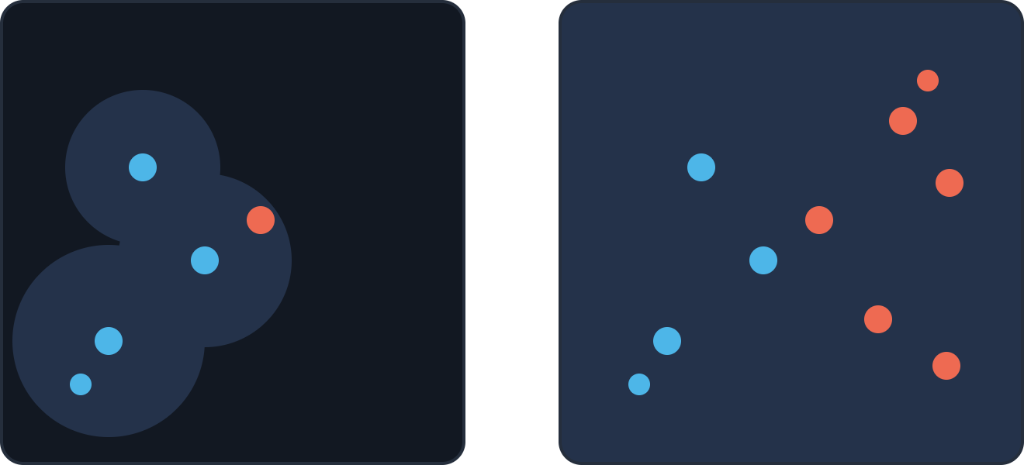
Let the critic see the opponent
ALPHASTAR · TRICK 5
The value function is used only in training, so it can also read the opponent’s observations. Its targets get lower variance, and nothing changes at play time.
AVERAGE WIN RATE VS FIXED OPPONENTS
82%
22%
Policy input: fog of war
Critic input in training: both players’ views
own units
opponent units
Without opponent info
With opponent info
Vinyals et al., Nature 2019 · Fig. 3K and Methods (value and policy updates). Map sketch is illustrative.

Slide 21
League training with exploiters
ALPHASTAR · TRICK 6
Twelve learning agents feed a league of frozen snapshots, almost 900 players by the end. Exploiters exist to find and expose weaknesses.
×3 · ONE PER RACE
×3 · ONE PER RACE
×6 · TWO PER RACE
Main agents
Main exploiters
League exploiters
35% self-play
Play only the current main agents
PFSP vs the whole league
50% PFSP vs all past players
Join the league after beating all three in over 70% of games
Join after over 70% vs every player
15% vs forgotten players, exploiters
25% chance of a reset when they join
Never reset
Then reset to supervised weights
ABLATION · ELO OF THE MAIN AGENTS
RELATIVE POPULATION PERFORMANCE
Main agents only
1,540
Main agents only
6%
+ main exploiters
1,693
+ main exploiters
35%
+ league exploiters
1,824
+ league exploiters
62%
Vinyals et al., Nature 2019 · Fig. 3A–B (relative population performance measures exploitability), Methods (populating the league)

Slide 22
Prioritised fictitious self-play
ALPHASTAR · TRICK 7
Pick frozen opponents by how often they still beat you. Self-play learns fast but forgets past opponents; adding PFSP keeps them covered.
METHOD
TEST ELO
MIN WIN RATE VS PAST
OPPONENT WEIGHTING
FSP (uniform)
1,143
69%
f_hard(x) = (1 − x)^p
PFSP
1,273
70%
x = P(agent beats opponent). Opponents it always beats get no games.
Self-play (SP)
1,519
46%
f_var(x) = x(1 − x)
PFSP + SP
1,540
71%
Opponents near its own level: used by main exploiters and struggling main agents.
Minimum win rate against all past versions, averaged over training: a proxy for forgetting.
Vinyals et al., Nature 2019 · Fig. 3C–D (PvP, one map, 10¹⁰ steps) and Methods (prioritised fictitious self-play)

Slide 23
Play under human-like limits
ALPHASTAR · TRICK 8
A camera view, at most 22 non-duplicate actions per 5 s, about 110 ms of latency, and the agent picks its own delay before the next observation (370 ms on average).
TEST ELO VS APM LIMIT, RELATIVE TO ALPHASTAR’S
CAMERA INTERFACE
1,536
1,540
87% vs 96%
1,419
1,411
1,392
1,145
supervised win rate vs the Elite bot, with and without the camera
MORE APM HURTS
At 2× or no limit, Elo drops to 1,411 and 1,392. The paper’s guess: effort goes into refining micro instead of learning diverse strategies.
0
0%
10%
25%
50%
100%
200%
None
Vinyals et al., Nature 2019 · Fig. 3G–H and Methods (camera view, APM limits, delays)
Notes:
MORE APM HURTS: this is an indication of suboptimal training procedure. More actions do make longer chanis that are harder to learn (more noise per signal when backproping) but cutting out good decisions doesn't seem optimal:
Also the numbers are suspiciously clean 100%
Also this is still "cheating" (able to learn a much better micro) due to delay and being accurate. The camera effect indicates that.

Slide 24

Results and resources
ALPHASTAR · RESULTS
Evaluated blind on Battle.net with the unconditional policy, against ranked human players.
PROTOSS
TERRAN
ZERG
RESOURCES
6,275
6,048
5,835
12 agents × 32 TPU v3 × 44 days
MMR
MMR
MMR
Per agent: 16,000 concurrent games on ≈150 CPUs of 28 cores; a 128-core TPU learner at ≈50,000 agent steps/s
Grandmaster level with all three races, above 99.8% of ranked human players.
≈900 players created in the league
JAN 2019 VERSION
Supervised only
Mid · 27 days
Final · 44 days
14 days, 16 TPUs per agent, up to 200 years of play per agent. Raw interface, ≈280 APM. Beat TLO and MaNa 5–0 each.
top 16%
top 0.5%
top 0.15%
Vinyals et al., Nature 2019 · Fig. 2, Methods (infrastructure) · DeepMind blog, Jan 2019

Slide 25
Dota 2
PART III
Five heroes per team, 45-minute games, and a game that kept changing during training
OpenAI Five (2019)
Image: OpenAI Five Finals vs OG, game 1 (OpenAI et al. 2019, Fig. 11a)

Slide 26
What Dota 2 adds beyond StarCraft
DOTA 2 · THE PROBLEM
Most of the new difficulty comes from teamwork, game length and a moving target.
01
02
03
Teamwork
Longer games
Bigger observation
Five heroes run five copies of one policy, with shared weights and no explicit messages. Credit must be split across the team.
≈45 minutes at 30 fps; acting on every 4th frame gives ≈20,000 steps per game (StarCraft ≈10 min, Go ≈150 moves).
≈16,000 values per step, mostly floats and categoricals (Go ≈6,000 binary values, chess ≈1,000).
04
05
06
Heroes and items
A moving target
No human replays
117 heroes with unique abilities, a large item shop, and a hero draft before every game.
Game patches and code changes roughly every two weeks, inside a single 10-month training run.
OpenAI Five learned by self-play from scratch. AlphaStar started from 971,000 replays.
OpenAI et al., “Dota 2 with Large Scale Deep Reinforcement Learning”, 2019 · Sections 1–3

Slide 27




What is easier, and the training data
DOTA 2 · WHAT HELPS
Each agent has a smaller control problem than in StarCraft, and the game is full of reward signals.
One hero per agent
TRAINING DATA
AlphaStar steers up to hundreds of units with one policy.
45,000
8,000–80,000 actions
years
valid actions per step after discretisation, depending on the hero (AlphaStar: ≈10²⁶)
of Dota self-play over 10 months, ≈250 years per day
No camera
The bot API gives everything the team can see, every step.
0 human games. The only human data: item-purchase statistics used to randomise item builds.
Dense signals
Gold, XP, last hits and towers make reward shaping natural.
770 ± 50 PFLOPs/s·days of optimisation compute by the OG match
AlphaStar: 971,000 human replays
OpenAI et al. 2019 · Sections 2–4, Appendix A, O.2 · OpenAI blog, Apr 2019 (45,000 years)

Slide 28
Compromises: a smaller Dota
DOTA 2 · COMPROMISES
OpenAI Five played a restricted version of the game, and scripts made some of the decisions.
HERO POOL
SCRIPTED
17
Item purchase order, ability build order (which skill to level, when), courier control and items kept in reserve. In matches the builds are fixed, so they never react to the opponents.
of 117 heroes
Each training game samples both line-ups from these 17.
REMOVED
Items that control extra units: Illusion Rune, Helm of the Dominator, Manta Style, Necronomicon
ABLATION
An 80-hero pool trained only about 20% slower early on (speedup ≈0.8).
RANDOMISED IN TRAINING
Item builds around the scripted one, so agents meet other builds
OpenAI et al. 2019 · Sections 2–3, Appendix F (scripted actions), O.2, P (hero pool size)

Slide 29
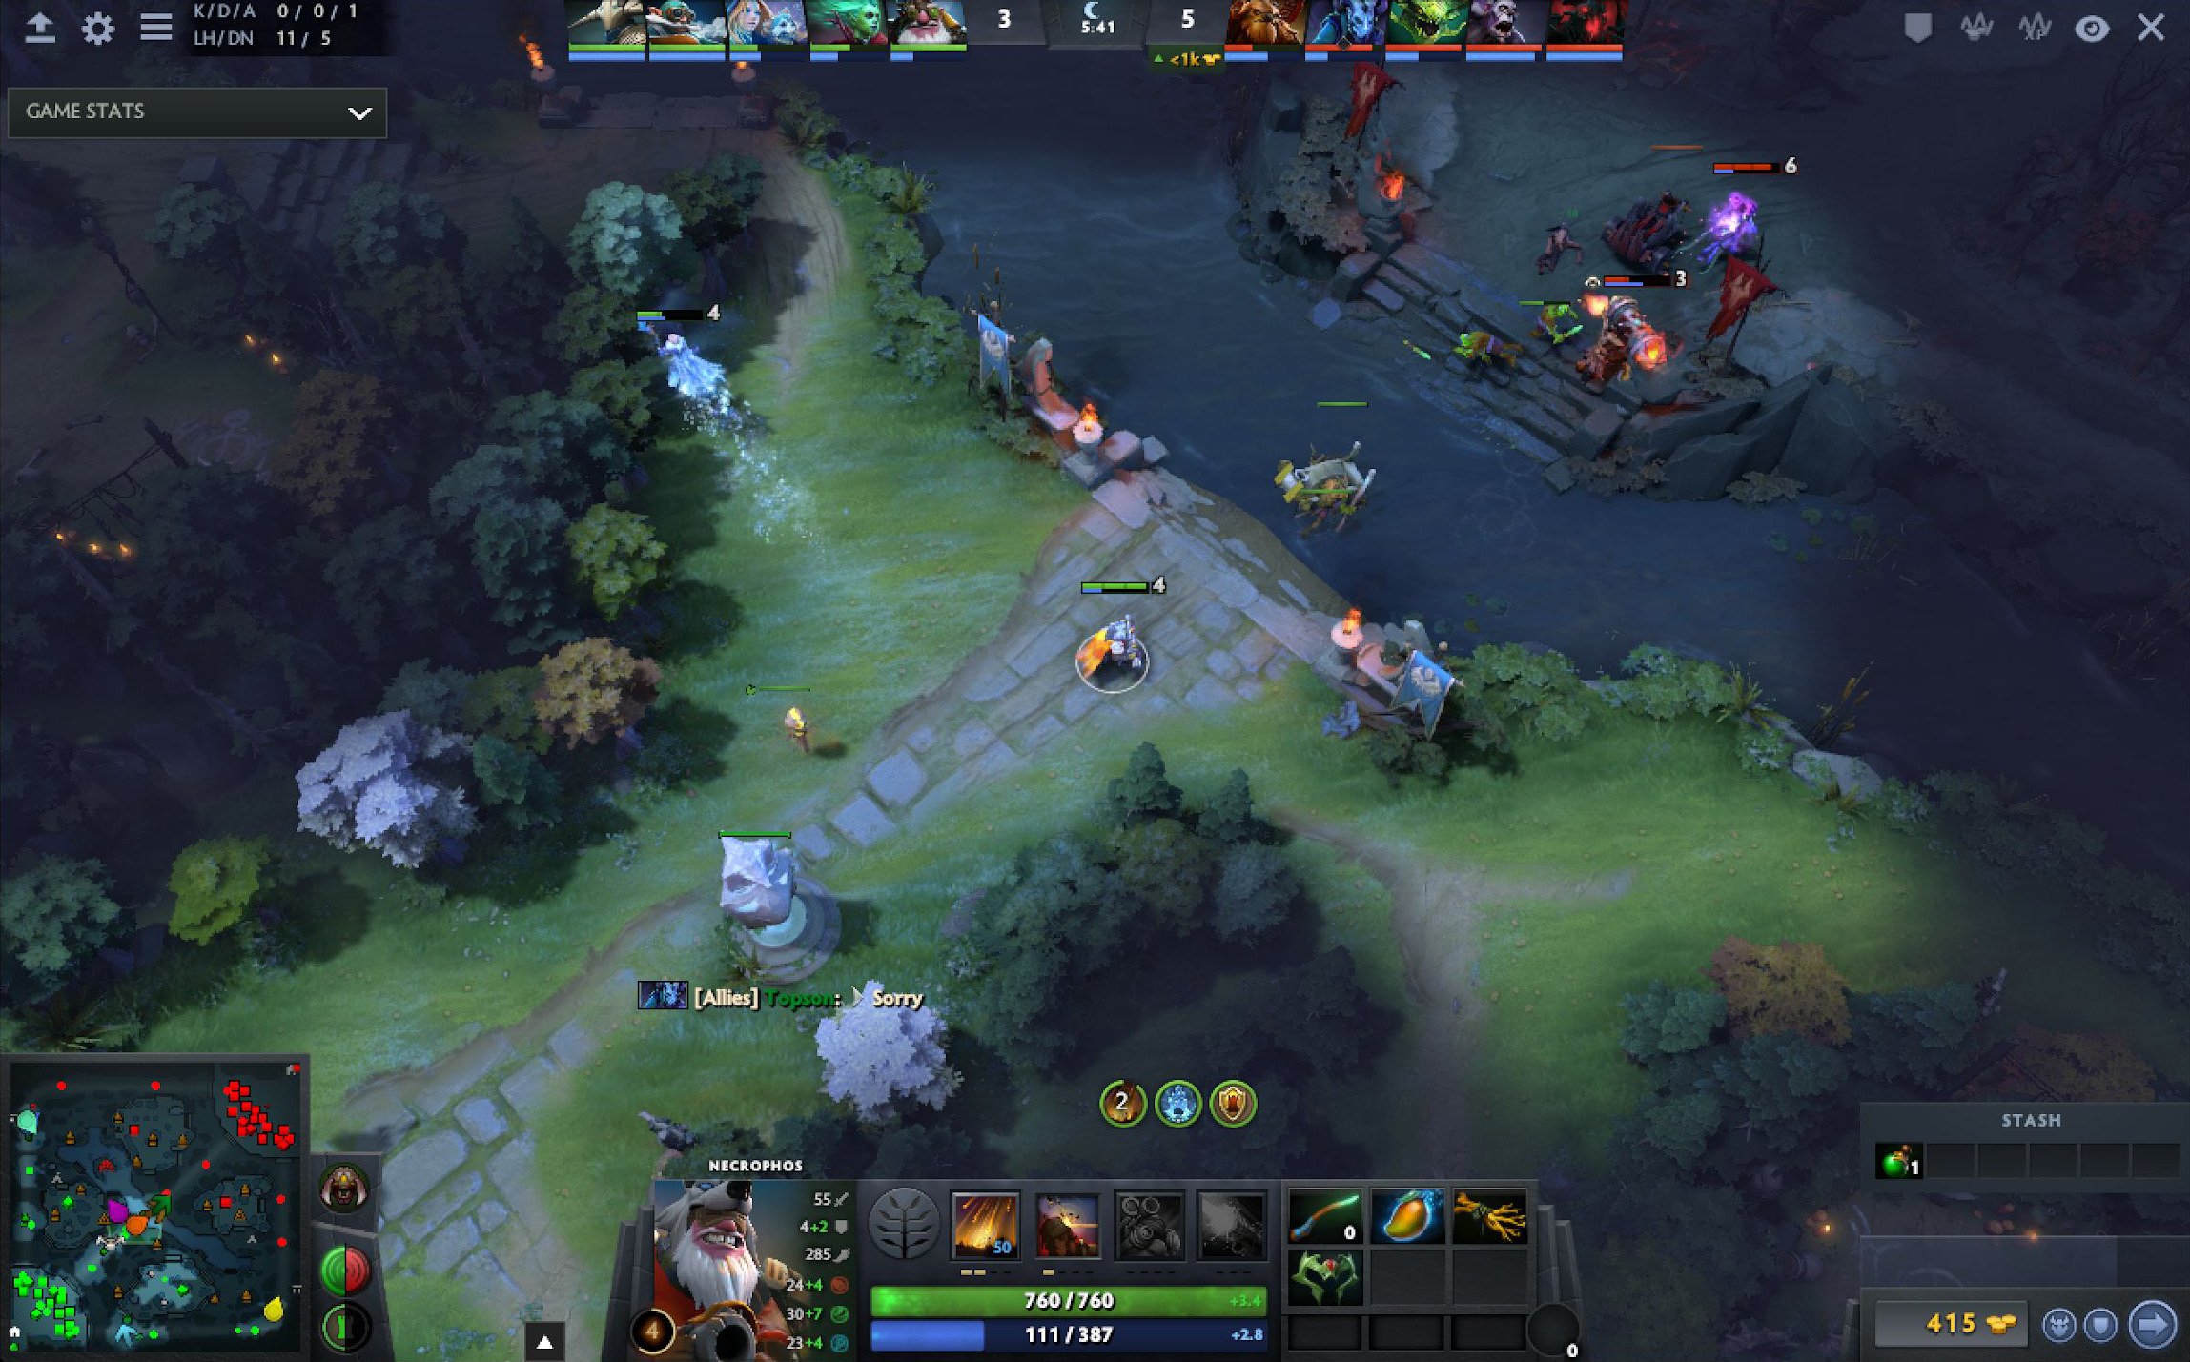
Micro makes up for scripted builds
DOTA 2 · COMPROMISES
With its builds fixed, OpenAI Five wins on execution: faster reactions and exact numbers.
217 ms
average reaction to a game event; typical human visual reaction is ≈250 ms
EXAMPLE · LAST HITS
Only the killing blow on a creep pays gold. Five knows the creep’s exact health and when incoming ranged-creep and tower shots land.
NOT PIXEL-PERFECT
Spells aimed at the ground pick 1 of 81 offsets (a 9 × 9 grid) around a unit, and Earthshaker’s Fissure gave it trouble.
The authors kept the scripts because the agent was already superhuman.
A human’s view. Five instead reads exact numbers for up to 189 units every 133 ms: position, facing, health over the last 16 steps, attack damage.
OpenAI et al. 2019 · Appendices D.2, E (Table 4), F, F.1, L (reaction time) · Image: Fig. 13

Slide 30
Shaped reward: what each hero is paid
OPENAI FIVE · TRICK 1
Winning is worth 5. Everything else is a small hand-set term, chosen once at the start and barely changed.
SOLO EVENT
REWARD
PER
SOLO EVENT
REWARD
PER
Hero death
−1
death
Mana
+0.75
change in mana fraction
XP gained
+0.002
point of experience
Killed a hero
−0.6
kill; offsets the large gold and XP
Gold gained
+0.006
gold; kept when spent or lost
Last hit
−0.16
last hit; net ≈ +0.4 with gold and XP
Gold spent
+0.0006
gold spent on items without the courier
Deny
+0.15
deny
Wrong lane
−0.15
second outside the assigned lanes
Health
+2
change in health fraction, curved*
≈2k vs ≈25k
iterations to reach TrueSkill 150, with these terms vs win/loss only. A game is ≈20,000 steps with one result; the shaped terms pay out all game long.
* Health at fraction x of maximum is worth (x + 1 − (1 − x)⁴) / 2, so a change near death counts 5× more than one near full health.
OpenAI et al. 2019 · Appendix G, Table 6 (shaped reward weights) · Fig. 16 (win/loss only, read from the plot)

Slide 31
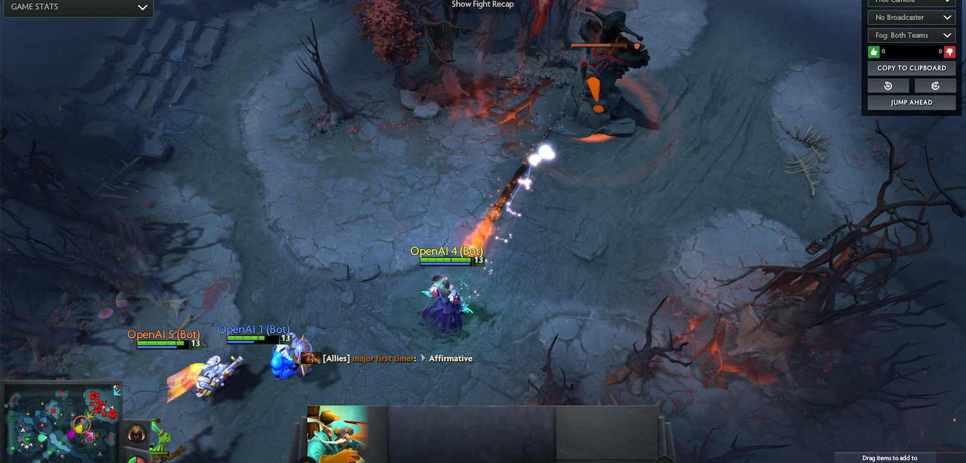
Shaped reward: team and building terms
OPENAI FIVE · TRICK 1
Team terms go to all five heroes. Buildings pay two thirds as they lose health, one third when they fall.
TEAM EVENT
REWARD
Barracks
+6
Tier-3 tower
+4.5
Tier-2 tower
+3
Tier-1 tower
+2.25
Tier-4 tower, shrine
+2.25 each
Ancient health lost
+5 × fraction
Win +5
Aegis gained +5
Finals game 1: OpenAI Five (Radiant) on the Dire mid tier-2 tower. At team spirit 1, a team term pays 5× a solo term.
Megas unlocked +4
Courier death −2
OpenAI et al. 2019 · Appendix G, Table 6 · Image: Fig. 11b

Slide 32
Team spirit: from selfish to shared reward
OPENAI FIVE · TRICK 2
Each hero’s reward blends its own reward with the team average. Low τ gives clearer credit early; τ = 1 is the real team objective.
rᵢ = (1 − τ)·ρᵢ + τ·mean(ρ)
τ = 0.8 · end of Rerun
τ = 0 · every hero for itself
τ = 0.3 · start of training
τ = 1 · equal split, end of OpenAI Five
ABLATION · EARLY TRAINING
SCHEDULE
TrueSkill below 125: τ = 0 learns fastest. TrueSkill 150–175: τ = 0.5 is fastest.
OpenAI Five annealed τ from 0.3 to 1.0.
Rerun only reached 0.8 and still matched the final OpenAI Five.
The authors expect τ = 1 to win later in training, since it is the true objective.
OpenAI et al. 2019 · Appendix G (team spirit), Appendix O.1 and Fig. 29, Fig. 7 and Appendix C (schedules)

Slide 33
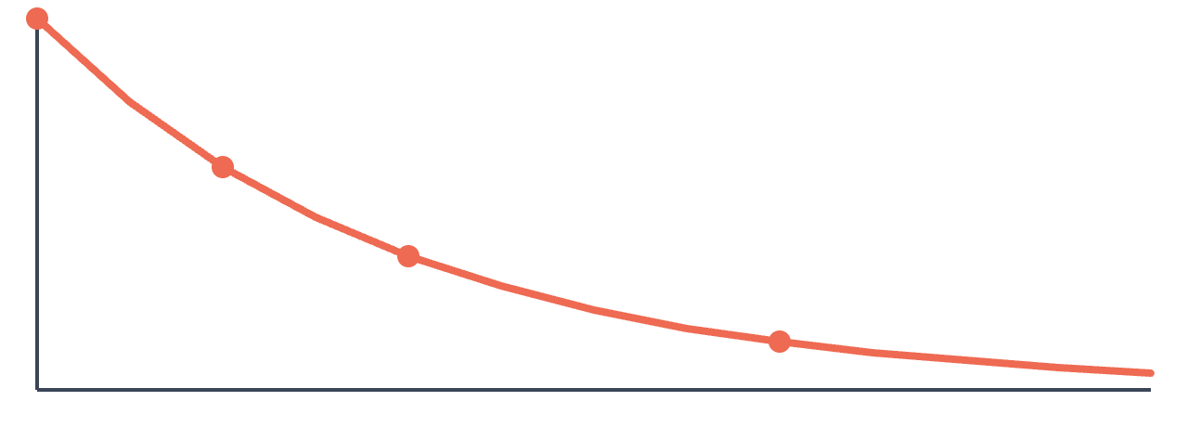
Zero-sum and time-weighted rewards
OPENAI FIVE · TRICK 3
Two corrections applied on top of the shaped terms.
ZERO-SUM
GAME-TIME WEIGHTING
rᵢ ← rᵢ − mean(r of enemy heroes)
ρ ← ρ × 0.6^(T / 10 min)
Only one team can win, so anything that helps one team hurts the other. Every hero’s reward is symmetrised against the enemy team.
Heroes earn far more late in a game; without this decay, learning would chase the late game. Win/loss is not decayed.
×1.0
×0.6 at 10 min
×0.36 at 20 min
×0.13 at 40 min
game time →
OpenAI et al. 2019 · Appendix G (zero sum, game time weighting, Eq. 11)

Slide 34
Stretch the horizon over training
OPENAI FIVE · TRICK 4
The horizon is how far ahead a reward still counts. With discount γ per 0.133 s step, H = 0.133 s / (1 − γ), and a reward H away keeps ≈37% of its weight.
WIN RATE VS THE 180 S AGENT, ≈2,000 VERSIONS LATER
≈95%
WHAT A LATER REWARD IS WORTH
≈90%
Reward in
H = 60 s
H = 840 s
≈65%
10 s
85%
99%
1 min
37%
93%
≈30%
≈15%
5 min
0.7%
70%
14 min
≈0%
37%
45 s
90 s
180 s (base)
360 s
720 s
Early on, 60 s keeps credit near last hits and kills; by the end, 840 s lets towers, Roshan and the win still count.
Ablation: a skilled agent resumed with a longer horizon gets stronger, up to the 6–12 minute horizons tried, with diminishing returns. Bars read from Fig. 6, approximate.
OpenAI et al. 2019 · Section 4.5, Eq. 3, Fig. 6, Appendix C · table: weight = γ^(t / 0.133 s) ≈ e^(−t / H)

Slide 35

Plain PPO at very large scale
OPENAI FIVE · TRICK 5
Standard PPO and GAE on a 4,096-unit LSTM. The new work was the system around it.
PPO · Proximal Policy Optimization, clip 0.2
GAE · Generalized Advantage Estimation, λ = 0.95
A policy-gradient step whose new/old probability ratio is clipped to 0.8–1.2, so one update does not move the policy far.
The advantage blends 1-step to full-game returns, weighted by λ. At 0.95 it leans long, with less variance than full returns.
Observation
Encoders
LSTM, 4,096 units
Heads
≈16,000 values per step from the bot API
unit features processed into one vector
84% of the 159M parameters
factorised actions and a value
×5: one replica per hero, with shared weights and its own LSTM state.
1–3M
1,536
172,800
≈2.5×
timesteps per batch
optimizer GPUs at peak, plus 1,440 rollout GPUs
rollout CPU cores at peak
ablation: faster to TrueSkill 175 with 983k vs 123k batches
Compared with AlphaGo: 50–150× the batch size, 20× the model, 25× the training time.
OpenAI et al. 2019 · Sections 3.1–3.2, 4.1, 4.3, Fig. 1, Fig. 5a, Appendix C and H

Slide 36
Keep the data fresh
OPENAI FIVE · TRICK 6
Games last up to two hours, so rollouts stream short chunks to the optimisers and pull new weights about once a minute.
ABLATION · STALENESS
ABLATION · SAMPLE REUSE
+8 versions
2–3× reuse
of lag between the weights that played and the weights being trained cause a significant slowdown
makes learning about 2× slower; 8× reuse may stop it learning a competent policy at all
Target: 0–1 versions
Target: ≈1
“High quality data matters even more than compute consumed.”
OpenAI et al. 2019, Section 4.4
OpenAI et al. 2019 · Section 4.4, Fig. 5b–c, Fig. 8, Appendix M (early training, 8× smaller than Rerun)

Slide 37
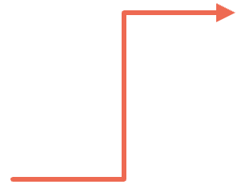
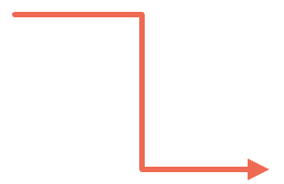
Self-play against a scored pool of past selves
OPENAI FIVE · TRICK 7
80% of games against the latest weights, 20% against past versions picked by a softmax over quality scores.
80% OF GAMES
NEW SNAPSHOT
against the latest weights: plain self-play
Every 10 iterations the agent joins the pool with the highest existing score.
Current agent
SCORE UPDATE
learns from every game
If it beats version i: qᵢ ← qᵢ − η / (N·pᵢ), η = 0.01. A loss changes nothing.
20% OF GAMES
against past versions, picked with probability ∝ exp(qᵢ)
EFFECT
When progress is fast, old versions sink and are rarely picked.
Compare:
AlphaGo · random earlier policy
AlphaStar · league + PFSP
OpenAI Five · 80/20 scored pool
OpenAI et al. 2019 · Section 3.2 and Appendix N (self-play, Eq. 14)

Slide 38
Surgery instead of restarts
OPENAI FIVE · TRICK 8
When the model, observations, actions or the game changed, function-preserving edits (Net2Net style) carried the trained weights over.
20+
surgeries in 10 months, one every 1–2 weeks
ABLATION · RERUN FROM SCRATCH
150 vs 770
40 vs 10
months: restarting after each of 20 major changes vs surgery (the paper’s naive estimate)
PFLOPs/s·days: Rerun (2 months, final code and game) vs OpenAI Five, about 20% of the compute
2,048 → 4,096
LSTM units, widened mid-run without a restart
Rerun beat the final OpenAI Five in over 98% of games and was still improving when stopped.
8 days
before the OG match, the agent moved to game patch 7.21d
Surgery let the environment change every week, but the patched model plateaued below what the from-scratch run reached.
OpenAI et al. 2019 · Sections 3.3, 4.2, Appendix A–B (surgery, Rerun)

Slide 39
Randomise the world to explore
OPENAI FIVE · TRICK 9
Every training game perturbs the environment, so agents meet varied situations and do not settle into local optima.
Hero line-ups
Item builds
Starting state
Both teams drawn at random from the hero pool in every game
Items swapped, added or removed around the scripted build
Small random changes to level, gold, armour, speed, regeneration and attributes
Roshan
Lane assignments
Ablations
The big neutral monster gets health drawn between zero and full, so it is sometimes easy to kill
Added after all five heroes kept grouping in one lane: random lanes, −0.15 per second outside them
Lane assignments gave little benefit in the end. A pool of 80 heroes instead of 17 trained ≈20% slower early.
OpenAI et al. 2019 · Appendix O.2 (environment randomization), Figs. 30–31, Appendix P

Slide 40
Results and resources
OPENAI FIVE · RESULTS
One training run, from 30 June 2018 to 22 April 2019.
2–0
99.4%
RESOURCES
770 ± 50 PFLOPs/s·days
vs OG, the reigning world champions, 13 April 2019
of 7,257 public Arena games won, vs 3,193 teams, 18–21 April 2019
optimisation compute by the OG match (820 ± 50 at shutdown)
180 days
of training over 10 months
45,000 years
of Dota self-play
Arena: 42 losses to 29 teams; 3,140 of the 7,215 wins were games the humans abandoned.
Peak
1,536 optimizer GPUs, 1,440 rollout GPUs, 172,800 CPU cores
217 ms
average reaction time, acting on every 4th frame
Optimisation was about 30% of the cost; rollout GPUs and CPUs about 30% each.
OpenAI et al. 2019 · Section 4, Appendix A, C, L · OpenAI blog, Apr 2019 (45,000 years)

Slide 41
Four systems side by side
SUMMARY
What each one learned from, how it chose moves, and what it cost.
AlphaGo
AlphaGo Zero
AlphaStar
OpenAI Five
Human data
160K KGS games
None
971K replays
None
Search at play time
MCTS
MCTS
None
None
Learning
SL, then policy gradient
MCTS as policy improvement
SL, then V-trace + UPGO
PPO + GAE
Opponents
Random past policy
Best player so far
League, PFSP, exploiters
80% latest, 20% past pool
Reward
Win / loss
Win / loss
Win / loss + build-order terms
Shaped, team spirit
Compute
50 GPUs to train, 176 to play
4 TPUs to play
12 × 32 TPU v3, 44 days
770 PFLOPs/s·days
Result
Lee Sedol 4–1
100–0 vs AlphaGo Lee
Grandmaster, top 0.15%
OG 2–0, 99.4% online
Silver et al. 2016, 2017 · Vinyals et al. 2019 · OpenAI et al. 2019 · numbers as on the earlier slides

Slide 42
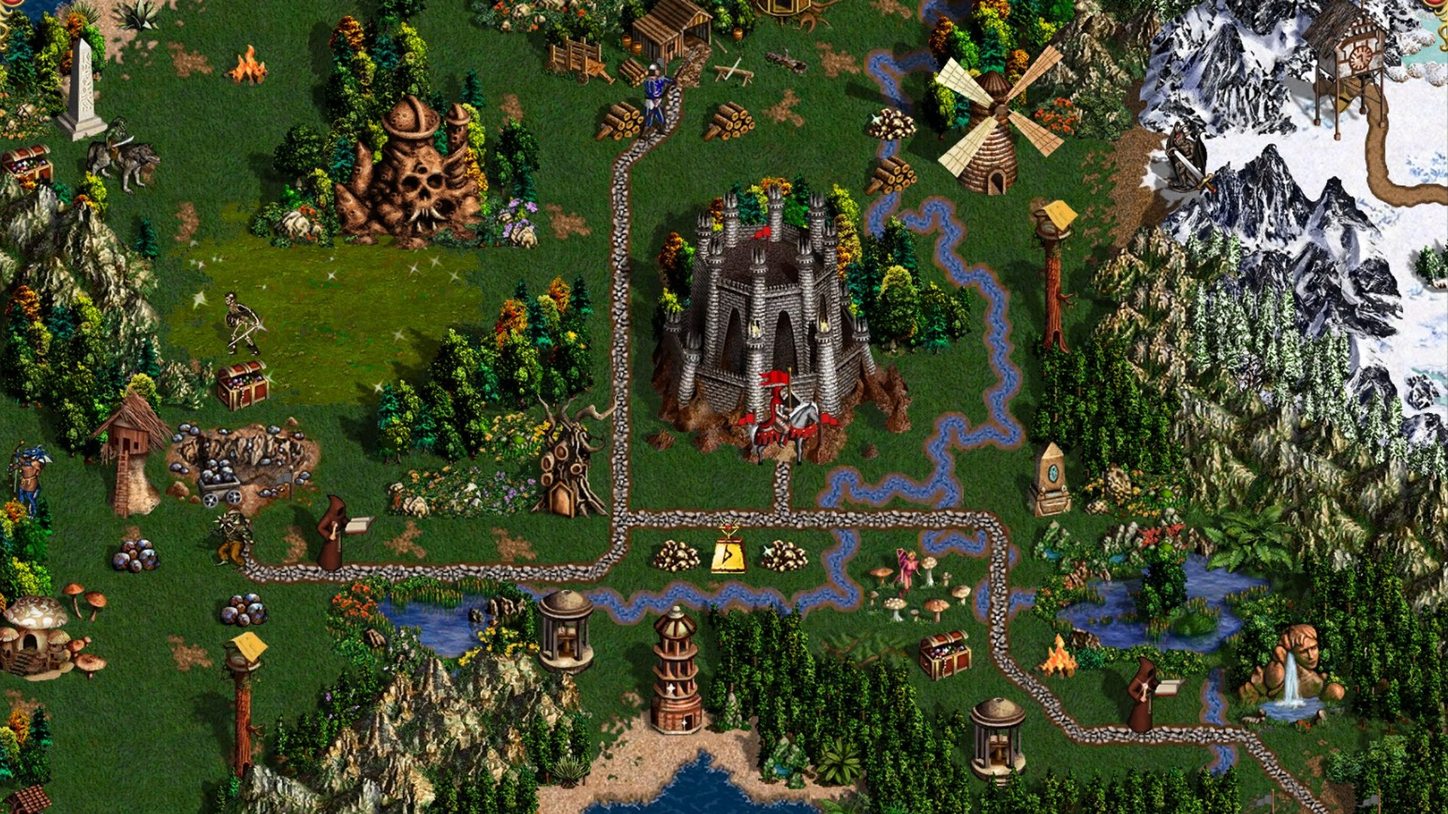
Heroes III
PART IV
A game built for people, not machines: dozens of kinds of decisions, and every one of them matters
AlphaHeroes (2026, in progress)
Image: Heroes of Might & Magic III – HD Edition (Ubisoft)
Notes:
Part IV is our own project. Heroes of Might and Magic III is a 1999 turn-based strategy game, designed for people with no thought of a learning machine. It is full of decisions of many different kinds, and good game design makes nearly all of them matter. The next slides explain the game for people who have never played it, then the challenges, then the tricks we use.

Slide 43
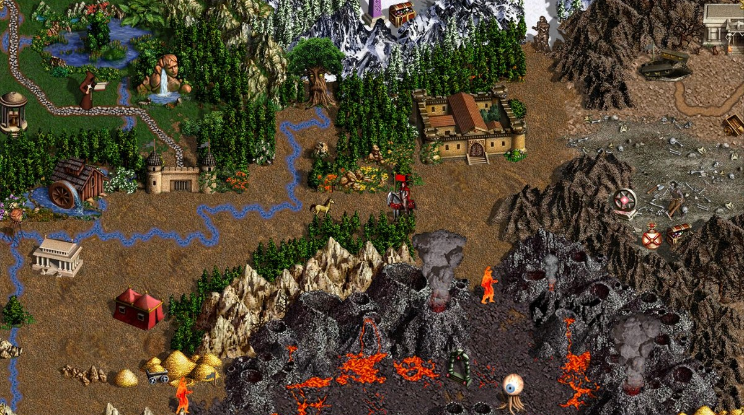
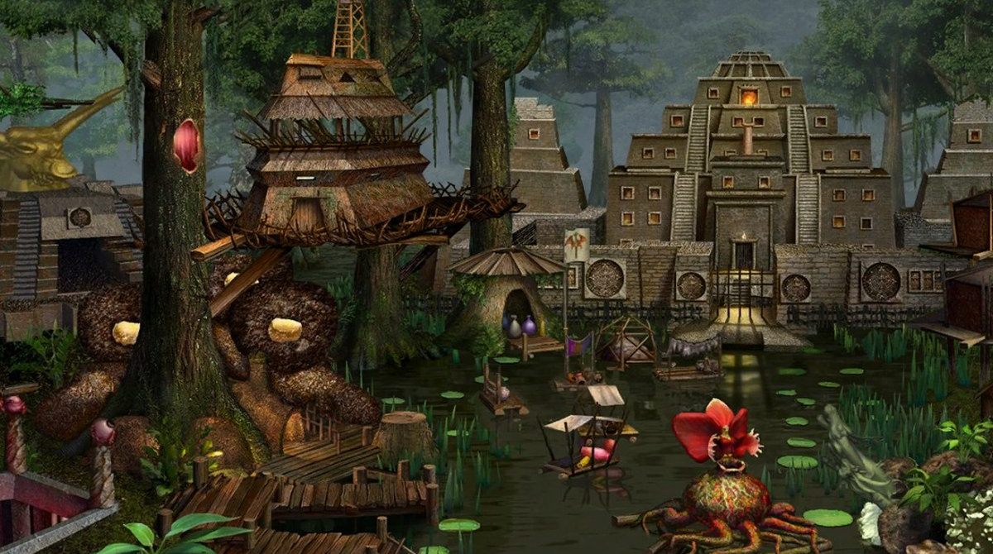
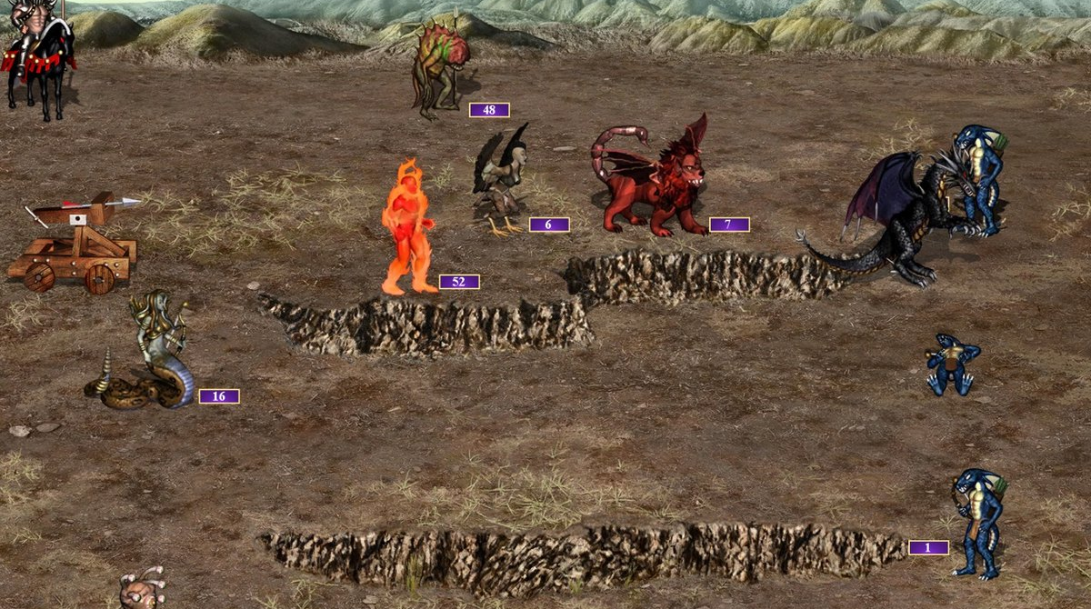
A 1999 strategy game in three layers
HEROES III · THE GAME
Up to eight players take turns, one day each, until one has eliminated the rest. Heroes roam the map, towns turn gold into armies, every clash becomes a battle, and the game keeps asking questions.
01 · ADVENTURE MAP
02 · TOWNS
03 · BATTLES
Heroes walk the map
Towns build armies
Every clash is a battle
Each hero has movement points a day. Flag mines, collect resources and artifacts, visit ≈230 kinds of objects, fight neutral monsters.
One building a day per town. Creatures grow every week; buy them, learn spells at the mage guild, trade at the market.
A hex field, up to 7 creature stacks a side, turn order by speed, one hero spell a round. Lose, and the hero may be gone.
Screens: Heroes of Might & Magic III – HD Edition (Ubisoft) · we train on VCMI, an open-source re-implementation of the 1999 engine
Notes:
For anyone who has never played. The adventure map: each hero has a daily movement budget and walks around flagging mines, picking up resources, visiting objects and fighting neutral monsters. Towns: one building per day, creatures grow weekly and must be bought. Battles: whenever two armies meet, the game switches to a tactical hex battle. A day is one turn per player, seven days make a week, four weeks a month. Games are typically decided in months two or three.

Slide 44
Why Heroes III is harder than all three
HEROES III · THE PROBLEM
Turn-based, so it looks like Go. On every other row it matches StarCraft II or Dota 2, or goes past them.
PROPERTY
GO
STARCRAFT II
DOTA 2
HEROES III
Information
Perfect
Fog of war
Fog of war
Fog of war
Players
2
2
2 teams of 5
2–8, fixed-sum
State
19×19 board
≤512 units
≈16,000 values
Near-infinite: stacks and gold up to 2³¹, split or traded any way
Decisions
≈150 a game
thousands
≈20,000 steps
≈1,500 on a small map, plus every battle’s
Horizon
150 moves
≈10 min
≈45 min
≈100 turns on a small map, many moves in each
Chance
No
Yes
Yes
Yes
Sub-games
No
No
No
Yes: every fight is a tactical battle
Human data
160K games
971K replays
none
None at scale: one player’s recorded games
Go, StarCraft II, Dota 2: earlier slides · Heroes III: VCMI rules (stack sizes and gold are 32-bit integers) and our small-map games
Notes:
The one property Heroes shares with Go is that it is turn-based. Up to eight players makes it constant-sum rather than two-player zero-sum: rivals can gang up, so two-player self-play theory does not carry over. The state is near-infinite: a stack can hold up to two to the 31 creatures and be split any way, and gold, also up to the integer limit, can be traded any way. On a small map a game is about a hundred turns, with many moves in each turn, about 1,500 decisions, some 500 for each player, plus every battle’s. And every fight is a sub-game of its own. There is no large replay set.

Slide 45
Many kinds of decisions, all meaningful
HEROES III · CHALLENGE 1
The designers wrote for human players, never for a learning machine. Almost any object can ask its own question, and good games are made of exactly these choices.
LEVEL-UP
TREASURE CHEST
A · LEARN, DON’T SCRIPT
Which of two skills? 28 skills, 3 levels each
2,000 gold, or 1,500 experience?
OpenAI Five scripted its item and skill builds (Part III). Here those choices are the game: a script would cap the agent at the script.
FLEEING MONSTERS
MONSTERS JOIN
They run from you: chase them or let go?
They offer to join, maybe for gold. Accept?
CREATURE BANK
TREE OF KNOWLEDGE
Fight its guards for the treasure?
A level, for 2,000 gold or 10 gems?
B · WHY A NEUTRAL REWARD WORKS
UNIVERSITY
PANDORA’S BOX
Good design balances these options, so a reward that prices them as equal, zero gain on the day, is a fair start. Learning finds the difference.
Buy a skill for 2,000 gold? Which one?
Open it, not knowing what is inside?
DWELLING
TOWN PORTAL
How many creatures do we recruit here?
Which of our towns do we jump to?
And many more. Some are still closed to our model: the University and map markets are answered without asking it.
Questions as in Heroes III: Shadow of Death (VCMI 1.7) · AlphaHeroes decision kinds: turn, exchange, yes/no, select, level-up, object, amount
Notes:
Before the technical challenges, the one that shapes everything else. Heroes III was designed for people, and nobody imagined a learning machine playing it. So the game keeps asking questions, each in its own way: on a level-up, which of two skills; a treasure chest, gold or experience; monsters that flee, chase them or not; monsters that want to join; a creature bank, fight the guards or not; the Tree of Knowledge, pay for a level; the University, buy a skill; and many more. Good games are made of exactly these choices, so they are meaningful. That has two consequences. First, we must learn them: OpenAI Five scripted the Dota equivalents, item and skill builds, but here a script would cap the agent at the script. Second, it is one reason our neutral reward works: when the designers balanced the options, pricing them as equal on the day is a fair start, and learning finds the difference.

Slide 46
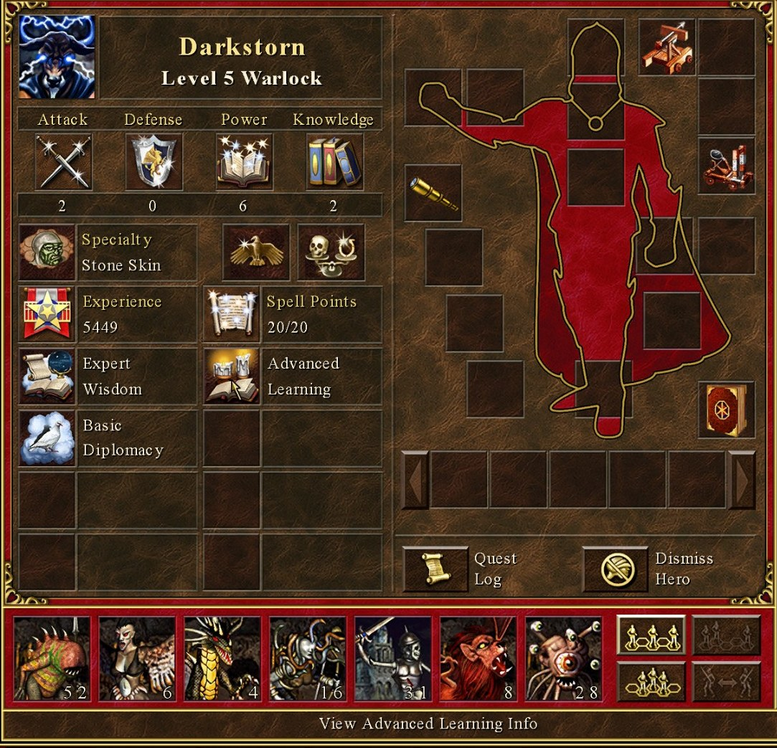
Complex objects, unbounded numbers
HEROES III · CHALLENGE 2
A hero is a whole data structure, and the number that matters most, how many creatures are in a stack, has no upper limit.
HERO
Level, 4 primary skills, up to 8 of 28 secondary skills at 3 levels, up to 70 spells and a mana pool, 19 artifact slots plus a backpack, an army of 7 stacks, movement points.
TOWN
One of 9 factions with ≈40 buildings, a garrison of 7 stacks, weekly creature growth, a mage guild, a market, and maybe a hero inside.
STACK
A creature type (≈140 of them) and a count: 1 Black Dragon or 4,000 Skeletons. The count has no bound, and its worth is far from linear.
A LOG IS NOT ENOUGH
Taking the log of a count is the obvious trick, and alone it is useless and even harmful: it blurs the few creatures that decide a fight. Our trick: the game’s own damage formula runs inside the network as an op, so the model reasons with what a stack does to another, not with how big it is.
Hero screen: Heroes of Might & Magic III – HD Edition (Ubisoft) · counts per VCMI 1.7, Shadow of Death rules
Notes:
Go has stones. StarCraft has units with fixed attribute lists. A Heroes III hero is a small database: skills, spells, mana, artifacts in nineteen slots and a backpack, and an army of up to seven stacks. Each stack is a creature type and a count, and the count can be 1 or 4,000. That count is the most important number in the game and it has no upper bound. The obvious trick, taking its log, is not enough on its own, and it can hurt: a fight is often decided by a handful of creatures, and the log blurs exactly that. What works for us is putting the game’s own damage formula inside the network as an operation: in battle, the engine’s damage range and kills; on the map, a damage race between two armies. The model then reasons with what a stack does to another, not with how big the number is.

Slide 47
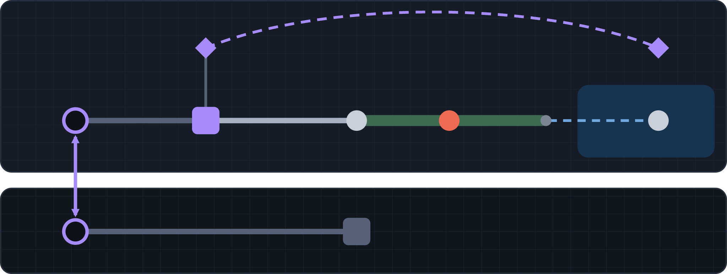
The map is not a grid
HEROES III · CHALLENGE 3
It looks like tiles, but it plays like a graph: two levels, gates, teleports, boats and spells. Distance is movement points and days.
SURFACE
Teleports. Monoliths, one-way portals and whirlpools: the map is a graph, not a lattice.
two-way monolith
road: 50 a tile
swamp: 175
boat
Water. Crossing it takes a boat from a shipyard, or the spells Summon Boat and Water Walk.
our town
mine
guards
island
Terrain. A tile costs 50 movement points on a road, 100 on grass, 175 in a swamp.
subterranean gate
cave: 100 a tile
Spells. With Town Portal, Dimension Door or Fly, a hero plays on a different map.
UNDERGROUND
dungeon
Guards and gates. Monsters guard the passes; a border gate needs its keymaster’s tent.
WHAT WE DO
The engine’s pathfinder gives each hero its reachable tiles and their day costs. MOVE: a tile reachable today in a 33 × 33 window. TRAVEL: one of 18 × 18 areas, days away. A U-Net reads both levels as 36 × 36 cells.
Diagram: an illustration, not a real map · move costs per tile: VCMI config/terrains.json and roads.json
Notes:
On screen the map looks like a grid of tiles, but it plays like a graph. Two levels, surface and underground, are joined only by subterranean gates. A pair of two-way monoliths connects distant places in one step; one-way portals and whirlpools do the same in one direction. Water needs a boat. Terrain changes the cost of every step: a road costs half of grass, a swamp nearly twice. Spells like Town Portal and Dimension Door change the geometry for the hero who knows them. So “near” means “reachable today” or “three days away”, not a tile distance. We let the engine’s own pathfinder compute what each hero can reach and how many days it takes, and the network reads those numbers instead of guessing the geometry.

Slide 48
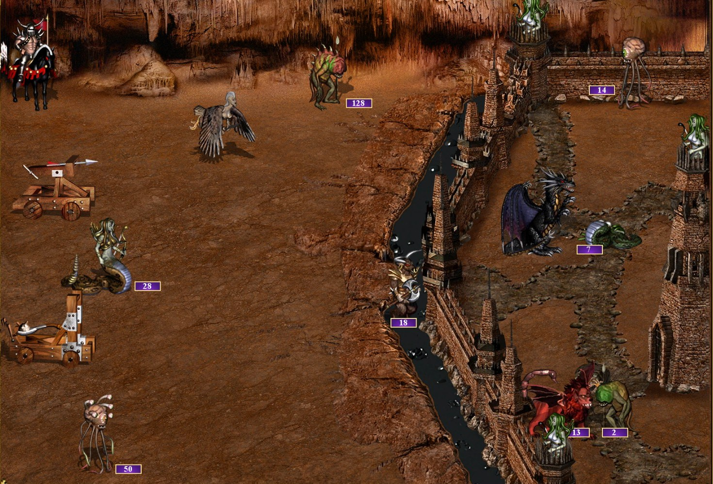
A battle inside every fight
HEROES III · CHALLENGE 4
Every clash on the map starts a tactical game of its own: its own board, its own dice, tens to hundreds of decisions.
15 × 11
13
hexes, plus a column each side for war machines
action types, from wait and defend to catapult
Units. Up to 7 stacks a side of ≈140 creature kinds, each with its own rules, plus war machines; a siege adds walls, a moat and towers.
Turn order and dice. By speed, every round. Waiting and defending reshuffle it; morale grants extra turns, and luck doubles damage.
OUR ANSWER
SIEGE: WALLS, MOAT, ARROW TOWERS
A separate battle model, 430k weights. In the same seats it scores better than VCMI’s BattleAI and MMAI, yet it is not optimal: its shooters still waste 2–3% of their full-damage shots (Trick 6).
Siege screen: Heroes III – HD Edition (Ubisoft) · battle evals of run joint7, 9 Nov 2026: +0.08 to +0.09 over BattleAI and MMAI in the same seats
Notes:
Every time two armies meet, the game becomes a different game: a tactical battle on a 15 by 11 hex grid, with up to seven stacks a side plus war machines, and in a siege also walls, a moat and towers. Turn order goes by creature speed, with luck and morale adding dice, and each of the roughly 140 creatures has its own abilities. Our answer is a separate model that only resolves battles. It works well: in the same seats it scores better than VCMI’s own battle AI and than MMAI, another learned battle AI. But it is still not optimal, and we know that from our dumb-decision counters: for example, its shooters still waste two to three percent of their full-damage shots. Splitting the battle off also raises two harder questions, on the next slide.

Slide 49
Two models, and what falls between them
HEROES III · CHALLENGE 5
Separate campaign and battle models train faster. But a battle model that sees only this battle cannot know what the campaign needs afterwards.
WHAT THE BATTLE MODEL CANNOT SEE
Campaign model
3.3M weights · every map, town and army decision
Saving mana. A spell cast to win a fight already won is missing tomorrow, when the real army arrives.
a fight starts
the result
Which creatures die. Gold prices them; only the campaign knows which can be replaced this week.
armies, heroes, spells
what survived, in Φ
Battle model
Retreat or surrender. Surrender keeps the army for gold; retreat saves only the hero. The right call depends on gold, tavern and threats.
430k weights · one battle, hex by hex, to its end
ZERO-SUM OR NOT?
OUR COMPROMISE
Surrender lets the loser pay gold and keep its army, a deal both sides may prefer to a fight to the death. So a battle is not zero-sum, yet we train it as one: the attacker’s gain is the defender’s loss. A modelling choice, not a fact.
One currency: the battle is paid the change in Φ, the campaign’s gold value of all a player owns, mana included. Next: the campaign sends each battle its prices.
AlphaHeroes design notes: battle reward and Φ (Oct 22, 28 and 30, 2026) · both models train together in one run
Notes:
We split the problem in two: a campaign model for the map and a battle model for fights. That makes both easier to train, but the boundary loses information. A battle model that only sees this battle cannot know that the hero should save mana for tomorrow, that one creature is irreplaceable this week while another is cheap, or whether retreating or surrendering is better given the gold in the treasury. Our compromise is one currency: the battle is rewarded by the change in Φ, the campaign’s own gold value of everything a player owns, and both models train together on the same games. The second question is whether a battle is zero-sum at all. Technically it is not: surrender lets the loser pay gold and keep its army, which can be better for both sides than fighting to the end. We still train it as zero-sum, the attacker’s gain being the defender’s loss; that is a modelling choice we may revisit.

Slide 50
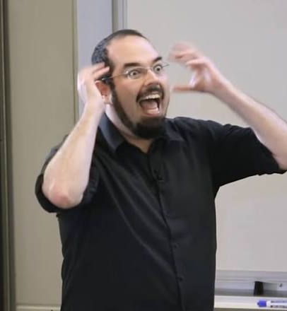
Every reward leads to the same endgame
HEROES III · CHALLENGE 6
Maximise gold, armies or paperclips: given enough days, the best plan is always the same. Eliminate every rival and take the whole map.
“The AI does not hate you, nor does it love you, but you are made out of atoms which it can use for something else.”
Eliezer Yudkowsky, 2008
WHY EVERYTHING CONVERGES
THE REAL PROBLEM
Whatever the goal, more resources help, and every resource on the map belongs to someone. Bostrom’s paperclip maximiser, played on a Heroes map, conquers it.
Not which reward wins on day 999, but which one teaches sane decisions on day 3, from few games.
Eliezer Yudkowsky
Bostrom 2003 (paperclip maximiser) · Omohundro 2008 (basic AI drives) · Yudkowsky 2008
Notes:
Here is the uncomfortable truth about rewards in Heroes. Almost any value function works in theory. Maximise gold, maximise army size, maximise paperclips: on a long enough game, the winning strategy is the same, kill everyone and take whatever you want from the entire map. This is instrumental convergence, the idea behind Bostrom’s paperclip maximiser, and Yudkowsky put it best: the AI does not hate you, nor does it love you, but you are made out of atoms which it can use for something else. So choosing the reward is not about which one is right on day 999. The real problem is finding a reward that teaches sane decisions on day 3, efficiently, from a limited number of games. Our answer is on the next slide.

Slide 51
Make most decisions value-neutral
ALPHAHEROES · TRICK 1
Price everything a player owns in gold. Building and recruiting then only turn gold into equal value, so the reward moves only when something real happens.
Φ · EMPIRE VALUE
NEUTRAL BY DESIGN
THE LABEL
What a player owns
Zero gain on the day
How the share moves
Creatures at their cost; war machines at half
Buildings at their cost
Mines, resources and artifacts
Heroes, by level and skills
Spells at 500 a level; explored tiles at 5
Build, recruit or upgrade: gold becomes equal value and Φ stays put.
s = Φ_me / Σ Φ_all
Δk = logit s(d+k) − logit s(d)
It moves with income, pickups, fights won or lost, levels and land explored. Not all decisions can have 0 immediate value.
k = 2, 5, 7 days, and the end
Constant-sum for any number of players. In the logit, rivals’ hidden values cancel: only their growth is left to guess.
AlphaHeroes campaign_model/empire.py and docs/empire_value.md · compare OpenAI Five Trick 1 (shaped reward) and Trick 3 (zero-sum)
Notes:
Our answer to the reward problem: make as many decisions as possible value-neutral. We price everything a player owns in gold, Φ: creatures at their cost, buildings at their cost, mines, resources, artifacts, heroes by level and skills, spells, even explored tiles. Then building, recruiting and upgrading only turn gold into equal value: zero gain on the day. The reward moves only when something real happens: income, pickups, fights won or lost, levels, exploration. Where we cannot price a choice, we do not try, and what follows decides. Strictly, creatures that no hero leads count at 95.3 percent, so a recruit shows a small loss until a hero takes it, and a purchase paid through the market loses the market’s spread: real costs, priced on purpose. This works because, as we saw, the game’s decisions are meaningful and balanced. The label is our share of all the empires’ value, which is constant-sum for any number of players, and the heads learn how its log-odds change 2, 5 and 7 days ahead and at the end.

Slide 52
The telescope: four horizons, one target
ALPHAHEROES · TRICK 2
Value heads predict the share 2, 5 and 7 days ahead and at the game’s end. Each head learns from the shorter head’s later forecast, not from the raw outcome.
THREE FORECASTS OF THE SAME DAY
WHY IT HELPS
V7, asked on day d
the share at the end of day d + 7
2–3 days
V5, asked on day d + 2
of luck in each label instead of 7. In a linear toy model, that is worth 1.1–3.4× the data.
V2, d + 5
A day’s decisions share their luck. AlphaGo kept one position per game to break that link; we cannot afford to, so we cut the luck in each label instead.
d
+1
+2
+3
+4
+5
+6
+7
V7 · d
←
V5 · d+2
←
V2 · d+5
←
real share · d+7
Only V7 and V_end steer the policy. V2 and V5 are there to teach them.
Each head is graded by the next shorter head’s later forecast, mixed with the real outcome (at least 25% of it once the heads are trusted).
Not from AlphaStar or OpenAI Five, which each learn one discounted value. Nearest published idea: fixed-horizon TD (De Asis et al., 2020).
AlphaHeroes campaign_model/labels.py (ladder_targets, horizon_advantages) · De Asis et al., AAAI 2020
Notes:
This is the trick we are proudest of, and it is ours, not AlphaStar’s or OpenAI Five’s: they each learn a single discounted value. We have value heads at three horizons, 2, 5 and 7 days, plus the game’s end. Look at day d plus 7: V7 forecasts it on day d, V5 forecasts the same day from day d plus 2, V2 from day d plus 5. So instead of grading V7 against the real outcome, which carries seven days of luck, we grade it against V5’s later forecast, V5 against V2, and V2 against the real share. Each label then carries only two or three days of luck. This matters because a day’s decisions share their luck: AlphaGo kept one position per game to avoid correlated examples, and we cannot afford that. The shorter heads exist to teach the longer ones; only V7 and the end head drive the policy. The closest published idea is fixed-horizon TD. One limit, measured on 9 November: all of a day’s decisions still share most of their credit, 96.5 percent of its variance; a per-decision term is on the next-steps slide.

Slide 53
Auxiliary heads: more to predict
ALPHAHEROES · TRICK 3
Outputs trained beside the value that the policy never reads. Each gives the shared trunk a denser, less noisy signal than the reward alone.
HEAD
PREDICTS
WHY IT HELPS
V2 and V5
our share’s change 2 and 5 days on
the rungs of the telescope (Trick 2)
Growth heads
our own Φ’s growth over the same days
only our own luck, none of a rival’s
Battle V0, V1, V2
the battle’s reward after this round, the next and the one after
dense targets inside a battle; each head adds the previous head’s logit
Teacher
Nullkiller 2’s choice in our position
imitation as one more loss term (Trick 4)
Privileged critic
the share, reading every rival’s hidden state
training only: end-value error −23%, share error −5.5%
ALPHASTAR TRICK 5, OUR VERSION
The critic max-pools the hidden states of every rival, one to seven of them. It is used only in training, so playing needs no hidden information.
AlphaHeroes model_v2.py (PrivilegedCritic) and battle_model value heads · errors measured in run joint7, Nov 7, 2026
Notes:
Auxiliary losses: extra things the network must predict, which the policy never acts on. They shape the shared trunk with denser signals than the reward. The short value heads are the rungs of the telescope. Growth heads predict only our own empire’s growth, which carries none of the rivals’ luck. The battle model has value heads at the end of this round, the next round and the one after, each building on the previous head’s logit. The teacher’s label is one more loss term. And the privileged critic, AlphaStar’s trick 5 adapted to up to eight players: in training only, the critic reads every rival’s hidden state through a max-pool. It cut the end-of-game value error by 23 percent.

Slide 54
Learn from the scripted AI, never play it
ALPHAHEROES · TRICK 4
Nullkiller 2, VCMI’s strongest hand-written AI, is both our teacher and our exam. Training against it would teach us its bugs.
WHAT WE LEARNED
1 · IMITATE
Watch Nullkiller 2 play itself and copy its moves. That is the starting point: 37% top-1 agreement.
72 → 30
Label the plan, not the request. NK2 sends one request per tile, so its labels taught one-tile moves. Labelling its destination cut decisions a day from 72 to ≈30.
2 · ASK FOR ADVICE
0.38 → 0.25
A label change is a policy change. Advice that overrode NK2’s label at 40% of decisions dropped the eval within hours. Rolled back.
In self-play, a private copy of Nullkiller 2 looks at our own position and says what it would do. About 92% of its answers are moves we can express; each takes 5–30 ms.
52% → 10%
Advice carries its bugs too. Asked afresh at each decision, NK2 looped: 52% of its moves sent our heroes to meet each other (1.7% in its own games).
3 · LET GO
The teacher’s weight is built to fall as our exam score rises, so the student can overtake it. In this run it is held fixed for now, at ≈60% of the gradient.
+380 Elo
AlphaStar’s version. A KL pull toward the supervised policy took 1,020 to 1,400 Elo (AlphaStar Trick 3).
AlphaHeroes run joint7, Oct 31 – Nov 10, 2026 · Vinyals et al. 2019, Fig. 3E
Notes:
Transfer from the hard-coded AI without ever playing against it. Nullkiller 2 is VCMI’s strongest scripted AI. We first imitate it, then during our own self-play we ask a private copy of it what it would do in our position, and add that as a cross-entropy term. Its weight is built to fall as our evaluation score against Nullkiller 2 rises; in this run it is held fixed for now, at about 60 percent of the gradient. We never train against it as an opponent: we would learn to exploit its bugs, and it is also our exam, so training against it would contaminate the measurement. Three lessons. Label the plan, not the raw request: Nullkiller sends one move request per tile, which taught our model to walk one tile per decision. Any change to the labels is a change to the policy: one advice change collapsed the eval in hours. And the teacher’s bugs reach us through its advice too. We ask it afresh at every decision, and a Nullkiller 2 bug made it plan deliveries of a hero’s own army back to that hero, a task that is never done: it kept sending our heroes to meet each other, in 52 percent of its advised moves against 1.7 percent in its own games. A quarter of all our movement went into those meetings. Fixed in the advisor on 9 November: 10 percent.

Slide 55
Priors, not masks; surgery, not restarts
ALPHAHEROES · TRICK 5
Never forbid an action the model overuses: give it a prior it can unlearn. Add inputs and heads so the trained function stays exactly as it was.
PRIORS, NOT MASKS
SURGERY, NOT RESTARTS
Start where the scripted AI is
Change the model mid-run
Values known from hand-written AIs enter as a fixed bias plus small learned corrections that decay back to it, so the first batch already plays like the scripted AI.
Every new head and input starts at zero (OpenAI Five Trick 8). Adding 144 × 144 maps left every 36 × 36 output unchanged, bit for bit.
Old game records are widened when loaded, so earlier games stay trainable.
A new action starts at a learnable −4 logit: tried rarely until it proves itself, never impossible.
6
0.22 → 0.07
contract changes in one run (schemas 11 → 16), no restart. A clean rerun with the final code is still due.
the eval after we masked spells the model “overused”. They revealed enemy heroes; the overuse was a credit problem.
AlphaHeroes notes: prior-anchored features (Oct 28), no action masking (Oct 30), map-size blocks (Nov 8, 2026)
Notes:
Two engineering rules. First, priors, not masks. Known values from hand-written AIs enter the network as a fixed bias plus small learned corrections that decay back towards it, so the untrained model already behaves like the scripted AI. A brand-new action starts with a strongly negative but learnable logit. We never mask an action because the model overuses it: when we did, masking information spells, the eval fell from 0.22 to 0.07, because those spells revealed enemy heroes. Overuse is a credit-assignment problem to fix, not something to hide. Second, surgery, not restarts, as in OpenAI Five: every new head or input starts at zero, so the trained function is unchanged. Support for big maps was added this way, and small-map outputs stayed bit-for-bit identical. Six contract changes went into one run without a restart.

Slide 56
Count the dumb decisions
ALPHAHEROES · TRICK 6
A win rate says how much is wrong, not what. Each metric is the share of chances to make one named mistake: near zero, never forced to zero.
CAMPAIGN
BATTLE
pickup_passed_end
shooter_not_shooting
ended a turn with a free, safe pickup still in reach
a shooter wastes a full-damage shot: defends, wanders, waits
troops_left
escape_while_ahead
left creatures in a mine, where they guard next to nothing
retreats while its own value head says it is winning
repeat_meetings
worthless_cast
met the same hero of ours again, the same day
a spell that costs us value: Frost Ring on our own stacks
idle_movement
cast_skipped_on_loss
ended the turn with movement points unused
lost the battle with mana it never spent
Shooters idling after an optimiser change, while the battle score stayed flat.
Movement spent meeting our own heroes, before and after a teacher fix. The eval stayed flat: unused movement rose from 10% to 27%.
1–2% → 3.7%
26% → 7%
AlphaHeroes campaign_model/failures.py and battle_model/train.py (failure_counts) · logged in every eval and training update
Notes:
The win rate, or the share of value, tells you how much is wrong but not what. So we define dumb decisions one by one, each with a denominator: of all the times a shooter could fire at full damage, how often did it defend, wander or wait instead? Of all the turns ended, how many left a free, unguarded resource pile within reach? These numbers should be near zero, but we never force them to zero with masks or penalties: they are diagnostics. They paid off twice. After an optimiser change the battle score stayed flat, but shooter idling rose from 1–2 percent to 3.7 percent, and the metric said exactly what had gone wrong. And on 9 November an audit found that a quarter of all our heroes’ movement went into meeting each other, again and again, a loop learned from the teacher (Trick 4). No metric counted it and the eval never showed it, so now repeat_meetings does. After the fix that share fell to 7 percent, and the eval stayed flat again: the waste had moved. Heroes ended the day with 27 percent of their movement unused, against 10 percent before; that has a metric now too, at about 18 percent.

Slide 57
Structured actions, and what they hide
ALPHAHEROES · TRICK 7
Like AlphaStar: pick the type, then each argument in turn. Every shortcut we add is a choice the model can no longer get wrong, so it can never learn why it is wrong.
DECISION KINDS
ACTION TYPE → ITS ARGUMENTS
Turn
MOVE
hero → a tile reachable today
ARMY
army → stack → amount → army → slot
any of the 14 types, until it ends the turn
TRAVEL
hero → a map area days away
TRADE
sell → buy → fraction
BUILD
town → building
CAST
hero → spell → target
RECRUIT
town → creature → how many
ARTIFACT
hero → item → give, wear, combine
Exchange
two of our armies meet: troop moves, then END
HIRE
town → tavern hero
MULTI
11 macros: recruit all, gather, …
UPGRADE
army → stack
DISMISS
hero (reserved)
BUY
town → spellbook, war machine
END
end the turn or the exchange
Questions
yes or no, pick a reward, pick a skill, how many, which town
THE COST OF SHORTCUTS
A macro like ‘recruit all’, or a ‘force buy’ in place of free market trades, removes suboptimal choices, and with them the chance to learn they are suboptimal.
AlphaHeroes contract, schema 16 (Nov 2026) · MOVE sees a 33 × 33-tile window; TRAVEL picks one of 18 × 18 map areas
Notes:
How we model the actions, which is part of the solution, not of the problem. Like AlphaStar, the model picks an action type and then each argument in turn: ARMY alone has five arguments. Three kinds of decisions: the turn, an exchange when two of our armies meet, and the game’s questions. There is a cost to every shortcut in this design. A macro like recruit all, or a forced buy in place of free market trades, makes some suboptimal choices impossible, and a choice the model can never make is a choice it can never learn to avoid. These are design decisions we want to revisit.

Slide 58
Learn the match, not the price
ALPHAHEROES · TRICK 8
Which hero goes where: each (hero, tile) pair’s score is a learned match plus the engine’s price for the move, and one softmax over every pair picks both at once.
MATCH
PRICE
SCORE
MATCH · LEARNED
Main
Scout
Main
Scout
Main
Scout
Who should go. The hero’s token (query) and the tile’s map cell (key), both read from the whole game, summed with the pathfinder’s reach; a small MLP scores the pair. Starts at 0.
Gold mine
+0.3
−0.4
3.6
1.2
3.9
0.8
Chest
−0.9
+0.7
+
2.4
2.6
=
1.5
3.3
−0.2
+0.1
1.0
0.6
0.8
0.7
PRICE · FROM THE ENGINE
Our town
What the move is worth, by Nullkiller 2’s rules: the tile’s contents in Φ’s gold × P(we win its guard), less the danger of stopping there. As a logit, 4,000 gold is +3.3.
SOFTMAX OVER THESE SIX
price alone
with the match
Main → gold mine
53% → 56%
ONE SOFTMAX · EVERY PAIR
Scout → chest
20% → 31%
Hero and tile, one choice. Up to 8 heroes × 33 × 33 tiles: 8,712 entries. AlphaStar picks its units, then a target; this table is small enough to score whole.
Main → chest
16% → 5%
AlphaHeroes campaign model v2, MOVE head (Nov 2026) · the six pairs are an illustration, not a real position
Notes:
An architecture trick, in the decision the policy makes most: MOVE, which hero goes to which tile. Once the type is MOVE, every pair of one of our heroes and a tile it can reach today gets one score, and a single softmax over all of them, up to 8 heroes times a 33 by 33 window, picks the hero and its destination together. AlphaStar picks its units first and then a target; our table is small enough to score whole. The score has two parts. The match is learned. The hero’s token, after the transformer has read every hero, town and rival, is the query; the tile’s cell from the map U-Net is the key. Their projections are summed with the pathfinder’s reach and the fight there, and a small MLP turns the pair into one number: additive attention, not a dot product. The price is not learned: it is what the engine and our value function say the move is worth. What the tile holds, in Φ’s gold, times the chance we win the fight in front of it, less the danger of stopping where a rival hero can reach us, by Nullkiller 2’s rules: its discount for the movement spent, whose strength the model learns, and its refusal of fights it cannot win, as a large negative prior, never a mask. Gold becomes a logit on a log scale: 550 gold is plus 2.2, 4,000 is plus 3.3. In attention terms, the hero is the query and the tile the key, and in place of a learned value the engine’s own estimate is added to the score. The match’s last layers start at zero, apart from the same hopeless-fight rule, so the untrained policy is the price, and training only has to learn what the price cannot know. In the illustration, the price alone sends the main hero to the chest 16 percent of the time. The match knows the scout can take it, so that falls to 5 percent, and the scout’s share rises from 20 to 31.

Slide 59
One GPU, not 384 TPUs
ALPHAHEROES · STATUS
Where the project stands on 10 November 2026: below the scripted AI, and roughly flat since the 6th.
EVAL VS NULLKILLER 2 · OUR SHARE × PLAYERS, DAY 56
1 GPU
Start: imitation
0.11
an RTX 5090 PC trains; a Mac adds game slots
Moves labelled by their target
0.22
Before the neutral-town fix
0.39
≈470
After it
0.48
self-play games an hour, ≈1,500 decisions each
Now: last 12 evals, mean
0.44
Parity: the average player
1.0
3.3M · 430k
1.0 means as much as the average player in the game, Nullkiller 2 seats included. One eval is 48 fixed games, ±0.05; the best single eval so far was 0.54.
weights: campaign model · battle model
For scale: AlphaStar used 12 agents × 32 TPU v3 × 44 days; OpenAI Five, 770 PFLOPs/s·days. Our wall is the game itself: each training decision waits ≈70 ms for inference.
AlphaHeroes run joint7 campaign evals, Oct 31 – Nov 10, 2026 · Vinyals et al. 2019 · OpenAI et al. 2019
Notes:
Honest status. The score is our share of all empires’ value at day 56 times the number of players, so 1.0 means as much as the average player in the game, Nullkiller 2 seats included. We started from imitation at 0.11. Labelling moves by their destination doubled it, and a bug fix about neutral towns took it to 0.48. Since then it has been roughly flat: the last twelve evaluations average 0.44, each with a standard error of about 0.05, and the best single one was 0.54. The two newest, 0.51 and 0.49, came after the teacher fixes of 9 and 10 November: promising, but inside the noise. That is about half of parity. Everything runs on one RTX 5090 plus a Mac, against AlphaStar’s 384 TPUs per run. The bottleneck is producing games, not the GPU: the teacher fix alone took a game from about 2,500 decisions to 1,500, and the run from about 300 games an hour to 470.

Slide 60
Tricks we have not used yet
HEROES III · NEXT
Each one worked somewhere else, or follows from what we learned. Each waits for a reason, or for a stronger agent.
TRICK
FROM
WHY IT FITS HEROES III
Search in battles
AlphaZero, stochastic MuZero
short, copyable, full of dice; the battle value head is a ready leaf evaluator
A league of past selves
AlphaStar, OpenAI Five
guards against forgetting and exploitable habits, once we beat Nullkiller 2
Rerun from scratch
OpenAI Five
six surgeries deep; their rerun used ≈20% of the compute and won over 98%
A strategy statistic z
AlphaStar
rare, vital actions like hiring vanish in greedy play; a sampled plan keeps them
Human games
AlphaStar’s 971K replays
3 recorded games: ≈660 decisions, 802 battle actions; a test set before a teacher
Campaign prices for battles
ours
mana and each creature priced by the campaign’s state, battle by battle
Credit for each decision
ours
a day’s decisions share 96.5% of their credit; a per-decision term is built
Open up the shortcuts
ours
raw choices instead of macros and forced buys: mistakes become learnable (Trick 7)
Silver et al. 2017 · Antonoglou et al. 2022 (stochastic MuZero) · Vinyals et al. 2019 · OpenAI et al. 2019 · AlphaHeroes notes
Notes:
Tricks we have not used, and why each could fit. Search: battles are short, we can copy a battle state, and they are full of dice, so stochastic MuZero-style search with our battle value head as the leaf evaluator is the obvious next step; the campaign is too long for that. A league of past selves only matters once we are strong enough to be exploitable. A clean rerun with the final code, as OpenAI Five did, after six surgeries. AlphaStar’s strategy statistic z addresses a real problem: when we evaluate greedily, rare but necessary actions like hiring a hero almost never get chosen. Human games: we can now record a human’s games, but three games are a test set, not a teacher. Campaign prices for battles close the gap between the two models. Credit for each decision: an audit on 9 November found that 96.5 percent of the credit’s variance is shared by all of a player’s decisions on the same day, so a good move and a wasted one get almost the same push. A per-decision term, each decision’s own step in the critic’s forecast, is built and set aside for now. And opening up our own shortcuts, so the model can make, and learn from, the choices our macros now make for it.

Slide 61
Lessons so far
HEROES III · LESSONS
What we would tell anyone starting on a game this size.
01
02
03
Neutral by default
Teacher, not opponent
Never mask
Every reward ends in conquest. Pick one that stays neutral wherever you cannot price a choice, and let what follows teach.
Learn from the scripted AI’s advice and measure against it. Never train against it, and audit the advice: both pass on its bugs.
Overuse is a credit problem. Give the action a prior the model can unlearn instead.
04
05
06
Labels are the policy
Count the mistakes
Every human action fits
A changed label or prior moves the policy within a few updates. Measure the drift on fixed decisions before trusting an eval.
A named metric, with a denominator, for each dumb decision finds what a flat win rate hides.
Before learning from people, make each of their actions one of yours: one click is one decision, not one per tile.
AlphaHeroes project notes, Oct 22 – Nov 10, 2026
Notes:
Six lessons. Every reward ends in conquest, so choose one that stays neutral wherever you cannot price a choice, and let consequences teach. A scripted AI makes a great teacher and a great exam, and a terrible sparring partner; audit its advice on your own states too, because its bugs come through that as well. Never mask an action to stop overuse; fix the credit. Any change to a label or a prior is a change to the policy, so measure drift before trusting the next eval. Name each kind of dumb decision and count it with a denominator. And before learning from human games, make sure every human action maps to exactly one of the model’s actions: the game’s interface sends one request per tile walked, so a single click looked like dozens of decisions.

Slide 62
Sources and credits
REFERENCES
PAPERS
IMAGES
Silver et al. “Mastering the game of Go with deep neural networks and tree search.” Nature 529 (2016).
Go stones photo: Dietmar Rabich, Wikimedia Commons, CC BY-SA 4.0
Silver et al. “Mastering the game of Go without human knowledge.” Nature 550 (2017).
Go board evaluations: Silver et al. 2016, Fig. 5
StarCraft II frame: DeepMind, AlphaStar vs TLO
Vinyals et al. “Grandmaster level in StarCraft II using multi-agent reinforcement learning.” Nature 575 (2019).
Dota 2 frames and the human view: OpenAI et al. 2019, Figs. 11 and 13
OpenAI et al. (Berner et al.) “Dota 2 with Large Scale Deep Reinforcement Learning.” arXiv:1912.06680 (2019).
Heroes III screens: Heroes of Might & Magic III – HD Edition (Ubisoft), Steam store page
OTHER SOURCES
HEROES III
DeepMind blog, “AlphaStar: Mastering the real-time strategy game StarCraft II”, Jan 2019
De Asis et al. “Fixed-Horizon Temporal Difference Methods for Stable Reinforcement Learning.” AAAI 2020.
OpenAI blog, “OpenAI Five defeats Dota 2 world champions”, Apr 2019
VCMI open-source engine and its Nullkiller 2 AI
Tromp, “Number of legal Go positions”, 2016
Trademarks: StarCraft II (Blizzard), Dota 2 (Valve), Heroes of Might and Magic (Ubisoft).
Values marked ≈ were read from paper figures.

