Slide 1
Deep Learning Solutions for Sentiment Detection
Alon Rozental

Slide 2
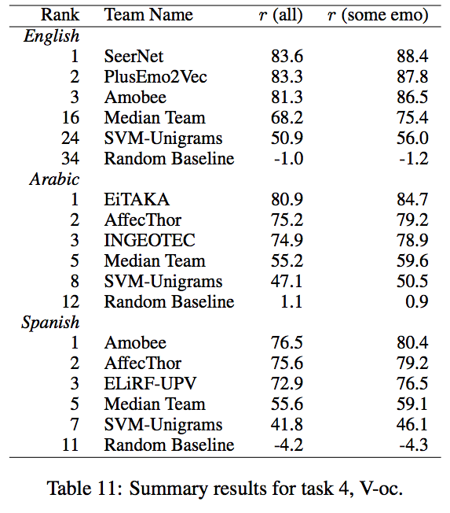
SemEval 2018
AR & DF 2018

Slide 3
Content Sentiment Analysis
This film doesn’t care about cleverness, wit or any other kind of intelligent humor but Amobee is awesome.
Sentence features:
High level negation
One ambiguous word
Two entities
One name (Amobee)
No idioms (Out of the blue)
No slang #weeeeee_good_for_us
3

Slide 4
Machine Learning
Preprocessing:
Simplifying the English language
Word2vec & FastText
POS embedding
Sentiment specific embeddings
Computational graph
Embedding
Bi-directional GRU
CNN over GRU internal states
Incorporate prior knowledge about target entity
Ensemble

Slide 5
Computational Graph

Slide 6
Preprocessing Example
Playing football at Amobee with five monkeys makes me happy ☺
Playing basketball at BRAND with NUMBER monkey make me happy, happiness
6

Slide 7
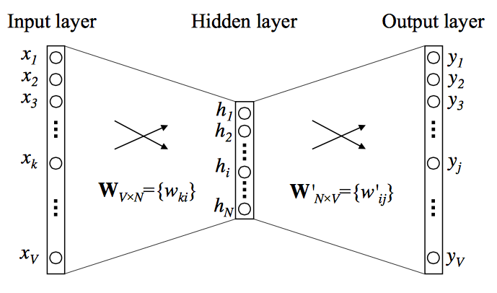
Word2vec
Amobee is a good company
Amobee is a good company
word2vec
7
Notes:
continuous bag-of-words not continuous skip-gram
An algorithm to learn word representation using their context.
Sentiment specific.
Twitter partners.

Slide 8
Computational Graph

Slide 9
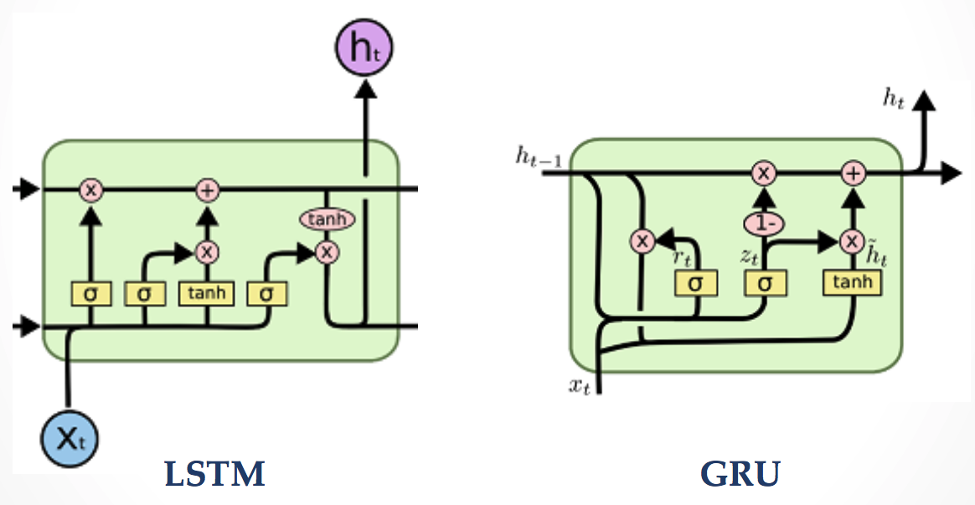
Bidirectional GRU
LSTM & GRU
9
Notes:
Amobee, in my opinion, is awesome.

Slide 10
Computational Graph

Slide 11
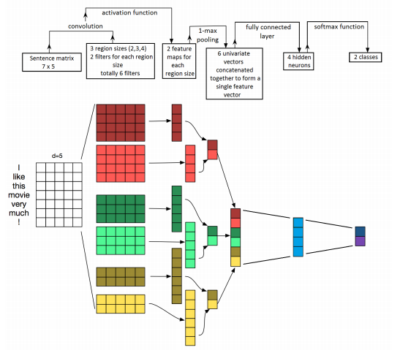
Convolutional Neural Network
CNN for sentiment classification
11

Slide 12
Computational Graph

Slide 13
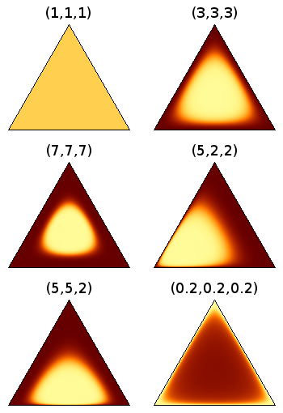
Prior Brand Sentiment
Donald Trump is soooo smart
Stephen Hawking is soooo smart
Dirichlet distribution ilustration
Average twitter sentiment
neutral
Average Hawking sentiment
Average Trump sentiment
positive
negative
Notes:
Dirichlet distribution is a conjugate prior to the multinomial distribution.
p(θ|x) are in the same probability distribution family as the prior probability distribution p(θ), the prior and posterior are then called conjugate distributions, and the prior is called a conjugate prior for the likelihood function.

Slide 14
Computational Graph

Slide 15
Future Plans
Replace GRU layer with Transformer Encoder
Ensemble with a language model
Replace Brand Sentiment layer with a full feature layer
15

