Slide 1
Randomized Online-DRL vs Online-DRL
What improves, what it costs, and how every metric is computed
Evidence from drl-sim - the simulator of
Edge Service Caching With Delayed Hits (Deka & Sukapuram, IEEE TCC 2025) and of the
Randomized DRL with Multi-Resource (CPU, RAM, Disk) Capacity proposal
Synthetic Zipf/Poisson traffic + the paper's adversarial Large Sequence; the offline optimum is an exact MILP (HiGHS).
All numbers are read from results/*.json - nothing is hand-written.

Slide 2
The question
and the short answer
• How does each algorithm decide what to keep?
• Does the randomized algorithm IMPROVE the deterministic one, or does it only EQUALIZE it?
• Where does it LOSE?
• How are the metrics (ratio, cost, utilization, regret, running time) actually calculated?
Short answer:
it strictly improves the competitive ratio on the adversarial family the paper analyses (gamma = 2k -> ~3, flat in k), it EQUALIZES the deterministic algorithm on ordinary traffic (1.443 vs 1.430) while spending 3x less download cost, it loses on short traces (1.279 vs 1.145), on CPU time (25-70x more per request) and on the literal form of goal G3.
2

Slide 3
The common setting
the environment both algorithms run in
• An edge node caches N services; a service has a forwarding latency l, a download time M and a demand vector (CPU, RAM, disk).
• Latency and cost are kept separate: latency = what the user waits, cost = the download time the operator pays.
event | condition | latency | cost
Hit | the service is cached | 0 | -
Delayed hit | a download is in flight and the remaining time <= l (the request is buffered) | min(l, remaining) | the download already paid
Request forwarding | not cached, no download in flight (or the remaining time > l) | l | -
Why it matters:
every request is charged its latency, every started download its M; the two algorithms are measured with exactly the same engine, so every difference in the next slides is a difference in CACHE MANAGEMENT, not in the environment.
3

Slide 4
How Online-DRL works
the paper: deterministic, per-service state
• TRIGGER (Algorithm 1). At the first request of a miss epoch a download starts iff T_i >= theta*M_i or L_i >= theta*M_i, where T_i = time since the epoch began and L_i = l * (number of requests of the service in the epoch). theta = 1 in the paper, theta = 0 is LL-RC.
• EVICTION (Algorithm 2, Landlord). Every cached service carries a credit, initialised to M and reset on every hit. When a new service does not fit, the credits are decreased proportionally; the services whose credit hits 0 become eligible and are evicted in increasing order of the resources they use beyond the unmet need.
• ADMISSION. A service enters only if it fits in ALL THREE resources and the cardinality C.
• Guarantee: competitive ratio gamma in O(k(1 + 3 beta_up M_x)); the proof exhibits an adversarial family on which gamma = Theta(k).
4

Slide 5
How Randomized Online-DRL works
the proposal: R1 + R2 + R3
• R1 - a FRACTIONAL state + projected OGD. Instead of a credit per service the algorithm keeps p in D_vec = {p in [0,1]^N : sum p <= C, sum a_n,r p_n <= 1 for every r}. Each request takes one gradient step on the requested service and projects back onto D_vec with a dual-ascent projection (eqs. 22-25); eta = sqrt(N)/(l_max sqrt(T)).
• R2 - RANDOMIZED ROUNDING with repair. K persistent uniform vectors give the paths s_k = 1[U_k < p], so E[s] = p and E|ds| = |dp|. A path that violates the constraints is repaired by evicting services. The real cache = (downloaded) AND (sampled on): a service that was sampled but never downloaded is NOT a hit.
• R3 - a RANDOMIZED download threshold, drawn from f(theta) = e^(theta/M_n)/(M_n(e-1)) on [0, M_n]: the rent-or-buy ratio 2 becomes e/(e-1) = 1.582.
• BUDGET awareness. The trigger probability is lowered to budget_left/(M_n * requests_left) so that the expected download cost stays below B_max (goal G2).
5

Slide 6
Side by side
what actually differs
aspect | Online-DRL | Randomized Online-DRL
state | one credit per cached service | fractional p in D_vec + K rounding paths
download decision | deterministic counters vs a fixed theta | same counters, random threshold, budget-aware probability
eviction | Landlord: credit reaches 0, then a greedy resource-aware order | the OGD state lowers p, the rounding switches the service off, violating paths are repaired
entering the cache | when the download completes | when the download completes AND the serving path samples it on
guarantee | gamma in O(k(1+3 beta_up M_x)) | surrogate regret <= sqrt(N) l_max sqrt(T); expected cost <= B_max
resource feasibility | checked exactly at admission | guaranteed by the repair step
price | no randomness, no learning | 25-70x more CPU per request; needs a warm-up
6

Slide 7
How the metrics are calculated (1/2)
the objective quantities
metric | formula | why it is the right one
latency | sum_t lat_t, with lat_t = 0 (hit), min(l, remaining) (delayed hit) or l (forward) | exactly the objective of the paper
cost | sum of M_n over the STARTED downloads | the operator's cost; forwarding is charged through the latency, not the cost
downloads | number of started downloads | the download budget is spent per download
competitive ratio gamma | ALG(I)/OPT(I); OPT = MILP optimum (HiGHS) or the paper's (k+2n)l on the Large Sequence | the paper's definition; if the MILP hits its time limit the ratio is only a lower bound
fit of gamma(k) | least squares: linear / logarithmic / power law (log-log) with R^2 | shows empirically whether the linear behaviour disappears - it is not a proof
beta_up, beta_down | per service fwd_i/M_i, where fwd_i counts the requests forwarded WHILE a download of i was in flight | the paper's beta is exactly that fraction; beta_up = max (with M_x), beta_down = mean (with M_min)
7

Slide 8
How the metrics are calculated (2/2)
the resource, regret and cost metrics
metric | formula | why it is the right one
U_r,t, U^max | sum of a_n,r over the services cached at t | the proposal's per-resource occupancy
imbalance, stranded W | U^max - min_r U_r and sum_r (U^max - U_r) | proposal eqs. (30)-(33)
violation rate | fraction of steps with max_r U_r,t > 1 | goal G1 is about the TRUE constraints, not the reduced ones
Lambda_phi (eq. 18) | max_n phi(a_n) / max_r a_n,r | how much a slot reduction over-charges a service
surrogate regret | sum_t F_t(P_t) - min_P sum_t F_t(P), the minimum computed exactly by an LP | the comparator of Proposition 1, solved to optimality (not an approximation)
running time | 1e6 * wall-clock time of the request loop / T | measures the algorithm only, not the catalogue or the trace
latency per unit resource | L / sum_t U^max_t | proposal eq. (34)
8

Slide 9
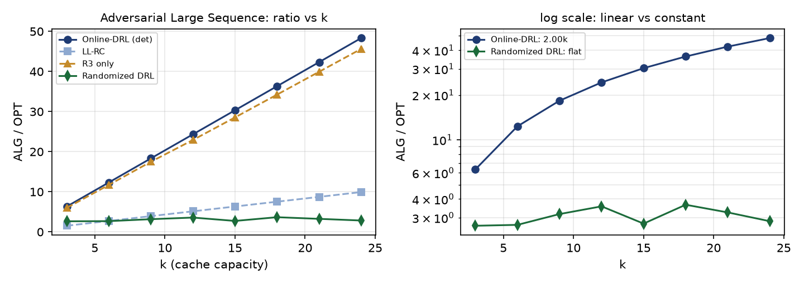
Result 1 - the adversarial family
the paper's Large Sequence, OPT = (k+2n)l
k | gamma det. | gamma R3 | gamma rand. | cost det. | cost rand.
3 | 6.33 | 6.0 | 2.65 | 204 | 42
6 | 12.33 | 11.7 | 2.68 | 840 | 85
9 | 18.33 | 17.5 | 3.17 | 1,908 | 146
12 | 24.33 | 22.9 | 3.57 | 3,408 | 216
15 | 30.33 | 28.5 | 2.74 | 5,340 | 158
18 | 36.33 | 34.2 | 3.66 | 7,704 | 325
21 | 42.33 | 39.9 | 3.25 | 10,500 | 275
24 | 48.33 | 45.6 | 2.84 | 13,728 | 234
Takeaway:
Online-DRL is EXACTLY linear: gamma = 2.00k + 0.33 (R^2 = 1.000). R3 alone does not help (1.88k): the blow-up comes from the cache management, not from the download trigger. With R1+R2+R3 the ratio is FLAT (gamma ~ 3) and the download cost is 5-60x lower.
9

Slide 10
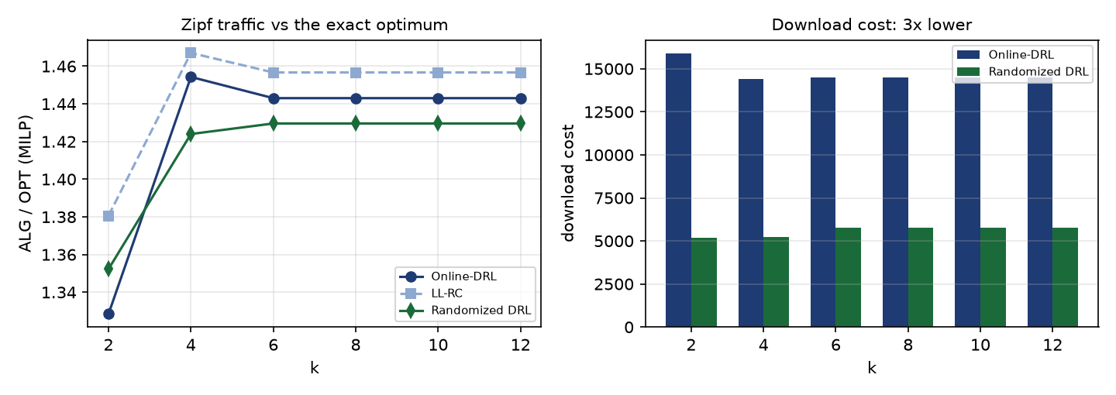
Result 2 - ordinary traffic: it EQUALIZES
Zipf/Poisson, offline optimum = MILP
• All algorithms are flat in k: the resource limits bind before the cardinality does.
• Randomized 1.430 vs Online-DRL 1.443 - parity in the ratio, 3x less download cost.
• On SHORT traces (T = 120, 5 traces, MILP optimal) it is worse: 1.279 +- 0.138 vs 1.145 +- 0.072 (Online-DRL) and 1.102 (R3 only) - the fractional state has to be learned first.
Takeaway:
on easy workloads randomization buys COST and utilization, not ratio. Its advantage appears in the worst case.
10

Slide 11
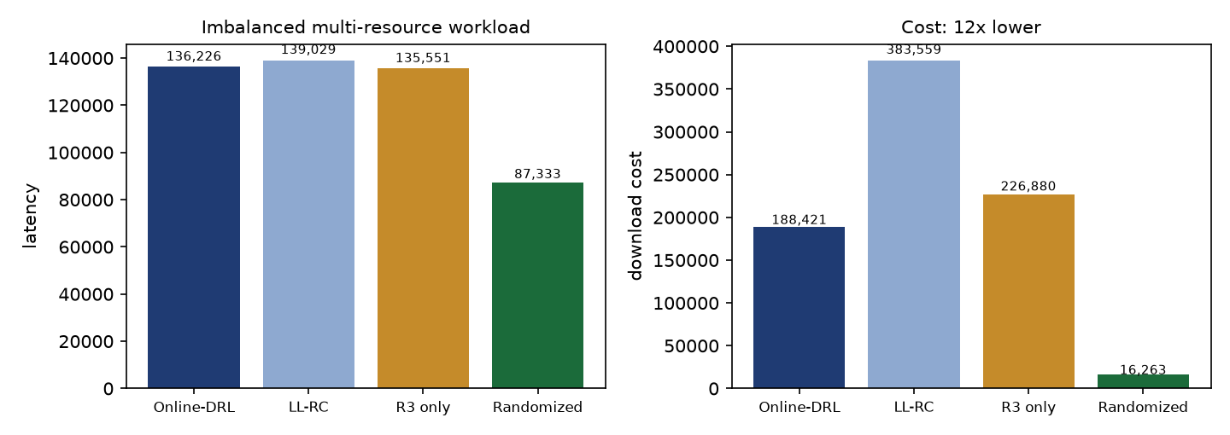
Result 3 - the multi-resource setting
CPU, RAM and disk at the same time
algorithm | latency | cost | dl | U^max | imb | viol.
Online-DRL | 136,226 | 188,421 | 517 | 0.786 | 0.459 | 0.00
LL-RC | 139,029 | 383,559 | 1020 | 0.792 | 0.463 | 0.00
R3 only | 135,551 | 226,880 | 611 | 0.787 | 0.461 | 0.00
Randomized DRL | 87,333 | 16,263 | 40 | 0.740 | 0.334 | 0.00
• 5-13x fewer downloads, 30-36 % less latency, less imbalance and less stranded capacity, and 0 % violations of the three resources.
• Part of the gain is 'simply downloading less' on a stationary popularity - the specifically multi-resource advantage still needs a non-stationary resource mix.
11

Slide 12
The goals of the proposal - which ones hold
G1 - G5, measured
goal | measured | verdict
G1 feasibility | the un-repaired rounding violates the true limits in 40 % of the (path, step) pairs and reaches 1.73x the capacity; with the repair 0 % | CONFIRMED (repair mandatory)
G2 budget | respected at 20 %, 50 %, 100 % of the deterministic cost, for every seed; the budgeted deterministic algorithm loses 11.6 % latency | CONFIRMED
G3 regret (surrogate) | always below sqrt(N) l_max sqrt(T), exogenous and endogenous, with and without the peek update | CONFIRMED
G3 regret (literal) | 3.7-9.6x the bound and growing with T | SURROGATE ONLY - see the next slides
G4 expected ratio | 1.102 (R3), 1.145 (Online-DRL), 1.279 (Randomized) on short traces | CONFIRMED (R3 best on short traces)
G5 slot reductions | weights on the simplex or uniform shadow prices give Lambda < 1 and a lower latency but violate the true limits in 55-85 % of the steps | UNSAFE REDUCTIONS EXIST
12

Slide 13
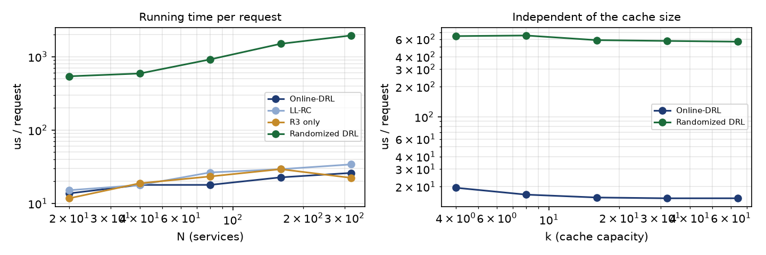
Where Randomized Online-DRL LOSES
the honest list
• Short traces. T = 120: 1.279 +- 0.138 vs 1.145 (Online-DRL) and 1.102 (R3 only). The fractional state is not learned yet.
• Computing time. 440-1 665 us per request against 13-26 us: every request does an O(N) projection, an O(K*N) rounding and an O(N) repair. About 35 ms of CPU per second at 1 000 requests/s.
• The literal form of goal G3. The bound only holds for the surrogate loss; the realized-latency version is violated by a factor 3.7-9.6.
• It never loses on resource feasibility: the repair step makes the constraints exact (0 % violations everywhere).
13

Slide 14
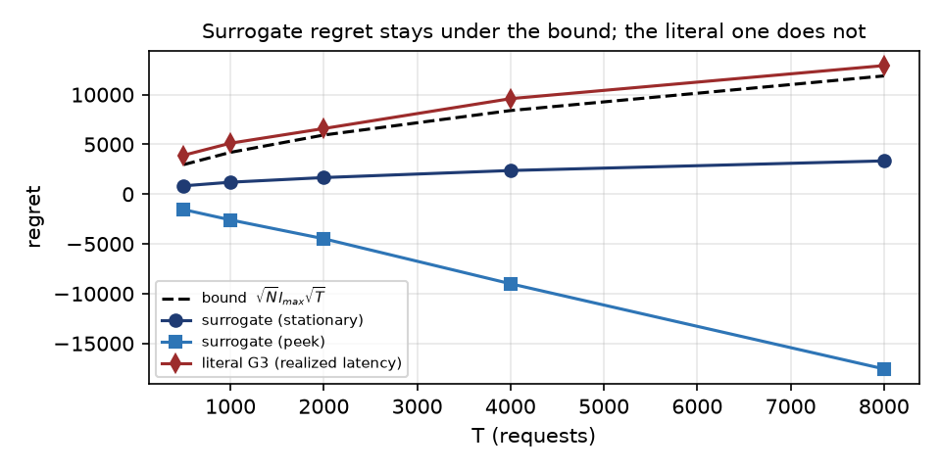
Terminology 1 - 'surrogate only'
goal G3 read carefully
• The regret we would LIKE to bound uses the realized latency: sum_t l - min_P sum_t l 1[n_t not in P].
• But that expression is not a function of p alone: whether a request is a hit, a delayed hit or a forward also depends on q_t (a download in flight) and dm_t (its remaining time), which are decided by the discrete download dynamics.
• The proposal therefore uses a SURROGATE loss that IS a function of p: F_t(P) = (1 - p_nt) * g_t, with g_t = (1-q_t) l + q_t min(l, dm_t) - 'a request that is not covered by the fractional cache costs g_t'.
• The bound sqrt(N) l_max sqrt(T) is the regret of the SURROGATE, because D_vec has diameter <= sqrt(N) and eta = sqrt(N)/(l_max sqrt(T)).
• Why the literal version fails: the fractional comparator may cache a service INSTANTLY, while the real system must first DOWNLOAD it - and the comparator is not charged for those downloads.
• Fixes: define G3 on the surrogate loss, charge the comparator for its downloads, or compare against a download-aware comparator.
'Surrogate only' means:
the bound holds for the surrogate and only for the surrogate.
14

Slide 15
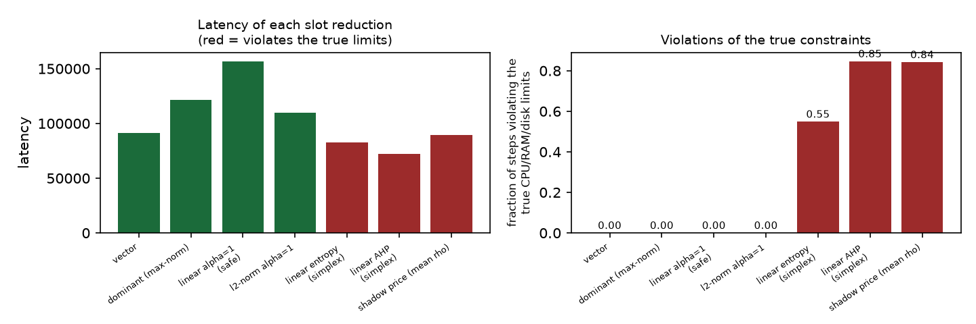
Terminology 2 - 'unsafe reduction'
goal G5: slot reductions
• A slot reduction replaces the three resource constraints by ONE scalar constraint sum_n phi(a_n) p_n <= 1, with a weight function phi (dominant resource, a linear or l_p mix, shadow prices, AHP or entropy weights).
• Lambda_phi = max_n phi(a_n)/max_r a_n,r (eq. 18) measures the damage: Lambda < 1 means the reduction charges a service LESS than its true bottleneck demand, i.e. the reduced constraint is WEAKER than the real one.
• Such a reduction is called UNSAFE: the cache it produces can exceed the real CPU/RAM/disk limits.
• The proposal's own warning: with weights on the simplex (sum_r alpha_r = 1) a disk-only service looks cheap; the reduction is safe only if alpha_r >= 1 for every r, at the price of wasting up to a factor R of the capacity.
• Measured: entropy, AHP and uniform shadow prices all have Lambda < 1 and a LOWER latency - and all three violate the true limits in 55-85 % of the steps (up to 2.37x the capacity). The safe reductions never violate, but waste capacity (linear alpha = 1: Lambda = 2.52, +71 % latency).
'Unsafe reduction' means:
a slot reduction is not a free simplification - the exact vector formulation dominates every safe reduction.
15

Slide 16
Summary
the verdict in one slide
regime | Online-DRL | Randomized DRL | verdict
adversarial patterns, large caches | gamma = 2k (linear) | gamma ~ 3 (flat) | randomized WINS
ordinary stationary traffic | 1.443, 3x more cost | 1.430, 3x less cost | randomized EQUALIZES and saves cost
multi-resource workload | 136 226 latency | 87 333 latency (-36 %) | randomized WINS
short traces | 1.145 | 1.279 | randomized LOSES (warm-up)
download budget | clipped, -11.6 % latency | respected in expectation and per seed | randomized WINS
computing time | 13-26 us/req | 440-1 665 us/req | randomized LOSES (25-70x)
goal G3 | - | surrogate only | partial
Bottom line:
strictly better in the worst case, equal in the average case, slightly worse during the warm-up, and 25-70x more expensive per request. Still open: the real Google / SHARCNet traces, a non-stationary resource mix, and an adversarial family designed against the randomized algorithm (to separate O(log k) from O(k)).
16

Slide 17
How to reproduce
every number in this deck
• cd extracted/drl-sim && pip install -r requirements.txt && make test
• python experiments/run_all.py # ~30 min, writes results/*.json and results/*.png
• python docs/make_slides.py # this deck
• python docs/make_comparison_pdf.py # the 6-page comparison PDF
• python docs/make_contexts_pdf.py # the contexts PDF (surrogate, unsafe reduction)
• Documentation: docs/simulation_methodology.md (model, conditions, how every number is computed) and docs/results.md (all results).
• Caveat: the Google / SHARCNet traces are NOT in this repository; the headline numbers here come from synthetic Zipf traffic and the paper's adversarial sequence.
17

