Slide 1
DUNGEON_DIVER.EXE
By: Ryan Fox, Brianna Blain-Castelli
Alexander “Sasha” Kharag

Slide 2
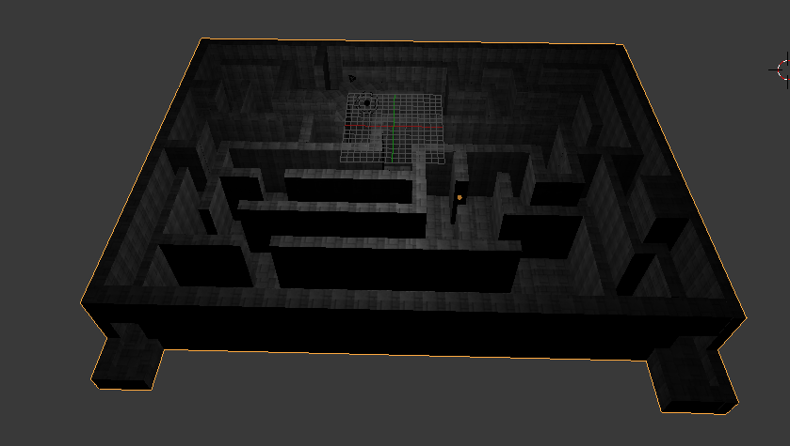
Basics:
Models
Textures
Moveable Camera
Interactivity

Slide 3

Bullet
Invisible Object
Collisions with Walls
Collisions with Floors
Collisions with other objects
Ball pit

Slide 4
Lighting
Multiple Lights
Adjust Specular and Ambient Lighting

Slide 5
Demonstration
Watch

