Slide 1
SPELL CHECKER USING C++
MADE BY -AKASH SANGWAN(3211)
AMIT KUMAR GHOSH(3214)

Slide 2

WHAT IS IT?
Checks whether the word entered by the user exists in english literature or not?
If not, then it suggests most similar word present in the dictionary.

Slide 3
WHAT WE USED?
DATA STRUCTURE USED-
HASH TABLE FOR STORING DICTIONARY
HASH FUNCTION – USED HORNERS METHOD
--------------------------------------------------------------------------------------------------
WHAT ARE HASH TABLE AND HASH FUNCTIONS?

Slide 4
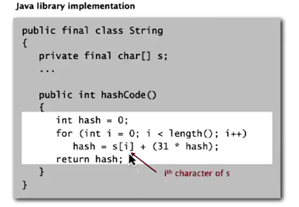
HORNERS METHOD
Used to calculate key for a given string.

Slide 5
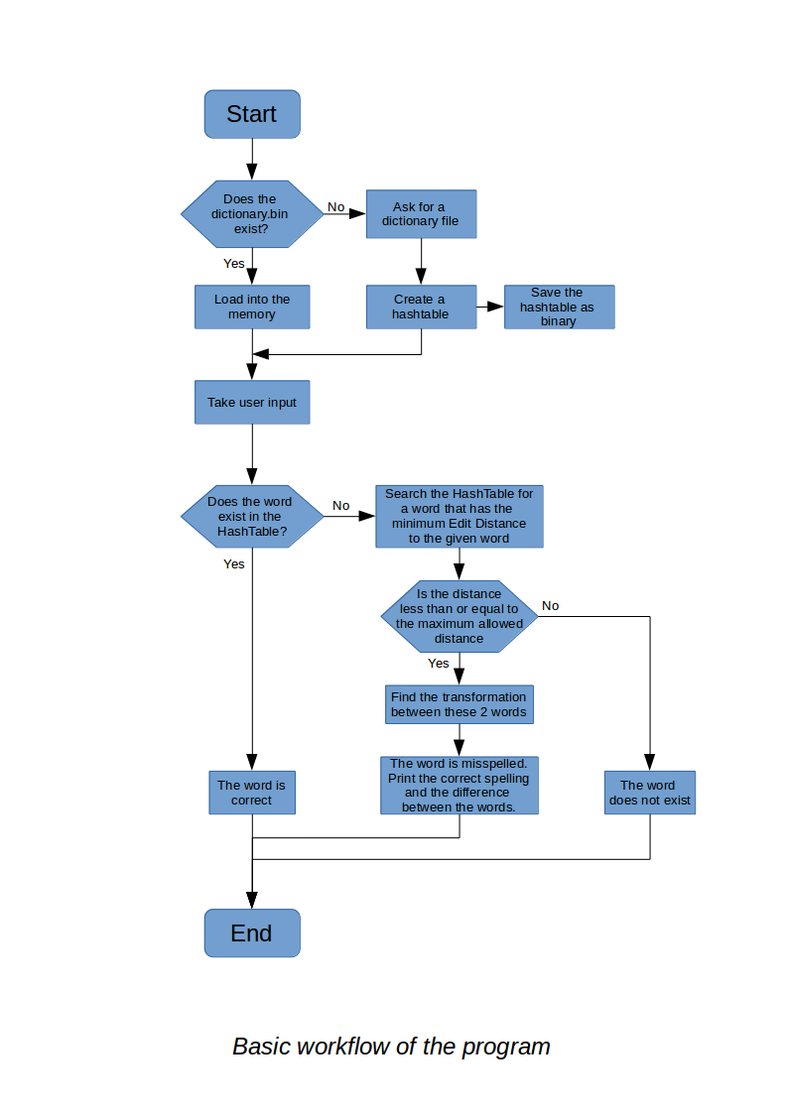
HOW IT WORKS?

Slide 6
ALGORITHM USED
MINIMUM EDIT DISTANCE ALGORITHM
In computer science edit distance is a way of quantifying how dissimilar two strings are to one
another by counting the minimum number of operations required to transform one string into the other.
Example-
The edit distance between "kitten" and "sitting" is 3. A minimal edit script that transforms the former
into the latter is:
kitten → sitten (substitution of "s" for "k")
sitten → sittin (substitution of "i" for "e")
sittin → sitting (insertion of "g" at the end).

Slide 7
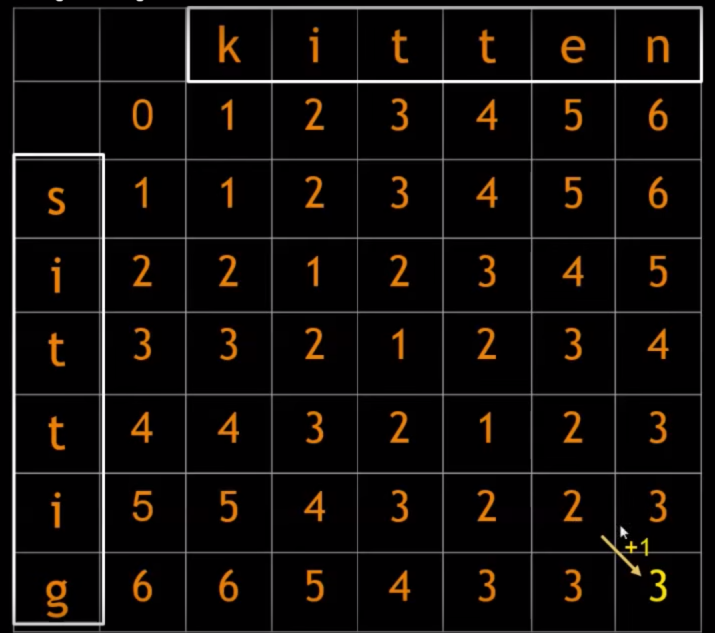

Slide 8
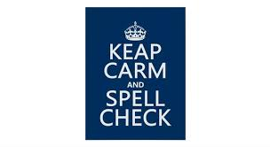
THANK YOU

