Slide 1

Introduction to Data Science
Introduction to Data Science
^{3rd} Semester CSE (R-21)

Slide 2
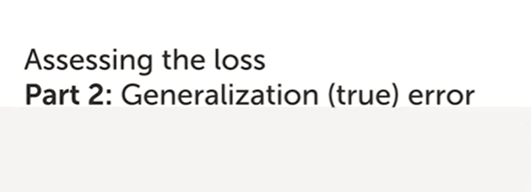
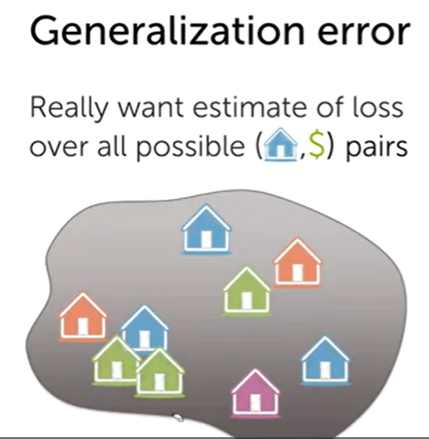

Slide 3
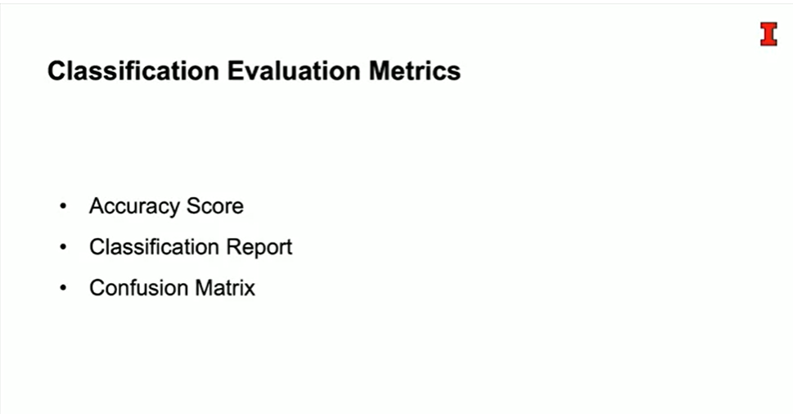

Slide 4
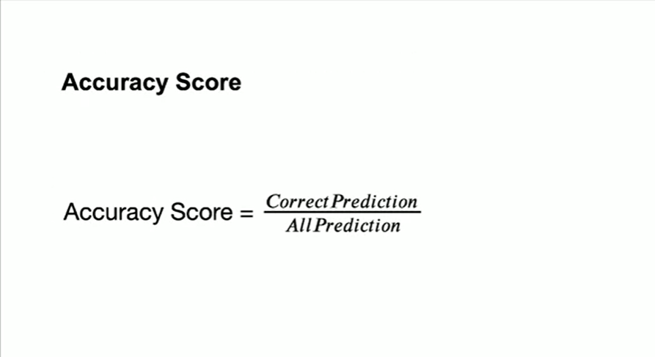

Slide 5
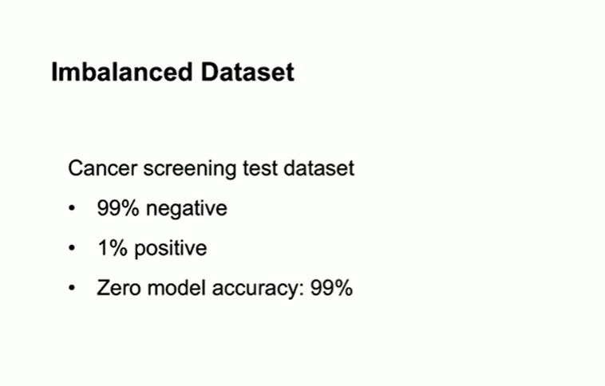

Slide 6
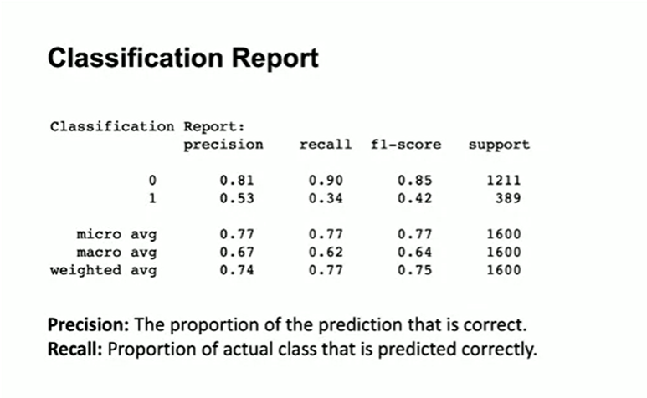

Slide 7
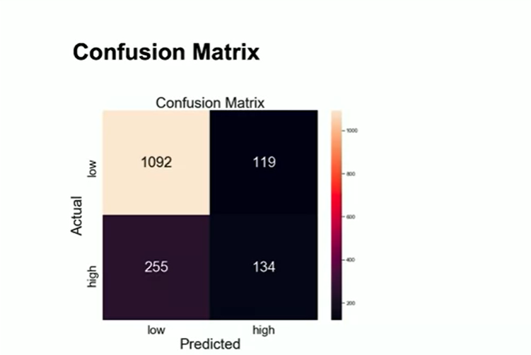

Slide 8
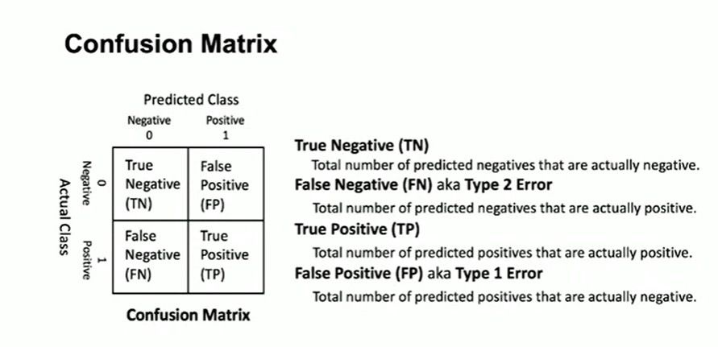

Slide 9
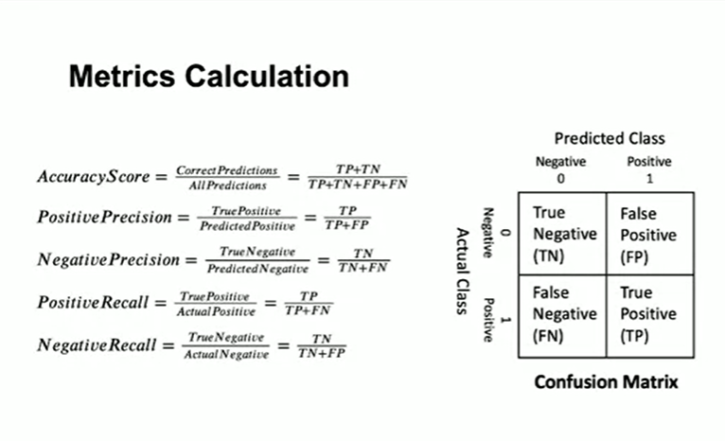

Slide 10
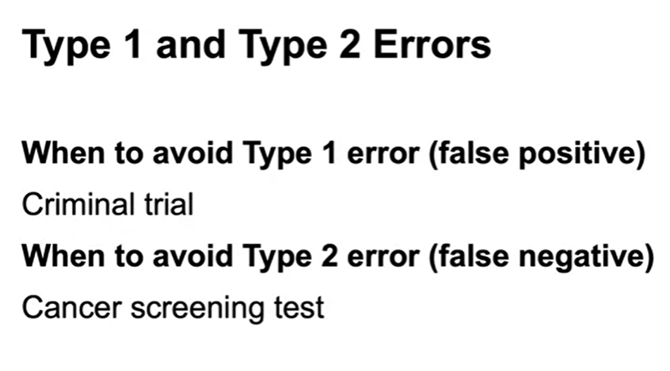

Slide 11
Bias And Variance
There are two main types of errors present in any Data Science model.
They are 1) Reducible Errors and
2) Irreducible Errors.
Irreducible errors are errors which will always be present in a machine learning model, because of unknown variables, and whose values cannot be reduced.

Slide 12
Reducible errors are those errors whose values can be further reduced to improve a model.
They are caused because our model’s output function does not match the desired output function and can be optimized.
We can further divide reducible errors into two:
Bias and
Variance.

Slide 13
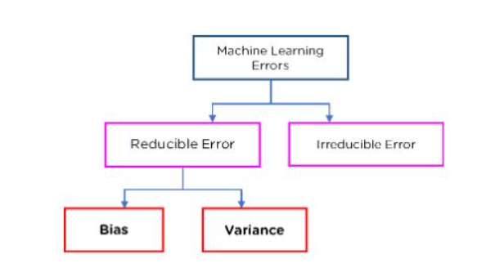

Slide 14
1. Bias:
The overall error associated with “Training Data” is termed as bias. When the training data error increase, or training data accuracy decrease, it is referred to as high bias and when the training data error decreases or training data accuracy increases, it is referred to as low bias
High Bias: High training data error / low training data accuracy.
Low Bias: Low training data error / high training data accuracy.

Slide 15
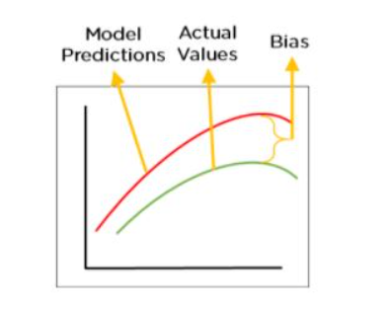
What is Bias?
To make predictions, our model will analyze our data and find patterns in it. Using these patterns, we can make generalizations about certain instances in our data. Our model after training learns these patterns and applies them to the test set to predict them.
Bias is the difference between our actual and predicted values. Bias is the simple assumptions that our model makes about our data to be able to predict new data.

Slide 16
2. Variance:
Note that variance is associated with “Testing Data” while bias is associated with “Training Data.” The overall error associated with testing data is termed a variance. When the errors associated with testing data increase, it is referred to as high variance, and vice versa for low variance.
High Variance: High testing data error / low testing data accuracy.
Low Variance: Low testing data error / high testing data accuracy.

Slide 17
What is Variance?
Variance is the very opposite of Bias. During training, it allows our model to ‘see’ the data a certain number of times to find patterns in it. If it does not work on the data for long enough, it will not find patterns and bias occurs. On the other hand, if our model is allowed to view the data too many times, it will learn very well for only that data. It will capture most patterns in the data, but it will also learn from the unnecessary data present, or from the noise.

Slide 18
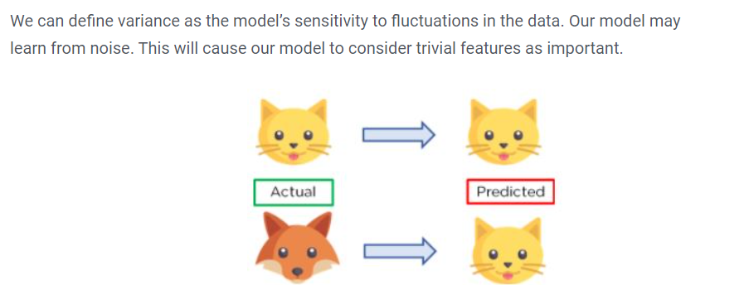

Slide 19
Bias Variance Trade-off
The relationship among bias, variance, and model error will be explored.
In the following Figure, X-axis depicts the algorithm’s complexity or degree of the polynomial, while the Y-axis depicts the error provided by the model. The primary objective here is to reduce the error on the y-axis by balancing bias and variance.
The variance is represented by the yellow curve, and it is obvious that as the complexity of the algorithm or the degree of polynomial increases, the variance increases, causing the model error on the y-axis to increase exponentially. However, Bias in the white curve behaves differently: as the algorithm’s complexity increases on the x-axis, Bias^2 decreases exponentially, causing the model’s error on the y-axis to decrease.
Here, we’re supposed to find a sweet spot / optimal point where the error is low in terms of bias and variance. The overall error indicated by the yellow and white curves is depicted by the red curve. The optimum point on this red curve is the one with the lowest error value. This is exactly what we wanted.

Slide 20
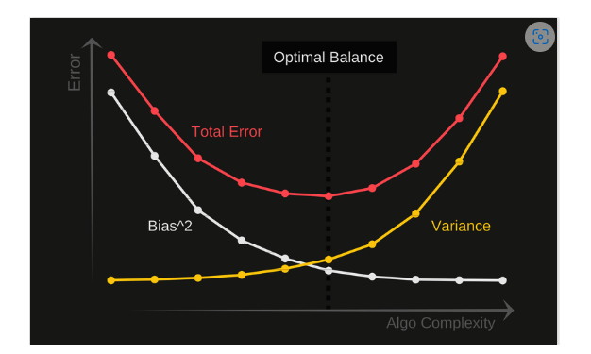

Slide 21
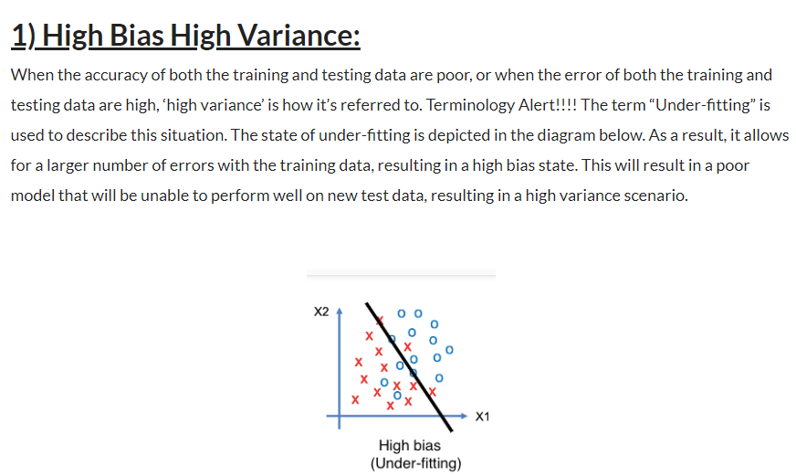

Slide 22
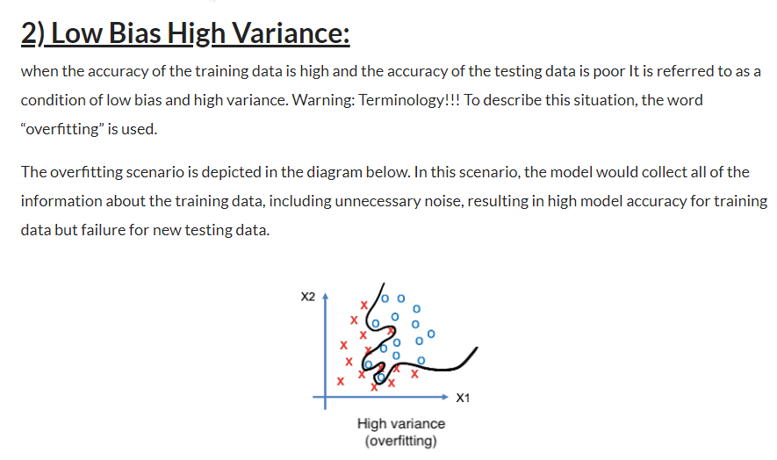

Slide 23
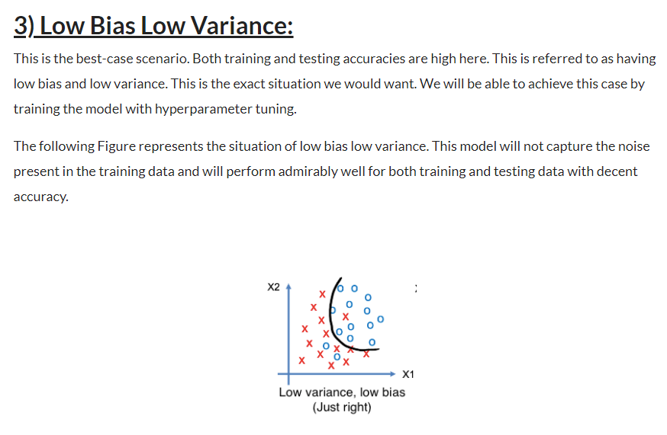

Slide 24
Cross Validation
In machine learning, we couldn’t fit the model on the training data and can’t say that the model will work accurately for the real data. For this, we must assure that our model got the correct patterns from the data, and it is not getting up too much noise. For this purpose, we use the cross-validation technique.
Cross-validation is a technique in which we train our model using the subset of the data-set and then evaluate using the complementary subset of the data-set.
The three steps involved in cross-validation are as follows :
Reserve some portion of sample data-set.
Using the rest data-set train the model.
Test the model using the reserve portion of the data-set.

Slide 25
LOOCV (Leave One Out Cross Validation) In this method, we perform training on the whole data-set but leaves only one data-point of the available data-set and then iterates for each data-point. It has some advantages as well as disadvantages also. An advantage of using this method is that we make use of all data points and hence it is low bias. The major drawback of this method is that it leads to higher variation in the testing model as we are testing against one data point. If the data point is an outlier it can lead to higher variation. Another drawback is it takes a lot of execution time as it iterates over ‘the number of data points’ times.

Slide 26
K-Fold Cross Validation In this method, we split the data-set into k number of subsets(known as folds) then we perform training on the all the subsets but leave one(k-1) subset for the evaluation of the trained model. In this method, we iterate k times with a different subset reserved for testing purpose each time.
Example The diagram below shows an example of the training subsets and evaluation subsets generated in k-fold cross-validation. Here, we have total 25 instances. In first iteration we use the first 20 percent of data for evaluation, and the remaining 80 percent for training([1-5] testing and [5-25] training) while in the second iteration we use the second subset of 20 percent for evaluation, and the remaining three subsets of the data for training([5-10] testing and [1-5 and 10-25] training), and so on.

Slide 27
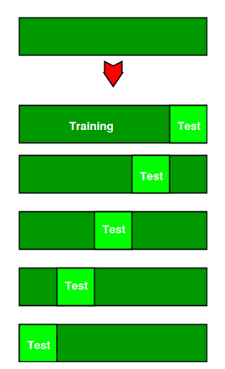

Slide 28
Advantages of train/test split:
This runs K times faster than Leave One Out cross-validation because K-fold cross-validation repeats the train/test split K-times.
Simpler to examine the detailed results of the testing process.
Advantages of cross-validation:
More accurate estimate of out-of-sample accuracy.
More “efficient” use of data as every observation is used for both training and testing.

Slide 29
Stratified K Fold Cross Validation
What are random sampling and Stratified sampling? Suppose you want to take a survey and decided to call 1000 people from a particular state, If you pick either 1000 males completely or 1000 females completely or 900 females and 100 males (randomly) to ask their opinion on a particular product. Then based on these 1000 opinions you can’t decide the opinion of that entire state on your product. This is random sampling. But in Stratified Sampling, Let the population for that state be 51.3% male and 48.7% female, Then for choosing 1000 people from that state if you pick 513 male ( 51.3% of 1000 ) and 487 female ( 48.7% for 1000 ) i.e 513 male + 487 female (Total=1000 people) to ask their opinion. Then these groups of people represent the entire state. This is called Stratified Sampling.

Slide 31
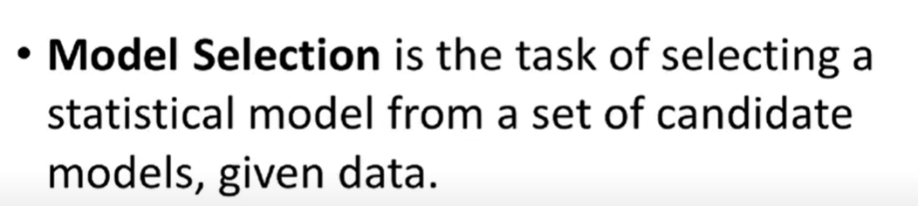
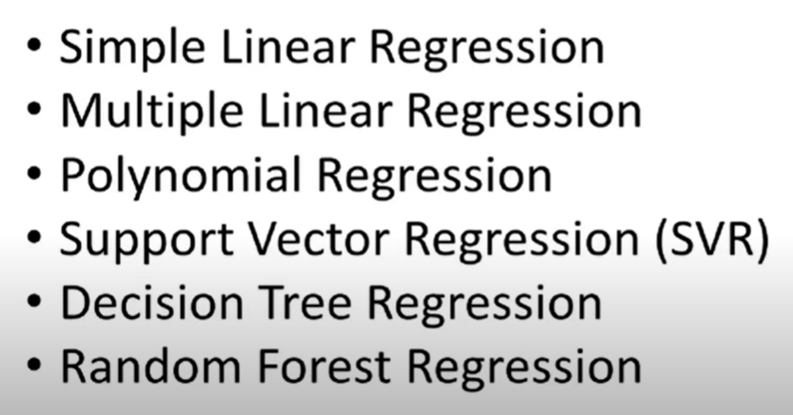

Slide 32
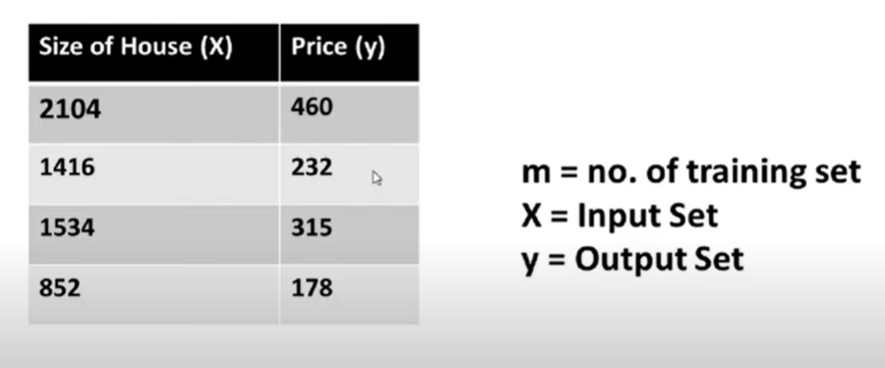

Slide 33
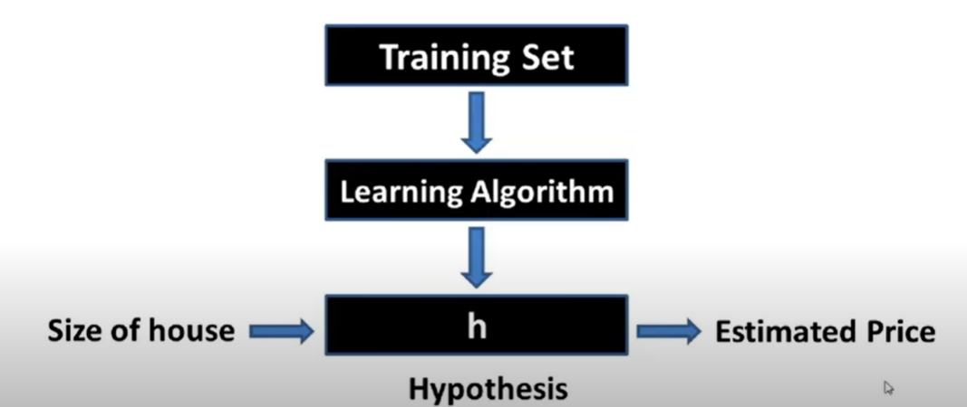

Slide 34

Any Question Please?

Slide 35


