Slide 1
Optical Components
Booklet notes
Contents (just the topics, full contents on the booklet):
Free and guided propagation of optical waves
Weakly non-linear dielectrics
Maxwell’s equations (linear and nonlinear)
Ideal reference case
Fourier transform
Wave equation for complex amplitudes (linear and nonlinear contributions)
Nonlinear Schrödinger equation (NLSE)
Linear and nonlinear terms in the NLSE
Guided propagation of optical waves
Propagation in optical fiber
Guided modes → LP and Gaussian approximations

Slide 2
Optical Components
Booklet notes
Chapter 1: Free and guided propagation of optical waves
1.1 Premise
Performance:
Transmission capacity: Quantity of information transferred per unit time
Maximum distance between the source and used
All the physical phenomena must be known
Visible: 400 nm → 750 nm
Microwaves: 25 um → 1mm
Information transfer → Modulated electromagnetic signal
In this chapter: main properties of the modern communications systems
Guided or non-guided propagation’;
Guided: EM radiation is confined in a guiding structure
Non-guided: EM radiation propagates through space → for broadcast
We start with slowly varying weakly nonlinear dielectrics at optical frequencies
NLSE3D describes the evolution of the electric field envelope
Then we apply the results for guided and non-guided propagation independently
Free space propagation: Neglect all nonlinear and dispersive terms (purely diffractive propagation)
Guiding structures: Diffractive and guiding effects (the later due to the refractive index variation in the transverse plane with respect to propagation direction) compensate each other

Slide 3
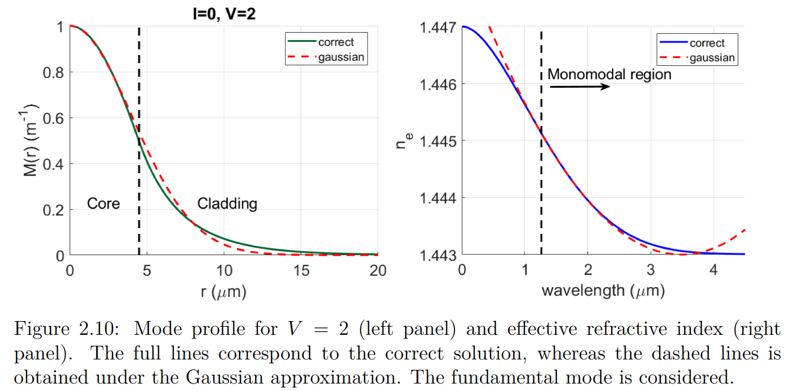
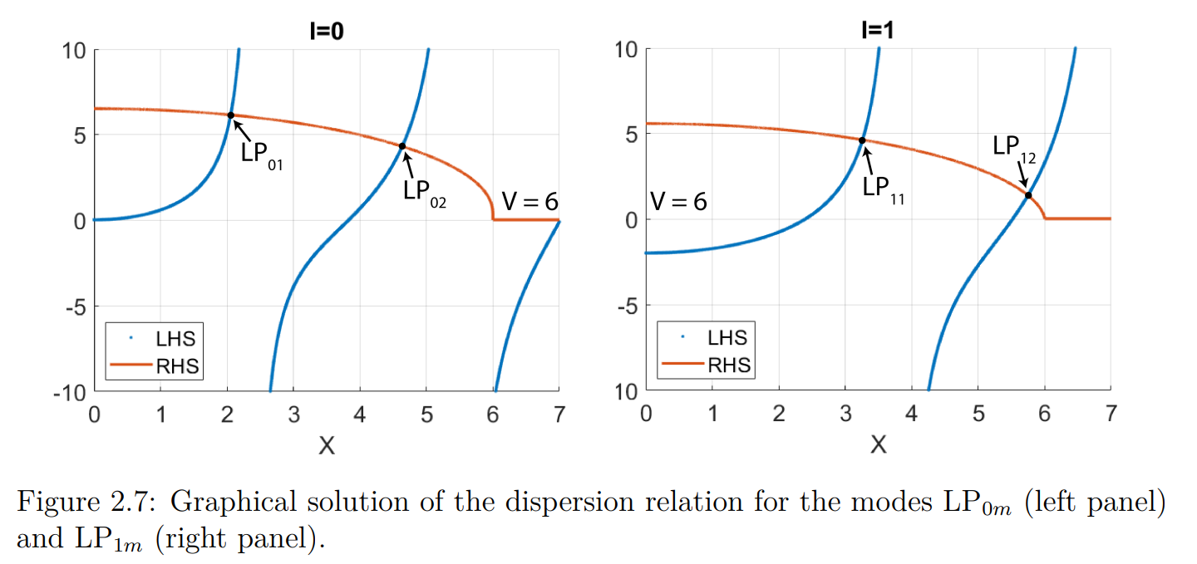
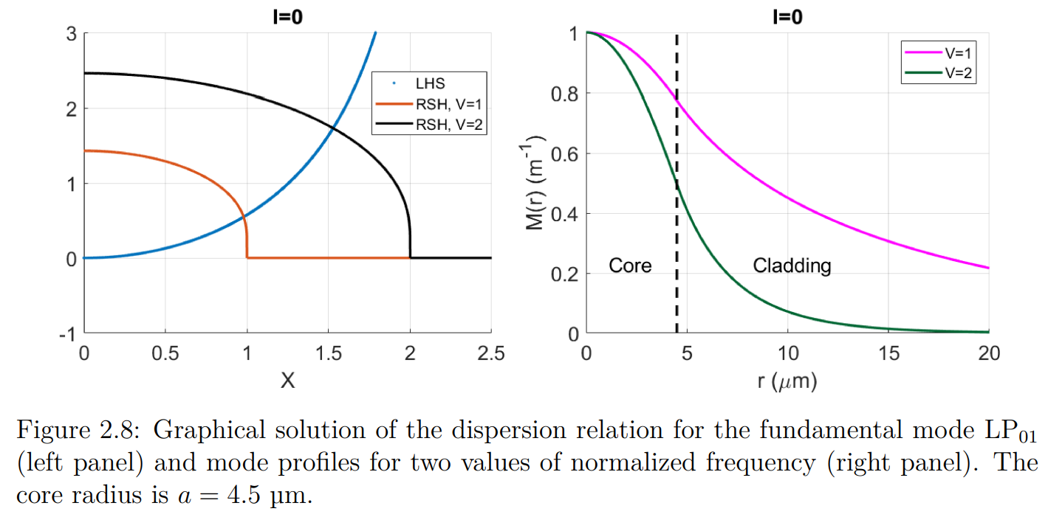
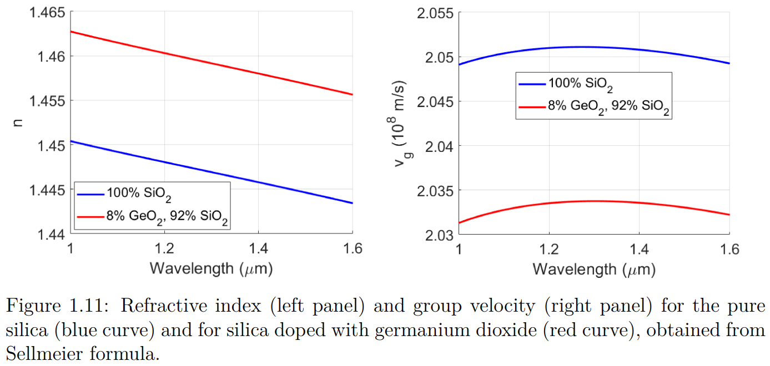
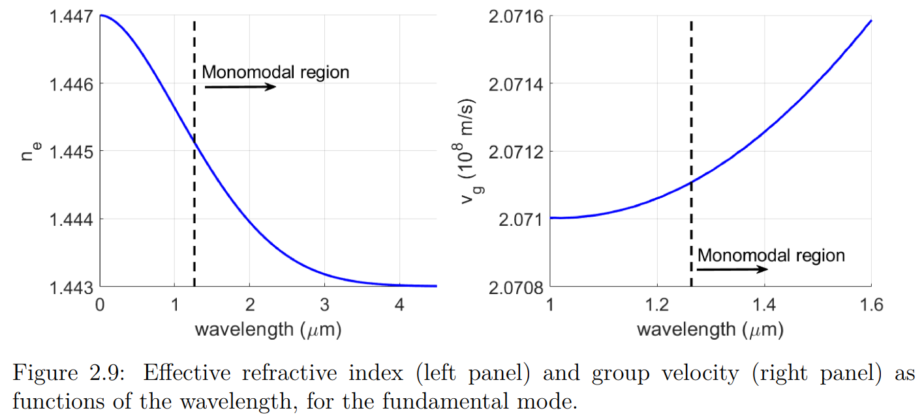
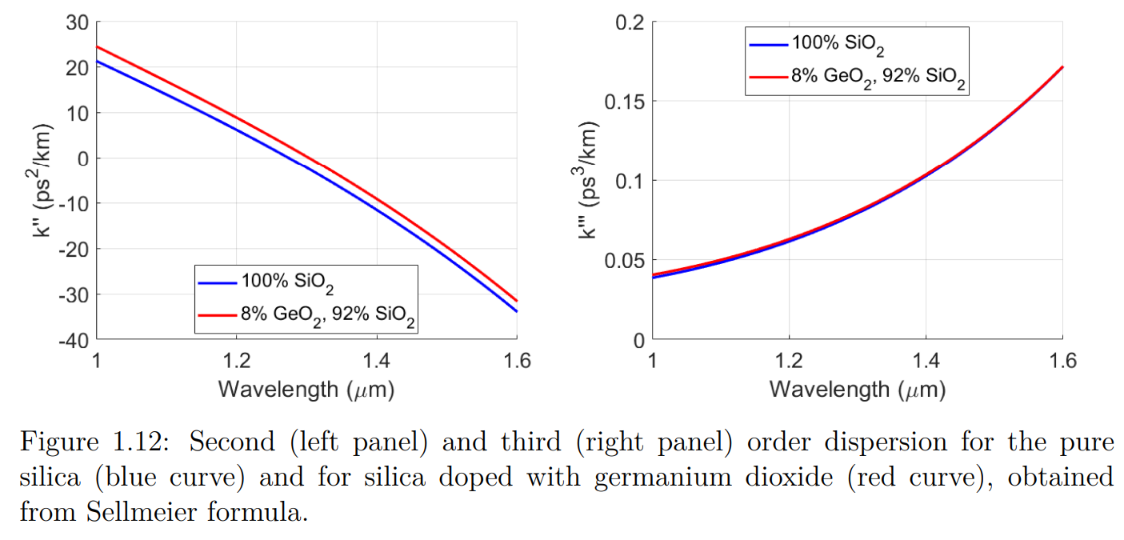
Optical Components
Booklet notes
Figures
p53
P56 check
P39 check
P54 check
P40 check
P55 check

Slide 4
Optical Components
Booklet notes
Exercise 1: Isotropic media
We apply any rotation on E and we should get the same in P
We obtain the relation: XR = RX with X the susceptibility tensor
We do it with a z-axis and x-axis rotation
Exercise 2: Frequency dependent and complex X
From the relation P = e_0[[X]]*[E]
From the fact that X(r, t-tau) = 0 for t-tau<0 due to causality
Exercise3: Linear isotropic media
Directly from the wave equation and P = e_0XE
Exercise 4: Linear and homogeneous medium → \Nabla . [E] = 0
From
Exercise 5: Ideal reference case
Directly from the wave equation
Exercise 6: Propagation constant
- Taking the operators of the derivatives acting on the cosine function
Exercise 7: 2D Fourier transform
Apply the Fourier transform and separate the exponentials
Exercise 8: H and <P> calculations
- Apply Maxwell’s equations and assume slowly variant envelope

Slide 5
Optical Components
Booklet notes
Exercise 9: Intensity attenuation
We have the electric field, get the poynting vector
Exercise 10: Neglect third order dispersion
We start with the equation and the suggested values
Exercise 11: Verify the effective refractive index with data
Use the graphical solution and then calculate beta and n_eff
Exercise 12:
Exercise 13:
Exercise 14:
Exercise 15:
Exercise 16:

Slide 6
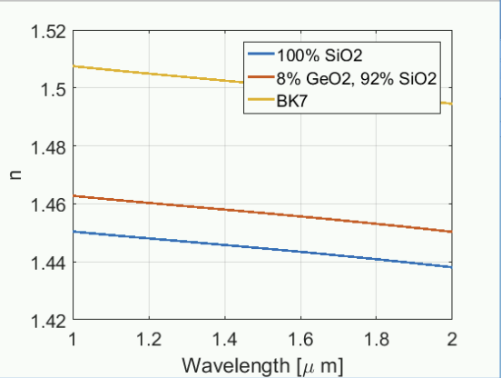
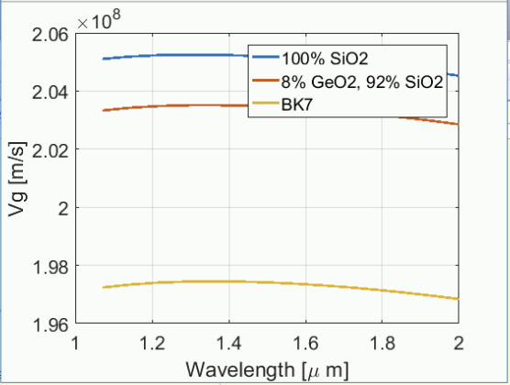
Figure 1.11: Refractive index for pure Silica and Silica doped with Germanium from the Sellmeier formula
Figure 1.11: Group velocity for pure Silica and Silica doped with Germanium from the Sellmeier formula

Slide 7
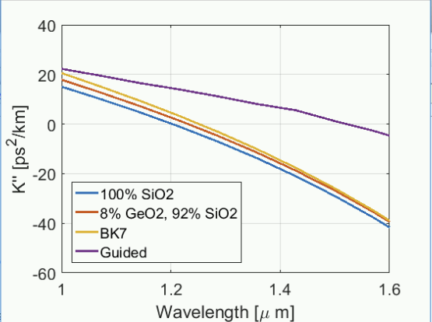
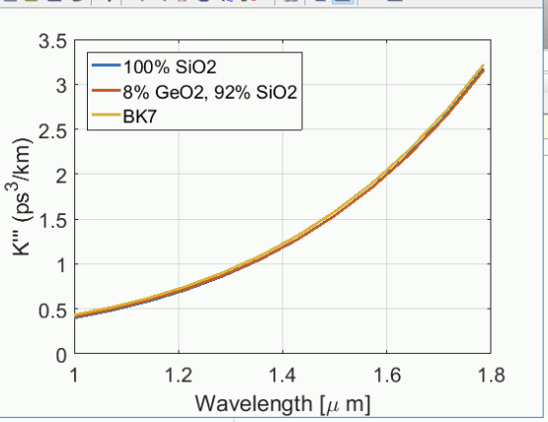
Figure 1.12: Refractive index for pure Silica and Silica doped with Germanium from the Sellmeier formula
Figure 1.12: Group velocity for pure Silica and Silica doped with Germanium from the Sellmeier formula

Slide 8
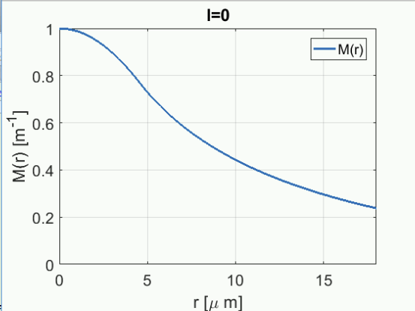
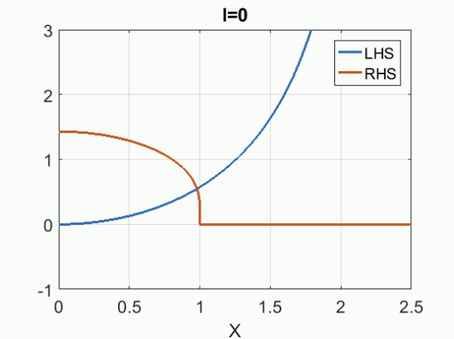
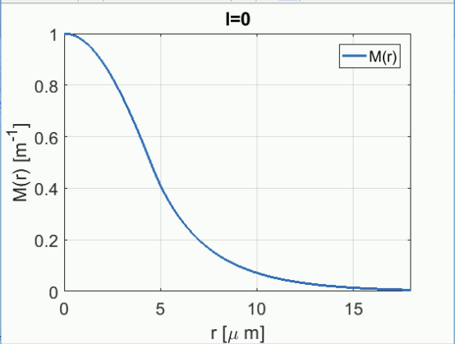
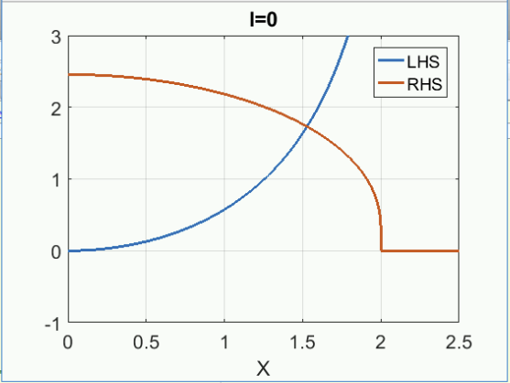
Figure 2.8: Graphical solution of the dispersion relation for the LP01 mode
Figure 2.8: Mode profiles for 2 normalized frequencies

Slide 9
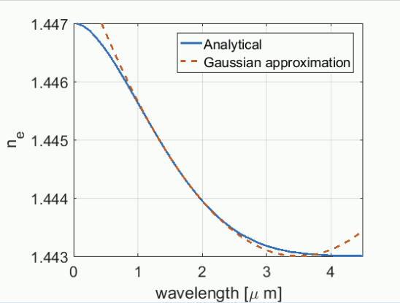
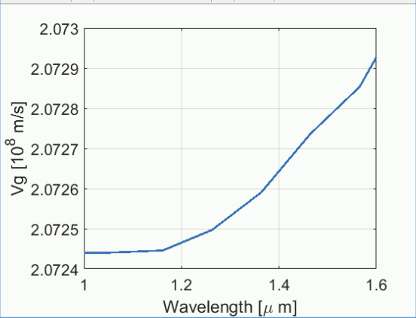
Figure 2.9: Effective refractive index for the L01 mode
Figure 1.11: Group velocity of the LP01 mode

Slide 10
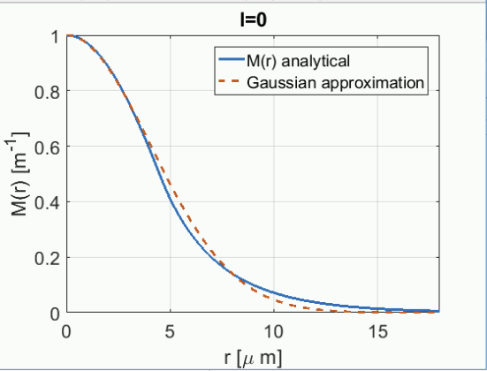
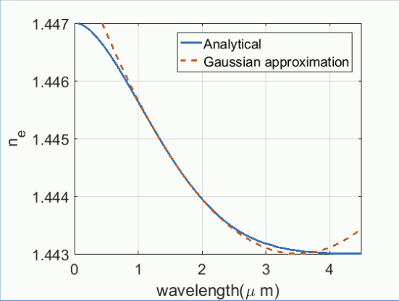
Figure 2.10: Mode profile for V=2
Figure 1.11: Effective refractive index

