Slide 1

Turbo Codes: an Introduction
Pierangelo Migliorati
DII - University of Brescia

Slide 2
Standard (classic-style) Concatenated Coding (Series)
Outer
Encoder
Block
Interleaver
Inner
Encoder
Channel
Outer
Decoder
De-
interleaver
Inner
Decoder
Turbo codes (1993)
LDPC (1962, and then (rediscovered !!!) 1999)

Slide 3
Power Efficiency of Standard Binary Channel Codes
1.0
BPSK Capacity Bound
Uncoded
BPSK
Iridium
1998
Shannon Capacity Bound
Spectral Efficiency
Pioneer
1968-72
Code Rate r
Turbo Code
1993
0.5
LDPC Code
2001 Chung, Forney,
Richardson, Urbanke
IS-95 1991
Odenwalder
Convolutional
Codes 1976
Voyager
1977
Galileo:LGA
1996
Galileo:BVD
1992
Mariner
1969
arbitrarily low
BER:
-2
-1
0
1
2
3
4
5
6
7
8
9
10
Eb/No in dB

Slide 4
Turbo Codes
Background
Proposed by Berrou, Glavieux, …, in ICC 1993
Performance within 0.5 dB from channel capacity !!!
Principal (New) Characteristics
Parallel (instead of series) concatenated coding
Recursive systematic convolutional encoders
Pseudo-random interleaving
Iterative (SISO) decoding (as the turbo engine …)

Slide 5
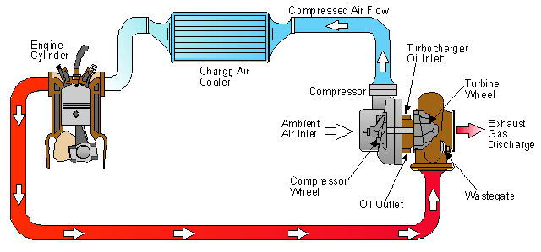
Turbo principle
Turbo Engine …

Slide 6
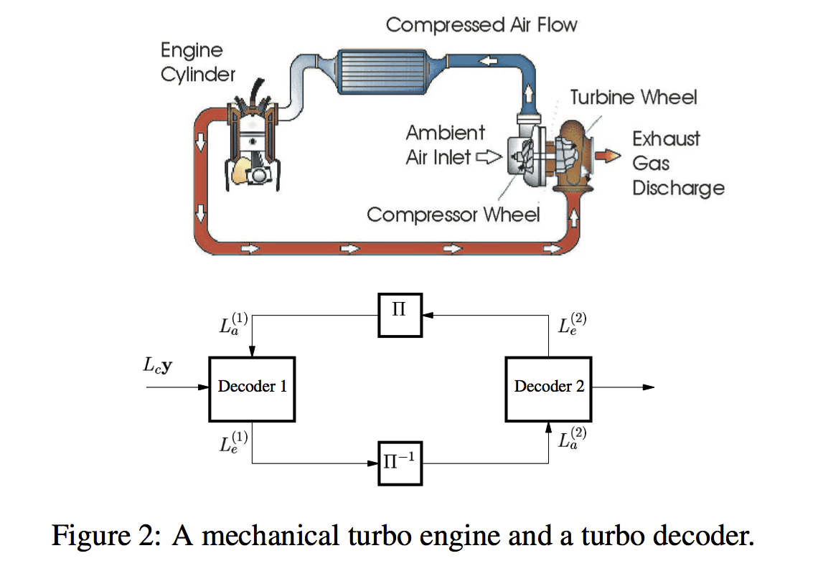

Slide 7
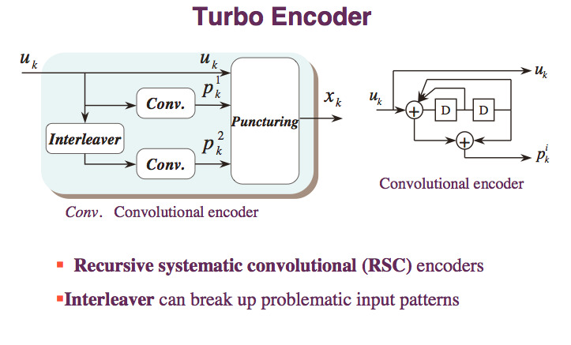

Slide 8
Parallel Concatenation, with Inter-leaver
u₁, u₂ ... u_{K}
x⁽¹⁾
RSC, R_{c}=1/2
encoder 1
Puncturer
RSC, R_{c}=1/2
encoder 2
π
x⁽²⁾
u_{π(1)}, u_{π(2)} ... u_{π(K)}

Slide 9
SISO Decoder (1)
Soft decoder (Soft-In-Soft-Out):
Every binary symbols is described by a unique value: (+1/-1), Algebric value or Log-Likelihood-Ratio (LLR):
L_{c}(x⁽¹⁾)
L_{c}(u)
L_{p}(u)
At the input of the decoder, from the AWGN channel, we receive y instead of u:
To evaluate the “a posteriori” algebric value, we use the BCJR algorithm (MAP, Maximum-a-Posteriori)

Slide 10
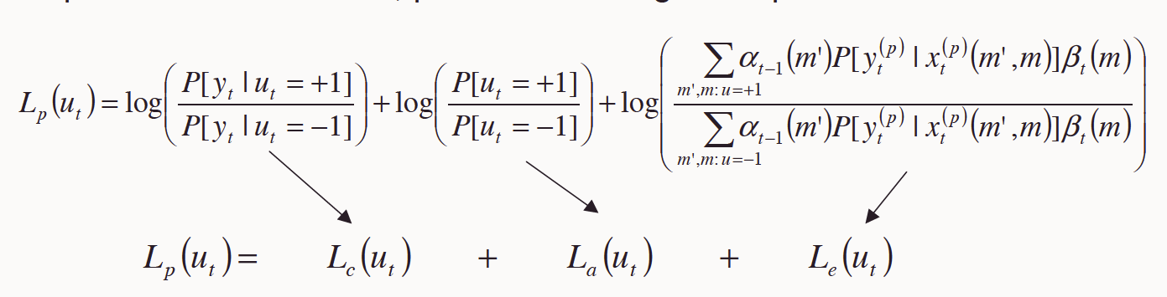
SISO iterative decoding …

Slide 11
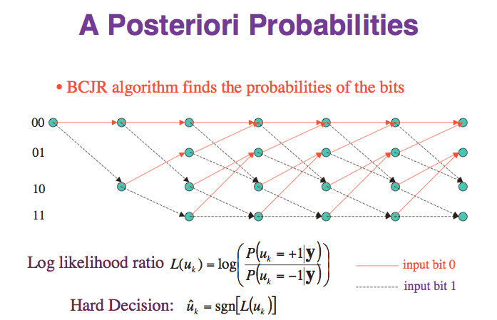

Slide 12
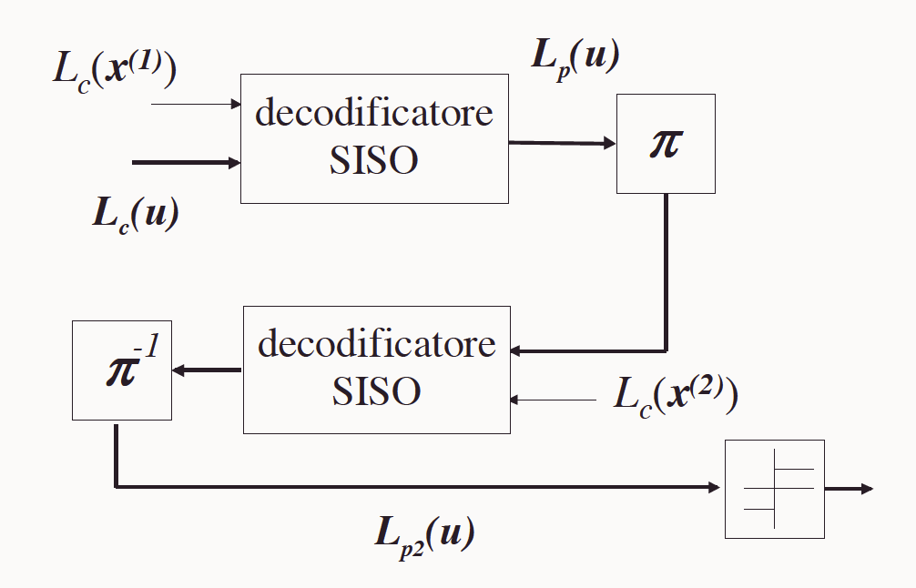
SISO decoding
The first decoder decides considering the signal observation from the channel, whereas the second decoder get helps from the information that arrives also from the first decoder …
New estimation … more affordable ?
!!! YES, but only if we consider the really new (The “extrinsic” !!!) information … !!!

Slide 13
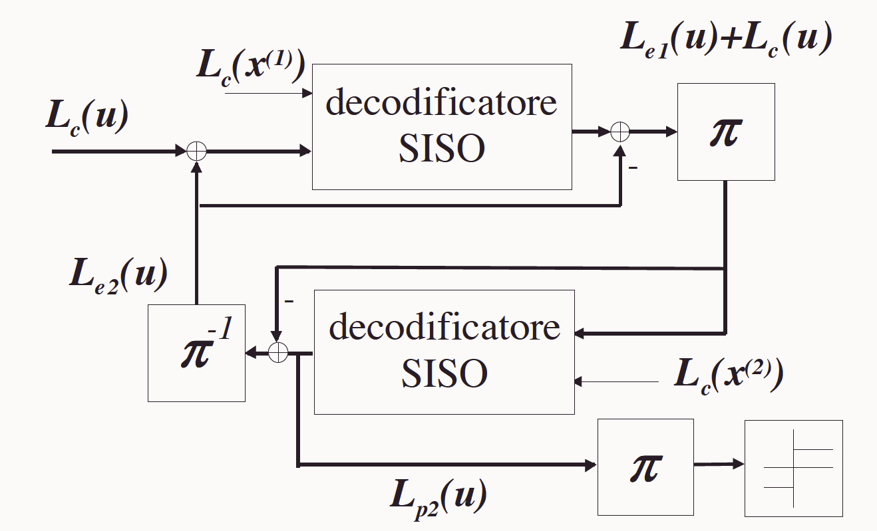
SISO iterative decoding …

Slide 14
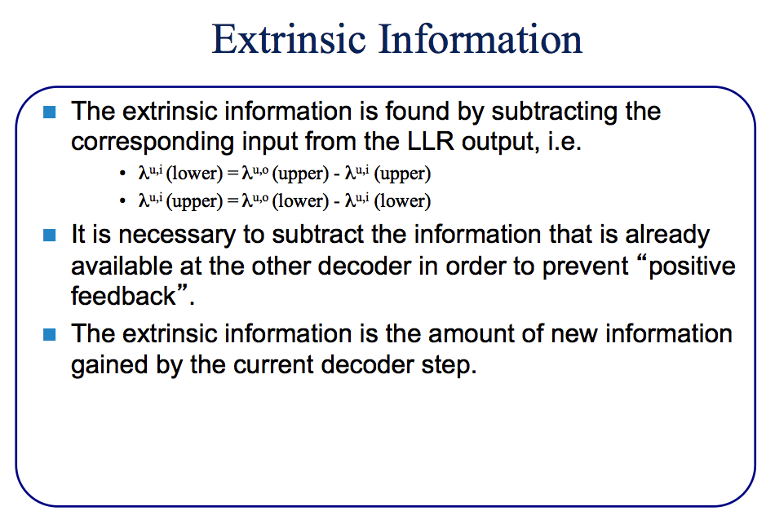
SISO decoding

Slide 15
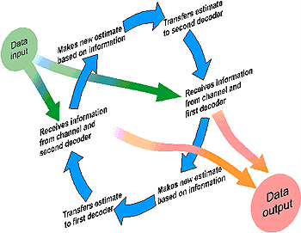
Iterative Decoding

Slide 16
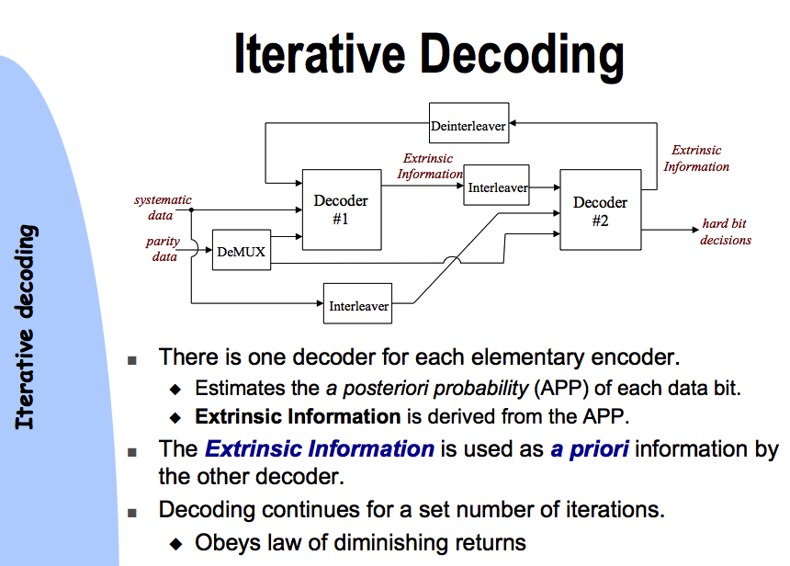
SISO iterative decoding …

Slide 17
Performance …
Shannon: random codes and large blocks (many bits) !!!
Also very Important: soft decoding [therefore, convolutional codes (???, e.g.: LDPC)]
Conv. R=1/2,K9
RS(255,131)
hard dec.
Turbo-codes
Capacity of
binary channel, R=1/2
BCH(63,36,11)
Hard dec.

Slide 18
Iterations: Waterfall (Cliff) and Error Floor

Slide 19
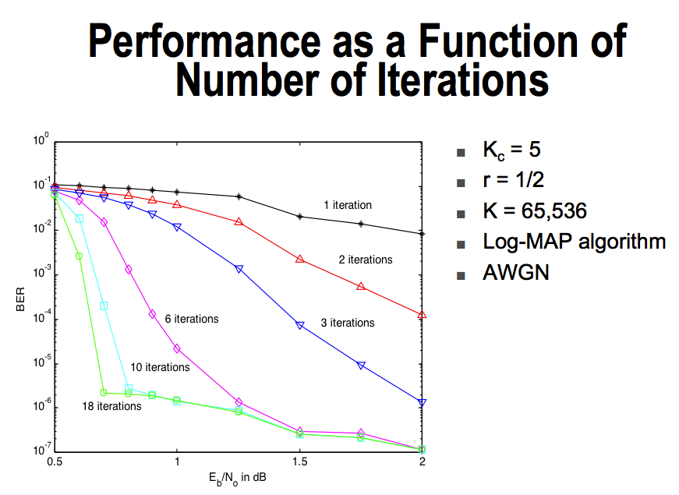
Iterations and Error Floor

Slide 20
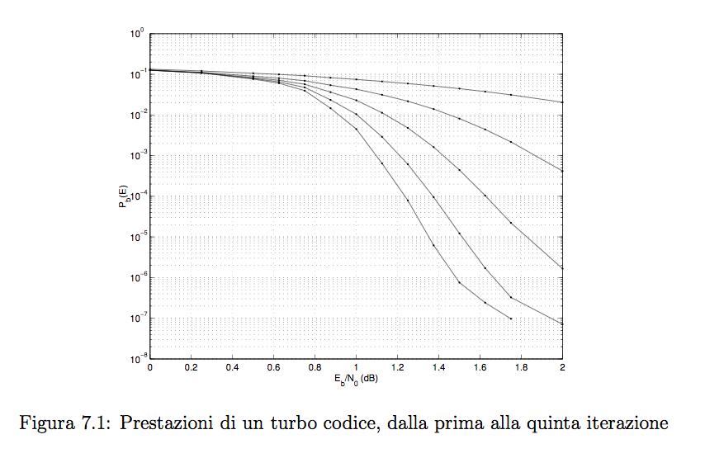
Iterations

Slide 21
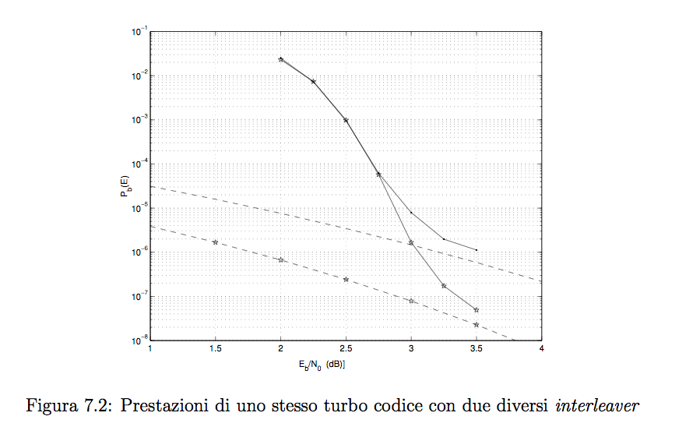
The effect of the Interleaver

Slide 22
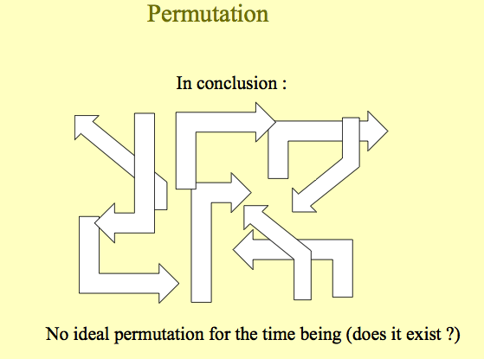
The effect of the Interleaver

Slide 23
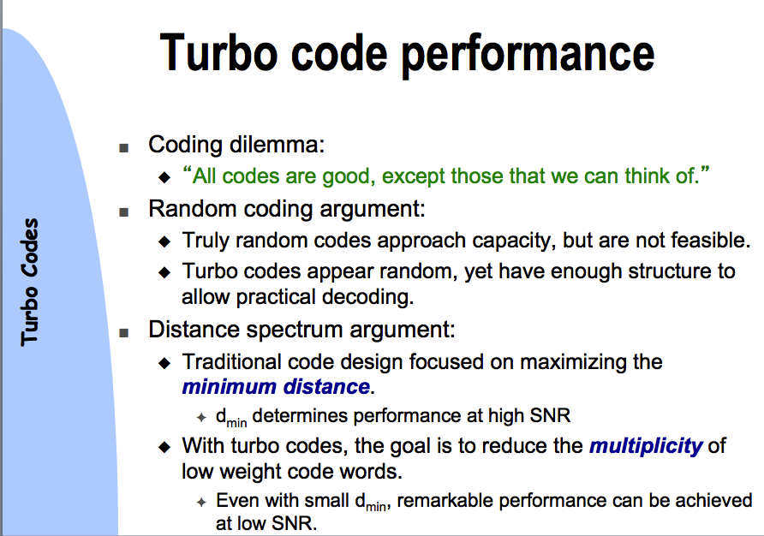

Slide 24
Power Efficiency of Standard Binary Channel Codes
1.0
BPSK Capacity Bound
Uncoded
BPSK
Iridium
1998
Shannon Capacity Bound
Spectral Efficiency
Pioneer
1968-72
Code Rate r
Turbo Code
1993
0.5
LDPC Code
2001 Chung, Forney,
Richardson, Urbanke
IS-95 1991
Odenwalder
Convolutional
Codes 1976
Voyager
1977
Galileo:LGA
1996
Galileo:BVD
1992
Mariner
1969
arbitrarily low
BER:
-2
-1
0
1
2
3
4
5
6
7
8
9
10
Eb/No in dB

Slide 25
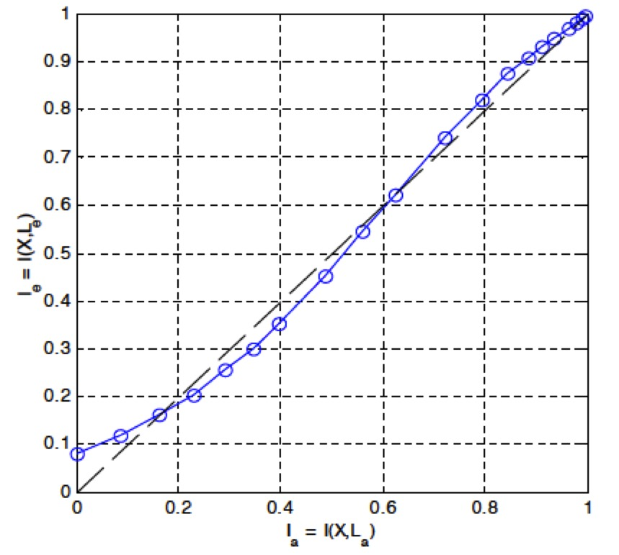
EXtrinsic Information Transfer (EXIT) Chart
Ia = Mutual Information at the INPUT of the SISO decoder
Ie = Mutual Information at the OUTPUT of the SISO decoder
(X is the original information)

Slide 26
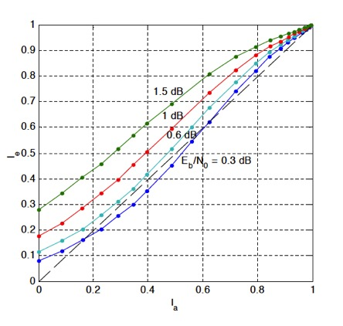
EXIT (2): SNR

Slide 27
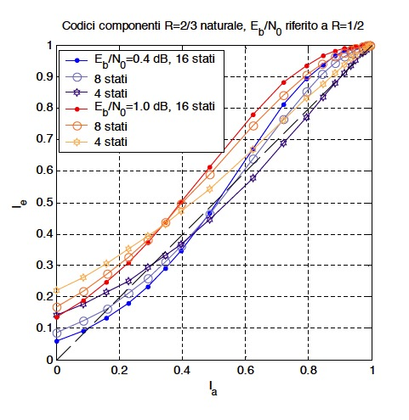
EXIT (3): Memory (Number of States)

Slide 28
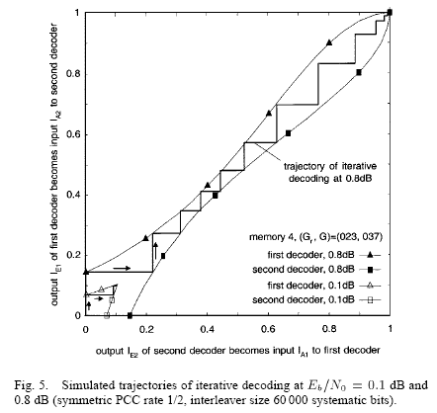
EXIT Chart Analysis of Turbo Codes
PCCC (turbo) codes can be analyzed with an EXIT chart by plotting the mutual information transfer characteristics of the two decoders.
Figure is from: S. ten Brink, “Convergence Behavior of Iteratively Decoded Parallel Concatenated Codes,” IEEE Trans. Commun., Oct. 2001.

Slide 29
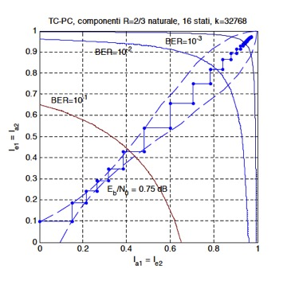

Slide 30
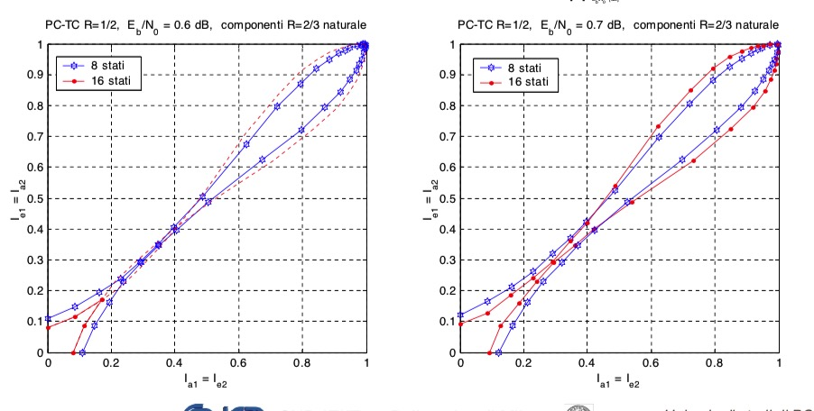
EXIT: Tunnel

Slide 31
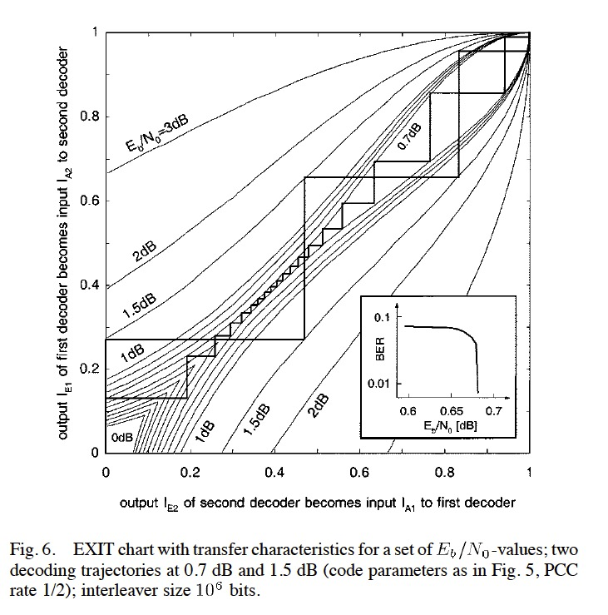
EXIT: Tunnel

Slide 32
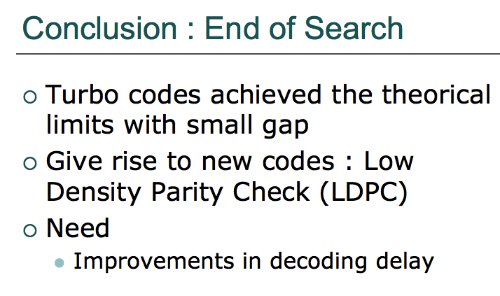

Slide 33
Conclusions
It is now possible to closely approach the Shannon limit by using Turbo and LDPC codes.
Binary capacity approaching codes can be combined with higher order modulation.
These code are making their way into standards
Binary turbo: UMTS, cdma2000
Duo-binary turbo: DVB-RCS, 802.16
LDPC: DVB-S2 standard.
Software for simulating turbo and LDPC codes can be found at: www.iterativesolutions.com

Slide 34


