Slide 1
Boston Breathes
Angelina Sun

Slide 2
Data Source
Population data: U.S. Census & ACS — resident population and student housing characteristics
Universities: IPEDS & official academic calendars — enrollment, housing, and semester/break dates
Urban activity: Bluebikes, MBTA & street counts — observed transportation activity
Environmental: NOAA — weather variables affecting transportation patterns

Slide 3
Features
Many of them are labelled by week, and compared to the school calendar
Residents baseline from resident data records
Student housing to distinguish local and students might leave
Transportation activity and weatehr together to estimate the student presence

Slide 4
Pre-process
Line up based on weeks
Remove the invalid data
Mark the zone of uni and line up with the activity data
Check the age range on Bluebike to identify potential students
Mark COVID-19
Distinguish online students and in person

Slide 5
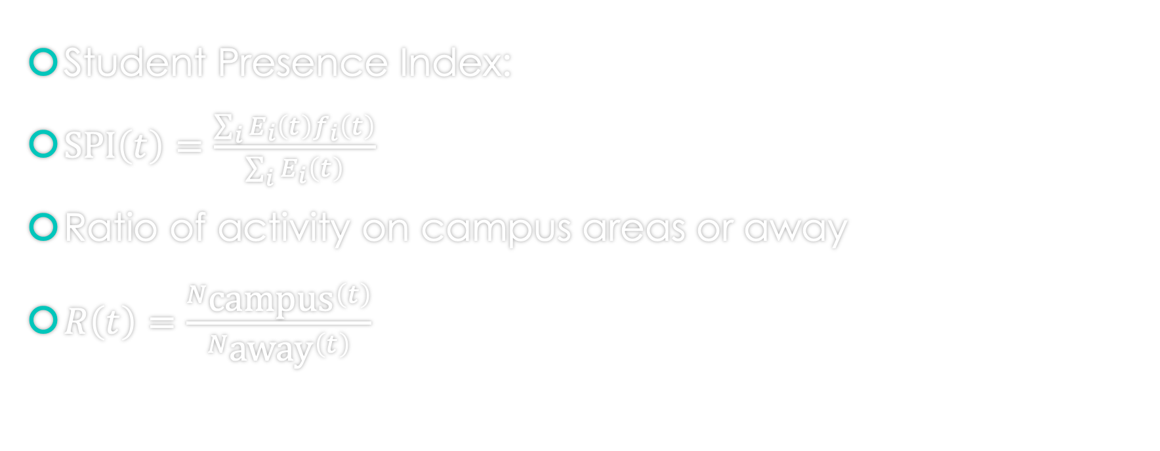
The equations
Student Presence Index:
$\text{SPI}\left(t\right)=\frac{\sum_{i}{E_{i}\left(t\right)f_{i}\left(t\right)}}{\sum_{i}{E_{i}\left(t\right)}}$
Ratio of activity on campus areas or away
$R\left(t\right)=\frac{N_{\text{campus}}\left(t\right)}{N_{\text{away}}\left(t\right)}$

Slide 6
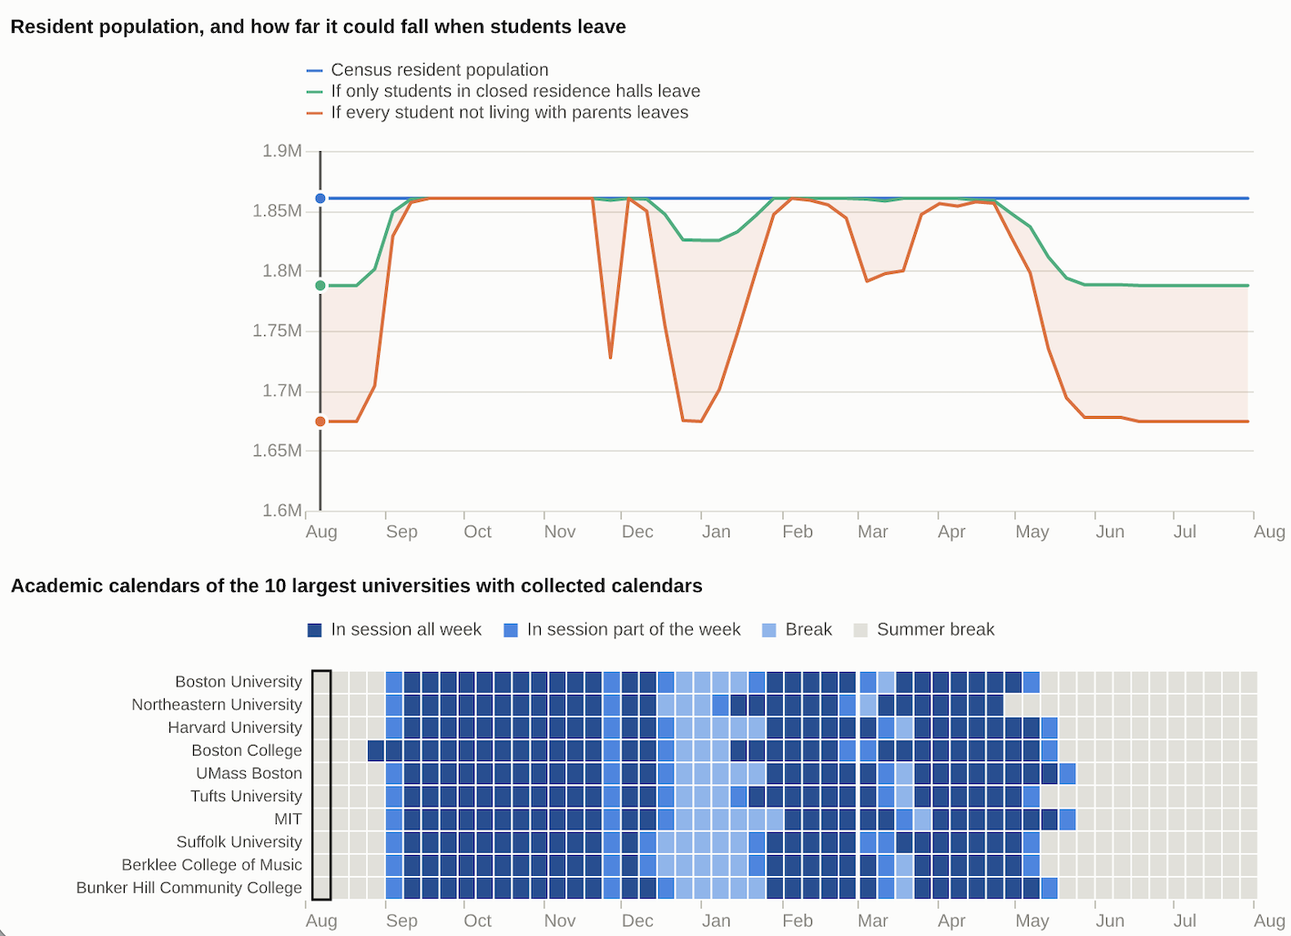

Slide 7
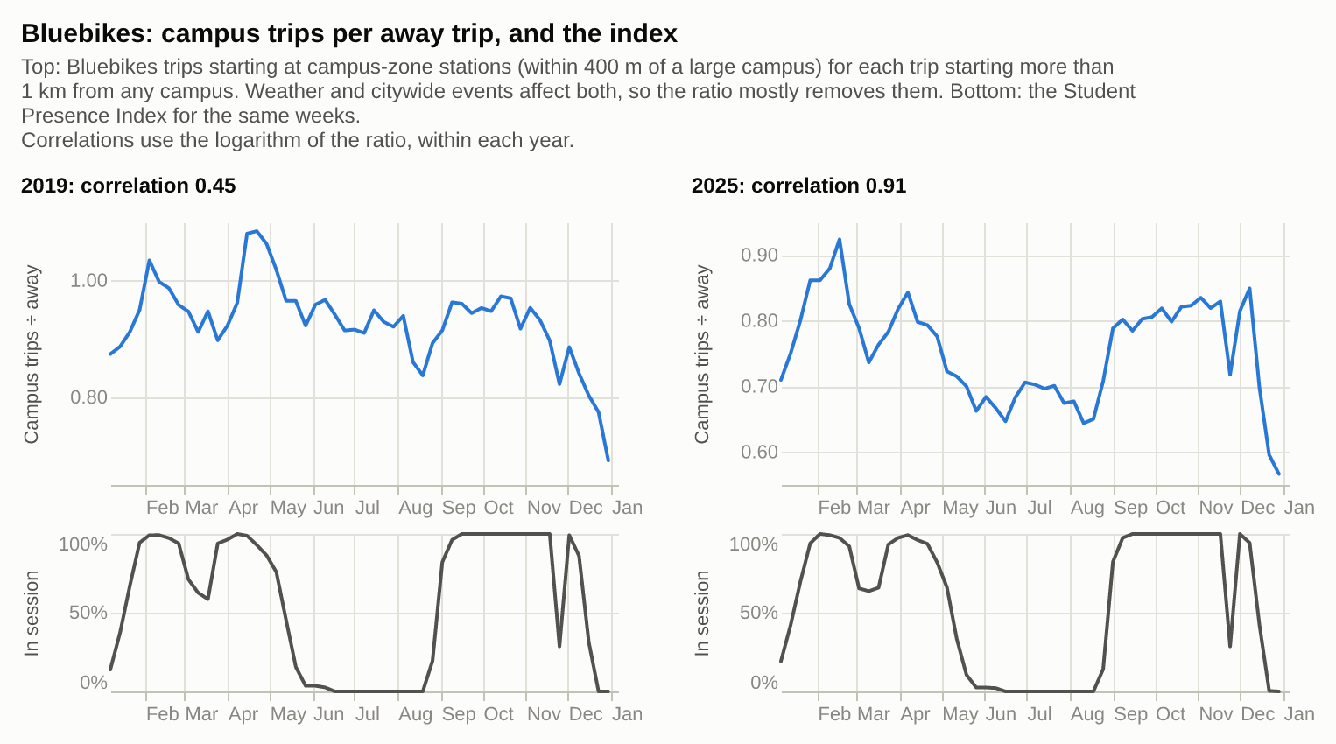

Slide 8
