Slide 1
Voice Powered Analytics
AWS Loft, NYC
Adam Westrich, Solutions Architect, @WestrichAdam
Chad Neal, Manager, Solutions Architecture, @chadneal
Tuesday, February 6, 2018

Slide 2
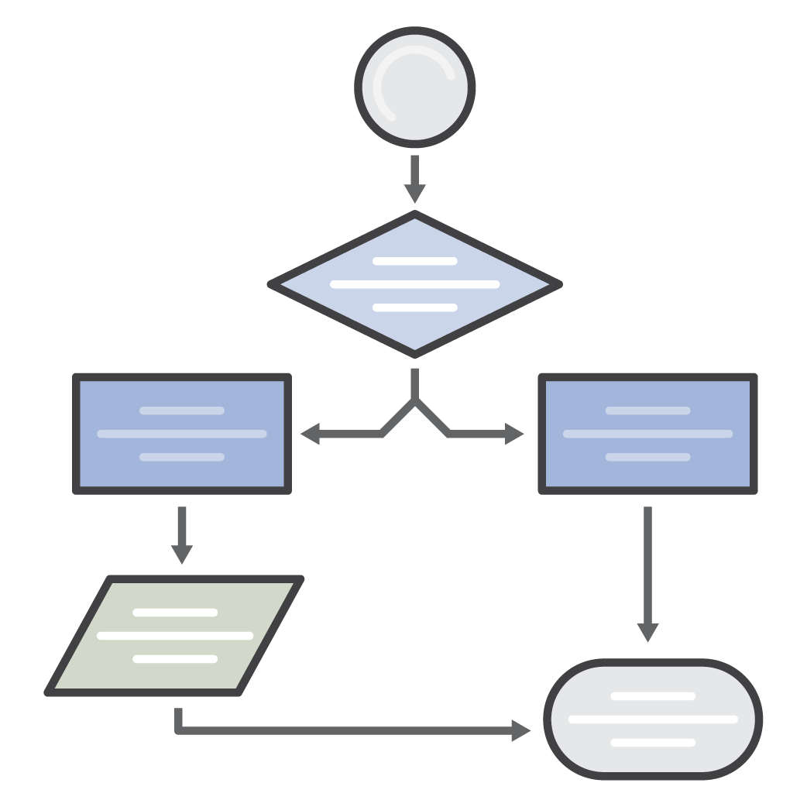









Logistics
We talk (We’ll try and keep it short)
Review workshop architecture
Check access to required products
Quick talk about Athena and Alexa
You build
Explore dataset
Build Lambda, DynamoDB, and Athena resources
Create Alexa skill

Slide 3
How many unique
monthly users have we had?
How many 1 star
ratings have we received?
How many tweets have we
posted in the last month?
What page are visitors
viewing the most?
What is my monthly
revenue?
What country has
bought the most
products in the last month?
Metrics
How many ‘likes’ or ‘retweets’
have we received in the
last month?
What demographic is most
appealing
to our products?
What time of the
day do we get the
most views?
Which reseller has sold the
most products in the
last month?
How many orders
have breached our
delivery SLA?

Slide 4


Why Do We Need To Change The Delivery Model?
?
?
?
?
?
?
?
?
?
?
?
?
?
?
?
?
Data is scattered
ETL takes careful design and lead time
Data Warehouses can be expensive
What if you can make delivering metrics fun and easy

Slide 5




The Architecture
CW Events
Lambda
Firehose
S3
Athena
Alexa
DynamoDB
Lambda
Twitter API
Lambda
CW Events

Slide 6
Today’s workshop
CW Events
Lambda
Firehose
S3
Athena
Alexa
DynamoDB
Lambda
Twitter API
Lambda
Created in advance
This workshop
CW Events

Slide 7
Pre-requisites
Want to learn, have fun, and build cool new services to bring back to your organization
Foundational AWS knowledge on core services
User Permissions:
AWS Account with admin access
Ability to create new IAM policies and roles
Full access to Athena – Clusterless Query Engine
Full access to Quicksight – Interactive BI Visualizations
Full access to S3 – Limitless and durable object store
Full access to Lambda – Event-triggered functions
Full access to DynamoDB – Managed NoSQL database
Full access to Alexa and Alexa for Business – Voice-powered skills

Slide 8
Athena
Amazon Athena is an interactive query service that makes it easy to analyze data directly from Amazon S3 using Standard SQL

Slide 9
Why Athena?
Decouple storage from compute
Serverless – No infrastructure or resources to manage
Pay only for data scanned
Schema on read – Same data, many views
Encrypted
Standard compliant and open storage formats
Built on powerful community supported OSS solutions

Slide 10
Simple Pricing
DDL operations – FREE
SQL operations – FREE
Query concurrency – FREE
Data scanned - $5 / TB
Standard S3 rates for storage, requests, and data transfer apply

Slide 11


Familiar Technologies Under the Covers
Used for DDL functionality
Complex data types
Multitude of formats
Supports data partitioning
Hive compatible SerDe (Serializer/Deserializer)
Used for SQL Queries
In-memory distributed query engine
ANSI-SQL compatible with extensions

Slide 12
Our Dataset
{
"id": 914642318044655600,
"text": "Two months until #reInvent! Check out the session calendar & prepare for reserved seating on Oct. 19! http://amzn.to/2fxlVg7 ",
"created": "2017-10-02 00:04:56",
"screen_name": " AWSReinvent ",
"screen_name_followers_count": 49864,
"place": "none",
"country": "none",
"retweet_count": 7,
"favorite_count": 21
}

Slide 13
How we get the data
CW Events
Lambda
Firehose
S3
Twitter API

Slide 14
How we query the data
CW Events
Lambda
Firehose
S3
Athena
DynamoDB
Lambda
Twitter API
CW Events

Slide 16




Creating an Alexa Skill
+
Voice User Interface
Programming Logic
developer.amazon.com
aws.amazon.com

Slide 17
Voice User Interface: Utterance, Intent, Slots
What’s my What are my
monthly tweet count for reinvent mentions in the last hour
WhatsMyMetric
Intent
utterance
slot value
“Your metric monthly tweet count for reinvent is 250”
Sample Response
mentions in the last hour monthly tweet count for reinvent
List my Metrics What are my Metrics
ListMetrics
Intent
utterance
slot value
“Your metrics are monthly tweet count for reinvent, mentions….”
Sample Response

Slide 18
How Alexa gets the data
CW Events
Lambda
Firehose
S3
Athena
Alexa
DynamoDB
Lambda
Twitter API
Lambda
CW Events

Slide 19
Bring Alexa to Work, with Alexa for Business
Provisioning of Devices
Setting up one Amazon Echo device is easy, but setting up many becomes challenging.
Central Management
In order to ensure devices are functioning as intended, it’s critical to have central visibility and control.
Privacy &
Security
Sensitive information is commonplace and it’s important that employee and company privacy be protected.
Notes:
-setup for 1 echo is easy, 20? 100?
-what if i don’t want certain skills on my conference room Echo’s?
-what if i don’t want my company’s skills out on the public skill store? will anyone know what “bean buyer” is? it will only work for starbucks backend corporate systems for ordering...

Slide 20
Alexa for Business
Enable Alexa as a business capability
Manage shared devices in conference rooms and common spaces
Enroll users to access private Alexa for Business skills from their own devices
Deploy private Alexa for Business skills to devices in your organization

Slide 21
Manage Shared Devices: Assign devices and skills to rooms

Slide 22
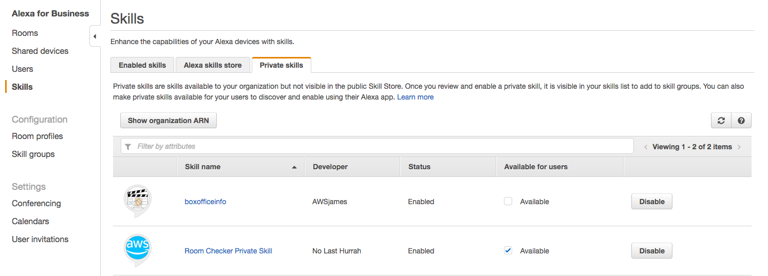
Enabling Private Skills

Slide 24

Questions before we get started?

