Slide 1
Agent Development (Decision Making, Behavior and Control)

Slide 2
Player Structures (Implementations)

Slide 3
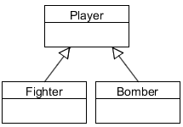
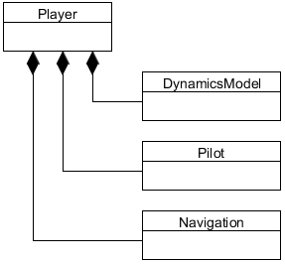
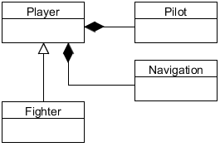
Player Structures
Player functionality can be implemented several ways
Composite: components attached to a generic Player class
Subclass: a new derived Player implements functionality
Mixture: partial implementation of functionality in subclass
Subclass
Combination: Subclass and Composite
Composite

Slide 4
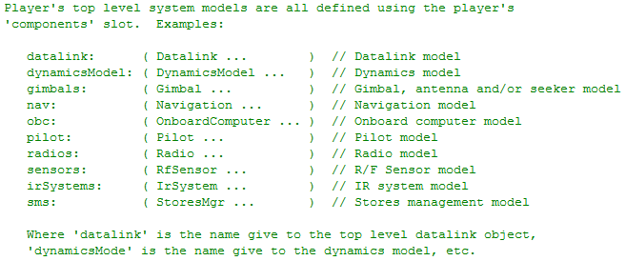
Composite Structure
General purpose interface to those sub-systems
“Aero model” for aircraft
from Player.hpp

Slide 5
Aero Model: Generalized 6-DOF
Pilot
Engine(s)
Coefficients
Lift
Aircraft
State
Autopilot
Flight
Control
System
Control
Surfaces
Drag
Forces
And
Moments
EOM
F = m*a
Side
Roll
Pitch
Features and capabilities of FCS and Autopilot vary. Because of that, different “layers” of control exist.
Yaw
Wt & CG
Ground
Reactions

Slide 6
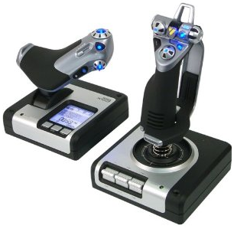
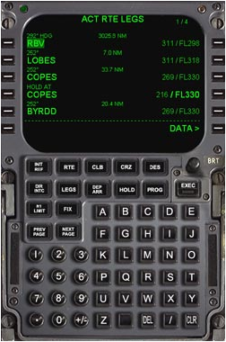
FCS / Autopilot / FMS Relationships (Wikipedia Definitions)
Flight Control System (FCS)
The direct (mechanical or fly by wire) connection between pilot stick and throttle inputs to aerodynamic surfaces
Autopilot
System used to guide or control a vehicle without assistance from a human being
Often an integral component of a Flight Management System
Flight Management System (FMS)
FMS controlled through a CDU
Guide aircraft along with flight plan, includes navigation database, waypoints, routes, etc
Saitek X52 Flight Control System
Functionality of each system component is not always this clear cut.
Example FMS Control Display Unit (CDU)

Slide 7

Layers of Functionality
Pilot
“Decision Making”
Flight Mgt System
“Behavior”
Autopilot
“Control”
Flight Control System

Slide 8
Layers of Functionality
Simple player dynamics
Position and simple movement
Stick & throttle control
FCS / Autopilot
Pilot Interface
AutoPilot

Slide 9
Simple Player Dynamics

Slide 10
Simple Player Dynamics
Every Player can do the following
Set position
North/East/Down (NED) (x, y, altitude)
Geodetic (lat, long, altitude)
Geocentric (ECEF) (x, y, z)
Set roll, pitch & heading
Initial velocity
Player has a built-in dynamics model for simple movement
Simple player dynamics model useful for testing

Slide 11
Stick & Throttle Control (assumes DynamicsModel or Subclassing)

Slide 12
Composite Structure
General purpose interface to those sub-systems
Required
from Player.hpp

Slide 13
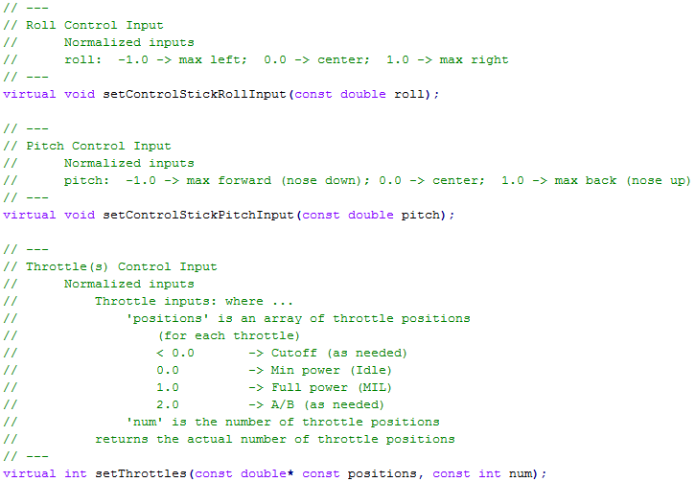
Player FCS Interface
from Player.hpp

Slide 14
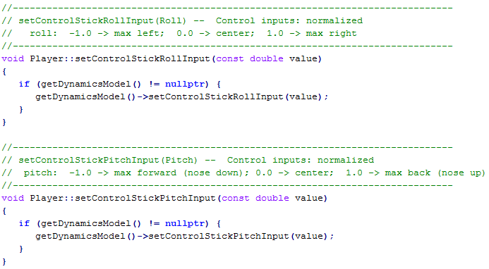
Player FCS Interface
Default: requires a DynamicsModel to do anything meaningful
Functionality can be implemented in subclass
from Player.cpp

Slide 15
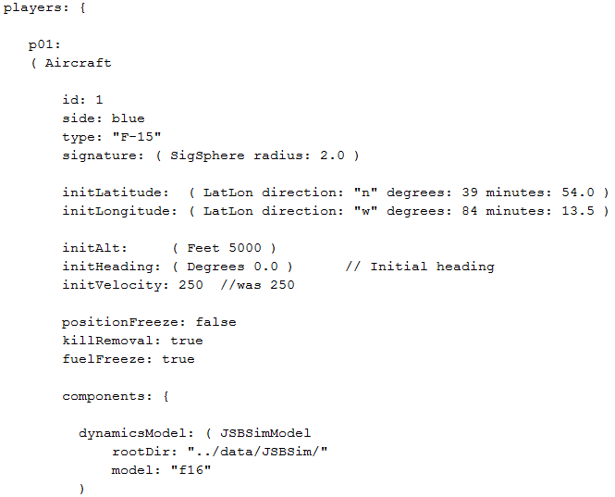
Input File Example

Slide 16
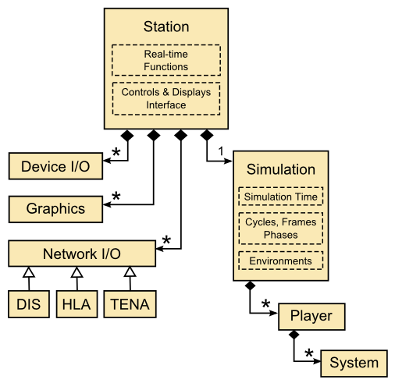

Human Input to Player
Stick & Throttle Inputs Arrive Here

Slide 17

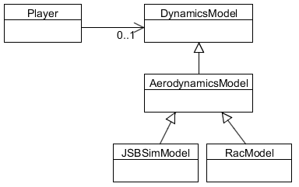
Player w/DynamicsModel
Player may or may not have an attached dynamics model
If attached, then stick and throttle inputs are forwarded to the dynamics model
Aero-model

Slide 18
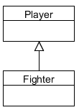
Subclassed Player
Stick and throttle functionality implemented in subclass

Slide 19
Flight Control System (FCS) / Autopilot
(Higher level commands/control)

Slide 20
Composite Structure
General purpose interface to those sub-systems
Must contain an auto pilot
from Player.hpp

Slide 21
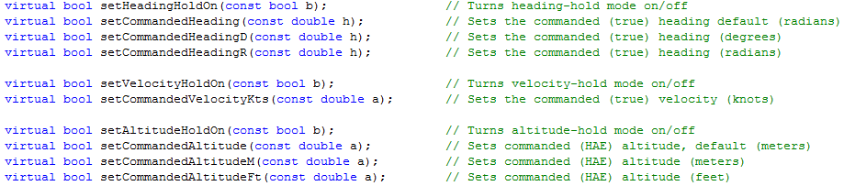
Player FCS / Autopilot Interface
Player interface to FCS / Autopilot is driven by “commands”
from Player.hpp

Slide 22
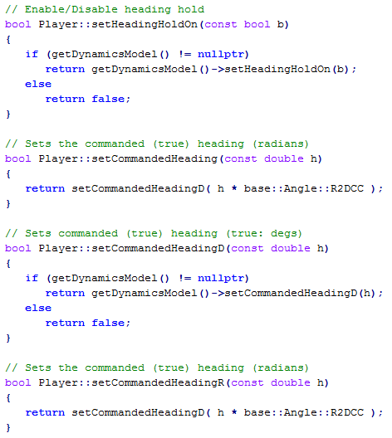
Player FCS / Autopilot Interface
from Player.cpp

Slide 23
Player FCS / Autopilot Interface
Player may or may not have an attached dynamics model
If attached, then stick and throttle inputs are forwarded to the dynamics model – some dynamics models do not include an autopilot!
If overridden in subclass, subclass will receive inputs
May or may not include autopilot
Includes an autopilot

Slide 24
Pilot Interface (Not associated with a DynamicsModel)

Slide 25
Composite Structure
General purpose interface to those sub-systems
from Player.hpp

Slide 26
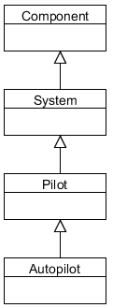
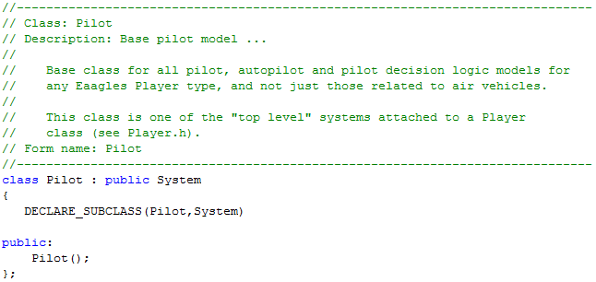
Pilot
NOT part of DynamicsModel!
General interface class to implement pilot decision logic
Base pilot class does nothing interesting, AutoPilot class adds functionality

Slide 27
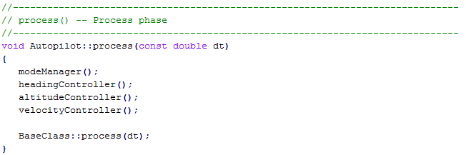
AutoPilot
AutoPilot complements the functionality of the FCS/Autopilot by providing higher level features (e.g., Flight Management System level capabilities)
Called in each frame (process phase)
As currently defined, it doesn’t make “decisions”
Behavior
Control

Slide 28
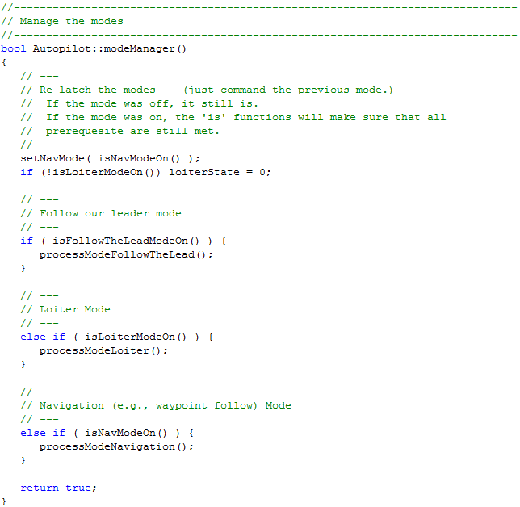
AutoPilot
Behavior (e.g., follow routes,
loiter, follow another player)

Slide 29
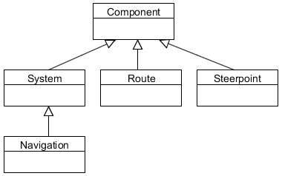
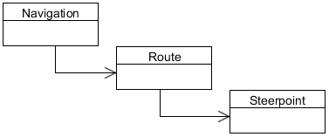
Navigation
AutoPilot uses Navigation
Navigation contains routes, which contain steerpoints
Steerpoints can contain Actions!

Slide 30
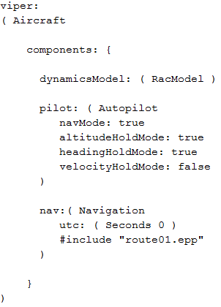
Example Input File
RacModel has a auto pilot within its dynamic model
Auto pilot that follows the defined route within navigation system
Attached navigation system that includes a defined route

Slide 31
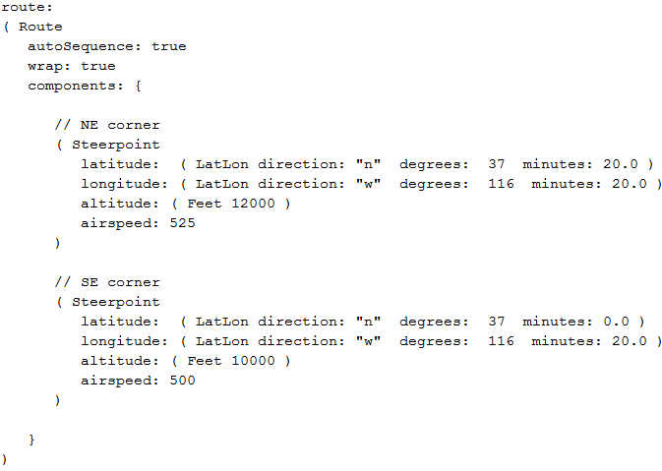
Example Input File
Steerpoints define position and desired airspeed, etc

Slide 32
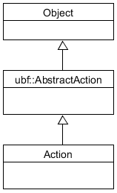
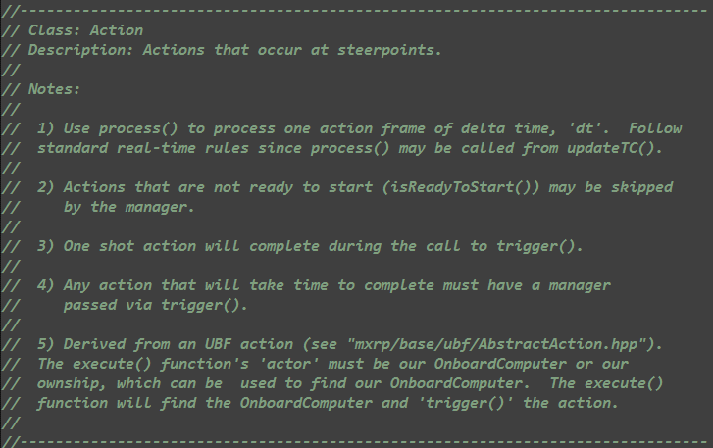
Steerpoint Actions
Steerpoint can have an associated Action
Examples: Take SAR image, release weapon, release decoy, etc

Slide 33
Flow of Decisions and Actions
AutoPilot determines “high level” things to do, and how to do it via commands to “FCS / Autopilot” or even through direct control in some cases
Onboard computer could also be used to perform related functions

Slide 34
Pilot Structures (Implementations)

Slide 35
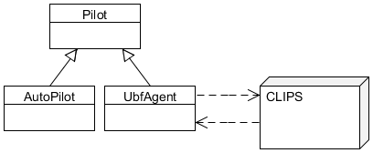

Pilot Structures
Pilot functionality can be implemented several ways
Direct subclassing (e.g., AutoPilot, UBF Agent, etc)
Indirect interface to external software system (e.g., Soar, CLIPS, scripts, etc)
Control
Behavior
Decision Making

Slide 36
EOF

