Slide 1

Netflix Data Visualization Dashboard
Python · Pandas · Plotly · Streamlit
Presented by Asala Nithish · MSc Data Science

Slide 2
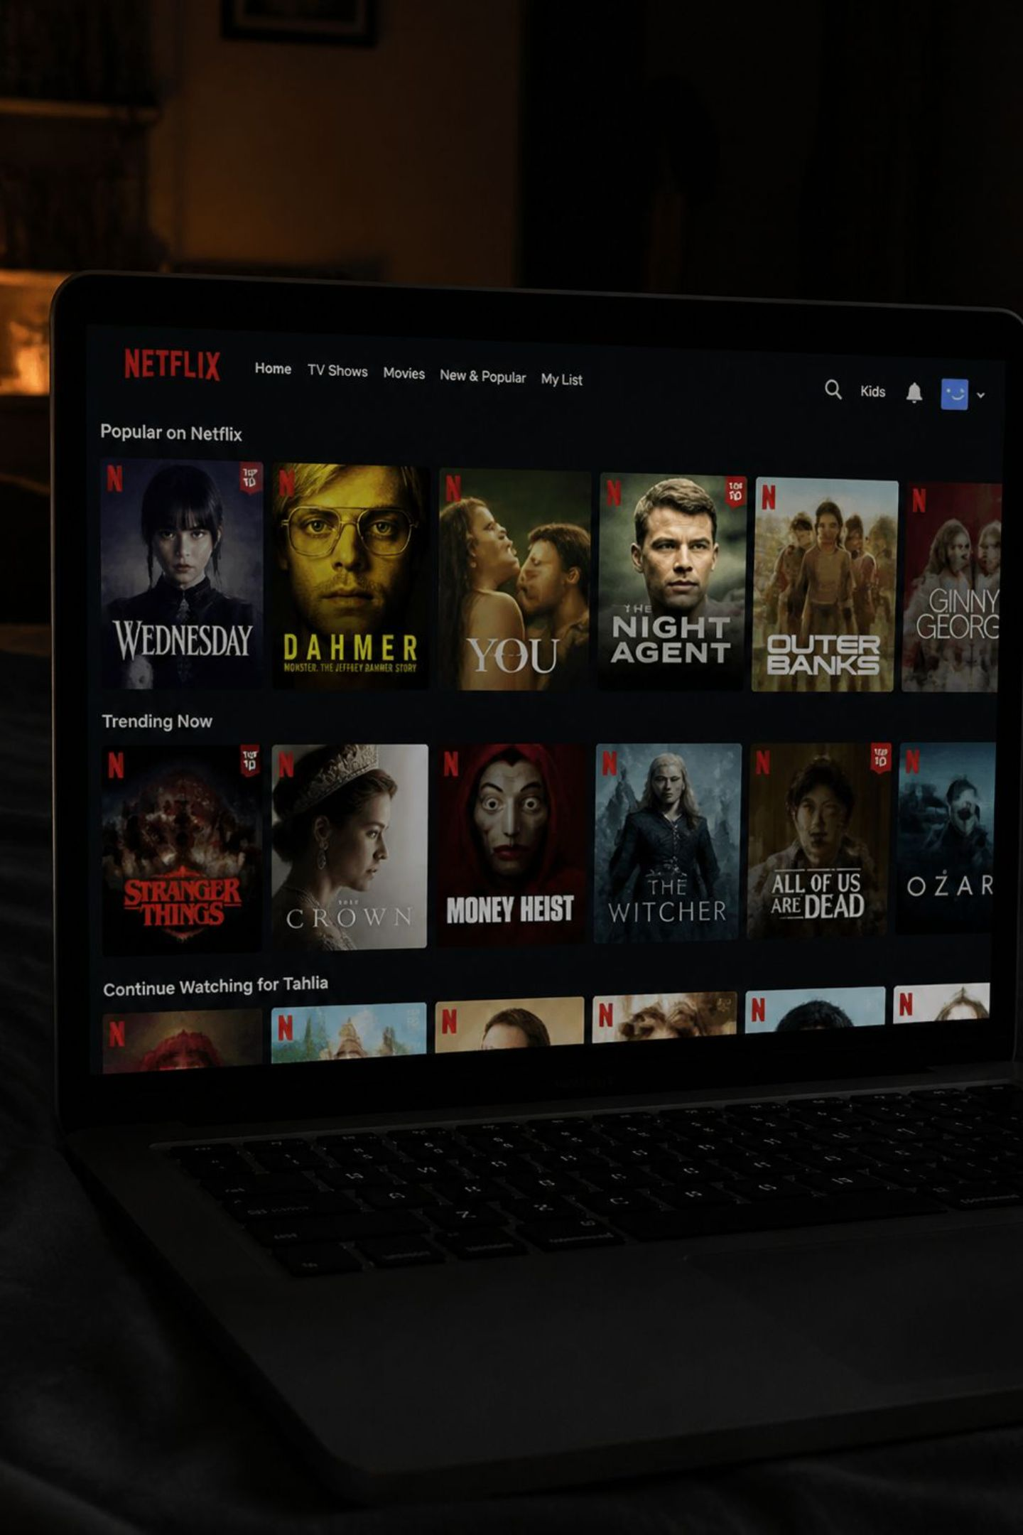
Project Overview
Netflix is the world's leading streaming platform with thousands of titles across 190+ countries. This project transforms raw Netflix content data into an interactive, insight-driven dashboard — making it easier to explore trends, patterns, and content strategy at a glance.
The Platform
The Data
200M+ subscribers, vast global content library spanning movies and TV shows
~8,800 records covering titles, directors, countries, ratings, and release years
The Goal
Turn raw data into meaningful, interactive visual insights using Python

Slide 3


Problem Statement
The Challenge
Netflix's catalog contains thousands of titles with rich metadata — but raw data alone tells no story. Without visualization, critical trends in content strategy, regional distribution, and audience targeting remain hidden.
The Solution
Interactive dashboards surface patterns instantly — enabling faster, data-driven decisions about what content exists, where it comes from, and how it has evolved over time.
Key question: What does Netflix's content landscape actually look like?

Slide 4
Project Objectives
A structured workflow from raw data to a fully interactive dashboard.
01
02
03
Analyze Netflix Content
Clean & Preprocess
Exploratory Data Analysis
Explore the structure and composition of the catalog
Handle missing values, duplicates, and format inconsistencies
Uncover patterns in genre, geography, ratings, and duration
04
05
Interactive Visualizations
Streamlit Dashboard
Build dynamic charts using Plotly for deeper exploration
Deploy a user-friendly, filterable web application

Slide 5
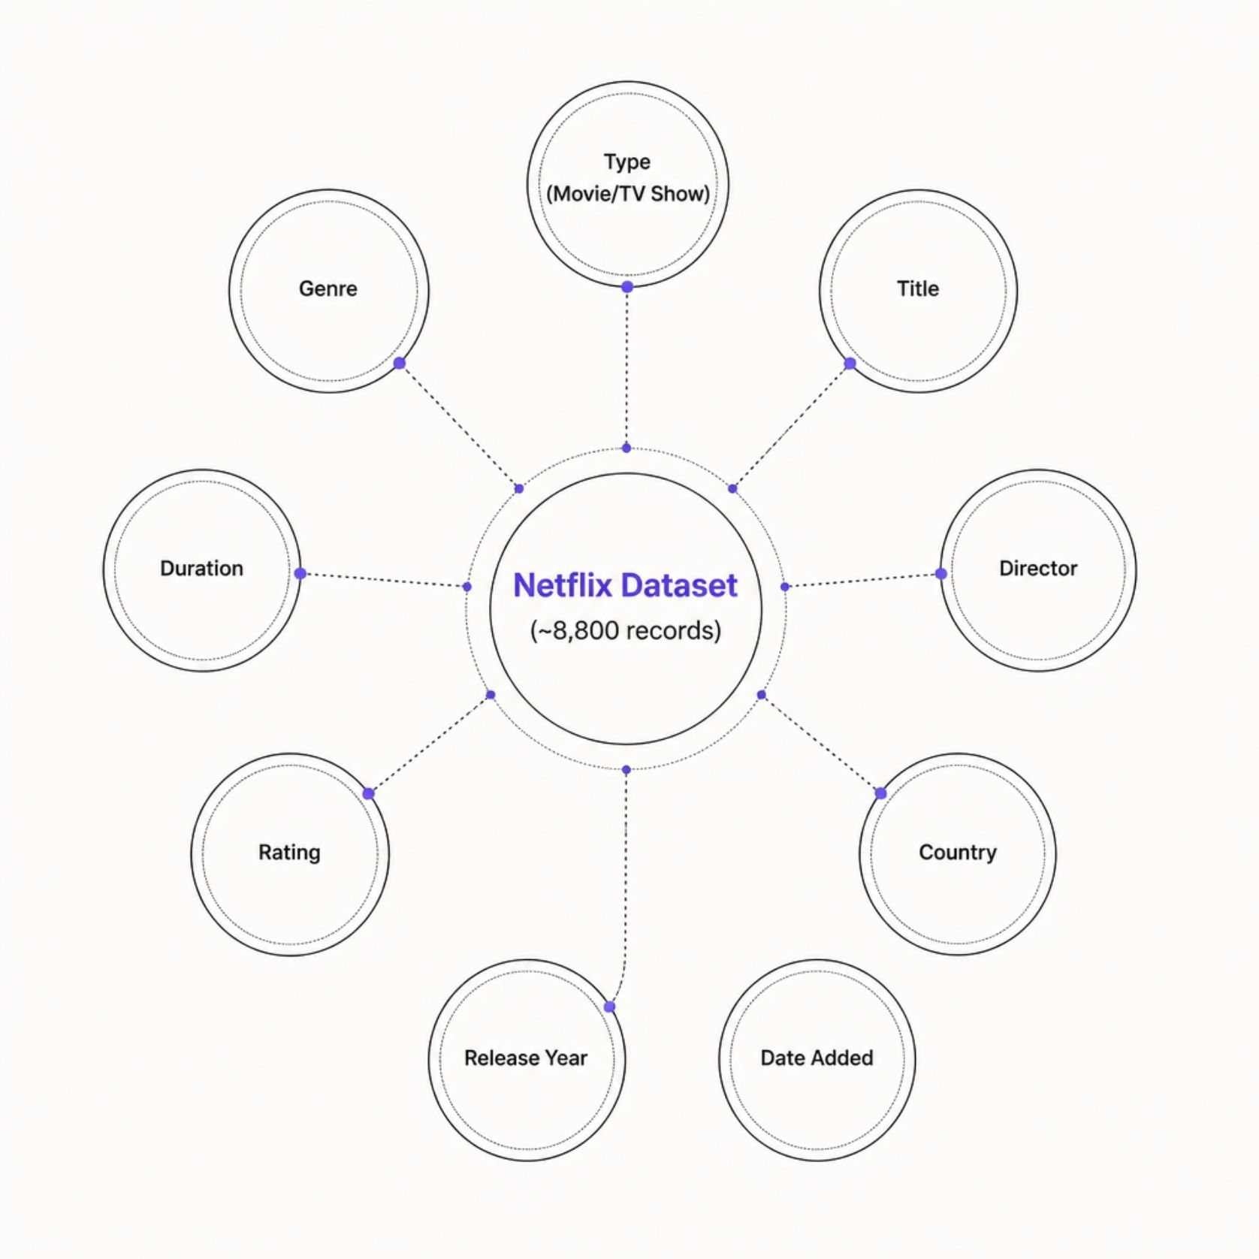
Dataset Description
Source & Scale
Dataset: Netflix Movies & TV Shows
Source: Kaggle
Records: ~8,800 titles
Key Features
Type — Movie or TV Show
Title, Director, Country
Date Added, Release Year
Rating, Duration, Genre

Slide 6
Technologies Used
Python
Pandas
Plotly
Core programming language for data manipulation, analysis, and visualization
Data cleaning, transformation, and structured data exploration
Interactive, publication-ready charts with zoom, hover, and filter
Streamlit
Jupyter Notebook
Rapid deployment of interactive data apps directly from Python scripts
Iterative exploration, prototyping, and documentation of the analysis workflow

Slide 7

Data Cleaning & Feature Engineering
Data Cleaning
Removed duplicate records
Handled missing values in Director, Country, and Cast fields
Standardized date formats for consistency
Trimmed whitespace and normalized text fields
Raw Data
Cleaning
Feature Engineering
Year Added — extracted from Date Added
Month Added — for seasonal trend analysis
Content Age — years since original release
Feature Engineering

Slide 8
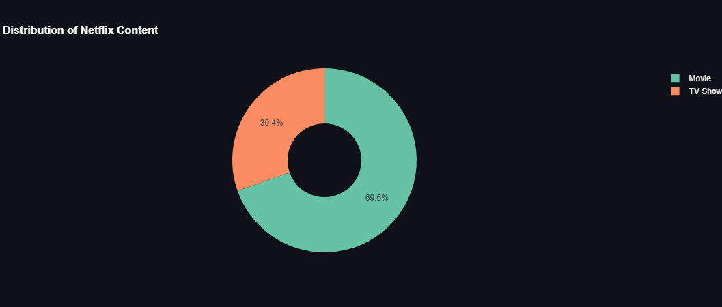
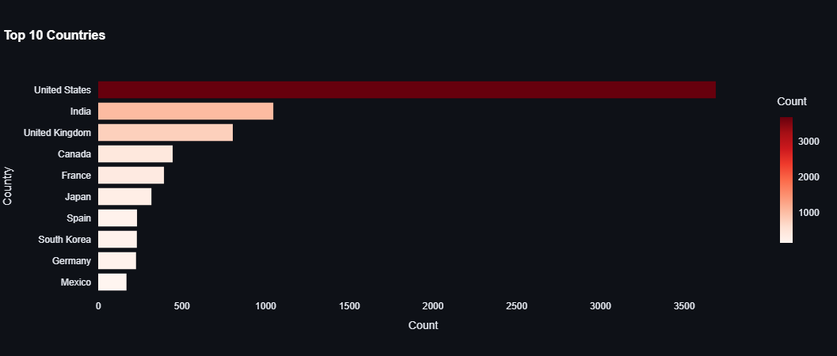
Exploratory Data Analysis
Key visualizations revealing Netflix's content landscape.
Movies vs. TV Shows
Top 10 Countries
Movies dominate ~69% of the catalog
United States leads by a wide margin

Slide 9
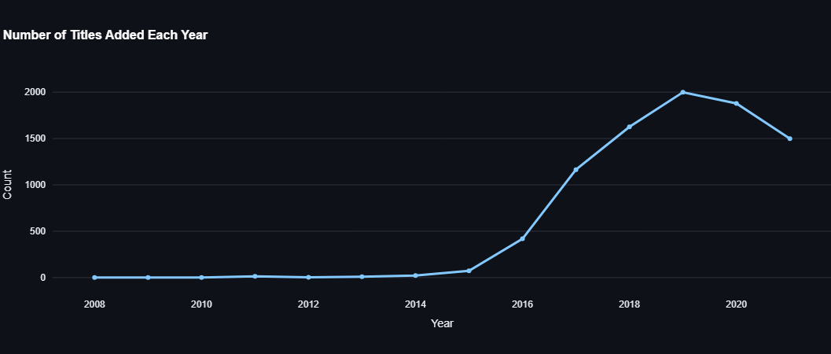
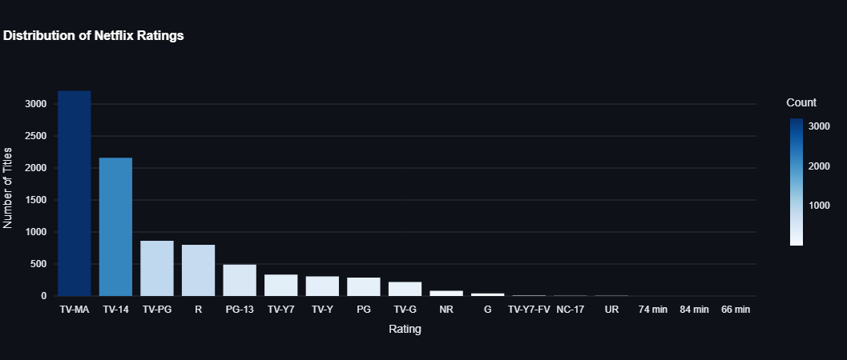
Content Added Over Time
Ratings Distribution
TV-MA is the most common rating
Rapid expansion after 2015

Slide 10
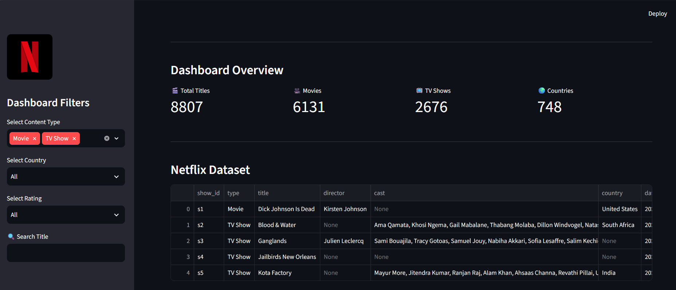
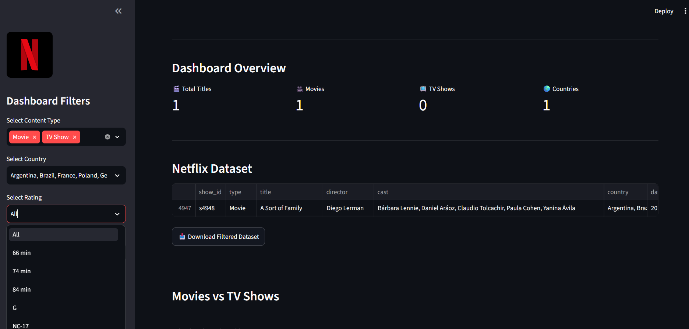
Streamlit Dashboard
A fully interactive web app enabling real-time exploration of Netflix's content library — no coding required from the end user.
KPI Cards
Sidebar Filters
Total titles, movies, TV shows, and unique countries at a glance
Filter by type, country, rating, and year dynamically

Slide 11
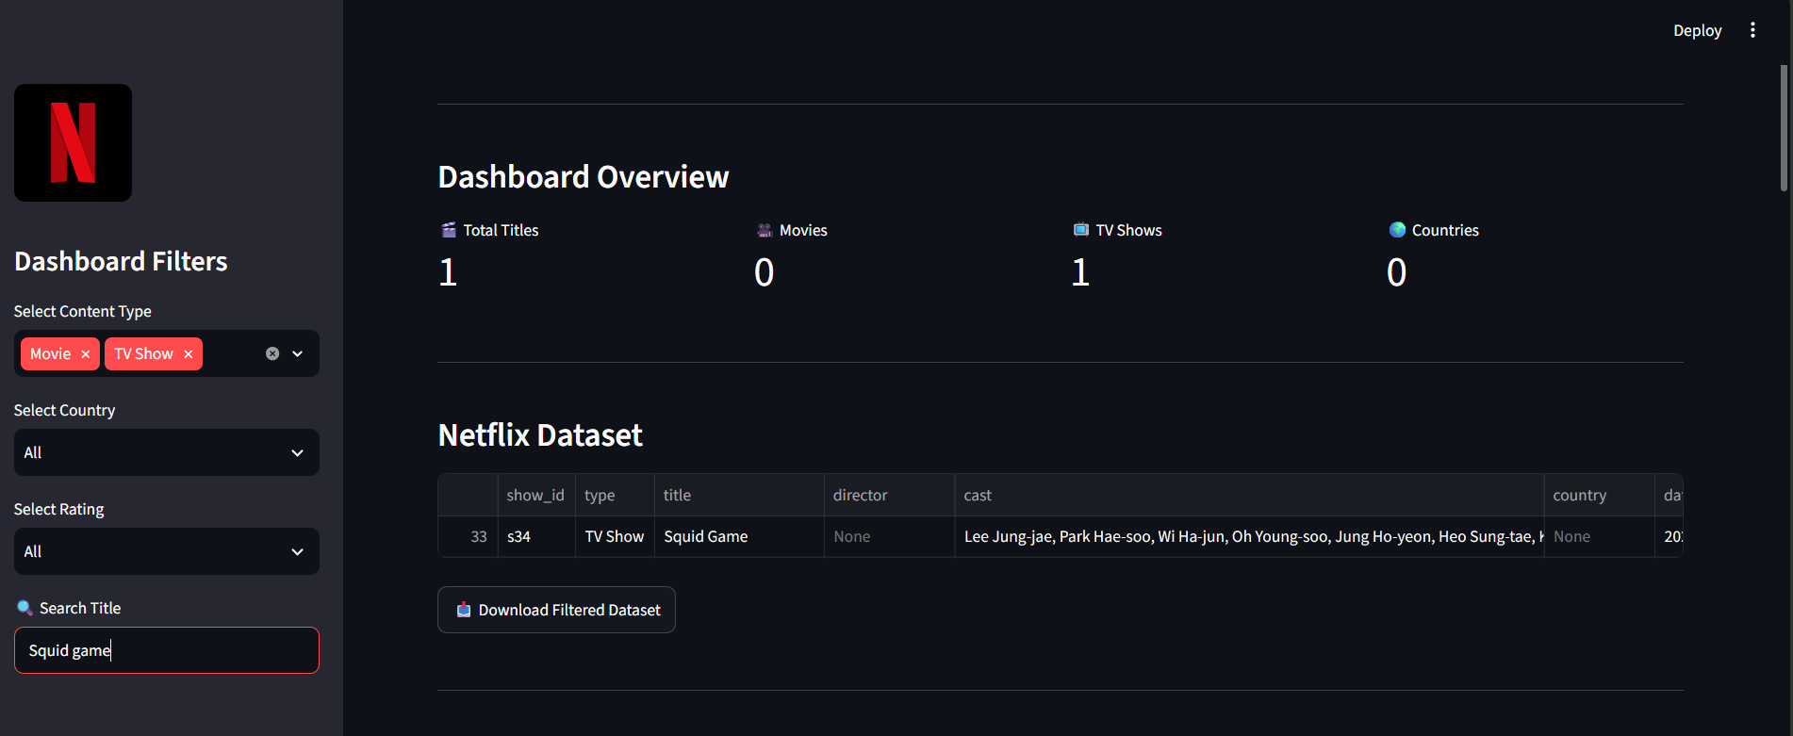



Search by Title
Download Data
Instant lookup of any movie or show in the dataset
Export filtered results as CSV for further analysis

Slide 12
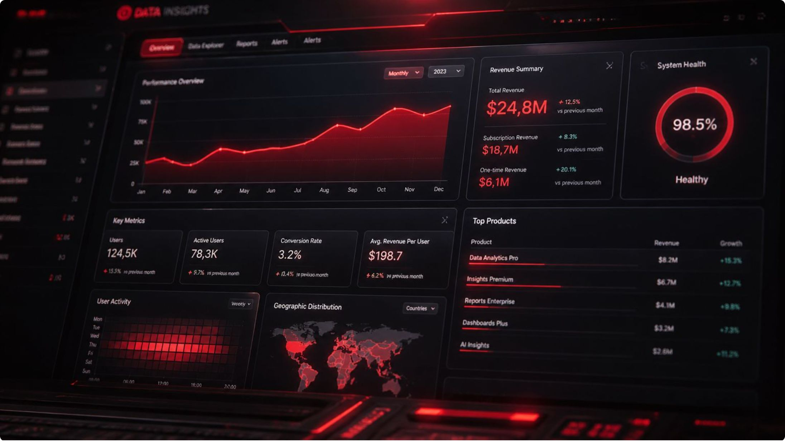
Key Insights
🎬 Movies Dominate
~69% of Netflix's library is movies vs. 31% TV shows
🇺🇸 US Leads Content
United States contributes the largest share of titles globally
📈 Post-2015 Boom
Netflix's content library expanded dramatically after 2015
🔞 TV-MA is Top Rating
Mature audience content is the most prevalent rating category
⏱ 80–120 Min Films
Most movies fall within the standard feature-length runtime

