Slide 1
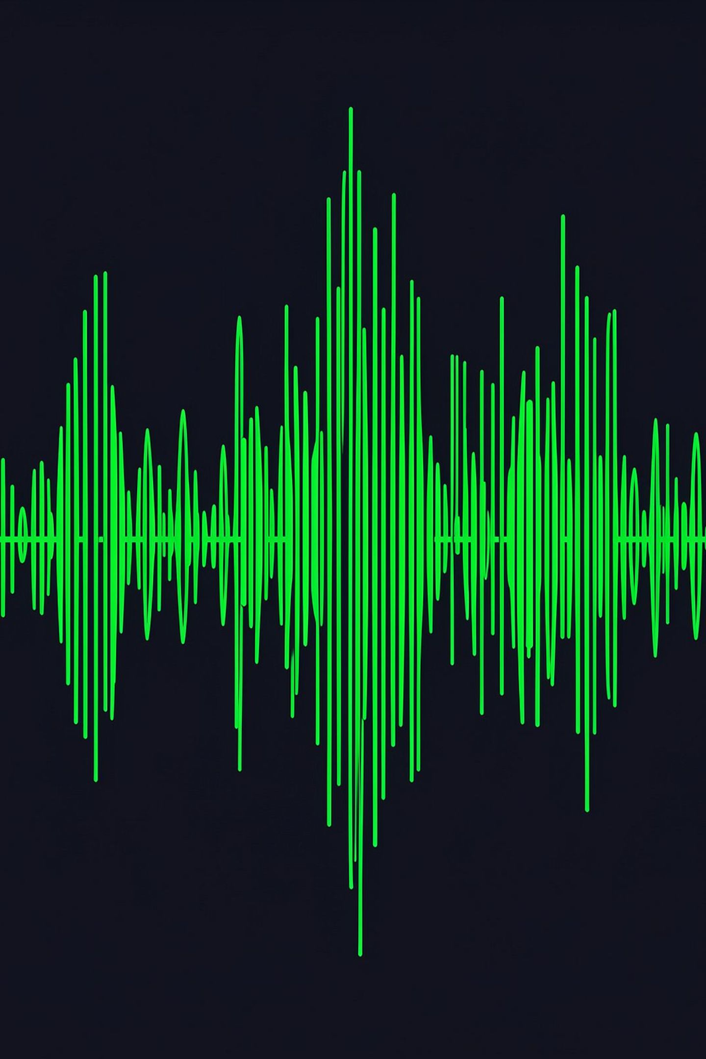
The Anatomy of a Hit Track
Uncovering Mainstream Popularity Drivers in Spotify Audio Features
Presented by
Nithish Asala
Matriculation: 86313451 (120B)
DATA VISUALIZATION FINAL PROJECT · SUMMER 2026

Slide 2
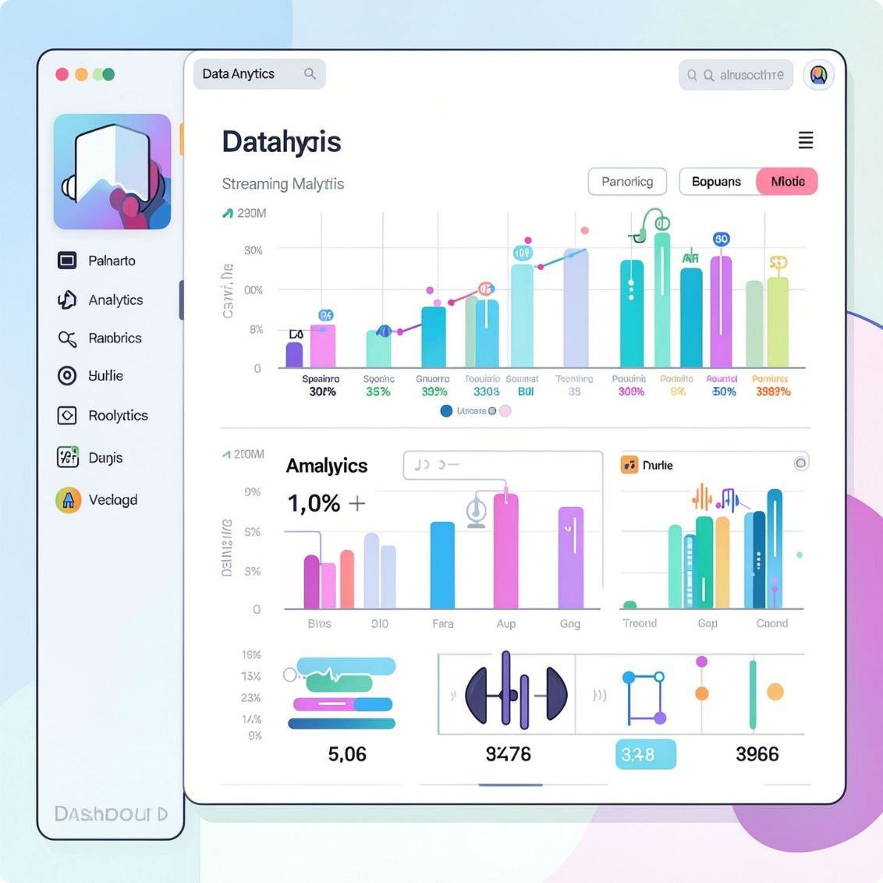
Interrogating 114,000+ Tracks Across Audio and Genre Dimensions
This project interrogates a real-world dataset of over 114,000 tracks, examining audio features — danceability, energy, loudness, valence, duration, and acousticness — to decode what separates chart-topping hits from niche tracks. Methodology centers on multi-dimensional exploratory data analysis built with Plotly and Streamlit.
Dataset
Core Goal
Methodology
114,000+ tracks with Spotify audio features
Decode audio characteristics that separate hits from niche tracks
Multi-dimensional EDA built with Plotly and Streamlit

Slide 3
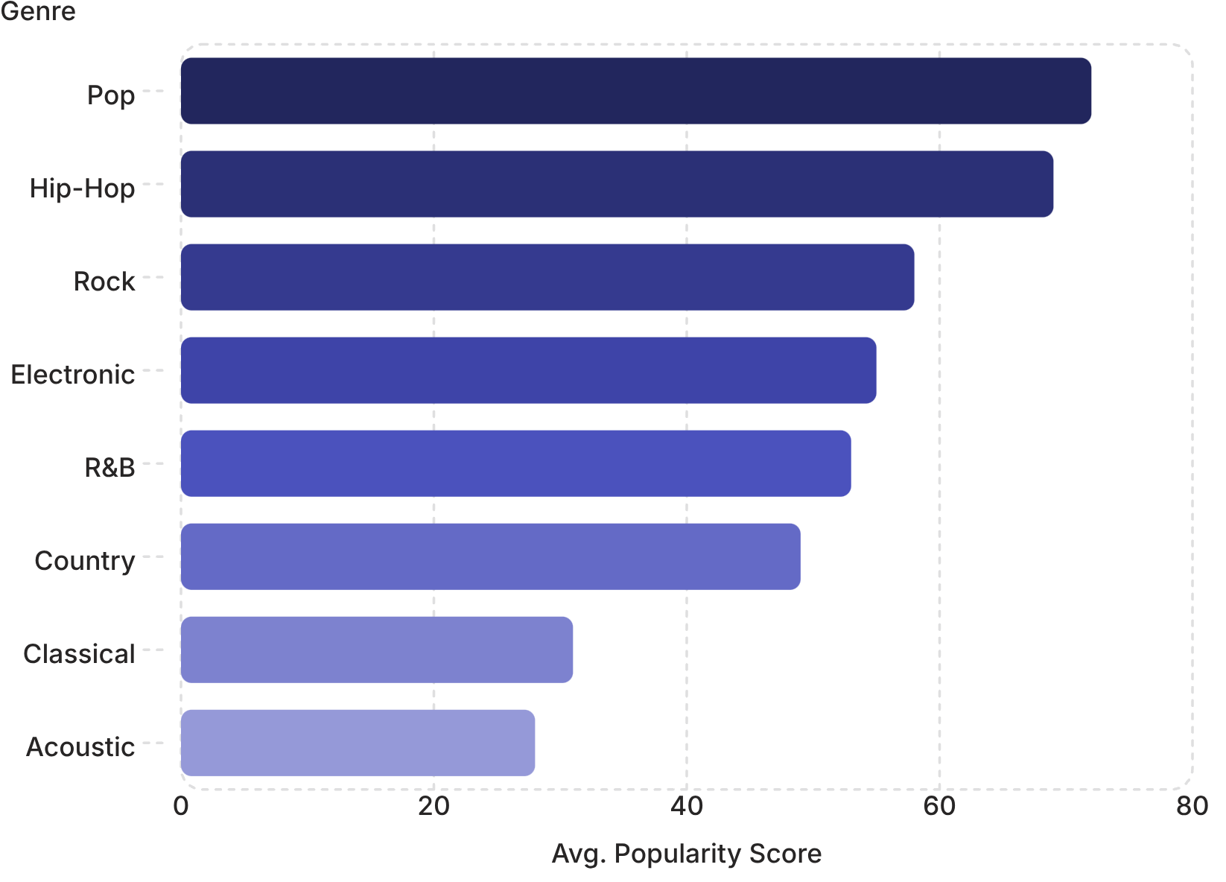
FINDING 1
Pop and Hip-Hop Lead Mainstream Listener Engagement
Pop and Hip-Hop consistently achieve the highest average popularity scores across streaming charts. Traditional genres like Classical and Acoustic serve niche audiences with significantly lower average popularity distributions. Genre context sets the baseline ceiling for mainstream reach — a structural reality that shapes every downstream production and marketing decision.

Slide 4
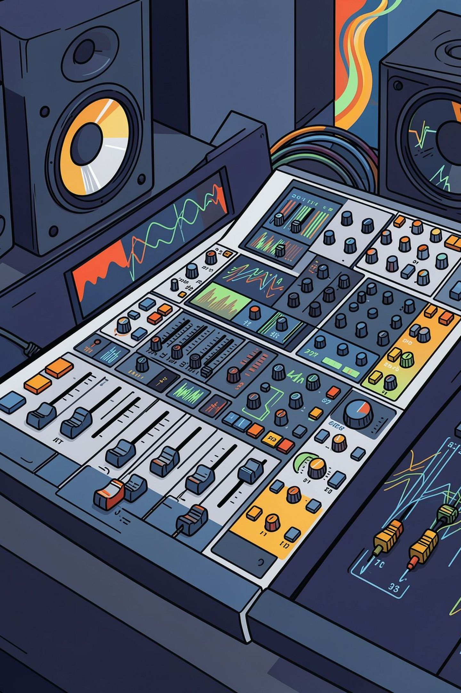

FINDING 2
Explicit Tracks Cluster at Peak Energy and Loudness Levels
High Loudness
Peak Energy
Tracks with elevated dB levels correlate strongly with top popularity tiers, signaling competitive mastering for playlist placement.
High-energy tracks dominate the upper popularity percentiles — intensity is a measurable mainstream signal.
Explicit Content
Explicit tracks cluster densely in high-energy, high-loudness zones, reinforcing a production profile tied to mainstream appeal.
Strategic Insight: Mainstream appeal rewards intense, high-impact production. Loudness and energy are not incidental — they are engineered for chart performance.

Slide 5
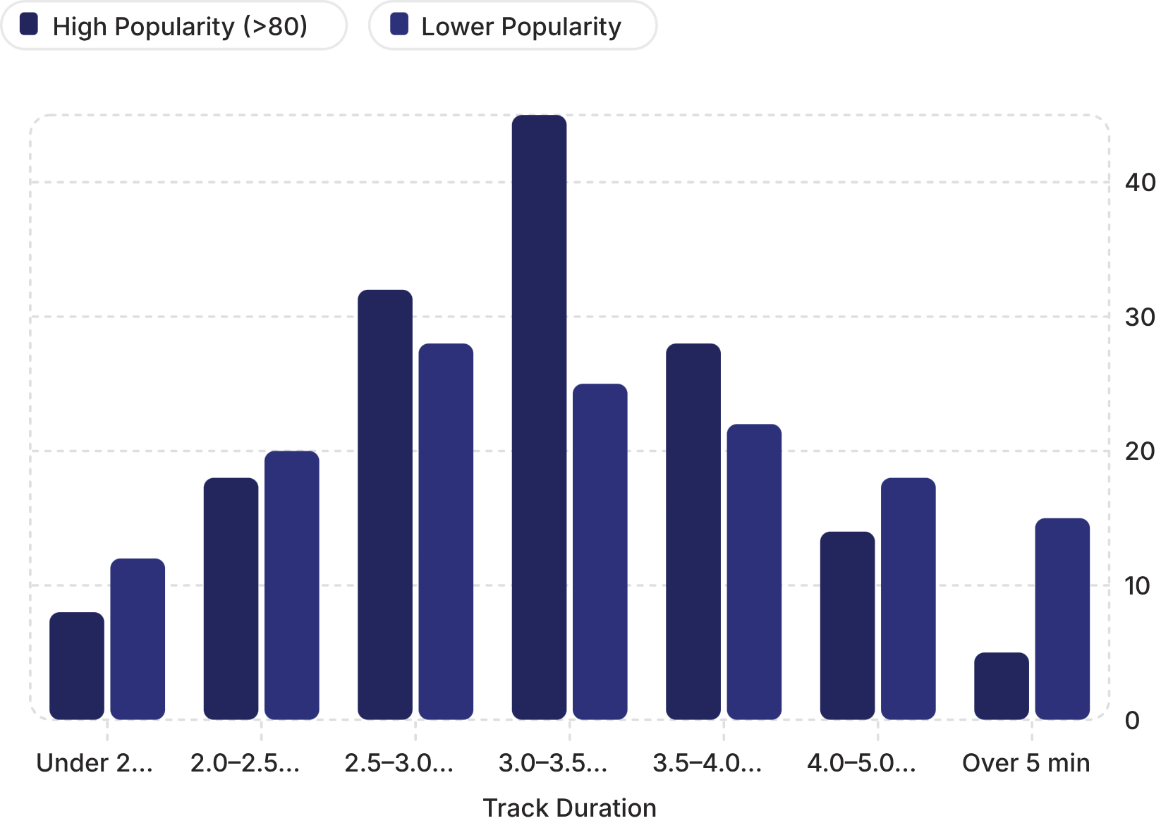
FINDING 3
Chart-Topping Hits Strictly Adhere to the 3.2-Minute Format
The distribution of popular tracks (popularity >80) peaks tightly between 3.0 and 3.5 minutes. Longer tracks — especially those exceeding 5 minutes — experience sharp drop-offs in mainstream popularity. This is not an artistic constraint; it is a streaming economics reality: shorter tracks facilitate higher replayability and algorithmic loop amplification.

Slide 6
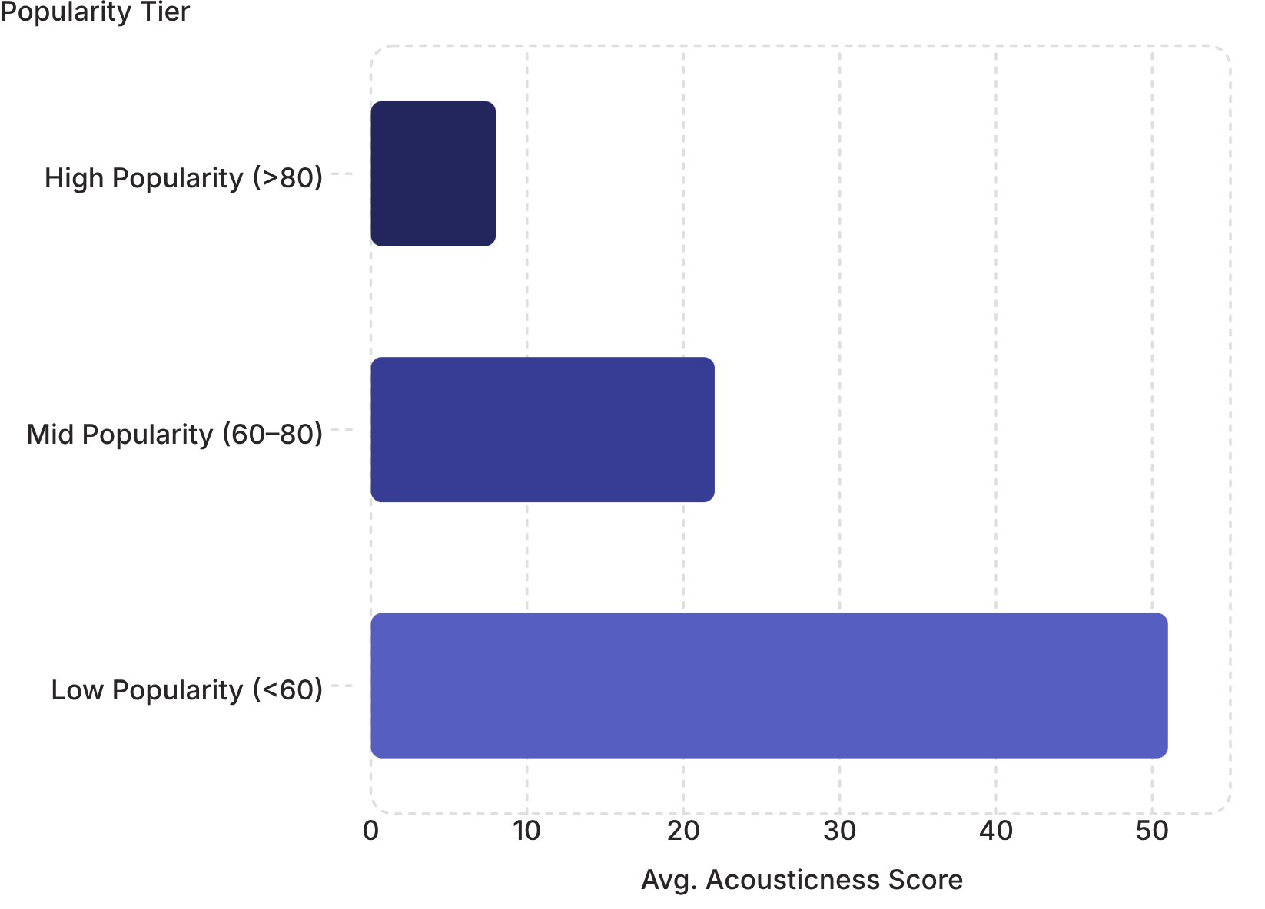

FINDING 4
Mass Appeal Favors Polished, Produced Soundscapes Over Pure Acousticness
High-popularity tracks show near-zero acousticness scores. High acousticness is predominantly restricted to lower popularity tiers or specialized genres like Folk and Classical. Electronic enhancement and modern mixing are not optional — they are prerequisites for mainstream radio and playlist placement.
Acousticness is an inverse signal: the more organic the sound, the lower the mainstream reach.

Slide 7
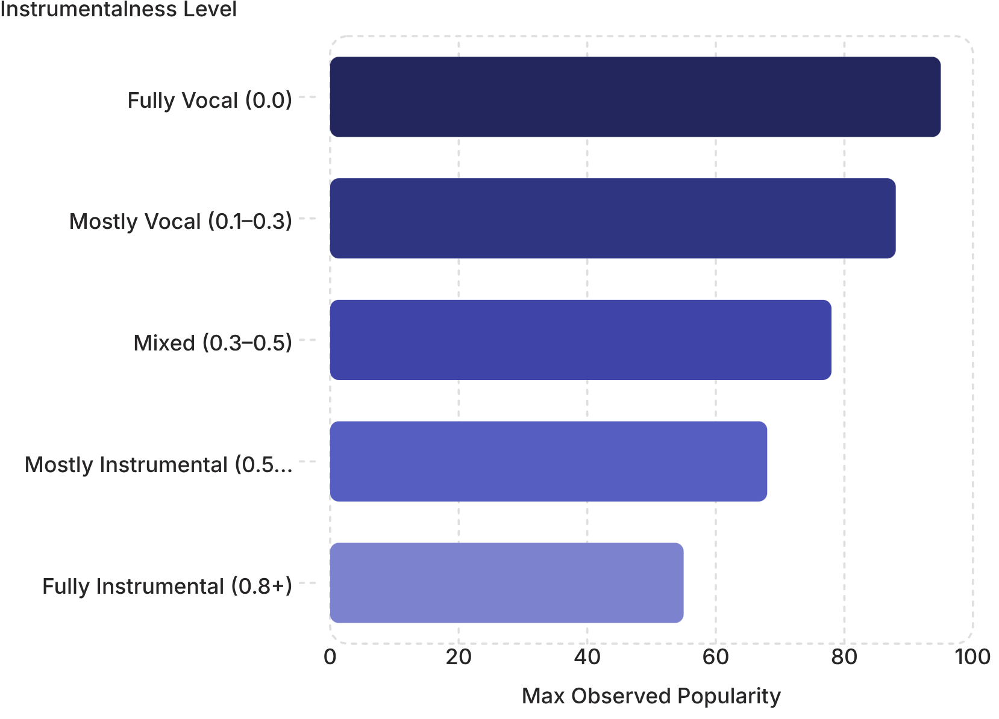
FINDING 5
Vocals Are Essential: Instrumental Tracks Face a Hard Ceiling
Tracks with high instrumentalness (>0.5) rarely break past the 75+ popularity threshold. Vocal presence remains the single strongest catalyst for listener connection and lyrical virality — a pattern consistent across all major genres in the dataset.
Why It Matters
Lyrics drive social sharing, playlist adds, and cultural resonance that purely instrumental tracks cannot replicate at scale.

Slide 8
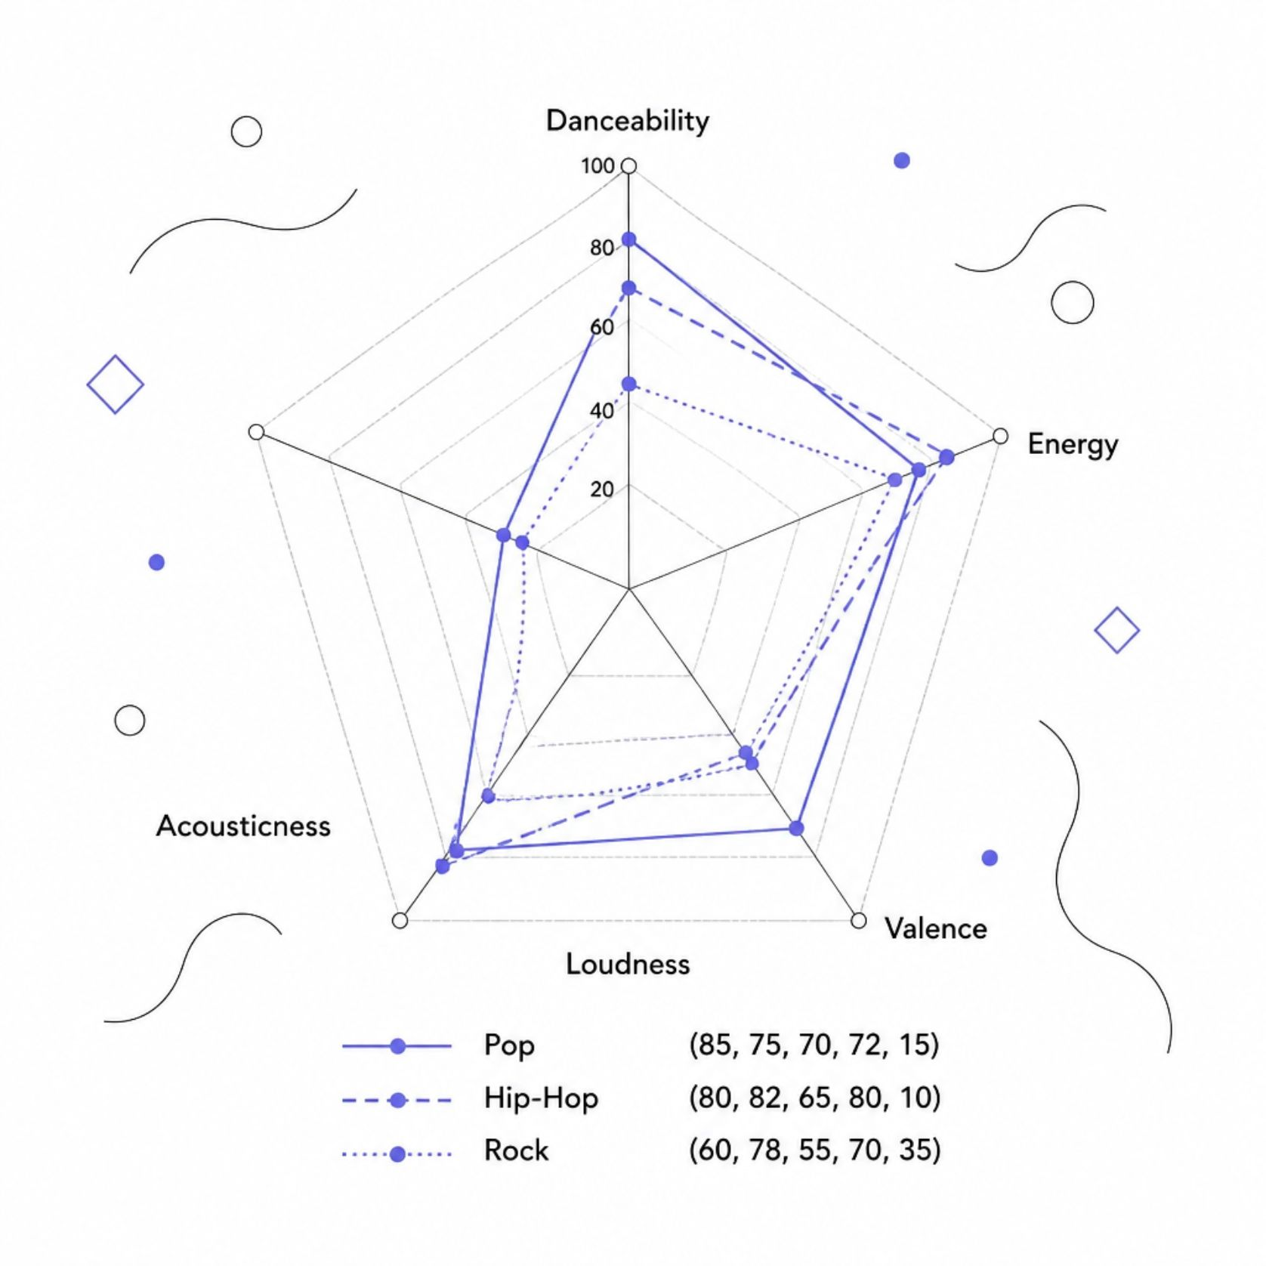
FINDING 6
High Energy and Danceability Unify Leading Mainstream Genres
A radar profile comparison of Pop, Hip-Hop, and Rock reveals a shared audio fingerprint. Danceability and Energy form the core framework of top-performing tracks across all three genres. Valence — musical positivity — varies widely, confirming that hits can be cheerful or melancholy; emotional tone is flexible, but sonic intensity is not.
Danceability
Energy
Valence
Consistently high across all top genres
Non-negotiable for mainstream chart performance
Wide variance — hits span the emotional spectrum

Slide 9
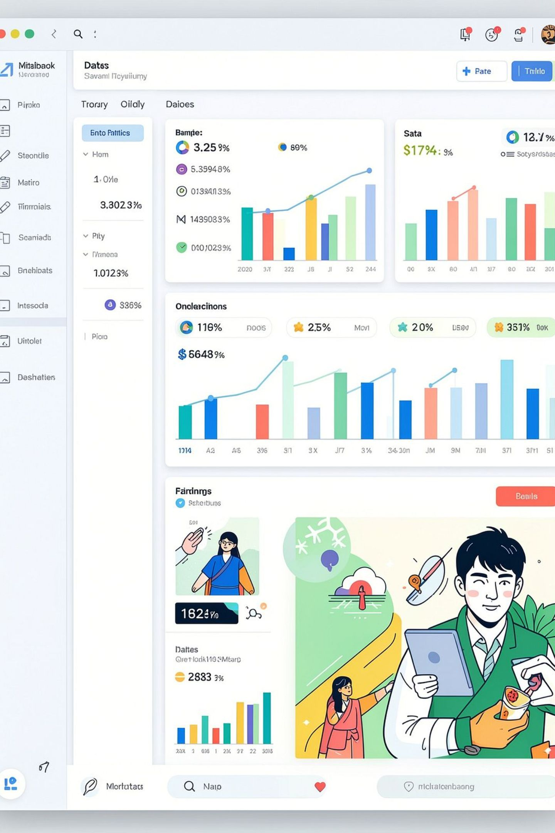
Real-Time Data Exploration via Interactive Web Application
An interactive dashboard built with Streamlit & Plotly, deployed on Streamlit Community Cloud, enables dynamic exploration of the full 114,000+ track dataset.
Genre Filtering
Isolate and compare audio profiles across any genre combination in real time.
Dynamic Metric Sliders
Adjust popularity thresholds, duration ranges, and audio feature filters on the fly.
Audio Profile Radar Charts
Visualize multi-dimensional audio fingerprints side-by-side for any selected genre set.
Real-Time KPI Counters
Live aggregate statistics update instantly as filters are applied, surfacing patterns at a glance.

Slide 10

Key Playbook for Modern Music Production & Streaming Strategy
01
02
Optimize Duration
Prioritize Vocal Production
Target 3.0 to 3.5 minutes for maximum playlist retention and replayability.
Limit purely instrumental tracks if mainstream reach is the primary goal — vocals drive virality.
03
04
Master for Loudness & Energy
Select Genre Strategically
High-impact mixing at competitive dB levels is a prerequisite for chart placement.
Pop and Hip-Hop offer the highest baseline popularity ceiling — genre context matters from day one.
Explore the Data: Full GitHub repository and live Streamlit dashboard available at [Link Placeholder].

