Slide 1
ASAPbio preprint licensing survey
Closed 2018-03-05

Slide 2
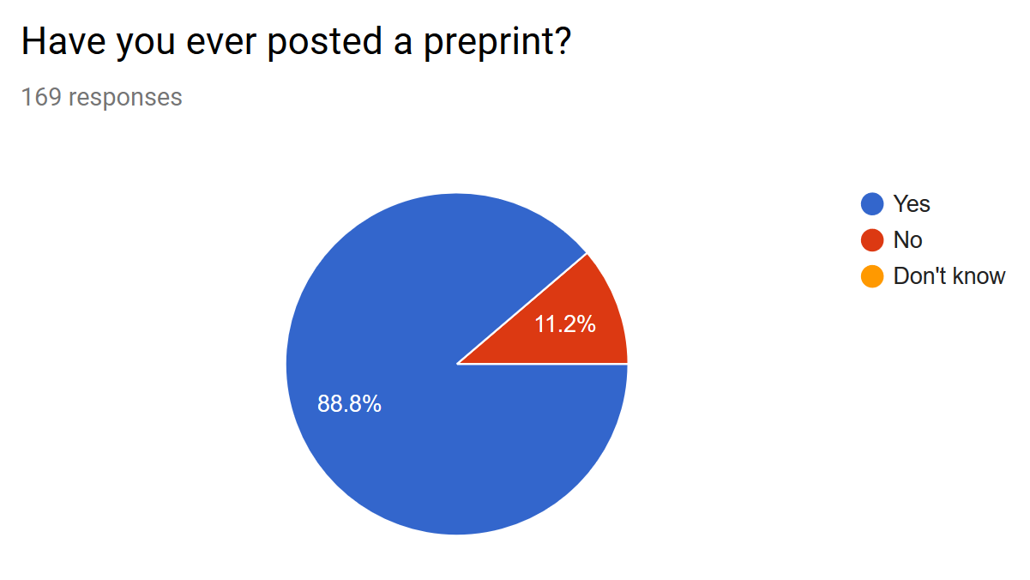
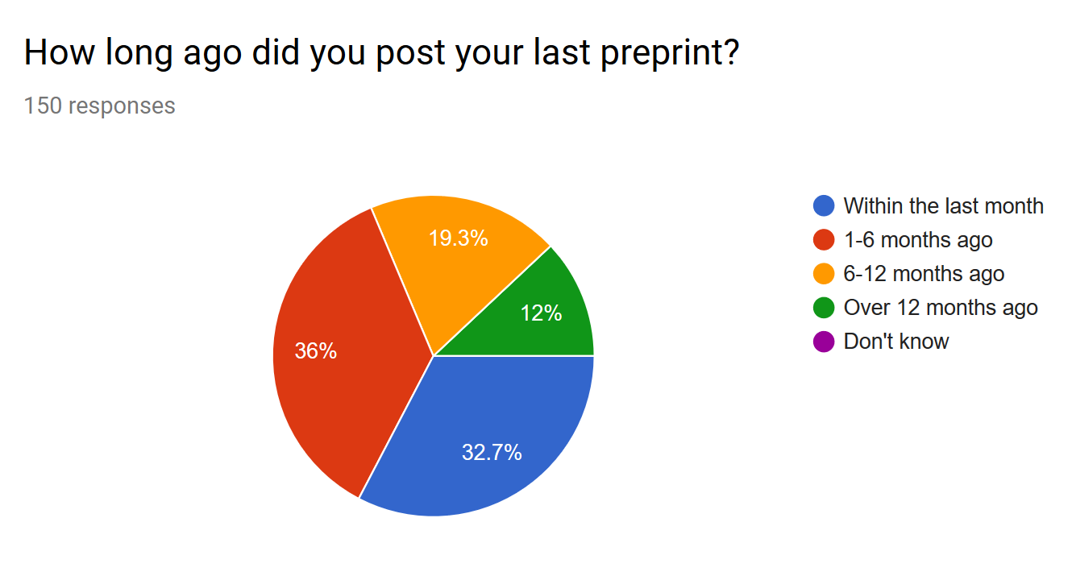
Original form

Slide 3
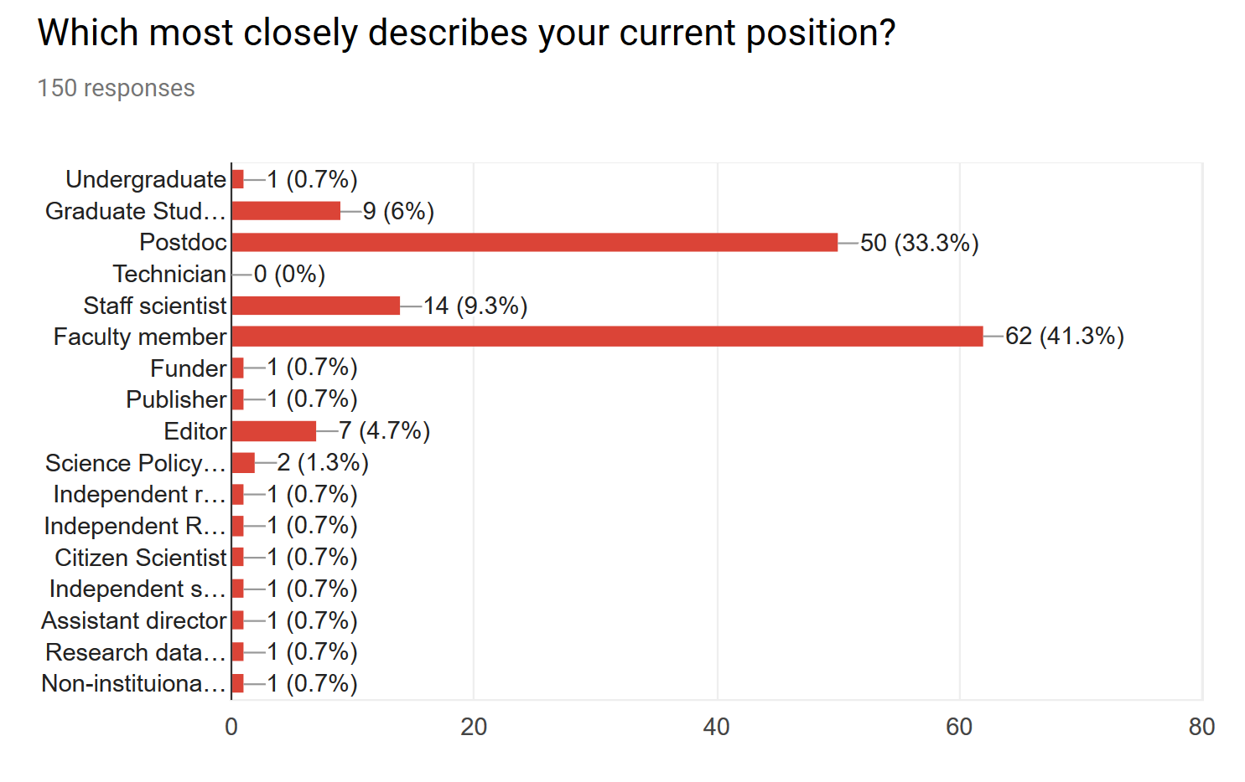
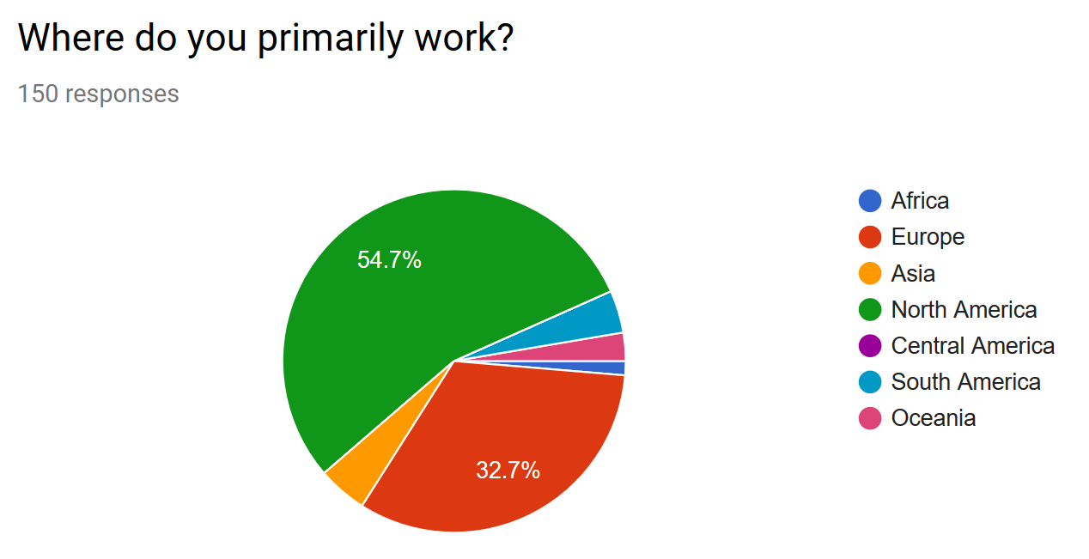

Slide 4
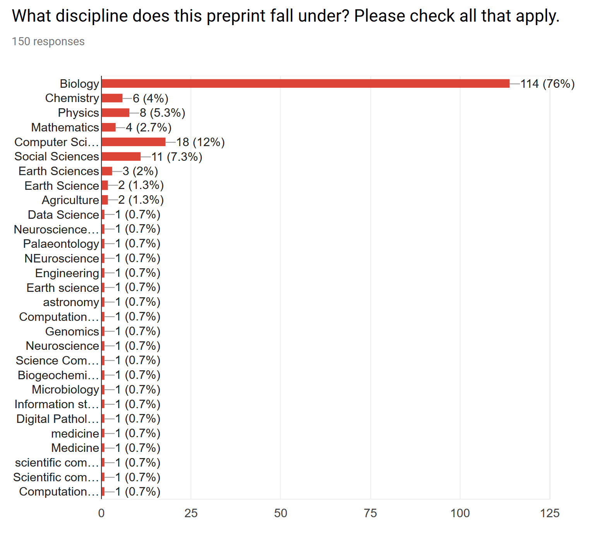
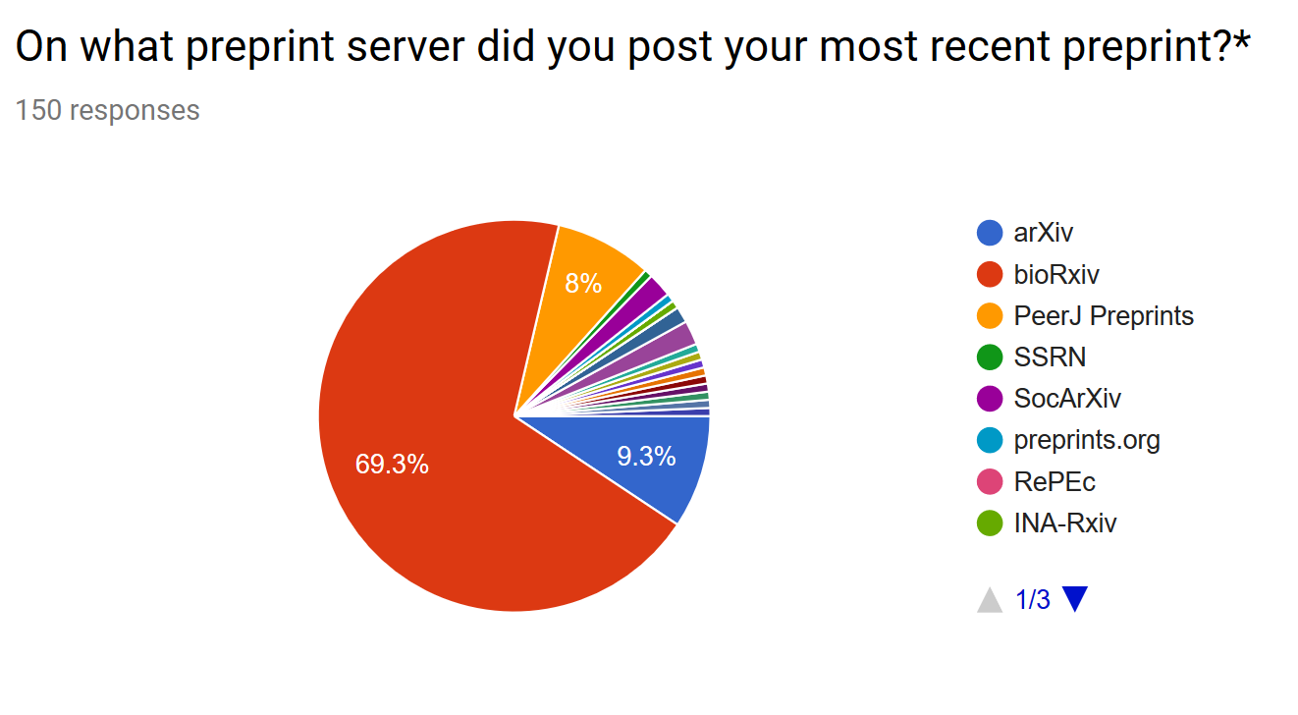

Slide 5
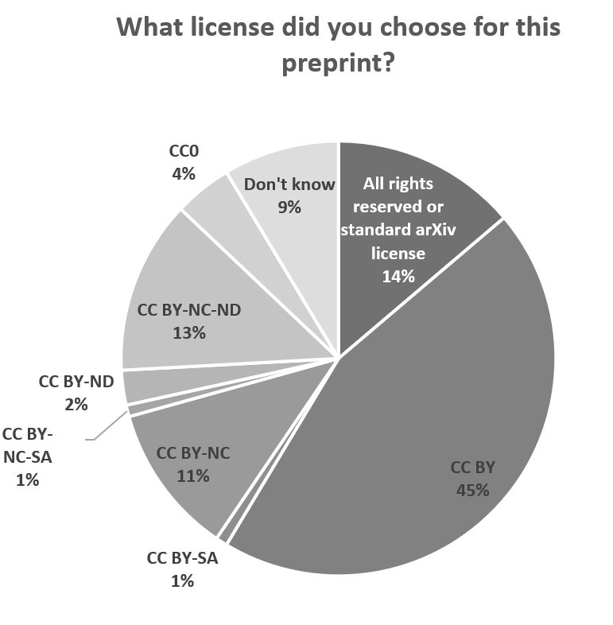
Chose the license: 117
BioRxiv license representation (as of 2016-12-05, Daniel Himmelstein)
License | Count | Percent
CC BY | 1,237 | 17.8%
CC BY-ND | 496 | 7.2%
CC BY-NC | 586 | 8.5%
CC BY-NC-ND | 2,553 | 36.8%
None | 2,061 | 29.7%

Slide 6
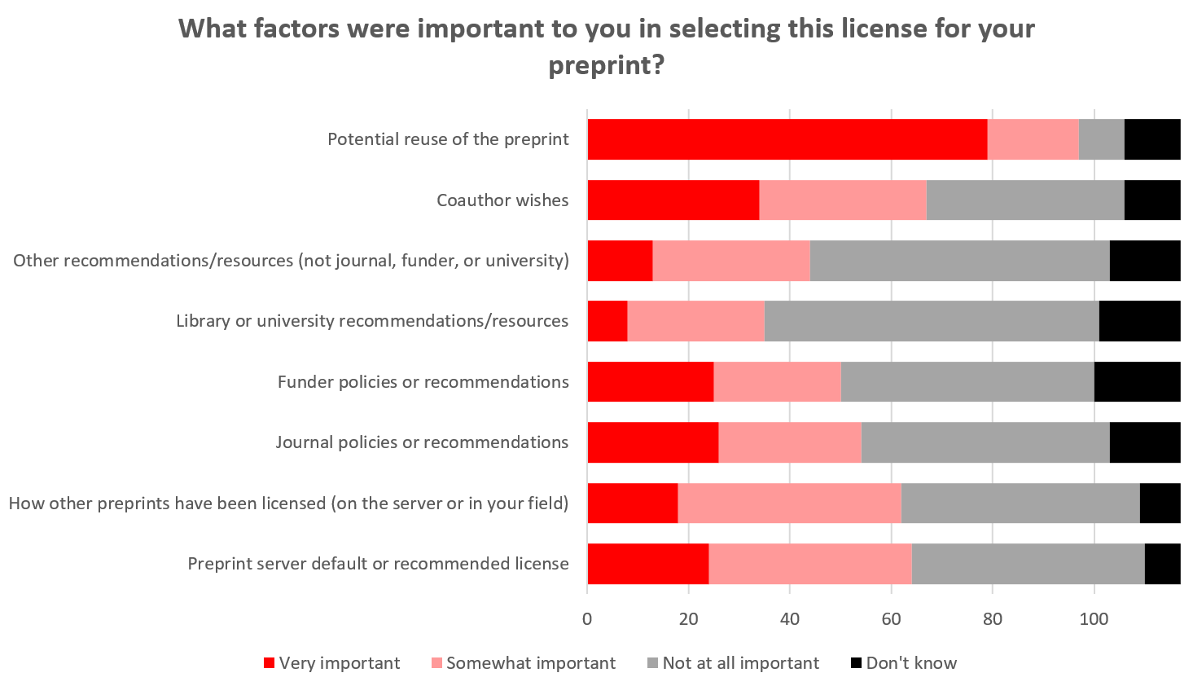

Slide 7
Comments on preprint license choice
“If factors not listed above were important to you, please explain below.”
All rights reserved
The only significant factor is maintaining control of my and my coauthors' intellectual work-product. For decades we have had to surrender rights to parasite publishers. I will not now surrender rights to a preprint server.
I don't fully understand the implications of all the various licenses, and I relied on my coauthors' expertise to select the license.
To be honest, I was very confused by the difference between some of the choices. I haven’t looked recently, but it seems like the explanations and consequences of the different options should be explained better.
I really did not understand the options and thus guessed as to which would be less likely to cause trouble when the paper was accepted at a journal
I don't fully understand the implications of all the various licenses, and I relied on my coauthors' expertise to select the license.
I wanted as many people to be able to use the material as possible
I heard some journals want to reserve rights so went with that.
I was surprised by the question. Had no relevant existing knowledge nd tried to find the option tht would not interfere with future publiction while aiding "open science". I didn't know nor currently remember the meaning of the codes listed above.
I assume that since future publications could have commercial value that this is the right license. Should we wish to publish e.g. with Elsevier then they might wish to retain some control on reuse. Preprint can be so similar to the final version that I gauged this not worth the risk.
Worried that CC licensing would lead to corrupted versions / inappropriate commercial reuse (like books automatically generated from wikipedia articles). Realize CC BY-NC-ND might exclude this, but going through licenses with fine tooth comb seemed like a large time commitment. The default arxiv license is good enough for ensuring the paper is shared by people within my field (my primary concern). Might choose an alternate if it was more clearly just "arxiv + text mining usage for academics."
Did not know the other licenses and wanted to be save
I don't know what the downsides are of choosing CC-BY.
I want my work to be useful (liberally licensed), but I want it clear that I should be cited when my work is useful.
CC BY
CC BY-ND
Don’t know
Don’t know
CC BY
All rights reserved
Don’t know
CC BY-NC-ND
All rights reserved
All rights reserved
CC BY-NC-ND
CC BY

Slide 8
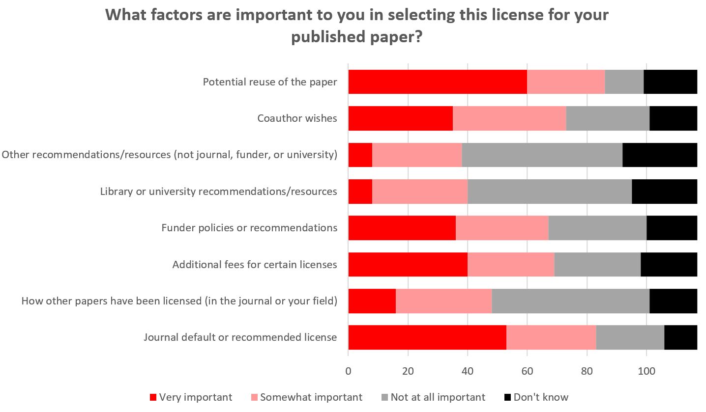

Slide 9
Comments on paper license choice
“If factors not listed above were important to you, please explain below.”
I chose to submit my work to an entirely open-access journal to support the ongoing change away from paywall journals
Once again, I am ignorant of the differences--I know I should not be but we're all so busy that.......
Targeting an OA-only journal for first submission.
Reproducible Research standards: https://www.computer.org/csdl/mags/cs/2009/01/mcs2009010035-abs.html
I don't understand the implications to be honest. Will i now be rejected based on this choice? This survey is almost making me regret posting a preprint. Was I too naive?
not expected to have commercial re-use (like drug company distribution)
It's the right thing to do.

Slide 10
If you expect the license of the final version will be different from the license you selected for the preprint, please explain the difference in your choices.
I don't know if we have enough choices for published papers, as Journal decides everything. Journal Policy on licensing does not affect my choice of journals as my manuscripts are already available at preprint servers.
Lack of funding to publish in a OA journal
I'm sorry I have no idea. That preprint is in revision at Nature Commun. I probably have to sign away who knows what and still pay them thousands of dollars.
Huge cost associated with CC-BY in most journals.
Less concerned about commercial use than I was in the past.
What the journal allows without an extra fee. Don't have funding to cover OA fees.
can't afford open access fees for publication
At the time of posting to biorxiv I thought NC was a good thing; I've since learnt this prevents some non-commercial uses and have decided to go with CC-BY from now on
I’ll be open with the preprint licence. The journal will not.
As long as the options are clearly explained, they could be the same, except if there is significant cost at the journal.
Targeting an OA-only journal for first submission but if the paper is rejected, I might resubmit in a non-OA journal.
When submitting a preprint I don’t want to lose my chances with top journals due to their policies. When publishing the paper itself I wish to follow the funder's regulations.
Journal charges extra for open-access; no reason to choose OA option when preprint copy is sufficient.
I would always hope the journal license to be the least restricted.
I will choose a more permissive license if the journal allows.
I don't know enough about the options and got confused when I started researching them on Wikipedia, so I just went with the defaults...
Publisher rules
Possibly. See the preprint as an open version of the published manuscript
Did not thinker about it before
In most cases entirely up to the journal/publisher
I expect journals to be tyrannical cleptocracies. I accept whatever license they foist upon me because I need publications for tenure more than they need my paper. On the other hand, the raison d'etre of preprint repositories is to be open access. I wouldn't post there were it not for the CC license.
My institution may patent the software that comes out of my algorithms.
default journal license is not open. Open access license fees prohibitively costly
Publisher limitations. I have had to wait three months once because their "system can't currently handle CC0"

Slide 11
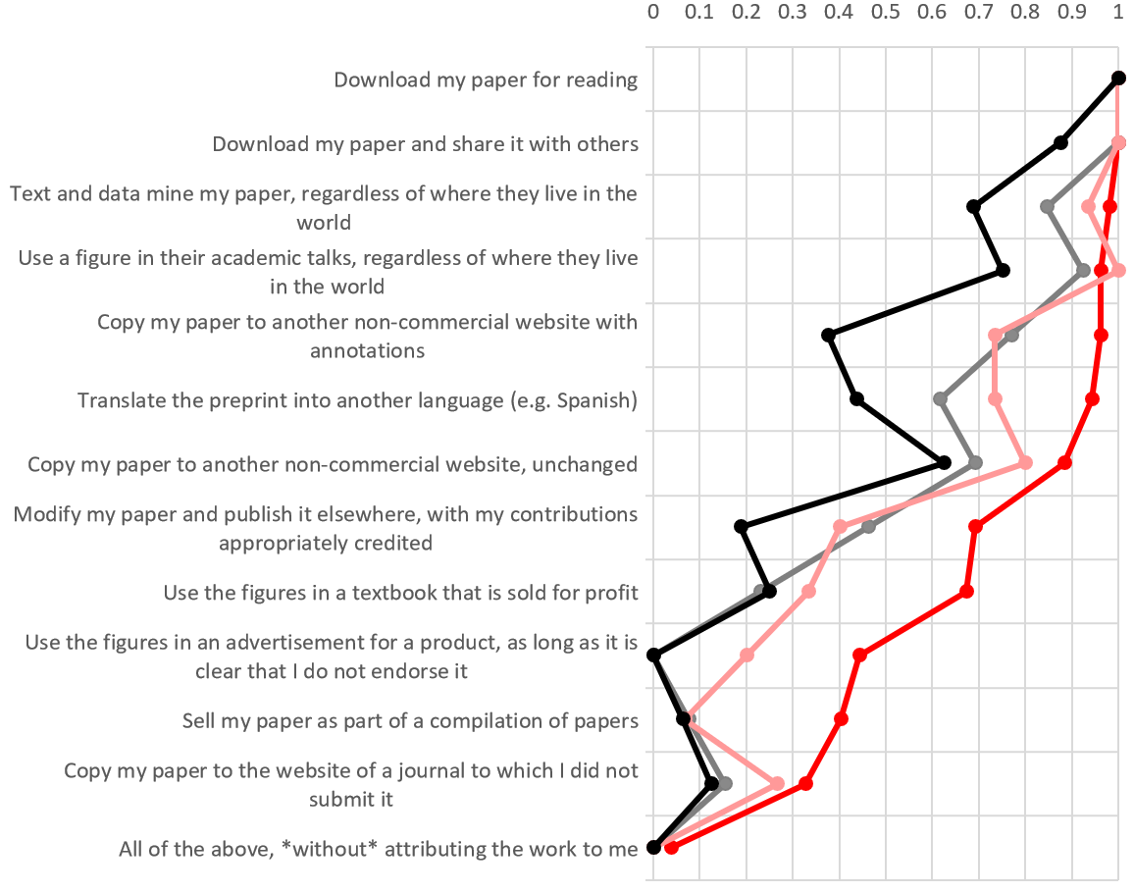
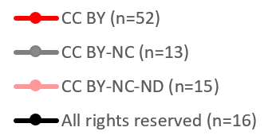
What would you like others to be able to do with your preprint, without having to ask for your permission? Assume, unless noted, that your work would be attributed to you and your co-authors.

Slide 12
Do you have any other comments regarding preprint licensing?
I think most people, like me, don't completely understand the differences between different licenses, or how a preprint license impacts the journal license.
Keep up the good work! You people are awesome.
viva la revolution
My preference would be something like a CC BY-NC license, but where I hold the rights, not a journal. Specifically, if a drug company wants to hand out copies of my article, I'd rather have them pay me (rather than a journal). For papers where commercial uses are unlikely, I pick CC BY. Also, for the "copy my paper to a website" options, for purposes other than archiving / backup, I don't see why they can't just create a link. I'd rather direct traffic to a journal site to get my article as long as the access is free to the user. I'm ambivalent about translation. One the one hand, I don't have time or skill to translate it into every language. But I'd rather have no translation than a poor one (the book _Scientific Babel_ shows how this was a serious hindrance to Mendeleev's career).
More medical journals need to explicitly allow for posting of preprints so I can feel more comfortable doing it. Most don't mention them on their "author information" pages.
Professional attribution standards still apply.
Some of the list above are things that I don’t actively ‘want’ (eg selling it in a collection) but I’m not that bothered if people choose to and would rather have unrestricted reuse rather than putting restrictions on it that are unlikely to ever be challenged by anyone anyway.
What would happen if sketchy stem cell therapy company use stem cell researcher's figures with crediting those researchers names? How can we prevent this?
Just a note to the choices above: good job, they really got me thinking and I am still internally debating about the for profit options!
I know that this is important and I promise I have tried to understand licencing, but I simply don't understand it and there is conflicting advice on what to do.
I do not _like_ some of the commercial options, but am willing to accept them giving how problematic NC can turn out to be in practice
The world would be far better place if CC BY is mandatory for every scholarly work.
It would be good to add a sentence about possible implication for submission when posting a preprint. I'm now getting scared as mentioned above.
I would want credit for anything commercial arising. Potentially financial credit.
People are dumb and make wrong choices with good intentions, but misinformed all the while. Accept that and guide them towards the best choices whilst allowing them to choose something different if they can reasonably justify it.

