Slide 1
Autonomous Mobile Robots
Control and Planning: Autonomous Mobile Robots and Autonomous Vehicles
Aliasghar Moj Arab

Slide 2
Lecture 5
P A R T 0 1
Advanced Model Predictive Control (NMPC) + Constraints

Slide 3
Topics
Introduction & Physical Constraints
Vehicle Kinematics & Equations of Motion
Control & Perception Fundamentals
Nonlinear Control Methods
Advanced Model Predictive Control (NMPC) + Constraints
Motion Planning Algorithms (RRT*, RRT, DWA, path generation)
Learning-Based Planning & Control
Industry Standards, Architectures, & Safety

Slide 4
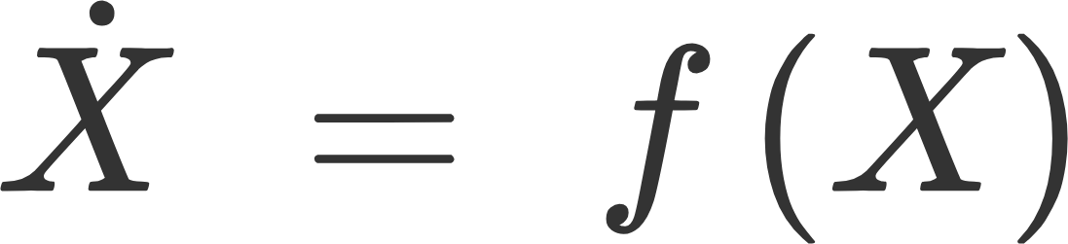
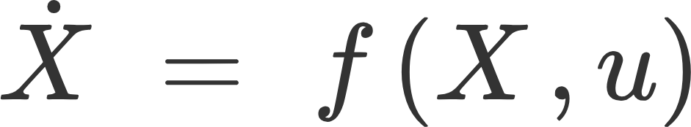
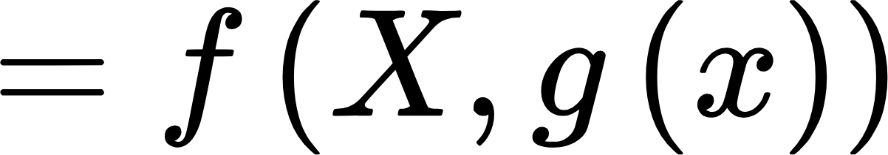
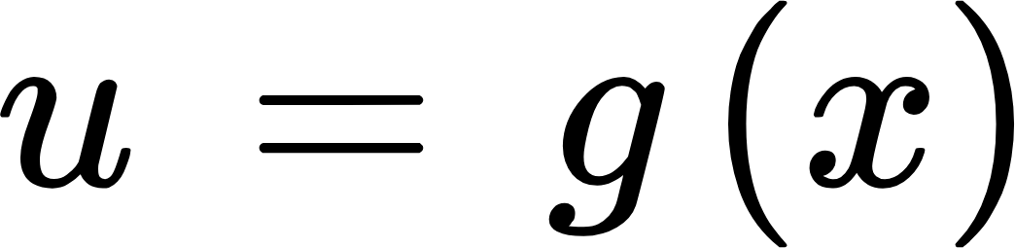
Nonlinear Systems
Autonomous system: Independent of time
This is a closed-loop eq
For nonlinear systems, we study the behavior from equilibrium point to equilibrium point.

Slide 5
Linear vs Nonlinear Systems
Linear Systems | Nonlinear Systems
1 equilibrium point Predictable behavior | Multiple equilibrium points Chaos Bifurcations
Note: linearization gives only local info at each ẋ
https://www.youtube.com/watch?v=wOQDGvCLOs8

Slide 6
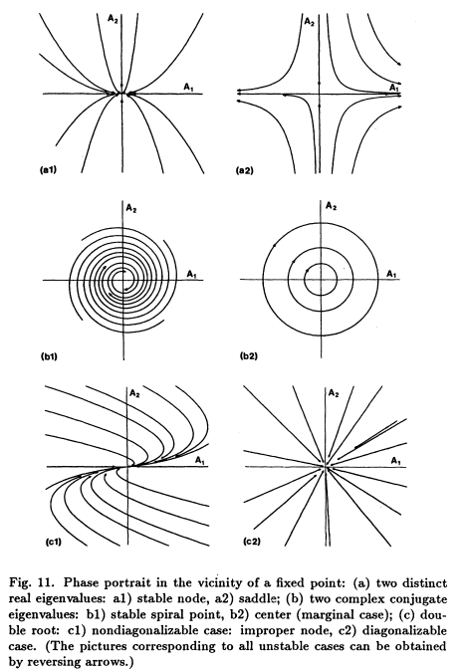
Methods to Analyze Nonlinear Systems
Plotting Phase portraits
This is helpful to visualize the system behavior in state space
Limitation: Can be used at most for 2nd-order differential equations
https://ars.els-cdn.com/content/image/3-s2.0-B9780080924458500092-f05-11-9780080924458.jpg

Slide 7
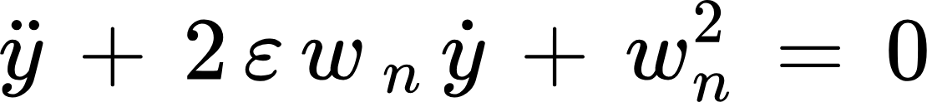
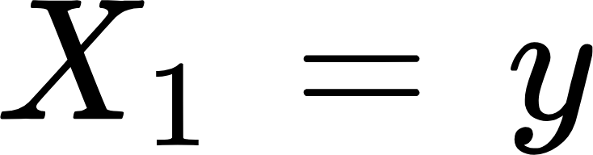
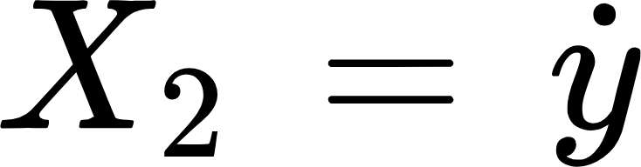
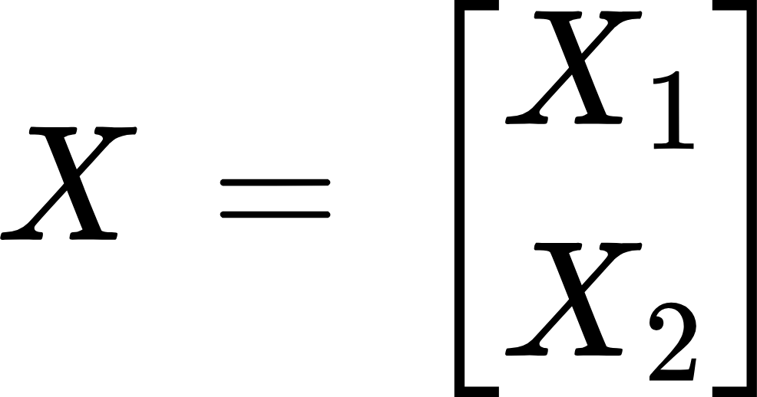
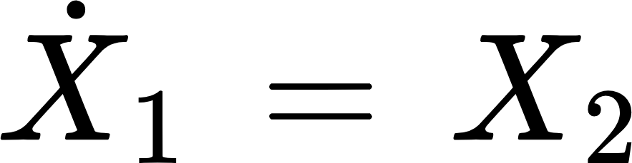
Example Linear 2nd-Order System → State Form
A General Linear System

Slide 8
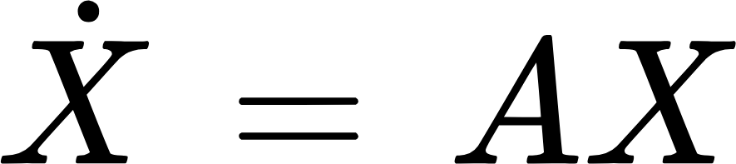
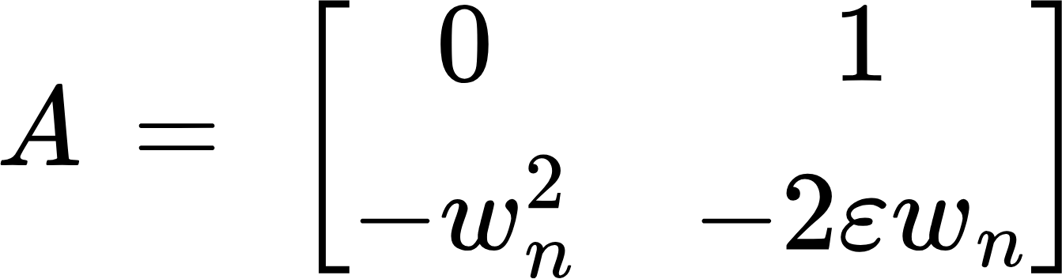


Matrix Form
This is the only equilibrium point

Slide 9
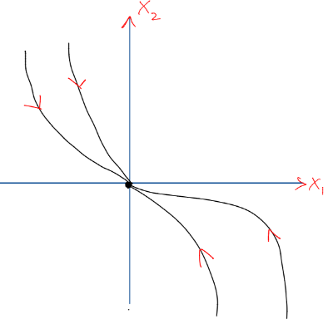
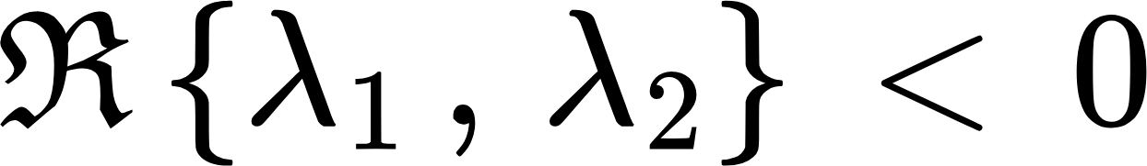
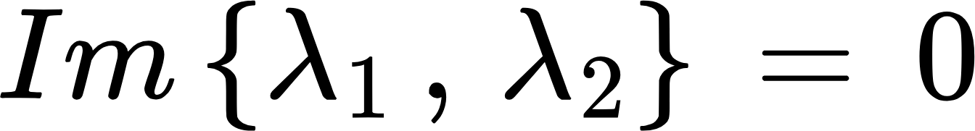
Linear System
Stable Equilibrium

Slide 10
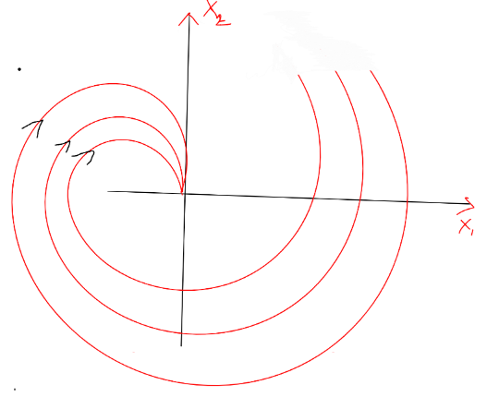
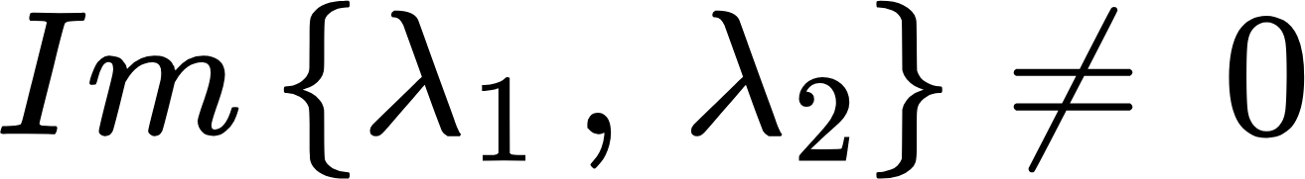
Linear System

Slide 11
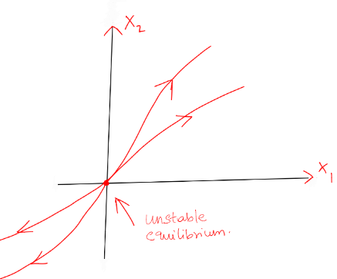
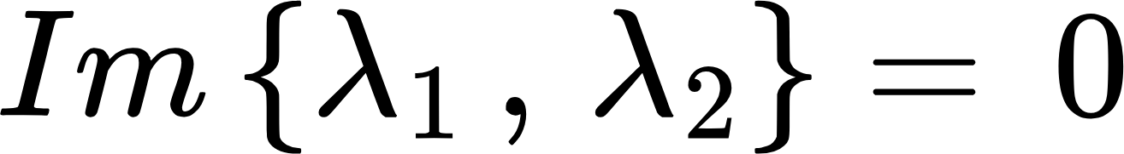
Linear System
Unstable equilibrium.
It is only stable at a point; even for a slight movement, it will become unstable
>
Directions are coming from the stability of the system

Slide 12
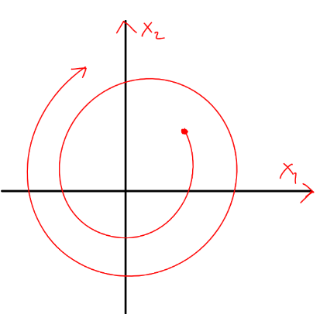
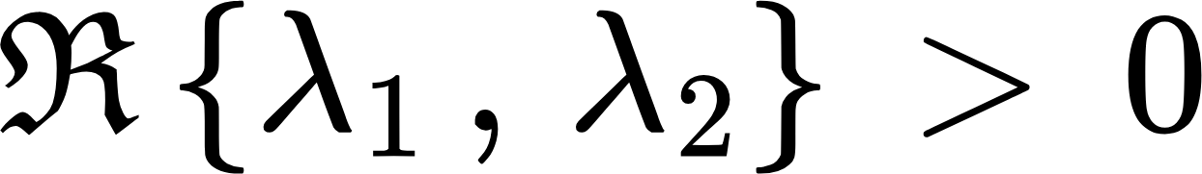
Linear System
Linear system with unstable equilibrium

Slide 13
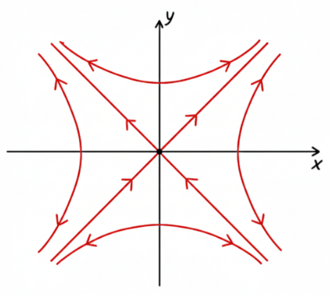
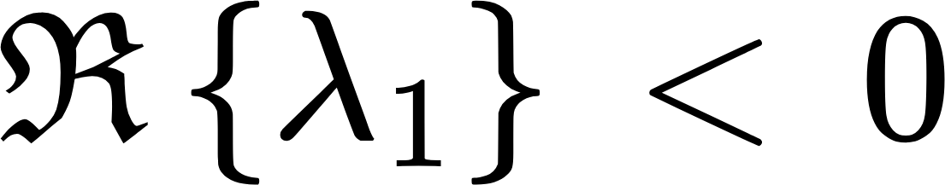
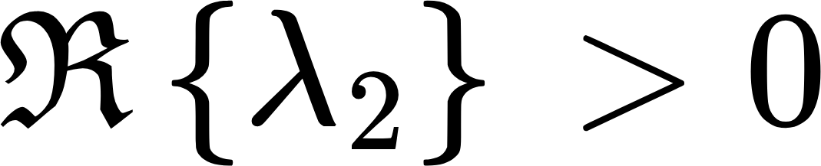
Linear System
Saddle Point

Slide 14
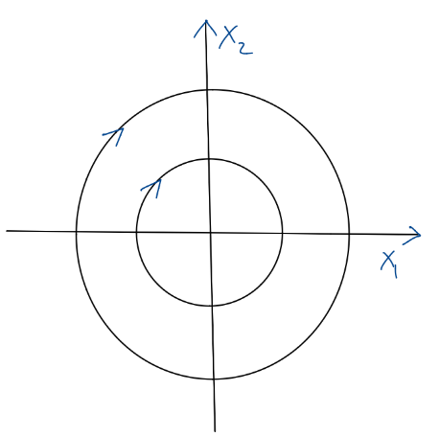
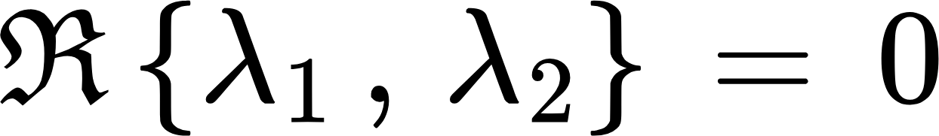
Linear System
This behaviour can be found in a spring and damper system with no damping so the system keeps oscillating

Slide 15
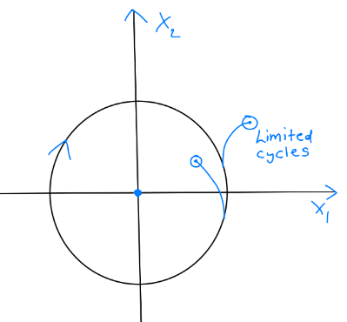
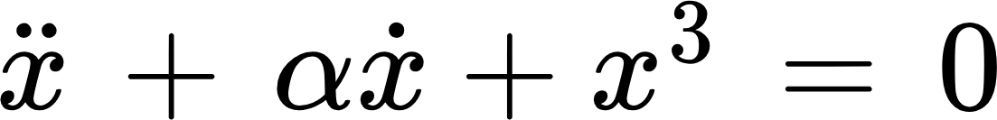
Nonlinear System

Slide 16
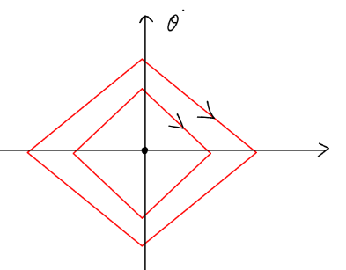
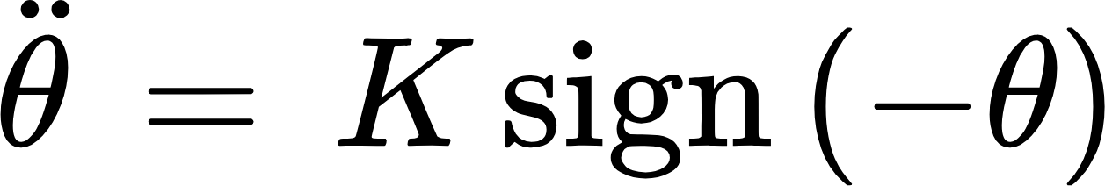
Nonlinear System
Switching Model
Models in space - satellite

Slide 17
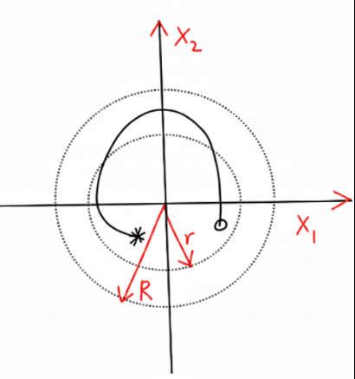
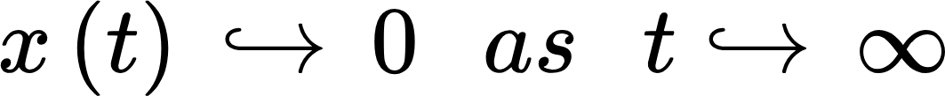
Lyapunov Stability
Asymptotically stable
Asymptotically stable is stronger than lyapunov stability

Slide 18
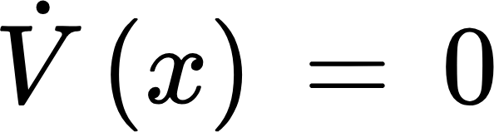
Lyapunov Stability : Conditions
Positive Definite and Non-increasing
If the only point where is x=0 , then x(t)→0 as t→∞ t→∞ ⇒ Asymptotic stability
Global Stability:
Equilibrium Point

Slide 19
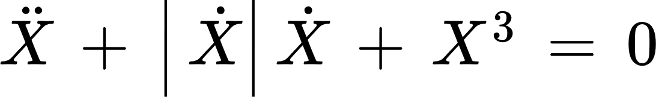
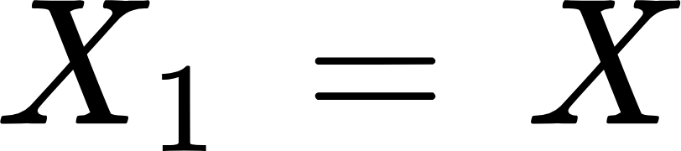
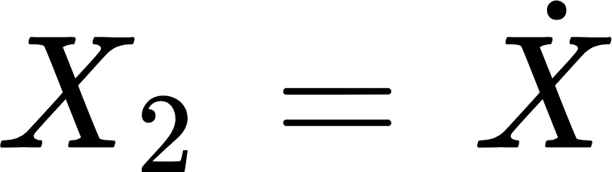
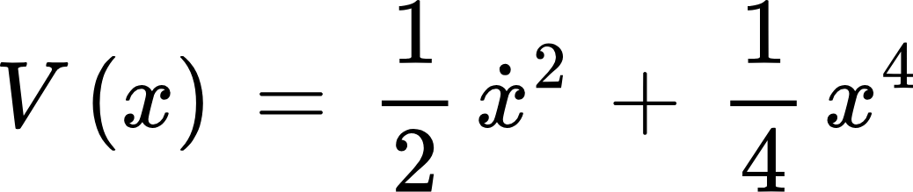
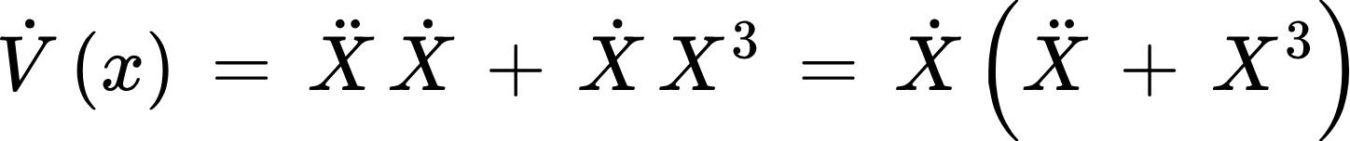
Ex: Nonlinear system
We Choose:
Since V(0) = 0
& V(x!=0) > 0
Lyapunov function
Now we analyze for stability:
Derivative Calculation
=-|x_dot|x_dot^2 <= 0 → Lyponov Stable

Slide 20
Lyapunov Stability
Since V˙≤0, the system is Lyapunov stable; because V(x)→∞ as ∥x∥→∞, it is globally stable.
Stability analysis: (Semi-negative definite ⇒ Lyapunov stable and globally stable)

Slide 21
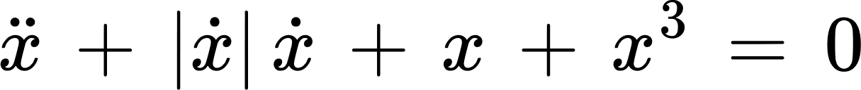
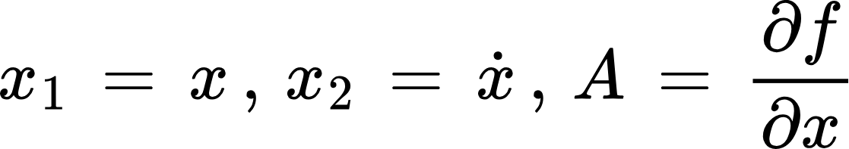
Linearization of a Nonlinear System for Stability Analysis
Equation of Motion and State Definition
Nonlinear EoM:
State variables:
when x* = 0

Slide 22
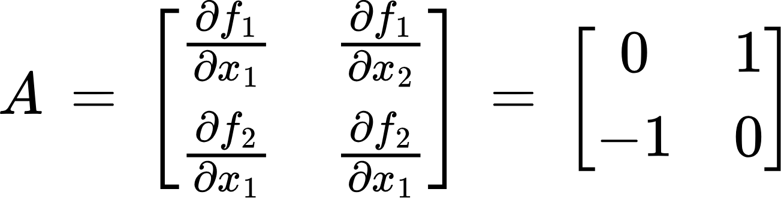
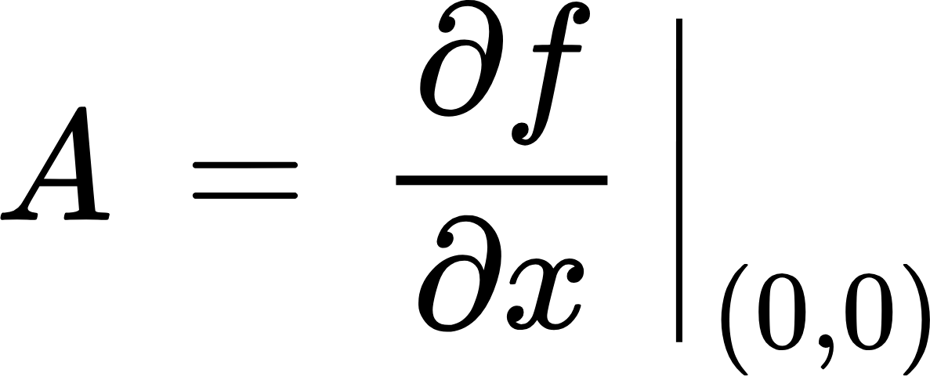
Linearization of a Nonlinear System for Stability Analysis
Compute the Jacobian Matrix A at (x₁, x₂) = (0, 0)
System in form
Jacobian Entries:

Slide 23
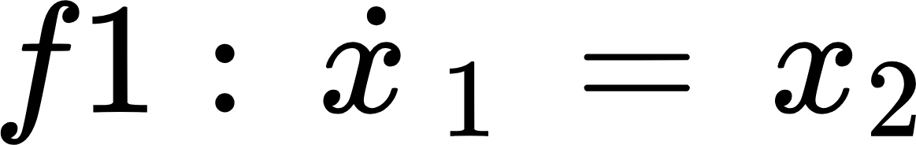
Linearization of a Nonlinear System for Stability Analysis

Slide 24
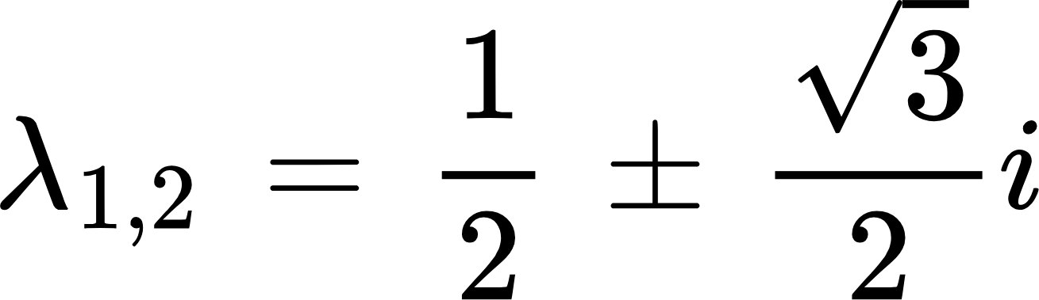
Linearization of a Nonlinear System for Stability Analysis
Eigenvalue Analysis
Characteristic equation:
Stability Conclusion
Equilibrium at (0,0) is unstable

Slide 25
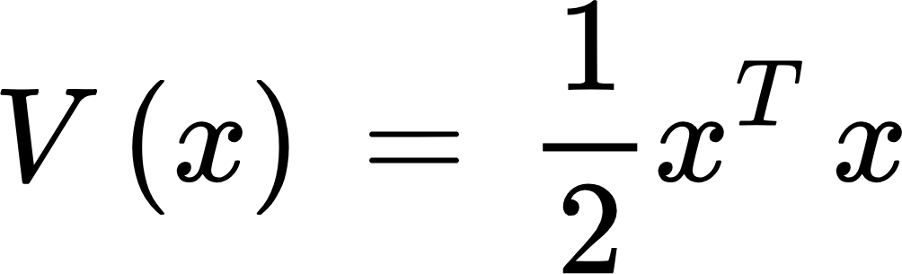
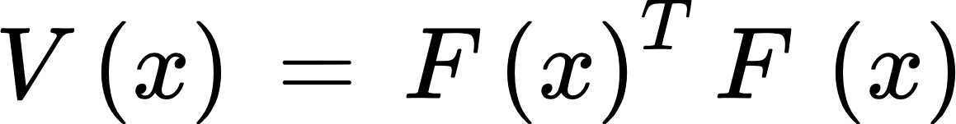
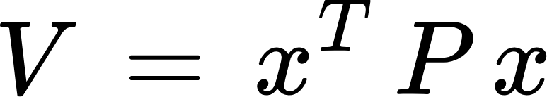
Three Main Functions of a Lyapunov Candidate
Choosing V(x):
Energy interpretation: Any scalar function that mirrors system energy.
Sum of squares Method:
General form:
Linear system optimal choice

Slide 26
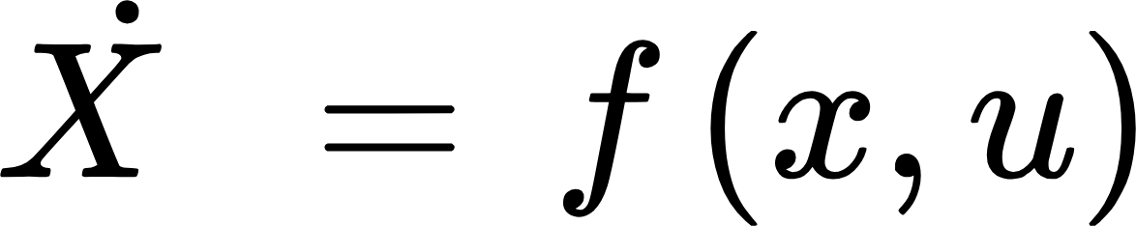
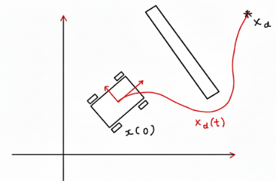
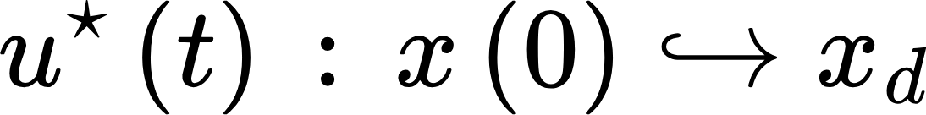
Designing a Lyapunov-Based Controller
Energy interpretation—Any scalar function that mirrors system energy

Slide 27


Designing a Lyapunov-Based Controller
Energy interpretation—Any scalar function that mirrors system energy
Finding u that is stable
By using Lyapunov framework

Slide 28




Designing a Lyapunov-Based Controller
Using 1 and 2
Globally Asymptotically Stable

Slide 29
Lyapunov-Based Holonomic Robot Control
kₚ, k_d are diagonal positive-definite gain matrices
M(q) = Positive definite.
M* - 2C = positive semidefinite. It is skew symmetric

Slide 30


Lyapunov-Based Holonomic Robot Control

Slide 31



Lyapunov-Based Holonomic Robot Control
Globally asymptotically stable

