Slide 1
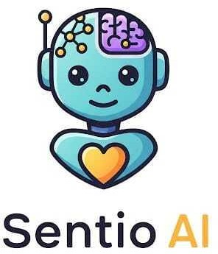
SentioAI – Every Emotion Matters
Team Name: CodeLoom
Team Members:
Alisha A Pinto
Ashwini Shenoy B(Team Creator) 3.Akshatha

Slide 2

Company Purpose
SentioAI offers an AI-powered wellness companion that actively listens to a user's tone of voice to provide empathetic conversation and personalized content recommendations that adapt to their real-time emotional state.cc

Slide 3

Problem
Today, users interact with digital systems that don’t understand emotions. Whether you’re stressed, happy, or frustrated, the response is the same. This leads to poor engagement and user dissatisfaction.
Users want content matching their mood. Current systems rely only on history, forcing manual searches or skips, leaving experiences disconnected and frustrating.
Voice assistants fail during stressful moments. Customers need empathy and clarity, but robotic replies increase irritation, forcing repetition, shouting, or complete abandonment of service.

Slide 4

Solution
1. Healthcare / Telemedicine
Benefit to User
Emotion-aware virtual assistants offer comforting, clear communication to anxious or stressed patients.
Where It Fits
E-learning apps, online
tutoring platforms, educational
chatbots.
Use Case
Detects patient stress during symptom reporting and adjusts responses to reduce anxiety and build trust
.
.
.

Slide 5
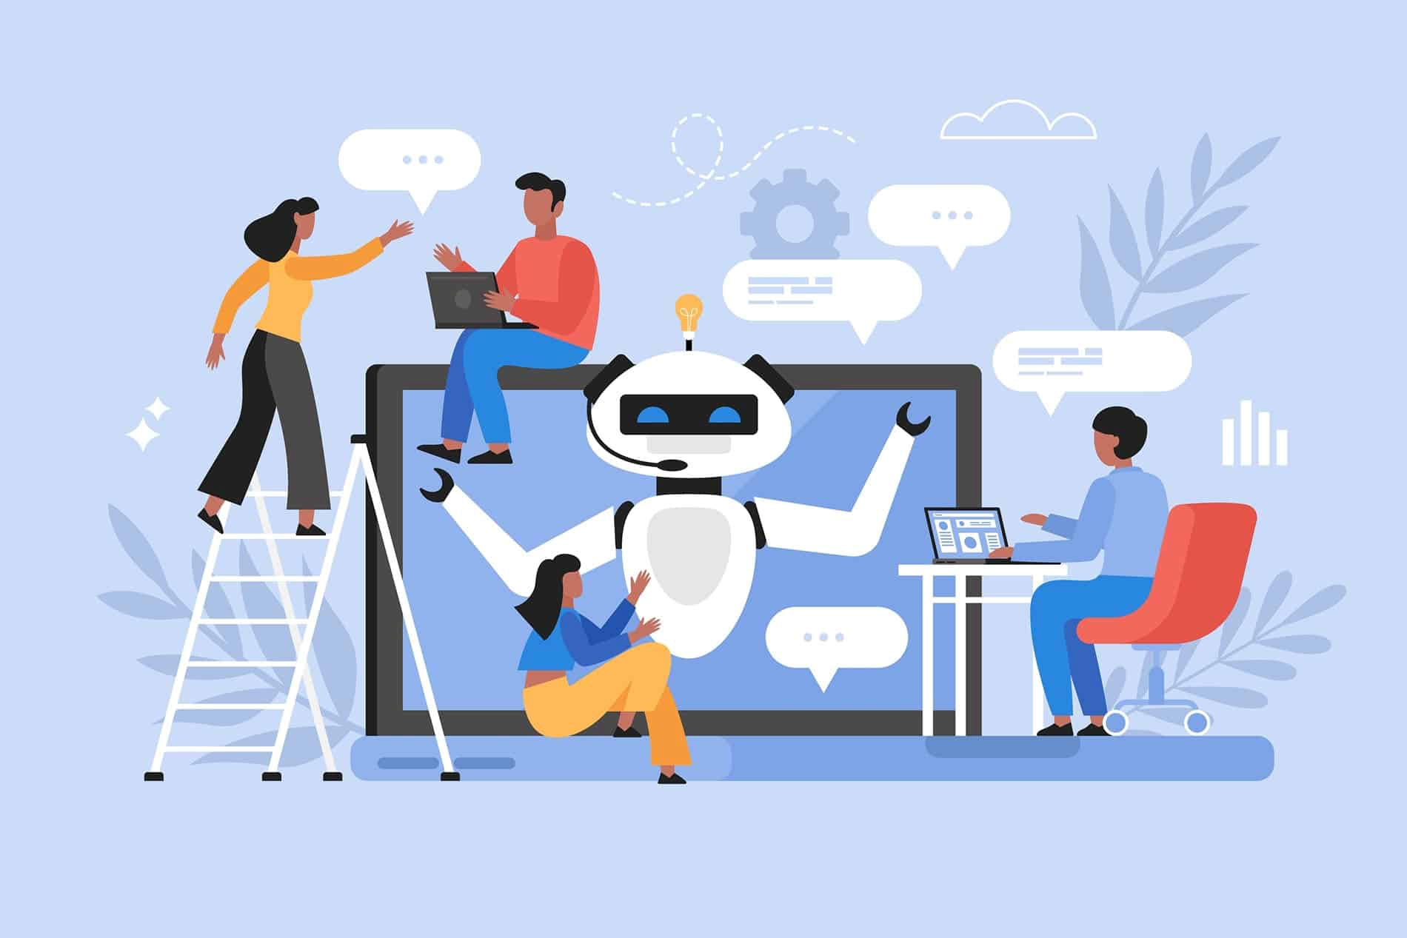
2.Ed-Tech Platform
Benefit to User
Chatbot senses confusion or
disengagement and proactively
encourages or switches learning modules.
Where It Fits
E-learning apps, online
tutoring platforms, educational
chatbots.
Use Case
Detects student disengagement and
offers motivation or suggests alternate
lessons suited to mood.

Slide 6

3. OTT Platform
Benefit to User
Mood-based recommendations
personalize content, enhancing
user satisfaction and engagement.
Where It Fits
Streaming apps like Hotstar,
Amazon Prime, regional content platforms.
Use Case
Detects relaxed and happy tone to
recommend feel-good
regional movies, enhancing
family viewing.

Slide 7

Why now
India is at a unique inflection point for digital empathy.
The Digital India Boom
Government initiatives and rapid smartphone
penetration have brought hundreds of millions
online—users who expect intuitive, emotionally
intelligent services.
World’s Cheapest Data
Affordable mobile data has driven explosive
growth in video, audio, and streaming—creating
a massive opportunity for mood-driven content
personalization.
Rise of Vernacular Tech
SentioAI is building the core emotional intelligence layer that future vernacular technologies can plug into starting with tone, stress, and mood detection, which are language-agnostic signals to a large extent.

Slide 8
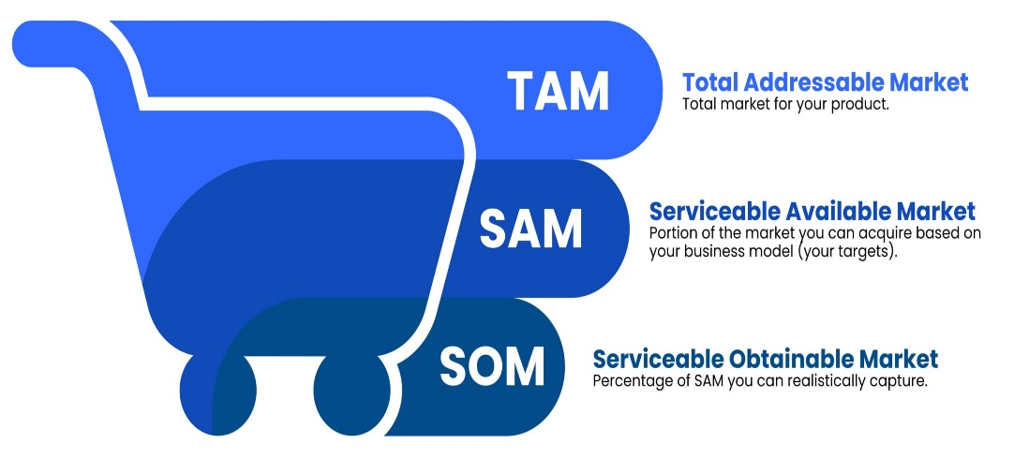
Market Size
Target Customer Profile: We are targeting
Indian B2B companies in high-growth
sectors: OTT Media, FinTech, Ed-Tech,
and E-commerce.
Market Calculation:
TAM (Total Addressable Market): The Indian Conversational AI market, which is projected to exceed ₹10,000 Crores by 2028.
SAM (Serviceable Addressable Market): The market for AI-powered customer experience and recommendation engines within our target sectors in India, estimated at ₹2,500 Crores.
SOM (Serviceable Obtainable Market): Our goal is to capture 2% of this market within three years, representing an initial market opportunity of ₹50 Crores.

Slide 9

Competition
Competitors in the Indian Market
Local Chatbot Leaders
Companies like Jio Haptik and Yellow.ai
offer robust chatbots but lack real-time
emotion adaptation.
In-House Recommendation Engines
Platforms like Hotstar, Gaana, and
JioSaavn recommend content based on
viewing history, not the user’s immediate
emotional state.
Our Core Features & Competitive Advantages
Emotion-Adaptive Chatbot
Voice Interface Adapting to Stress
Mood-Driven Recommender System
Why We Stand Out
Unified Emotional AI API combining text sentiment, voice emotion, and adaptive recommendations in one platform.
Built for India’s Diversity with a roadmap to tune models for Hinglish and regional languages.
Cost-Effective Cloud-Native Architecture designed for scalable, volume-based pricing ideal for Indian businesses.

Slide 10

Product
Product Line-up
Single, easy-to-integrate API designed for Indian developers and
businesses, built to handle India’s linguistic and emotional diversity.
Core Functionality
Emotion-Adaptive Chatbot: Real-time sentiment analysis from chat text enabling empathetic, context-aware conversations.
Voice Interface Stress Detection: Detects stress, excitement, and frustration in voice streams to adapt interactions dynamically.
Mood-Driven Recommender System: Personalized content recommendations (music, video, etc.) based on users’ current emotional states.

Slide 11
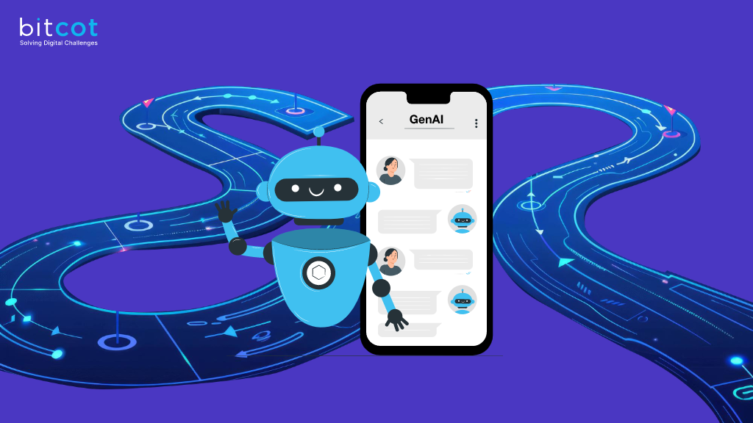
Architecture
Lightweight, scalable backend powered by
transfer learning on pre-trained AI models,
Fine-tuned on Indian language and speech
datasets (including Hinglish and major
regional accents) for high accuracy
Development Roadmap
Current: A working prototype demonstrating
the core functionalities.

Slide 12
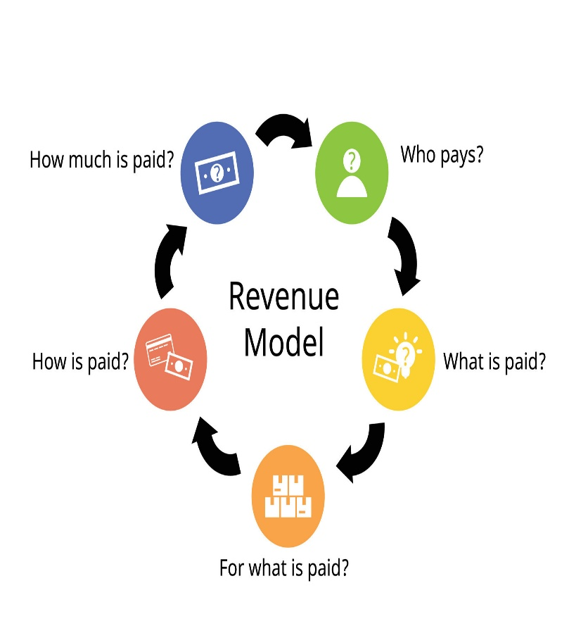
Business Model
Revenue Model
B2B Freemium SaaS tailored for India’s price-sensitive market.
Pricing (in INR)
Free Tier: Up to 2,000 API calls/month, ideal for Indian startups and developers to try SentioAI for free.
Growth Tier: Starting at ₹4,999/month, affordable for growing Indian businesses needing more usage.
Enterprise Tier: Custom pricing with dedicated support for large Indian enterprises like hospitals and universities.
Sales & Distribution
Engage Indian developers through hackathons and online tech communities.
Partner with startup incubators and industry bodies like NASSCOM.
Directly reach product heads in healthcare, education, therapy, and wellness sectors.

Slide 13

Customer Pipeline
Healthcare: Apollo Hospitals, Max Healthcare (initial outreach)
Therapy & Counseling: BetterLYF, YourDOST (pilot talks)
Education: IIT Bombay, Amity University (demo planned)
Wellness: Cult.fit, Art of Living (early interest)

Slide 14

CodeLoom
"Weaving Code into Innovation"
Team Members:
Ashwini Shenoy B - Lead: Expertise in building scalable products for the Indian market.
Alisha A Pinto- Passionate about generating innovative ideas that make an impact.
Akshatha - Business & Strategy: Experience in B2B sales and partnerships within the Indian tech ecosystem.

Slide 15



