Slide 1



CAPSTONE PROJECT
HP QE TRAINING
PRESENTED BY:
PRESENTED TO:
NITISH JANGALAGI
RAJESH TRAINER

Slide 2
TASKS ASSIGNED
JIRA DASHBOARD
SELENIUM WEB UI TEST AUTOMATION
API AUTOMATION WITH POSTMAN AND NEWMAN
GITHUB INTEGRATION

Slide 3
REFERENCE LINKS
LINKS :
WEB APPLICATION : https://www.amazon.in/
API URL : http://localhost:8081/users [OWN API]
GITHUB REPOSITORY : https://github.com/ASC10Nitish/-CAPSTONE_COGNIXIA_WEB_API_MAY2025

Slide 4
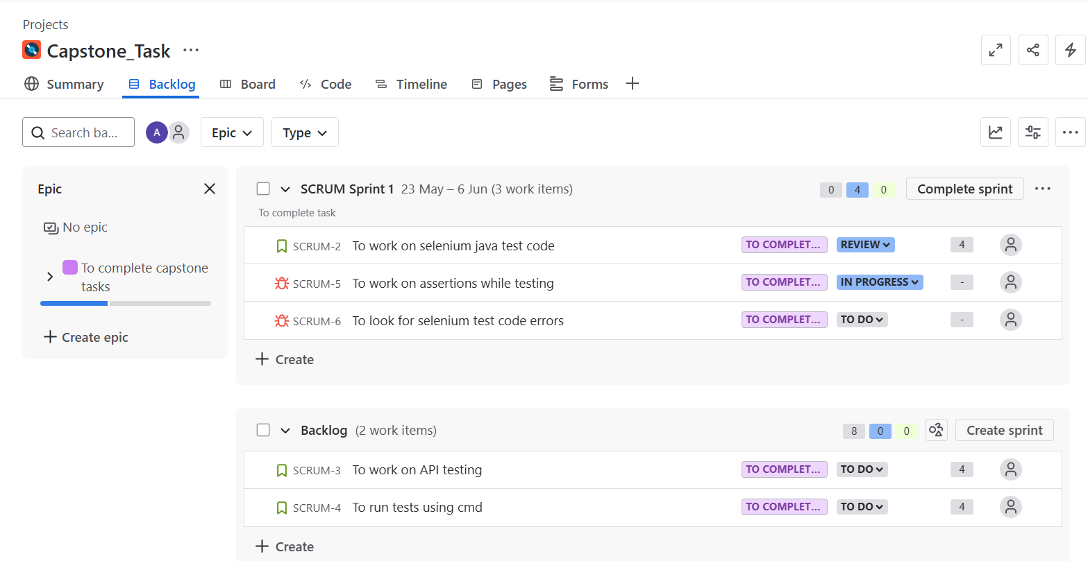
JIRA DASHBOARD
CREATED ONE EPIC UNDER WHICH 3 STORY ARE DEFINED
FRIST STORY IS LINKED WITH 2 BUGS AND ARE PLACED IN SPRINT FOR EXECUTION AS THESE ARE OF HIGH IMPORTANCE
THE OTHER 2 STORY ARE IN BACKLOG

Slide 5
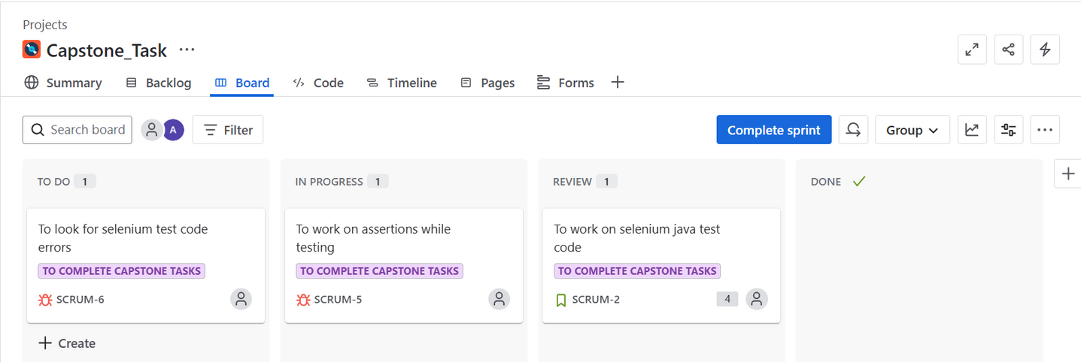
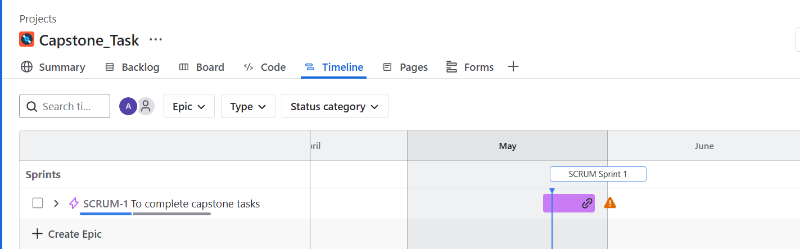
JIRA DASHBOARD
PROCESS OF SPRINT COMPLETION
SPECIFIED TIMELINE FOR SPRINT COMPLETION

Slide 6
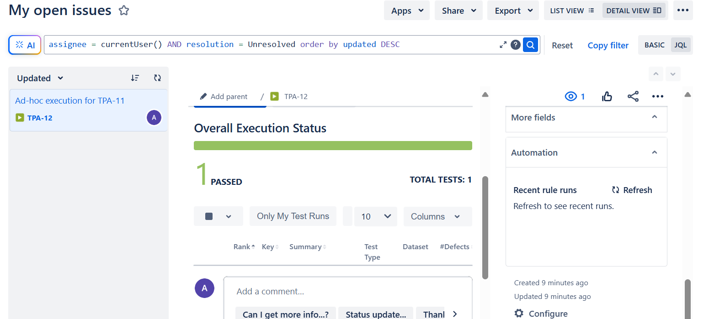
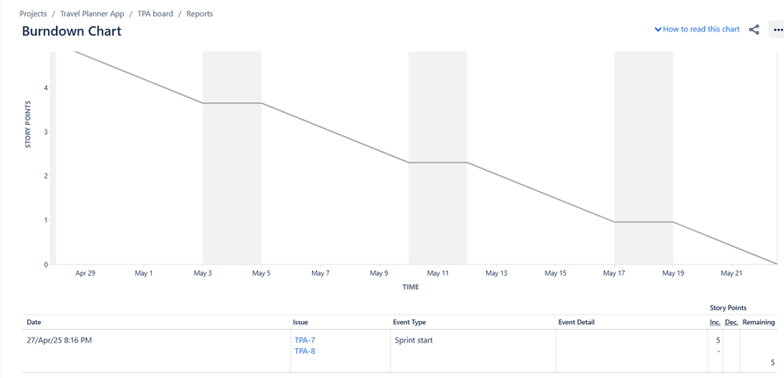
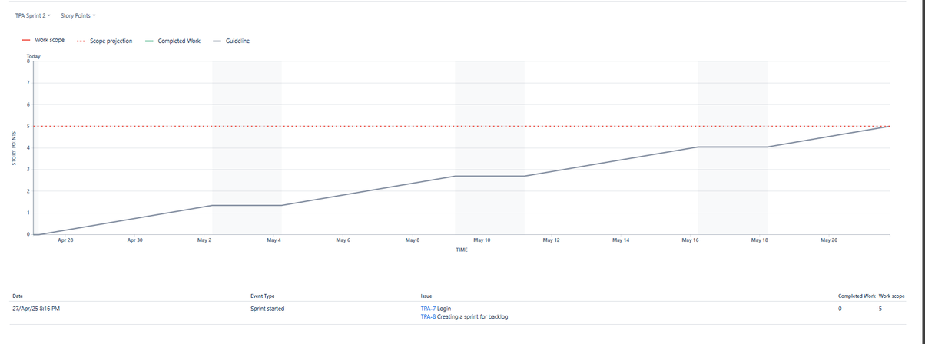
JIRA DASHBOARD
TEST EXECUTION RESULTS USING XRAY

Slide 7
SELENIUM WEB UI TEST AUTOMATION OVERVIEW
FEATURES:​
​​
TESTNG ASSERTIONS
LOG4J LOGGING FOR TRACEABILITY​
EXECUTION VIA TESTNG_CAPSTONE.XML​
SCREENSHOT CAPTURE ON TEST FAILURE​
HEADED AND HEADLESS MODE VIA CONFIG.PROPERTIES​
​
TECH STACK:
JAVA
SELENIUM WEBDRIVER
TESTNG
MAVEN​
CODE DESIGN PATTERN:
PAGE OBJECT MODEL (POM)​

Slide 8
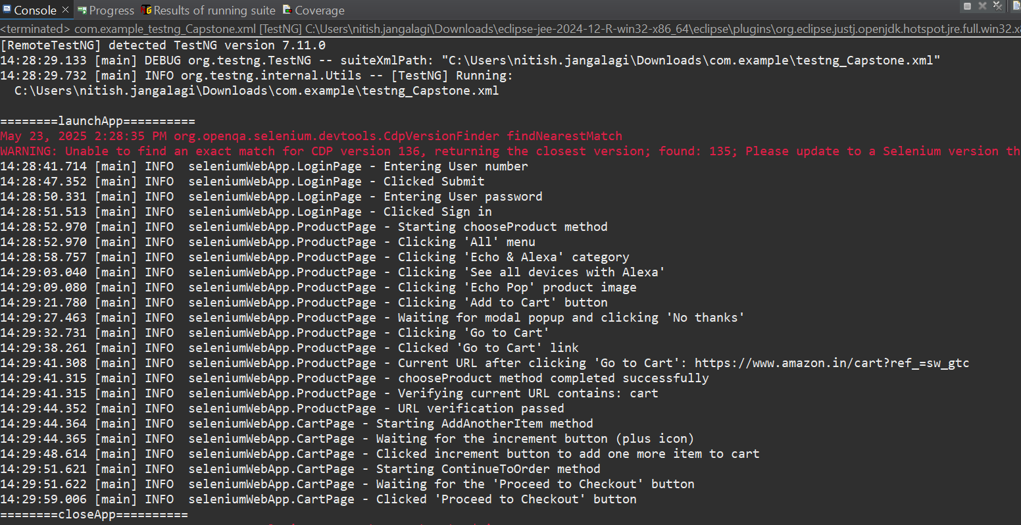
SELENIUM WEB UI TEST AUTOMATION
WEB APPLICATION USED IS AMAZON
TEST EXECUTION FLOW USING LOGS :
USAGE OF PAGE OBJECT MODEL , ASSERTIONS AND LOGGING
DESIGNED CODE FOR BOTH HEADED AND HEADLESS MODE USING CONFIG.PROPERTIES FILE
EXECUTED TEST FROM TESTNG_CAPSTONE.XML FILE

Slide 9
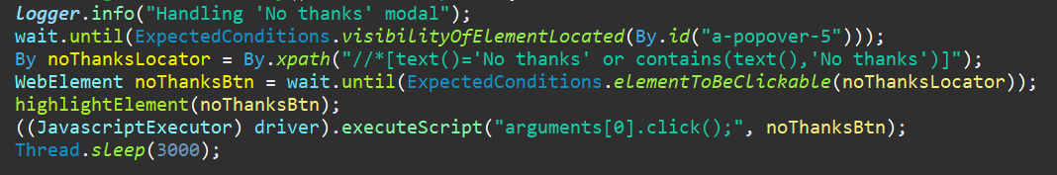
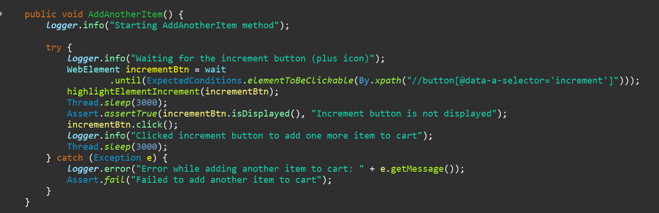
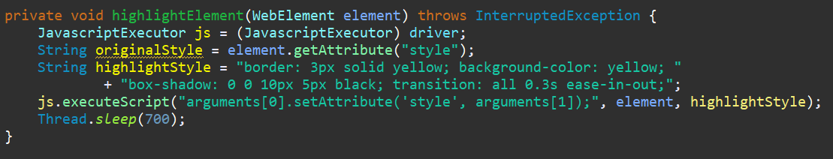
SELENIUM WEB UI TEST AUTOMATION
(CODE SNIPPETS )
TO FIND AND CLICK ELEMENT
STRUCTURE OF A METHOD
METHOD FOR HIGHLIGHTNING
ELEMENTS

Slide 10
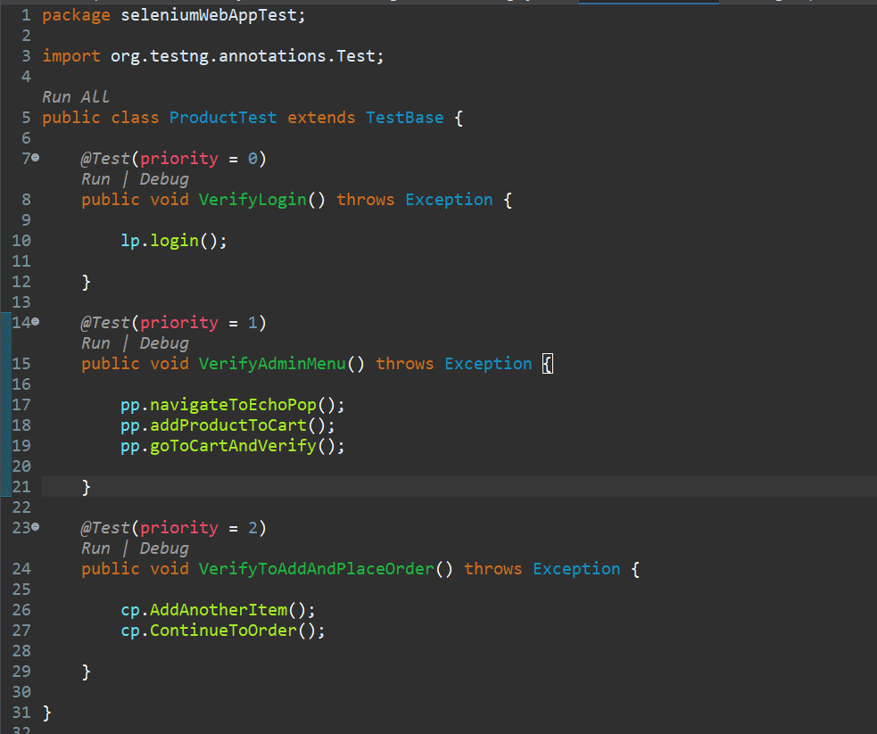
SELENIUM WEB UI TEST AUTOMATION
PRIORITY BASED TEST EXECUTION

Slide 11
API AUTOMATION WITH POSTMAN AND NEWMAN
VALIDATION CHECKS:​
HTTP STATUS CODES: 200, 201​ ,404
RESPONSE BODY CONTENT: E.G., APPLE IPHONE 14​
RESPONSE TIME: UNDER 2000MS​
HEADER : CONTENT-TYPE: APPLICATION/JSON​
TECH STACK:
POSTMAN
NEWMAN CLI
REQUESTS AUTOMATED:​
GET/USERS — FETCH ALL USERS
POST /USERS— ADD A NEW USER
GET /USERS/{{USERID}} — FETCH USER BY ID​
PUT /USERS/{{USERID}} — UPDATE USER BY ID​
DELETE /USERS/{{USERID}} — DELETE USER BY ID​
COMMAND LINE EXECUTION:
RUN NEWMAN VIA CMD
GENERATE HTML REPORT
STORE OUTPUT AT NEWMAN FOLDER

Slide 12
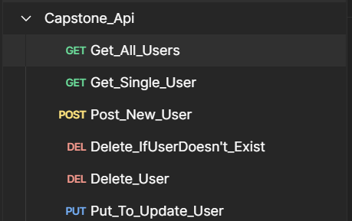
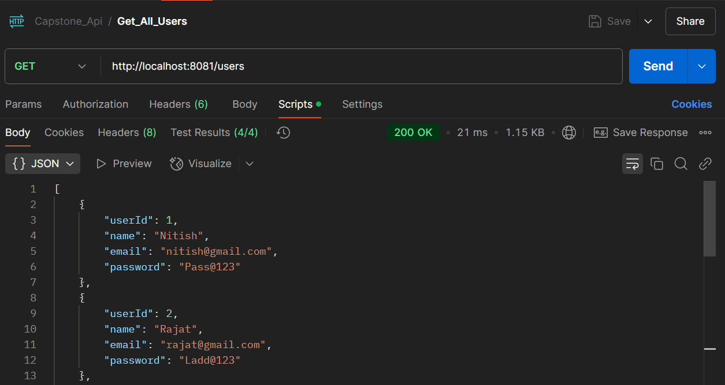
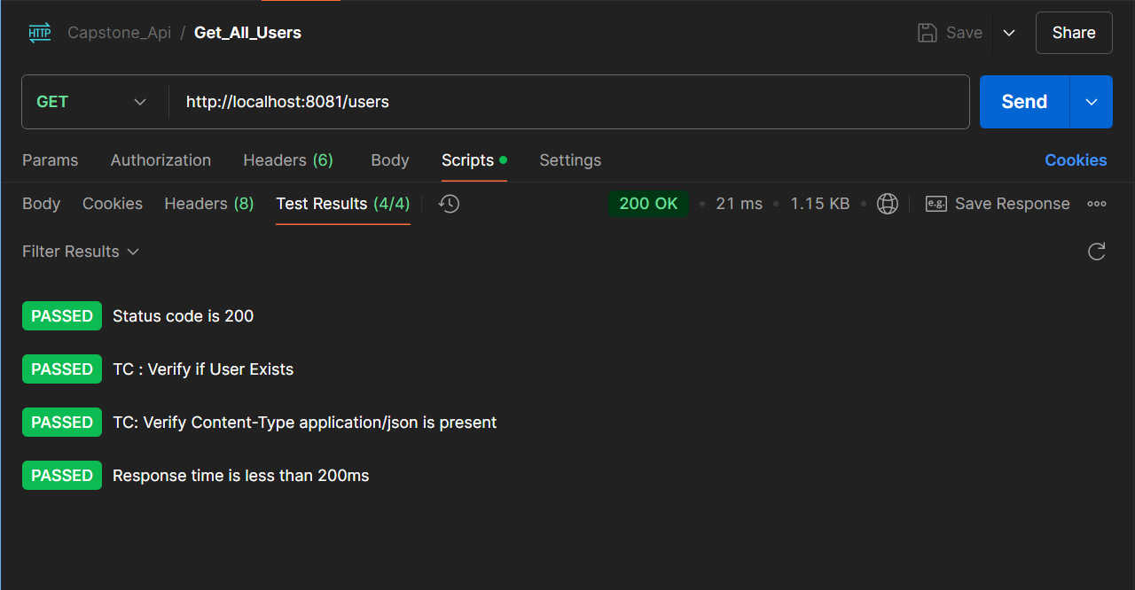
API AUTOMATION WITH POSTMAN AND NEWMAN
API USED : http://localhost:8081/users
PERFORMED REQUESTS FOR GET,PUT,POST,DELETE
POSTMAN COLLECTION DESIGN SCREENSHOT ATTACHED
GET REQUEST

Slide 13
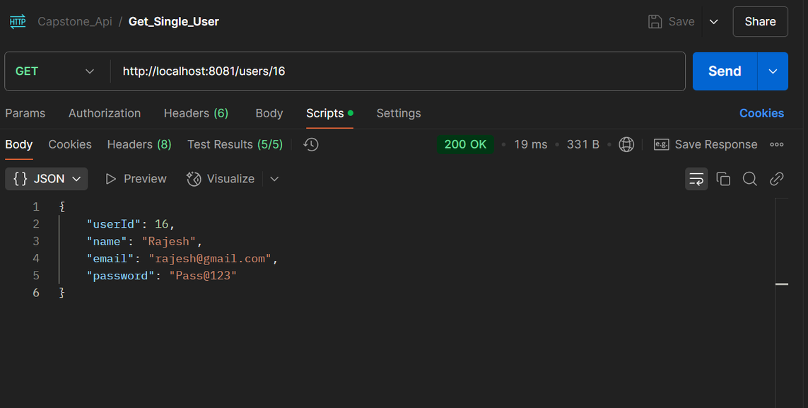
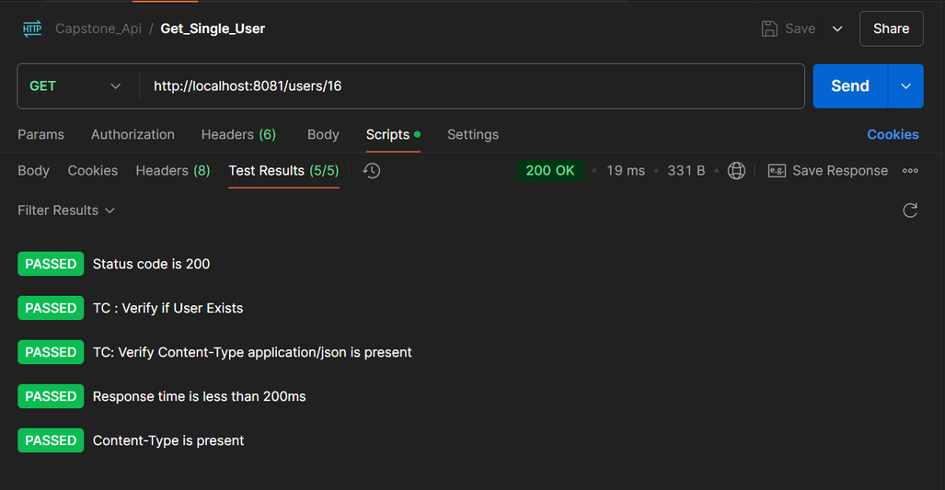
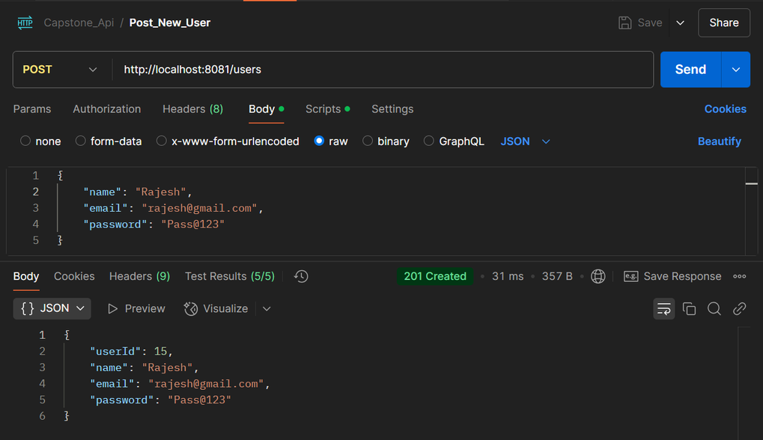
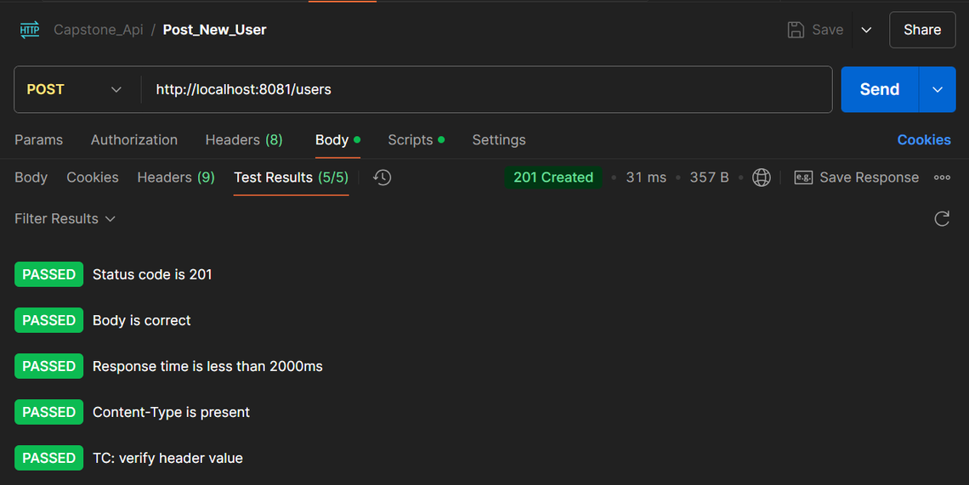
API AUTOMATION WITH POSTMAN AND NEWMAN
GET REQUEST TO GET SINGLE USER
POST REQUEST

Slide 14
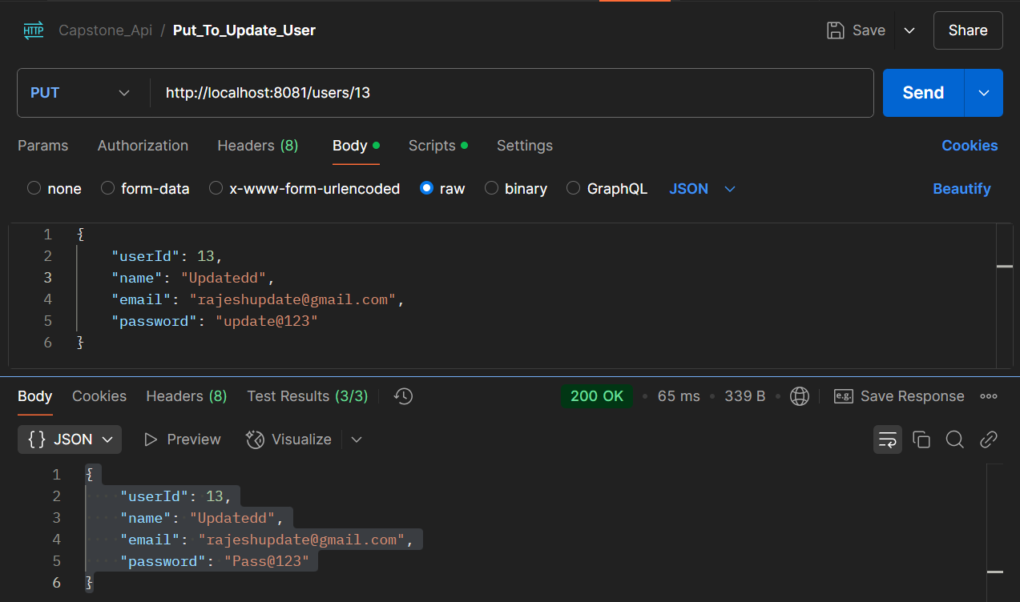
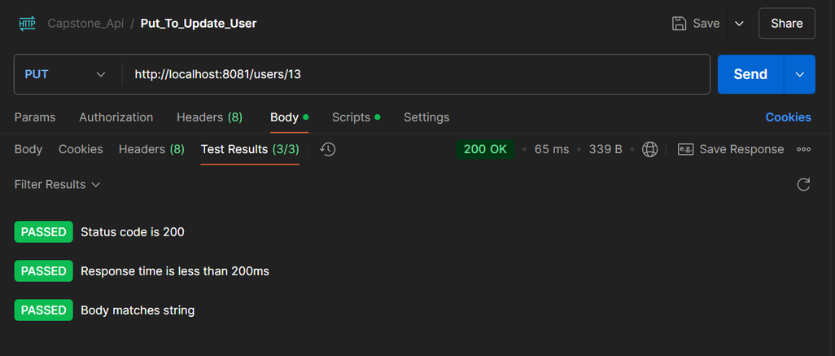
API AUTOMATION WITH POSTMAN AND NEWMAN
PUT REQUEST

Slide 15
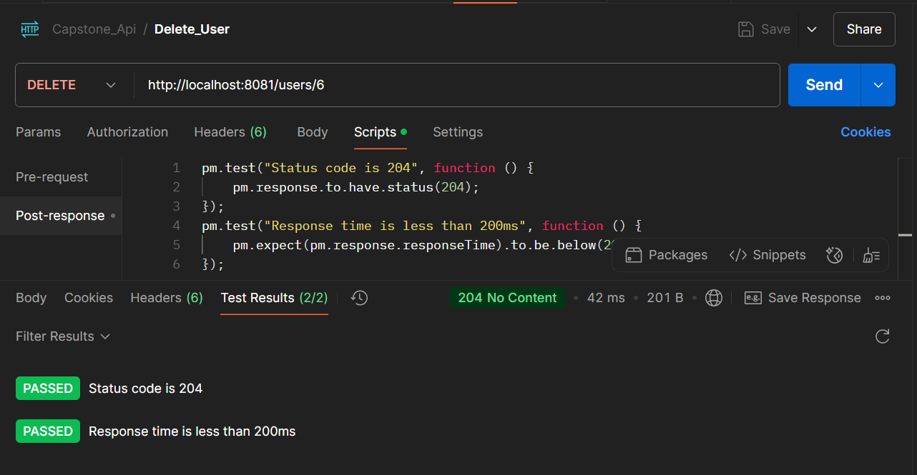
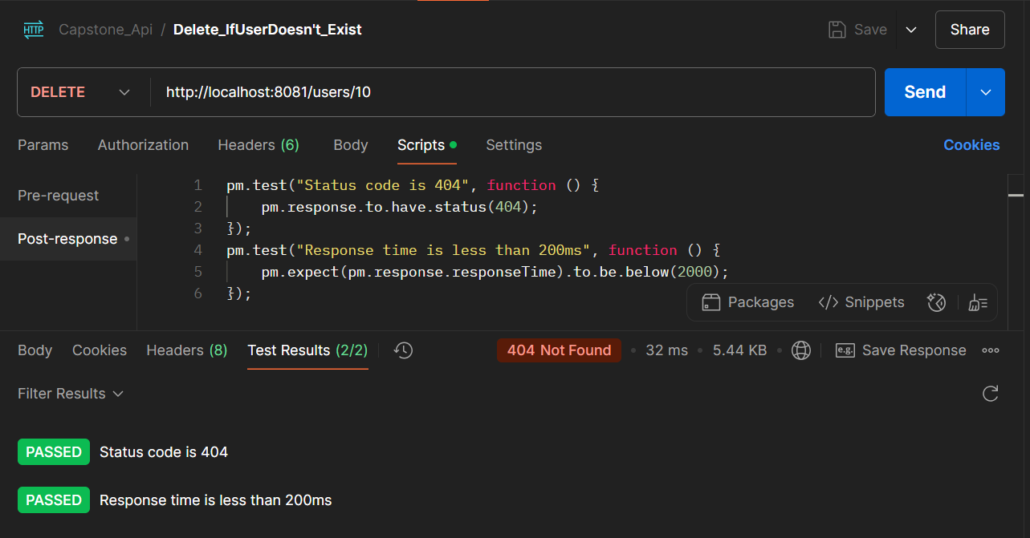
API AUTOMATION WITH POSTMAN AND NEWMAN
DELETE REQUEST

Slide 16
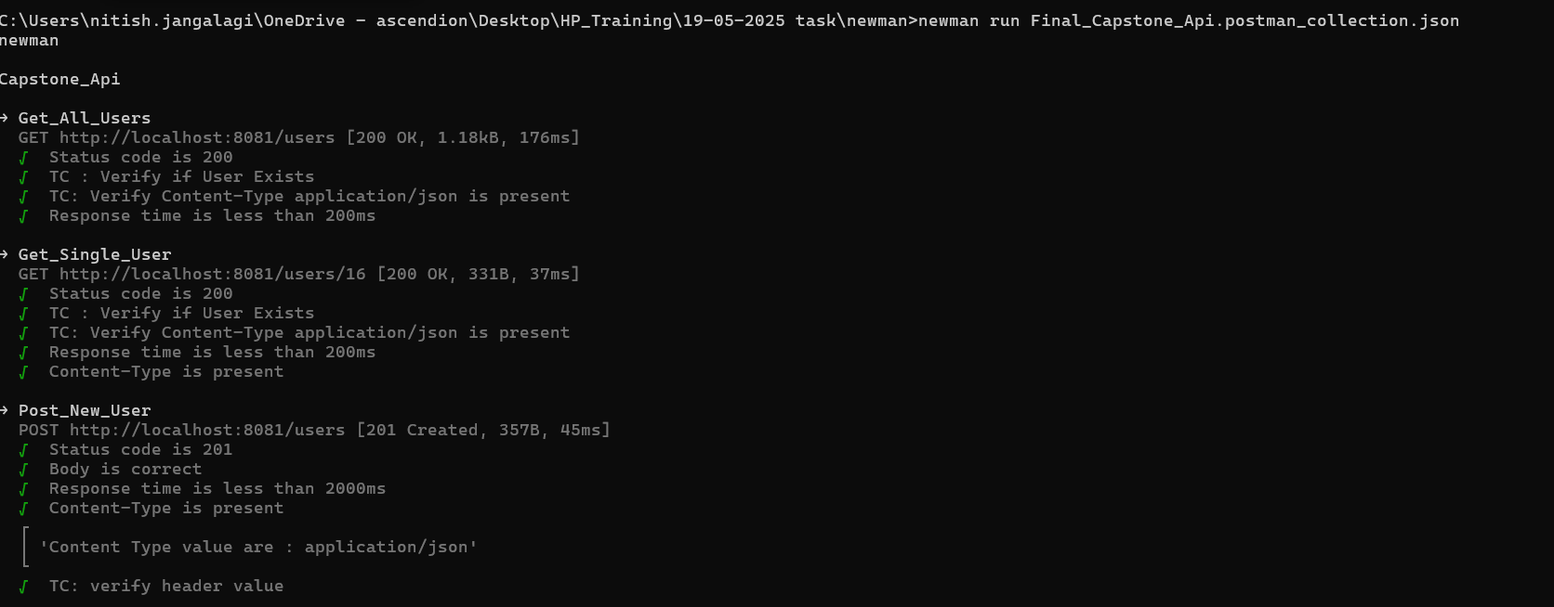
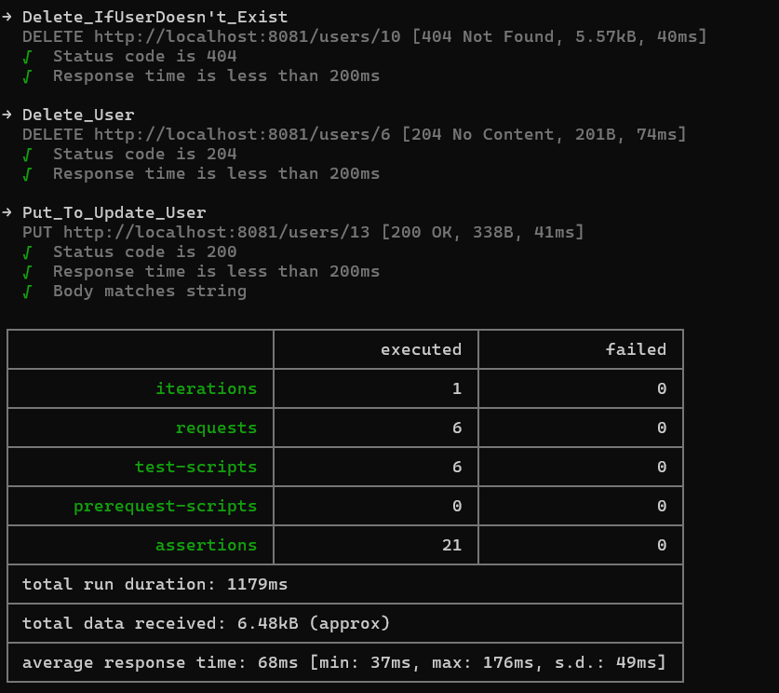
API AUTOMATION WITH POSTMAN AND NEWMAN
EXECUTING THE EXPORTED COLLECTION IN CMD FROM POSTMAN USING NEWMAN
COMMAND TO GENERATE HTML REPORT

Slide 17
CONCLUSION :
AS PART OF THIS QUALITY ENGINEERING CAPSTONE PROJECT, I HAVE GAINED HANDS-ON EXPERIENCE IN BOTH UI AND API TEST AUTOMATION, AND LEARNED THE FOLLOWING:
DESIGNED STRUCTURED SELENIUM WEB UI TEST CASES USING JAVA, TESTNG, AND THE PAGE OBJECT MODEL (POM) FOR MAINTAINABILITY AND SCALABILITY.
IMPLEMENTED FUNCTIONAL TEST SCENARIOS (E.G., PRODUCT SEARCH, CART OPERATIONS), ADDED ASSERTIONS, LOGGING (LOG4J)
ENABLED HEADLESS/HEADED TEST EXECUTION DYNAMICALLY USING A CONFIGURATION FILE, IDEAL FOR BOTH LOCAL AND CI/CD ENVIRONMENTS.
BUILT AND VALIDATED POSTMAN API TESTS COVERING MAJOR HTTP METHODS (GET, POST, PUT, DELETE), WITH CHECKS ON STATUS CODES, RESPONSE BODY, HEADERS, AND PERFORMANCE.
EXECUTED API TESTS USING NEWMAN CLI, WITH COMMAND-LINE REPORTING AND HTML REPORTS USING THE HTMLEXTRA REPORTER FOR BETTER VISIBILITY.

Slide 18
THANK YOU

