Slide 1














Healthcare Management
System
-Presented by : Nitish Jangalagi

Slide 2

Technology Stack for Healthcare Management System
Frontend: Angular, HTML, CSS
Backend: Spring Boot (Java), Spring Data JPA
Database: MySQL
Other Tools: Postman (for API testing)

Slide 3
Requirements Met
Valid Email Address: The Administrator ID must be a valid email address.
Password Requirements: The password must contain at least one uppercase letter, one lowercase letter, one digit, and one special character.
Non-Blank Fields: Both the email ID and password cannot be blank.
Error Handling: Appropriate error messages will be displayed for incorrect login credentials.
Maximum Attempts: The administrator has a maximum of three attempts to enter the correct credentials.
Account Lock: After three consecutive invalid login attempts, the account will be temporarily disabled for 30 minutes.
Successful Login: Upon correct credentials, the administrator is granted access to the application menu.

Slide 4
Structure
Login
The application starts with a login page where administrators can enter their credentials, and if not registered, they can register through the "Register" option.
After successful registration, administrators can log in with their new credentials to access the application, with proper data validation in place.
Dashboard
After successful login, the administrator is directed to the application menu, which provides access to various components such as appointments, doctors, hospitals, patients, and reviews.
The application menu allows the admin to navigate through different sections to manage and view required details, ensuring efficient healthcare management.
Component
Upon selecting a particular component, the administrator can view relevant data fetched from the backend, displayed in a user-friendly interface for efficient management.
The component supports CRUD operations (Create, Read, Update, Delete), allowing the admin to add, update, delete, or search specific data as required.

Slide 5
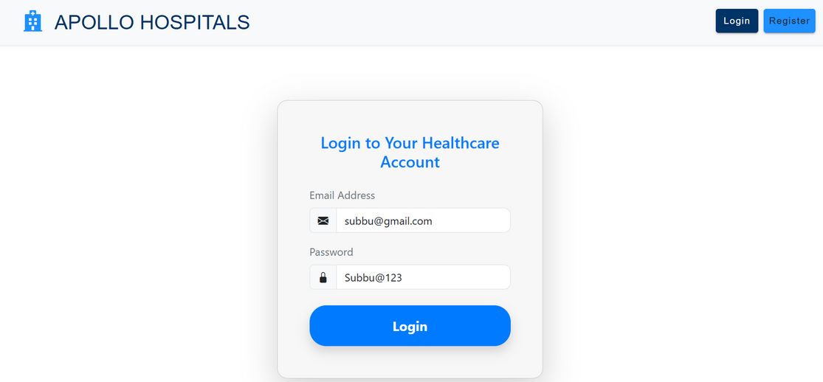
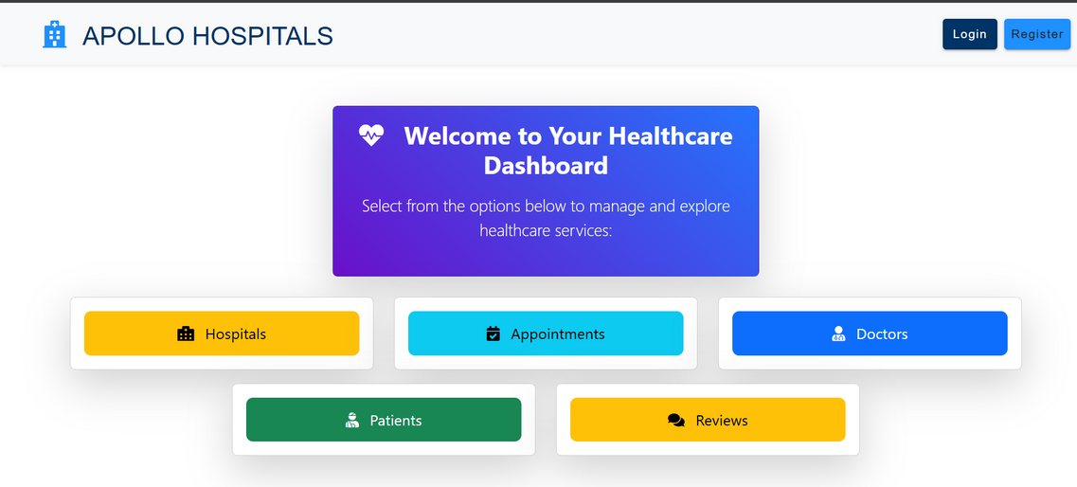
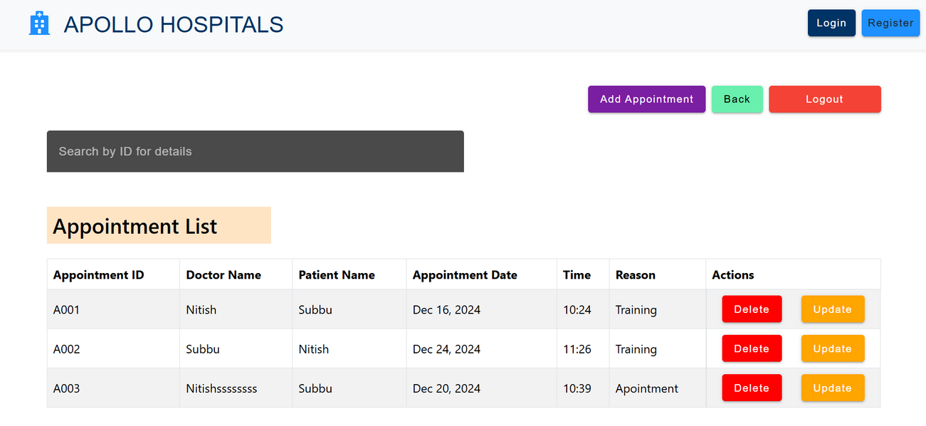
ARCHITECTURE

Slide 6
ERRORS FACED
01
02
03
Mapping using
@JsonProperty:
Occurs when field names in Java and the JSON data differ
Ex:
// The JSON field 'doctor_id' is mapped to 'doctorId' in Java@JsonProperty("doctor_id")private String doctorId;
Data display when update component viewed
Resolved by fetching data and displaying using service
Injecting component directly inside other component throws
Erroe:
NullInjectorError: No provider for _DoctorsListComponent!
ex: under addDoctorComponent
constructor(doctorComponent:DoctorComponent)

Slide 7
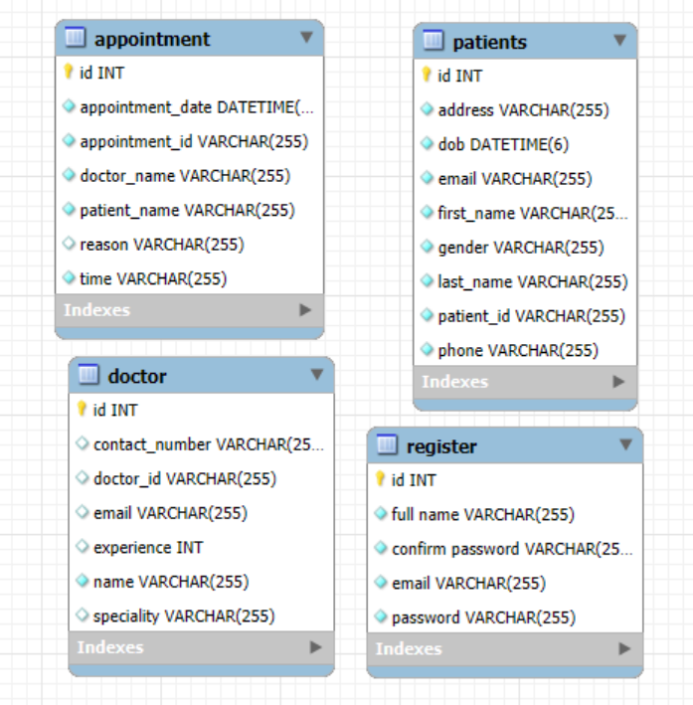
ER DIAGRAM

Slide 8

Scope Of Improvement
Mainly to focus and work on building attractive UI.
To enhance debugging skills .
Strengths
Adaptive Learning
learning new technologies
Understanding logic

Slide 9
Thank you very much!

