Slide 1


HOSPITALCARE MANAGEMENT SYSTEM
Komal Rokhade
Asscociate Engineer
11/Dec/2024
Guided by:
Subramanian

Slide 2
Technologies Used
Frontend: Angular
Backend: Spring Boot
Database: MySQL
Styling: CSS and Bootstrap
Other tools: Postman (for testing), etc.

Slide 3
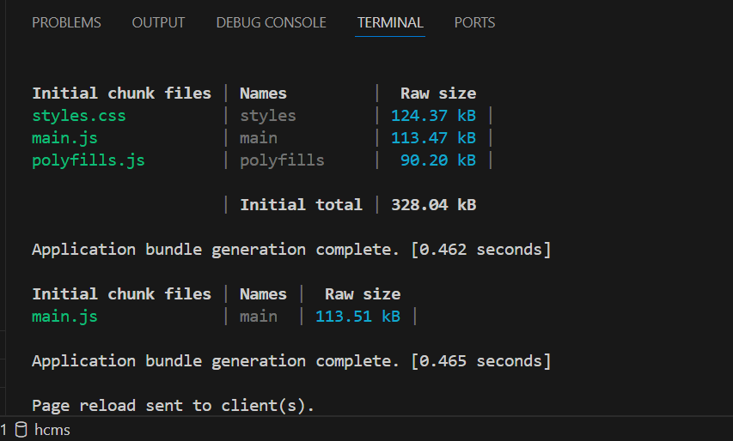
Starting the Application
Launch the application by running the ng serve command in the terminal.
The application will be accessible at: http://localhost:4200/

Slide 4
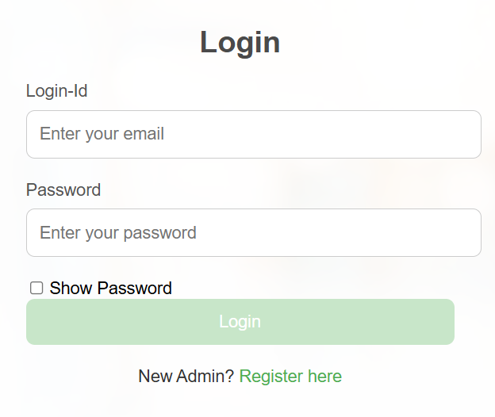
Login Component
Launch the application by running the ng serve command in the terminal.
The application will be accessible at: http://localhost:4200/

Slide 5
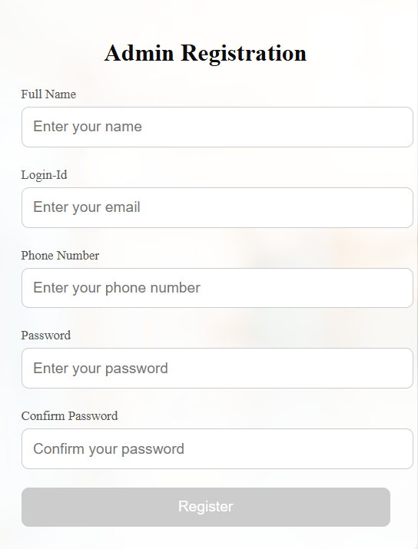
Register Component
The application currently supports admin registration only.
After successful registration, the admin can log in and gain full access to the system’s features.

Slide 6
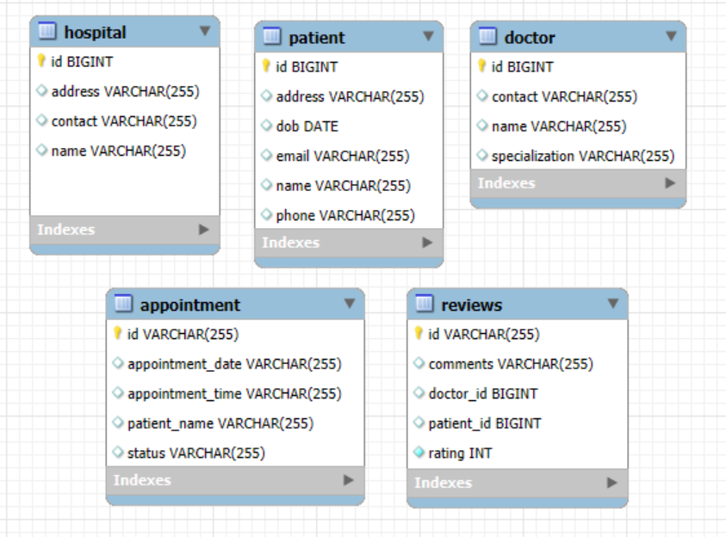
Database Diagram

Slide 7
Dashboard
After a successful login, the user is redirected to the Dashboard page.
From the Dashboard, the admin can choose from various options such as:
Doctors
Patients
Hospitals
Appointments
Reviews

Slide 8
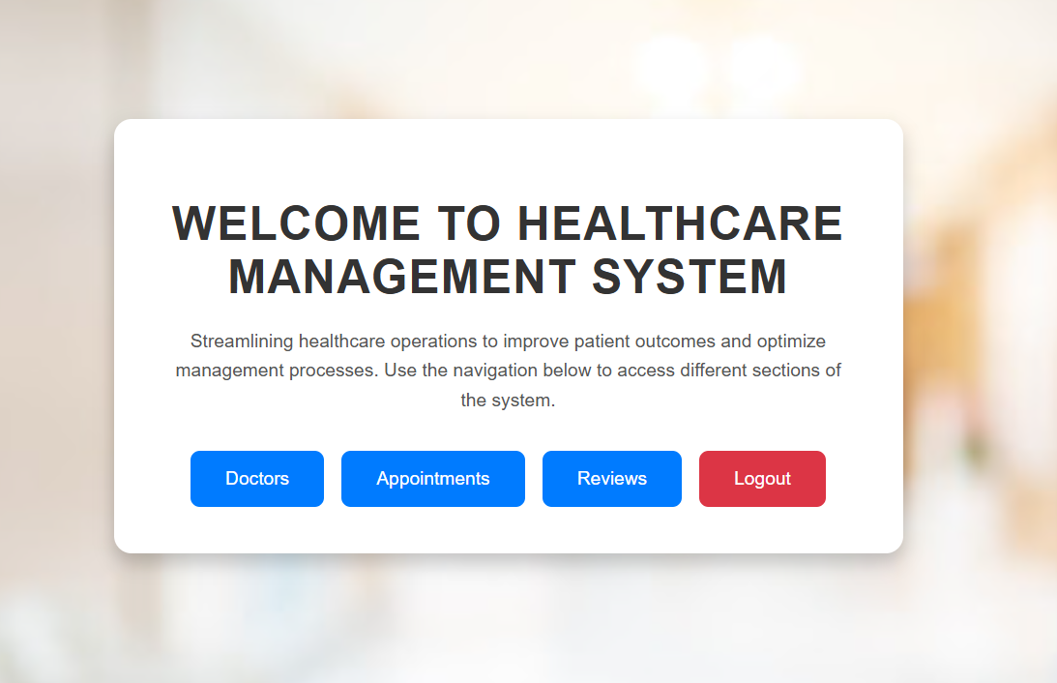
Dashboard

Slide 9
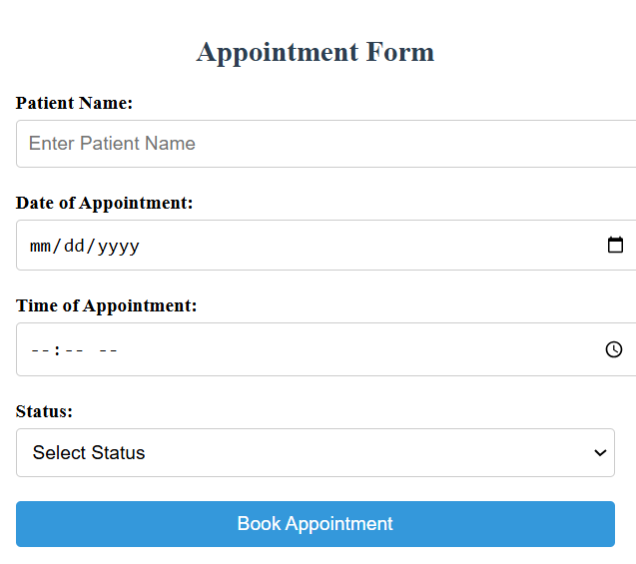
Appointment Bookings
Admin can create, view, update, and delete appointments.
All tasks are managed through the Manage Appointment Component.

Slide 10
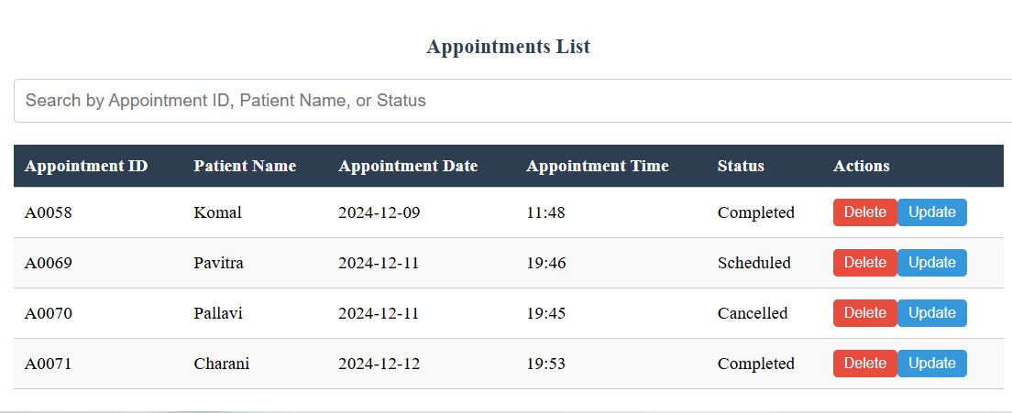
Manage Appointments
View all appointments in the Manage Appointments section.
Appointments can be edited or deleted as needed.
Each appointment is assigned a unique ID in the A0000 format.

Slide 11
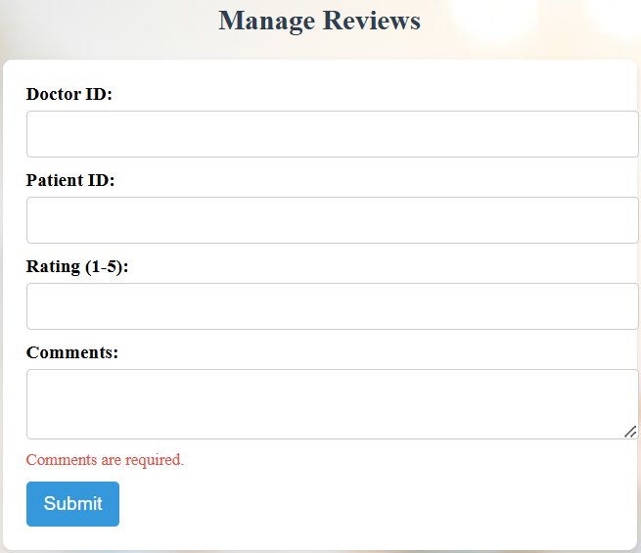
Manage Reviews
User can create, view and delete reviews.
All tasks are handled through the Manage Review component.

Slide 12
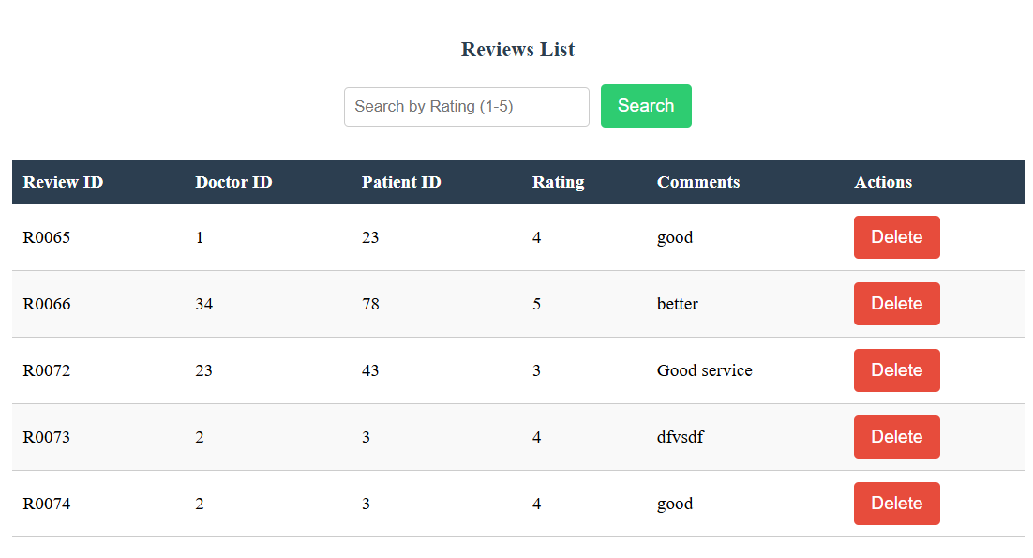
Manage Reviews
Users can see the list of reviews.
Reviews can be filtered based on ratings.

Slide 13
Challenges faced
Connecting the Angular front-end with the Spring Boot back-end.
Using MySQL to store and manage data.
Ensuring secure user login and data protection.
Designing an easy-to-use interface with Angular.

Slide 14
Thank you

