Slide 1
VIRTUAL LEARNING SYSTEM
BODHA KULKARNI
Associate Software Engineer
Under the Guidance of : Subbu Sir

Slide 2
WHAT IS VIRTUAL LEARNING SYSTEM
Virtual Learning System or VLS is a app that allows administrators to manage various courses, authors, learners, registrations and reviews
The application is implemented with Spring Boot at the backend and Angular at the frontend.
The application is implemented in three versions:
• Version 1: An application with Frontend as Angular.
• Version 2: An application with Backend as Spring Boot and MySQL as Database
• Version 3: Connecting Frontend and Backend using Rest API’s.

Slide 3
FrontEnd-Angular
Angular is a web framework that empowers developers to build fast, reliable applications.
It is a component-based framework for building scalable web applications
It has collection of well-integrated libraries that cover a wide variety of features, including routing and forms management.
In the Project Angular is used to build Frontend components, create forms and connect them through routing.

Slide 4
Backend- Spring Boot
Spring Boot is a framework that simplifies building Java applications by providing pre-configured setups and reducing code time.
Auto-configuration: Automatically configures your application based on its dependencies, saving development time.
Embedded Servers: Includes built-in servers like Tomcat, so you can run applications without deploying them separately.
In the Project Spring Boot is used to build Backend and connect with SQL

Slide 5
REST API
REST APIs (Representational State Transfer Application Programming Interfaces) are a way for different systems to communicate by adhering to REST principles, using standard HTTP methods like GET, POST, PUT, and DELETE.
HTTP Methods: CRUD operations are mapped to HTTP verbs:
GET: Retrieve data
POST: Create new data
PUT: Update existing data
DELETE: Remove data
Used in the Project to connect Frontend,Backend and Database.

Slide 6
Components :
Admin registration: Used to register Admin
Login: Login with Proper Credentials
Courses: Add and display Courses
Authors: Add and display Authors
Learners: Add and view Learners
Reviews: Add and view Reviews

Slide 7
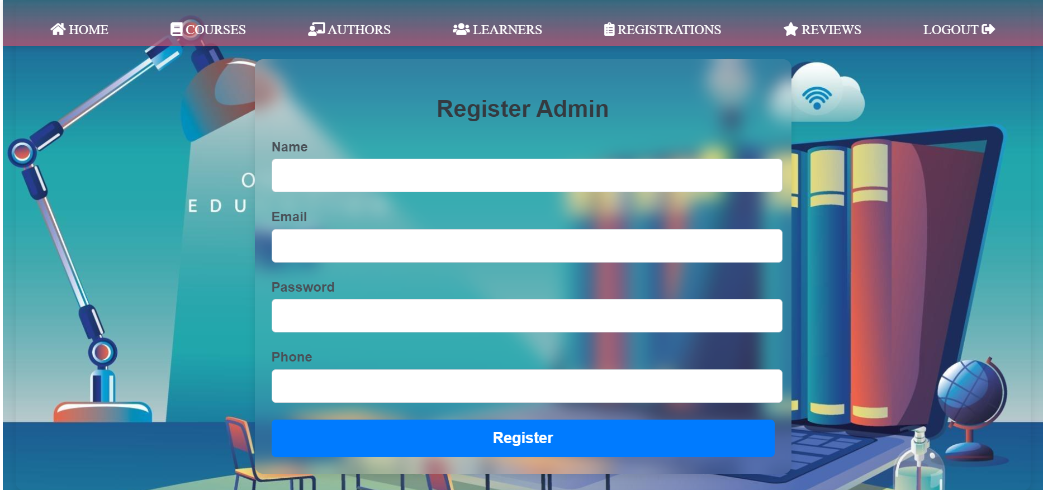
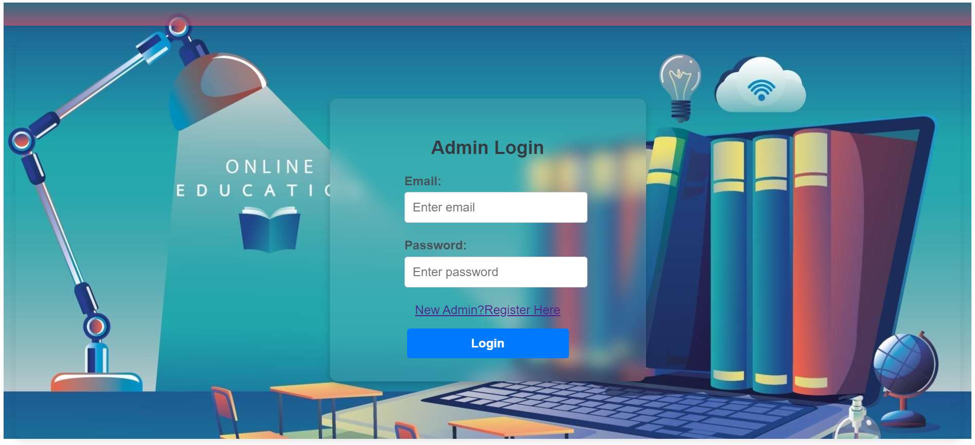
Admin registration and Login

Slide 8
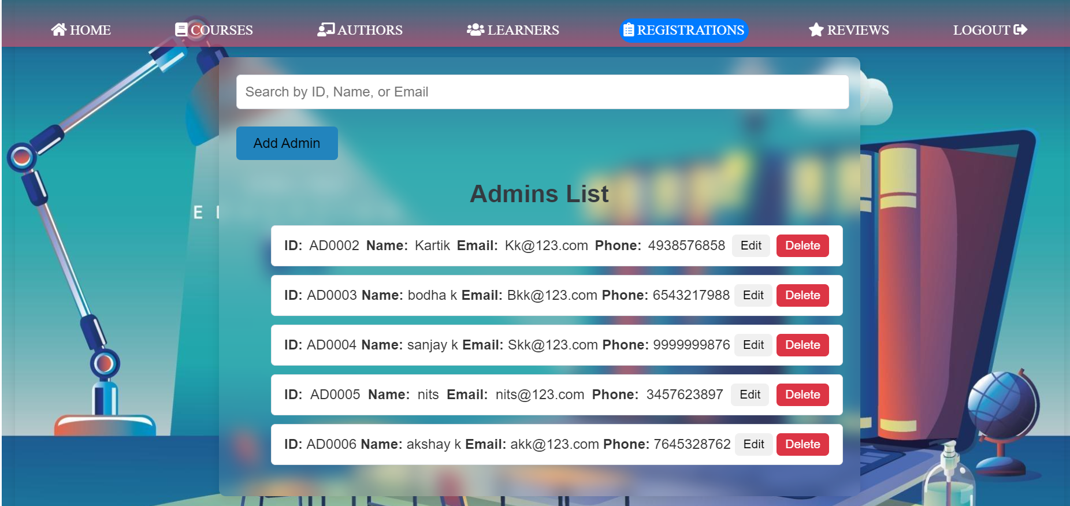
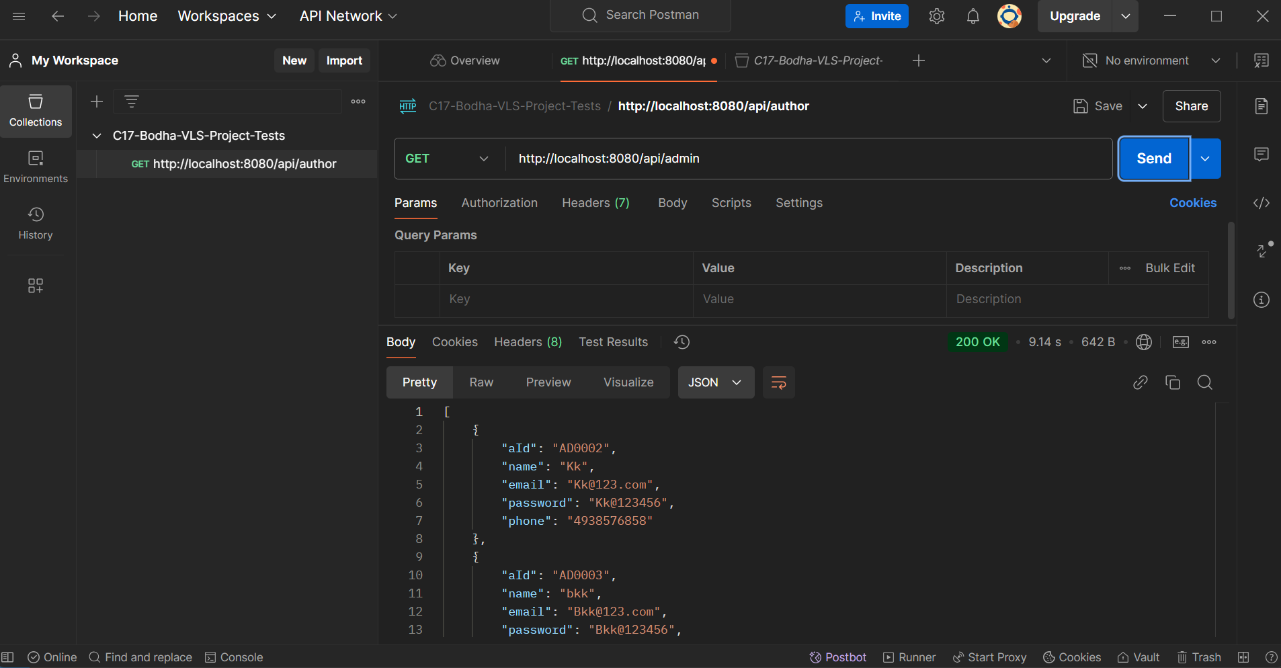
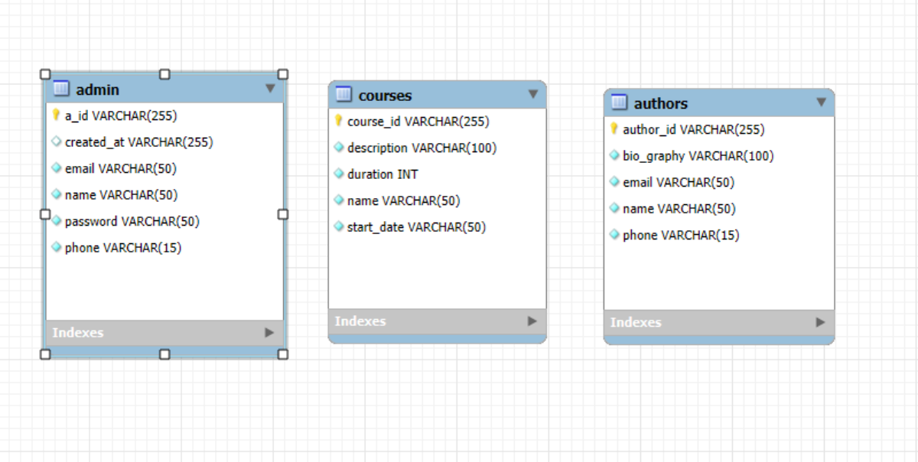
Registrations Testing and ER diagram

Slide 9
Challenges Faced
Learning and Implementing Spring Boot
Problems with CORS policy and Cross Origin
Understanding Spring Boot and MySql database connection

Slide 10
CONCLUSION
The Virtual Learning System or VLS is able register administrators to manage various courses, authors, learners and reviews. The admin registration is able to Register admins and can be logged in through Login component, Admin is able to add and view Courses, authors learners and reviews.

