Slide 1


PROJECT ON VIRTUAL LEARNING SYSTEM
Lakkireddy Charani

Slide 2
TECHNOLOGIES USED
Frontend : Angular
Backend : Springboot
Database : MySQL
Styling : CSS and BootStrap

Slide 3
Angular
Springboot
Angular is a web application framework designed to build dynamic and interactive single-page applications (SPA) efficiently.
In this project, the admin dashboard was built with reusable components for CRUD operations.
Spring Boot is an open-source Java framework used to create a Micro Service.
Developed RESTful APIs to handle CRUD operations for the admin module.
Implemented server-side validation and secure data handling with Spring Boot annotations.

Slide 4
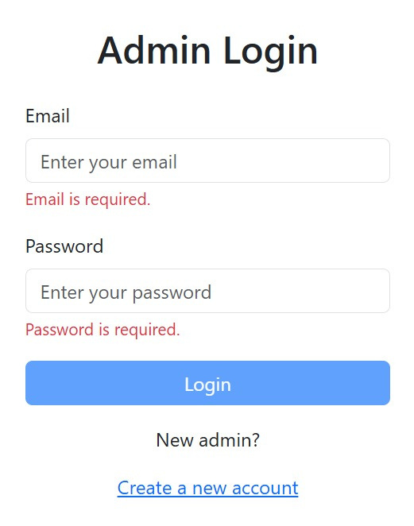
LOGIN COMPONENT
Admin has to register first
Admin has to login to access the dashboard and other components.
On three failed attemps admin account will be blocked for 30 mins

Slide 5
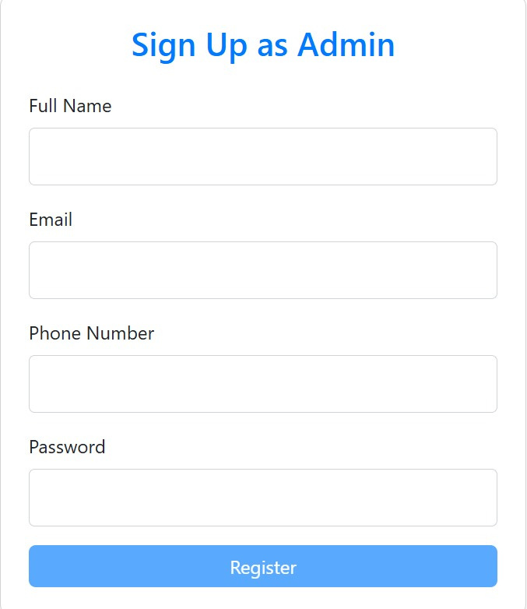
SIGN UP
The app contains only admin registrations
On registering admin can login and access the application

Slide 6
FEATURES AND FUNCTIONALITIES
User Authentication(Admin Login/Register)
CRUD - Courses, Authors, Learners, Registration and Reviews.
Validations in the pages.
Used Angular services to store and manage authentication tokens securely.

Slide 7
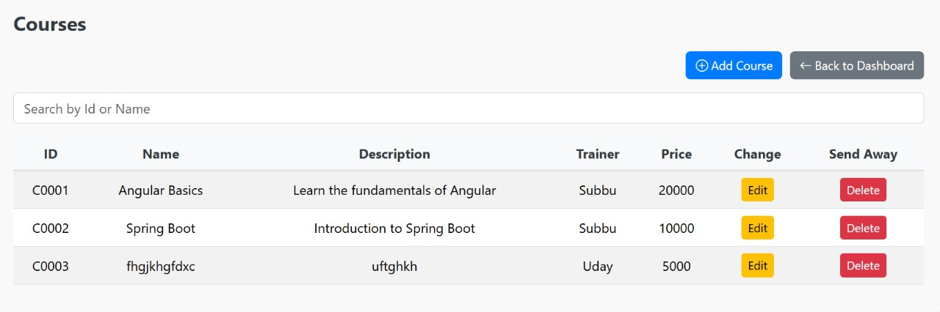
COURSES MANAGEMENT
Features:
Add new courses with detailed information.
Update existing course details.
View all courses in a search bar
Delete courses securely with confirmation dialogs.

Slide 8
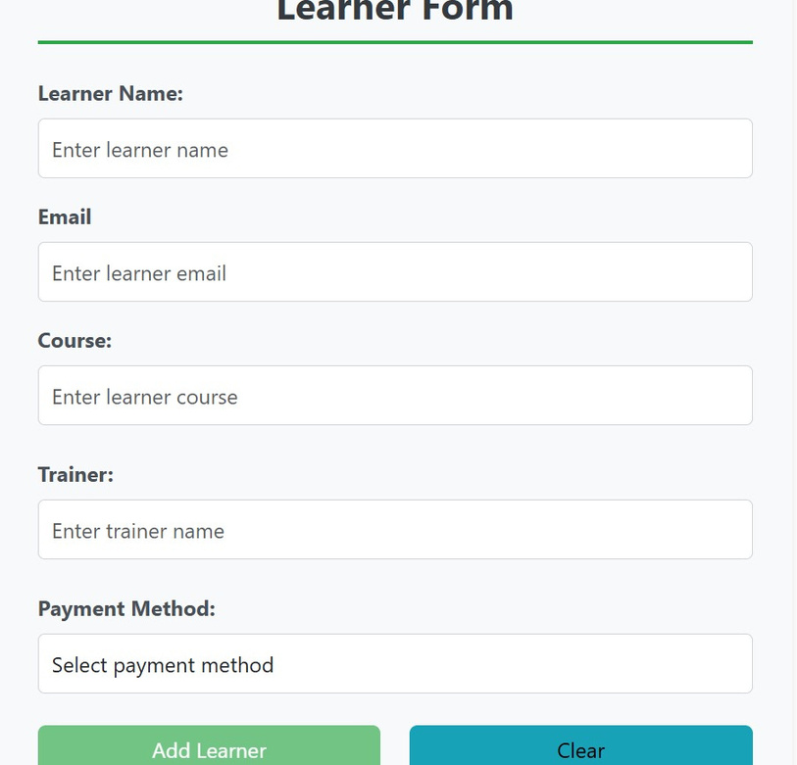
LEARNER MANAGEMENT
Purpose:
Allow administrators to manage learners effectively within the system.
Features:
Add new learners with detailed information.
Update existing learner details.
View all learners in a search bar
Delete learners securely with confirmation dialogs.

Slide 9
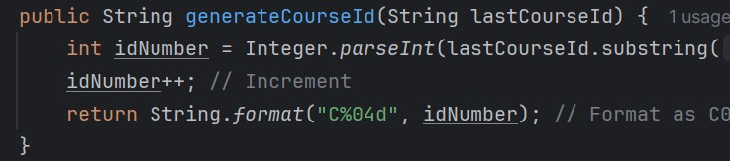
AUTOGENERATION OF ID
Purpose:
Ensure unique and structured identifiers for administrators.
Features:
Automatically generate Admin IDs in the format C0000, where each new admin receives the next available ID.
Maintain consistency and avoid manual errors in ID creation.

Slide 10
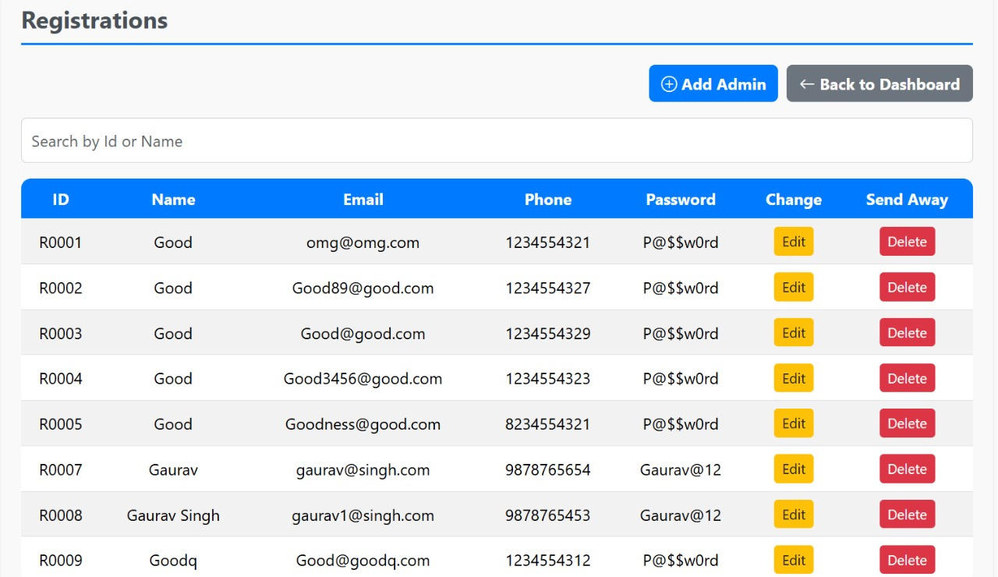
MANAGING ADMIN
You can view registered admin
One admin can delete other admin
Admin can add, delete and update the components

Slide 11
CHALLENGES FACED
PROJECT OUTCOME
Integrating frontend and backend efficiently
Managing state between components
Ensuring database consistency during updates
Utilized Angular services for state management
Followed best practices for API design and testing
Implemented database transactions for complex operations

Slide 12
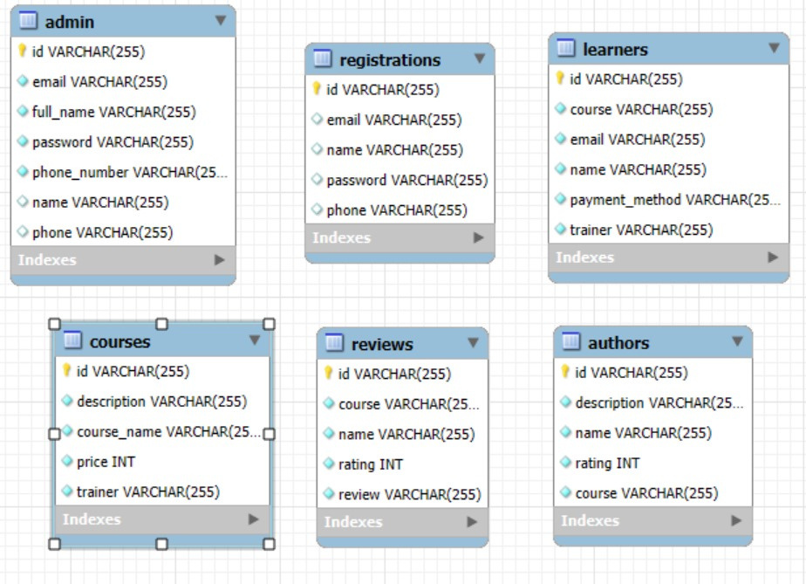
DATABASE DIAGRAM
Purpose:
Visualize the database structure for better understanding and planning.
Key Elements:
Admin Table:
Columns: AdminID, Name, Email, Password.
2. Courses Table:
Columns:CourseID,Title, Description, Duration.
3.Registrations Table:
Columns: , AdminID, Name, Email

Slide 13
CONCLUSION
KEY LEARNINGS
Successfully implemented a robust admin component
Seamless integration of Angular, Spring Boot, and MySQL
Admin-focused design with secure operations

Slide 14
Thank You

