Slide 1

Capstone Project

Slide 2



Personal BACKGROUND
(Name, Past Experience, Qualification, Career Summary)
Name : Abhishek S
Past Experience : Fresher
Qualification : BE CSE
Career Summary :
Eager Learner: A proactive fresher with a solid background in backend development, constantly expanding technical skills.
Technical Expertise: Proficient in Java, Spring Boot, REST APIs, and MySQL, with practical experience in scalable application development.
Project Success: Completed a capstone project in microservices architecture, demonstrating strong REST API and database management skills.
Key Skills: Developed strong analytical and communication abilities, ready to contribute effectively to dynamic teams.
www.collaberadigital.com

Slide 3


Key Takeaways/Learnings from the Program (HTD)
Advanced Technical Skill Enhancement
Real-World Project Implementation
Effective Collaboration and Communication
Agile Methodology Mastery
Strategic Problem-Solving and Debugging
Professional Growth and Mindset
Time Management and Prioritization
Critical Thinking and Innovation
Client-Centric Approach

Slide 4

Problem Statement of the Capstone Project
Develop a real-world project for administrators to manage airport details, plane information, and passenger bookings. The system involves creating microservices using Spring Boot.
Microservice Applications need to include:
Login Application
Admin Application
Plane Application
Airport Application
Booking Application
Flight Application
Passenger Application
The primary features include login authentication, CRUD operations for managing airports, planes, and bookings, and search functionalities.

Slide 5
MICROSERVICES IMPLEMENTED
ATS-LOGIN
ATS-ADMIN
ATS-BOOKING
ATS-PASSENGER
ATS-FLIGHTS
ATS-AIRPORT
ATS-PLANES

Slide 6
Microservices Implemented
Login Microservice
Functionality:
• Handles user authentication.
• Validates login credentials.
• Manages failed login attempts and account locking.
• Provides error messages for incorrect credentials or locked accounts.
Features:
• Locks accounts after three failed login attempts.
• Resets failed attempts and unlocks accounts on successful login.
• Integrates with the Booking microservice to fetch booking details upon successful login.

Slide 7
Booking Microservice
Functionality:
• Manages booking information and CRUD operations.
• Provides endpoints to fetch all bookings.
Features:
• Implements a BookingDto model for booking details.
• Supports operations like creating, reading, updating, and deleting bookings.
• Provides an API endpoint to retrieve all bookings, which is consumed by the Login microservice after a successful login.
Airport Microservice
Functionality:
• Manages airport-related information.
• Handles CRUD operations for airports.
Features:
• Contains fields such as ID, airportName,airportCode, and countryCode.
• Implements all necessary CRUD operations for airport management.

Slide 8
Plane Microservice
Functionality:
• Manages plane-related information.
• Handles CRUD operations for planes.
Features:
• Contains fields such as registrationNumber, planeMaker, model, imagePath and capacity.
• Implements all necessary CRUD operations for plane management.
Admin Microservice
Functionality:
• Manages user registration.
• Handles signup requests and validates input.
Features:
• Checks if the email already exists in the system.
• Provides appropriate messages if the user exists or if registration is successful.
• Stores new user details in the login table.

Slide 9
Passenger Microservice
Functionality:
• Manages passenger-related information.
• Handles CRUD operations for passenger.
Features:
• Contains fields such as ID, firstName, lastName, email and phoneNumber.
• Implements all necessary CRUD operations for passenger management.
Flight Microservice
Functionality:
• Manages flight-related information.
• Handles CRUD operations for flight.
Features:
• Contains fields such as ID, flightNumber, departure(Airport & Time) and arrival(Airport & Time).
• Implements all necessary CRUD operations for flight management.

Slide 10
DATABASE SCHEMA
LOGIN
BOOKING
PASSENGER
FLIGHTS
AIRPORT
PLANES

Slide 11
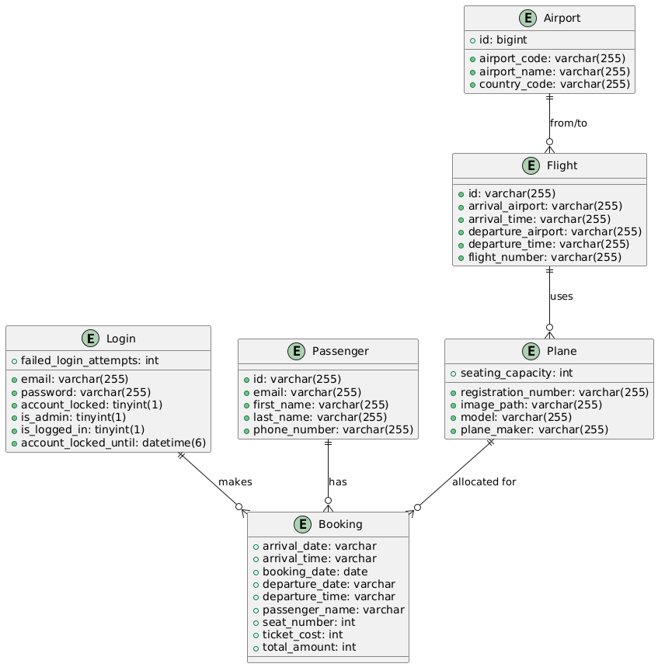
ER DIAGRAM

Slide 12

Service Integration:
• FeignClient: Used for communication between microservices.
For example, the Login microservice uses BookingFeignClient to fetch booking details from the Booking microservice.
Error Handling and Validation:
• Login Microservice: Implements password validation, failed login attempt tracking, account locking, and error messaging.
• Signup Microservice: Ensures unique email addresses and handles user registration.

Slide 13

Microservices Architecture:
Eureka Server: Used for service discovery.
Spring Boot & Spring Cloud: Used for developing and managing microservices.

Slide 14
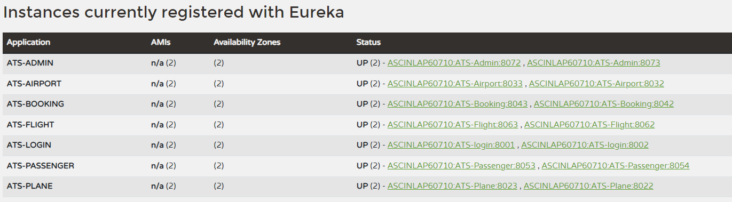
Important areas of the Project with screenshots
Eureka Server Running in AWS Server:

Slide 15
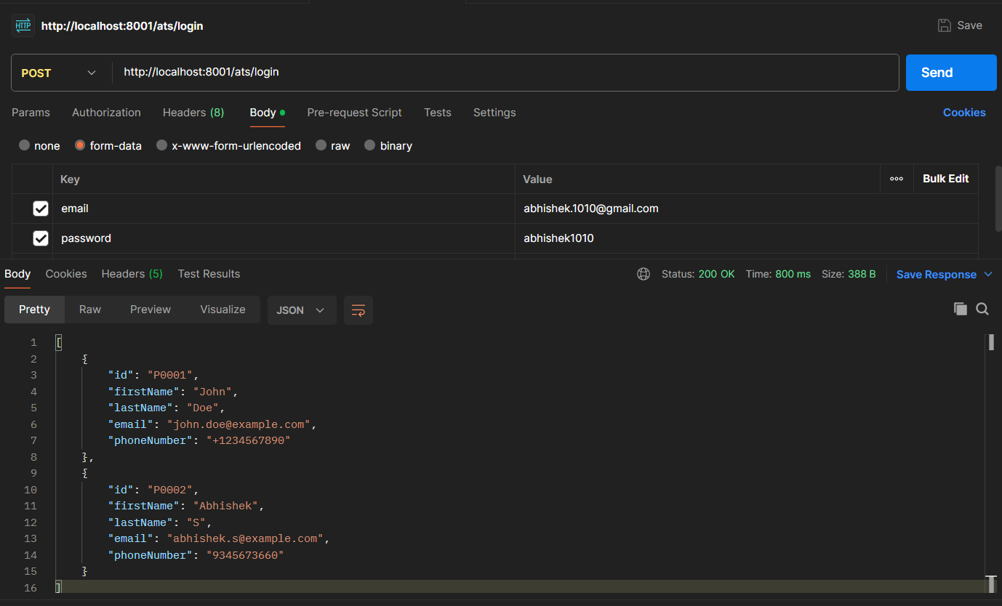
Testing with Postman:

Slide 16
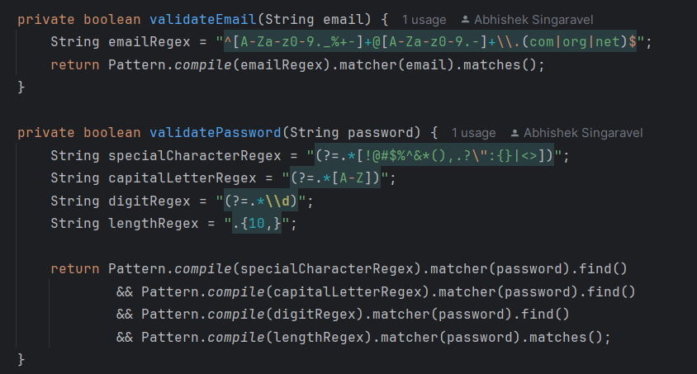
Validations of Email & Password

Slide 17
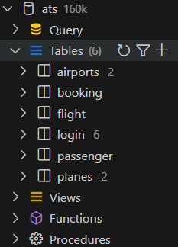
Database Structure

Slide 18
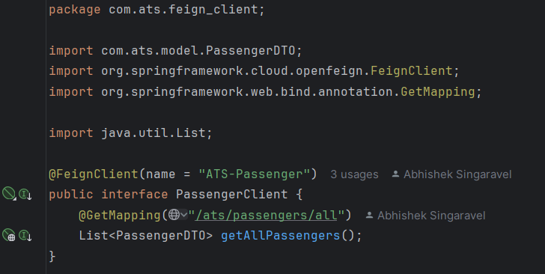
Feign Client Integration

Slide 19
Conclusion
The Air Transport System provides a comprehensive backend solution for managing air transport operations, developed using Spring Boot. It efficiently handles critical functionalities, including full CRUD operations for planes, airports, bookings, and user authentication. The project exemplifies the effective utilization of Spring Boot, Hibernate, REST API, JPA, and Maven. It integrates multiple microservices, such as login, booking, plane, and airport services, each meticulously designed with specific functionalities and seamlessly integrated to form a robust and cohesive system.

Slide 20
Thank You

