Slide 1
Software in the CaltechDATA Repository
Tom Morrell
Caltech Library, Pasadena, CA, USA
Scientific Software Registry Collaboration Workshop
November 14, 2019

Slide 2

CaltechDATA
Institutional Repository for Data and Software
Based on Invenio v3 (partner in InvenioRDM development)
Easy to describe and upload files
All records get a DOI
API for accessing data
Library takes care of preserving and maintaining access to files

Slide 3
CaltechDATA
Available since June 2017
1089 records, 186 software records
75 unique submitters
Generally quality metadata from user submissions

Slide 4

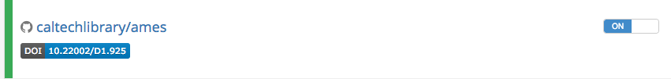
Software Preservation and Citation
GitHub integration automatically preserves software releases
Mints DOI and Provides Badge

Slide 5
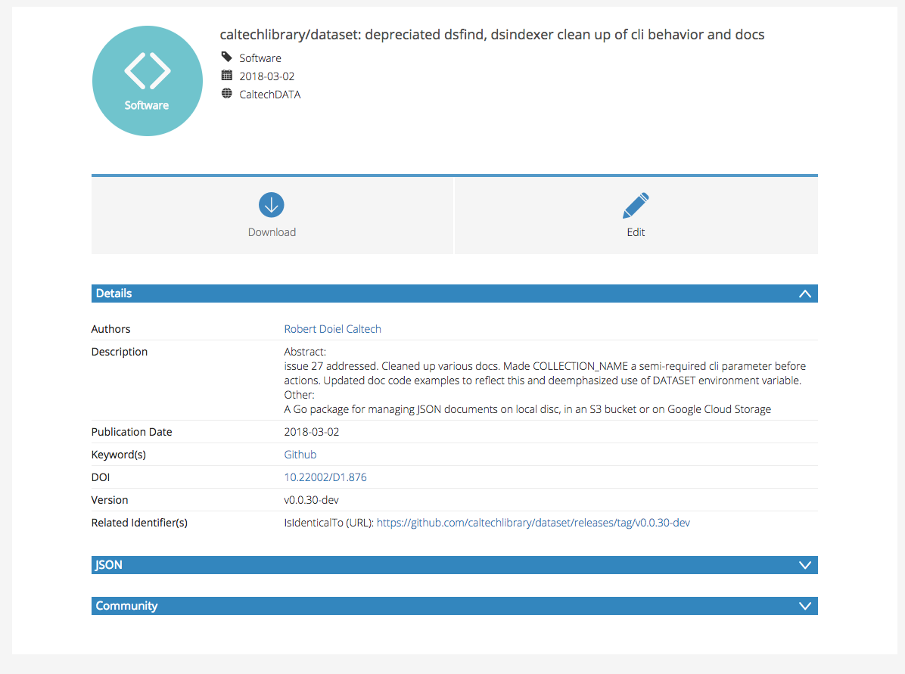
Initial GitHub Records

Slide 6
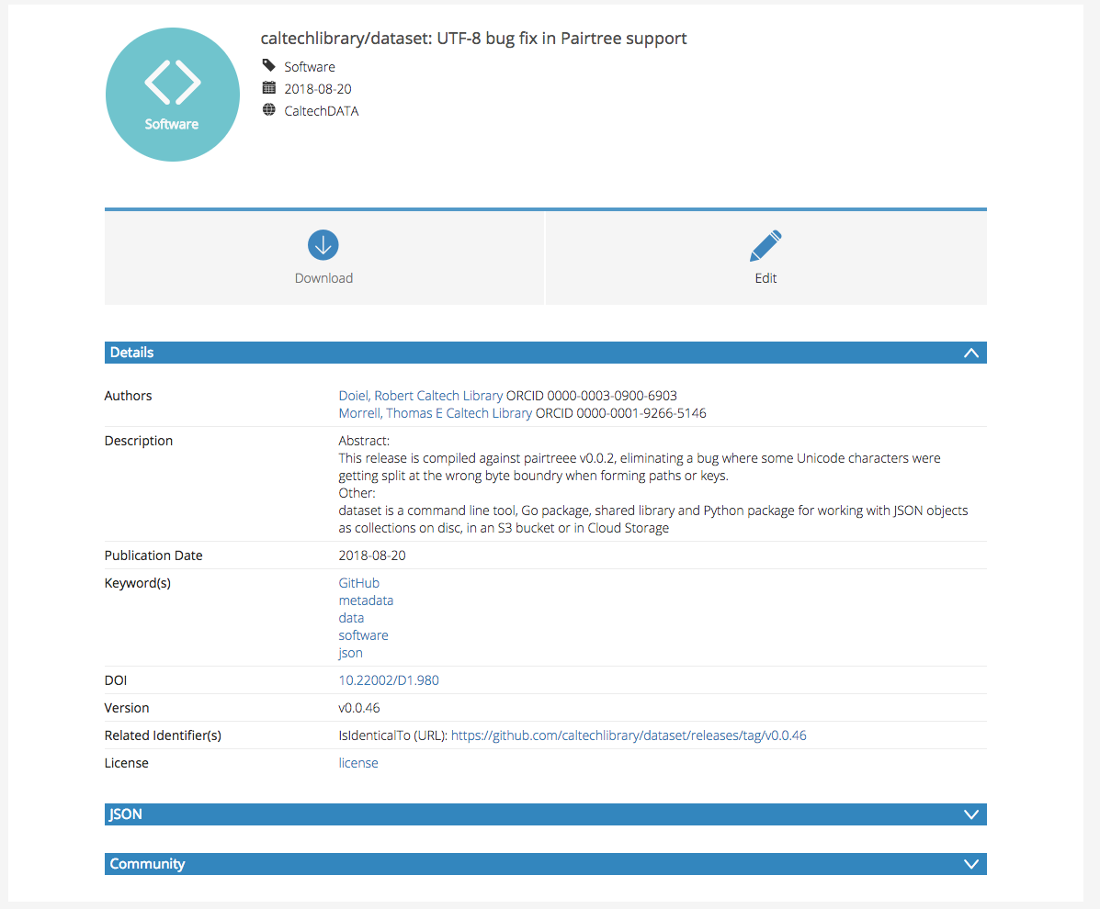
After Codemeta Integration

Slide 7
Implementation
Part of https://github.com/caltechlibrary/ames
Uses https://github.com/caltechlibrary/dataset
Dataset
Release
Harvest Files
Detect CodeMeta
ames
Record Created and DOI Generated
Update Record

Slide 8
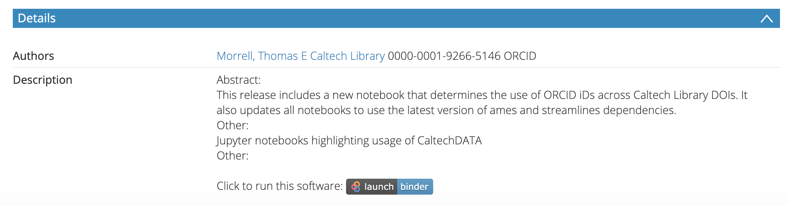
CaltechDATA and Binder Integration
Binder provides web-based access to Jupyter notebooks, RStudio, and other computing environments
Pulls content from GitHub, Zenodo, and other repositories
Researchers can test at mybinder.org
Then get a badge in CaltechDATA: https://doi.org/10.22002/D1.1259

Slide 9
Thanks!
tmorrell@caltech.edu
data.caltech.edu
https://library.caltech.edu/caltechdata

