Slide 1
Relationship between QS Rankings, International Student Mobility and National Economy Indicators Chun-Heng Chien
This project aims to explore how a country's QS ranking and economic indicators influence the flow of international students.
Key message: What factors are related to the number of international students coming into a country?
Target audience: Government agencies, educational institutions, and students from various countries.
High interactivity
High readability
Offers as many data selection options as possible to allow users to explore the data independently

Slide 2
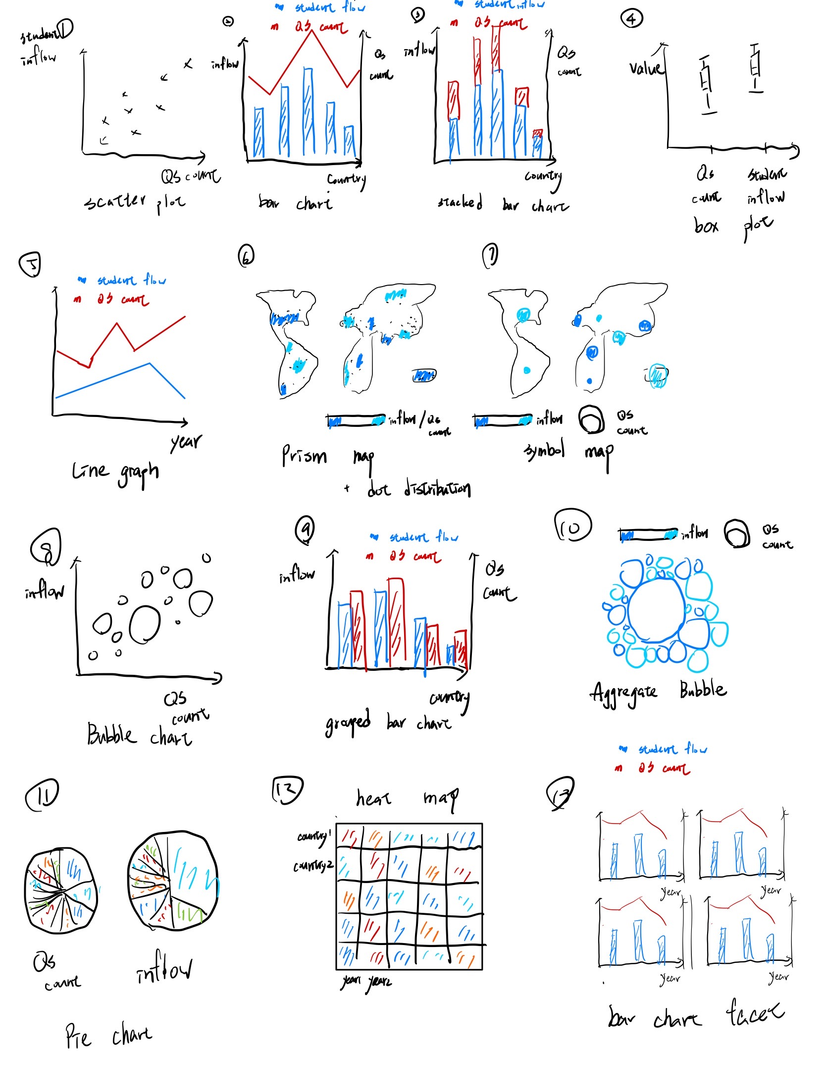
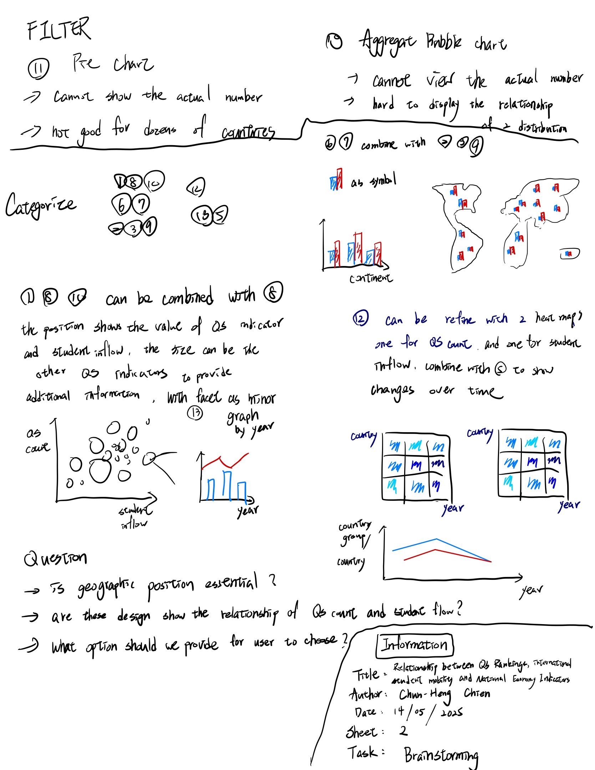
Sheet 1
Brain Storming:
13 ideas
11 ideas after filtering
Eliminated
Pie chart
Aggregate bubble chart
5 categories
2D-distributed
Map
Bar chart
Heat map
Line graph
Combined into 3 design
2D-distributed graph + bar chart
Map + bar chart
Heat map + line graph

Slide 3
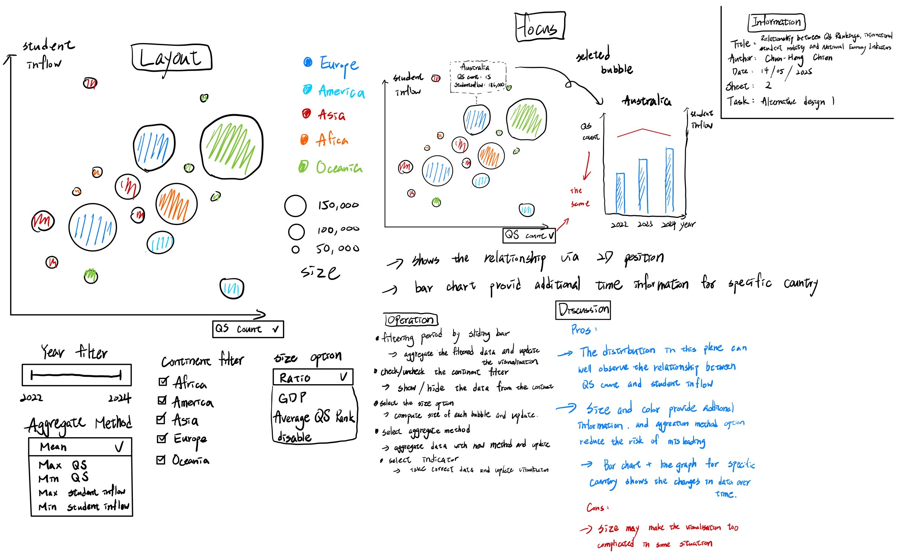
Sheet 2
Bubble Chart + Bar Chart
Core
2D position shows the relationship between QS/economy indicators and student flow
The bar chart shows the data changes over time
Provide high interactivity
Advantage
Clearly shows the relationship
Size option can provide additional information
Disadvantage
Size may reduce readability, need to avoid it when implementing

Slide 4
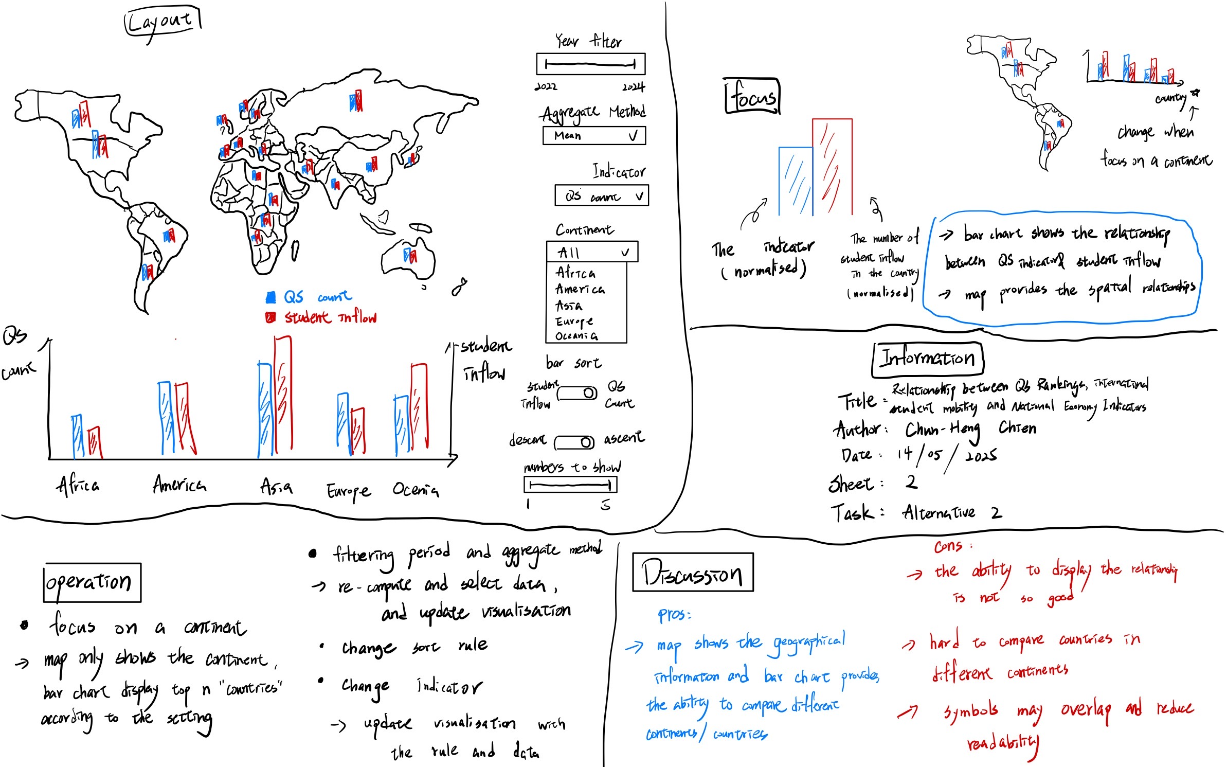
Sheet 3
Symbol Map + bar chart
Core
Geographical position shows the data distribution in the spatial domain
The bar chart shows the relationship of indicators and student flow
Users can zoom the map to view the area they concern
Advantage
Maps provide additional spatial information
Disadvantage
The symbol design might be misunderstanding
Not clear to show the relationship

Slide 5
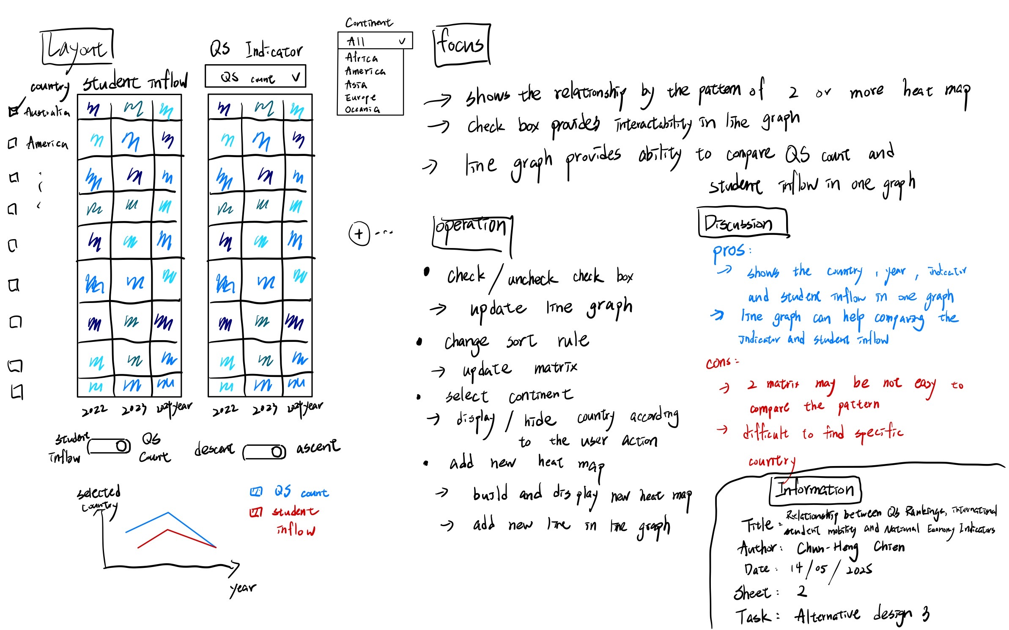
Sheet 4
Heat Map + line Graph
Core
Heat map shows the data changes over time
Multiple heat map shows the relationship
The line graph shows the relationship and changes over time
Advantage
Can show the most information without interaction
Disadvantage
Hard to compare the pattern
Multiple indicators in a line graph need multiple y-axes, increasing the difficulty of implement

Slide 6
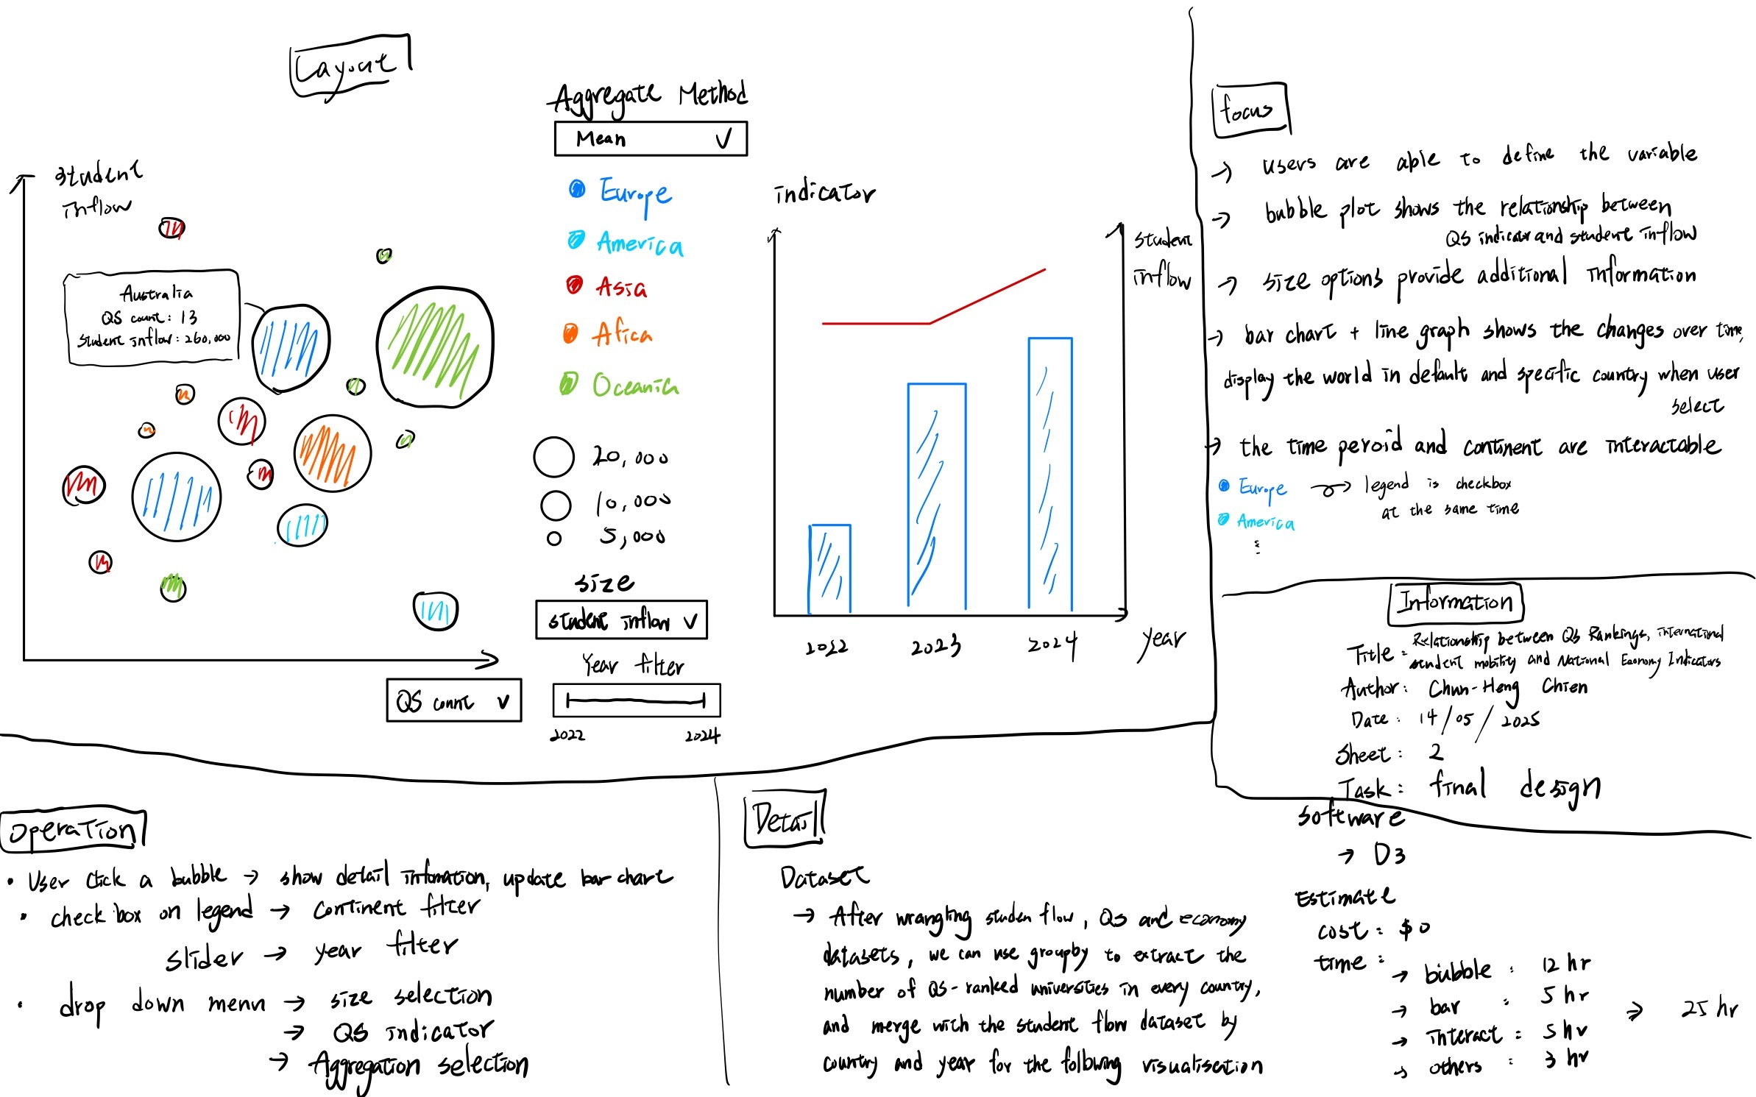
Sheet 5
Final design
Bubble Chart + Bar Chart
Core
Bubble chart focuses on the relationship between student flow and selected indicator
Bar chart gives additional information in time domain
Operation
Aggregate method of bubbles
Continents
X-axis and size value
Year filter
Bubble selection (detail)
Detail
QS, economy and student flow dataset
Implement in D3
~25 hours to build

