Slide 1
Bivariate regression
_{R}2
Exam review
Software check
Applied Statistical Analysis I
Bivariate regression
Trajche Panov, PhD
panovt@tcd.ie
Department of Political Science Trinity College Dublin
October 08, 2024

Slide 2
Bivariate regression
_{R}2
Exam review
Software check
Today’s Agenda
Lecture recap & exam review
Git pull
Tutorial exercises

Slide 3
Bivariate regression
_{R}2
Exam review
Software check
Linear regression model
What is a linear regression model? What interpretations can we make?

Slide 4
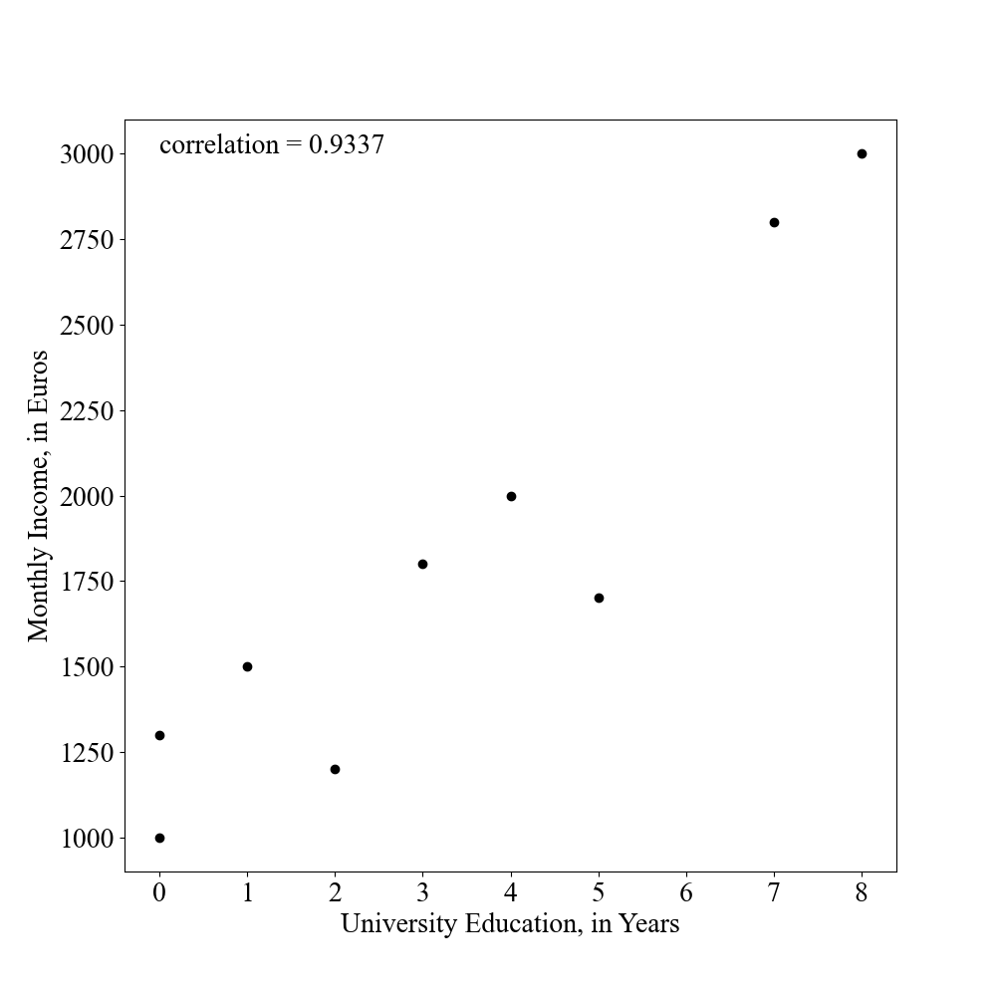
Bivariate regression
_{R}2
Exam review
Software check
So far, correlation analysis
Just by looking at the plot, can you identify the straight line which best describes the joint variation between X and Y ?
*This is fictional data.

Slide 5
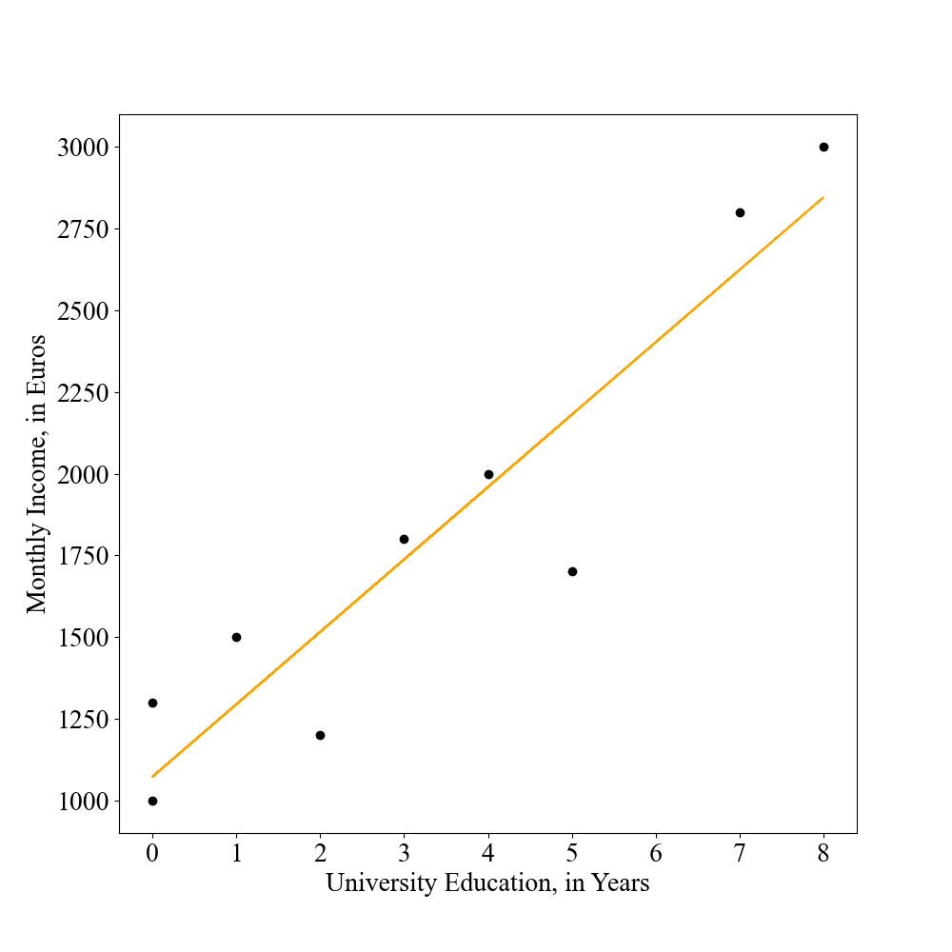
Bivariate regression
_{R}2
Exam review
Software check
Regression analysis
What is a linear regression model?
Find linear line of best fit, Y_{i} = α + βX_{i} + ϵ_{i}

Slide 6
Bivariate regression
_{R}2
Exam review
Software check
Regression analysis
What is a linear regression model?
Find linear line of best fit, Y_{i} = α + βX_{i} + ϵ_{i}
α (intercept): expected value of Y when X = 0
β (slope): expected change in Y when X increases by one unit
Y^{ˆ} (expected value): predicted outcome based on the regression model, Y^{ˆ}_{i} = αˆ + β^{ˆ}X_{i}
ϵ (error/residual): difference between actual and predicted outcome, ϵ_{i} = Y_{i} − Y^{ˆ}_{i}

Slide 7
Bivariate regression
_{R}2
Exam review
Software check
Regression analysis
What interpretations can we make?
income = α + β ∗ education
income = 1072.5490 + 221.5686 ∗ education

Slide 8
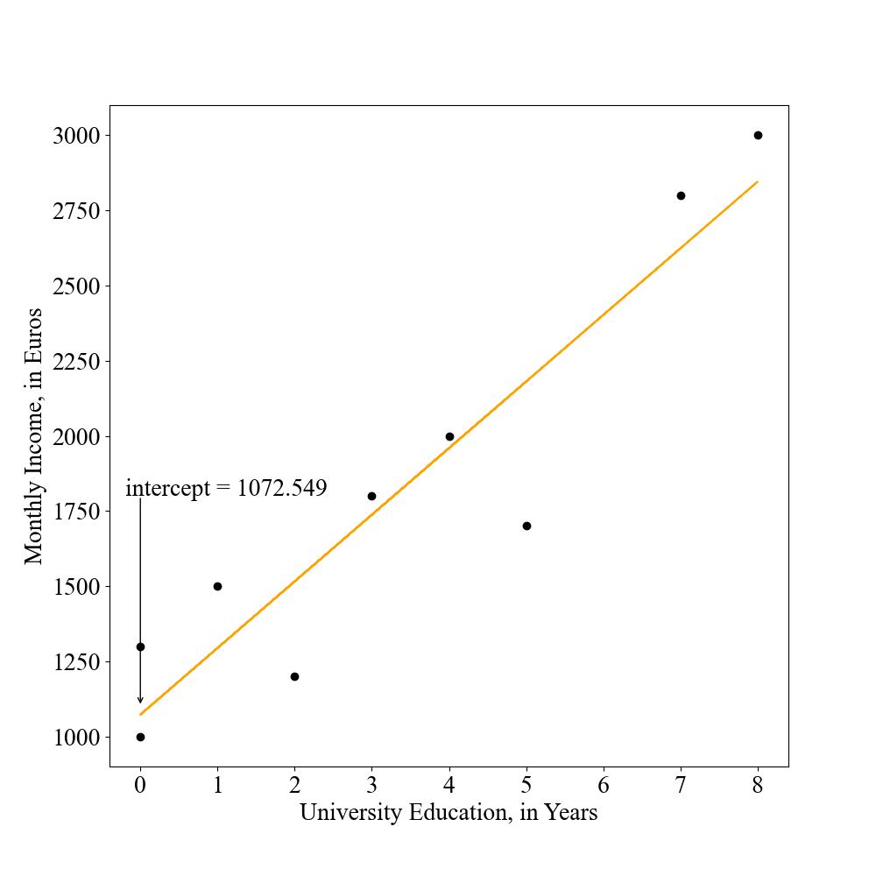
Bivariate regression
_{R}2
Exam review
Software check
Regression analysis
What interpretations can we make? (intercept)
If an individual has a university education of 0 years, what income would we expect for that person?
income = 1072.5490 + 221.5686 ∗ 0 = 1072.5490

Slide 9
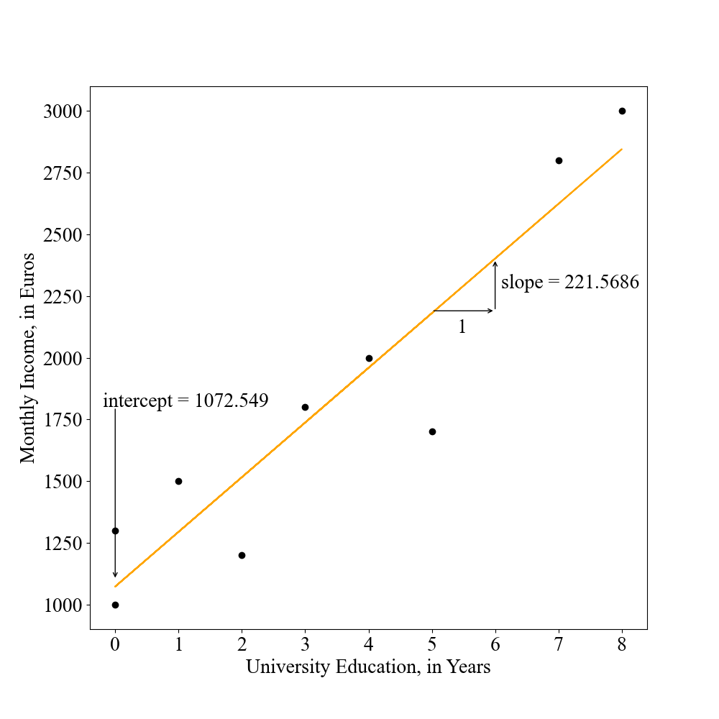
Bivariate regression
_{R}2
Exam review
Software check
Regression analysis
What interpretations can we make? (slope)
If the university education increases by one year, how much more Euros would we expect an individual to earn? income = 1072.5490 + 221.5686 ∗ 1 = 1294.1176
→ With every additional year of university education, the expected income increases by 221.5686 Euros.

Slide 10
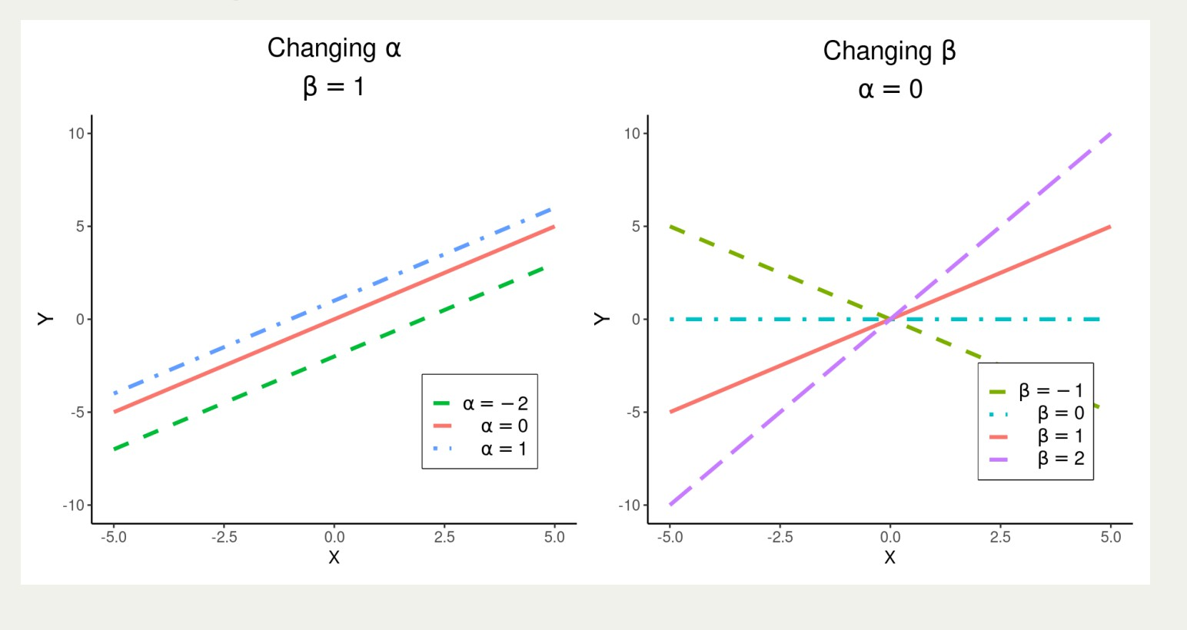
Bivariate regression
_{R}2
Exam review
Software check
Regression analysis
Varieties of linear relationships

Slide 11
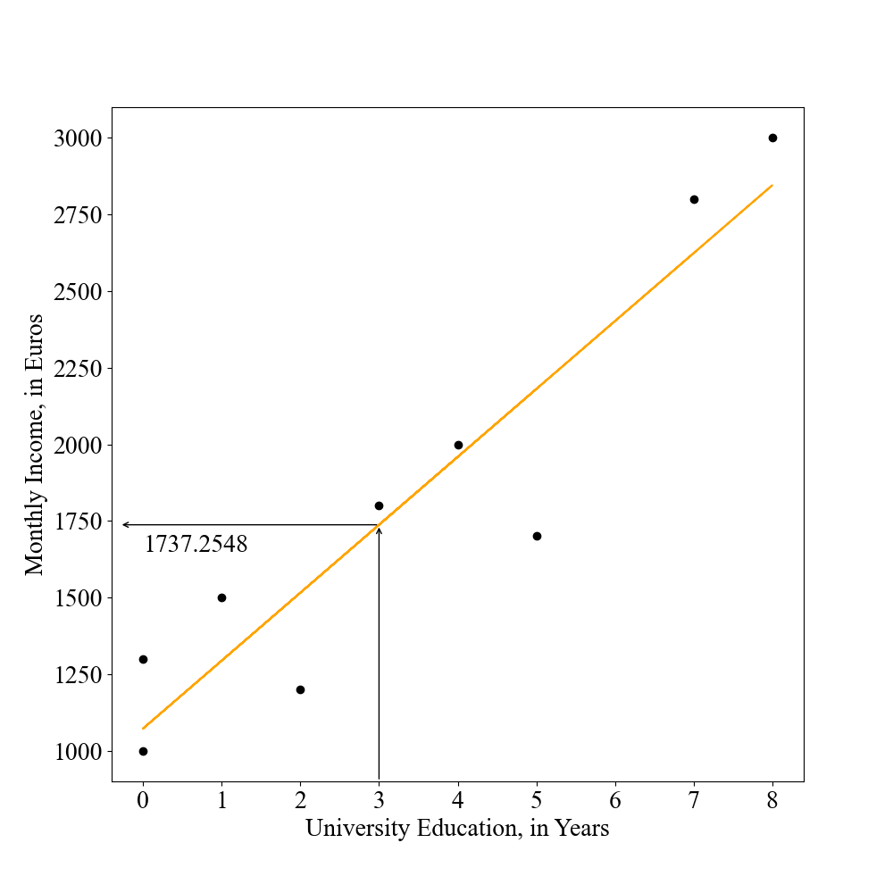
Bivariate regression
_{R}2
Exam review
Software check
Regression analysis
What interpretations can we make? (expected value)
If an individual has 3 university education years, what income would we expect for that person?
income = 1072.5490 + 221.5686 ∗ 3 = 1737.2548

Slide 12
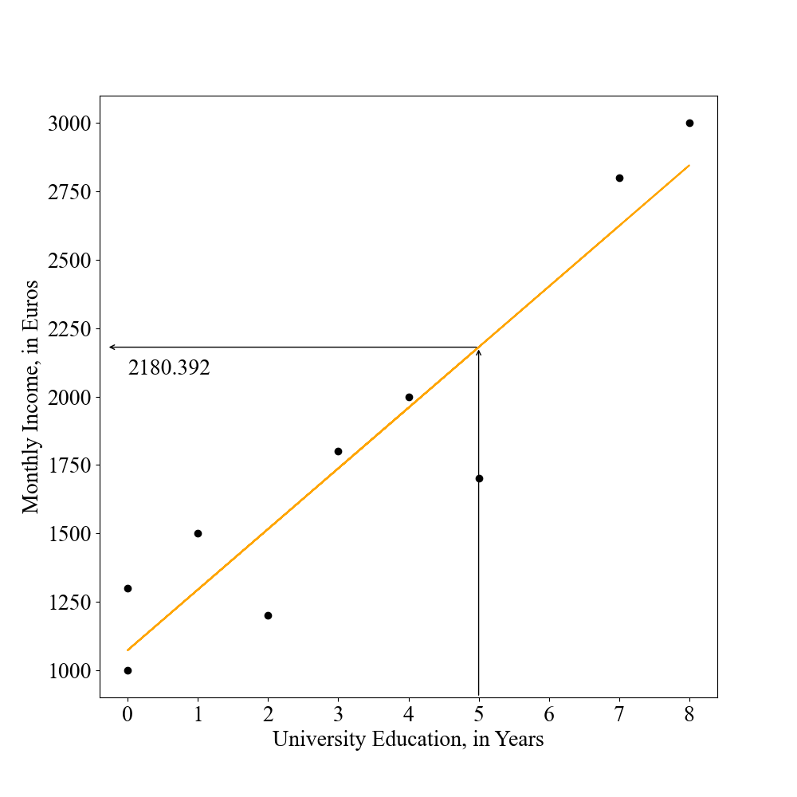
Bivariate regression
_{R}2
Exam review
Software check
Regression analysis
What interpretations can we make? (residual)
income = 1072.5490 + 221.5686 ∗ 5 = 2180.392
Residual = Actual – Predicted
Residual = 1700 – 2180.392 = –480.392

Slide 13
Bivariate regression
_{R}2
Exam review
Software check
Binary independent variables
How to include binary independent variables in simple linear regression?

Slide 14
Bivariate regression
_{R}2
Exam review
Software check
Binary independent variables
How to include binary independent variables in simple linear regression?
Y_{i} = α + βX_{i} + ϵ_{i} (X_{i} =binary/dummy variable)
α (intercept): expected value of Y when X = 0
β (slope): expected change in Y for X = 1, in comparison to
X = 0 (the reference category).

Slide 15
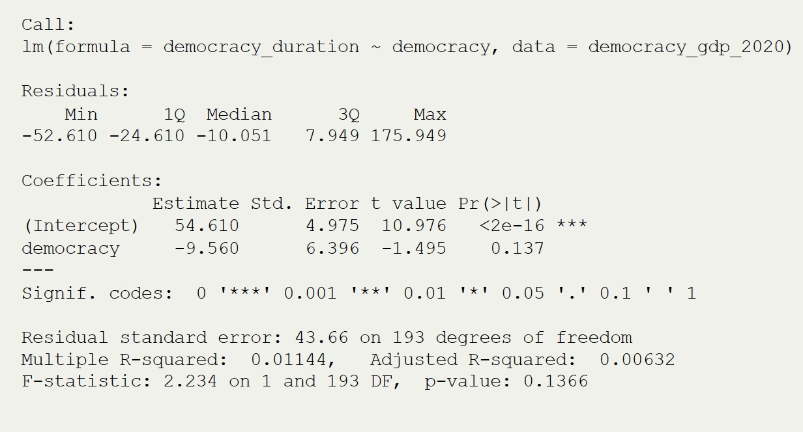
Bivariate regression
_{R}2
Exam review
Software check
Binary independent variables
How to include binary independent variables in simple linear regression?
Regime Longevity_{i} = α + β₁ ∗ Regime Type_{i}
In comparison to autocracies (= reference category), democracies last 9.56 years fewer.

Slide 16
Bivariate regression
_{R}2
Exam review
Software check
Binary independent variables
How to include binary independent variables in simple linear regression?
Y^{ˆ}_{i} = α + β₁ ∗ Regime Type_{i}
Model for Autocracies:
Y^{ˆ}_{i} = 54.610 + (−9.560 ∗ Regime Type_{i} )
Y^{ˆ}_{i} = 54.610 + (−9.560 ∗ 0)
Y^{ˆ}_{i} = 54.610
Model for Democracies:
Y^{ˆ}_{i} = 54.610 + (−9.560 ∗ Regime Type_{i} )
Y^{ˆ}_{i} = 54.610 + (−9.560 ∗ 1)
Y^{ˆ}_{i} = 45.05

Slide 17
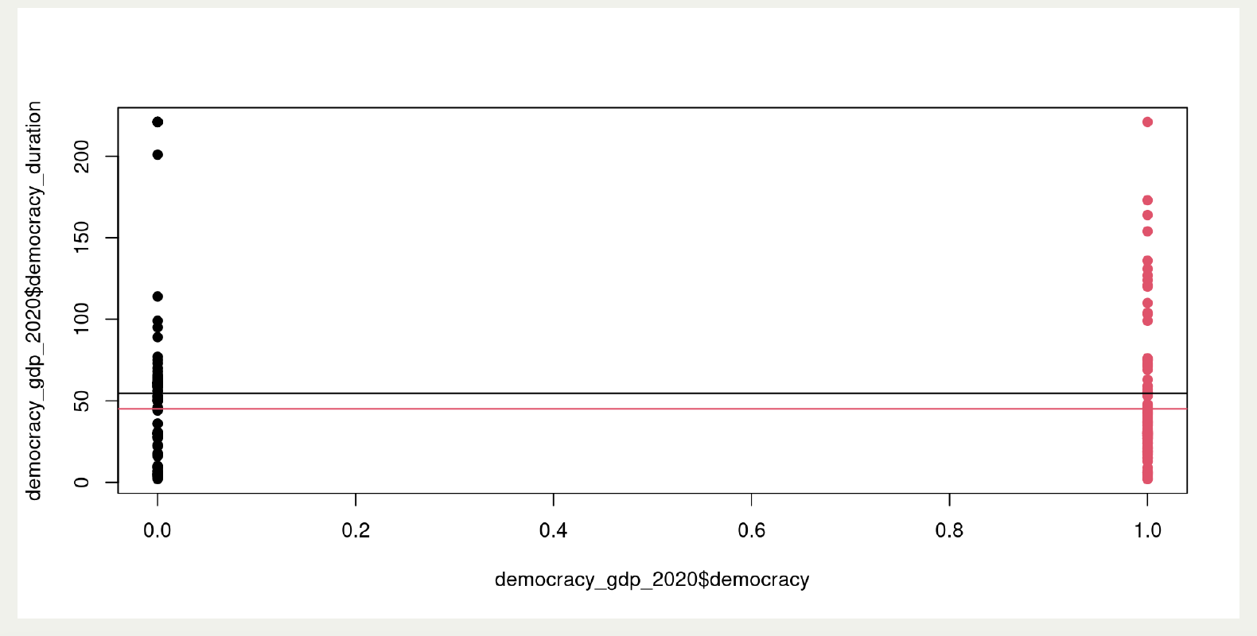
Bivariate regression
_{R}2
Exam review
Software check
Binary independent variables
How to include binary independent variables in simple linear regression?

Slide 18
Bivariate regression
_{R}2
Exam review
Software check
Partitioning the error
How can be partition the error?

Slide 19
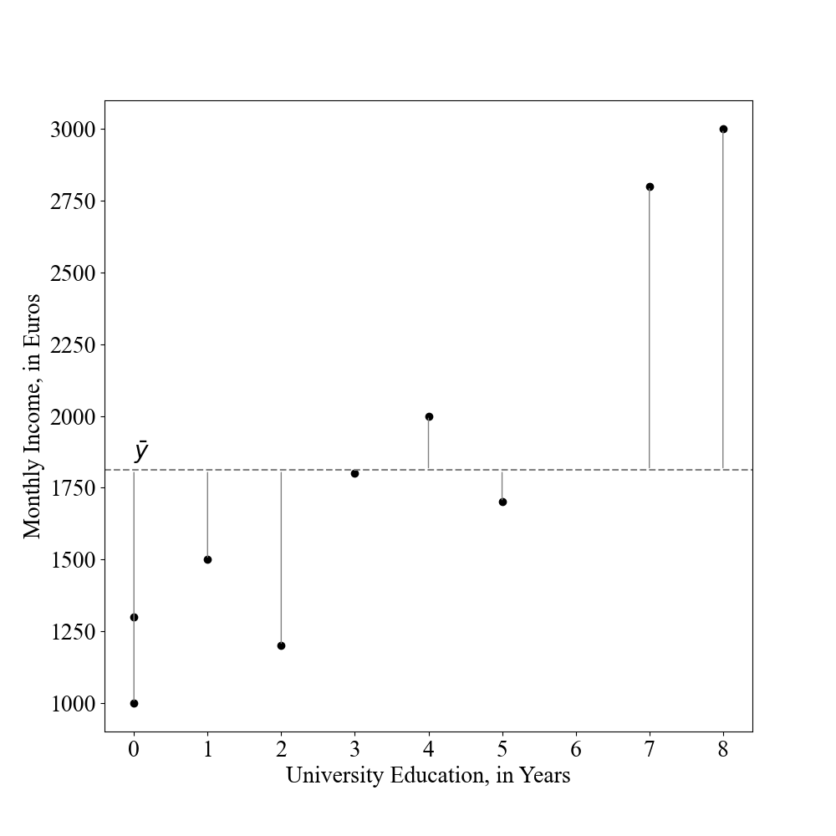
Bivariate regression
_{R}2
Exam review
Software check
Total sum of squares (SS_{T} )
SS_{T} = Sum of squared differences between observed values of Y and
Σ
the mean, SS =
n i =n
(y_{i} − y¯)²
T

Slide 20
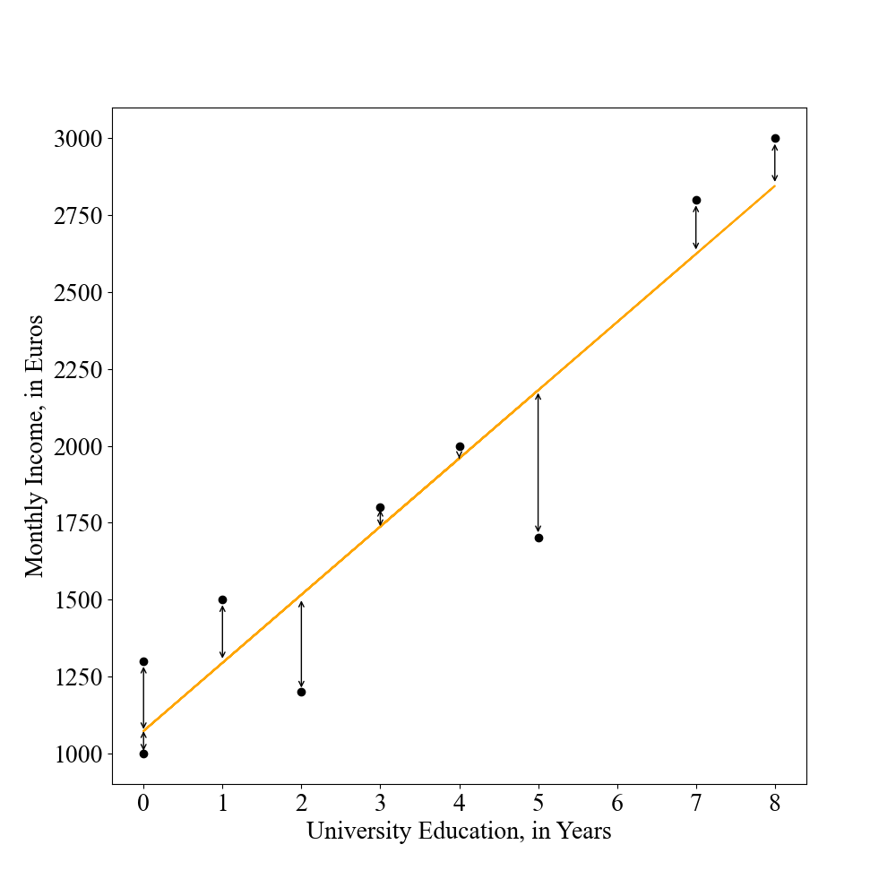
Bivariate regression
_{R}2
Exam review
Software check
Residual sum of squares (SS_{R} )
SS_{R} = Sum of squared differences between observed values of Y and
Σ
the regression line, SS =
n i =n
(y_{i} − yˆ_{i} )²
R

Slide 21
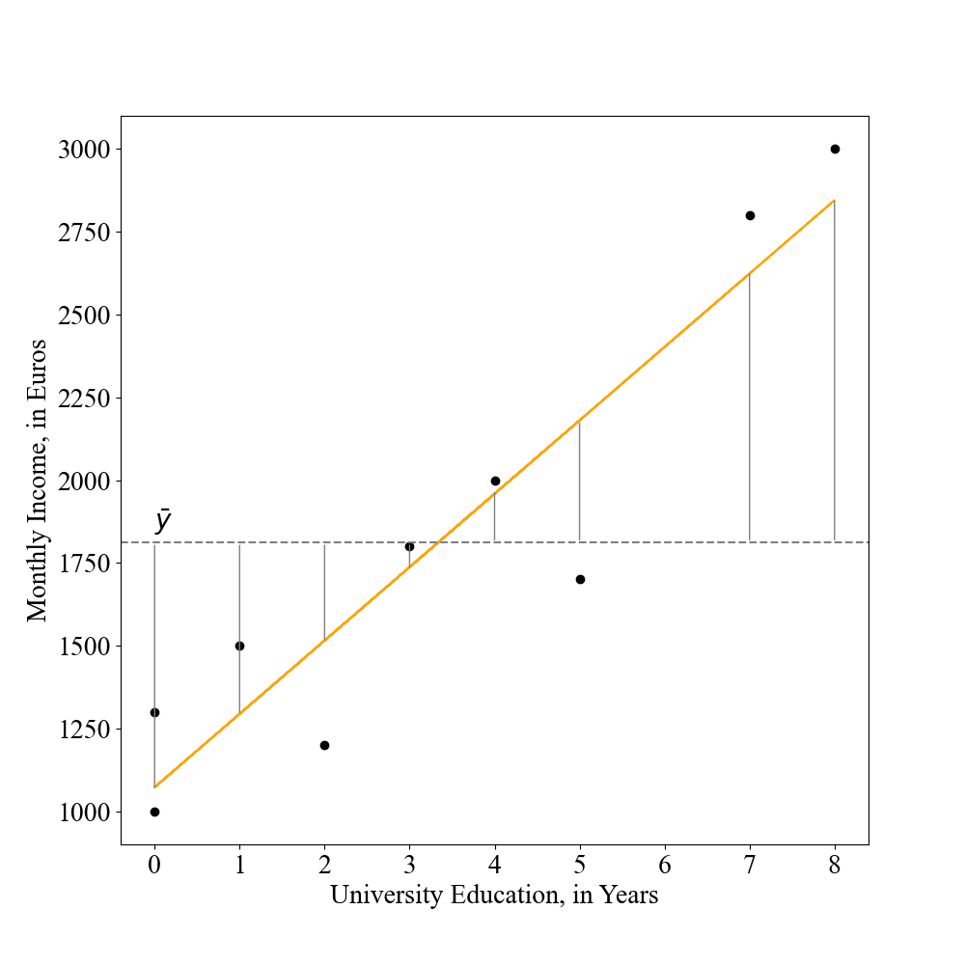
Bivariate regression
_{R}2
Exam review
Software check
Model sum of squares (SS_{M} )
SS_{M} = Sum of squared differences between the regression line and
Σ
the mean of Y, SS =
n i =n
(yˆ_{i} − y¯)²
M
→ Improvement if regression model is used rather than the mean.
21 / 55

Slide 22
Bivariate regression
_{R}2
Exam review
Software check
Regression analysis
What interpretations can we make? (model performance)
R²: the proportion of variation of Y explained by X . Varies between 0 and 1. If X explains all the variation in Y , then R² = 1.
SS_{T} = SS_{M} + SS_{R} and SS_{M} = SS_{T} − SS_{R}
SS
R
2
R = 1 −
=
SS_{T}
Variation not explained by model
1 −
=
Total variation in y
SS_{M =} Variation explained by model
SS_{T} Total variation in y

Slide 23
Bivariate regression
_{R}2
Exam review
Software check
Week 1–Introduction & stats review

Slide 24
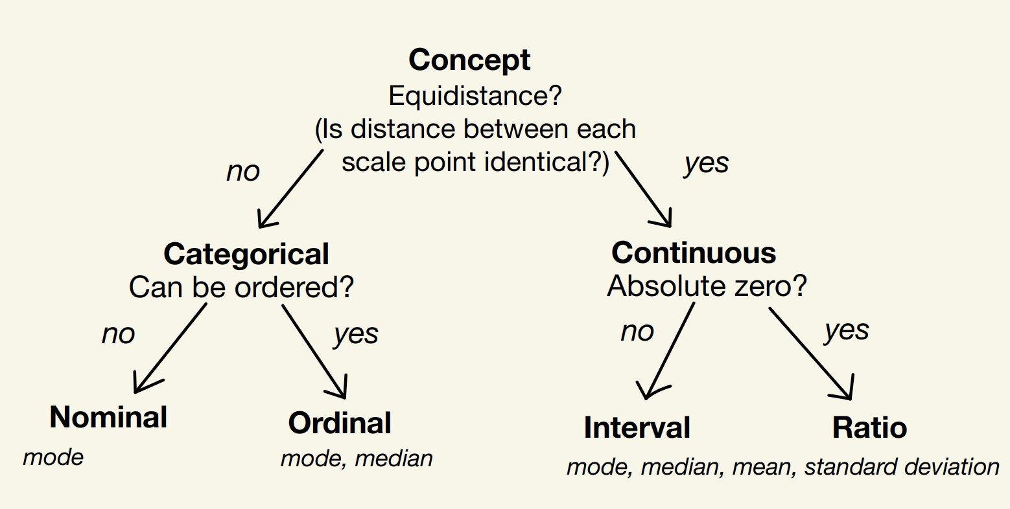
Bivariate regression
_{R}2
Exam review
Software check
Measurement Scales
How can we measure concepts? And why does it matter?
(Kellstedt and Whitten 2018, Chap. 5)
Discrete: finite set of possible values. Continuous: infinite set of possible values.

Slide 25
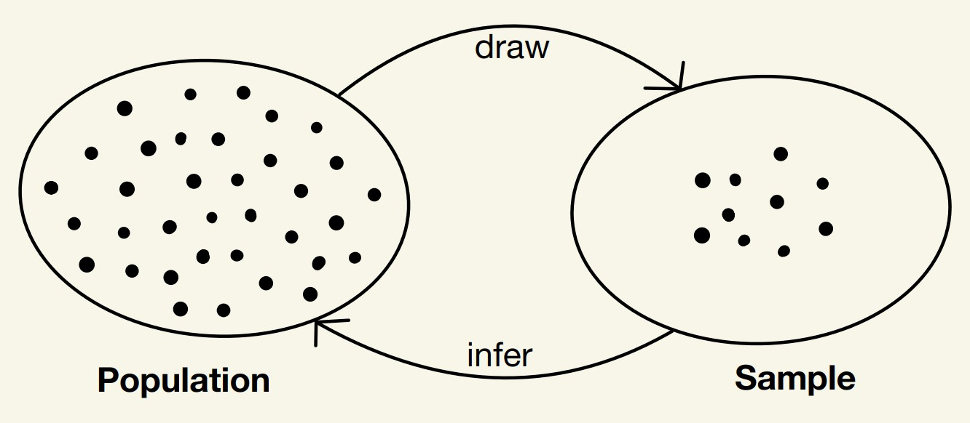
Bivariate regression
_{R}2
Exam review
Software check
Population, sample, parameter, statistic
What is the relationship between population and sample?
Population: “the total set of subjects of interest in a study” (Agresti and Finlay 2009, 5).
Parameter: “numerical summary of the population” (Agresti and Finlay 2009, 5).
Sample: “the subset of the population on which the study collects data” (Agresti and Finlay 2009, 5).
Statistic: “a numerical summary of the sample data” (Agresti and Finlay 2009, 5).
Observation: single subject/unit, one row in dataset

Slide 26
Bivariate regression
_{R}2
Exam review
Software check
Measures of central tendency and variability (dispersion)
How can we describe variables?
Mean: y¯ = Sum of all values divided by the number of
Σ
observations, y¯ = ¹
n i =1
y_{i}
n
Variance: s²(y ) = Sum of squared deviations divided by number
of observations (deviation is the difference between observed
Σ
n 2
2
(y −y¯)
value and the mean, y − y¯), s =
i
i
i =1
n−1
•
Standard Deviation: Return original units by taking square root,
q
Σ_{n}
s =
(y −y¯)
2
i
i =1
n−1

Slide 27
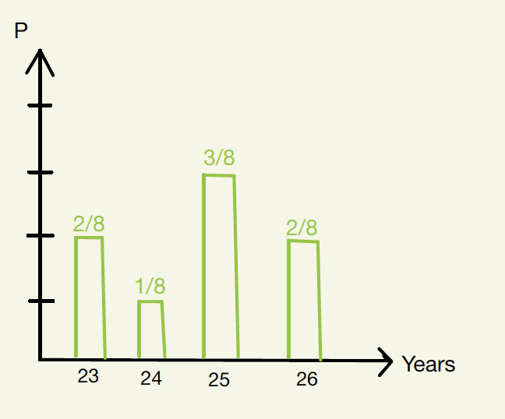
Bivariate regression
_{R}2
Exam review
Software check
Distributions and probability distributions
What is a probability distribution?
Probability distribution “lists the possible outcomes and their probabilities” (Agresti and Finlay 2009, 75).

Slide 28
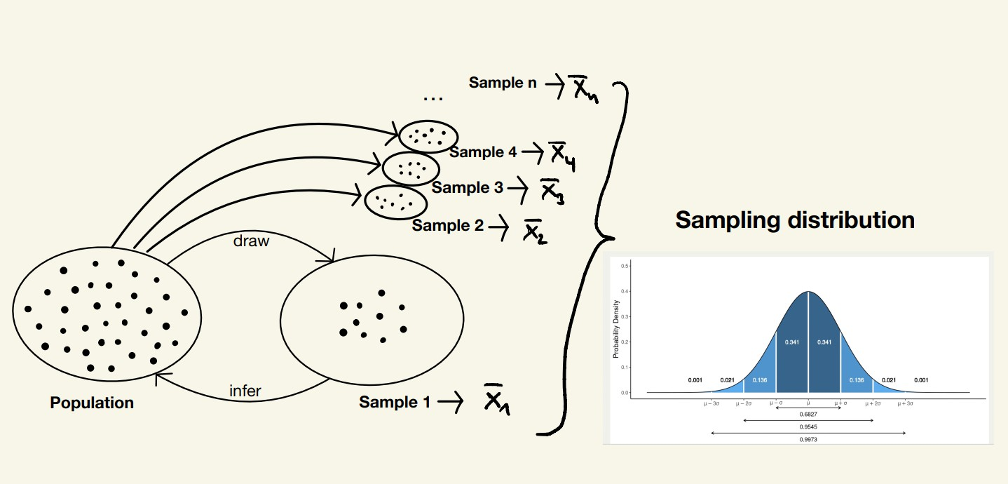
Bivariate regression
_{R}2
Exam review
Software check
Sampling distribution
theoretically...

Slide 29
Bivariate regression
_{R}2
Exam review
Software check
Sampling distribution
What is a sampling distribution?
Sampling distribution “A sampling distribution of a statistic is the probability distribution that specifies probabilities for the possible values the statistic can take” (Agresti and Finlay 2009, 87).
In other words, a probability distribution for a statistic rather than values of observations → What is the probability of
Y¯ = 0.5, rather than what is the probability of Y = 3?

Slide 30
Bivariate regression
_{R}2
Exam review
Software check
Sampling distribution
Why is this important?
The corresponding probability theory “helps us predict how close a statistic falls to the parameter it estimates” (Agresti and Finlay 2009, 87). → how close is y¯ to µ?
Usually only one sample/one estimate → Point estimate: “is a single number that is the best guess for the parameter value” (Agresti and Finlay 2009, 107).

Slide 31
Bivariate regression
_{R}2
Exam review
Software check
The sampling distribution of the mean, y¯
“If we repeatedly took samples, then in the long run, the mean of the sample means would equal the population mean µ” (Agresti and Finlay 2009, 90). → mean of the sampling distribution of y¯ equals the population mean, hence, µ = y¯
“The standard error describes how much y¯ varies from sample to sample” (Agresti and Finlay 2009, 90). → standard error is
estimated based on standard deviation, hence, σ =
σ
y¯
√
n
Why does this work?

Slide 32
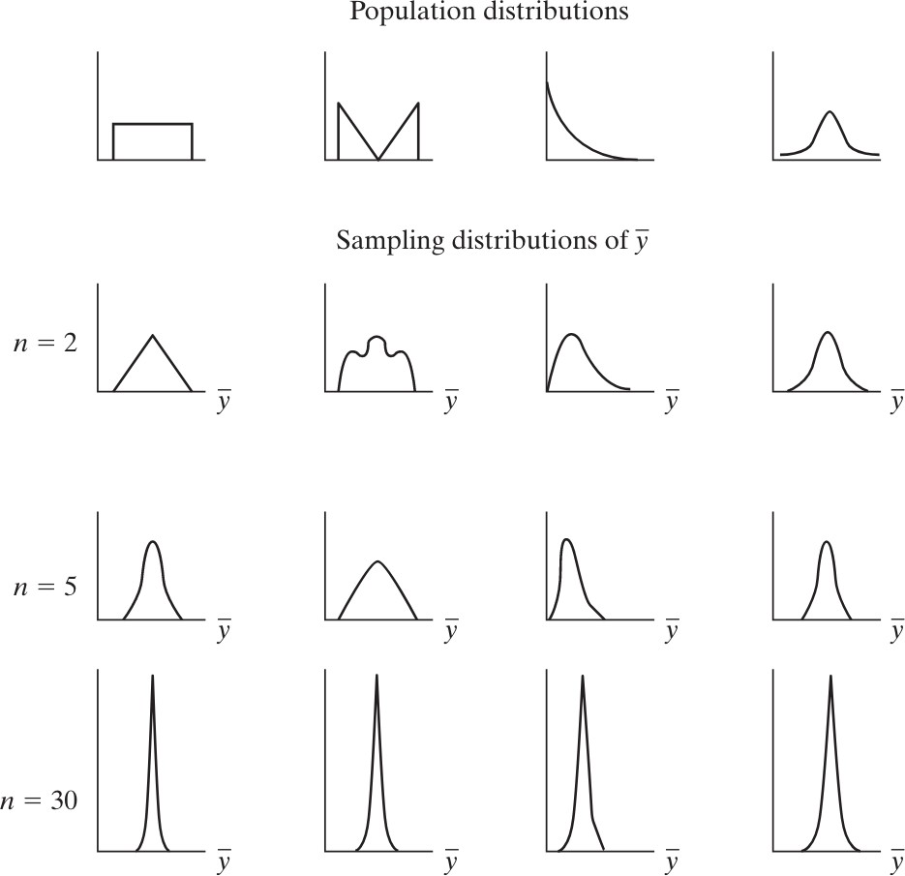
Bivariate regression
_{R}2
Exam review
Software check
Central Limit Theorem
What is the Central Limit Theorem?
“For random sampling with a large sample size n, the sampling distribution of the sample mean y¯ is approximately a normal distribution” (Agresti and Finlay 2009, 93). → regardless of the population distribution

Slide 33
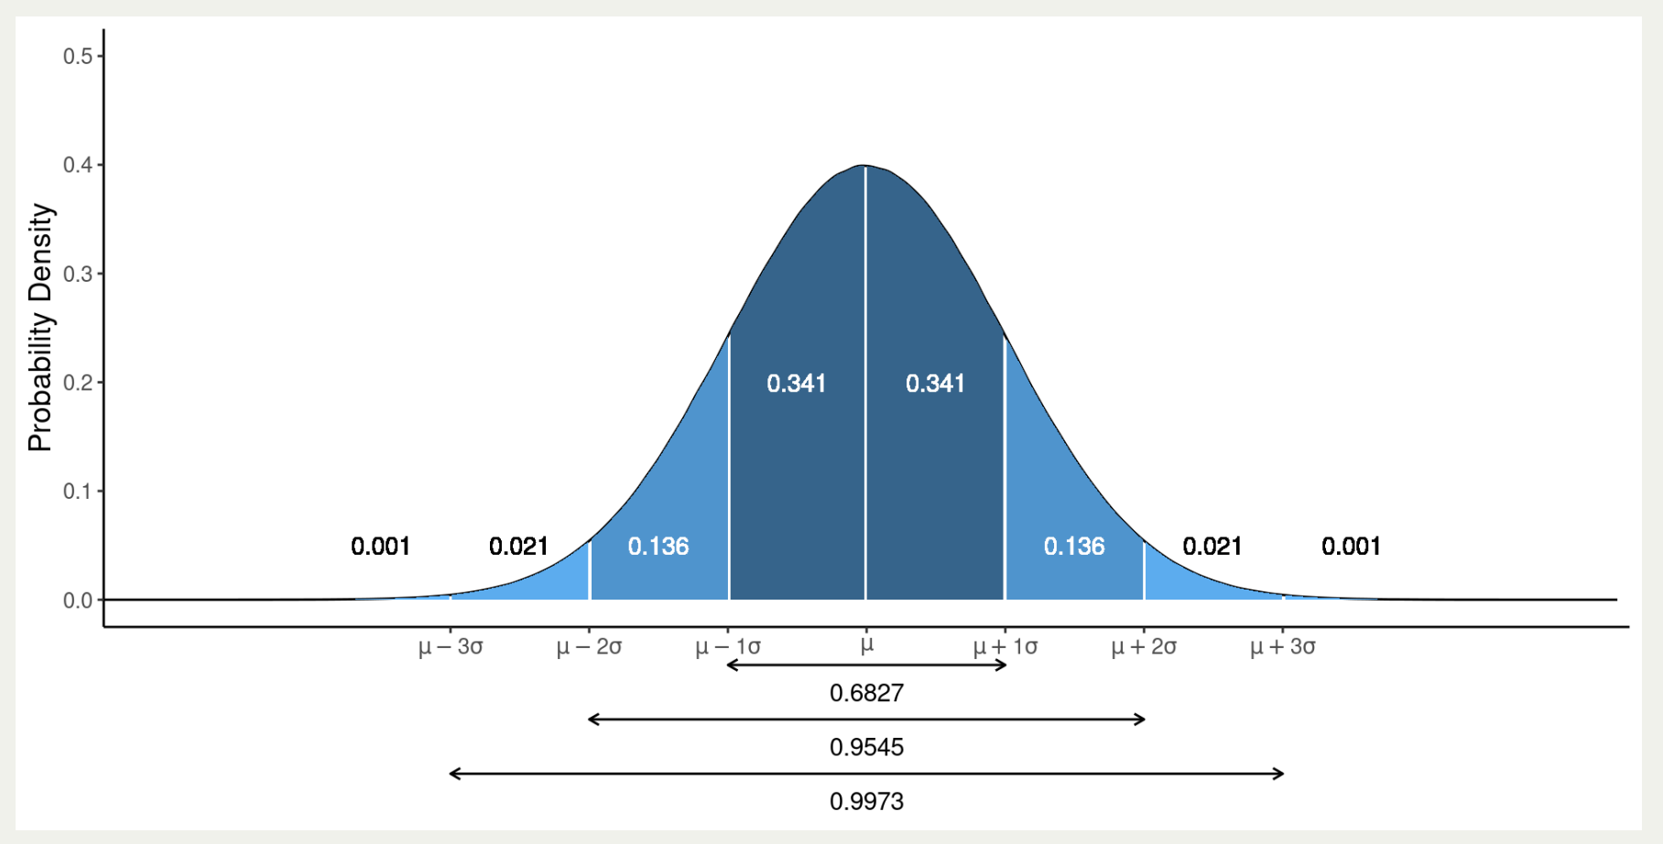
Bivariate regression
_{R}2
Exam review
Software check
Central Limit Theorem
What is the Central Limit Theorem?
“Knowing that the sampling distribution of y¯ can be approximated by a normal distribution helps us to find probabilities for possible values of y¯ (Agresti and Finlay 2009, 94). → key in inferential statistics

Slide 34
Bivariate regression
_{R}2
Exam review
Software check
Confidence intervals
What are confidence intervals?
Confidence interval: “an interval of numbers around the point estimate that we believe contains the parameter value” (Agresti and Finlay 2009, 110). → Point estimate ± Margin of error
Confidence level:“The probability that this method produces an
interval that contains the parameter” (usually 0.95, 0.99) (Agresti and Finlay 2009, 110).
σ
•
Margin of error = multiple of the standard error, σ =
√
y¯
n
(Agresti and Finlay 2009, 117).
For example, for 95% confidence level, the margin of error is
±1.96σ_{y¯} (have a look at the normal distribution).

Slide 35
Bivariate regression
_{R}2
Exam review
Software check
Week 2–Hypothesis testing, experiments, difference in means

Slide 36
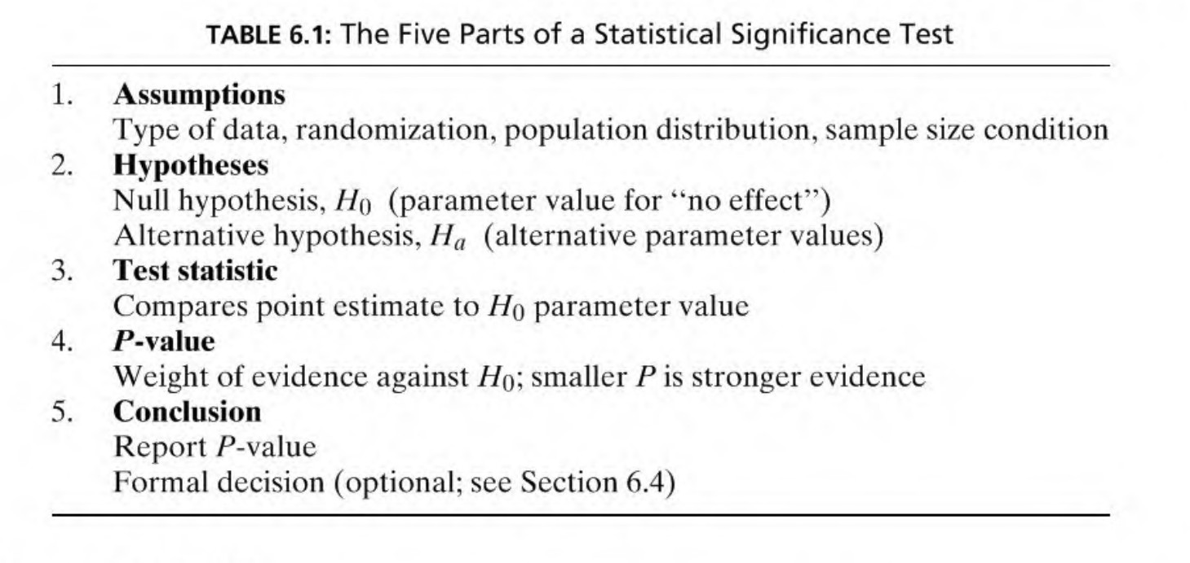
Bivariate regression
_{R}2
Exam review
Software check
Null-hypothesis significance testing
(
Agresti and Finlay 2009, 147)

Slide 37
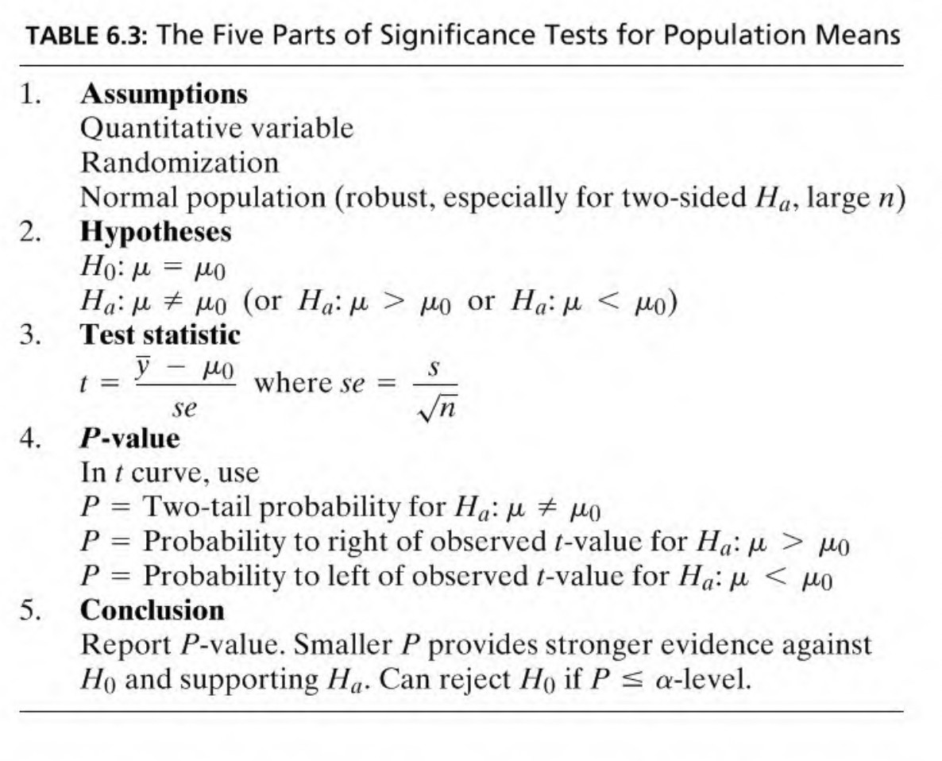
Bivariate regression
_{R}2
Exam review
Software check
Significance test for a mean (t-test)
(Agresti and Finlay 2009, 155)

Slide 38
Bivariate regression
_{R}2
Exam review
Software check
Significance test for a difference in means (t-test)
What is a t-test for the difference in means?
Null and alternative hypothesis: (Step 2) The means of two groups are identical, y¯₁ = y¯₂ or y¯₁ − y¯₂ = 0 (H₀), the means of two groups are different, y¯₁ ̸= y¯₂ (H_{a}).
Test statistics: (Step 3) “measures the number of standard errors between the estimate and the H₀ value” (Agresti and Finlay 2009, 192).
_{t =} Estimate of parameter − Null hypothesis value of parameter
Standard error of estimate
q
_{t =} (y¯1−y¯2)−0 _{, H}
assumes y¯ − y¯ = 0, se =
s
2
+
s
2
se
0
2 1
1
2
n1
n2

Slide 39
Bivariate regression
_{R}2
Exam review
Software check
Causal effect
What is a causal effect?
Causal effect: “change in some feature of the world that would result from a change to some other feature of the world”,
Y − Y
1
0
i
T =1,i T =0,i
= Y −
Y
i
Counterfactual comparison: “outcome would be different in a counterfactual world in which the action was different” → what would be the state of Y , had X not occurred?
Fundamental problem of causal inference: “we can only observe, at most, one of the two quantities–Y_{1i} or Y_{0i} –for any individual at a particular point in time” (Bueno de Mesquita and Fowler 2021, 164). → causal effect is unobservable
(Bueno de Mesquita and Fowler 2021, 159)

Slide 40
Bivariate regression
_{R}2
Exam review
Software check
Sample average treatment effect, Difference in means
Sample average treatment effect (SATE) is unobservable due to fundamental problem of causal inference → we only observe sample difference in means
Sample difference in means is biased estimate of the true SATE
→ Correlation does not imply causation
Baseline differences: “[d]ifference in the average potential outcome between two groups (e.g., the treated and untreated groups), even when those two groups have the same treatment status” → Confounders may cause baseline differences, which may cause bias (omitted variable bias)
(Bueno de Mesquita and Fowler 2021, 187)

Slide 41
Bivariate regression
_{R}2
Exam review
Software check
Week 3–Contingency tables, correlation & bivariate regression Week 4–Bivariate regression, inference & prediction

Slide 42
Bivariate regression
_{R}2
Exam review
Software check
Chi-square test of independence
What is the Chi-square test of independence?
Null and alternative hypothesis: Two variables are independent,
f_{o} = f_{e} (H₀), two variables are dependent, f_{o} ̸= f_{e} (H_{a}).
Test statistics: “compares the observed frequencies in the
contingency table with values that satisfy the null hypothesis of
Σ
2
2
(f −f )
independence” (Agresti and Finlay 2009, 225), X =
o e
fe

Slide 43
Bivariate regression
_{R}2
Exam review
Software check
Correlation
How can we measure correlation?
Covariance: covariance is the average of the product of
deviations of two quantitative variables from the mean,
Σ
n
¯ ¯
cov (X, Y ) =
(X −X )(Y −Y )
(only interpret sign)
i i
i =1
n
Correlation: (correlation coefficient, Pearson correlation coefficient, Pearson’s r , r ) standardized average of the product of deviations of two variables from the mean (=standardized
covariance), r_{xy} = ^{covariance(XY )} (interpret magnitude, range -1
S_{X} S_{Y}
and 1)

Slide 44
Bivariate regression
_{R}2
Exam review
Software check
Correlation
How can we test the statistical significance of correlation?
Null and alternative hypotheses:
there is no association between X and Y , ρ_{xy} = 0 (H₀)
there is an association between X and Y , ρ_{xy} ̸= 0 (H_{a})
•
Test statistic: t = ^{r√n−2} (in R)
√1−r ²
Test statistic: t = √ ^{r} (in Agresti and Finlay 2009)
1−r ²/n−2

Slide 45
Bivariate regression
_{R}2
Exam review
Software check
Ordinary least squares (OLS)
How are intercept and slope estimated?
How do we find the line which best fits the data?
Apply the OLS (Ordinary Least Squares) method, which minimizes the sum of squared errors (SSE).
Sum of squared errors = the sum of squared differences between
actual and predicted values of Y .
Σ Σ Σ
•
SSE =
n i =1
2
n i =1
ˆ
2
n i =1
(ϵˆ) =
(Y − Y ) =
(Y_{i} − (αˆ − β^{ˆ}X_{i} ))²
i
i i
→ minimize this!

Slide 46
Bivariate regression
_{R}2
Exam review
Software check
Assumptions of linear regression
Assumptions about the error (ϵ_{i} ), Y_{i} = α + βX_{i} + ϵ_{i}
ϵ_{i} ∼ N(0, σ²)
ϵ_{i} is normally distributed → needed for inference
E (ϵ_{i} ) = 0, no bias → violated if error is not random, but correlated with omitted variable
ϵ_{i} has constant variance σ² (Homoscedasticity ↔
Heteroscedasticity)
No autocorrelation, “Autocorrelation occurs when the stochastic terms for any two or more cases are systematically related to each other”.
X values are measured without error
(Kellstedt and Whitten 2018, 190–194)

Slide 47
Bivariate regression
_{R}2
Exam review
Software check
Assumptions of linear regression
Assumptions about the model specification, Y_{i} = α + βX_{i} + ϵ_{i}
No causal variables left out and no noncausal variables included
Parametric linearity
(Kellstedt and Whitten 2018, 190–194)

Slide 48
Bivariate regression
_{R}2
Exam review
Software check
Assumptions of linear regression
Minimal mathematical requirements, Y_{i} = α + βX_{i} + ϵ_{i}
X must vary
Number of observations must be larger than the number of predictors
In multiple regression: No perfect multicollinearity
(Kellstedt and Whitten 2018, 190–194)

Slide 49
Bivariate regression
_{R}2
Exam review
Software check
Inference about the slope
What is the t-test for the slope of a regression line?
Null and alternative hypotheses:
there is no association between X and Y , β = 0 (H₀)
there is an association between X and Y , β ̸= 0 (H_{a})
Test statistic: “measures the number of standard errors between the estimate and the H₀ value” (Agresti and Finlay 2009, 192). _{t =} Estimate of parameter − Null hypothesis value of parameter
Standard error of estimate
β^{ˆ} ˆ
t = ^{−βH0} = ^{β} , H assumes β = 0
se_{βˆ} se_{βˆ}
0

Slide 50
Bivariate regression
_{R}2
Exam review
Software check
Software check
How to update your local repository? How to git pull?

Slide 51
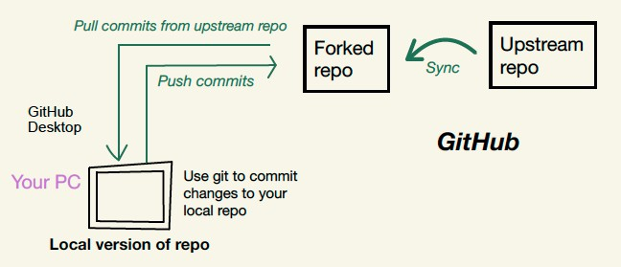
Bivariate regression
_{R}2
Exam review
Software check
Software check
Synchronize fork
Fetch origin

Slide 52
Bivariate regression
_{R}2
Exam review
Software check
Software check
How to update your repository on GitHub? How to git push?

Slide 53
Bivariate regression
_{R}2
Exam review
Software check
Software check
Make sure your local repository is updated:
Synchronize fork
Fetch origin
Commit changes in file (local)
Push commits to fork

Slide 54
Bivariate regression
_{R}2
Exam review
Software check
Software check
What to do in the event of merging conflicts?

Slide 55
Bivariate regression
_{R}2
Exam review
Software check
Software check
What to do in the event of merging conflicts?
Find out which files are causing the conflict in GitHub Desktop
Decide which version to keep, and delete the other one (either in GitHub Desktop or manually)

Slide 56
References I
References
Agresti, Alan, and Barbara Finlay. 2009. Statistical methods for the social sciences. Essex: Pearson Prentice Hall.
Bueno de Mesquita, Ethan, and Anthony Fowler. 2021. Thinking clearly with data: A guide to quantitative reasoning and analysis. Princeton: Princeton University Press.
Kellstedt, Paul M., and Guy D. Whitten. 2018. The fundamentals of political science research. Cambridge: Cambridge University Press.

