Slide 1
Outliers
Assumptions
Applied Statistical Analysis I
Regression diagnostics
Trajche Panov, PhD
panovt@tcd.ie
Department of Political Science Trinity College Dublin
November 19, 2024
1 / 18

Slide 2
Outliers
Assumptions
Today’s Agenda
Validating quadratic effects (from last week)
Lecture recap
Tutorial exercises: What is the relationship between education and Euroscepticism?
2 / 18

Slide 3
Outliers
Assumptions
Discrepancy, Leverage and Influence
What are influential cases/outliers?
3 / 18

Slide 4
Outliers
Assumptions
Discrepancy, Leverage and Influence
Not all outliers are concerning, because leverage ̸= influence, and discrepancy ̸= influence. −→ Influence = leverage x discrepancy
Number of books bought in the past 12 months
75
50
25
0
0
10
20
Education in years
30
40
*These are fictional data.
4 / 18

Slide 5
Outliers
Assumptions
Leverage
Observation is unusual in its value on X, has high leverage, but low discrepancy. −→ Low influence
100
Number of books bought in the past 12 months
75
50
25
0
0
10
20
Education in years
30
40
→ Hat values (h_{i} ), distance of each observation from the data center
5 / 18

Slide 6
Outliers
Assumptions
Discrepancy
Observation is unusual in its value on Y, given its value on X, has high discrepancy, but low leverage. −→ Low influence
100
Number of books bought in the past 12 months
75
50
25
0
0
10
20
Education in years
30
40
→ Standardized (ϵˆ_{i} ′) and studentized residuals (ϵˆ_{i} ∗), because ϵ_{i} is
scale-dependent and high leverage leads to low ϵ_{i}
6 / 18

Slide 7
Outliers
Assumptions
Influence
Observation has high leverage and discrepancy, an unusual value on X and Y. −→ High influence
100
Number of books bought in the past 12 months
75
50
25
0
0
10
20
Education in years
30
40

Slide 8
Outliers
Assumptions
Influence
Validate through
Cook’s Distance, difference in predicted values when observation
i is included and not included
Difference in betas (DFBeta), difference in coefficients when observation i is included and not included
Leverage versus residual plot
Remedies
Check for coding errors
Think carefully about omitted variables

Slide 9
Outliers
Assumptions
OLS assumptions
What are the assumptions of linear regression?

Slide 10
Outliers
Assumptions
Assumptions of linear regression
Assumptions about the error (ϵ_{i} ), Y_{i} = α + βX_{i} + ϵ_{i}
ϵ_{i} ∼ N(0, σ²)
ϵ_{i} is normally distributed → needed for inference
E (ϵ_{i} ) = 0, no bias → violated if error is not random, but correlated with omitted variable
ϵ_{i} has constant variance σ² (Homoscedasticity ↔
Heteroscedasticity)
No autocorrelation, “Autocorrelation occurs when the stochastic terms for any two or more cases are systematically related to each other”.
X values are measured without error
(Kellstedt and Whitten 2018, 190–194)

Slide 11
Outliers
Assumptions
Assumptions of linear regression
Assumptions about the model specification, Y_{i} = α + βX_{i} + ϵ_{i}
No causal variables left out and no noncausal variables included
Parametric linearity
(Kellstedt and Whitten 2018, 190–194)

Slide 12
Outliers
Assumptions
Assumptions of linear regression
Minimal mathematical requirements, Y_{i} = α + βX_{i} + ϵ_{i}
X must vary
Number of observations must be larger than the number of predictors
In multiple regression: No perfect multicollinearity
(Kellstedt and Whitten 2018, 190–194)

Slide 13
Outliers
Assumptions
ϵ_{i} is normally distributed
Validate through
Histogram for ϵ_{i}
QQ (Quantile-quantile) plot
→ If violated, standard errors are unreliable
Remedies
1. Gather more data

Slide 14
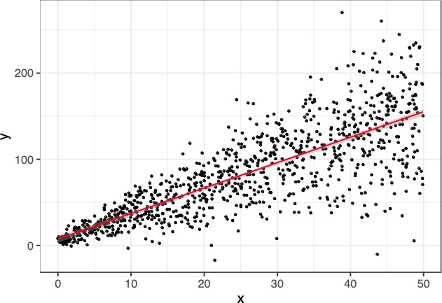
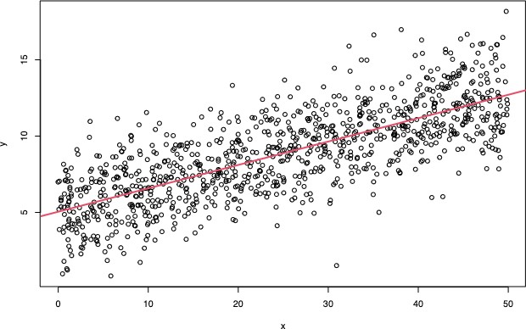
Outliers
Assumptions
ϵ_{i} has constant variance σ²

Slide 15
Outliers
Assumptions
ϵ_{i} has constant variance σ²
Validate through
1. Residual versus fitted plot
→ If violated, standard errors are unreliable
Remedies
Log-transform Y
Roust standard errors

Slide 16
Outliers
Assumptions
Parametric linearity
Validate through
Scatter plot
Residual plot
→ If violated, slope coefficients are unreliable
Remedies
1. Transform X

Slide 17
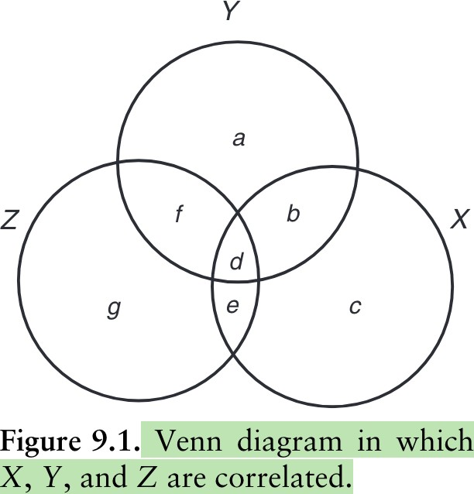
Outliers
Assumptions
No perfect multicollinearity
(Kellstedt and Whitten 2018, 212).

Slide 18
Outliers
Assumptions
No perfect multicollinearity
Validate through
Correlation matrix
Variance Inflation Factor (VIF), indicates how much variation in X is explained by other independent variables
→ Mathematical requirement, slope cannot be estimated
Remedies
Gather more data
Combine variables in index

Slide 19
References
References
Kellstedt, Paul M., and Guy D. Whitten. 2018. The fundamentals of political science research. Cambridge: Cambridge University Press.

