Slide 1
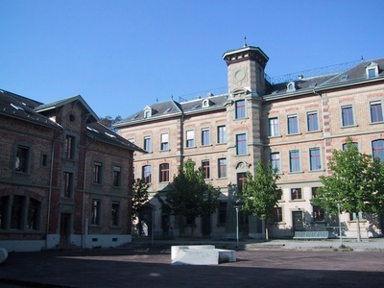
Sporticide
Adrian Kurt
Andreas Hohler
Karan Sethi
Lukas von Rotz
Pascal Zaugg
Notes:
Vorstellen wer wir sind

Slide 2
Outline
Project Idea
Services
Team Organisation
Project Plan

Slide 3
Project Idea
Members
Height
Weight
Location
Training preferences (intensitiy, time and day, sport, maximum traveling time)

Slide 4
Project Idea
Plan training sessions
Sport
Repetition (daily, weekly, monthly)
Length
Place / Location
Time
Teamsize
Weather
Private or public trainings
inside or outside
Transportation time
Training level (novice to expert)

Slide 5
Project Idea
Rate training session
Fun (a lot of fun to no fun at all)
Intensity (very intense to standing around)
Comments

Slide 6
Project Idea
Compare trainings
Length
Most attendent training
Communation services
Send message to others
Invite others to training (Email, Twitter, Facebook, InApp)
Notification about new trainings from your friends (Email, InApp)
Notification for planned trainings and ical feed

Slide 7
Project Idea
Build training teams
Training sessions summary
Most intense
Partners
Longest Training
Average time
Most fun
Training proposals
Depending on location, preferences and attended training

Slide 8
Project Idea
Plan training sessions
Sport
Repetition (daily, weekly, monthly)
Length
Place / Location
Time
Teamsize
Weather
Private or public trainings
Rate training session
Fun (a lot of fun to no fun at all)
Intensity (very intense to slandin around)
Comments

Slide 9
Project Idea
Compare trainings
Length
Most attendent training
Communation services
Send message to others
Invite others to training (Email, Twitter, Facebook, InApp)
Notification about new trainings from your friends (Email, InApp)
Notification for planned trainings and ical feed

Slide 10
Project Idea
Build training teams
Training sessions summary
Most intense
Partners
Longest Training
Average time
Most fun
Training proposals
Depending on location, preferences and attended training

Slide 11
Services
Facebook (https://developers.facebook.com/)
Twitter (https://dev.twitter.com/)
Google Maps (https://developers.google.com/maps/documentation/javascript/)
Weather (https://openweathermap.org/api)
SBB (http://transport.opendata.ch)
Gmail Account

Slide 12
Team Organisation
Scrum Master
Lukas von Rotz
Test Manager
Pascal Zaugg
Deployment Manager (Heroku)
Andreas Hohler
UI Specialists
Adrian Kurt
Karan Sethi

Slide 13
Project Plan
Versioning: Git / GitHub
Hosting: Heroku
Bug tracking: GitHub Issues
Doc: GitHub Wiki
Milestones / Tasks: Scrum excel
Testing
Unit tests: RSpec
Acceptance tests: Selenium

Slide 14
Project Plan II
 | Start | End | Implementation | Tasks
1 | 6.10.15 | 20.10.15 | Model creation | Login, facebook login, member management, CyberCoach integration
2 | 20.10.15 | 3.11.15 | Basic Features | Trainings, join& invite to training, rate training, training summary, Twitter
3a | 3.11.15 | 10.11.15 | Services | Weather, GoogleMaps, Transportation
3b | 11.11.15 | 17.11.15 | Refactoring and bug fixin'
4 | 17.11.15 | 1.12.15 | Additional features | Message service, comments, email notifications
5a | 1.12.15 | 8.12.15 | Minor features | Facebook invitations
5b | 8.12.15 | 13.12.15 | Feature freeze and bug fixin'

