Slide 1


Advancing Southeast Asia e-Commerce

Slide 2
ASEAN Ecom
Who are we:
ASEAN Ecom is a group of globalized professionals who have a "zeal" in advancing and developing the Southeast Asian e-commerce infrastructure.
What we do:
We are creating an e-commerce ecosystem by using technology to build an online payment platform, online trading sites and smart logistics.
Why we do it:
We want to solve the market problems that e-commerce faces and bring the convenience of doing business online to the people of Southeast Asia.
We support more economic growth and also open up many dormant opportunities such as web services, apps with freemium models, etc. We hope to shape e-commerce as a lifestyle.

Slide 3
Mission & Vision
Mission:
Our globalized startup team gathers diverse individuals with the same passion in e-commerce. To work together in providing the tools to make trading online easy and accessible for everyone in Southeast Asia. This is done by creating “trust” by providing a user-friendly, smart, convenient, reliable, and secure integrated payment platform and also accessibility through subsidiary online marketplaces and logistics .
Vision:
ASEAN Ecom aims to build and advance the future infrastructure of e-commerce across countries in Southeast Asia. Through the development of our projects that establish "trust", we set out to evolve the way Southeast Asians conduct online trading. Ultimately making e-commerce a lifestyle in the region.

Slide 4
ASEAN e-Commerce Landscape
Males buy 3Cs (Computer, Communication, Consumer Electronic Products)
Females buy fashion, health & beauty, and kitchenware
The growing of ecommerce startups and small businesses (B2C, C2C and online traditional businesses)
The ASEAN E-Commerce is worth approximately $34.5 billion by 2018.
Shopping Online is predicted to become a lifestyle for the people of this region in the near future.
The majority of online trading in SEA is through social media sites like Instagram, Facebook and meet up for payment.

Slide 5
Key Factors Fuel E-Commerce in ASEAN
The ecommerce/retail rate is low so there is a significant room to grow.
The rise of Southeast Asian middle class population.
Increasing Mobile, Internet and Credit/Debit Card penetration.
The ASEAN E-Commerce is worth approximately $34.5 billion by 2018.
Increasing logistic options.
Southeast Asia has a young online population (540+ Millions People)
The ASEAN Economic Community (AEC) will open borders and stimulate trade and commerce across Southeast Asia through better logistics capabilities.

Slide 6




ASEAN e-Commerce Challenges
Payment System
Consumer Behaviour
Security
Logistics
Low credit card penetration. Opt for cash on delivery.
Do not see the benefit of putting their cash in banks.
Existing payments systems fall short of creating trust.
Emphasis on inspecting the product before buying.
Many online marketplaces provide vague descriptions and pictures to illustrate products. General skepticism on digital content.
Poor privacy policies.
Identity theft and unauthorized bank account access.
Illegitimate online marketplaces.
Various consumer frauds.
Poor infrastructure planning.
Lack of technological adaptations to existing services.
Deliveries often get stolen/lost or are late upon arrival.

Slide 7

Solution
ASEAN Ecom aims to advance and develop the Southeast Asian e-commerce infrastructure by building a sustainable e-commerce ecosystem.
www.aseanecom.com

Slide 8
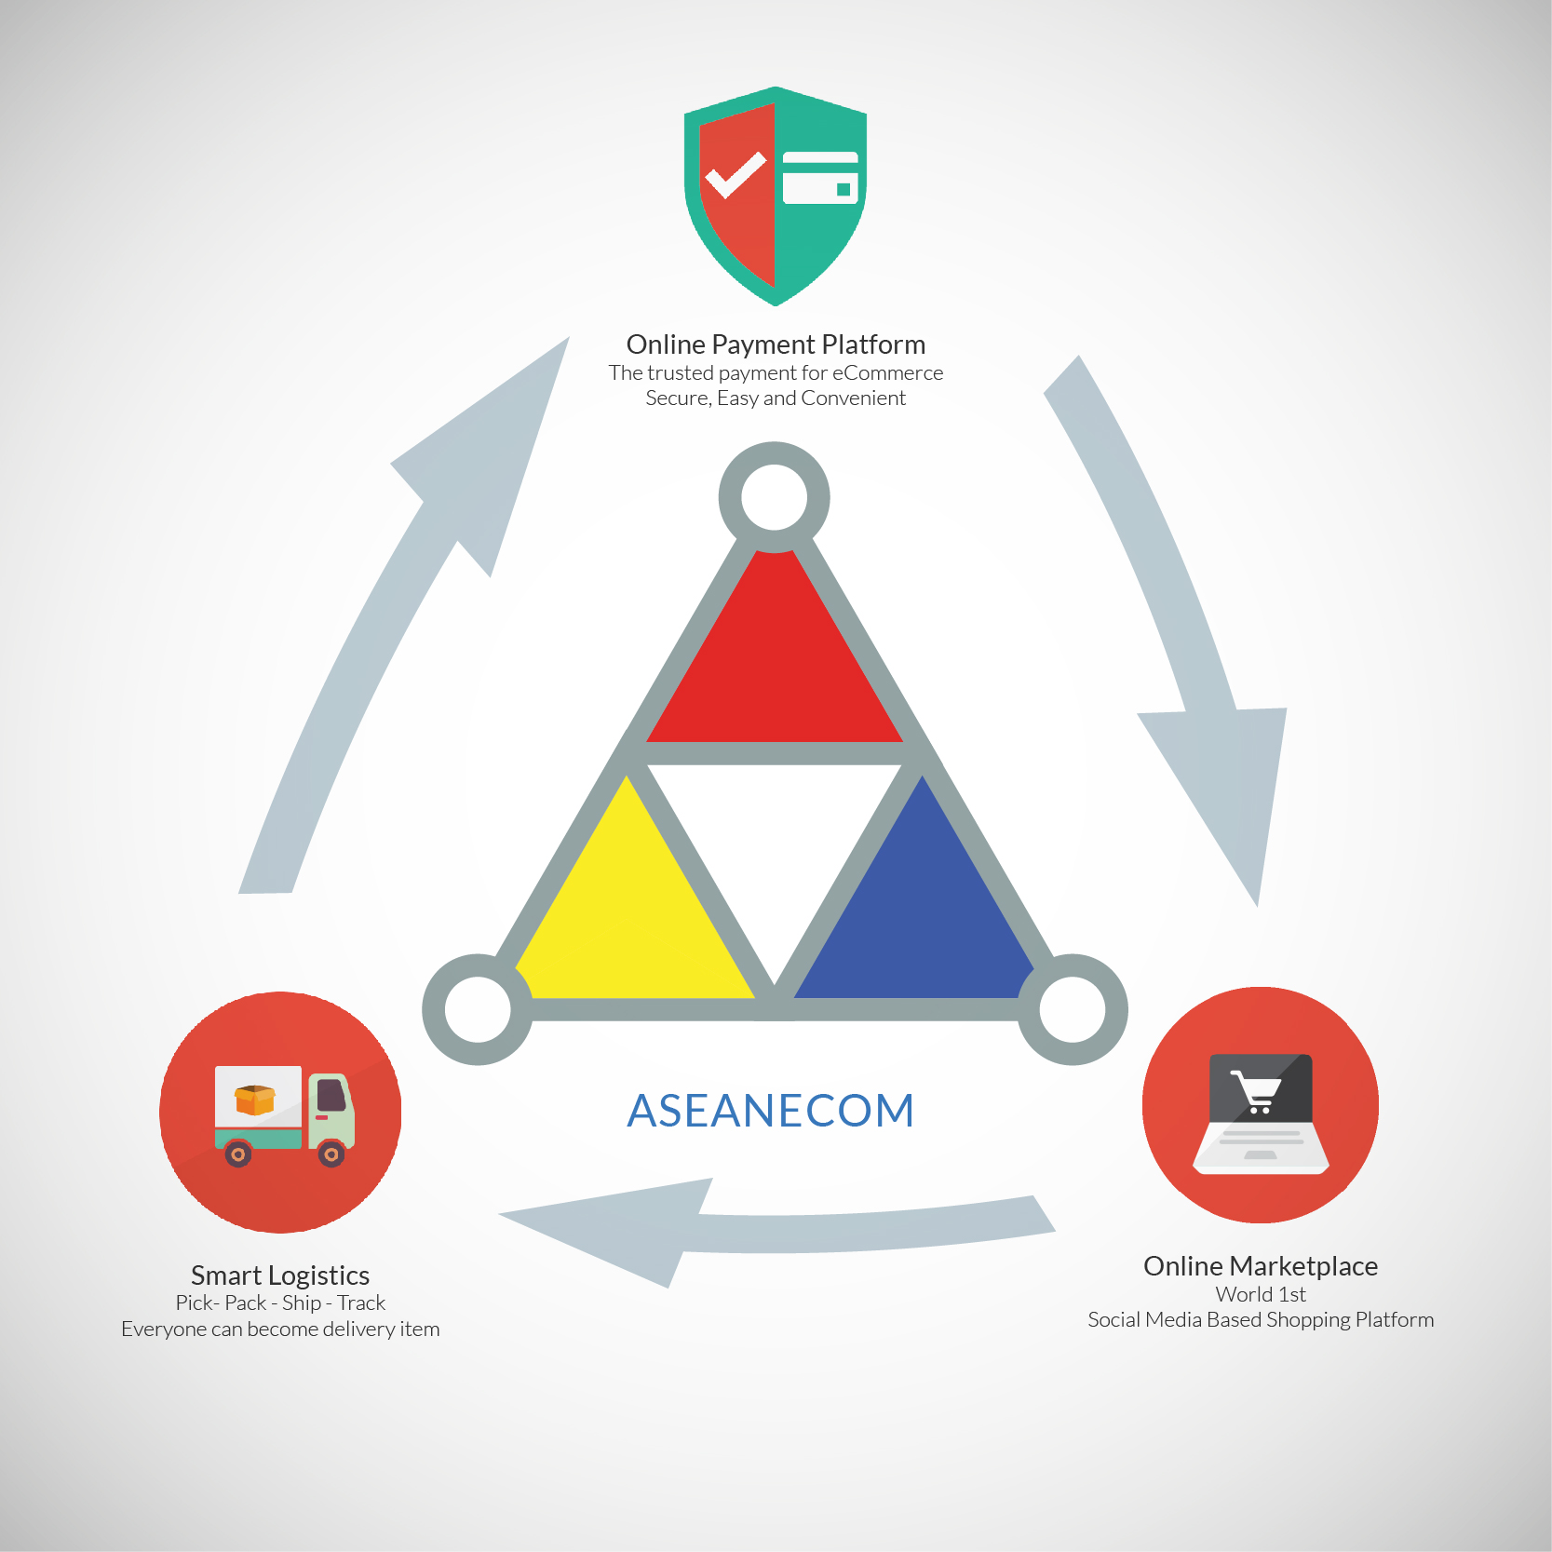
Introduction to the Solution

Slide 9


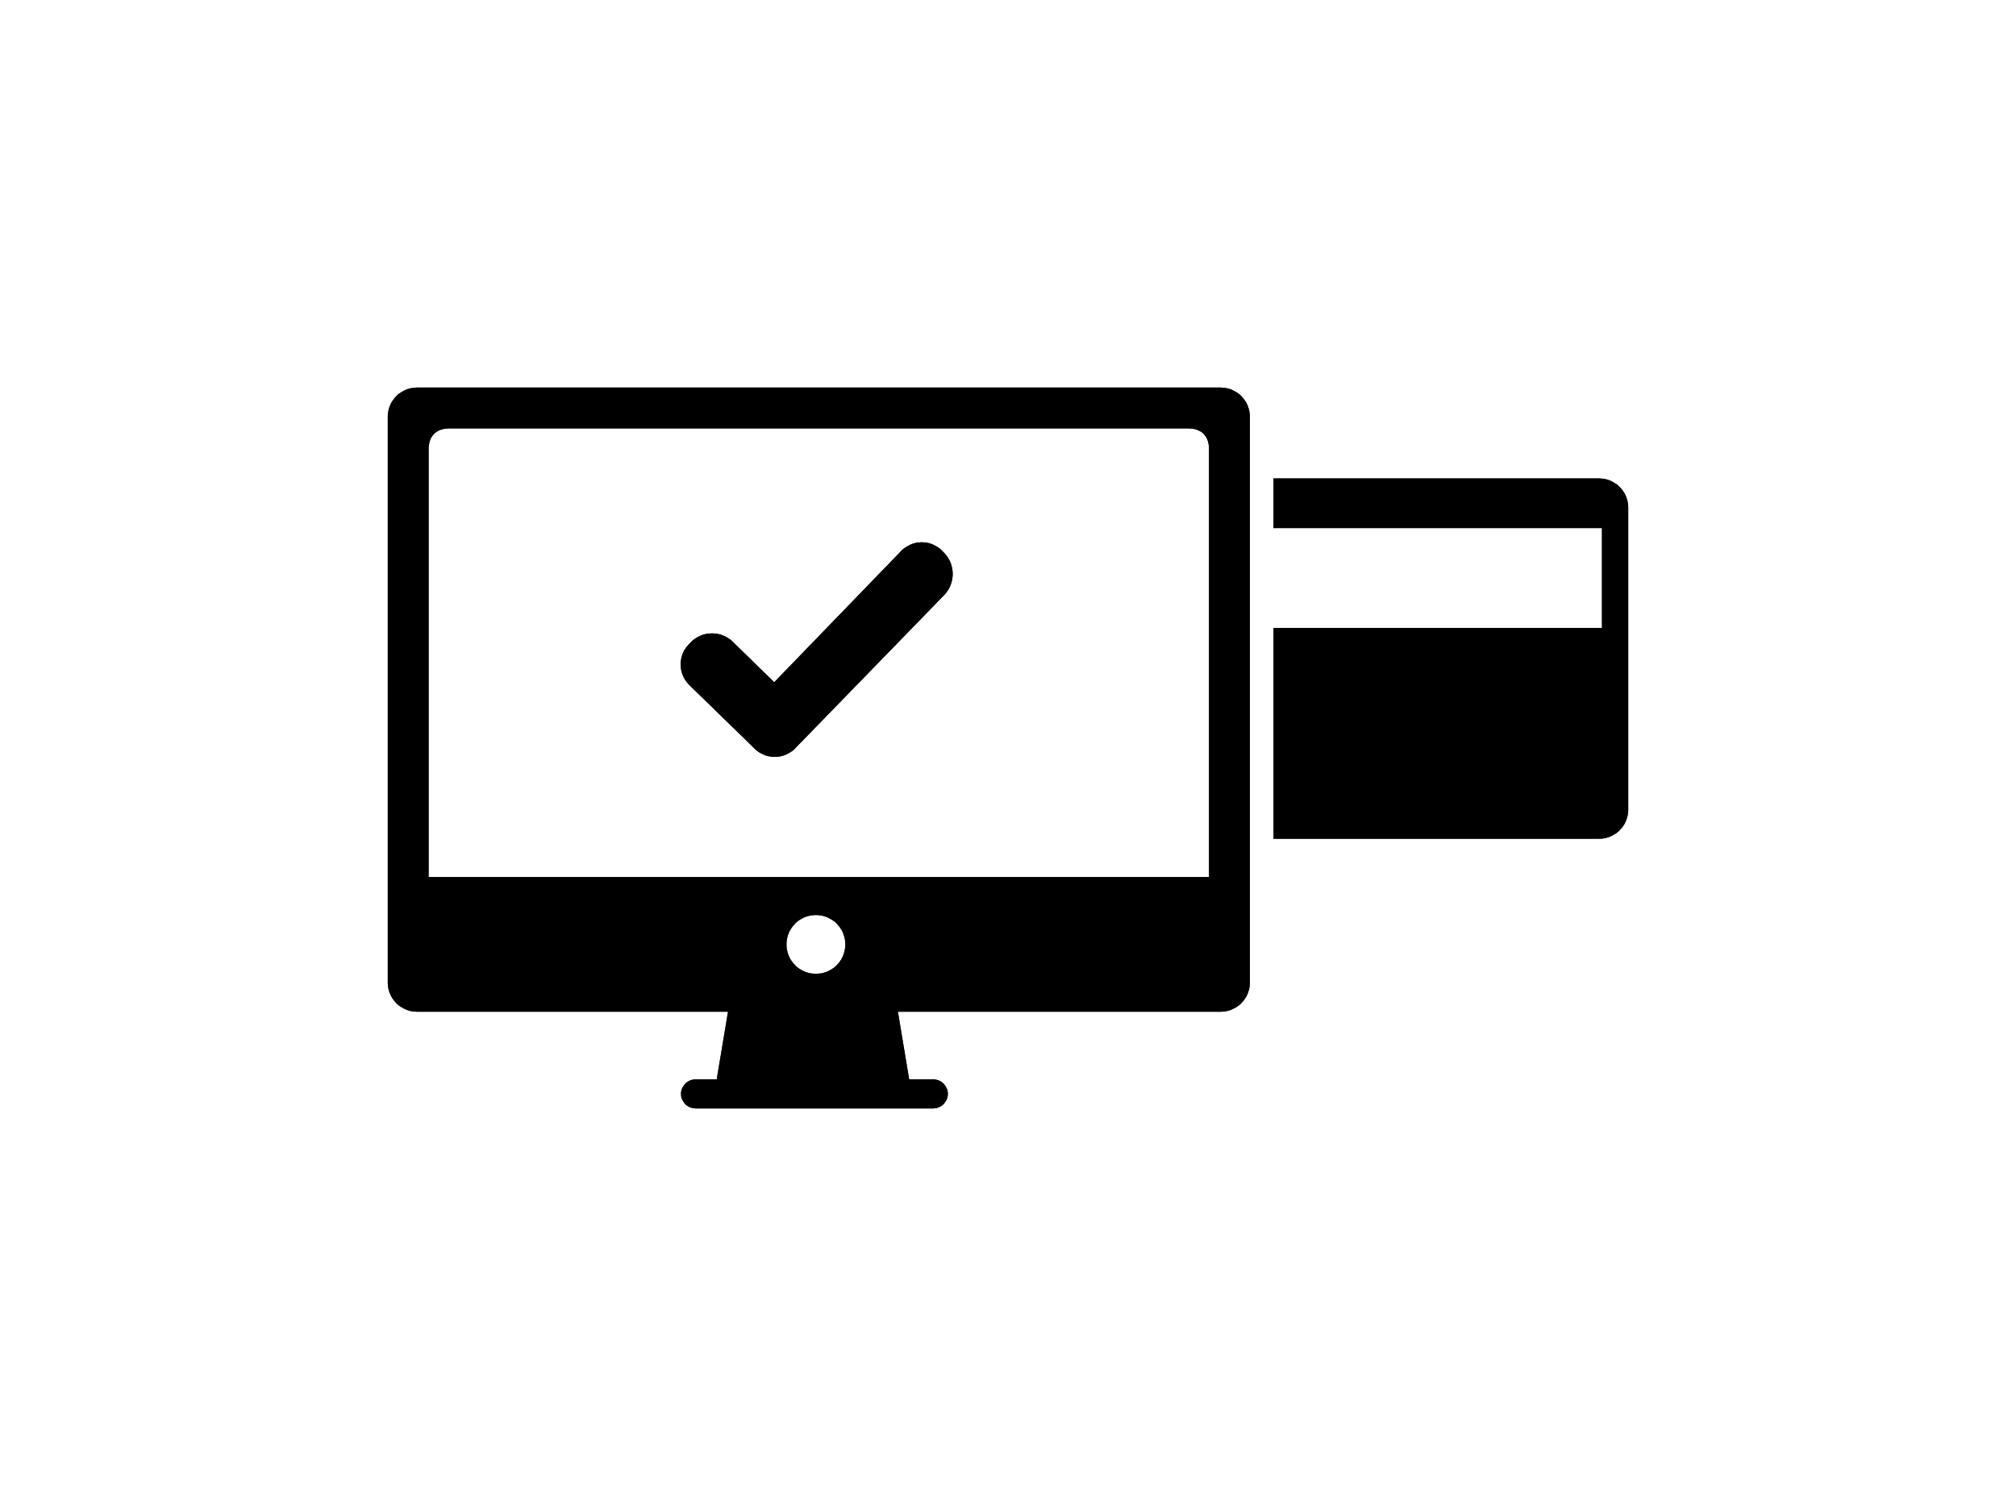

We build the trust for eCommerce
A secure user-friendly integrated payment platform.
The trusted payment platform with escrow concept features.
Intends to resolve the online trust & security problem of ecommerce in SEA.
Uses the latest PCI Data security standards.
The solution to further expand logistical development.
Opens up dormant services e.g. web services, freemium apps, etc.
*SeenPay’s detailed scheme is available upon request.

Slide 10


Social Media Based Online Marketplaces
AsiaticMall.com
An online marketplace that allows Sellers from different countries in Asia to trade with one another.
Lucloi.vn
C2C online marketplace for Vietnamese consumers.

Slide 11

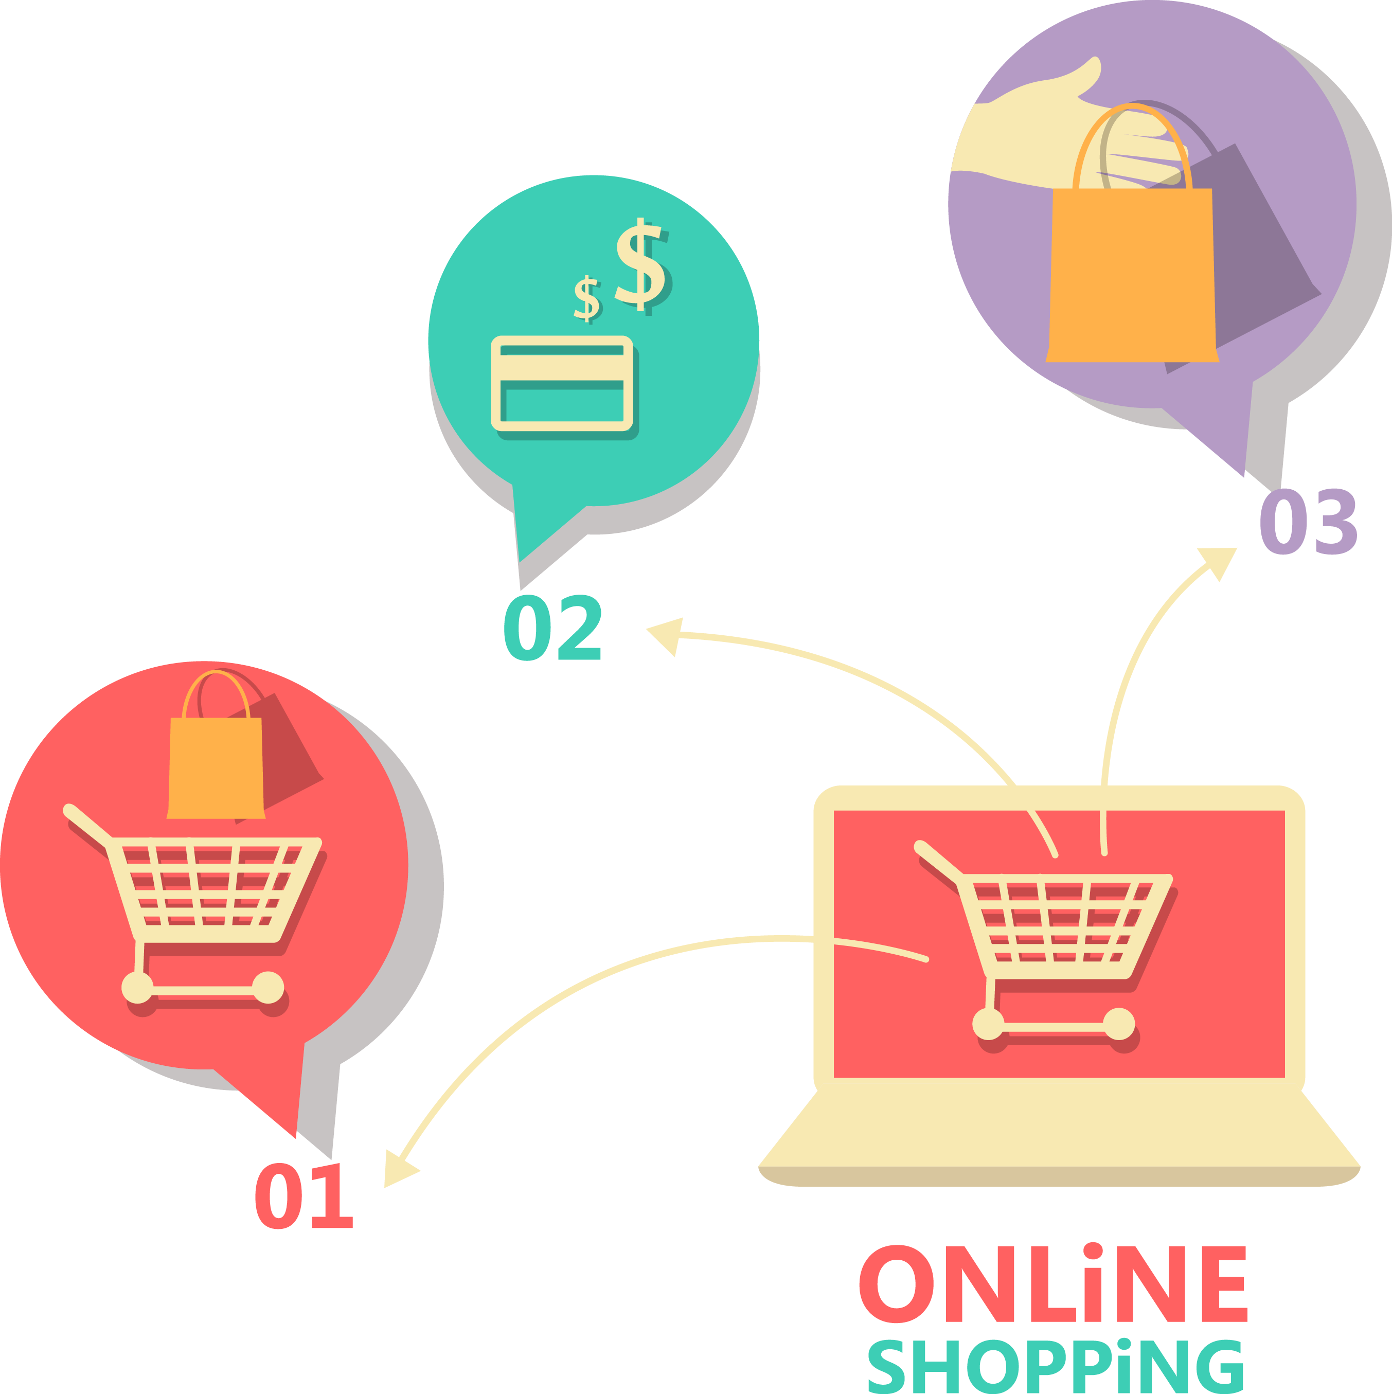
Social Media Based Marketplaces
What is social media based Marketplace?
A social media based online market is a new concept of online market which integrated all the features of social media websites like Facebook, Instagram or even Snapchat.
Social media
Online Market

Slide 12


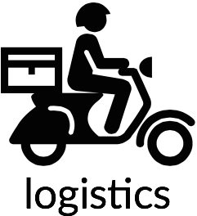
A service that
Picks ups - Packs – Ships the item.
Delivery service model is also inspired by Uber’s hiring concept.
*Subject to change.

Slide 13
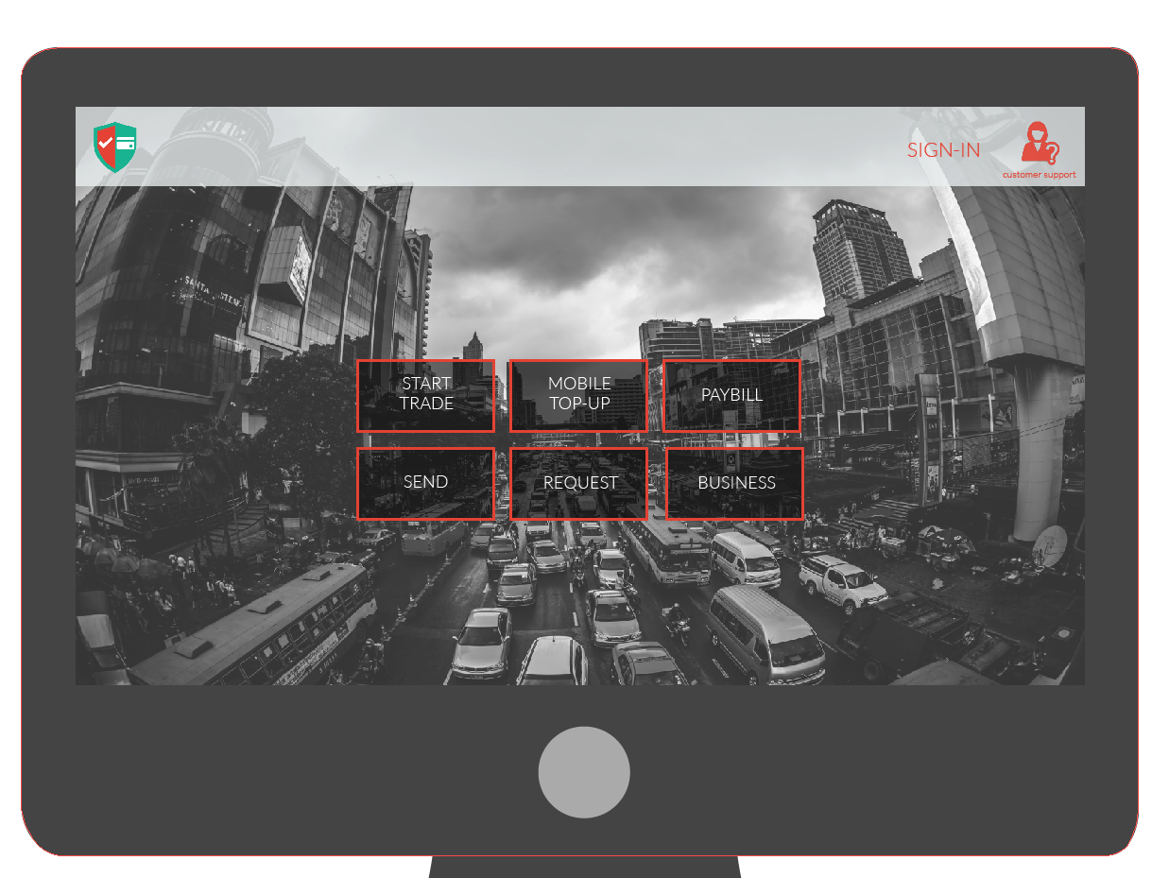
User Experience Outline

Slide 14
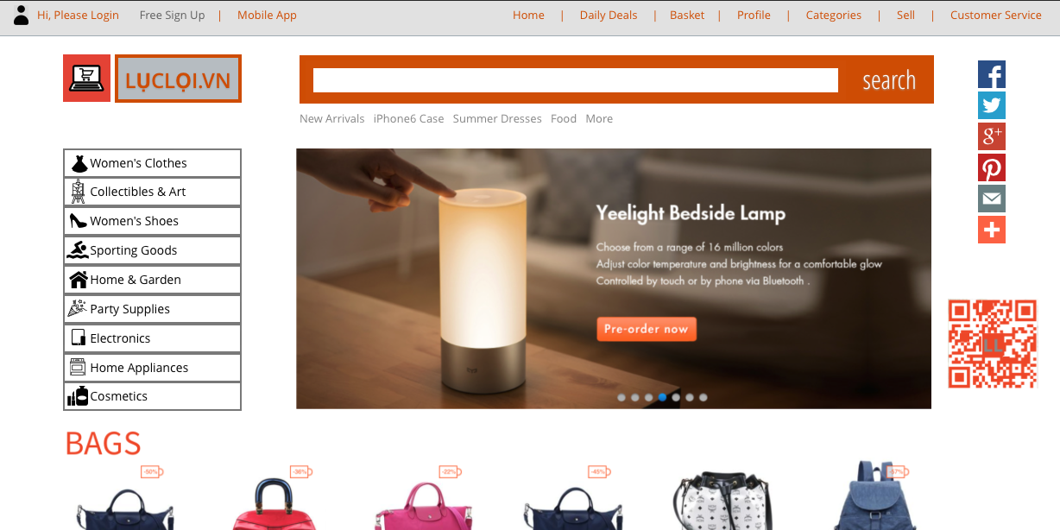
User Experience Outline

Slide 15









Competition

Slide 16
Competitive Advantages
Payment
Logistics
Online Marketplace
More Versatility
A lifestyle payment platform all in one. From paying utility bills, buying movie tickets to paying for a date’s meal discretely.
More Relevant
Users get to follow trendsetters and view a feed of items suited to their interest.
Flexible
Registrants can earn from delivering by customizing their schedule to the available delivery tasks days ahead.
Easier
Sell and buy anything with one click of a button. Just like social media, users get to share the items they are selling or buying. Including an instant chat feature to make deals happen. (C2C)
Smarter with Escrow
Personalization provides better user experience. Offer users different methods ….

Slide 17





Stages of Development
Current Phase
Phase II
Phase III
Further research on the market situation.
Refining ASEAN-Ecom’s strategy and recruiting members.
Developing and enhancing solutions i.e. payment platform.
Undergo rigorous product testing.
Introduce functionality to wider audience and appeal investors.
Official Launch of SeenPay and Lucloi.vn in Vietnam.
Logistics work-around through 3rd party partnership.
Finalize cross border-trading for AsiaticMall.com - possible through (AEC)
Start Marketing Ploy.

Slide 18
Contact: hello@aseanecom.com www.aseanecom.com Boston, MA - USA

