Slide 1
Y6CP FID DPM Recovery Analysis
SOCAMM2 | 7500MT/s | WW06-15

Slide 2
Executive Summary
SOCAMM2 7500MT | WW202606-15 (10 Weeks) HMB1 & QMON Steps
HMB1 Step:
• Yield: 98.32% (29,788 modules tested)
• Total FID DPM: 287.3 → Remaining: 72.6 DPM
• Recovery: 214.7 DPM (75% recoverable)
QMON Step:
• Yield: 98.79% (24,126 modules tested)
• Total FID DPM: 190.7 → Remaining: 64.0 DPM
• Recovery: 126.7 DPM (66% recoverable)
Combined SLT (HMB1 × QMON):
• Total FID DPM: 478.0 → Remaining: 136.6 DPM
• Total Recovery: 341.4 DPM (71% recoverable)
• Key Mechanisms: BIOS (67%) + HW+SOP (4%)

Slide 3
DPM to MFG View: Bridging the Communication Gap
Metric | HMB1 | QMON | Combined SLT
Current Yield | 98.32% | 98.79% | 97.13%
Modules Tested | 29,788 | 24,126 | -
Modules Failed | 500 | 292 | 792
Total FID DPM | 287.3 | 190.7 | 478.0
Recoverable DPM | 214.7 | 126.7 | 341.4
Remaining DPM | 72.6 | 64.0 | 136.6
Projected Yield | 99.58% | 99.59% | 99.18%
Key Message:
Current: 97.13% yield (478.0 FID DPM) → Projected: 99.18% yield (136.6 FID DPM)
Through BIOS/HW+SOP recovery, we improve SLT yield by +2.05% (341.4 DPM recovered)

Slide 4
DPM Calculation Method
Formula:
Unique Failing MSNs
FID DPM = ─────────────────────────── × 1,000,000
Total FID UIN
Calculation:
HMB1: FID DPM = 500 unique failing modules / 29,788 FID UIN × 1M = 287.3
QMON: FID DPM = 292 unique failing modules / 24,126 FID UIN × 1M = 190.7
Why count unique MSNs?
• For Mod-Sys, Hang, and Multi-Mod fails, the failure occurs at the MSN level
• FIDs and packages within the same MSN fail together from a single event
• Counting each failed FID would overcount the actual failure rate

Slide 5
Top FAILCRAWLER Categories by DPM
Sorted highest → lowest | Color-coded by risk: 🔴 Critical (>30%) | 🟠 High (15-30%) | 🟡 Medium (5-15%) | 🟢 Low (<5%)
HMB1 (Total: 287.3 DPM)
QMON (Total: 190.7 DPM)
• MULTI_BANK_MULTI_DQ: 115.2 DPM (40%)
• SINGLE_BURST_SINGLE_ROW: 48.7 DPM (17%)
• HGDC: 38.4 DPM (13%)
• Other: 26.0 DPM (9%)
• SYS_EVEN_BURST_BIT: 18.9 DPM (7%)
• DB: 15.3 DPM (5%)
• HANG: 11.2 DPM (4%)
• SB: 8.2 DPM (3%)
• ROW: 5.4 DPM (2%)
• MULTI_BANK_MULTI_DQ: 88.4 DPM (46%)
• SINGLE_BURST_SINGLE_ROW: 30.3 DPM (16%)
• Other: 22.9 DPM (12%)
• SYS_EVEN_BURST_BIT: 12.1 DPM (6%)
• HGDC: 9.2 DPM (5%)
• ROW: 8.7 DPM (5%)
• HANG: 8.1 DPM (4%)
• DB: 6.8 DPM (4%)
• SB: 4.2 DPM (2%)
Risk Legend: CRITICAL = Top pareto (>30%) | HIGH = Secondary (15-30%) | MEDIUM = Moderate (5-15%) | LOW = Minor (<5%)
"Other" includes: SECTION_FAIL_PERIPH, MULTI_HALFBANK_SINGLE_DQ, BOOT, BURST_FAIL, COLUMN_FAIL, BANK_FAIL_EVEN_DQ, BANK_FAIL_ODD_DQ, and additional minor patterns (<2% each)

Slide 6
Recovery Type Assignments
BIOS 100% Recovery (Full recovery projected):
• MULTI_BANK_MULTI_DQ
• Patterns with consistent multi-bank behavior
BIOS 50% Recovery (Partial recovery projected):
• Bank/Burst/Periph patterns
• SYS_EVEN_BURST_BIT, HGDC, etc.
HW+SOP Recovery (100% projected):
• HANG (MSN_STATUS based)
• Socket/debris contamination fixes
• SOP compliance enforcement
No Recovery (DRAM-related):
• SB (Single Bit)
• DB (Double Bit)
• ROW failures

Slide 7
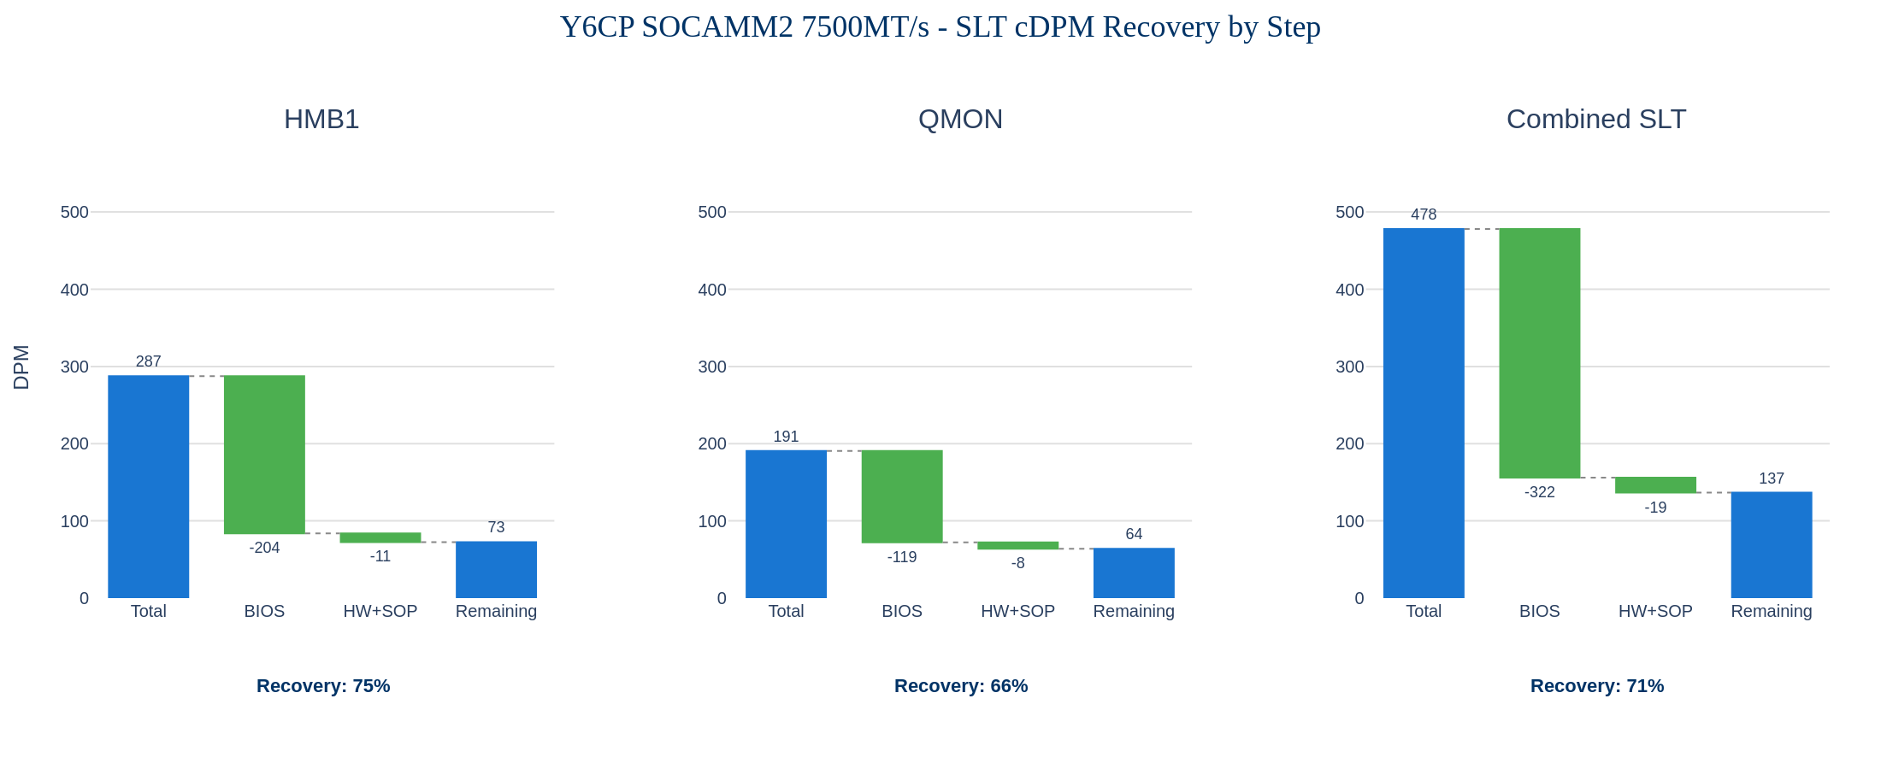
SLT Recovery Overview - All Steps
Combined SLT: 478.0 DPM total | BIOS: -322.1 (67%) | HW+SOP: -19.3 (4%) | Remaining: 136.6 DPM (29%)

Slide 8
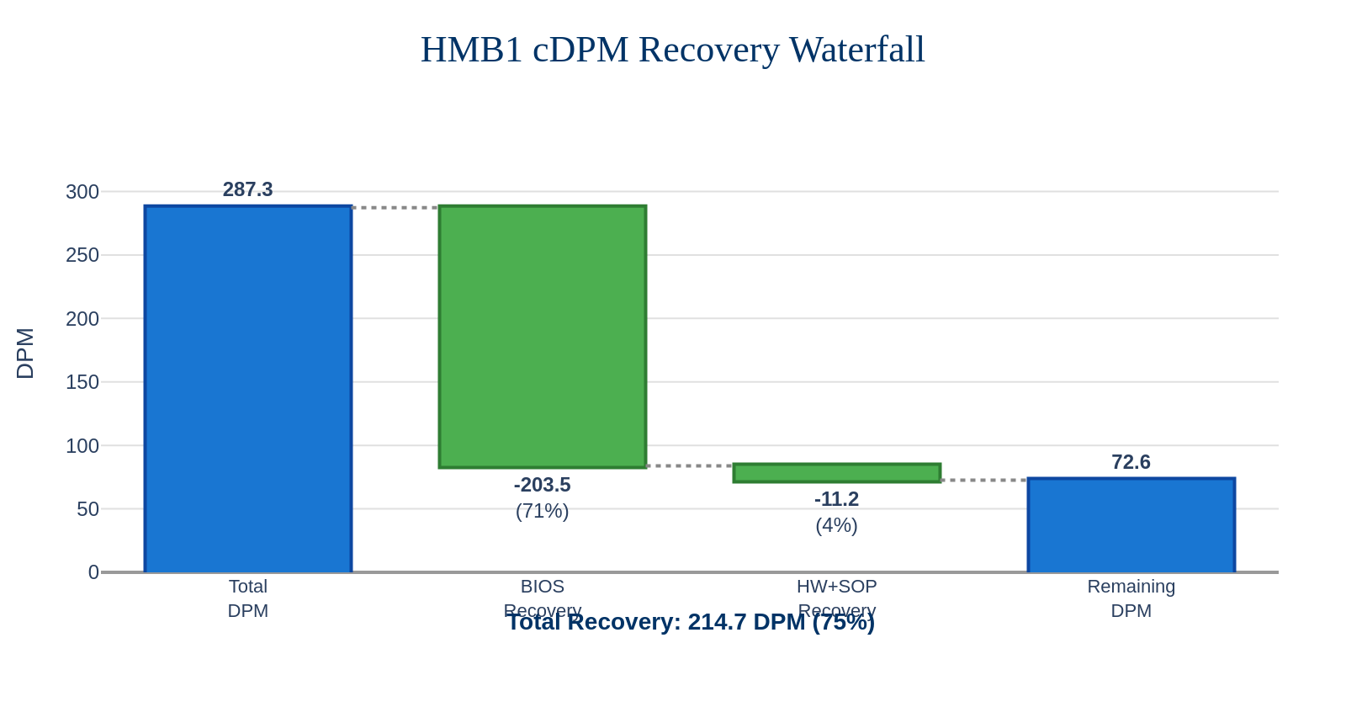
HMB1 cDPM Recovery Waterfall
HMB1 Recovery Summary
Total DPM: 287.3
BIOS Recovery: 203.5 (71%)
HW+SOP Recovery: 11.2 (4%)
Total Recoverable: 214.7 (75%)
Remaining: 72.6 (25%)

Slide 9
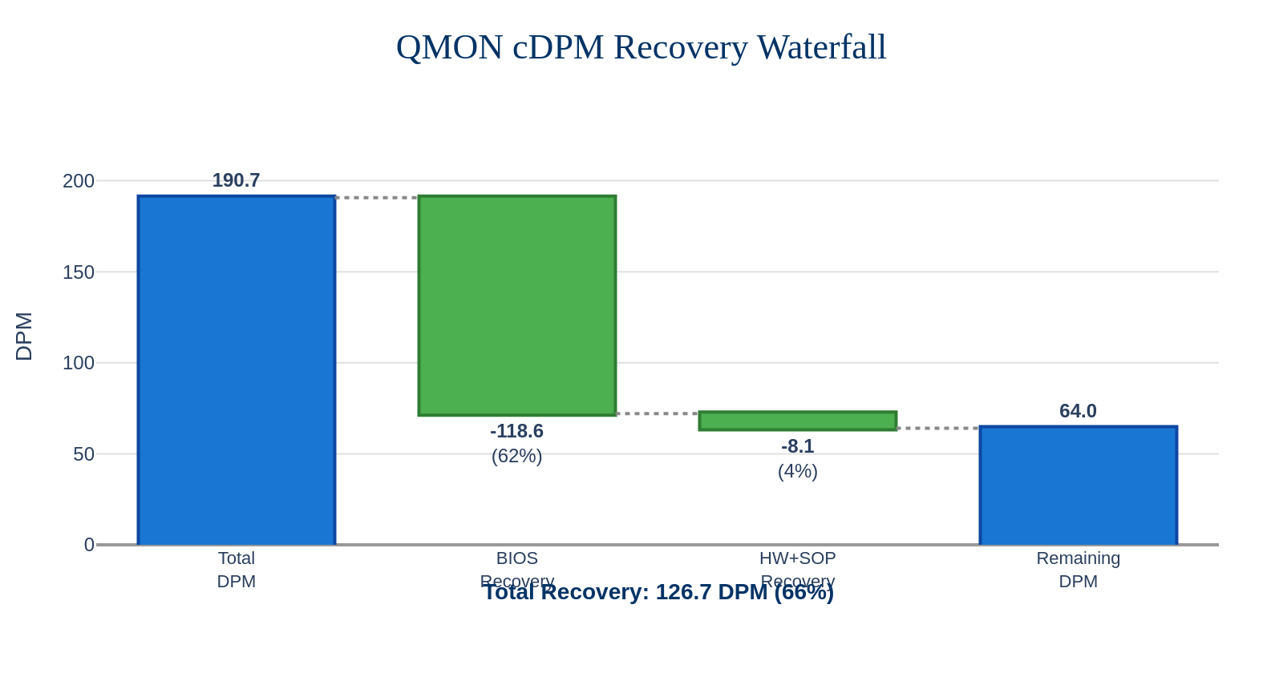
QMON cDPM Recovery Waterfall
QMON Recovery Summary
Total DPM: 190.7
BIOS Recovery: 118.6 (62%)
HW+SOP Recovery: 8.1 (4%)
Total Recoverable: 126.7 (66%)
Remaining: 64.0 (34%)

Slide 10
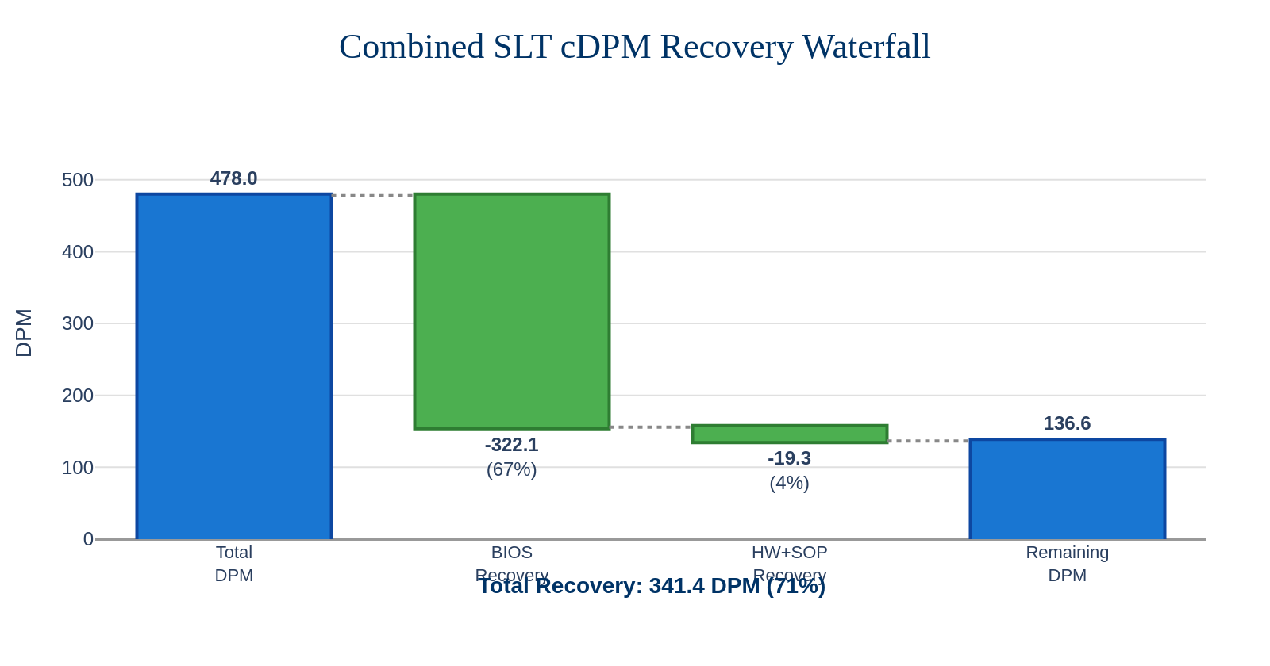
Combined SLT cDPM Recovery Waterfall
Combined SLT Recovery Summary
Total DPM: 478.0
BIOS Recovery: 322.1 (67%)
HW+SOP Recovery: 19.3 (4%)
Total Recoverable: 341.4 (71%)
Remaining: 136.6 (29%)

Slide 11
Step-Level DPM Breakdown
Step | Total DPM | BIOS | HW+SOP | Recoverable | Remaining
HMB1 | 287.3 | 203.5 (71%) | 11.2 (4%) | 214.7 (75%) | 72.6 (25%)
QMON | 190.7 | 118.6 (62%) | 8.1 (4%) | 126.7 (66%) | 64.0 (34%)
Combined SLT | 478.0 | 322.1 (67%) | 19.3 (4%) | 341.4 (71%) | 136.6 (29%)
Recovery Mechanisms:
BIOS: MULTI_BANK_MULTI_DQ (100%) + Bank/Burst/Periph patterns (50%)
HW+SOP: Socket/debris contamination fixes + SOP compliance
Note: 1st pass yield impacted by HW issues. Recovery projections assume fixes deployed.

Slide 12
Unrecovered Failures: Potential Yield Opportunity
Combined SLT - Remaining DPM breakdown by category
Category | FAILCRAWLER | Unrecovered DPM | Yield Gain
BIOS 50% | SINGLE_BURST_SINGLE_ROW | 39.5 | +0.237%
 | HGDC | 23.8 | +0.143%
 | SYS_EVEN_BURST_BIT | 15.5 | +0.093%
 | MULTI_HALFBANK_MULTI_DQ | 6.2 | +0.037%
Subtotal BIOS 50% |  | 85.0 | +0.51%
DRAM | DB | 22.1 | +0.133%
 | SB | 12.4 | +0.074%
 | ROW | 14.1 | +0.085%
Subtotal DRAM |  | 48.6 | +0.29%
Other | BOOT | 3.0 | +0.018%
TOTAL |  | 136.6 | +0.82%
Key Insights:
• BIOS 50% (85.0 DPM): Partial recovery patterns - potential +0.51% yield with improved BIOS fix
• DRAM (48.6 DPM): SB/DB/ROW failures - requires component-level improvement
• Total opportunity: +0.82% yield if all remaining failures addressed

Slide 13
MSN_STATUS × FAILCRAWLER Correlation
Understanding the linkage between module status and fail patterns
MSN_STATUS | Top FAILCRAWLERs | Recovery
Hang | HANG (100%) | HW+SOP (100%)
Boot | BOOT (100%) | No Fix (0%)
SB_Int | SB (100%) | DRAM (0%)
Mod-Sys | MULTI_BANK_MULTI_DQ (64%), SINGLE_BURST_SINGLE_ROW (11%), HGDC (10%) | BIOS (varies)
Multi-DQ | MULTI_BANK_MULTI_DQ (61%), SECTION_FAIL_PERIPH (19%) | BIOS 100%
DQ | SYS_EVEN_BURST_BIT (43%), MULTI_HALFBANK_SINGLE_DQ (36%), DB (3%) | BIOS 50% / DRAM
Row | SINGLE_BURST_SINGLE_ROW (74%), DB (17%), ROW (3%) | BIOS 50% / DRAM
Multi-Mod | SINGLE_BURST_SINGLE_ROW (42%), MULTI_BANK_MULTI_DQ (33%) | Mixed
How to Read This Table:
• MSN_STATUS = Module status category from test (what the tester reports)
• FAILCRAWLER = Fail pattern classification (root cause analysis)
• 100% correlation: Hang→HANG, Boot→BOOT, SB_Int→SB (easy to explain)
• Mixed correlation: Mod-Sys and DQ contain multiple FAILCRAWLER types
• Recovery depends on FAILCRAWLER, not MSN_STATUS

Slide 14
Appendix: Data Sources & Commands
Data Collection:
1. Unique Failing MSNs (Numerator):
mtsums -dbase=y6cp -step={step} -module_form_factor=socamm2 \
-module_speed=7500MTPS -mfg_workweek=202606,...,202615 +stdf +msnag
2. Total FID UIN (Denominator):
mtsums -dbase=y6cp -step={step} -module_form_factor=socamm2 \
-module_speed=7500MTPS -mfg_workweek=202606,...,202615 +fidag
3. FAILCRAWLER × MSN_STATUS Correlation:
mtsums ... +stdf +fc +msnag
4. Recovery Projections:
• RPx: socamm_false_miscompare.py script (verified rate)
• BIOS/HW+SOP: Based on fail mode classification

