Slide 1
2015 Fall UMKC Hackathon
Twitter Sentiment Analysis
IBM BDA Use case1
Hackathon Hackers Team:
Bharat Viswanadham
Lema Kandula
Manideep Tatineni
Venu Babu Kolla

Slide 2
Abstract:
Our application, US Elections analyses twitter data and displays a chart showing percentage of favorable, not-favorable and neutral opinions based on a hashtag.
Our application performs sentiment analysis on users’ tweets with the help of hashtags. Example.. @realDonaldTrump.
Stanford CoreNLP is used to perform sentiment analysis on collected dataset.
Each candidate’s opinion is analysed through Spark sentiment analyzer and the results are displayed using charts.

Slide 3
Software Specifications:
Web Technologies: Javascript, Twitter Bootstrap, CSS, HTML5
Analytic tools: Apache Spark,
Database: MongoDb,
Framework: JAX-RS
Services: Stanford CoreNLP, Twitter 4J, MongoDB Java API
Deployed on Bluemix.
Bluemix Url: uselectionanalysis.mybluemix.net/

Slide 4
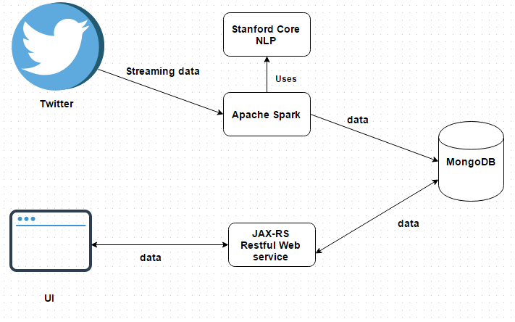
System Architecture:

Slide 5
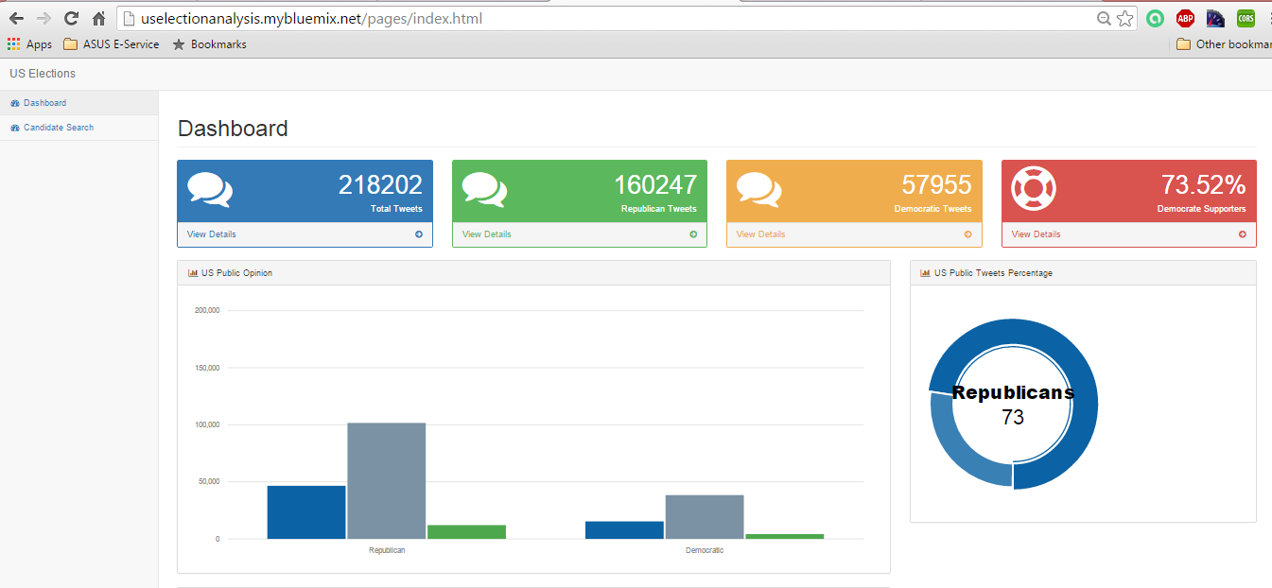
Screenshots displaying total tweets, Republican Tweets, Democratic Tweets,Us Public opinion:

Slide 6
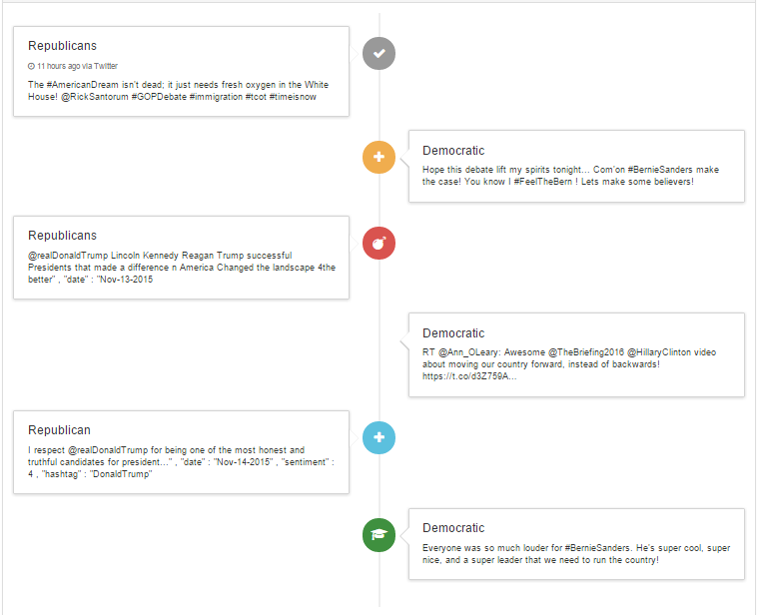
Screenshot displaying top most favorable or positive tweets:

Slide 7
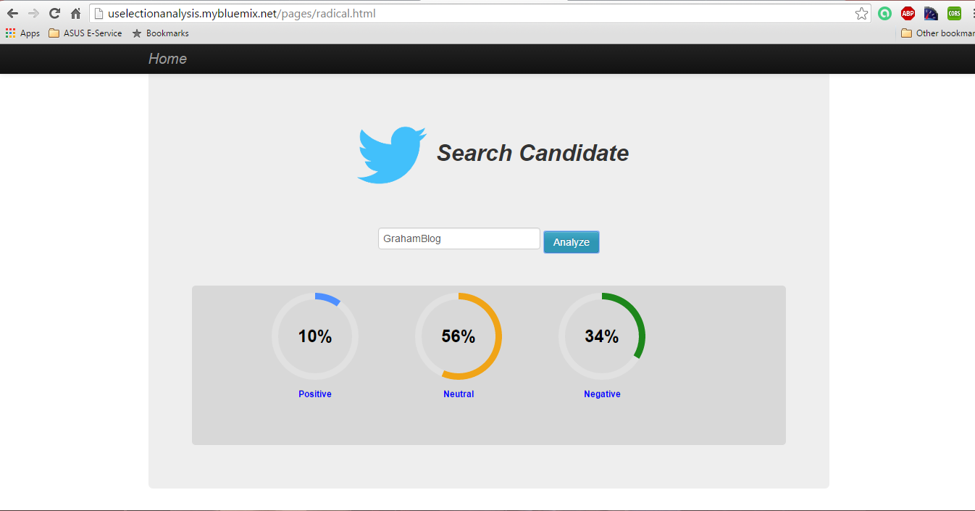
Screenshot displaying chart when candidate name is given in candidate search:

Slide 8
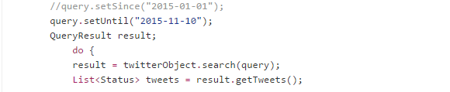
Limitations:
We are able to collect only streaming data, collecting older data from twitter has become a limitation to our application.
We have tried to collect twitter’s older data using .setSince(yyyy-mm-dd) and .setUntil(yyyy-mm-dd)
Some tools provide access to older tweets but in the most of them you have to spend some money before.
Reference: https://github.com/Jefferson-Henrique/GetOldTweets

Slide 9
Thank you

