Slide 1


PERSONAL ASSISTANT (HEALTH BOT)

Slide 2
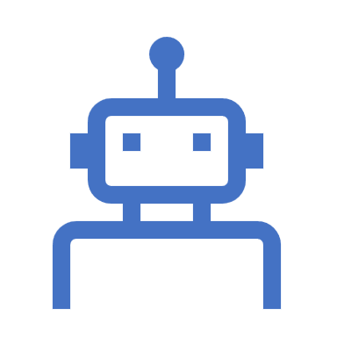
PROBLEM STATEMENT
Builds a rapport with the patients and provides assistance
All chatbots in the medical line have to be presented rightly and made as attractive as possible. Now imagine your patient’s looking up for a symptom on your website but doesn’t know where exactly to find the solution and how to book an appointment with you? They’re going to leave your website disappointed. But a health bot can help you turn that around. When a patient visits your website, your chatbot will give them a warm greeting and help them through the symptoms, predict potential diagnosis, and provide them the option of booking an appointment with you directly. They also take in user information by asking them questions, which gets stored for any form of reference and personalized experience. This is how chatbots build a good rapport with your patients.

Slide 3
INTRODUCTION
A chatbot is an artificial intelligence (AI) software that can simulate a conversion (or a chat) with a user in natural language through messaging applications, websites, mobile apps or through the telephone.
Why are chatbots important?
A chatbot is often described as one of the most advanced and promising expressions of interaction between humans and machines.
However, from a technological point of view, a chatbot only represents the natural evolution of a Question Answering system leveraging Natural Language Processing (NLP).
Formulating responses to questions in natural language is one of the most typical Examples of Natural Language Processing applied in various enterprises’ end-use applications.

Slide 4
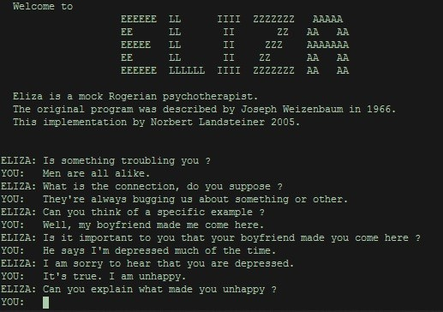
HISTORY OF CHATBOT
ELIZA – Chatbot
In the period of 1964-1966.The great scientist named Joseph Weizenbaum. He invented first chatbot named "ELIZA". Created using the concept of "pattern matching"

Slide 5

How does a chatbot actually works?
Chatbot's generally, uses the concept of supervised machine learning algorithm.

Slide 6
NLP (NATURAL LANGUAGE PROCESSING)
Natural Language processing (NLP) Chatbot takes some combination of steps to convert the customer’s text or speech into structured data that is used to select the related answer. Some of the Natural Language Processing steps are:
Sentiment Analysis: Tries to learn if the user is having a good experience or if the after some point the chat should be forwarded to the human.
Tokenization: The NLP divides a string of words into pieces or tokens that are linguistically symbolic or are differently useful for the application.
Named Entity Recognition: The chatbot program model looks for categories of words, like the name of the product, the user’s name or address, whichever data is required.
Normalization: The Chatbot program model processes the text in an effort to find common spelling mistakes or typographical errors that might the user intent to convey. This gives more human like effect of the Chatbot to the users.
Dependency Parsing: The Chatbot looks for the objects and subjects- verbs, nouns and common phrases in the user’s text to find dependent and related phrases that users might be trying to convey.

Slide 7
AI chatbots in healthcare
In the medical context, AI-powered chatbots can be used to triage patients and guide them to receive the appropriate help. Chatbots are considered a more reliable and accurate alternative to online searches patients carry out when they’re trying to understand the cause of their symptoms.
Healthcare providers believe that chatbots might help patients who aren’t sure where they should go to receive care.
At the end of the day, regular people aren’t trained medically to understand the severity of their diseases.
They collect basic information from patients, and then, based on the input, they provide patients with more information about their conditions and suggest the next steps.

Slide 8
Benefits of chatbots in healthcare
Benefits of using bots are:
Scheduling appointments
Health tracking
Symptom checking
Better organization of patient pathways,
Instant help in emergency situations or first aid,
Medication management,
Offering solutions for simpler medical issues.

Slide 9

RESULTS AND ANALYSIS

Slide 10
The future of chatbots in healthcare
In the future, we’re going to see more comprehensive chatbots solutions emerge on the market.
For example, a chatbot will help users to check their symptoms and, on the basis of the diagnosis, book an appointment, answer their questions, and even offer direct telemedicine consultation with a doctor through video chat. After such consultation, the doctor will prescribe medicine and the prescription will be stored in the system.
There is certainly a lot of room for growth in the healthcare sector when it comes to AI and other innovative technological solutions. Cloud adoption rates are on the rise, and an increasing number of healthcare providers are looking into new ways for streamlining their processes and reducing wait times.

Slide 11

THANKING YOU
“Let’s make this clear: chatbots will never substitute doctors. They can provide many opportunities to facilitate their jobs or improve their performance but, ultimately, it’s human doctors who are going to deliver the care”.

Slide 12
DEVSTARTER
TEAM MEMBERS :
SAI HARSHA VARDHAN A.V.N
MAHINDRA REDDY SURAM
VARSHITH .G
MUNI PRUDHVI.K

