Slide 1


Software Requirements Engineering SEng3302

Slide 2
Chapter one Software Requirements Fundamentals

Slide 3
Topics to be covered
Definition of software requirement Product and process requirement Functional and non-functional requirement Emergent Requirement Quantifiable requirements System requirements and software requirements

Slide 4
Definition of software requirement
The Software Requirements is concerned with the elicitation, analysis, specification, and validation of software requirements as well as the management of requirements during the whole life cycle of the software product.
Software requirements express the needs and constraints placed on a software product that contribute to the solution of some real-world problem.

Slide 5
Cont’d…
Requirements are a specification of
What should be implemented,
Descriptions of how the system should behave,
System property or attribute, or
May be a constraint on the development process of the system.
These requirements reflect the needs of customers for a system that serves a certain purpose such as controlling a device, placing an order, or finding information.

Slide 6
Cont’d…
The process of finding out, analyzing, documenting and checking these services and constraints is called requirements engineering (RE).
Some of the problems that arise during the requirements engineering process are a result of failing to make a clear separation between user and system requirements.

Slide 7
Cont’d…
User requirements are statements, in a natural language plus diagrams, of what services the system is expected to provide to system users and the constraints under which it must operate.
System requirements are more detailed descriptions of the software system’s functions, services, and operational constraints. The system requirements document (SRS) should define exactly what is to be implemented.

Slide 8
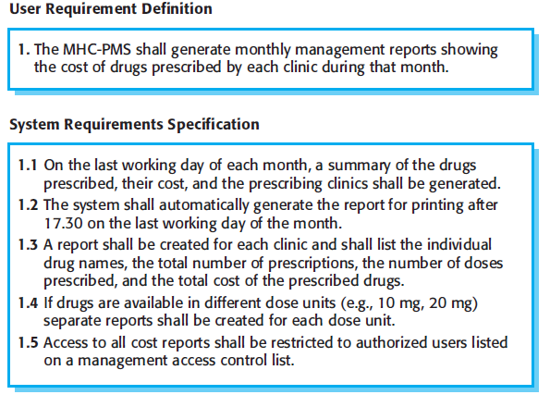
Cont’d…

Slide 9
Product and Process requirement
Product requirement specify the desired characteristics that a system or subsystem must possess.
E.g. The software shall verify that a student meets all prerequisites before you registers for this course.
Process requirement is impose a constraint on the development of the software. E.g. “The software shall be developed using a RUP (Rational Unified Process) process”.
may imposed directly by the development organization, their customer, or a third party such as a safety regulator.

Slide 10
Cont’d…
Product Requirements provides the specific properties or components that a product or system must contain. It includes the methods to which the requirements must integrate to achieve the desired result.
On the other hand, Process Requirements describes the activities that must be performed and constraints that must be followed in the organization.

Slide 11
Functional & Non-Functional Requirement
Software system requirements are often classified as functional requirements or nonfunctional requirements:
Functional requirements these are statements of services the system should provide, how the system should react to particular inputs, and how the system should behave in particular situations.
In some cases, the functional requirements may also explicitly state what the system should not do.

Slide 12
Cont’d
Requirement #1:
The user shall be able to search either the entire database of patients or select a subset from it (admitted patients or patients with asthma, etc)

Slide 13
Cont’d
Requirement #2:
The system shall provide appropriate viewers for the user to read documents in the document store.

Slide 14
Cont’d…
Non-functional requirements place restrictions on the product being developed, the development process, and specify external constraints that the product must meet.
Non-functional requirements define the overall qualities or attributes of the resulting system, rather than individual system features or services.
Examples of NFR - safety, security, usability, reliability and performance requirements.

Slide 15
Classification of NFRs
NFRs may be classified in terms of qualities that a software must exhibit.
A more general classification distinguishes between
Product,
Organizational and
External requirements.

Slide 16
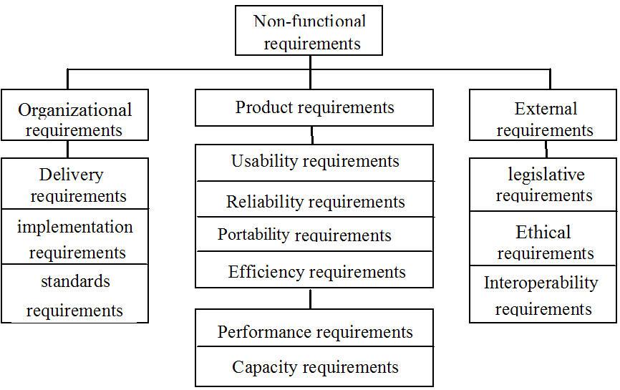
Cont’d

Slide 17
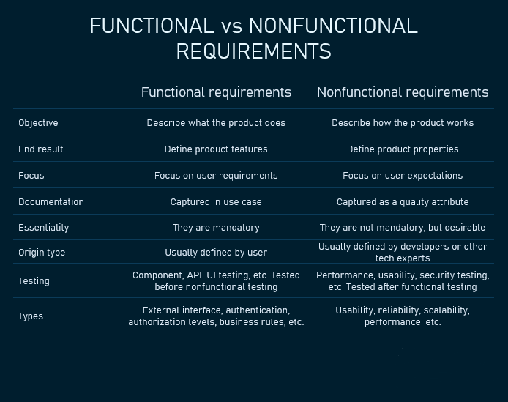

Slide 18
Emergent Properties
Simply mean that requirements that cannot be addressed by a single component but that depend on how all the software components interoperate.
For example, Ethio telecom call center depend on how the telephone system, information system, and the operators all interacted under actual operating conditions.
Emergent properties are crucially dependent on the system architecture.

Slide 19
Quantifiable Requirements
Software requirements should be stated as clearly and as unambiguously as possible, and, where appropriate, quantitatively.
It is important to avoid vague and unverifiable requirements that depend for their interpretation on subjective judgment like: -
“the software shall be reliable”;
“the software shall be user-friendly”.

Slide 20
Cont’d
This is particularly important for non-functional requirements.
Two examples of quantified requirements are the following:
a call center’s software must increase the center’s throughput by 20%; and
a system shall have a probability of generating a fatal error when it operational for more than 1000 hrs.

Slide 21
System Requirements and Software requirements
System - a group of independent but interrelated elements comprising a unified whole. These include hardware, software, firmware, people, information, techniques, facilities, services, and other support elements.
Software - Software is a set of instructions, data or programs used to operate computers and execute specific tasks.

Slide 22
Cont’d… System Requirements
System requirements are the requirements for the system as a whole.
In a system containing software components, software requirements are derived from system requirements.
System requirements describe the hardware and software infrastructure that the software system needs to operate correctly.

Slide 23
Cont’d…
They include information about the operating system, database management system, network protocols, and other components required to run the software.

Slide 24
Cont’d… Software requirements
Software requirements usually contain requirements with respect to
functionalities provided by the system, and
expectations on non-functional aspects of the solution such as performance, security, and scalability etc.

Slide 25
Reading Assignment – Quiz
Chapter 1: Software Requirements Fundamentals | Sommerville - 2011 | Wiegers – 2003
1.1 Definition of software Requirement | Chapter 4 | Chapter 1
1.2 Product and Process Requirement | Chapter 4 – section 1 | Chapter 1 & 6
1.3 Functional Requirement and Non-Functional Requirement | Chapter 4 – section 1 | Chapter 12
1.4 Emergent Properties | Chapter 10 – Section 1
1.5 Quantifiable Requirements |  | Chapter 1
1.6 System Requirements and Software requirements | Chapter 10 – Section 4 | Chapter 1

Slide 26
END OF CHAPTER ONE

