Slide 1



Assignment_1_PowerBI_AsharShamim_21616
View in Power BI
Last data refresh:
12/1/2023 7:17:46 AM UTC
Downloaded at:
4/6/2024 7:03:41 PM UTC

Slide 2
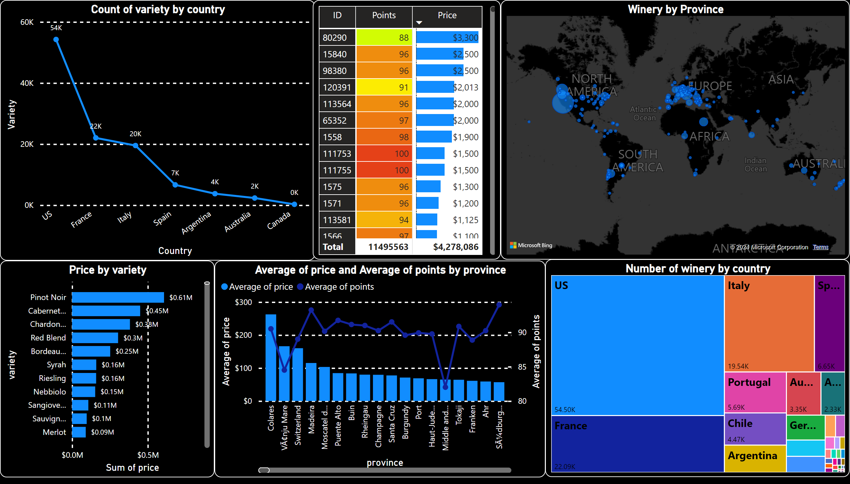
Page 1
Notes:
lineChart
No alt text provided
Number of winery by country
No alt text provided
Winery by Province
No alt text provided
pivotTable
No alt text provided
Price by variety
No alt text provided
lineClusteredColumnComboChart
No alt text provided

