Slide 1
REST API using FLASK
Ashutosh Mishra

Slide 2
Steps:
Getting data i.e from the document sent by DataGrokr.
Creating a database with country and capitals.
Creating a flask app with link to the database and rendering templates to show the result.
Creating a unique url to show the data.

Slide 3
My learning:
Use of flask app.
Use of templates to render python code
Using various types of open host platforms to host my web app.
Creating an API to work with my app.

Slide 4
Challenges:
Creating a server with unique url to show to DataGrokr.
I had to try more than 5 different websites and hosting platforms including the one provided in the document and finally interlinking it with the database.

Slide 5
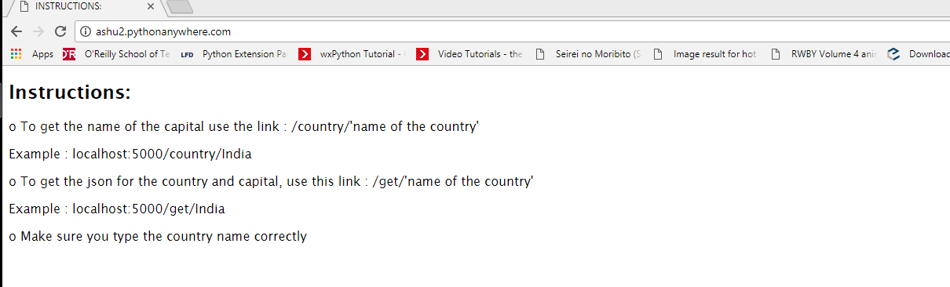
Results
Here are the results in my local machine. The final results are in the cloud.
Homepage :

Slide 6
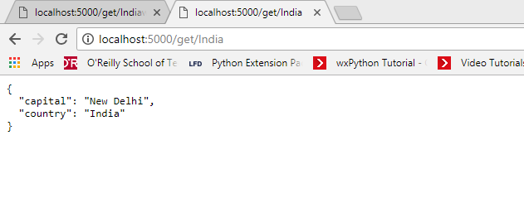
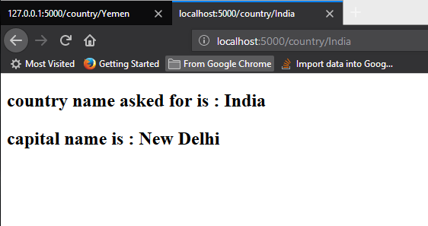
Results for India :

Slide 7
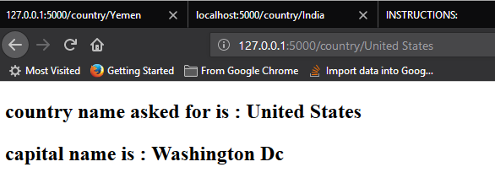
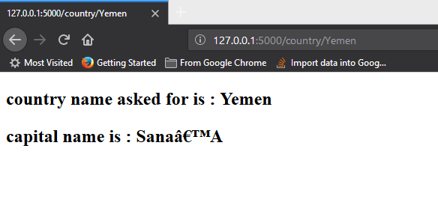
Results for US and Yemen:

Slide 8
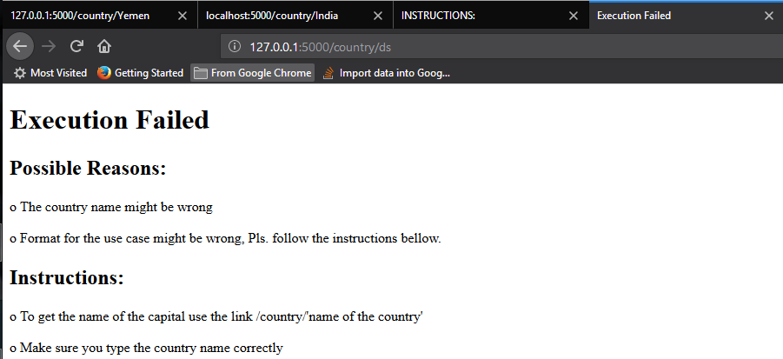
Results for wrong country name:

Slide 9
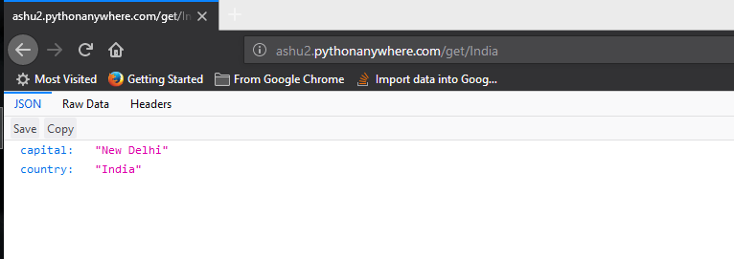
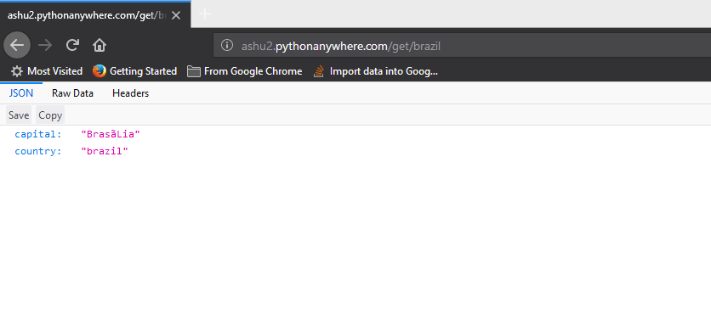
Results of API call in json.

Slide 10
The link to the unique URL:
ashu2.pythonanywhere.com
Test links:
http://ashu2.pythonanywhere.com/get/united states
http://ashu2.pythonanywhere.com/get/united state

Slide 11
Thank You
Sincerely,
Ashutosh Mishra
Contact : +91 8018642428
E-mail : prog.mishra@gmail.com

