Slide 1


Slide 2
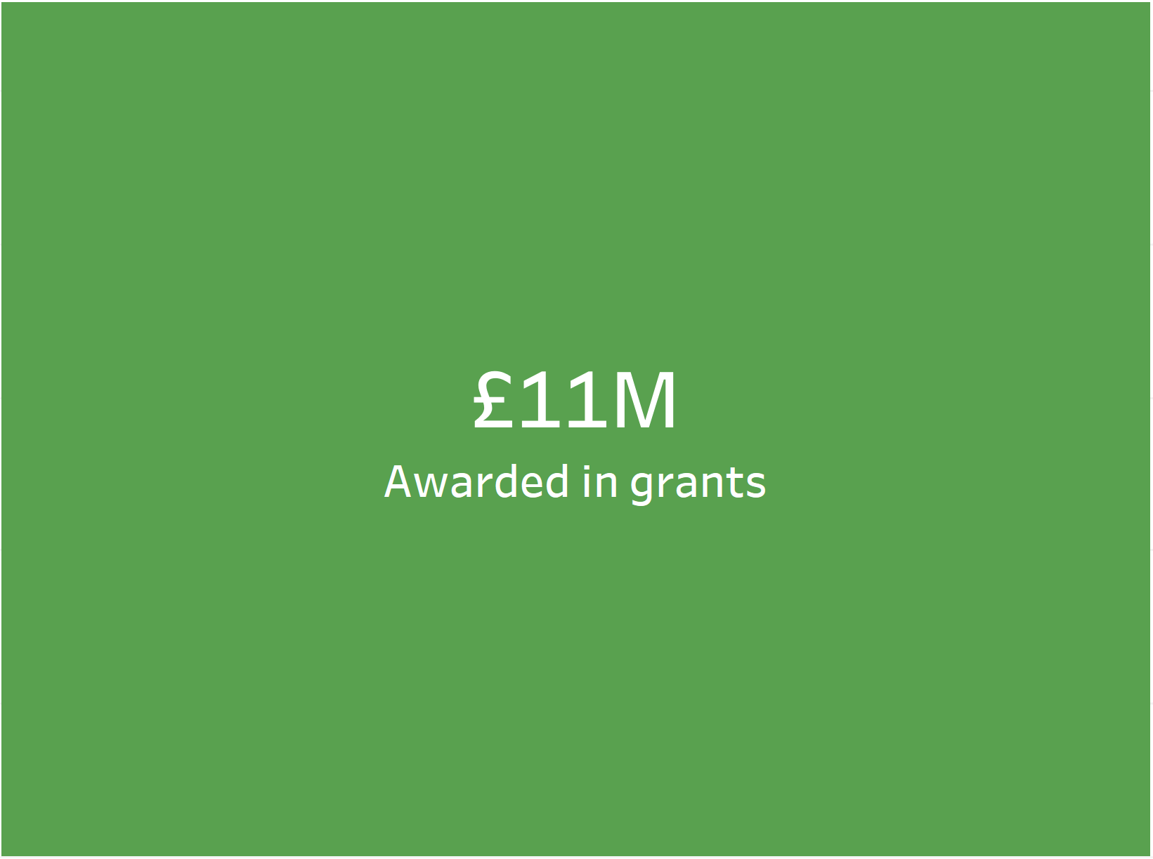

Exploratory Data Analysis of Grant Applications
Total Grant Applications
387
15% of applications were approved
A total of £11M was awarded in grants
A Fairer Future made up 55% of approvals
Creative, Confident, Communities made up 32% of approvals
Notes:
Grant applications made since 2010 in the “Expression of interest stage”

Slide 3
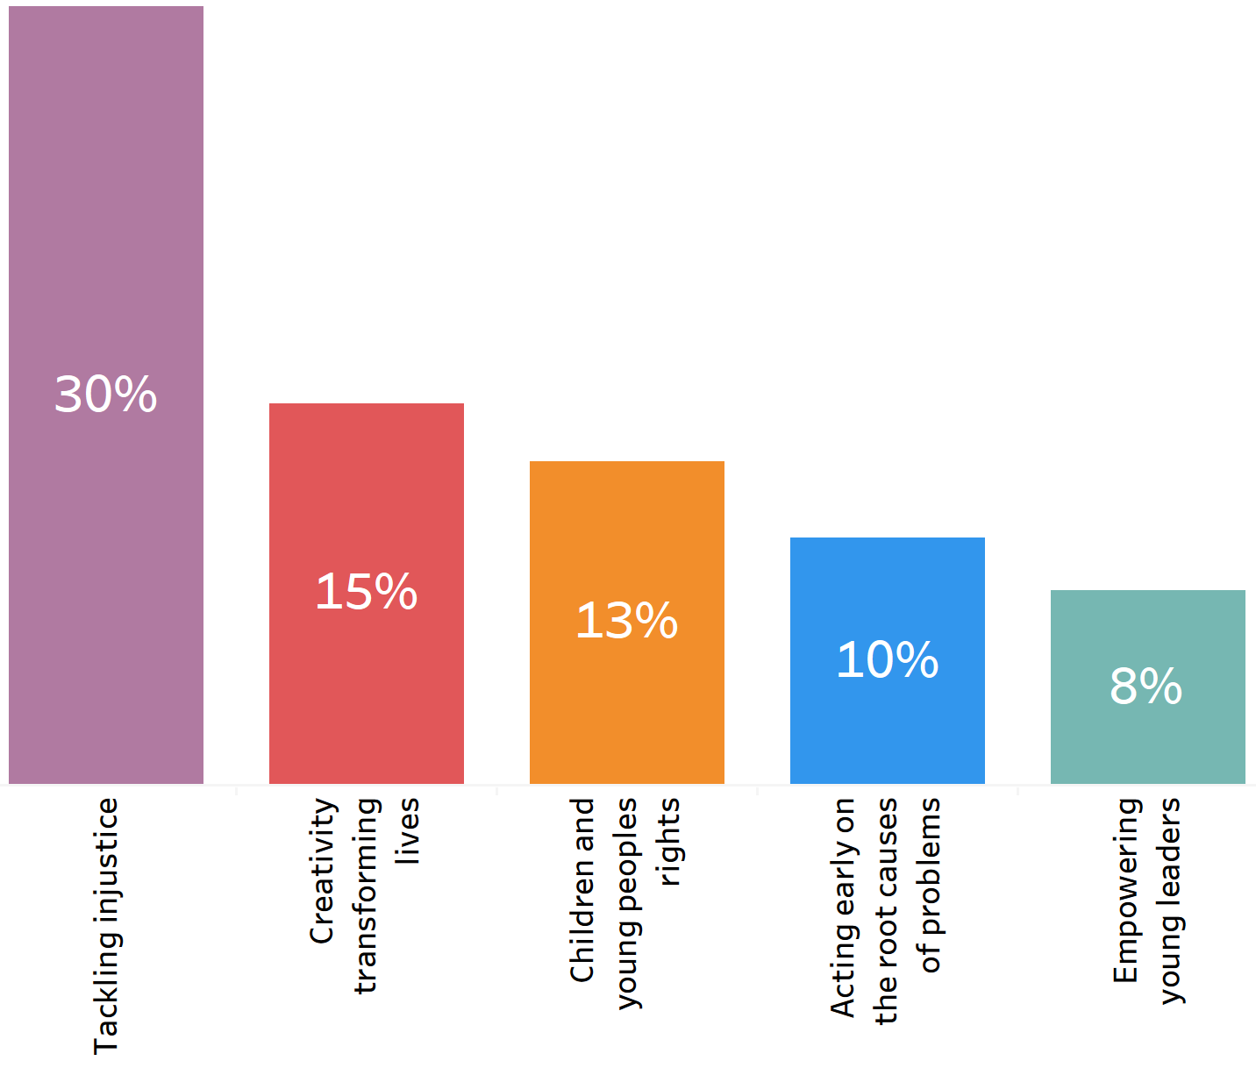
Breakdown of Funding Priorities
Tackling injustices was the number one funding priority
Notes:
5 highest funding priorities
30% of the total grant money went into Tackling injustices

Slide 4
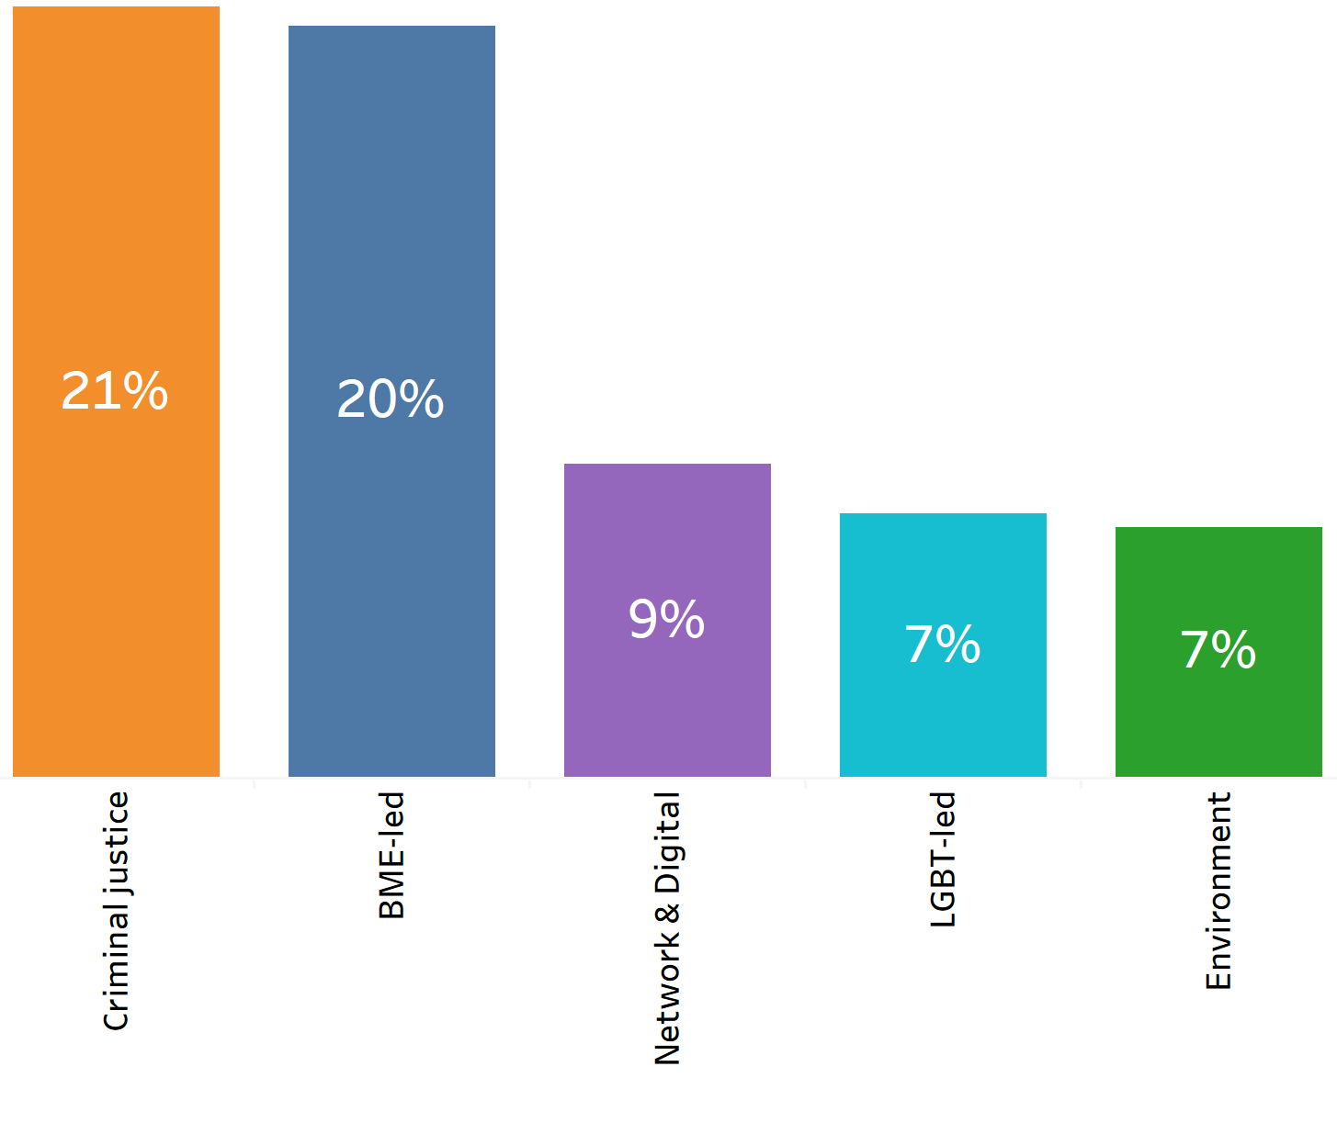
Types of organisations
Criminal justice organisations received the most funding
Closely matched by BME-led organisations
Notes:
Top 5 organisations that received funding
21% of the total grant money went to Criminal justice organisations
20% of the total grant money went to BME-led organisations

Slide 5
Data Limitations
Data quality - Accuracy, completeness, consistency, reliability
Type of organisations – over 50% of data was missing
Type of organisations – some data was put into “none of the above” category
Questions? Comments? Thoughts?
Presented by Asha Makwana
Notes:
Extension – Look deeper into the grouping of types of organisations once missing data is complete

