Slide 1


Slide 2

Introduction
Hungry Shark World is an aquatic adventure where the player controls a shark.
There are 8 different tiers of sharks with different stats (Speed, Bite and Boost)
There are also 3 different types of currencies: Coins, Gems and Pearls used for upgrades.
June – September (2022)
1624
Average Daily Active Users
13.2M
Downloads
4M
IAP Revenue

Slide 3
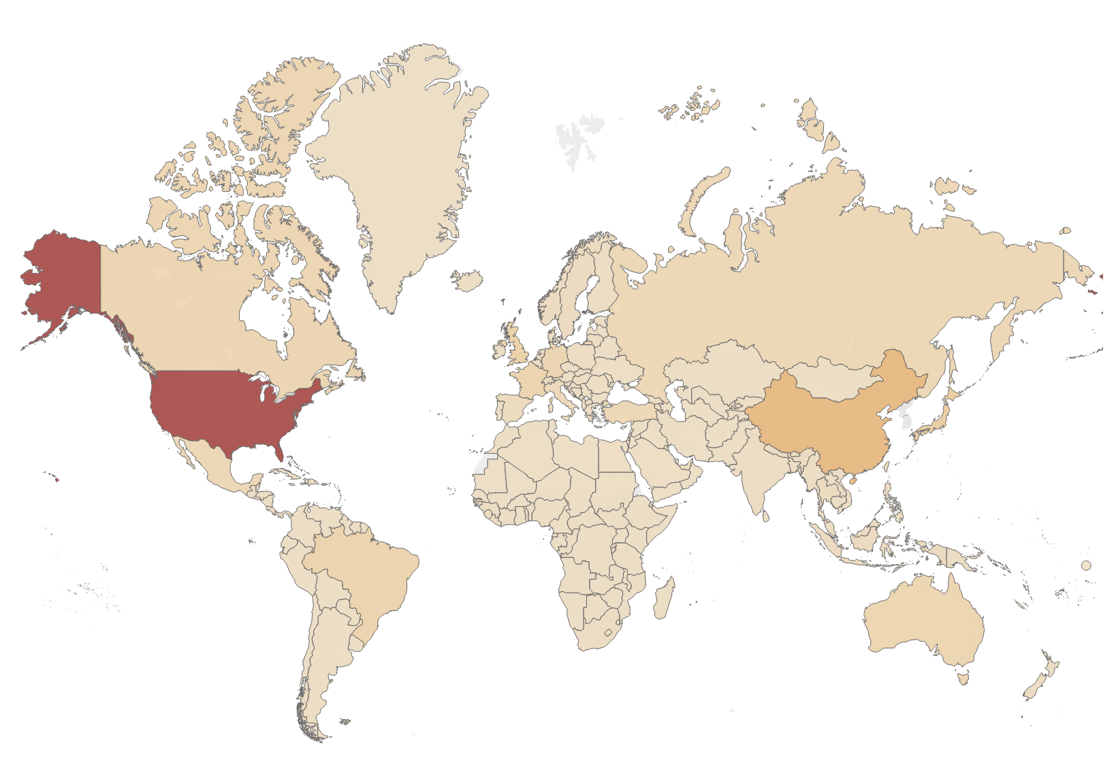
Overall revenue in different countries
US and China have the highest revenue generated over the 3 month period.

Slide 4
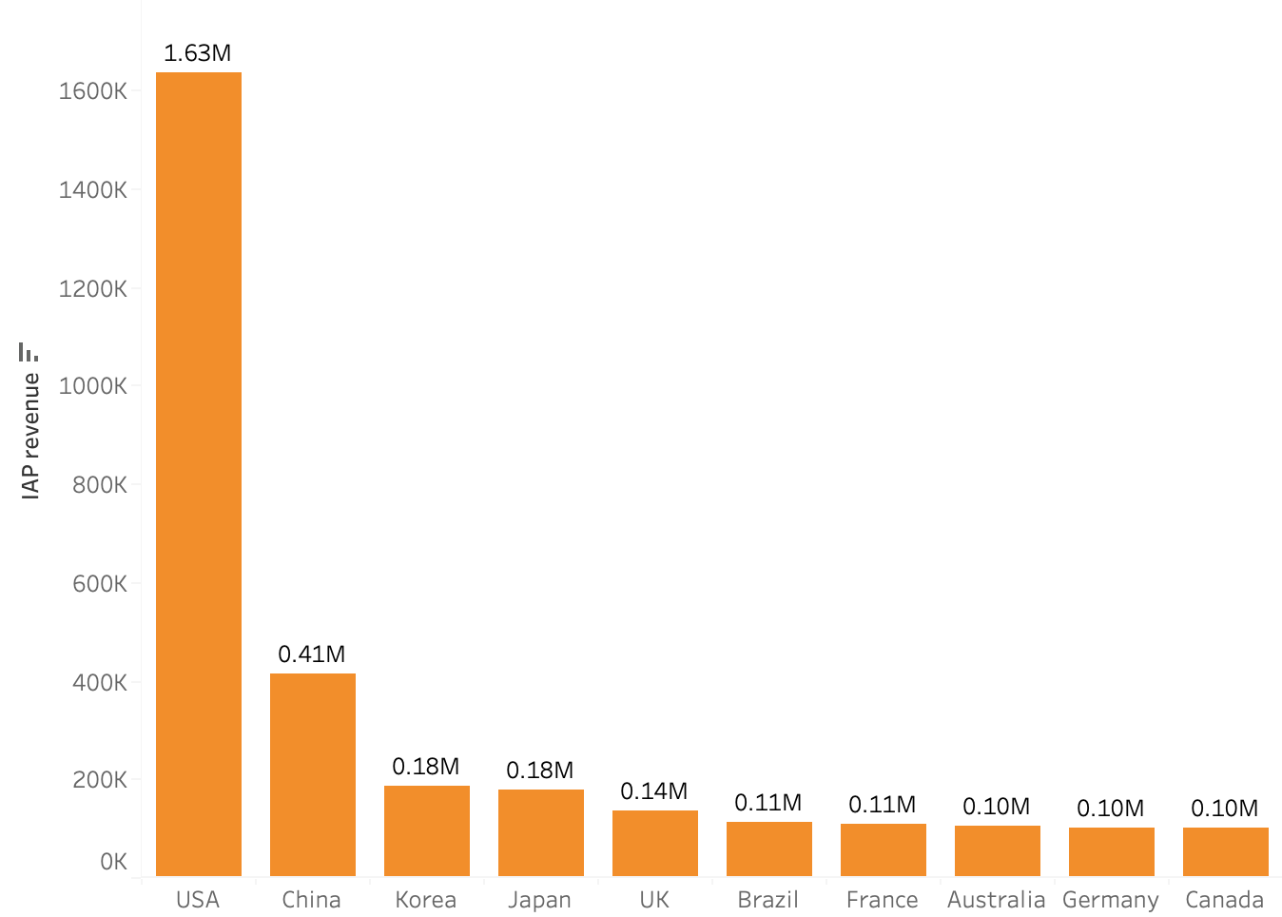
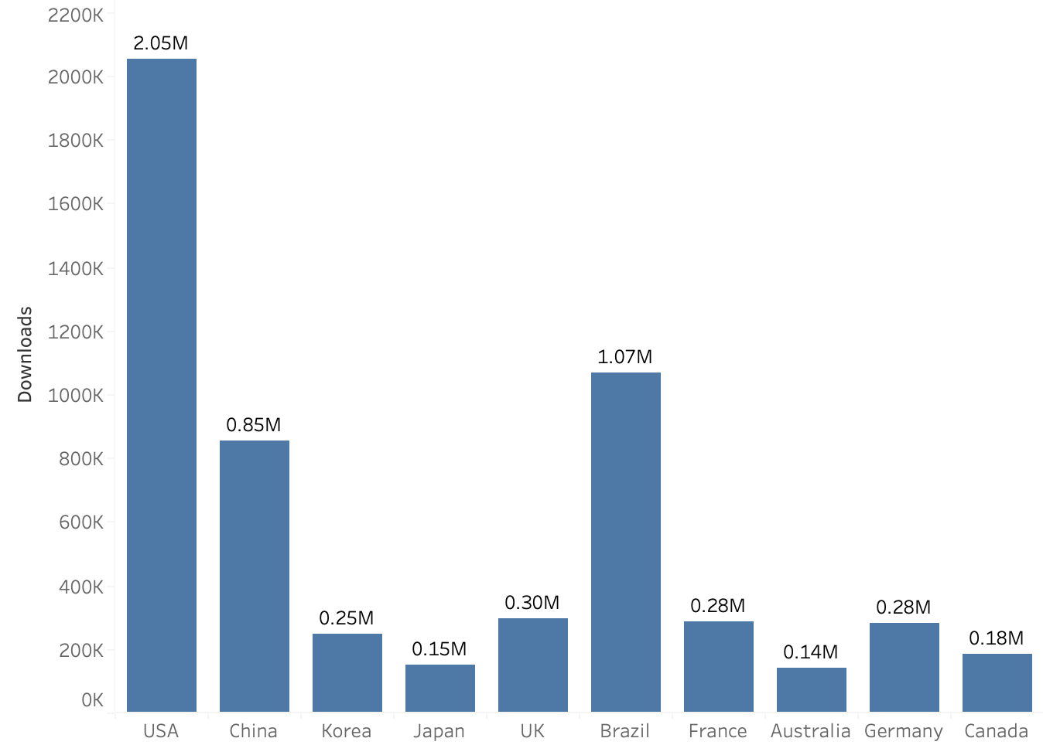
Comparing revenue and downloads
Japan has more IAP compared to the number of downloads
Brazil has higher downloads but the IAP revenue is much lower than other countries

Slide 5
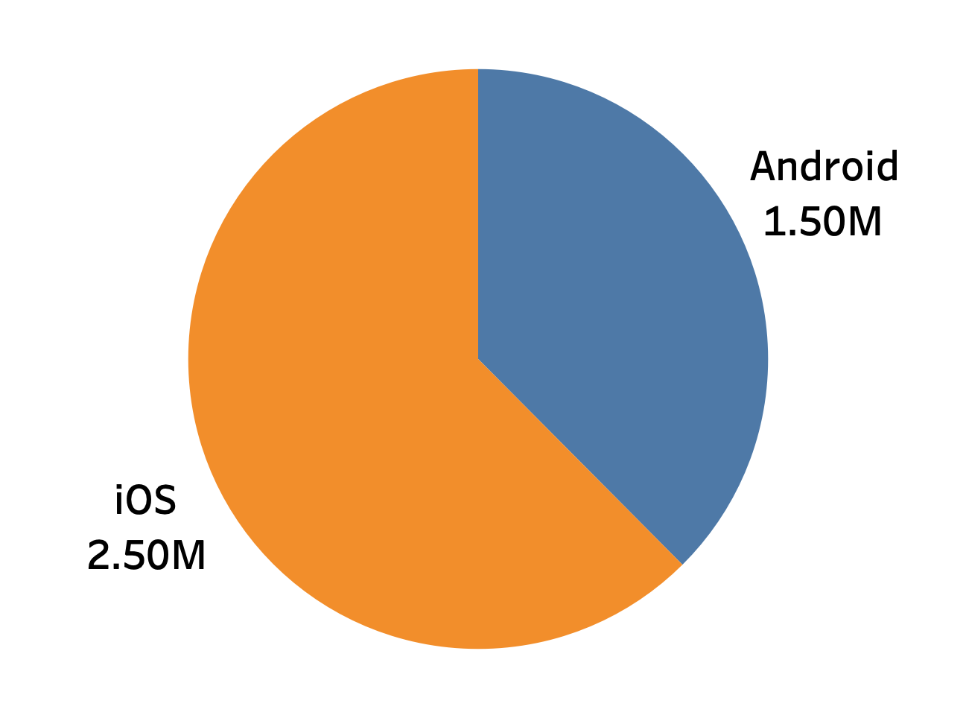
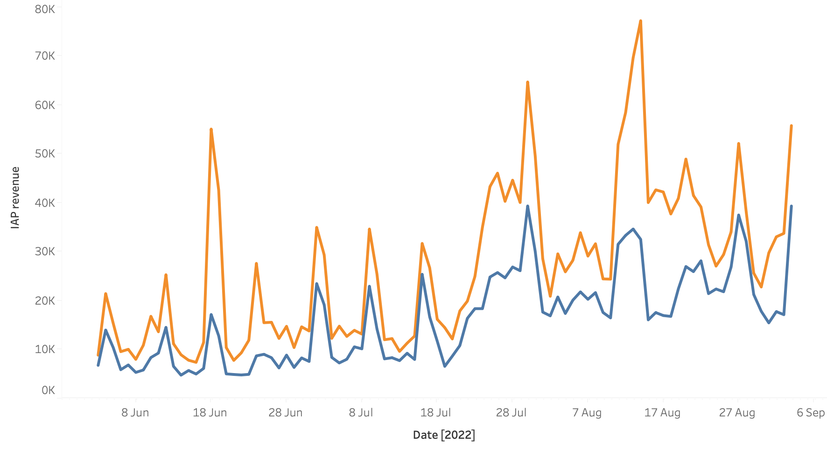
Revenue across platforms over time
iOS platform has generated more revenue compared to Android
The revenue increases around the shark week period (24th-30th july) for both platforms but the increase is more pronounced for iOS

Slide 6
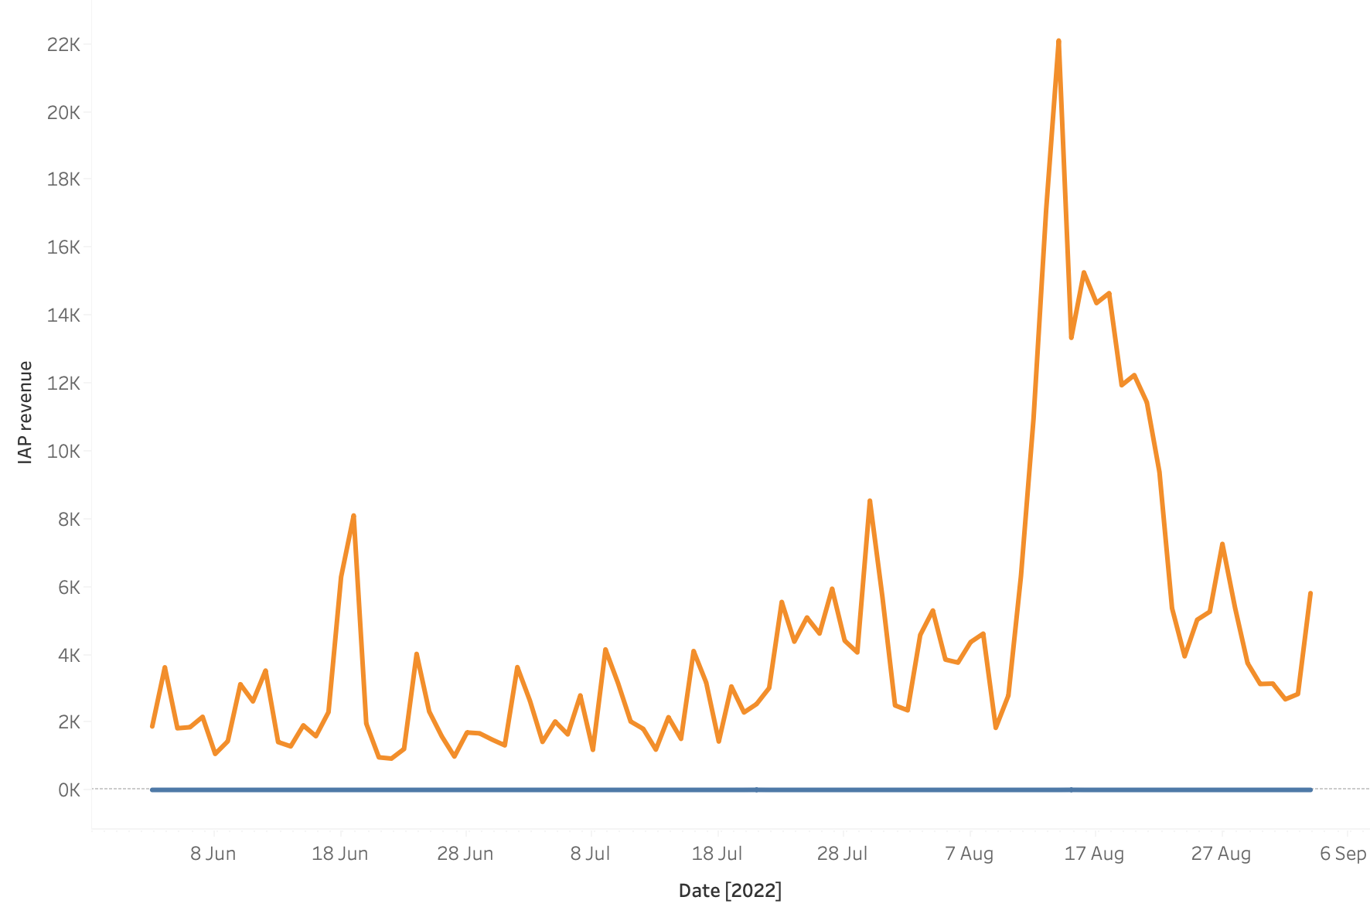
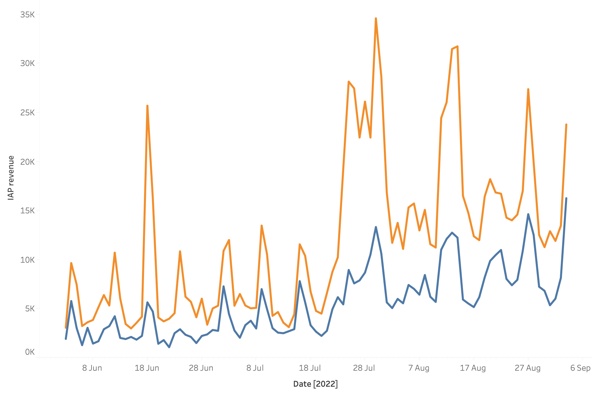
Difference in revenue between China and US
IAP revenue in China
IAP revenue in USA
The increase in china IAP revenue is after the shark week period and all revenue generated in iOS platform

Slide 7
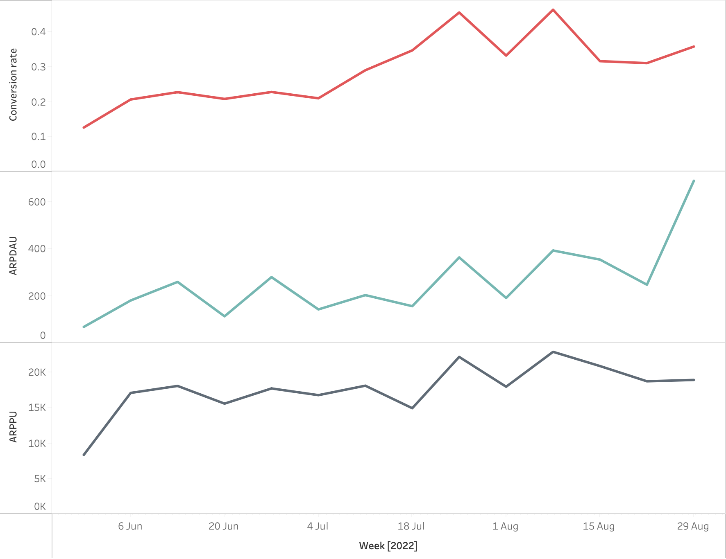
Weekly changes across 3 KPI’s
Conversion rate increases after shark week
Both ARPDAU and ARPPU show similar trends
By the end of august we notice more active users are paying users, would be interesting to see if this trend continues

Slide 8
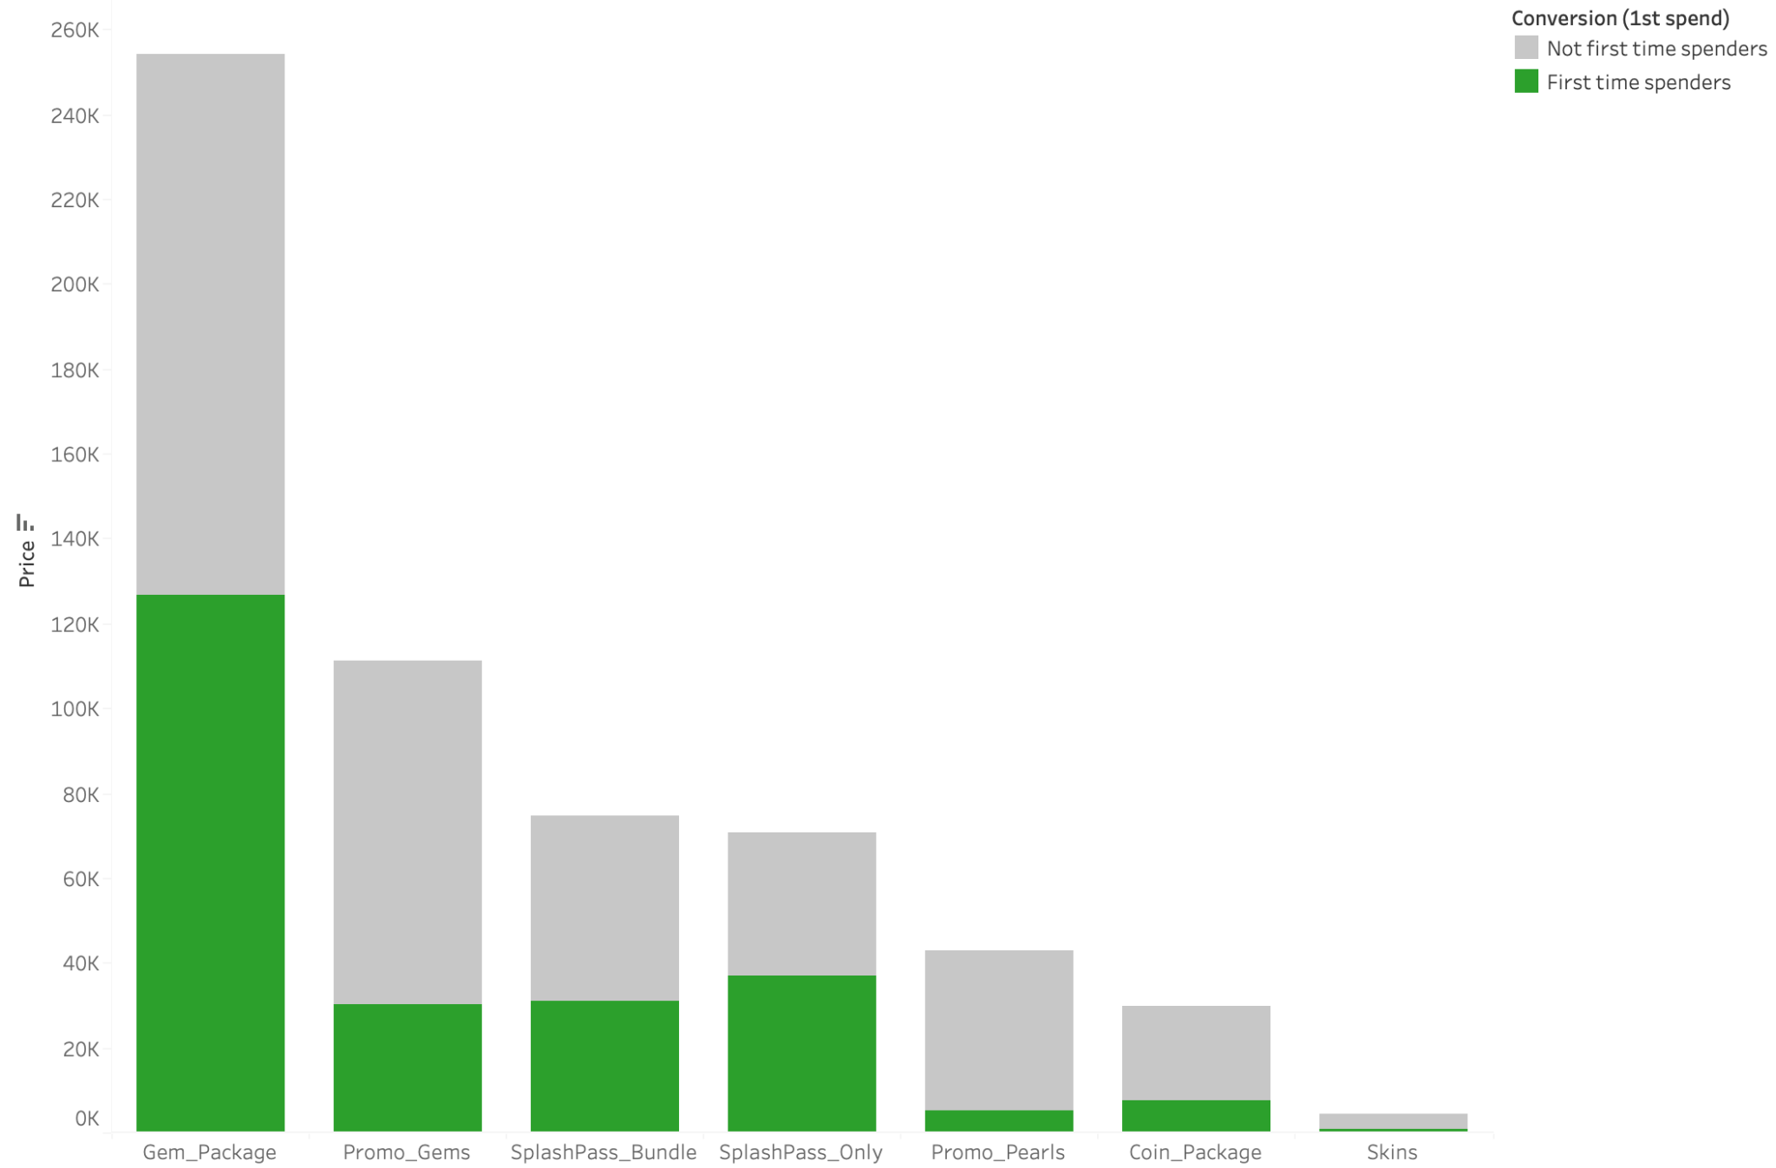

Which IAPs prompt the most conversion
Gem Package has the highest conversion
SplashPass only had highest first time conversion compared to SplashPass Bundle

Slide 9
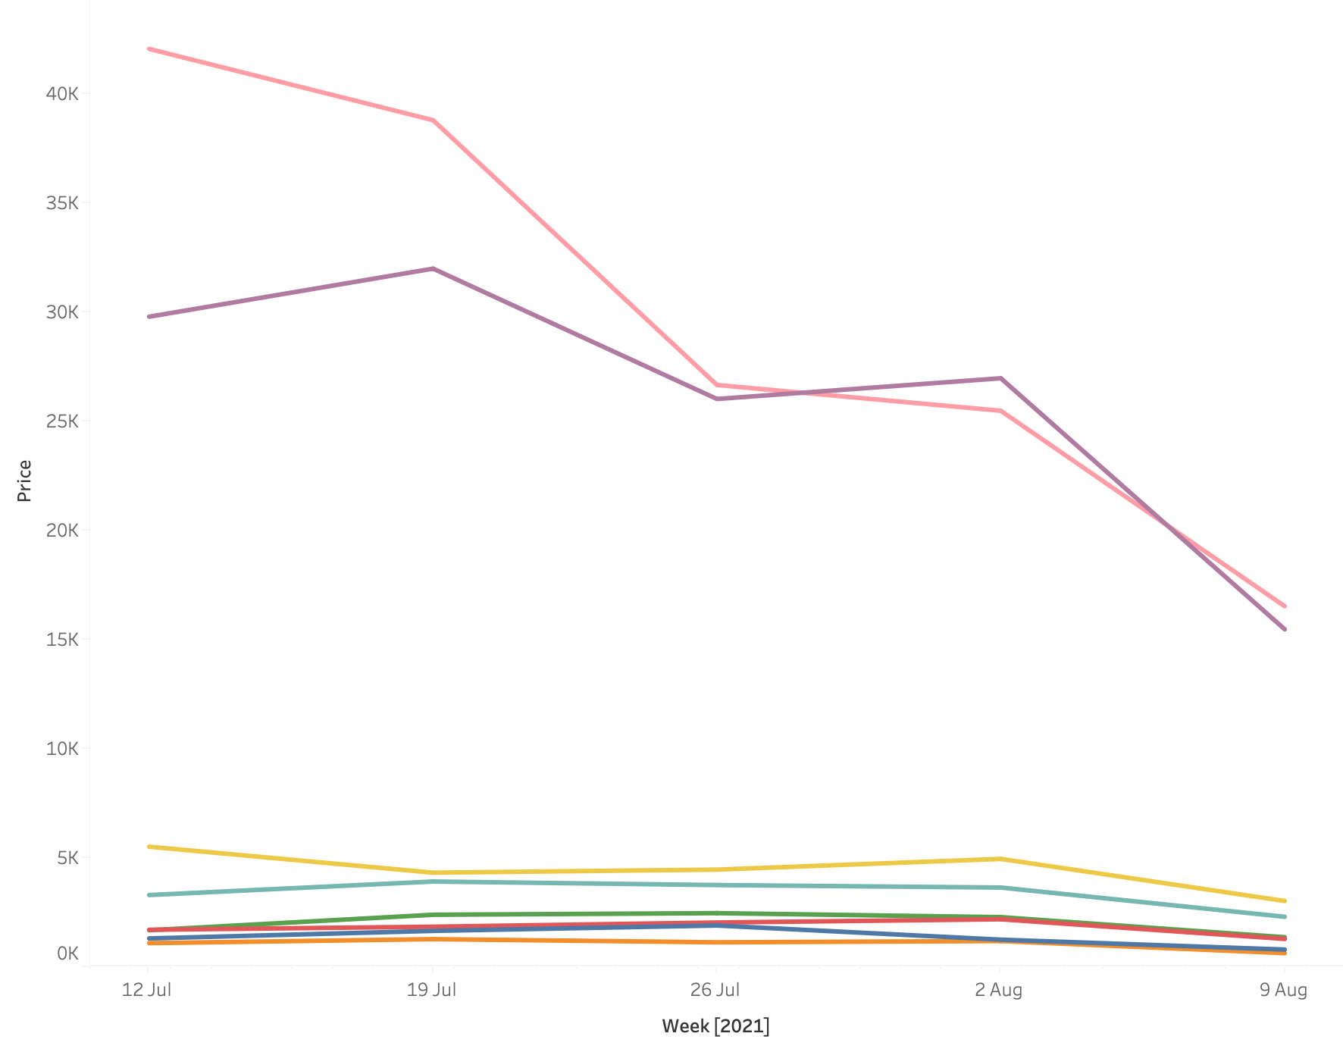
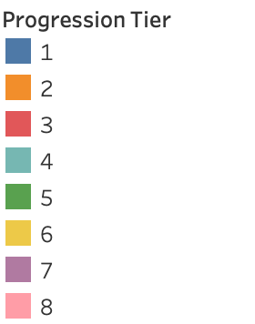
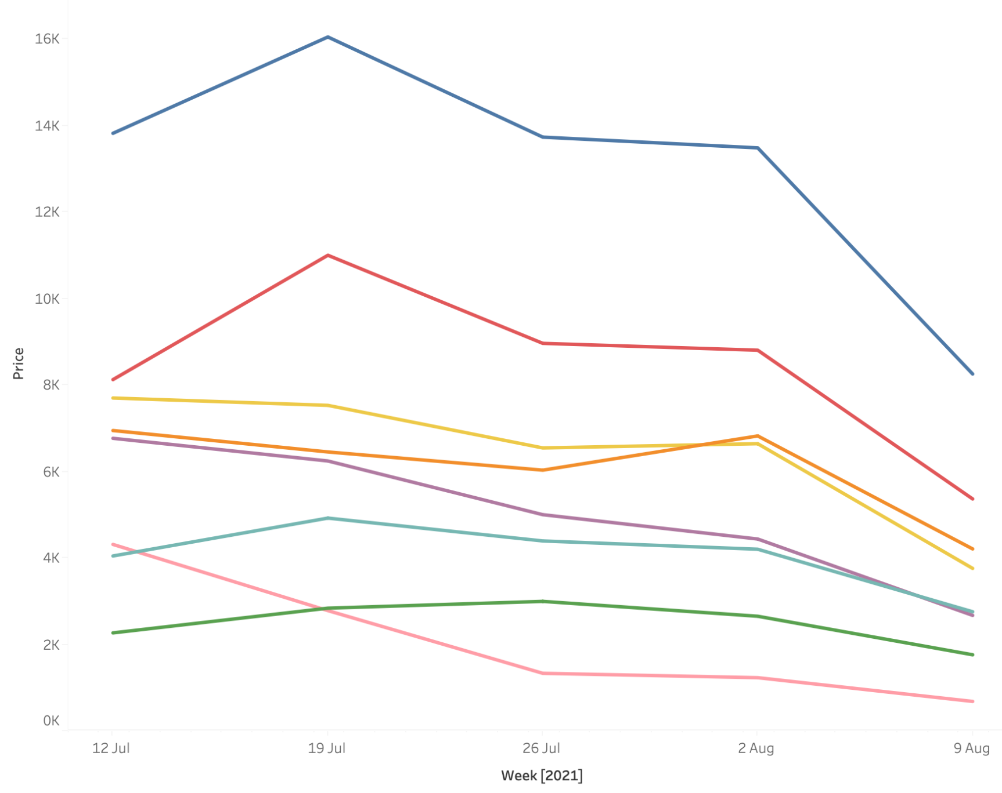
Relationship between progression tier and purchase behaviour
Not first time spenders
First time spenders

