Slide 1
Leave Track: Simplifying Employee Leave Management
20IT801L-Project Work
TEAM MEMBER
ASHIK K -

Slide 2
1.ABSTRACT
The Leave Management System is a comprehensive web-based application developed to simplify the process of managing employee leave requests within organizations. It serves as a centralized platform where employees can effortlessly submit their leave requests, and administrators can efficiently review, approve, or reject these requests. Built on the Django web framework, the system ensures a robust and secure architecture for handling sensitive employee data.
One of the core functionalities of the system is user management, enabling employees to register accounts and access the system to submit their leave requests. The system facilitates the submission of leave requests by allowing employees to specify the type of leave, duration, and reason for their absence.
A key feature of the Leave Management System is its robust approval workflow, which ensures that managers and administrators receive timely notifications for pending leave requests. They can then take appropriate actions, such as approving or rejecting requests, directly within the system.

Slide 3
Cont.
This streamlined workflow helps to expedite the leave approval process and improve overall operational efficiency. Role-based access control is another essential aspect of the system, providing different user roles, such as employees, managers, and administrators, with varying levels of access and permissions.
This ensures that only authorized personnel can perform specific actions within the application, maintaining data security and integrity. Moreover, the system incorporates automated email notifications to keep employees and approvers informed about the status of their leave requests.
These notifications are triggered upon submission, approval, or rejection of leave requests, enhancing communication and transparency within the organization.

Slide 4
2. INTRODUCTION
In the contemporary workplace landscape, where agility and efficiency are paramount, traditional methods of managing employee leave often fall short. Manual processes, paper-based forms, and scattered records not only consume valuable time and resources but also introduce the risk of errors and inconsistencies. To address these challenges and usher in a new era of leave management, organizations are increasingly turning to digital solutions.
Among these, the Leave Management System (LMS) stands out as a comprehensive platform designed to revolutionize the way organizations handle leave requests and administration.

Slide 5
2. INTRODUCTION
Historically, leave management has been a labor-intensive task, involving manual paperwork, spreadsheets, and email chains. Employees would submit leave requests in person or via email, which would then be manually processed by HR personnel or line managers. This approach was not only time-consuming but also prone to delays, miscommunications, and errors. Moreover, tracking leave balances, managing approvals, and generating reports often posed significant challenges, especially for larger organizations with multiple departments and locations.
Recognizing the limitations of traditional leave management methods, organizations are increasingly turning towards digital solutions to streamline and automate the process.

Slide 6
3.OBJECTIVES
The project aims to automate leave request management through an intuitive interface, facilitate role-based access control, and send real-time notifications. It ensures efficient tracking of leave balances, provides administrative tools for user management, and offers customizable workflows. The system prioritizes security, scalability, and compliance while enabling data analytics for informed decision-making.

Slide 7
Cont.
Findings and Gaps
The project identifies a need for streamlined leave request processing, highlighting inefficiencies in manual leave management systems.
It addresses gaps in user access control and notification mechanisms, aiming to enhance organizational efficiency and employee satisfaction. Additionally, it emphasizes the importance of data integrity and accessibility for comprehensive leave management.

Slide 8
Novelty in proposed system
Cont.
The proposed system introduces novel features such as role-based access control, automated leave request processing, and comprehensive user profiles.
It also incorporates email notifications for leave approvals and rejections, enhancing communication and transparency within the organization.
Additionally, the system offers customizable leave types and integrates seamlessly with existing HR systems, providing a tailored solution to modern leave management challenges.

Slide 9
5. PROPOSED SYSTEM
Role-based Access Control: The system implements role-based access control to ensure that users have appropriate permissions and access levels based on their roles within the organization.
Automated Leave Management: It streamlines leave request processing with automated workflows, reducing manual intervention and enhancing efficiency in managing employee leave.
Comprehensive User Profiles: The system maintains detailed user profiles, allowing administrators to track leave history, roles, and permissions for each user, facilitating better decision-making and resource management.

Slide 10
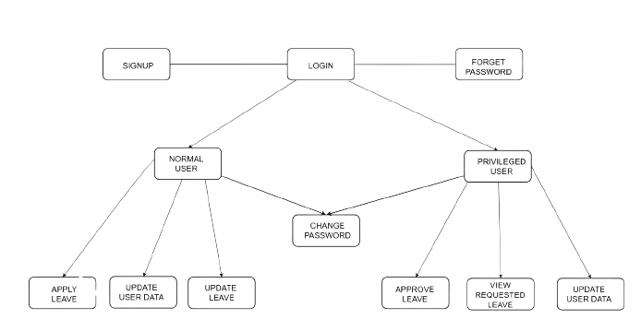
Architecture
Cont.

Slide 11
Cont.
Modules
Frontend:
HTML templates for rendering pages.
CSS for styling the user interface.
JavaScript for client-side interactions.
Backend:
Developed using Django framework, handling server-side logic.
Routing URLs to appropriate views.
Implementing business logic for leave management.

Slide 12
Cont.
Database Connectivity:
Utilizing Django's ORM for interaction with the database.
PostgreSQL is used.
Defining models for user profiles, roles, permissions, and leave requests.
Performing database operations such as querying and saving data.
Authentication and Authorization:
Implementing user authentication using Django's built-in authentication system.
Managing user sessions and login/logout functionality.
Enforcing access control based on user roles and permissions.

Slide 13
Cont.
Email Integration:
Integrating email functionality for notifications.
Sending email notifications for leave request submission, approval, and rejection.
Leave Management:
Allowing users to submit leave requests.
Implementing leave approval workflow.
Tracking leave balances and usage.

Slide 14
Cont.
User Management:
Providing user registration and profile management features.
Managing user roles and permissions.
Admin Panel:
Implementing administrative interface using Django Admin.
Allowing administrators to manage users, roles, permissions, and leave requests.

Slide 15
6.SYSTEM REQUIREMENT
HARDWARE REQUIREMENTS
Processor - Intel Core™ i3
RAM - 2 GB.
Hard Disk - 4 GB.
SOFTWARE REQUIREMENTS
Operating System - Windows 11.
Platform - PyCharm, VsCode, Pgadmin
Front End – HTML,CSS,BOOTSTRAP,JAVASCRIPT
Back End – Python,SQL

Slide 16
8. CONCLUSION
In conclusion, the Leave Management System offers a robust solution for organizations to efficiently manage employee leave processes. By implementing role-based access control, automated workflows, and comprehensive user profiles, the system enhances productivity, transparency, and accountability in leave management.
With its user-friendly interface and customizable features, it provides a scalable solution to meet the evolving needs of modern workplaces.

Slide 17
Thank You!!!

