Slide 1
IBM University Engagement Project Submission
“Exploring the Power of Agentic AI with IBM Granite and IBM Bob”

Slide 2
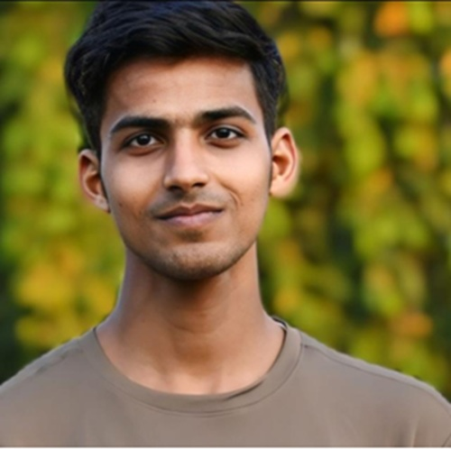
Project Tile – [Nutrition Agent]
Domain of Project – [ Health ]
Student Name | Recent Passport Photo | Email ID | Mobile number [WhatsApp]
ASHISH KUMAR |  | ashishku754499@gmail.com | 8210344700
Recommended font style and size:
Font Style: Arial
Font Size (Heading): 28
Font Size (Content): 20

Slide 3
Problem Statement -
Problem Statement No.8- Nutrition Agent
The Challenge - In an era where health awareness is growing, individuals increasingly seek personalized nutrition guidance. However, most existing tools provide generic diet plans, lack real-time adaptability, and fail to consider a person's holistic lifestyle, cultural preferences, allergies, and evolving health conditions. Furthermore, dieticians and nutritionists face limitations in scaling personalized consultations due to time and resource constraints. Generative AI presents a groundbreaking opportunity to revolutionize this space by enabling an intelligent, interactive, and adaptive virtual nutrition assistant. By leveraging natural language processing (NLP), multimodal understanding, and large-scale dietary databases, an AI-powered assistant can generate dynamic meal plans, recommend smart food swaps, and explain nutritional choices—all tailored to the individual. This project aims to develop “The Smartest AI Nutrition Assistant” using state-of-the-art generative AI models that: • Understand user inputs via text, voice, or image (e.g., food photos, grocery labels) • Generate personalized meal plans based on health goals, medical conditions, fitness routines, and preferences • Offer contextual explanations (e.g., “Why is this food better?”) • Adapt suggestions dynamically with continuous feedback By integrating health data, food databases, and LLM-powered reasoning, the solution will bridge the gap between one-size-fits-all diet apps and in-person nutrition counselling—delivering an AI that thinks, learns, and cares like a real nutrition expert.
Technology - Use of IBM cloud lite services /IBM Granity is mandatory.

Slide 4
Proposed Solution -
A RAG-powered AI nutrition assistant that delivers trusted, personalized, and explainable dietary guidance — tailored to each person's health goals, conditions, and preferences.
Key Solution:
IBM Granite-powered AI agent for intelligent nutrition assistance
RAG-based knowledge retrieval grounds every answer in trusted dietary data
Understands text, voice, food photos & grocery labels
Personalizes to health goals, medical conditions, allergies & culture
Recommends smart food swaps with clear, contextual explanations
Generates dynamic, adaptive meal plans — not static templates
Learns and improves continuously from user feedback
Cites sources and flags cautions to build trust and reliability
Expected Impact: Better Decisions → Healthier Choices → Improved Wellbeing → Reduced Dietician Load

Slide 5
Technology Used
IBM Bob platform -For designing and orchestrating multi-agent workflows visually
IBM Grainte model - for eg – ibm-granite-3-2-8b – For natural language understanding, reasoning, and personalization
IBM Cloud – It provides the infrastructure to build, deploy, and scale the Nutrition Agent efficiently. IBM Cloud enables a reliable, secure, and scalable environment for deploying the Nutrition Agent.
RAG– RAG to fetch real data first, then generate intelligent answers, making the Nutrition Agent more trustworthy and effective.
IBM Watsonx.ai - For model deployment, embeddings, and AI governance
Vector Database (FAISS/Chroma) – For RAG-based nutritional data retrieval

Slide 6
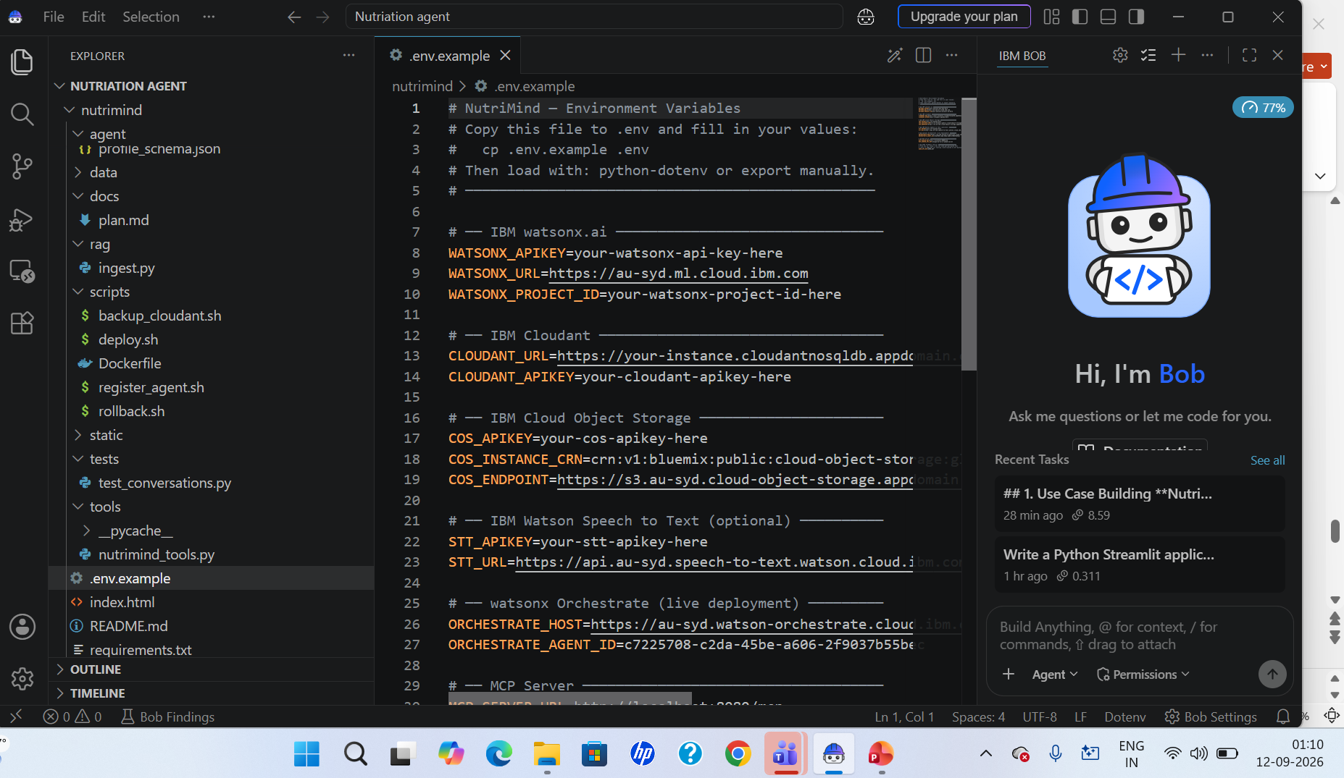
Required Files created using IBM bob -

Slide 7
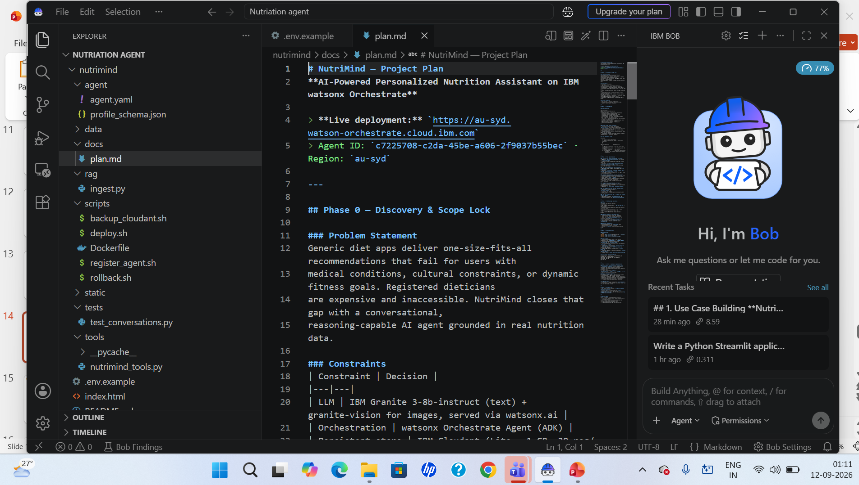
IBM Bob Screenshots:

Slide 8
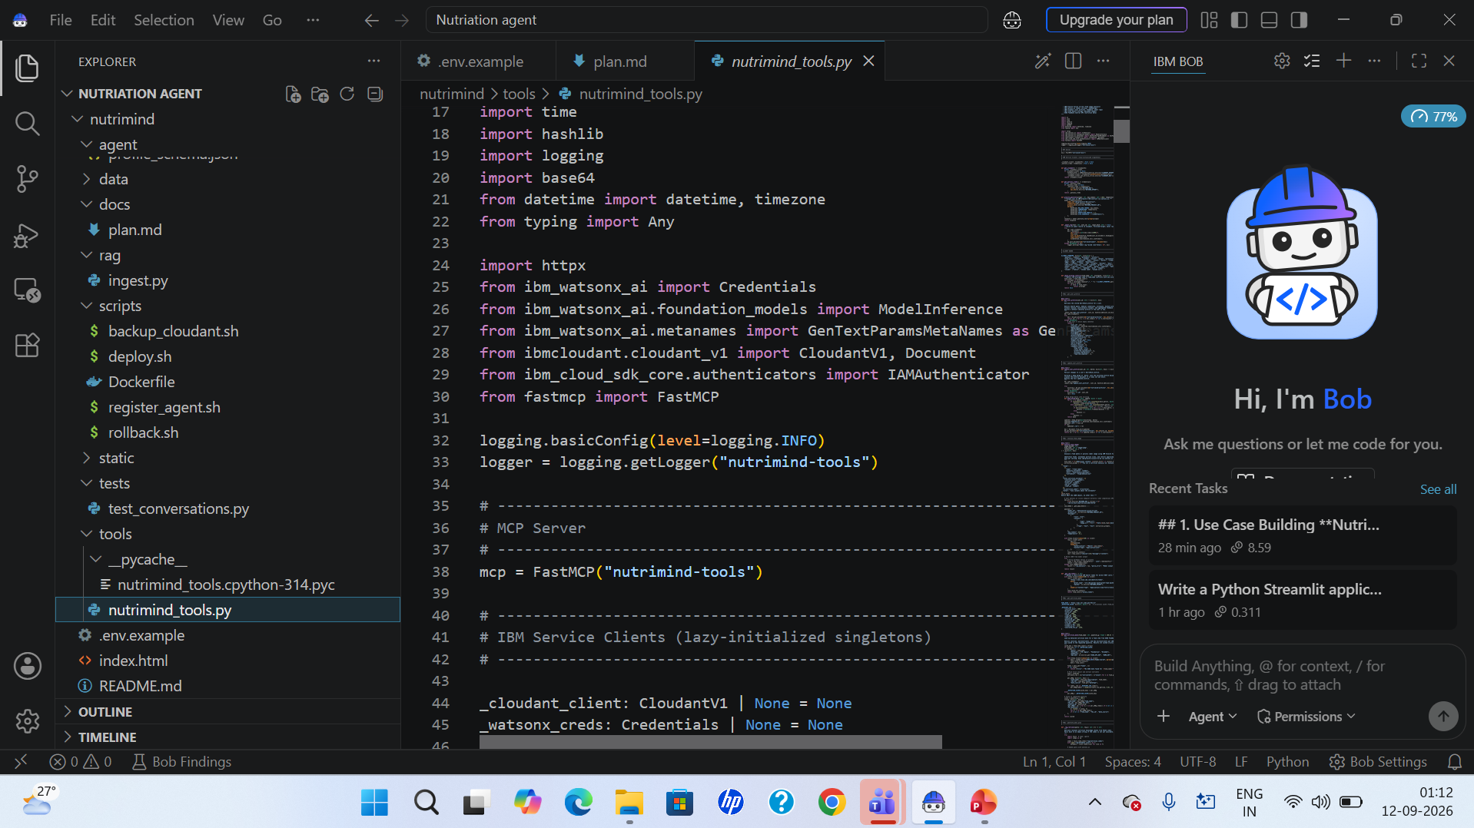

Slide 9
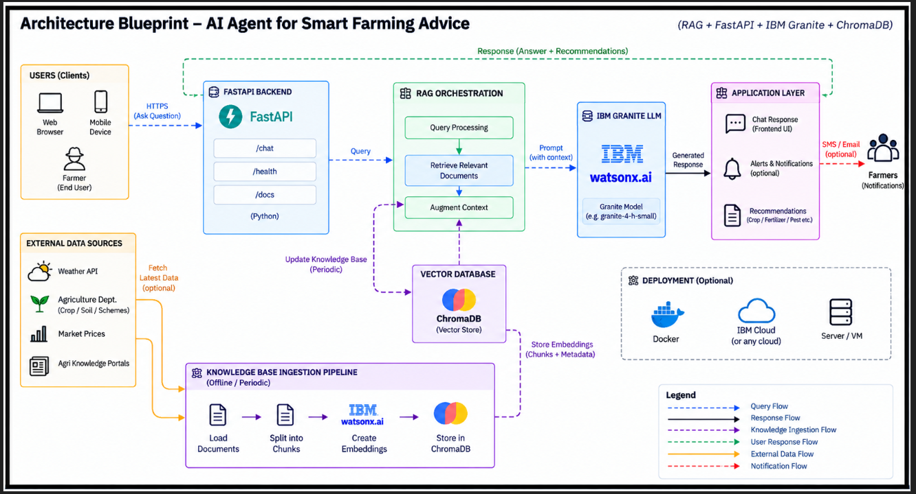
Architecture blueprint for IBM bob:

Slide 10

Role of Agentic AI in the solution
Intro: Agentic AI enables the Nutrition Assistant to function as an intelligent, autonomous system rather than a simple chatbot. Using IBM watsonx.ai and IBM Granite models, it coordinates multiple specialized agents to deliver personalized nutrition guidance.
Understands User Queries — Interprets diet & health questions across text, voice, and images.
Retrieves Relevant Knowledge — Uses RAG + a vector database to find trusted nutrition, food-composition & dietary-guideline data.
Reasons & Generates Advice — IBM Granite analyzes the retrieved context to produce a practical, easy-to-follow recommendation.
Provides Actionable Guidance — Converts information into concrete meal plans and food swaps, not just facts.
Ensures Safe & Reliable Responses — Flags allergens and medical cautions, cites sources, avoids unsafe dietary advice.
Personalizes Decision Support — Uses goals, conditions, allergies, culture & feedback history to tailor every response.
Outcome: User Query → AI Reasoning → Verified Nutrition Knowledge → Personalized & Safe Guidance

Slide 11
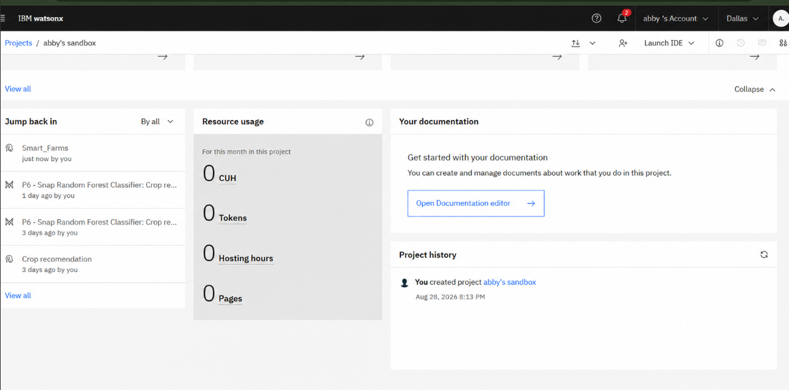
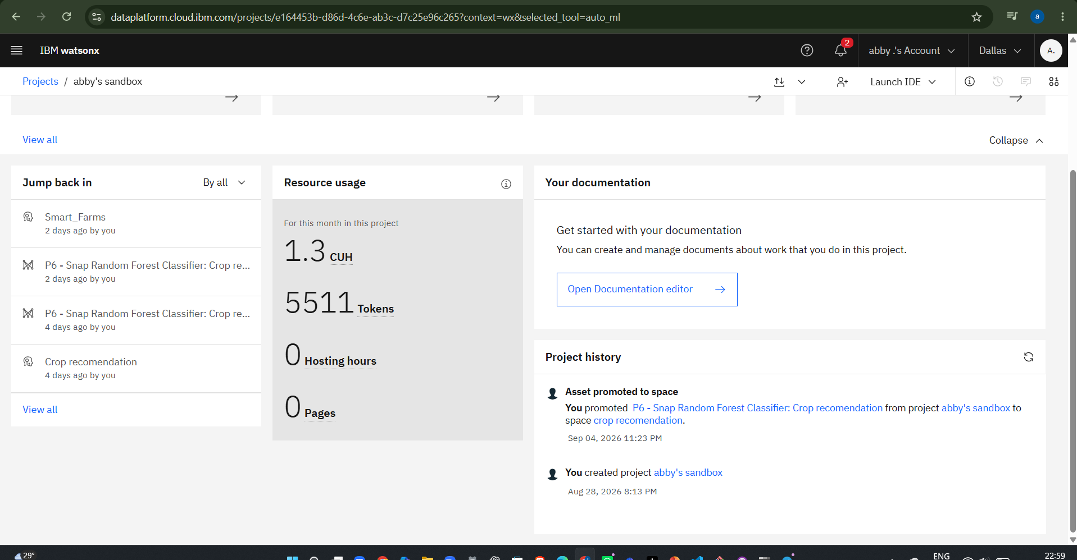
Token Usage
11,761 token are used
Before Prompt
After the Prompt
·
·
·

Slide 12
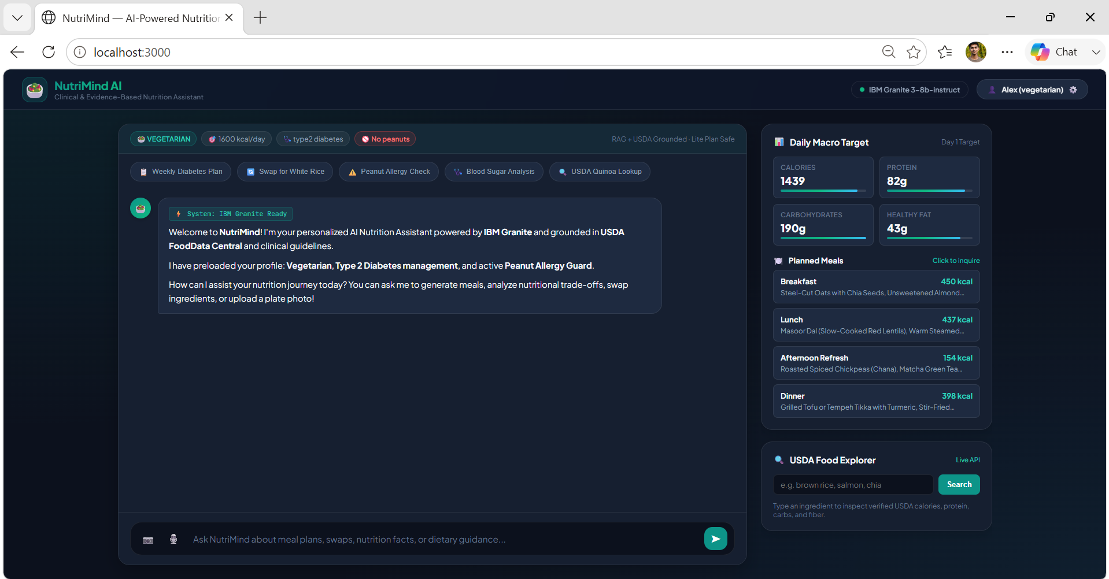
Project Output Screenshot
·
·
·

Slide 13
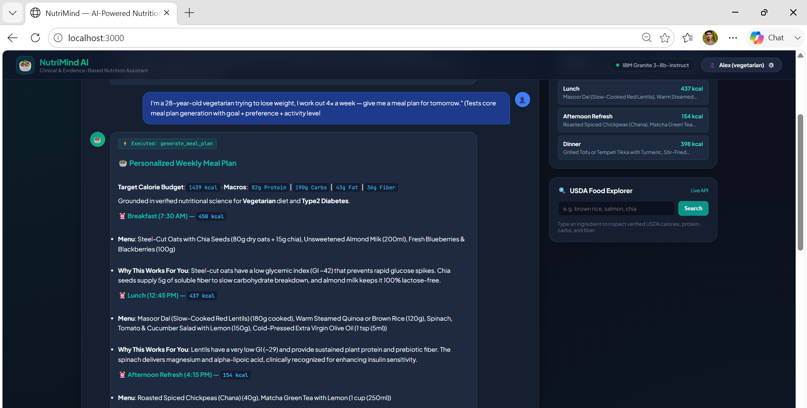
Project Output Screenshot
·
·
·

Slide 14
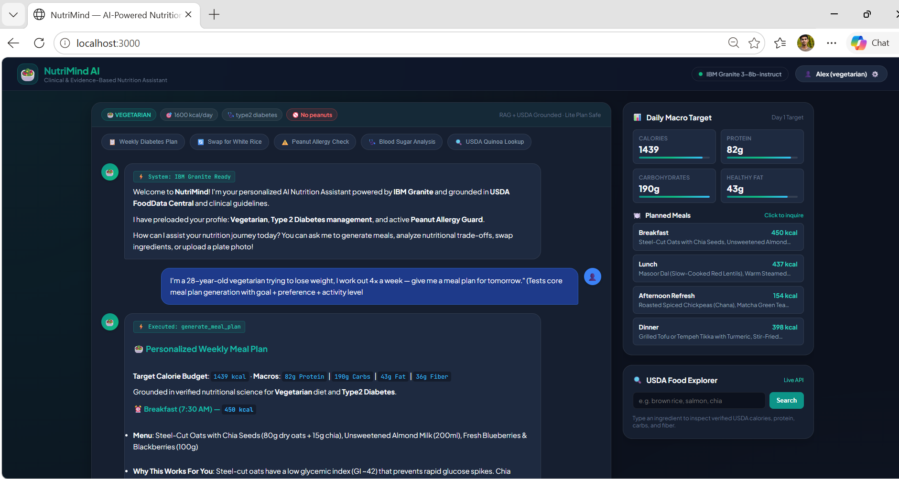
Project Output Screenshot
·
·
·

Slide 15
Novelty and Uniqueness
The Smartest AI Nutrition Assistant stands out by combining Agentic AI, RAG, and holistic personalization into one adaptive nutrition companion.
RAG-Grounded Accuracy — Retrieves trusted, curated nutrition & food-composition data before generating any advice.
Truly Multimodal — Understands text, voice, food photos, and grocery/label images, not text-only input.
Holistic Personalization — Accounts for health goals, medical conditions, allergies, and cultural preferences, not just calories.
Actionable & Explainable — Every recommendation comes with a clear "why," not just a plan to follow blindly.
Continuously Adaptive — Learns from user feedback, refining suggestions over time instead of staying static.
IBM Granite + watsonx.ai — Enterprise-grade generative reasoning with governance, paired with a lightweight RAG layer.
Key Differentiator: It turns generic dietary information into personalized, explainable, and continuously adaptive guidance — not a one-size-fits-all diet app.

Slide 16
Git Hub Link
https://github.com/ASHISH-8210/Nurtriation_Agent
·
·
·

Slide 17
Future Scope
Real-Time Health Data Integration — Connect wearables and lab reports for dynamic, biometric-aware recommendations.
Voice & Multilingual Support — Natural voice interaction across more languages for wider accessibility.
Advanced Food & Label Vision — Deeper computer vision for portion estimation and packaged-food label parsing.
Deeper Personalization Engine — Incorporate long-term progress tracking and richer health-history signals.
Mobile & Low-Connectivity Access — A lightweight mobile / WhatsApp interface with offline-friendly capability.
·
·

Slide 18
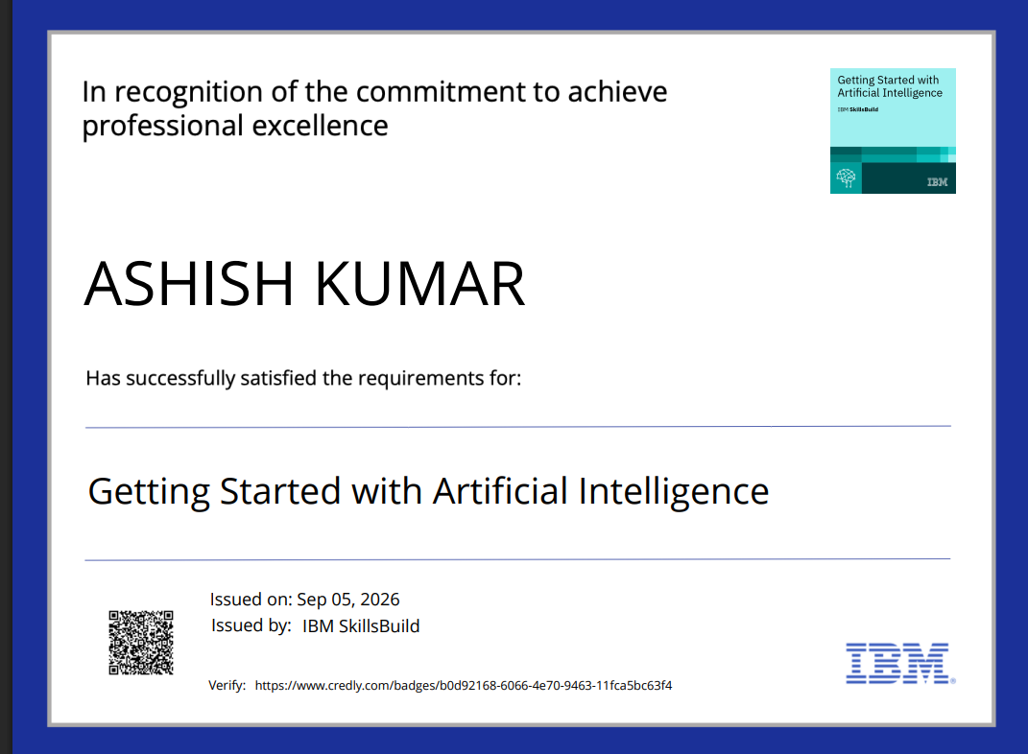
Certificates Earned:
Please add your credly certificate(Getting Started with Artificial Intelligence)

Slide 19
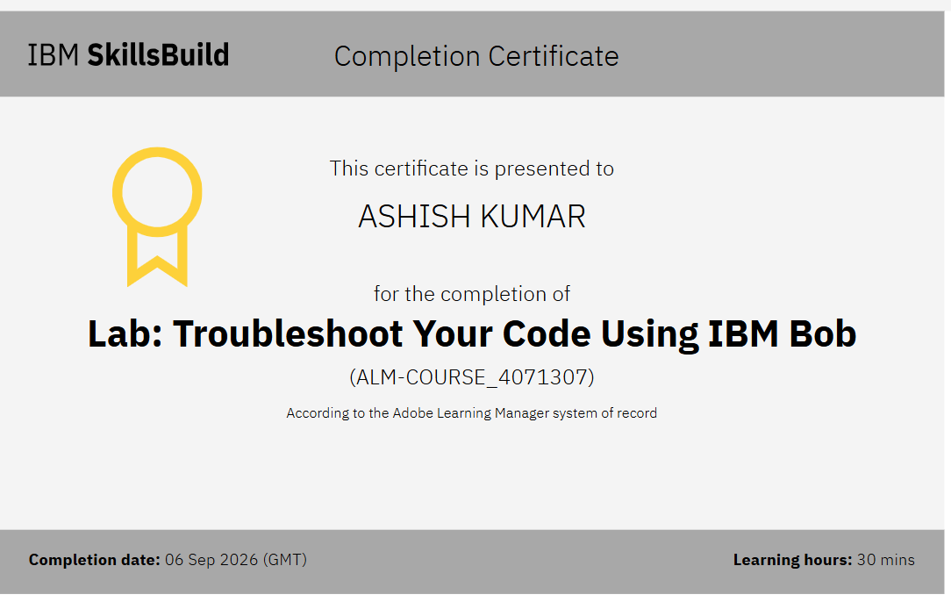
Certificates Earned:​
Add your IBM BOB Certificate

Slide 20


