Slide 1
Travel Planner Agent
IBM HACKATHON PROJECT
Presented By:
Student name :Ashish Ranjan
College Name & Department : Jagannath University , Btech Cse

Slide 2
OUTLINE
Problem Statement
Technology used
Wow factor
End users
Result
Conclusion
Git-hub Link
Future scope
IBM Certifications

Slide 3
Problem Statement
A Travel Planner Agent is an AI-powered assistant that helps users plan trips efficiently
and intelligently.
It uses real-time data to suggest destinations, build itineraries, and recommend transport and
accommodation options.
By understanding user preferences, budgets, and constraints, it tailors personalized travel plans.
Integrated with maps, weather updates, and local guides, it ensures a smooth travel experience.
The agent can also manage bookings, alert users to changes, and optimize schedules on the go.
This smart assistant transforms complex travel planning into a seamless, enjoyable process.

Slide 4
Technology used
IBM cloud lite services
Natural Language Processing (NLP)
Retrieval Augmented Generation (RAG)
IBM Granite model

Slide 5
IBM cloud services used
IBM Cloud Watsonx AI Studio
IBM Cloud Watsonx AI runtime
IBM Cloud Agent Lab
IBM Granite foundation model

Slide 6
Wow factors
This AI-powered agent saves hours of planning by giving personalized trip suggestions, optimized routes, and real-time cost tracking.
🚀 Key Features:-----
✈ Smart Search across destinations & activities
🗓 Auto-generated Itinerary based on your mood, budget & time
💰 Live Cost Tracking & booking comparisons
📊 Travel Trend Insights for the best timing
👥 Group Sharing & Suggestions from co-travelers
✨ Makes travel smarter, faster, and stress-free for everyon

Slide 7
End users
No more research hassle – just enter your mood or need
Instant itineraries with optimized routes
Real-time budget tracking & deal comparisons
Travel trend suggestions (best time to go)
Easy group planning with shared access

Slide 8
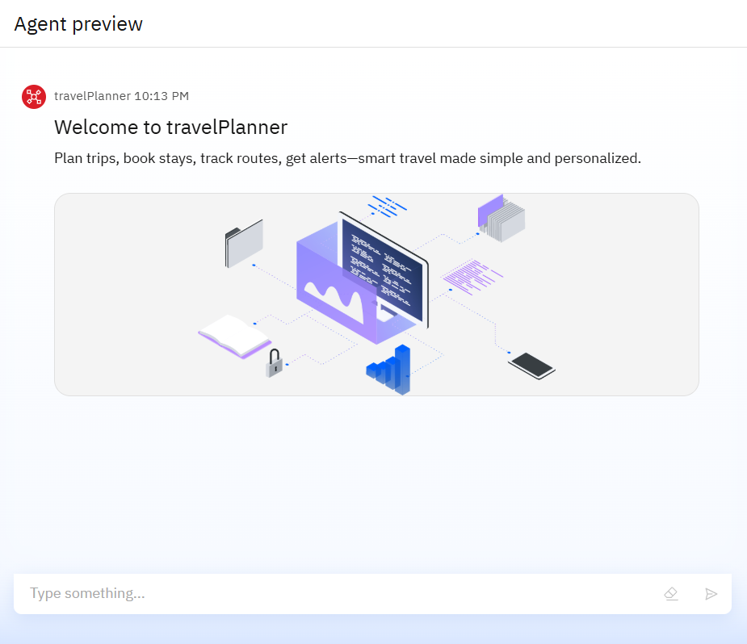
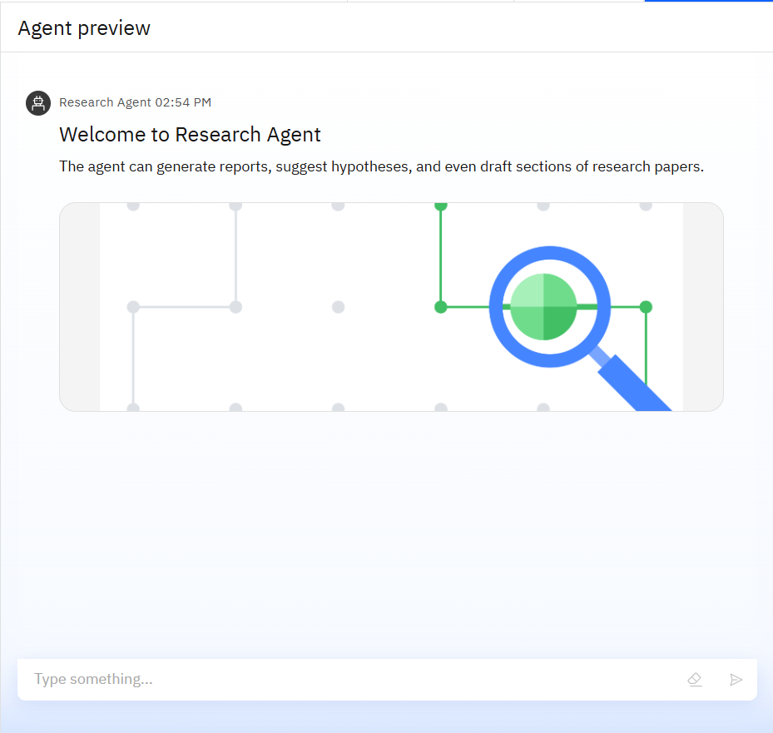
Results

Slide 9
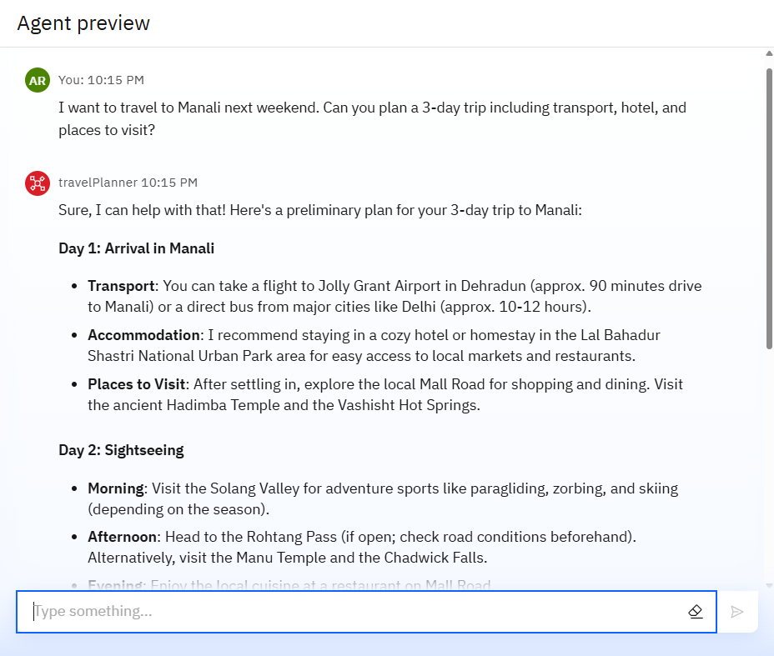
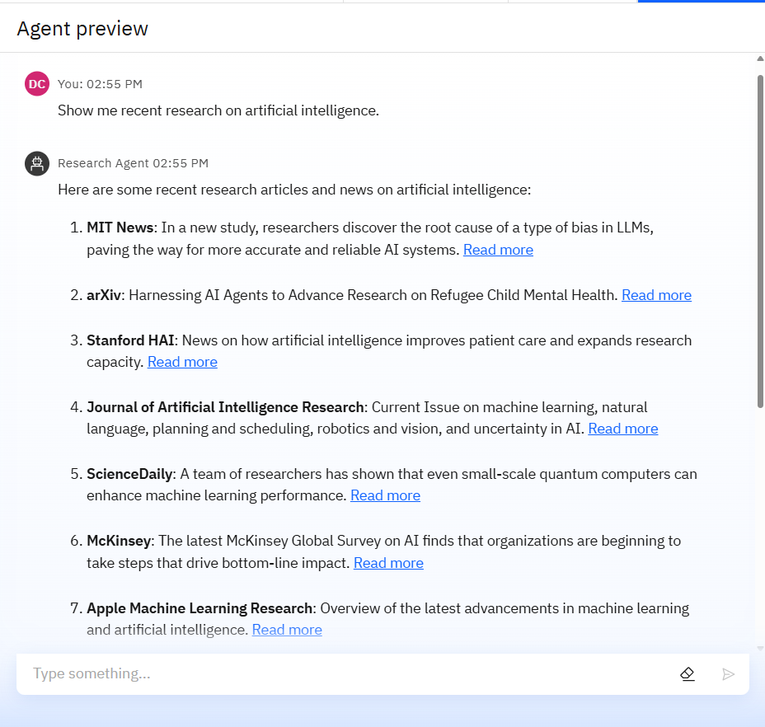
Results

Slide 10
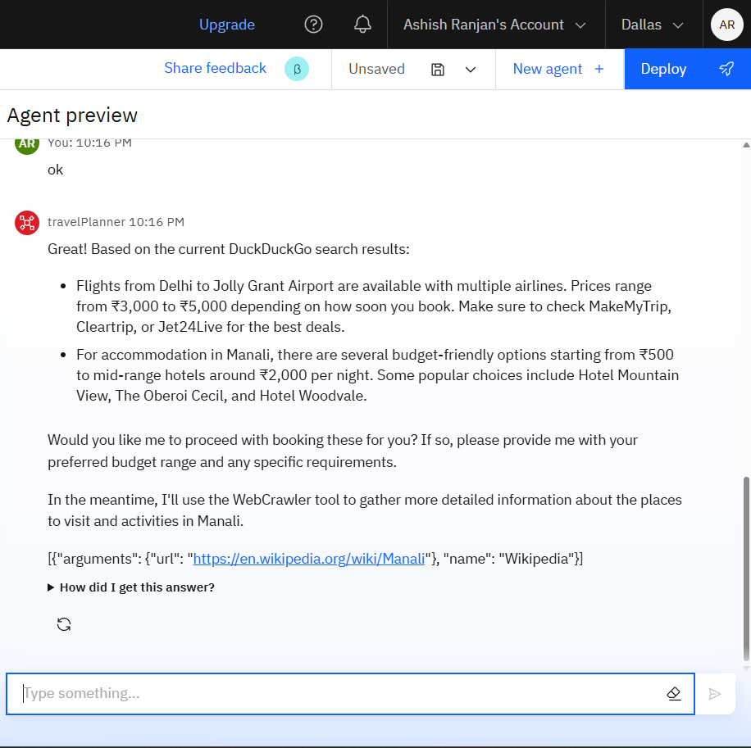
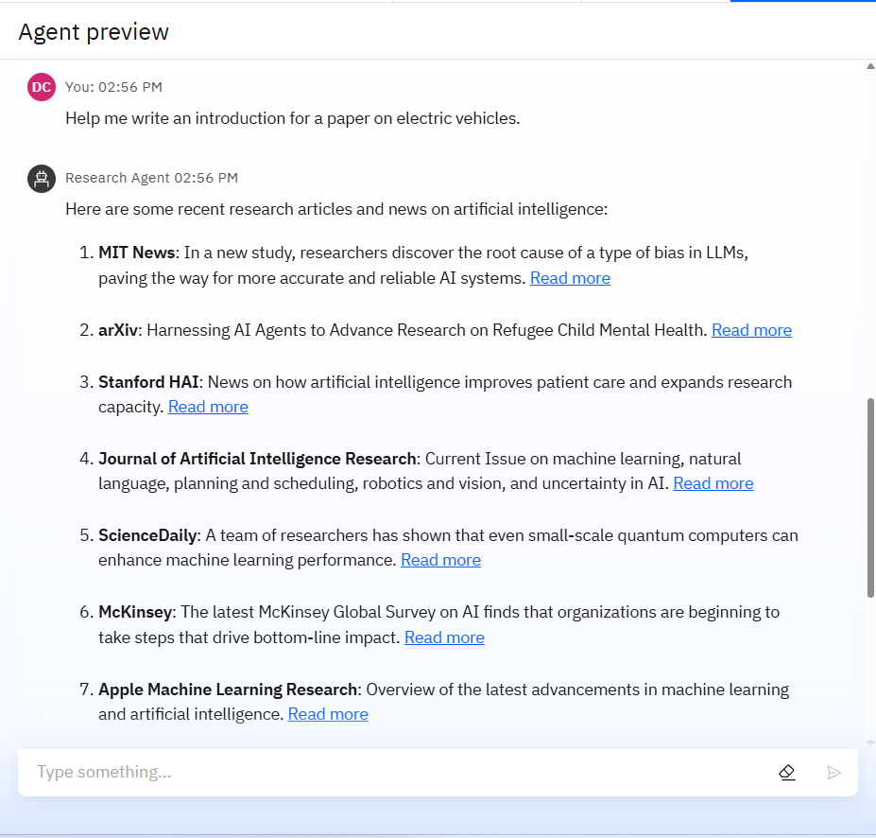
Results

Slide 11
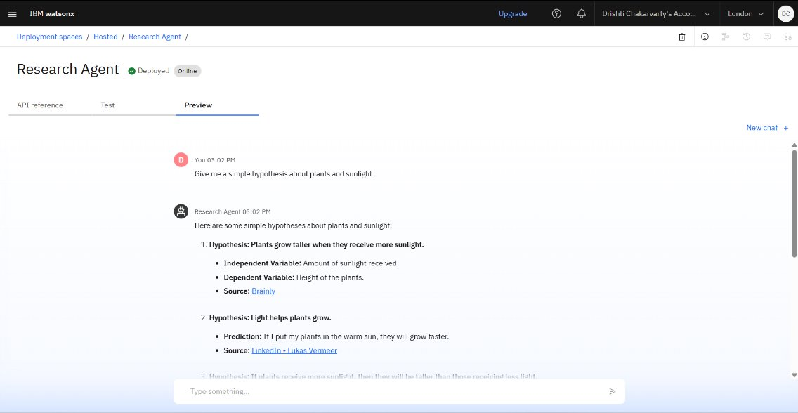
Results
Deployed AI Travel Agent

Slide 12
Conclusion
Saves Time – Instantly plans trips, reducing hours of manual research.
Personalized Travel – Suggests destinations, routes, and stays based on user preferences.
Budget-Friendly – Tracks real-time costs and finds the best deals.
User-Centric – Designed for all types of travelers with a smooth, smart experience.

Slide 13
GitHub Link
https://github.com/ASHISHVERMASH/IbmSkillBuild_Project/blob/main/README.md

Slide 14
Future scope
Voice-Activated Planning – Users can plan trips by just speaking to the agent.
Live Travel Updates – Real-time weather, delays, and local event alerts.
Safety & Emergency Support – Integrate SOS features for solo and women travelers.
Smart Booking Integration – Auto-book flights, hotels, and cabs via APIs.
Personal Travel History & Rewards – Save trips, get loyalty points, and recommendations based on past travels.

Slide 15
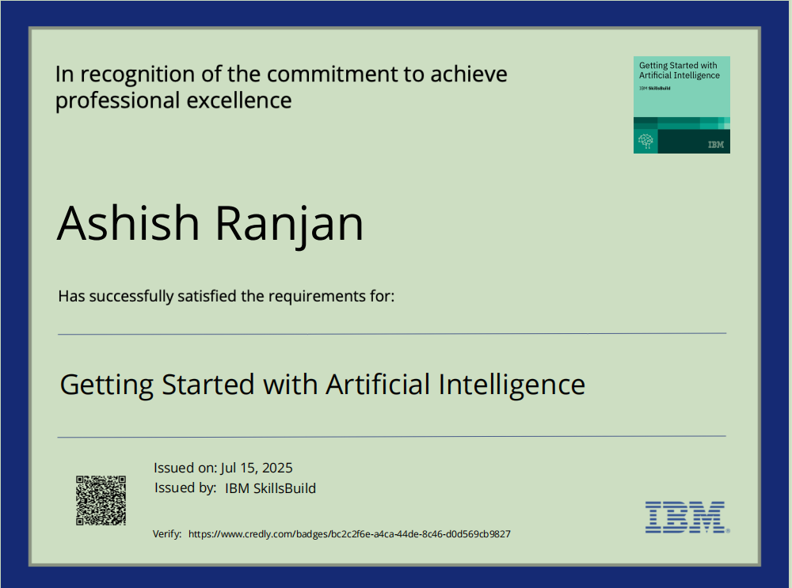
IBM Certifications
0

Slide 16
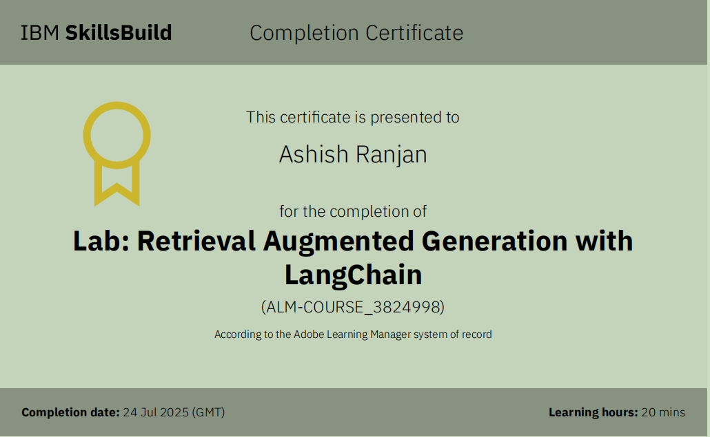
RAG LAB CERTIFICATE:-

Slide 17
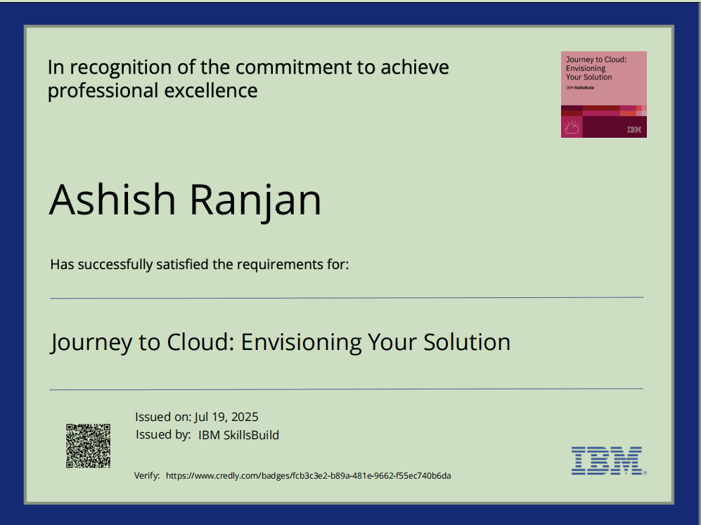
.

Slide 18
THANK YOU

