Slide 1

Impact-ta-thon
Team Name: WeNeedInvestorsForOurStartup
Theme: AI-Powered Personalized Learning
Team Leader: Ashlin John J
Team Members: Agnel Reno A
Barath N
Hariprasath SK

Slide 2

Introducing VLearn AI-Powered Personalized Learning Application
V-Learn helps students find the perfect pathway across top domains, built using a 100% accurate AI-trained model. It enables completion of structured courses with auto-certification and includes interactive features like a messenger box and leaderboards, aiming to guide every learner toward success.

Slide 3
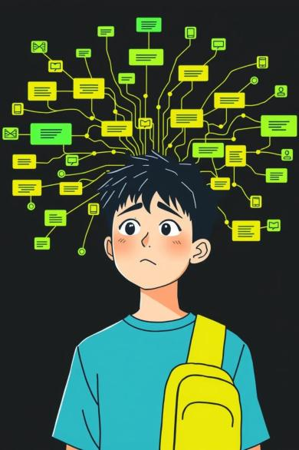
Problem Statement
Course Selection
Students struggle to choose the right course or domain.
Personalized Paths
Many platforms lack personalized learning paths.
Motivation & Tracking
Motivation drops due to lack of progress tracking and rewards.
Certification Disconnect
Certifications are often disconnected from real learning progress.

Slide 4

Our Solution:
AI generates domain-specific learning paths.
Structured modules with weekly content, quizzes, and certification.
NLP chat for prompt recognition.
Interactive features keep learners engaged and motivated.
Tracks and stores progress under individual user IDs to make it competitive

Slide 5
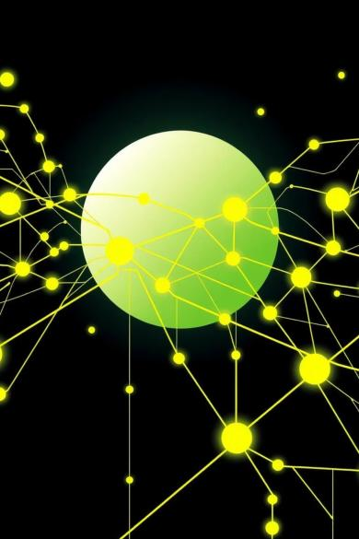





How VLearn Work ?
Select Interest
User prompts their interest in search bar.
AI Path
AI fetches learning path.
Complete Modules
User completes modules and quizzes.
Auto-Certify
Certificate generated automatically.
Leaderboard Update
Leaderboard and badges updated.

Slide 6
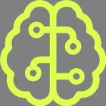





Features & Impacts
AI Path Suggestions
Module Courses
AI-trained dataset for personalized learning paths.
Structured, module-based course content.
Leaderboard & Certs
Messenger Box
Leaderboard linked to certifications.
Friends Interaction for Discussions.
Progress Tracking
Auto-Certificates
Real-time progress and badge tracking.
Certificates stored in user ID.

Slide 7
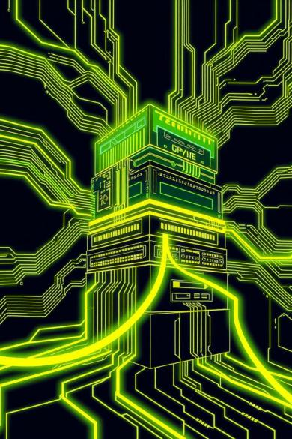
Tech Stack
Backend:
Database:
Python
Node.js
Trained AI/ML Model on
Educational Datasets
MongoDB
Frontend:
Our Tools:
React
Html
TailwindCSS
Using NLP to recognizing the
prompt
JSON based quizzes
Cloud Storage for
Certifications

Slide 8
Why V-Learn Matters
Democratizes Learning
1
Structured and personalized learning path for all students.
Right Domain, Right Time
2
Helps students pick the optimal domain.
Encourages Completion
3
Real-time progress and rewards drive completion.
Builds Portfolio
4
Creates a portfolio of certifications for each user.

Slide 9

Conclusion:
Virtual Learn is an all-in-one AI guide designed to help students learn, track, and succeed. It makes learning smart, structured, and certified, serving as a future-ready platform aligned with student goals and career success.

