Slide 1
TPO Sentinel
Clinical Decision Making & Payment Integrity for Treatment, Payment & Operations
Cotiviti Intern Assessment – Topic #2
Ashmeet Singh Sandhu | Indian Institute of Information Technology Una

Slide 2
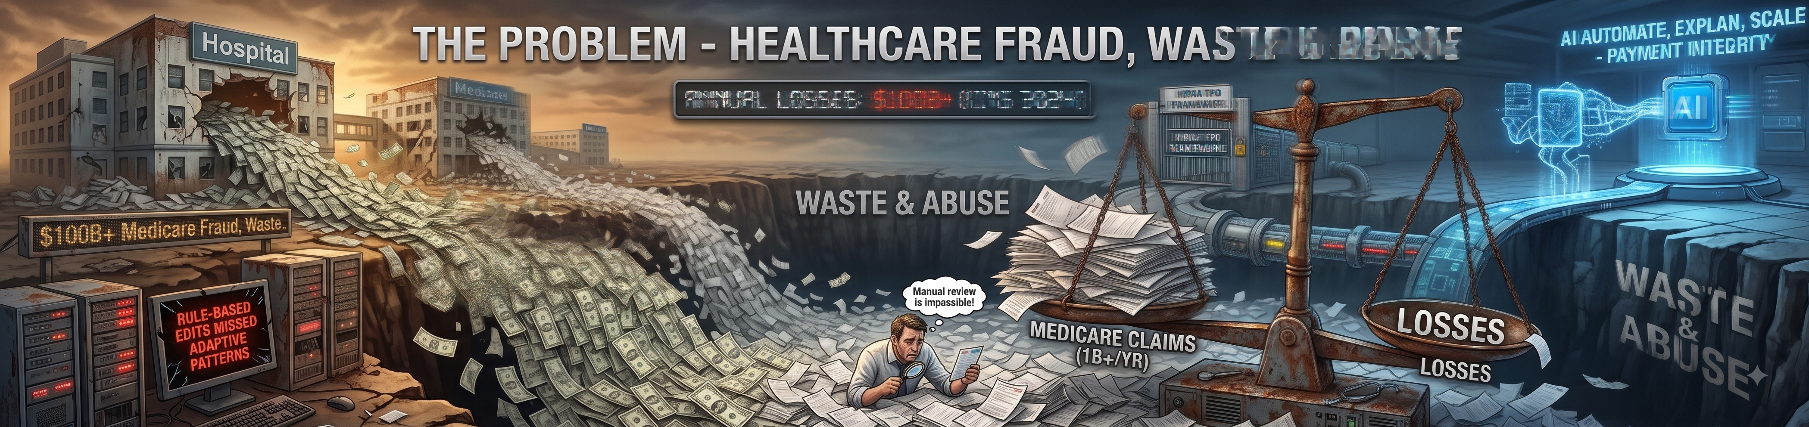
The Problem – Healthcare Fraud, Waste & Abuse
• $100B+ in annual Medicare fraud, waste & abuse (CMS, 2024)
• 1B+ claims processed per year – manual review is impossible
• Traditional rule-based edits miss novel, adaptive fraud patterns
• HIPAA TPO framework governs data use across Treatment, Payment & Operations
• AI can automate, explain, and scale payment-integrity decisions

Slide 3
Why Cotiviti?
Cotiviti's Strengths
Strategic AI Opportunity
• Leader in healthcare payment accuracy
• Processes claims for 150M+ covered lives
• Proprietary multi-payer benchmark data
• Established audit & recovery workflows
• AI + ML investment thesis already underway
• Needs explainable, auditable AI (regulatory pressure)
• Opportunity: shift from retrospective recovery to pre-payment accuracy
• Provider peer benchmarking = defensible competitive moat

Slide 4
Six AI Techniques → Three TPO Pillars
Payment
Classification
XGBoost fraud probability scoring
Payment
Inference (SHAP)
Feature attribution – explainable AI
Treatment
Prediction
Reimbursement & LOS regression
Operations
Clustering
KMeans provider peer-group benchmarking
Operations
Time-Series Anomaly Det.
STL + IsolationForest + z-score
All
Agentic Chain Reasoning
LLM orchestrates 5-step investigation

Slide 5
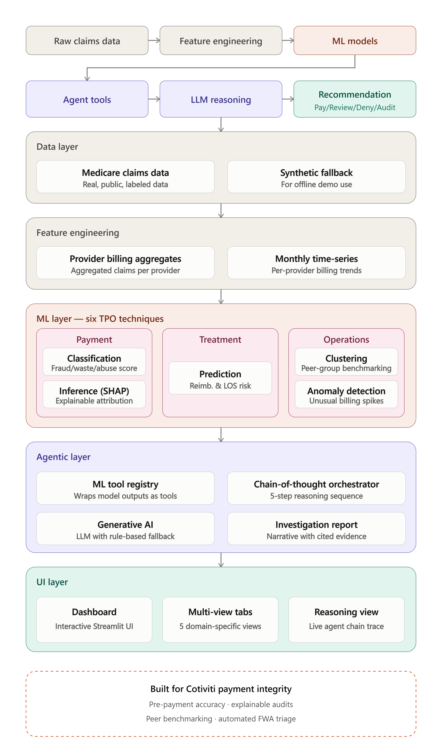
Architecture – TPO Sentinel

Slide 6
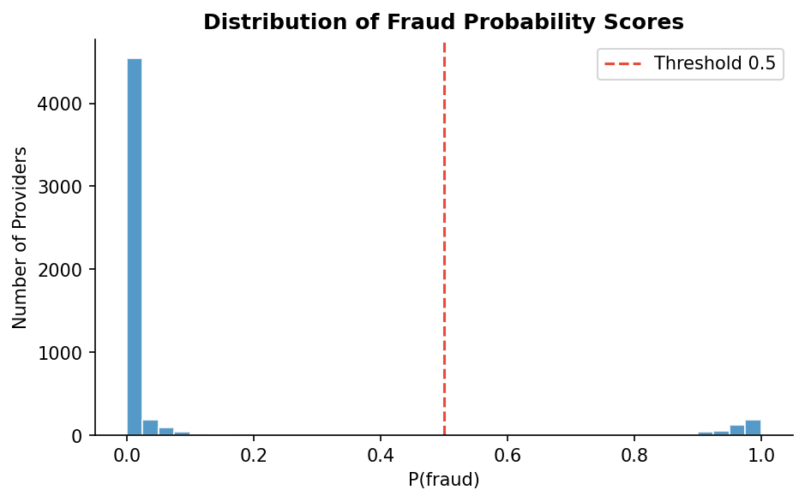
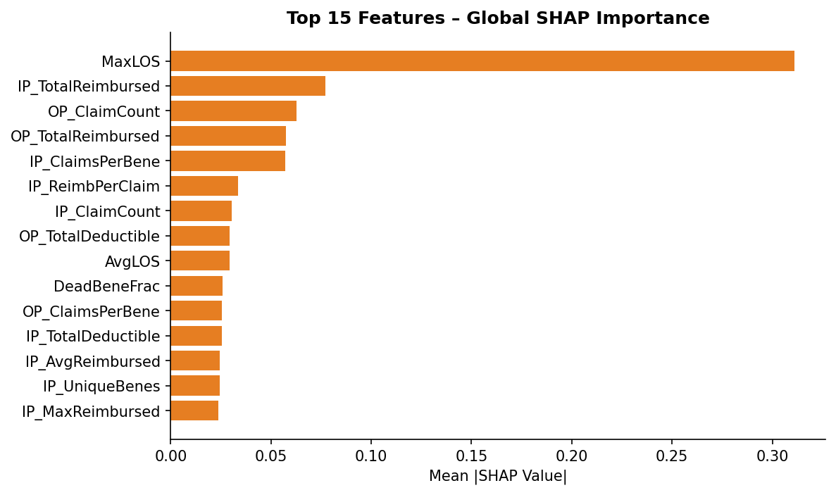
Payment Integrity – Classification & SHAP Inference
XGBoost classifier outputs P(fraud) per provider. SHAP explains which features drove each score.

Slide 7
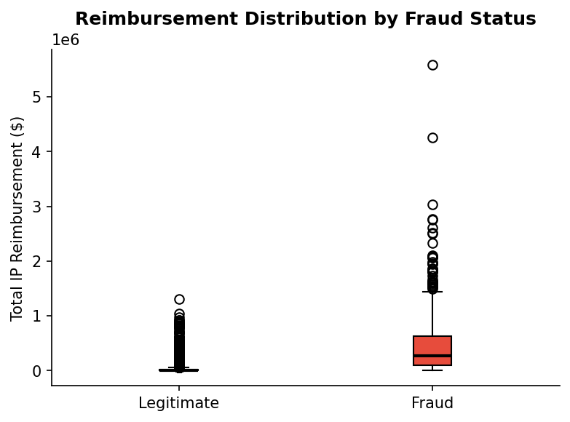
Clinical Risk – Prediction (Treatment Pillar)
Gradient Boosting regressor predicts expected reimbursement & average LOS per provider. Deviation from prediction = potential over-billing signal.

Slide 8
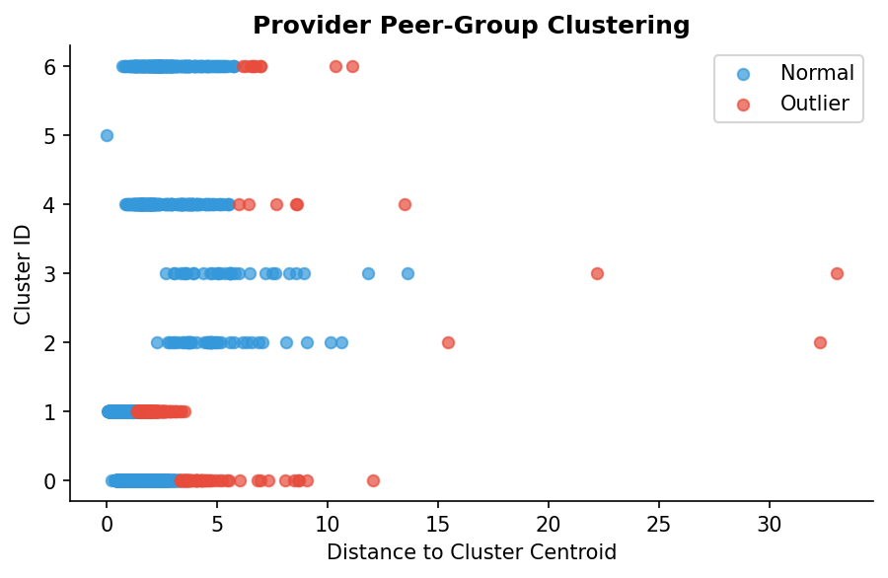
Operations – Provider Peer-Group Clustering
• KMeans segments providers into cohorts by billing behavior
• Silhouette score used to select optimal K
• Providers > 2 std from centroid are flagged as outliers
• Fraud rate per cluster quantifies peer-group risk
• Enables relative benchmarking vs. absolute thresholds

Slide 9
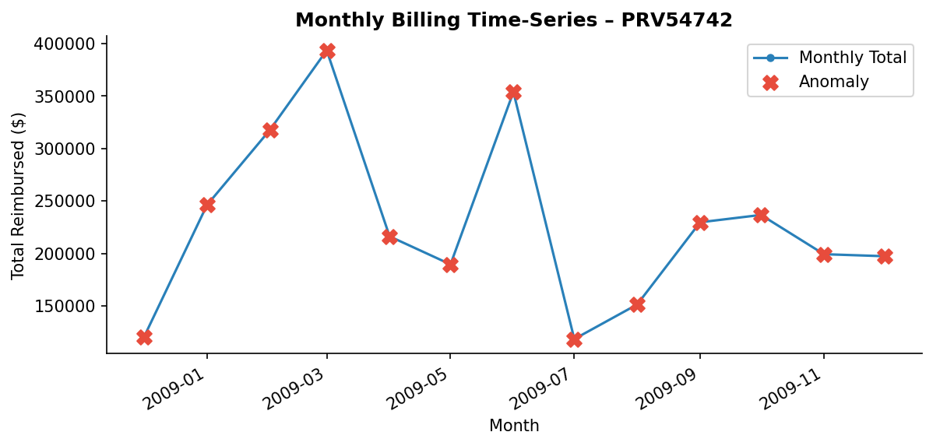
Operations – Time-Series Anomaly Detection
Three complementary methods applied per provider monthly series: STL seasonal decomposition residual z-score | Isolation Forest | Rolling z-score Red ✗ markers = months flagged as anomalous by ≥1 method

Slide 10
Investigator Agent – Agentic Chain-of-Thought Reasoning
Chain-of-Thought Steps
LLM: GPT-4o / Claude Haiku (API key) OR deterministic rule-based fallback (always runs)
1
Step 1 – Classify: get fraud probability (XGBoost)
2
Step 2 – Anomaly: query last N months for billing spikes
3
Step 3 – Peer Compare: check cluster + outlier flag
Demo: Streamlit → Investigator Agent tab • Select any provider • Watch each step expand in real-time • Read the full investigation report
4
Step 4 – Explain: retrieve SHAP top-5 features
5
Step 5 – Synthesize: LLM (or fallback) writes narrative recommendation
Output: PAY / REVIEW / DENY / AUDIT + cited evidence

Slide 11
Opportunities & Threats
✅ Opportunities
⚠️ Threats
• Agentic FWA triage replaces fragmented point solutions
• SHAP-powered explanations reduce provider dispute rates
• Pre-payment anomaly detection shifts from recovery to prevention
• Peer benchmarking creates defensible competitive moat
• LLM hallucination → clinical risk & liability
• HIPAA/BAA compliance required for PHI in LLM APIs
• Model drift demands continuous monitoring & retraining
• Disparate impact risk on minority-serving providers

Slide 12
Strategic Recommendations & Next Steps
Investment 1 – Agentic Payment Integrity Platform XGBoost + LLM orchestration + SHAP narratives → unified, auditable pre-payment pipeline
Investment 2 – Provider Peer Intelligence SaaS Quarterly KMeans refresh + deviation scores → client-facing analytics product
Questions? Thank you!

