Slide 1
Environment and Technology
TEAM: D_CODERS
DEEPAK KUMAR YADAV
NIYATI SINHA
AAKASH KUMAR DASH
ASHMITA DE

Slide 2
Problems in waste management
HIGH COST OF PRESENT TECHNIQUE USED FOR WASTE MANAGEMENT
INEFFICIENT COLLECTION, SEGREGATION, TRANSPORT AND SEGREGATION TECHNIQUES
NO GROUND WATER MANAGEMENT
HAZARDOUS TO ENVIRONMENT DUE TO HIGH RISK OF DISEASES DUE TO UNTREATED WASTE
SOLUTION:Redesigned Modern Waste Management System

Slide 3
Redesigned Modern Waste Management System
Proper disposal of waste (we use sand ,charcoal, etc for the drainage system) along with the transport facility.
For waste collection- an interface though application/ web page that will connect the public with the concerned authority
( eg. The Municipal)
For segregation- We are using basic Embedded technology along with some new ideas of management.
For transport and and disposal we have planned to make a new Sewage Architecture.

Slide 4
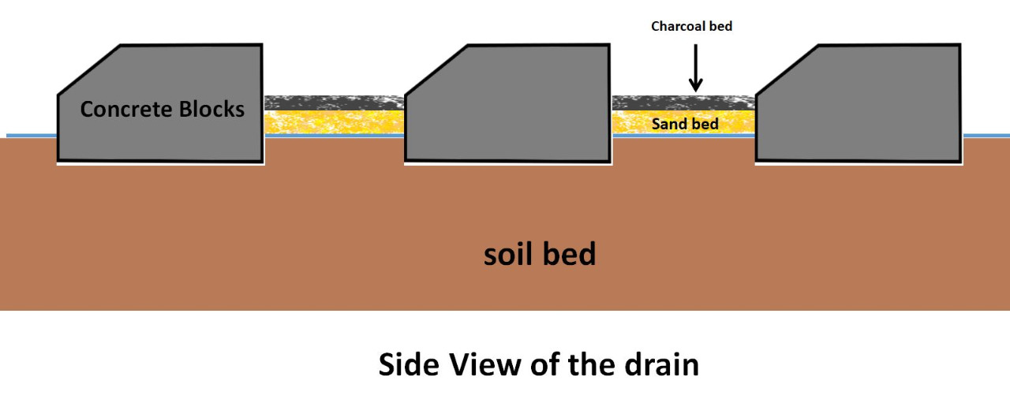
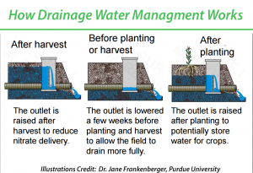
Basic principle of REDISIGNED MODERN WASTE MANAGEMENT SYSTEM
SEWAGE WASTE TREATEMENT

Slide 5
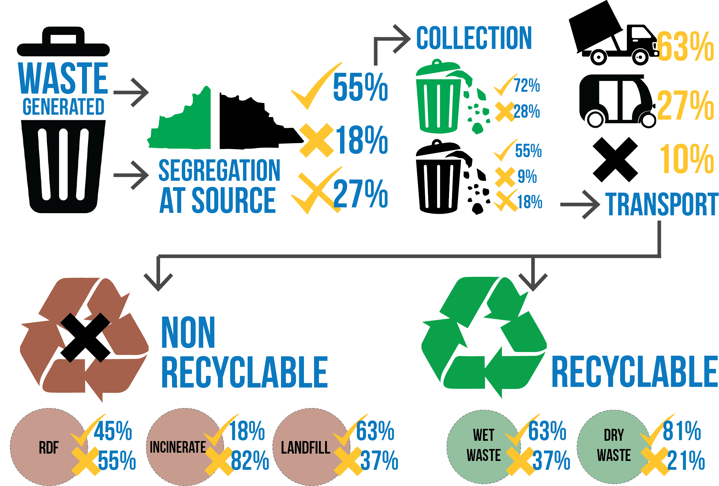
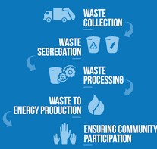
Basic principle of REDISIGNED MODERN WASTE MANAGEMENT SYSTEM
SOLID WASTE MANAGEMENT
SOLID WASTE SEGREGATION

Slide 6
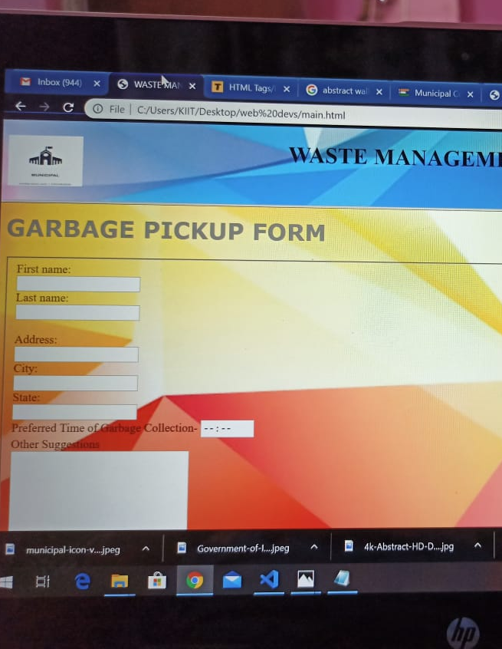
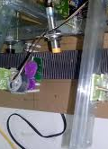
UNIQUENESS OF REDISIGNED MODERN WASTE MANAGEMENT SYSTEM
DEDICATED WEBPAGE
USE OF EMBEDDED SYSTEMS
AIMS TO PROVIDE:
HELP AND SUPPORT
REGISTER COMPLAINS (HELPDESK)
INFORMATION ABOUT TRASH COLLECTION
AIMS TO PROVIDE:
HELPS IN SEGREGATION OF SOLID, LIQUID AND RADIOACTIVE WASTE

Slide 7
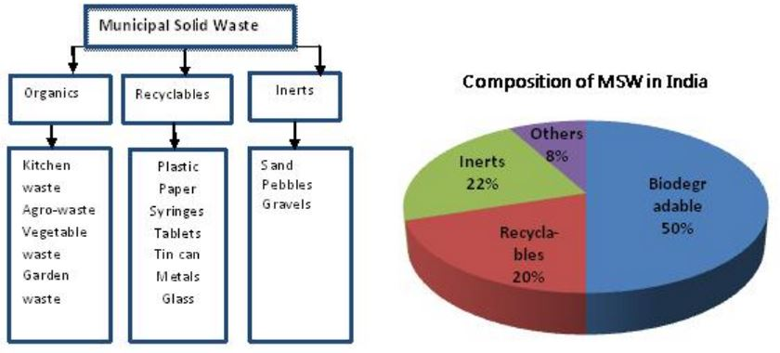
ExplainATION OF the planning and procedures
WASTE WATER FROM SEWAGE CAN BE TREATED USING INERT WASTE AND CHARCOAL
SOLID WASTE TO BE SEGREGATTED USING EMBEDDED BASED SENSORS (USING ARDIUNO MEGA)
WASTE WATER WHEN COMES IN CONTACT WITH SOIL HELPS IMPROVE GROUND WATER LEVELS

Slide 8
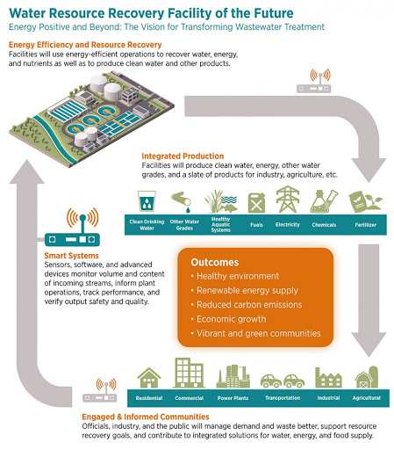
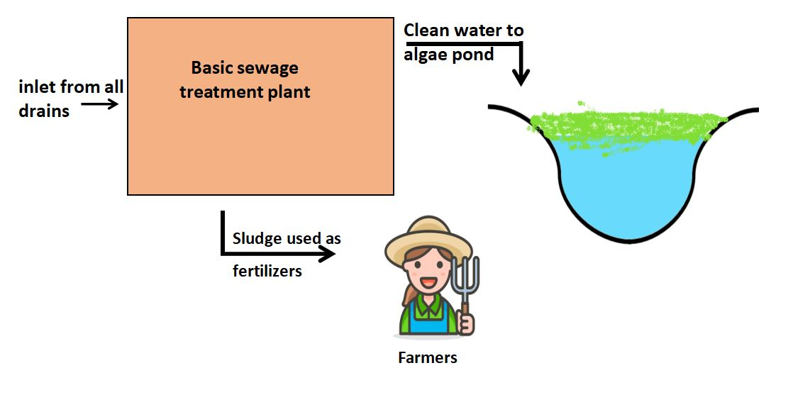
ExplainATION OF planning and procedures
USING NEW ARCHITECTURE OF DRAINS
PRESENT STEPS THAT WILL LEAD TO THE CORRESPONDING FUTURE
TO
The drains will originate from each house,and will merge into a centralized drain in each society or village, then this drain will go into the main sewage treartment plant of the city, or in case of village, there will be one treatment plant per “panchayat”. From there after treatment of sewage, clean water goes to the algae pond.

Slide 9
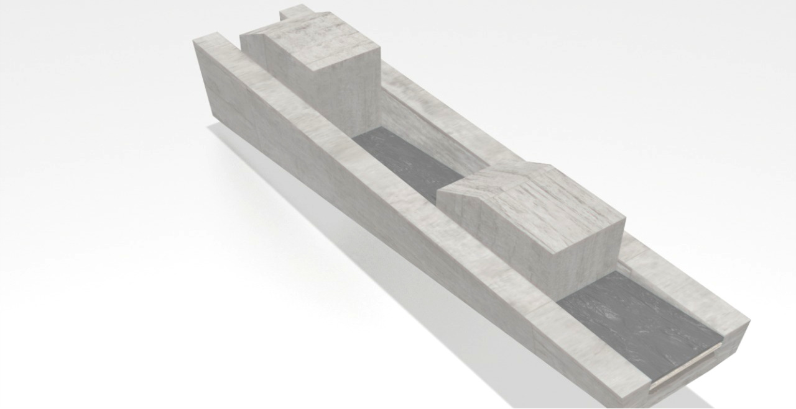
3-D MODEL OF THE PROTOTYPE OF NEW ARCHITECTURE SEWAGE PIPELINE
PROTOTYPE
At each house, a net is placed between the interface of house drain and the sewer drain, which separates coarse impurities.
some water seeps through the charcoal bed and the sand bed directly to the ground(as there’s no concrete layer between sand and soil bed) (A very important side benefit).
The charcoal also absorbs foul smell from the drains.and if any person feels that the drains in his/ her locality needs to be cleaned , he/she can go to the website, developed by us, and make a request.
The direct benefits of this new drain architecture will be the following:
There will be a much needed proper structure for waste management in the authorities and this will result into a better and clean environment.
There will be rise in the groundwater level due to the continuous seepage of water int the soil, and this will help in dealing with another very dangerous problem,the continuous decline of the ground water levels.
Also in the area in affinity of the drains, the fertility of the soil will increase which will result into more greenery on the planet.

Slide 10
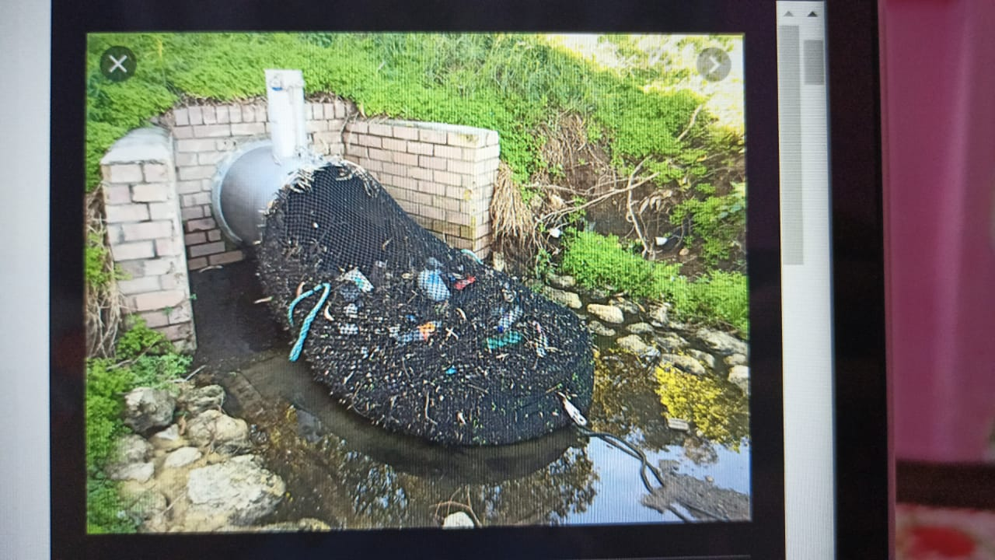
PROTOTYPE
Now after the sewage reaches the sewage treatment plant, it gets treated and the clean water goes into a algae pond.
The sludge(waste generated after sewage treatment) is then sold to farmers at very low prices, as it acts as a very good natural fertilizer.This will help the farmers as it will eliminate the need to buy costly fertilizers from the market and also help the rural economy in a positive way, as cash flow will increase.
Now in the algae pond, this water is oxygenated and naturally purified also, which helps in the healthy growth of the pond ecosystem.
Also this will again indirectly help in groundwater level replenishment.
BEFORE REACHING THE WATER BODY NETS CAN BE USED TO TRAP WASTE MATERIAL WHICH CAN FURTHER BE SEGREGATED AND PROCESSED

Slide 11
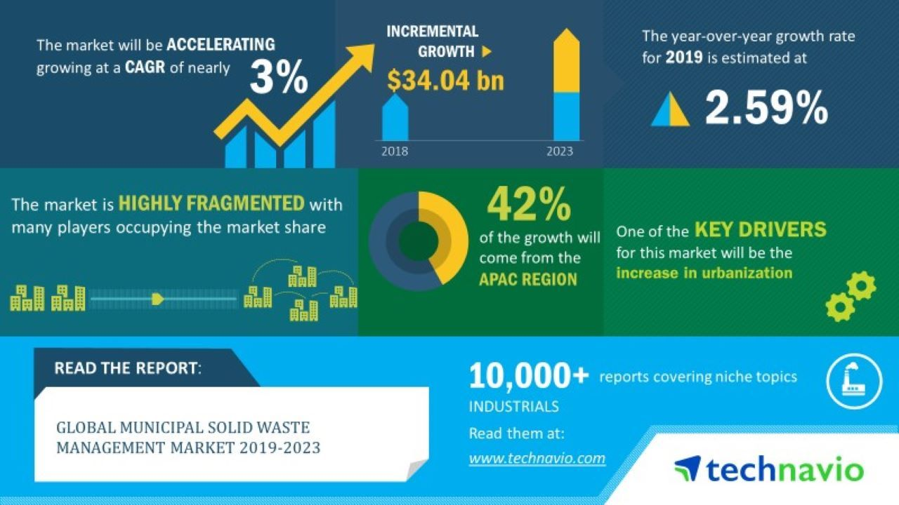
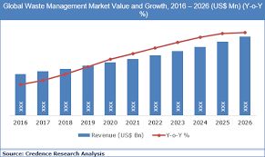
BUSINESS MODEL

Slide 12
TARGET MARKET: DEVELOPING COUNTRIES
MARKET ANALYSIS
DIFFERENT MARKET SECTORS
THE PRESENT WASTE MANAGEMENT SYSTEM IS MUCH MORE TIME TAKING AND COSTLY AS COMPARED TO OUR MODEL
OUR PROJECT MODEL HAS THE CAPACITY TO MAKE A HUGE CHANGE IN THE PRESENT ARCHITECTURE OF WASTE AND SEWAGE MANAGEMENT IN DEVELOPING COUNTRIES

Slide 13
TEAM DESCRIPTION
DEEPAK KUMAR YADAV
NIYATI SINHA
AAKASH KUMAR DASH
ASHMITA DE
1805483
CSE KIIT
1805501
CSE KIIT
1805452
CSE KIIT
1805474
CSE KIIT

Slide 14
THANK YOU!
INNOVATION FOR A BETTER TOMORROW

