Slide 1


Department of Electronics and Communication Engineering
Acharya Institute of Technology
Academic Year – 2022-2023
Project Presentation on
Deep Learning Techniques to Improve Accuracy for Early Detection of Glaucoma
Presented by [GROUP NO : 15]
NAME | USN
ANU HA | 1AY19EC018
ASHMITHA G | 1AY19EC023
MAINAK JANA | 1AY19EC051
ABHISHEK REDDY B H | 1AY19EC103
Under the Guidance of
Pranita Niraj Palsapure
Assistant Professor
Dept. Electronics and Communication Engg.
Acharya Institute of Technology

Slide 2
OVERVIEW
INTRODUCTION
OBJECTIVES
LITERATURE SURVEY
SOFTWARE AND LIBRARIES USED
WORK DONE
RESULTS
REFERENCEs

Slide 3
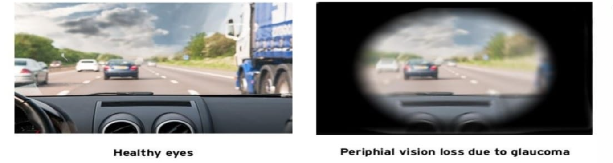
INTRODUCTION
Glaucoma is eye disease where human eye’s optic nerve will be damaged leading to blindness. Glaucoma is the leading cause of irreversible blindness .The main reason for nerve damage is massive pressure created within the eyeball called intra ocular pressure. In India, 12 million people are getting affected and 1.2 million people are blind from this disease. Thus early detection and diagnosis is highly necessary.
A machine learning model can be built for the detection of glaucoma by using the digital fundus images of the eyes. The model will make use of Convolution Neural Network(CNN) algorithm for the classification. By extracting optic disc as the region of interest it takes much lesser time compared to the segmentation of disc and cup.

Slide 4
OBJECTIVES
To Develop CNN model effectively with better accuracy
To compare different algorithms based on multiple parameters.
To effectively classify glaucomatous and non-glaucomatous fundus
1
2
3

Slide 5
SOFTWARE AND LIBRARIES USED
Jupyter Notebook: Jupyter Notebook is an open-source web application that enables easy creation and sharing of documents containing live code, visualizations, and narrative text.
Libraries used:
Keras - Keras is a high-level neural network library for Python that enables fast experimentation with deep neural networks
Numpy - NumPy is a Python library used for numerical computing, providing a powerful array object and tools for working with matrices and linear algebra.
Tensorflow - TensorFlow is a Python library used for machine learning and artificial intelligence. It allows users to create and train neural networks and deep learning models.
matplotlib.pyplot - matplotlib.pyplot is a sublibrary of the matplotlib library in Python, which provides a collection of functions that enable creating a variety of charts and graphs in Python.
sklearn.metrics- sklearn.metrics is a module in the scikit-learn library that provides a wide range of functions for evaluating the performance of machine learning models.

Slide 6
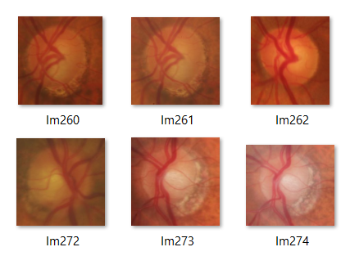
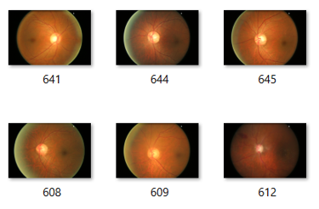
DATASET USED
1st Dataset:
Total Images : 400
Train samples : Glaucoma: 140,
Non Glaucoma: 140
Validation samples : Glaucoma: 40,
Non Glaucoma: 40
Test samples : Glaucoma: 20,
Non Glaucoma: 20
2nd Dataset:
Total Images : 678
Train samples : Glaucoma: 260,
Non Glaucoma: 260
Validation samples : Glaucoma: 65,
Non Glaucoma: 65
Test samples : Glaucoma: 14,
Non Glaucoma: 14

Slide 7
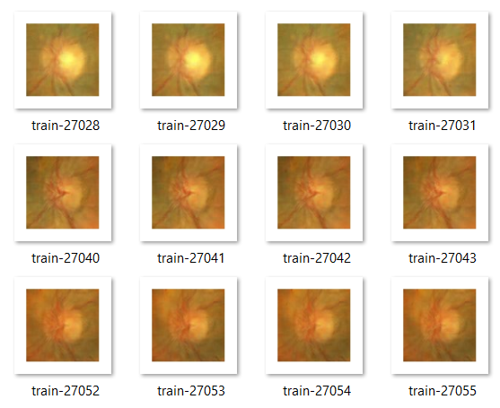
DATASET USED
3rd Dataset:
Total Images : 6000
Train samples : Glaucoma: 1800, Non Glaucoma: 1800
Validation samples : Glaucoma: 600, Non Glaucoma: 600
Test samples : Glaucoma: 600, Non Glaucoma: 600

Slide 8
EVALUATION METRICS
True Positives (TP) are cases where the model correctly predicted a positive outcome
True Negatives (TN) are cases where the model correctly predicted a negative outcome,
False Positives (FP) are cases where the model incorrectly predicted a positive outcome,
False Negatives (FN) are cases where the model incorrectly predicted a negative outcome
Accuracy indicates the proportion of all predictions that the model got correct, both positive and negative.
Accuracy = (TP + TN) / (TP + TN + FP + FN)
Precision indicates how precise the model is in identifying positive cases.
Precision = TP / (TP + FP)
Sensitivity indicates how well the model identifies positive cases correctly.
Sensitivity = TP / (TP + FN)
Selectivity indicates how well the model identifies negative cases correctly.
Selectivity = TN / (TN + FP)

Slide 9
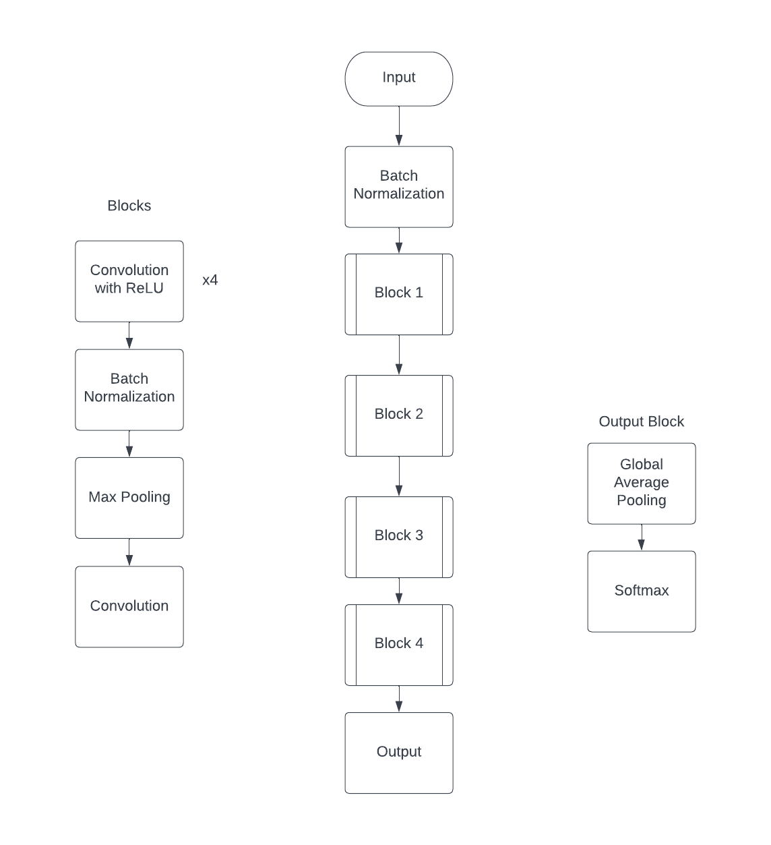
BLOCK DIAGRAM
Model 1

Slide 10
An input layer is defined with the specified image dimensions and three channels.
A Batch Normalization layer is added to the input layer. Four convolutional blocks are defined, each with multiple convolutional layers and a Batch Normalization layer.
The first block contains a max pooling layer, and all blocks end with a Batch Normalization layer. A 1x1 convolutional layer is added after the first block and the second block.
The output layer is defined with a Global Average Pooling layer and an Activation layer.
The model is compiled with a categorical cross-entropy loss function, Adam optimizer, and accuracy metric.

Slide 11
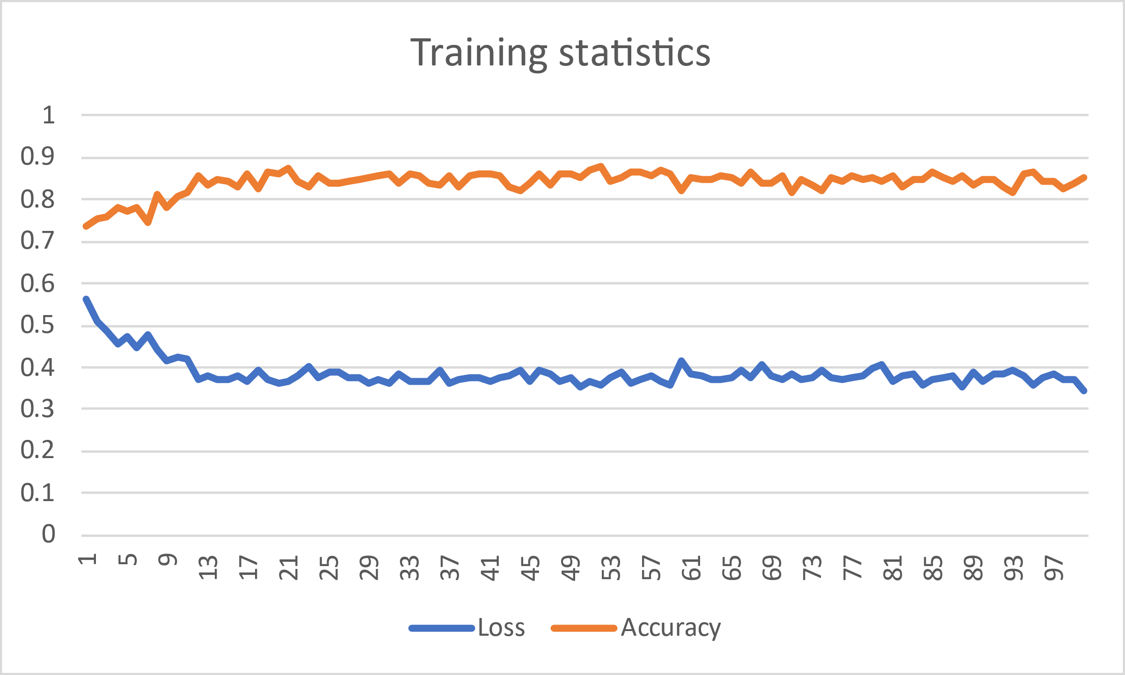
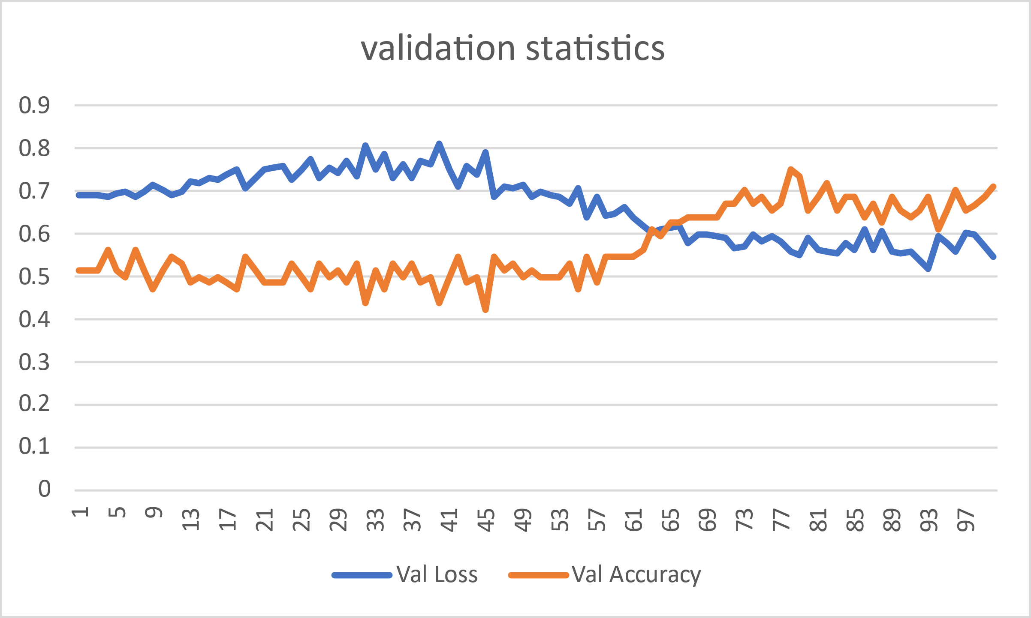
RESULTS
Dataset 1
Precision: 0.66 TP: 40
Selectivity: 0.5 FP: 20
Accuracy: 0.75 FN: 0
Sensitivity: 1 TN: 20

Slide 12
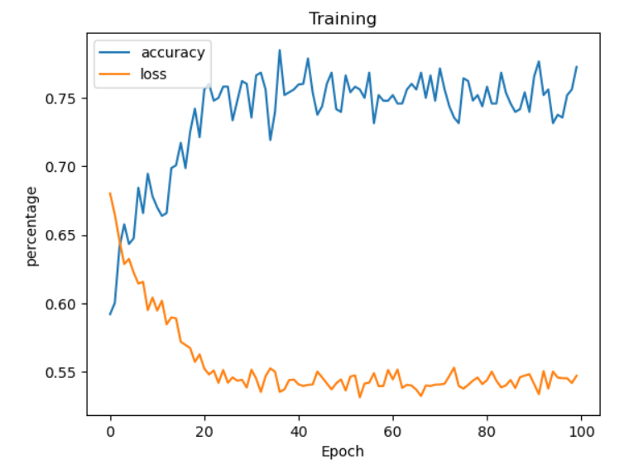
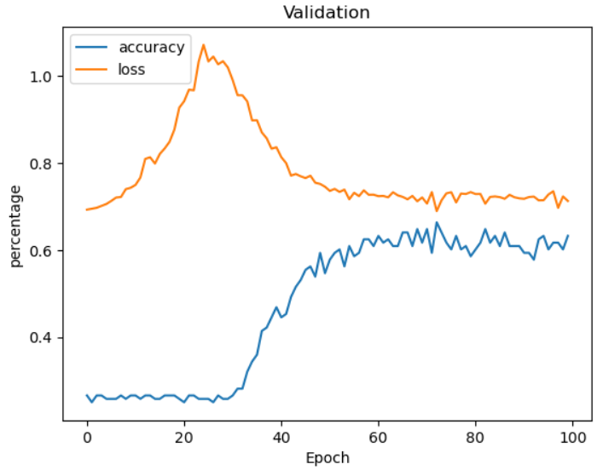
RESULTS
Dataset 2
Precision: 0.22 TP: 16
Selectivity: 0.40 FP: 58
Accuracy: 0.42 FN: 18
Sensitivity: 0.47 TN: 38

Slide 13
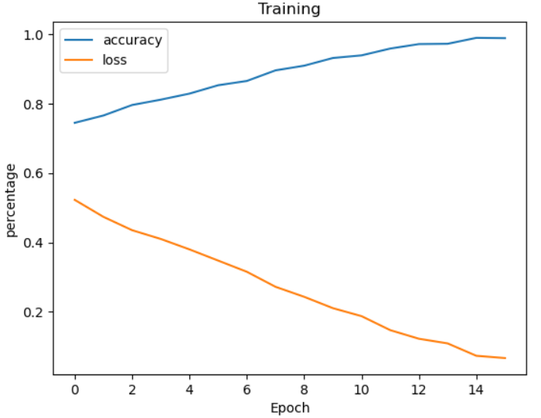
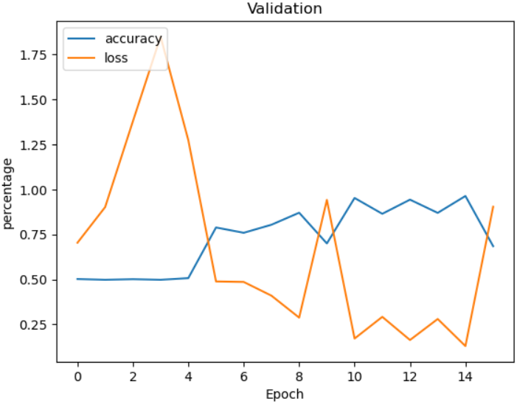
RESULTS
Dataset 3
Precision: 0.51 TP: 301
Selectivity: 0.73 FP: 289
Accuracy: 0.51 FN: 774
Sensitivity: 0.28 TN: 781

Slide 14
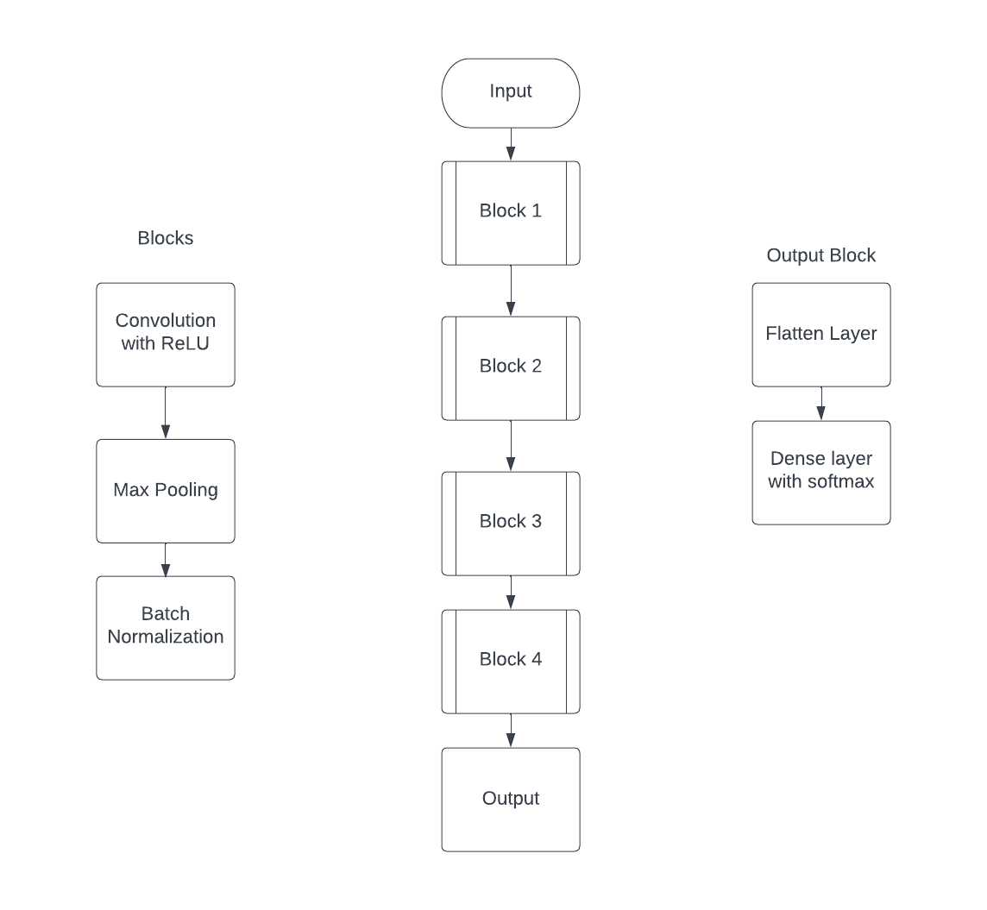
BLOCK DIAGRAM
Model 2

Slide 15
The input shape is defined as a tuple of height, width, and number of channels (in this case, 3 for RGB images).
Each convolutional block consists of a convolutional layer with a ReLU activation function, followed by max pooling and batch normalization layers.
The number of filters in the convolutional layers increases with each block, starting from 16 and doubling up to 128 in the fourth block.
The output block is defined by flattening the output from the last convolutional block and passing it through a dense layer with a softmax activation function to output probabilities for the two classes.

Slide 16
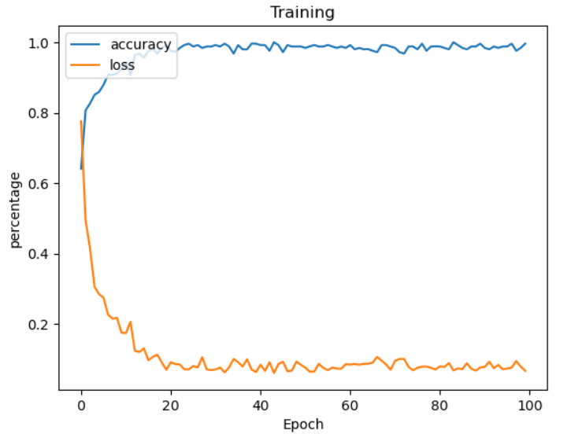
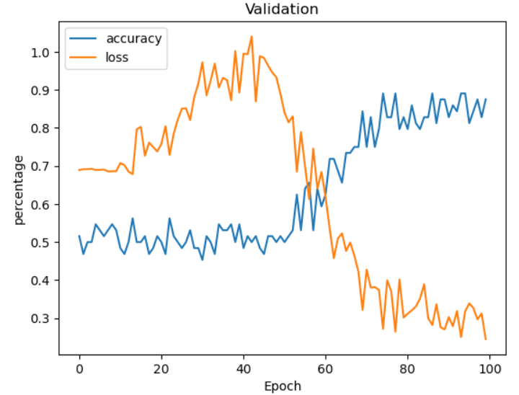
RESULTS
Dataset 1
Precision: 0.56 TP: 37
Selectivity: 0.3 FP: 12
Accuracy: 0.61 FN: 28
Sensitivity: 0.92 TN: 3

Slide 17
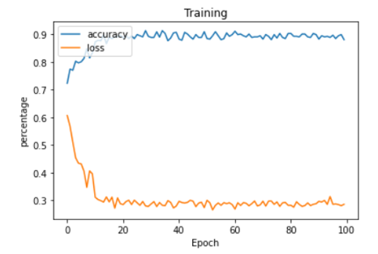
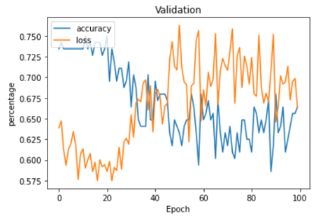
RESULTS
Dataset 2
Precision: 0.34 TP: 71
Selectivity: 0.34 FP: 25
Accuracy: 0.64 FN: 21
Sensitivity: 0.77 TN: 13

Slide 18
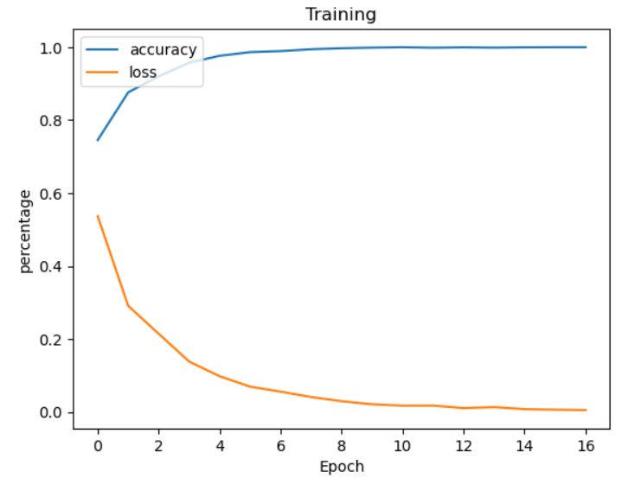
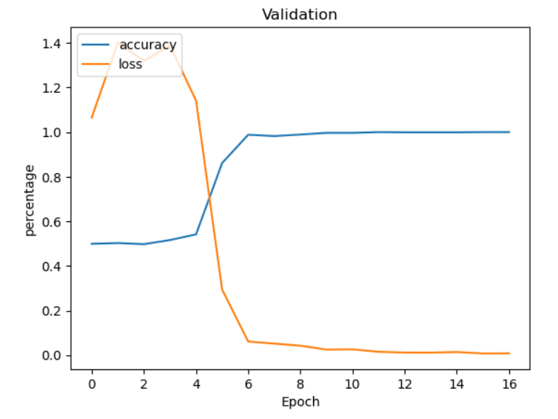
RESULTS
Dataset 3
Precision: 0.74 TP: 501
Selectivity: 0.71 FP: 175
Accuracy: 0.77 FN: 99
Sensitivity: 0.83 TN: 425

Slide 19
RESULTS
Model 1 | Model 2
More convolution layers 16 layers | Less Convolution Layers 4 layers , layers reduced by ratio 4:1
Complex Architecture | Simple Architecture
Global Average pooling layer to obtain a single value for prediction | Flattening layer to reduce all the values to a vector for prediction
Takes more time to train | Takes less time to train compared to model1

Slide 20
COMPARISON
Model 1 | Precision | Selectivity | Accuracy | Sensitivity
d1 | 0.66 | 0.5 | 0.75 | 1
d2 | 0.22 | 0.40 | 0.42 | 0.47
d3 | 0.51 | 0.73 | 0.51 | 0.28
Model 2 | Precision | Selectivity | Accuracy | Sensitivity
d1 | 0.56 | 0.3 | 0.61 | 0.92
d2 | 0.34 | 0.34 | 0.64 | 0.77
d3 | 0.74 | 0.71 | 0.77 | 0.83

Slide 21
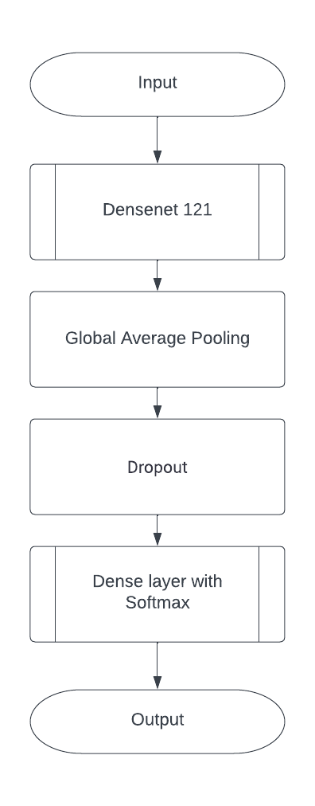
BLOCK DIAGRAM
Model 3

Slide 22
This is a neural network model designed for image classification using transfer learning with the DenseNet121 architecture, last fully connected layer of the network, which has been pre-trained on the ImageNet dataset
The model is defined as a sequential model, with the DenseNet121 model added as a layer, followed by a global average pooling layer, a dropout layer to prevent overfitting, and a dense layer with a softmaxactivation function that outputs a binary classification result.

Slide 23
REFERENCES
[1] Raveenthini. M, Lavanya. R ,Combined Diagnosis of Diabetic Retinopathy and Glaucoma Using Non-Linear Features , International Conference on Computer, Communication and Signal Processing (ICCCSP - 2021) ,
[2] Mr. Upendra singh, Ms Arkaja Saxena, Mr Lokesh Parashar A Glaucoma Detection using Convolutional Neural Network, Proceedings of the international conference on electronics and sustainable communication systems (ICESC 2020), pp 815-820 , November 2020.
[3] Sang Phan ,Yoshioki Yoda , · Kenji Kashiwagi, Evaluation of deep convolutional neural networks for glaucoma detection ,International Japanese Journal of Ophthalmology Feb 2019.
[4] Juan Carrillo, Lola Bautista, Jorge Villamizar, Juan Rueda , Mary Sanchez and Daniela rueda. Glaucoma detection using fundus image of eye, XXII Symposium on image,signal processing and artificial vision (STSIVA), March 2019.
[5] Xiangyu Chen, Yanwu Xu, Damon Wing Kee Wong, Tien Yin Wong , and Jiang Liu Glaucoma Detection based on Deep Convolutional Neural Network, 37th Annual international conference of the IEEE engineering in medicine and biology society (EMBC), pp 715-718, November 2015 .

Slide 24


