Slide 1


A
Presentation on
Multimedia Image Processing
Using OpenCV
Votary Softech Solution Pvt. Ltd.
Votary Softech Solutions Pvt. Ltd.| Copyright ©2017| Confidential
Notes:
<number>

Slide 2
Contents
Objective
Architecture & Design Diagram
Project Description
Roles and Responsibility

Slide 3
Objective
The main objective of this project is, to identify the person using OpenCV Library.

Slide 4
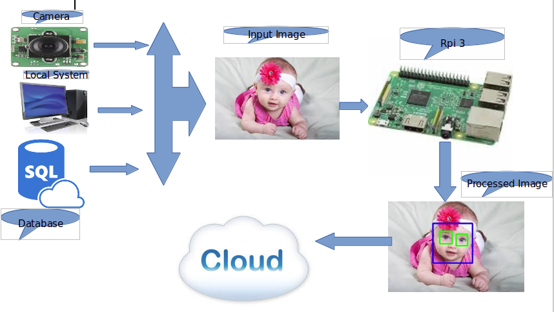
Architecture & Design Diagram

Slide 5
Image Acquisition Module
It is the Gateway to acquires raw data either from camera, local storage or database.
API Modules:
A] cam():This module will take images from the connected camera.
B] local_browse(): It will browse and select image from local system.

Slide 6
Image Processing Module
After selection of the image, Image Processing module will procees given image to identify the faces based on the pattern implemented by the algorithm.
API Module: face_detect(path of image)
This API will detect the faces and draws rectangular box on the face. Here we are using Haar algorithm to detect the face.

Slide 7
Database
Database is used to store the processed image and details from image processing module.
Mysql is used to create the database.

Slide 8
Roles & Responsibility
Installation of OpenCV Library
Setup of GIT server
Setup of Mysql server
Python script to Acquire, Process Image and detect the faces
Written test cases
Manual testing for each test cases

Slide 9
Tools Used
OpenCV
GIT
Python
Mysql

Slide 10
Thanks

